Slide 1
International Organisations II
International Security Policy, September 29, 2025
Vendula Divišová, FSS MU, vendula.divisova@mail.muni.cz

Slide 2
Structure
International security organisations (part II)
  European Union
  OSCE
  Council of Europe

Slide 3

European Union: Key facts
1951 - the European Coal and Steel Community founded [Belgium, France, Germany, Italy, Luxembourg, Netherlands]
1958 - European Economic Community (EEC)
1993 - name changed to the European Union
area of freedom, security, and justice; internal market; economic and monetary union
combat social exclusion and discrimination, promote social justice and protection….
external relations - peace, security, sustainable development, human rights…
Aim: “promote peace, its values and the well-being of its peoples“ (Art. 3, Lisbon Treaty)

Slide 4
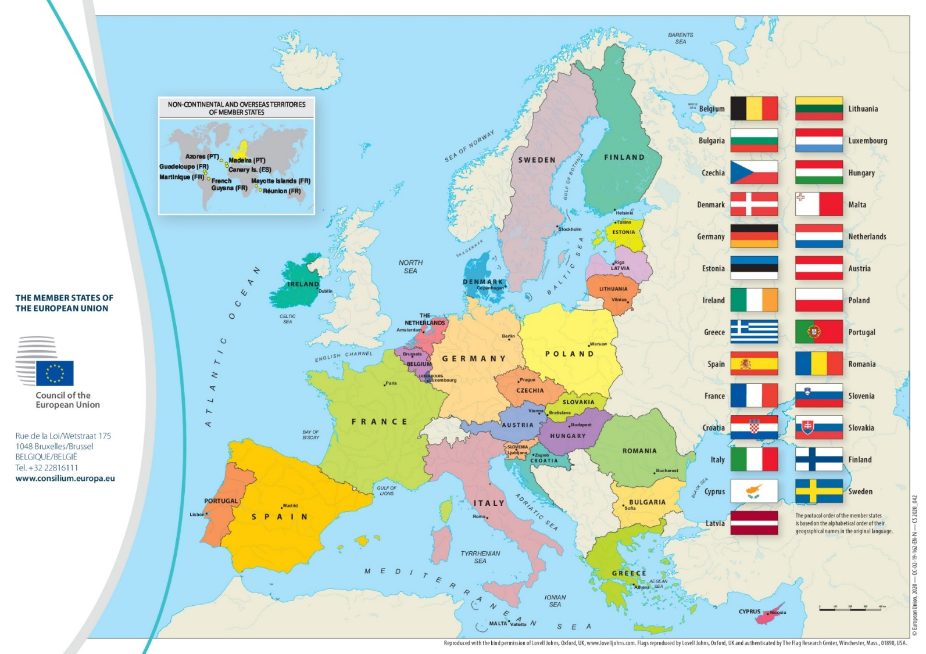

European Union: Membership
27 member countries
24 official languages
Candidate countries
Albania
Bosnia and Herzegovina
Georgia
Moldova
Montenegro
North Macedonia
Serbia
Türkiye
Ukraine
1 February 2020 - the UK left the EU

Slide 5
European Union: Structure
7 key institutions
  European Parliament (Brussels/Strasbourg/Luxembourg)
  European Council (Brussels)
  Council of the European Union (Brussels/Luxembourg)
  European Commission (Brussels/Luxembourg/Representations across the EU)
complemented by other institutions and bodies - including:
  Court of Justice of the European Union (Luxembourg)
  European Central Bank (Frankfurt)
  European Court of Auditors (Luxembourg)
decision-making institutions

Slide 6
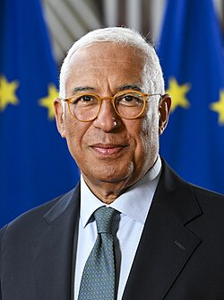

European Union: Institutions
European Council
heads of state or government of EU countries + President + President of the Commission
determines the EU's political direction and priorities (x does not make laws)
decisions taken by consensus
European Parliament
represents citizens of EU countries - elected directly by them
decides on European laws (jointly with the Council of the EU)
approves the EU budget
António Costa
elected by the EC, 2,5 years

Slide 7
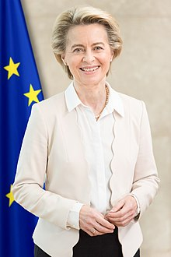

European Union: Institutions
Council of the European Union
national ministries (depending on the topic)
decides on European laws (with EP) and coordinates policies
decisions taken by a qualified majority
European Commission
main executive body, represents common interests of the EU
proposal for new laws, ensures the application of the Treaties and measures
27 commissioners
headed by President of the Commission (elected by EP and appointed by EC)
rotating presidency (6 months)
at least 55 % members (at least 15 states), representing at least 65 % of the population
Ursula von der Leyen

Slide 8
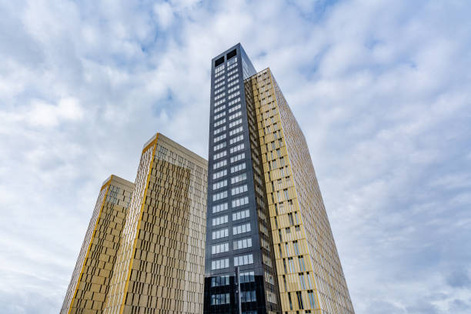

European Union: Institutions
Court of Justice of the European Union
ensures that EU law is followed, Treaties are correctly applied
includes the Court of Justice, the General Court and specialised courts
VIDEO (EU Institutions explained)

Slide 9
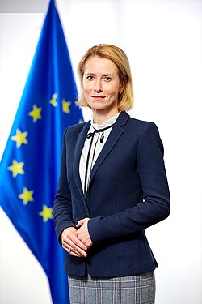
Common foreign and security policy (CFSP)
established by the Treaty on European Union (TEU) in 1993, updated by Lisbon Treaty
aim: to preserve peace and strengthen international security (UN Charter)
implemented by the High Representative and members states
defined and implemented by the EC and the Council acting unanimously
High Representative of the Union for Foreign Affairs and Security Policy
conducts the EU CFSP, ensures consistency of the Union‘s external action
presides over the Foreign Affairs Council
a vice-president of the Commission
Kaja Kallas

Slide 10
Common foreign and security policy (CFSP)
Main instruments of the CFSP
  Civilian and Military Capabilities (Common Security and Defence Policy)
  Sanctions
  EU Special Representatives
  Non-proliferation and disarmament projects
  European Peace Facility (EPF)
complementary strategies and tools [diplomacy, humanitarian aid, development cooperation, climate action, human rights, economic support, trade policy]

Slide 11

Common foreign and security policy (CFSP)
Foreign Affairs Council
responsible for the EU's external action
chaired by the High Representative
composed of the foreign ministers from all EU member states (or defence / development / trade)
defines and implements EU‘s foreign and security policy
European External Action Service (EEAS)
manages the EU's diplomatic relations + conducts EU foreign & security policy
delegations all over the world
led by + supports the EU HR
assisted by

Slide 12
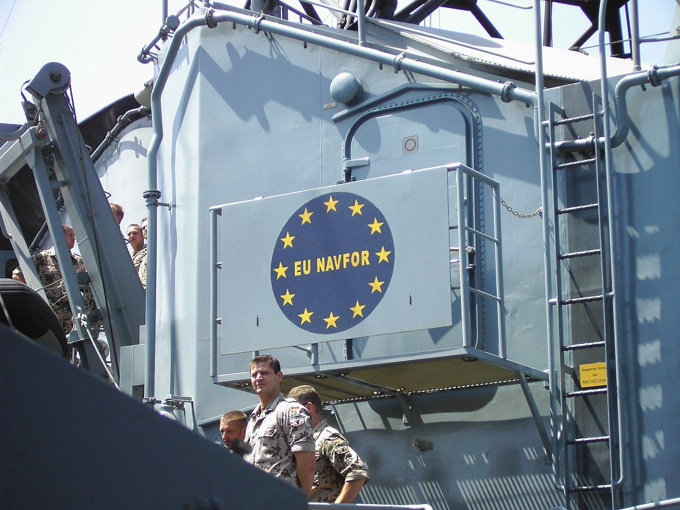
Common Security and Defence Policy (CSDP)
established in 2009 by the Lisbon Treaty, a specific part of the CFSP
allows the UE to deploy civilian and military missions and operations abroad - including:
  conflict prevention
  peace-keeping
  joint disarmament operations
  military advice
  humanitarian assistance
  post-conflict stabilization
decisions adopted by the Council (unanimity!)

Slide 13

CSDP: EU Battlegroups
part of the European Union's military rapid reaction capacity to respond to emerging crises and conflicts around the world, operational since 2007
  intended for smal-scale rapid response missions
multinational, military units, usually composed of 1500 personnel
  principle of multi-nationality
  2 Battlegroups on standby for a period of 6 months
deployment requires a unanimous decision of the Council
no longer functional! → EU Rapid Deployment Capacity
EUBG have never been deployed

Slide 14
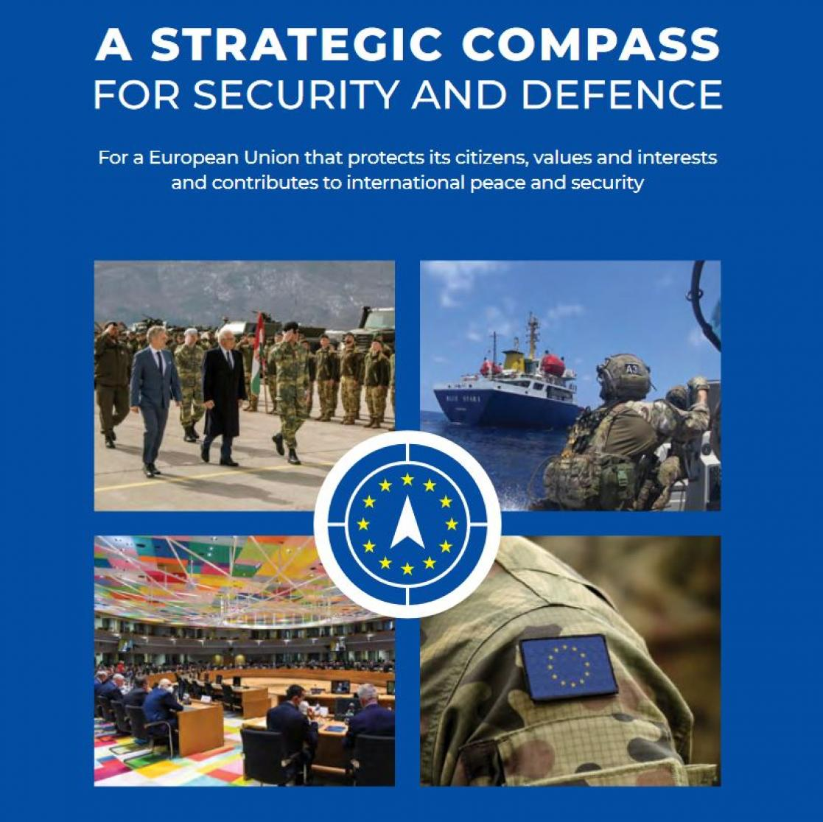
CSDP: Strategic Compass
ambitious plan of action for strengthening the EU's security and defence policy by 2030
a shared assessment of the strategic environment + actionable proposals
4 pillars:
  Act more quickly and decisively when facing crises;
    EU Rapid Deployment Capacity (up to 5 000 troops)
  Invest in the capabilities and technologies we need;
  Partner with others to achieve common goals;
  Secure our citizens against fast-changing threats

Slide 15
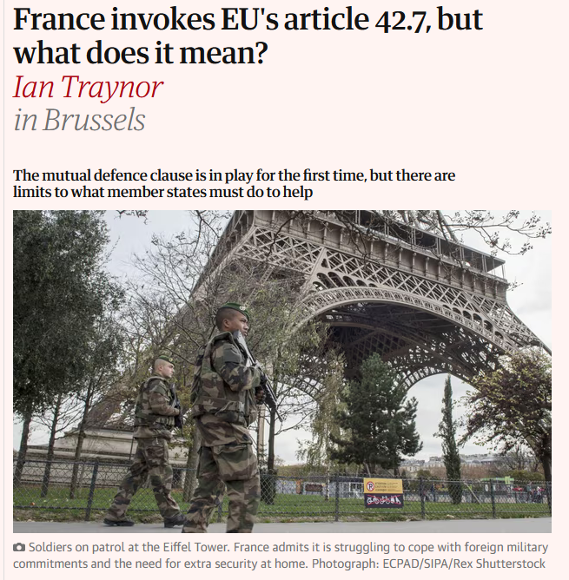
European Union: Mutual defence clause
Treaty of Lisbon: Art. 42,7
activated only once
“If a Member State is the victim of armed aggression on its territory, the other Member States shall have towards it an obligation of aid and assistance by all the means in their power, in accordance with Article 51 of the United Nations Charter. This shall not prejudice the specific character of the security and defence policy of certain Member States.“
“Commitments and cooperation in this area shall be consistent with commitments under the North Atlantic Treaty Organisation, which, for those States which are members of it, remains the foundation of their collective defence and the forum for its implementation.“

Slide 16

Western European Union: Mutual defence clause
Article V
If any of the High Contracting Parties should be the object of an armed attack in Europe, the other High Contracting Parties will, in accordance with the provisions of Article 51 of the Charter of the United Nations, afford the Party so attacked all the military and other aid and assistance in their power.

Slide 17
European Union: Solidarity clause
Article 222 of the Treaty on the Functioning of the European Union (TFEU):
“The Union and its Member States shall act jointly in a spirit of solidarity if a Member State is the object of a terrorist attack or the victim of a natural or man-made disaster. The Union shall mobilise all the instruments at its disposal, including the military resources made available by the Member States (…)
Should a Member State be the object of a terrorist attack or the victim of a natural or manmade disaster, the other Member States shall assist it at the request of its political authorities. To that end, the Member States shall coordinate between themselves in the Council.“

Slide 18
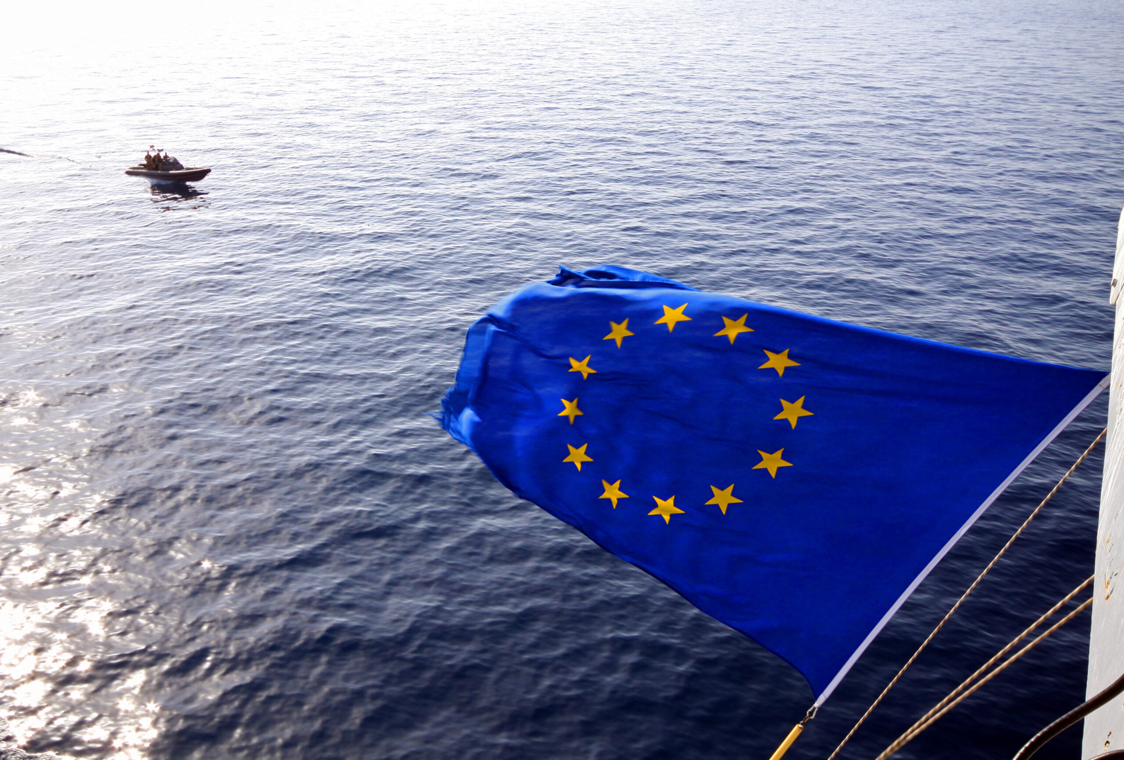
CSDP: Structure (overview)
The Political and Security Committee (PSC)
European Union Military Committee (EUMC)
Committee for Civilian Aspects of Crisis Management (CIVCOM)
The Politico-Military Group (PMG)
Security and Defence Directorate (SECDEFPOL.DMD)
The European Union Military Staff (EUMS)
The Civilian Planning and Conduct Capability (CPCC)
The Military Planning and Conduct Capability (MPCC)
European Defence Agency (EDA)

Slide 19
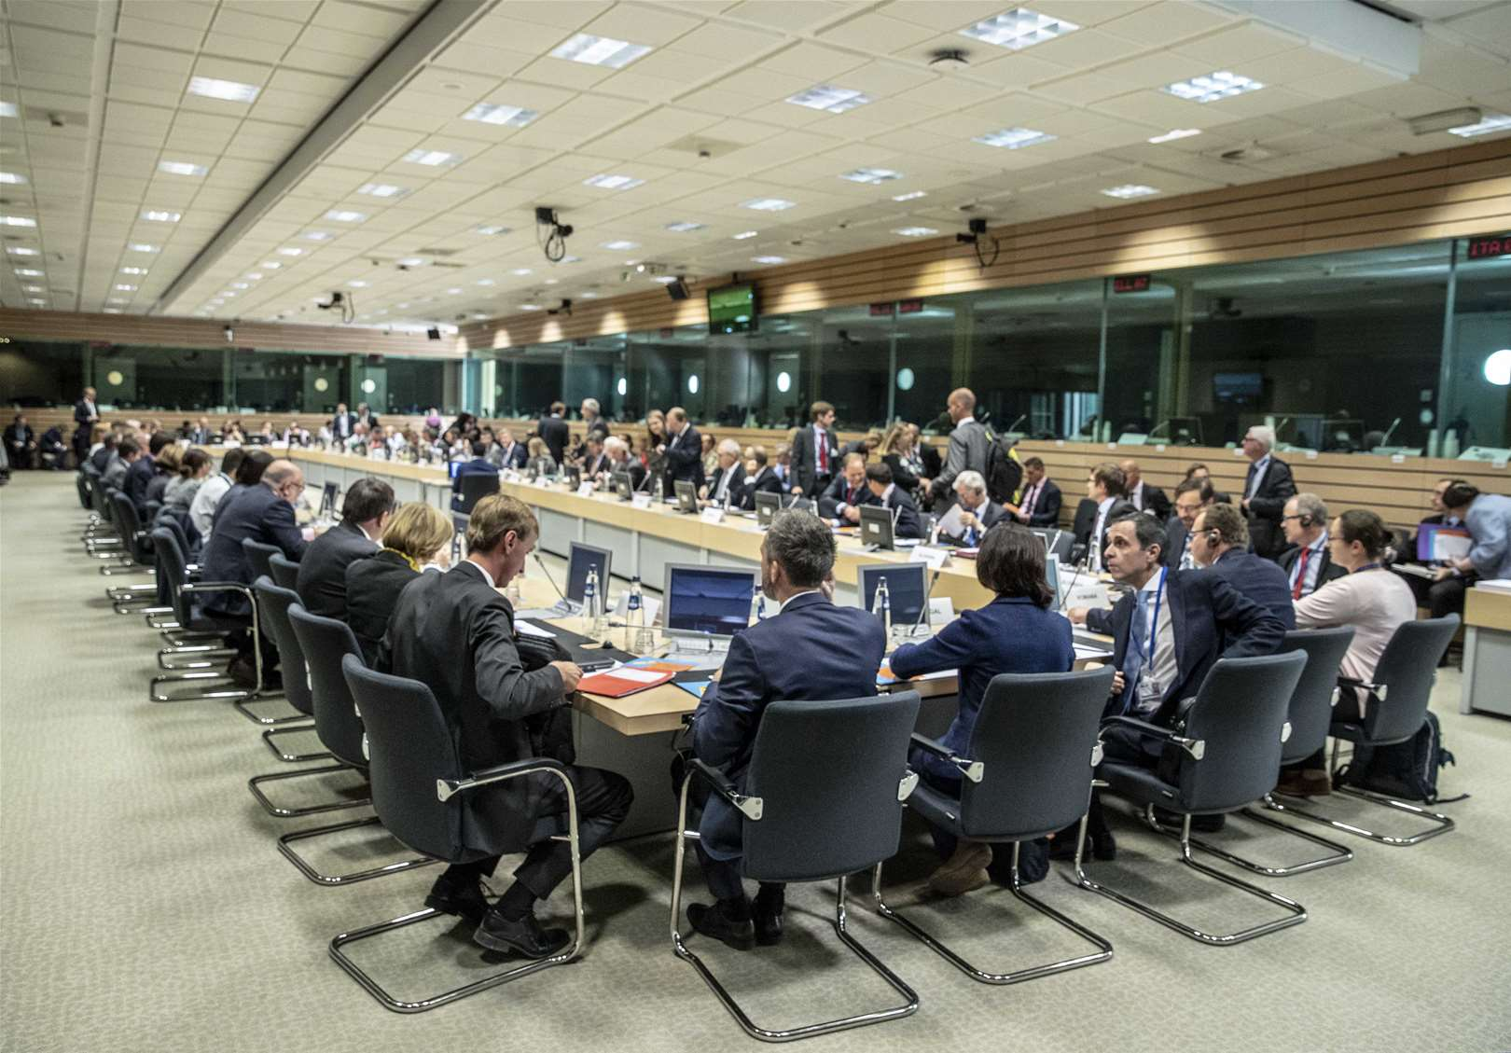
CSDP: Structure
The Political and Security Committee (PSC)
keeps track of the international situation
helps to define policies within the Common Foreign and Security Policy (CFSP) including the CSDP
redommends strategic approaches/policy options to the Council
provides guidance to the EUMC
composed of member states' ambassadors
preparatory body for the Council of the EU

Slide 20
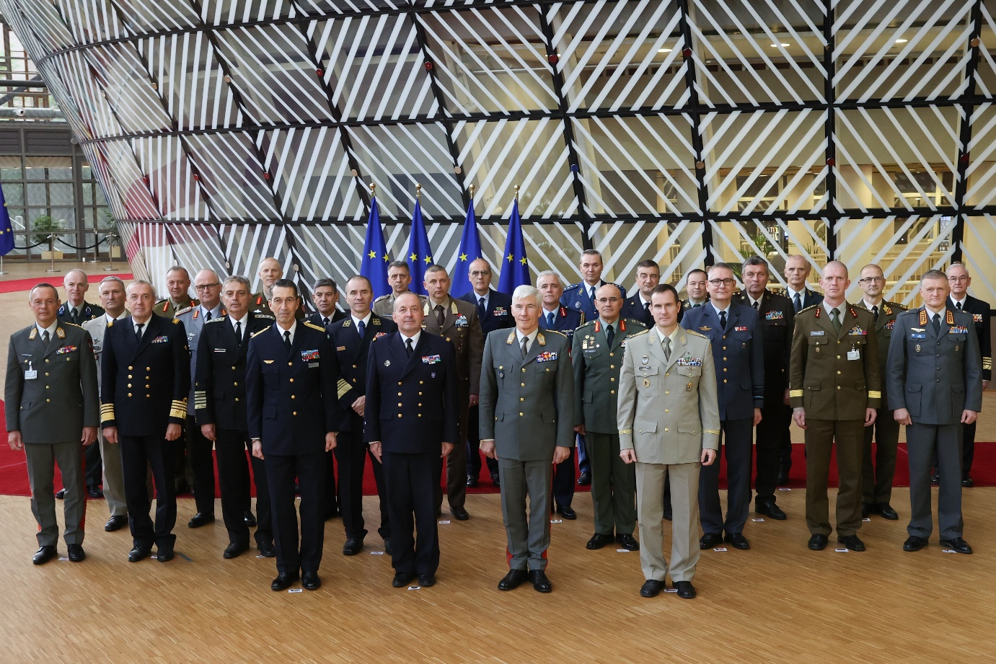
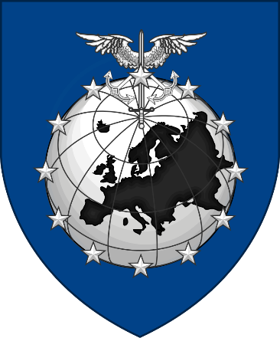
CSDP: Structure
European Union Military Committee (EUMC)
highest military body within the Council, advices PSC on all military matters
composed of the Chiefs of Defence, also represented by their mil representatives
forum for military consultation and cooperation (conflict prevention and crisis management)
directs all military activities (planning / execution of mil ops)
EUMC - Chiefs of Defence

Slide 21

CSDP: Structure
Committee for Civilian Aspects of Crisis Management (CIVCOM)
provides advice to PSC on civilian aspects of crisis management
The Politico-Military Group (PMG)
preparatory work in the field of CSDP
Security and Defence Directorate (SECDEFPOL.DMD)
responsible for coordinating and managing the EEAS overall contribution to addressing external security threats
The European Union Military Staff (EUMS)
source of mil expertise, coordinates the military instrument

Slide 22

CSDP: Structure
The Civilian Planning and Conduct Capability (CPCC)
responsible for an autonomous operational conduct of civilian CSDP operations
The Military Planning and Conduct Capability (MPCC)
operational planning and conduct of the EU’s non-executive military missions + one executive military operation of the size of an EU Battlegroup
European Defence Agency (EDA)
supports the development of defence capabilities and military cooperation among its Member States
headed by the HR

Slide 23

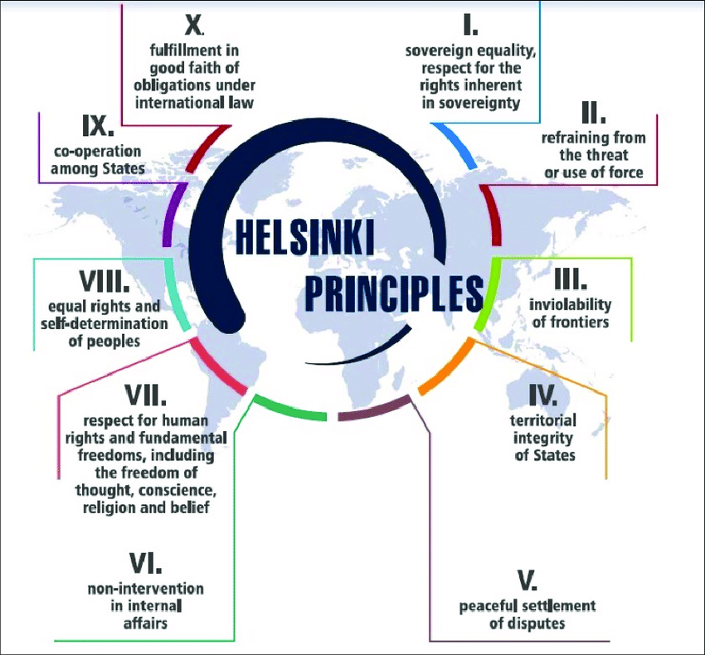
OSCE: Key facts
1973-75 - a diplomatic conference (East-West dialogue)
1975 - Helsinki Final Act, followed by meetings/conferences to monitor implementation - Conference on Security and Co-operation in Europe (CSCE)
1990 - Charter of Paris for a New Europe
1995 - CSCE more institutionalised and renamed the OSCE
idea of a comprehensive approach to security
number of key commitments (politico-military, economic and evironmental, HRs issues
„Decalogue“ (10 fundamental principles)

Slide 24
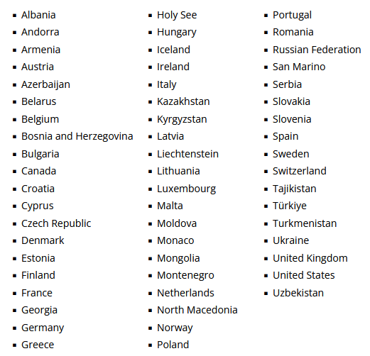
OSCE: Membership
most of the staff and resources are deployed in the OSCE’s field operations in South-Eastern Europe, Eastern Europe and Central Asia
57 participating States
6 Mediterranean and 5 Asian Partners for Co-operation
encompasses three continents - North America, Europe and Asia (more than a billion people)

Slide 25
OSCE: Activities (politico-military dimension)
3 dimensions: politico-military + economic and environmental + human
Arms control - a comprehensive set of confidence- and security-building measures (Vienna document, Treaty on Conventional Forces in Europe, Open Skies Treaty… )
Border management
Conflict prevention and resolution - network of field operations, Conflict Prevention Centre
  The Court of Conciliation and Arbitration, The OSCE High Commissioner on National Minorities
  conflict-related formats (The Minsk process, The Transdniestrian settlement process, The Geneva International Discussions)
Countering terrorism
Policing
Reform and co-operation in the security sector
  OSCE Code of Conduct on Politico-Military Aspects of Security - basic norms for the democratic control of armed and security forces
  guidelines on security sector governance and reform

Slide 26
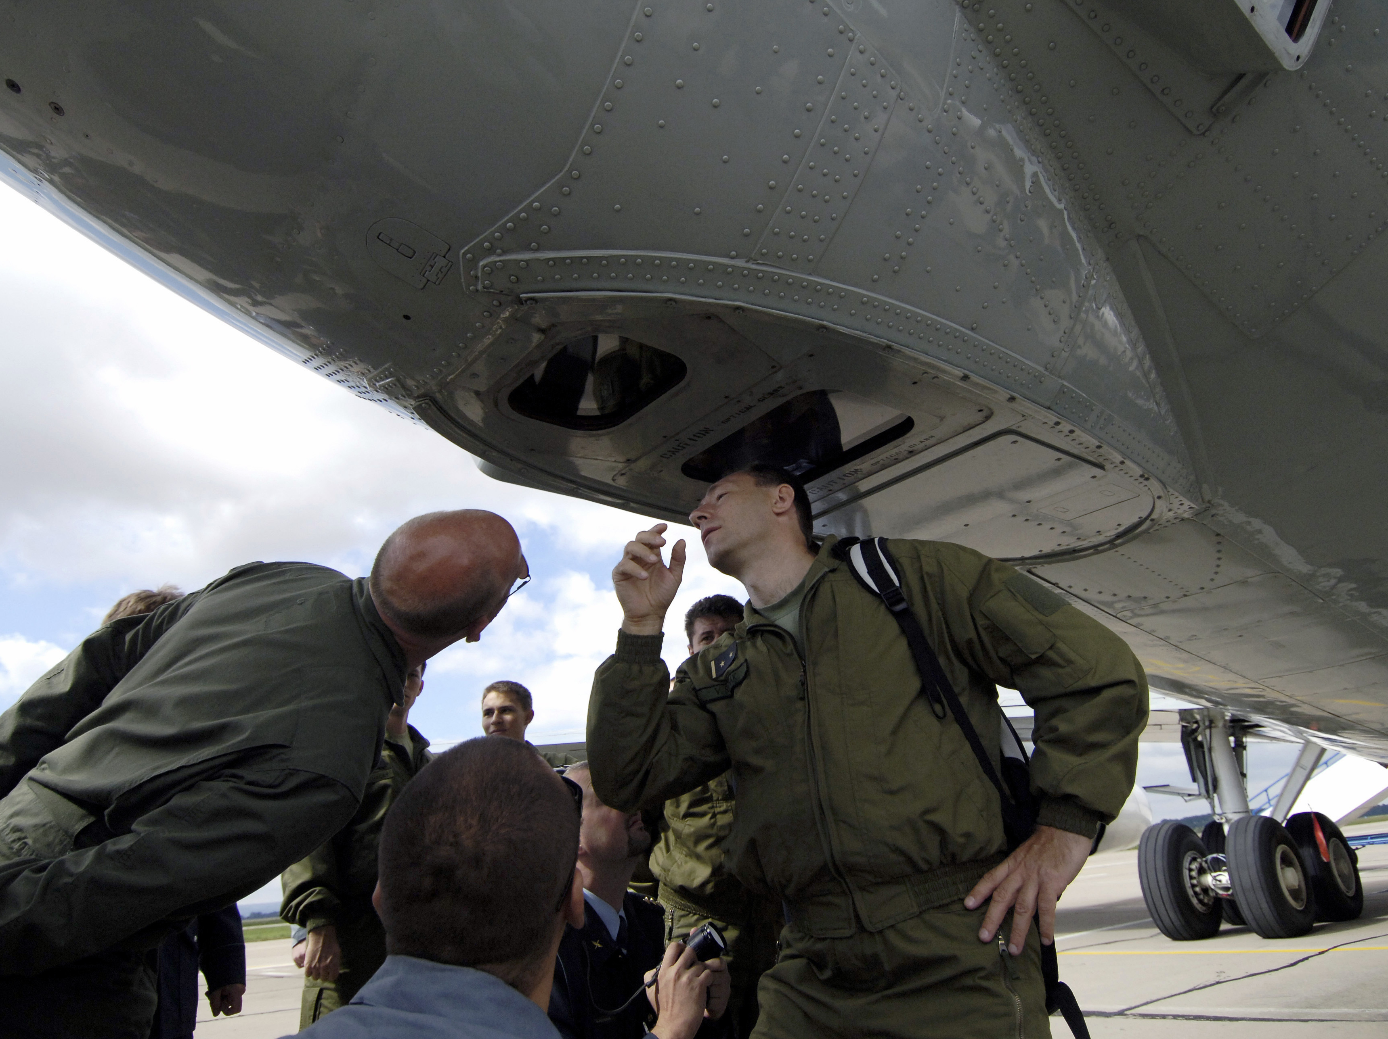
OSCE: Activities (politico-military dimension)
The Vienna Document on CSBMs
annual exchange of military information
prior notification of major military manoeuvres (or invite to observe)
explanations request
inspections
evaluation visits
annual implementation assessment meeting
RF no longer cooperates
Conventional Armed Forces in Europe Treaty (CFE)
setting equal limits on the number of tanks, armored combat vehicles (ACVs), heavy artillery, combat aircraft, attack helicopters
2007 - RF "suspension", 2023 withdrawal → NATO suspension
(NATO x Warsaw Pact)
Open Skies Treaty
short-notice, unarmed reconnaissance flights over the other's territories to collect data on military forces and activities
both US and Russia withdrew
prior notification: at least 9,000 troops, 250 battle tanks, 500 armored combat vehicles, 250 artillery pieces (…)

Slide 27
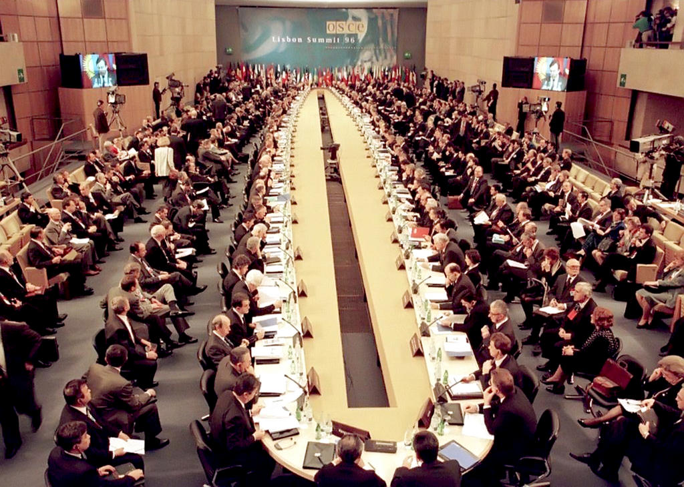
OSCE: Structure (decision-making bodies)
Chairmanship
each year held by one state = Foreign minister as
the Chairperson-in-Office (Elina Valtonen, Finland)
assisted by previous and succeeding Chairperson = Troika
Summits
set the priorities and orientation of the organisations, attended by Heads of State / Government

Slide 28
OSCE: Structure (decision-making bodies)
The Ministerial Council
central decision-making and governing body
composed of the Ministers for Foreign Affairs
ministerial meetings - convened once a year + additional meetings
Permanent Council
the principal decision-making body for regular political consultations and for governing the day-to-day operational work
implements tasks / decisions by OSCE Summits and the MC
composed of delegates of the participating states

Slide 29
OSCE: Structure (decision-making bodies)
Informal subsidiary bodies (within the Permanent Council)
3 committees - discuss issues in their dimensions (including implementation)
  Security Committee
  Economic and Environmental Committee
  Human Dimension Committee
Forum for Security Co-operation
helps implement confidence and security-building measures, develops norms in different areas (e.g., non-proliferation)

Slide 30
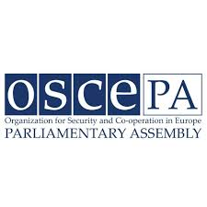
OSCE: Structure (decision-making bodies)
Parliamentary Assembly
323 members
a forum for diplomacy and debate
leading election observation missions
developing and promoting mechanisms for the conflicts prevention and resolution

Slide 31
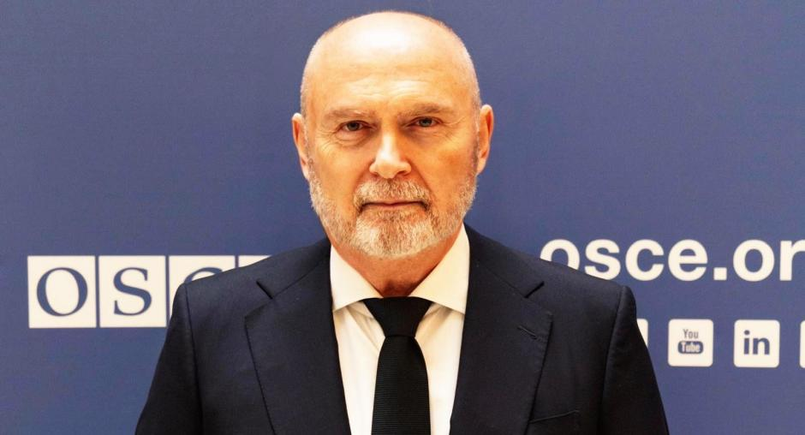
OSCE: Structure (executive bodies)
Secretariat
operational support to the OSCE
Secretary General
representative of the Chairperson-in-Office
supports negotiations, provides early warning, ensures implementation, oversees field operations
OSCE Office for Democratic Institutions and Human Rights
OSCE Representative on Freedom of the Media
OSCE High Commissioner on National Minorities
Feridun H. Sinirlioğlu

Slide 32
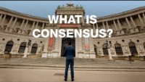
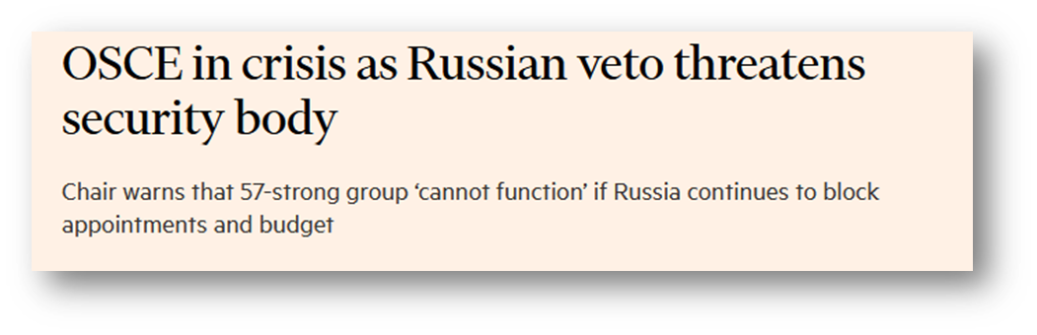
OSCE: Decision-making
negotiations - Plenary Meetings of the Permament Council
inclusive and relatively transparent decison-making process
decisions require consensus of all delegates → decisions become politically binding

Slide 33
“The basis of any cooperation, trust and adherence to common standards no longer exists between Russia and most OSCE States. Russia’s war has now thrown Europe back to its pre-1973 status in terms of security, confidence-building and peace, when the first negotiations on security and cooperation in Europe began.” (Vogel. 2024. In troubled waters. The OSCE in times of war)

Slide 34

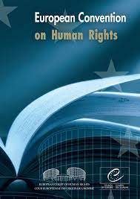
Council of Europe: Key facts
based in Strasbourg, France
founded in 1949 (the Statute of the Council of Europe)
goal: to advance human rights, democracy and the rule of law
all members are obliged to sign The European Convention on Human Rights

Slide 35
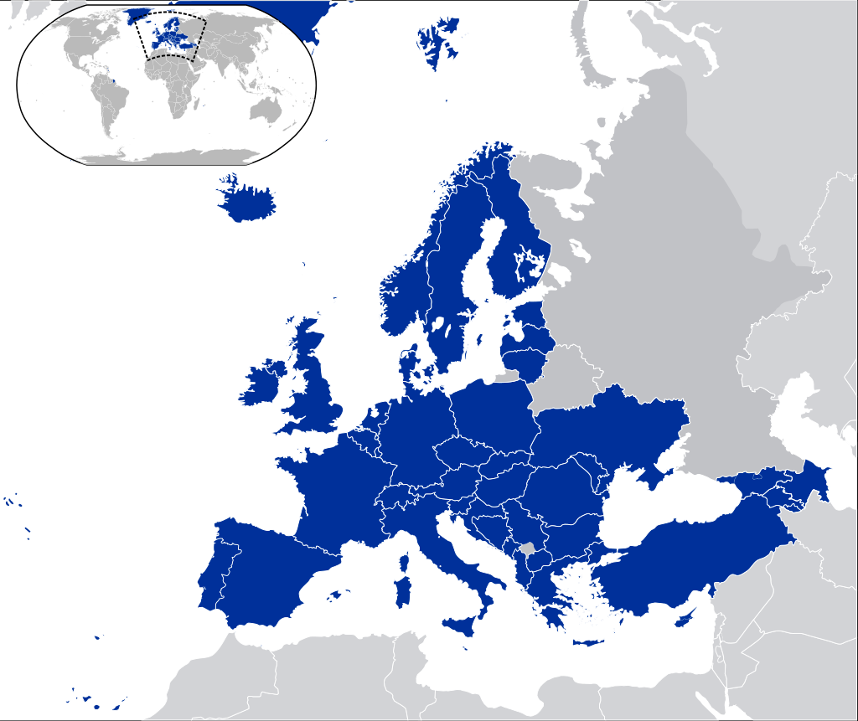
Council of Europe: Membership
46 member states
observer states: Canada, Holy See, Japan, Mexico and United States of America) + Israel (observer to the Parliamentary Assembly)
March 2022 - Russia expelled

Slide 36
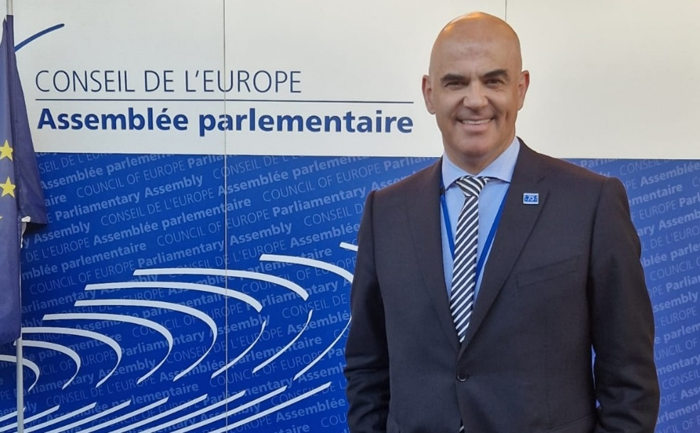
Council of Europe: Structure
Secretary General
strategic planning and direction + budget
elected by the Parliamentary Assembly, 5-year term
Committee of Ministers
decision-making body, ministers of foreign affairs / permanent diplomatic representatives
decides policy, approves budget and programme of activities
Parliamentary Assembly (PACE) - 306 members
elects the SecGen, the Human Rights Commissioner and the ECHR judges
a forum for debate
Alain Berset

Slide 37
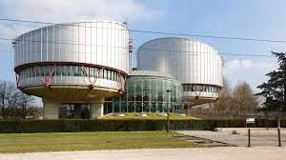

Council of Europe: Structure
Congress of Local and Regional Authorities
responsible for strengthening local and regional democracy
European Court of Human Rights
permanent judicial body
guarantees the rights safeguarded by the European Convention on Human Right
Commissioner for Human Rights
independently addresses and brings attention to human rights violations.

Slide 38
Council of Europe: Activity / Achievements
strengthening of human rights (through conventions)
  the European Convention on Human Rights (adopted in 1950)
  abolition of the death penalty (Protocol No. 6 + 13 to the ECHR)
  countries subject to independent monitoring mechanisms
issues of common concerns (Freedom of Expression, Gender Equality, Discrimination, Racism, Trafficiking in Human Beings, Corruption, Cybercrime, Sport, Data Protection… )
election observation - role of the PACE and the Congress of Local and Regional Authorities

Slide 39
Council of Europe: Treaties
protocol - legal instrument complementing / modifying the main treaty
output international treaties (different names - convention, agreement, charter… )
negotiations → Comittee of Ministers' decision to adopt the final text of a treaty → open for signature
legal existence given by the consent of the MSs that sign and ratify the treaties
published in European Treaty Series (ETS) and Council of Europe Treaty Series (CETS, no. 194 and following)
reservations can be made by individual states
can be opened for signature by non-members
list of treaties and protocols

