Slide 1

I. INTRODUCTION
PRESENTED BY:
JUDGE MARK A. SPEISER

Slide 2
A. PERSONAL AND PROFESSIONAL BACKGROUND OF LECTURER

Slide 3
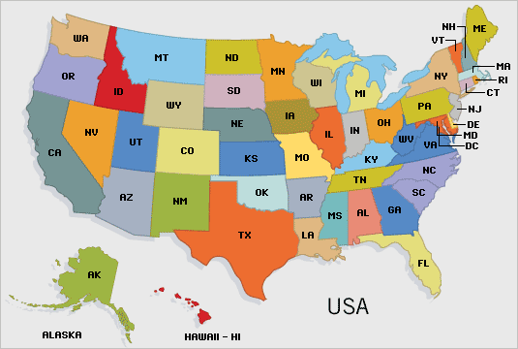


Slide 4
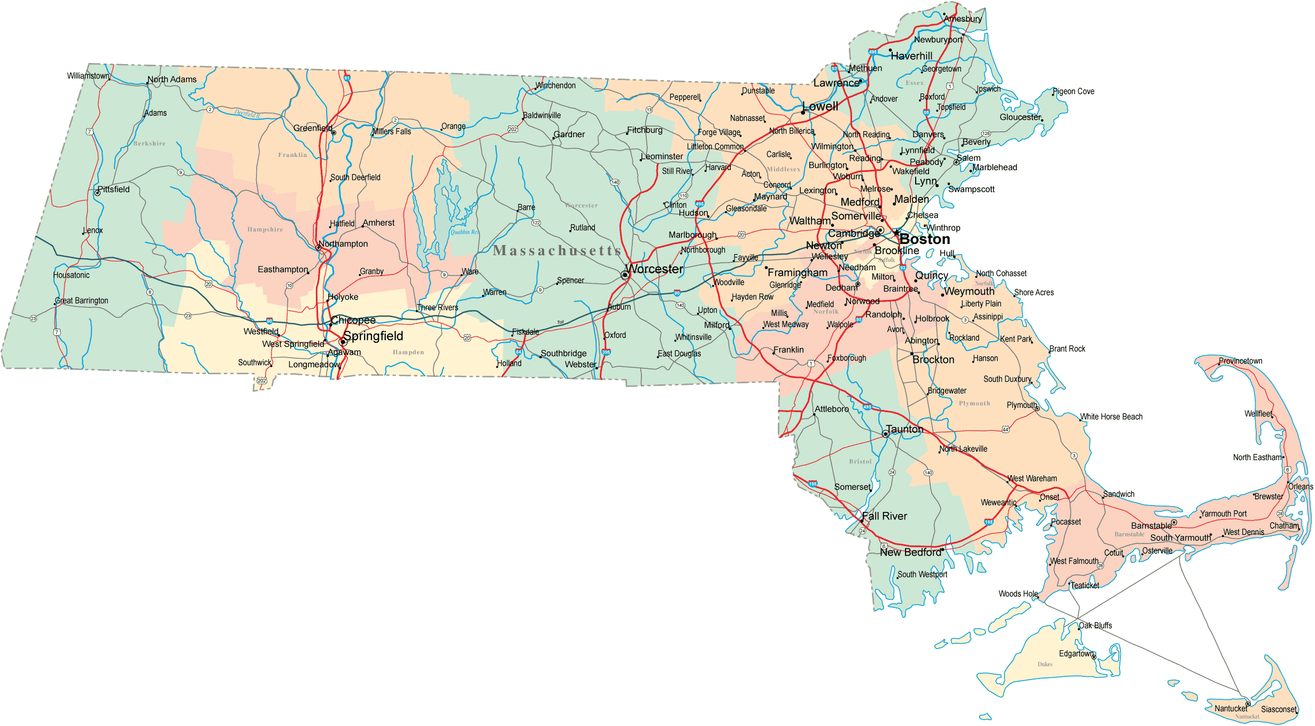

Slide 5
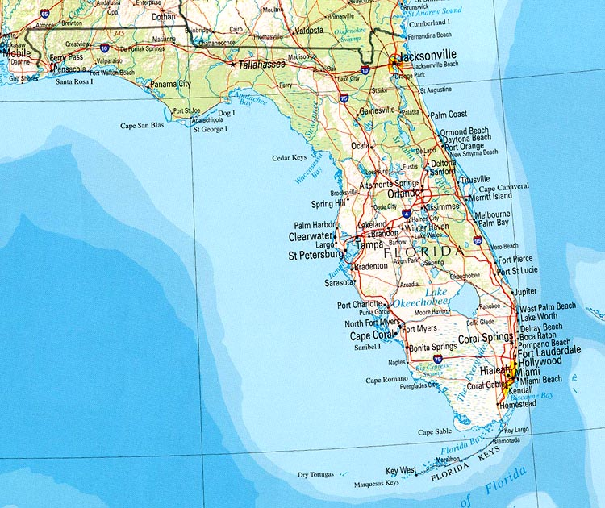

Slide 6
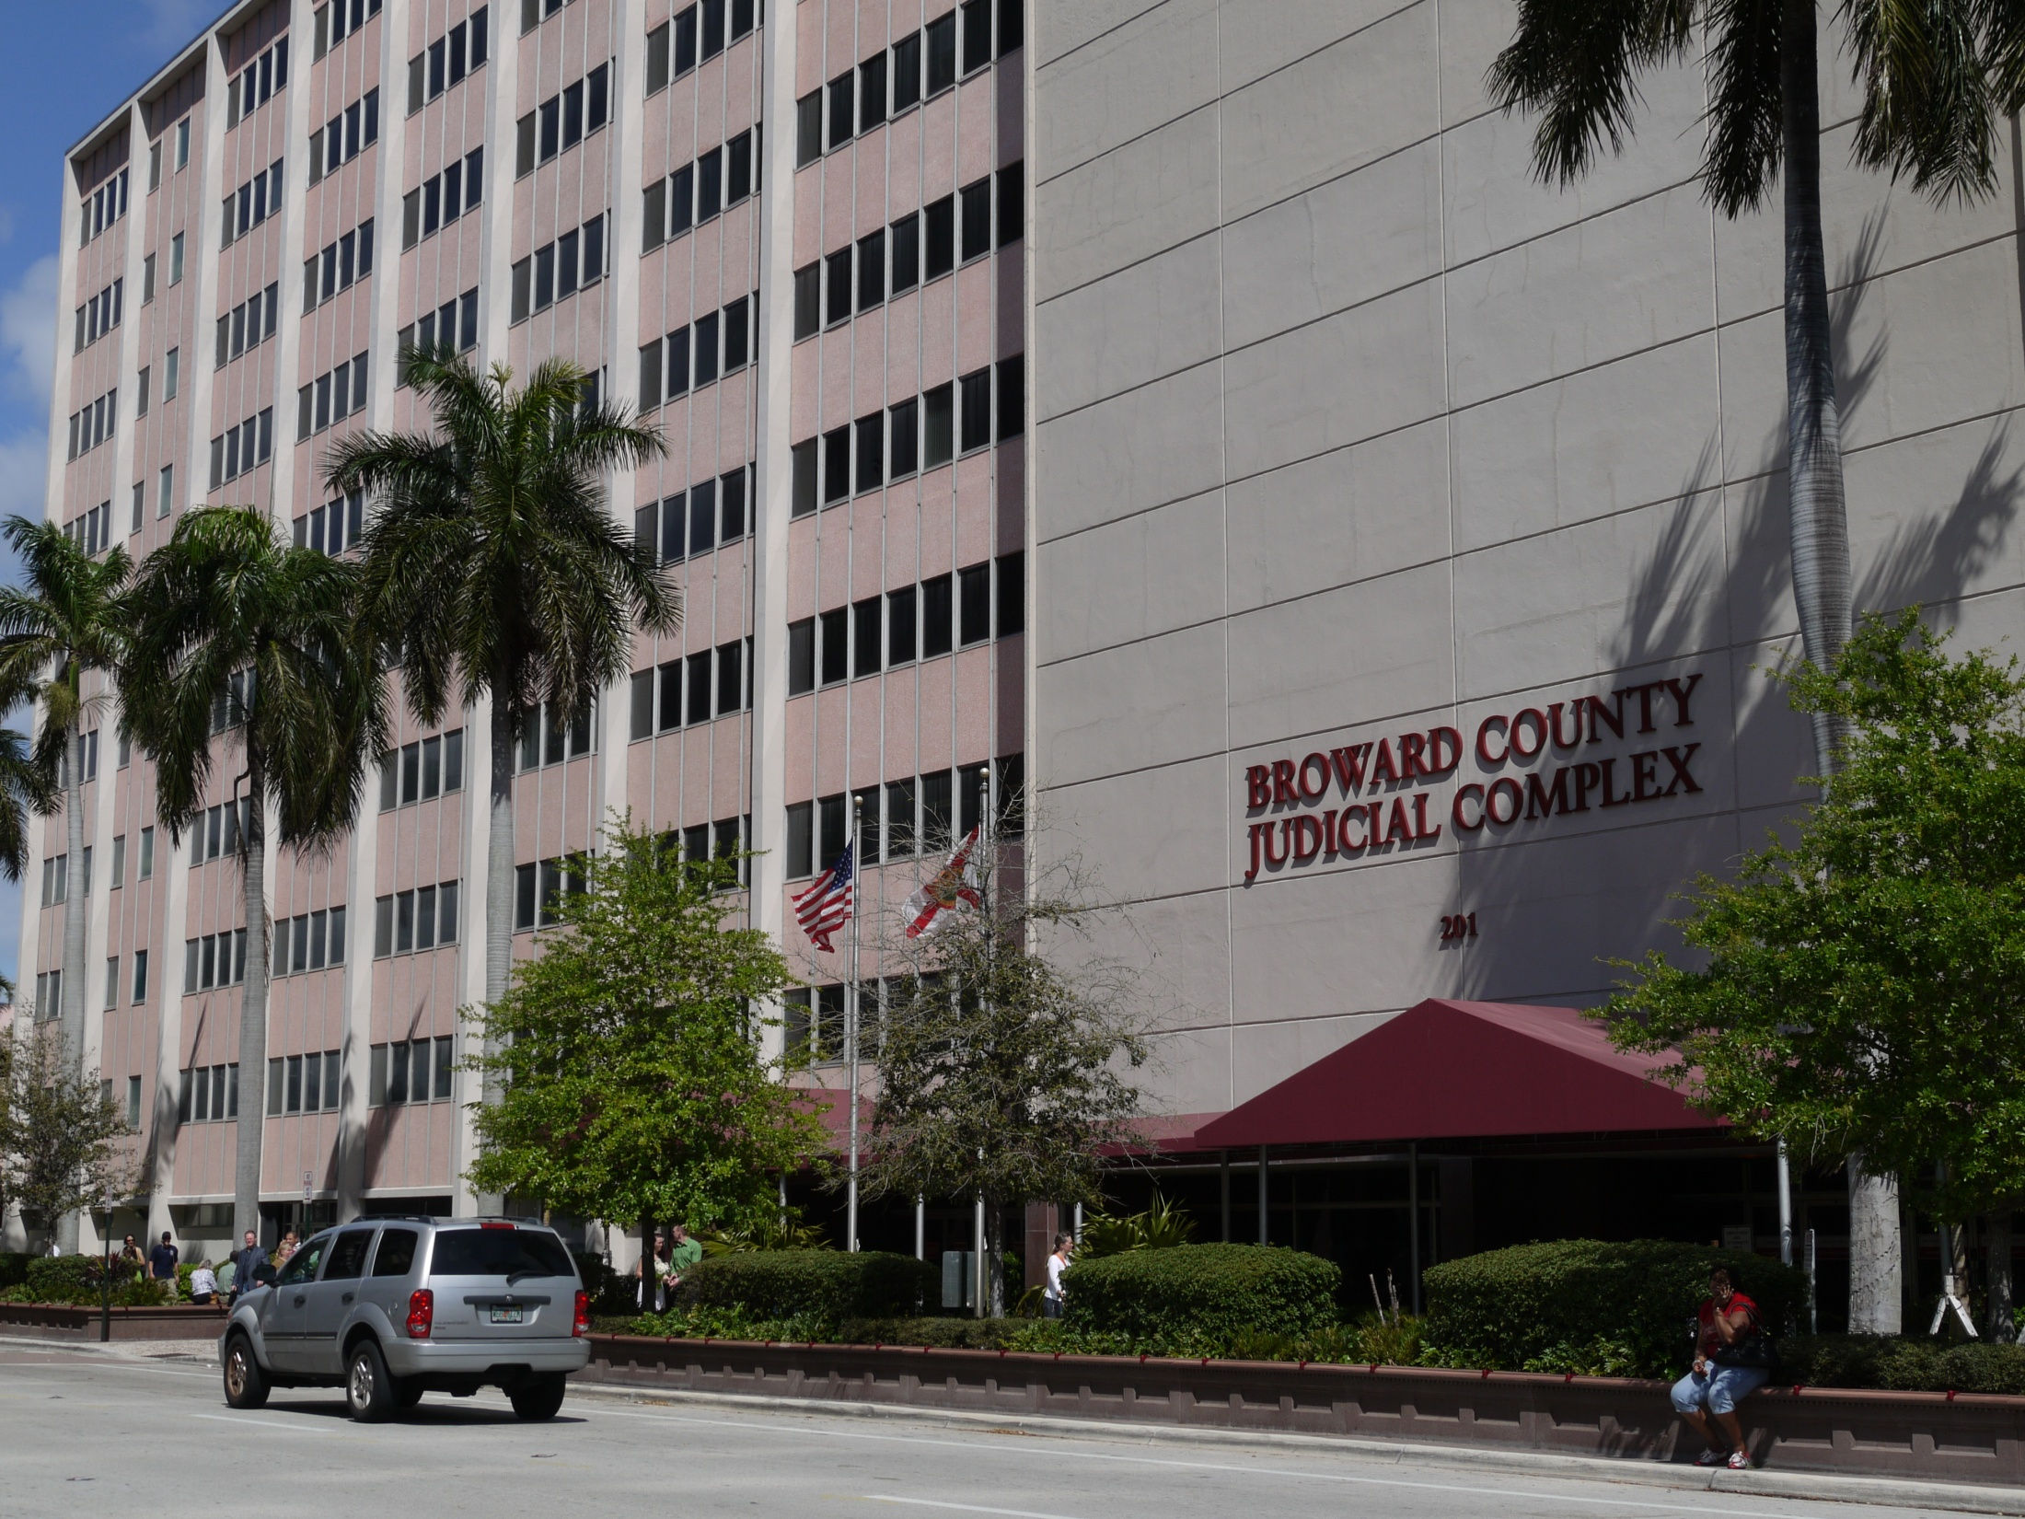

Slide 7
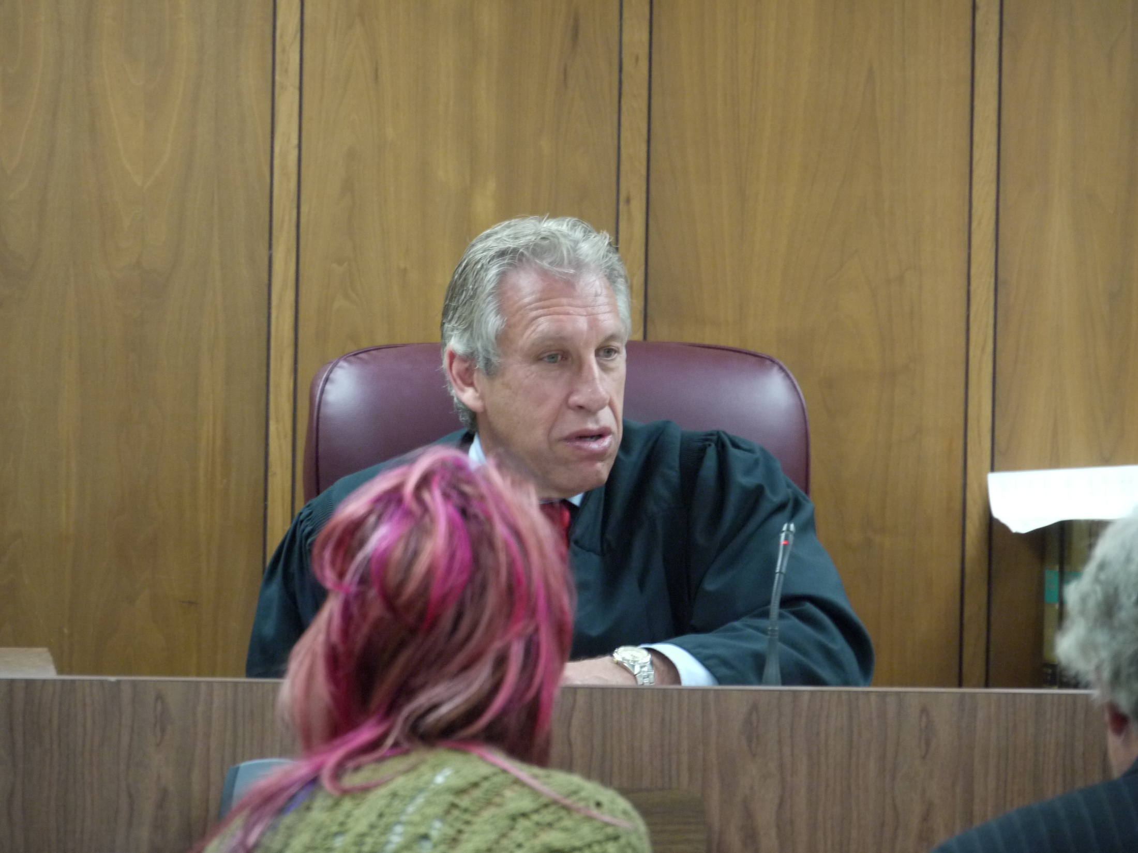

Slide 8
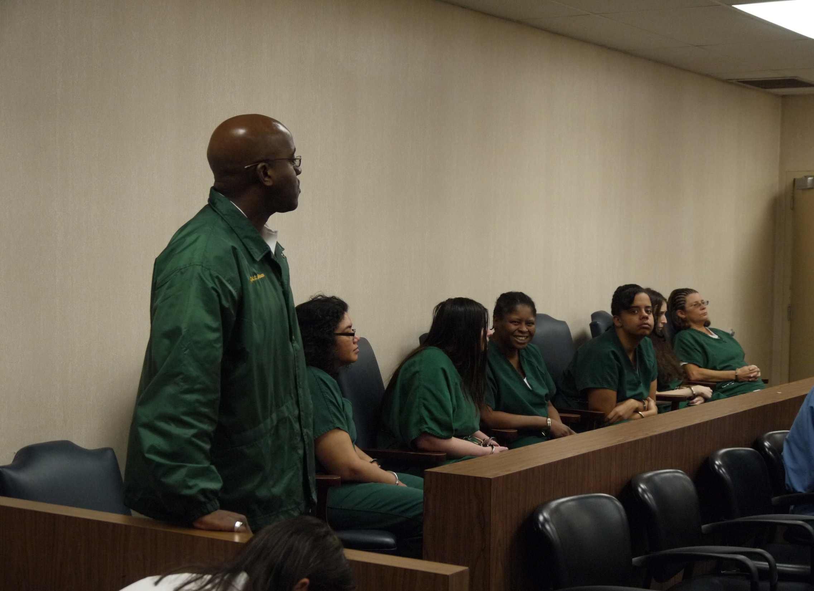

Slide 9
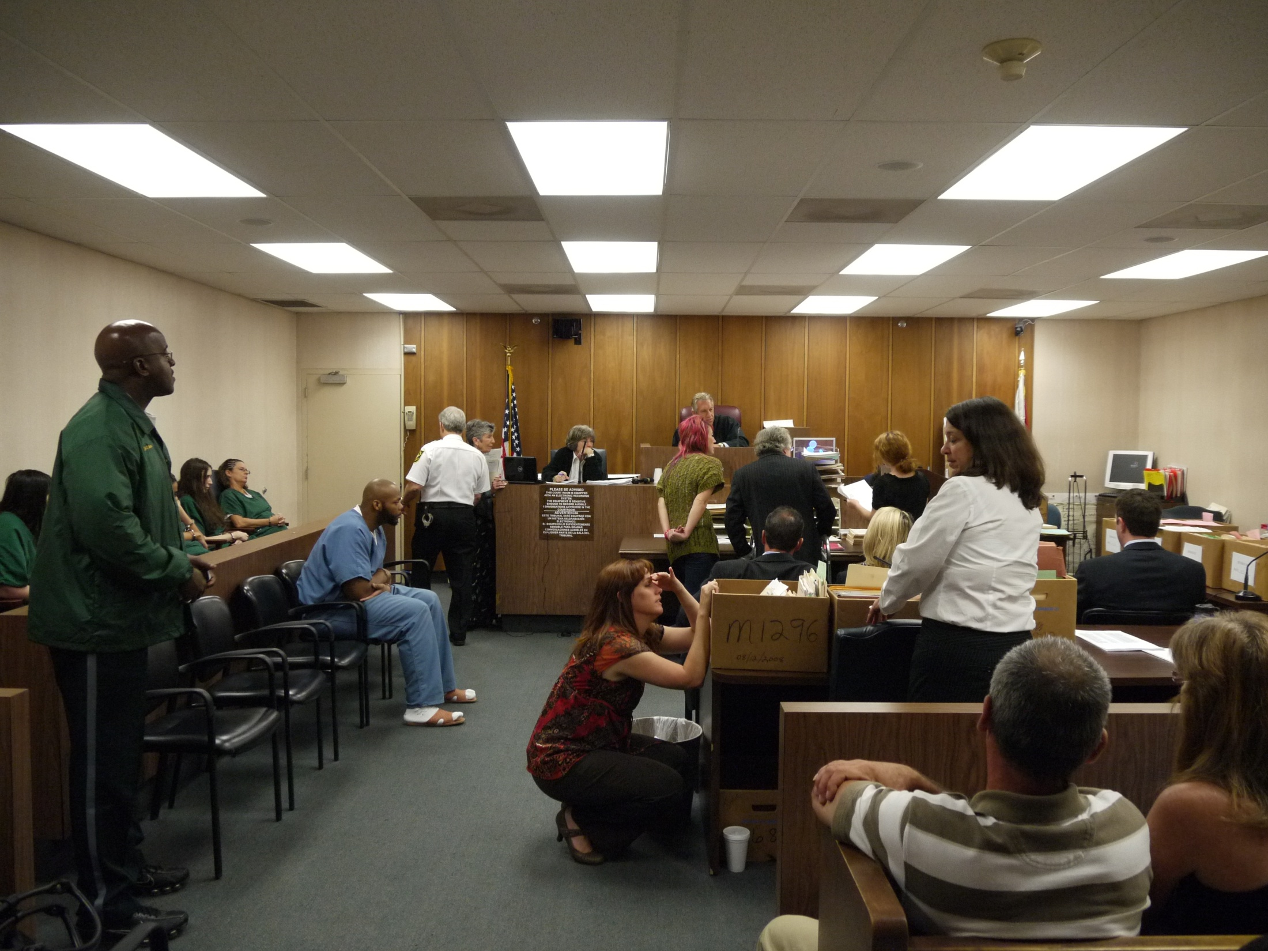

Slide 10
