Slide 1
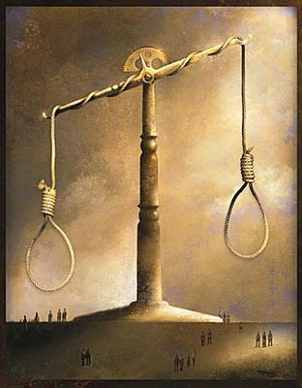
VIII. DEATH PENALTY CONSIDERATIONS
PRESENTED BY:
JUDGE MARK A. SPEISER

Slide 2
I GRAND JURY
AN INVESTIGATIVE AND ACCUSATORY PANEL SUPERVISED BY CIRCUIT COURT
ELIGIBLE CITIZENS OF THE JUDICIAL CIRCUIT ARE RANDOMLY SUMMONED AND SELECTED
GRAND JURORS MUST BE AT LEAST 18 YEARS OF AGE AND PANEL CONSISTS OF NO FEWER THAN 15 NOR MORE THAN 21 PERSONS
TERM OF DUTY IS 6 MONTHS AND MAY BE EXTENDED UP TO 90 DAYS

Slide 3
PAY IS $35 PER DAY
EVERY SESSION IS RECORDED BY A COURT REPORTER
DEFENSE ATTORNEY NOT ALLOWED TO BE PRESENT; THEREFORE DEFENSE SIDE OF CASE NEVER PRESENTED
PETIT JURY IS TRIAL JURY, HEARS ALL ADMISSIBLE EVIDENCE PRESENTED BY PROSECUTOR AND DEFENSE, AND RETURNS A VERDICT
GRAND JURY RETURNS A CHARGING DOCUMENT KNOWN AS AN INDICTMENT WHICH IS REQUIRED TO INITIATE A PROSECUTION OF A 1ST DEGREE MURDER CASE PUNISHABLE BY DEATH

Slide 4
II. GUILT PHASE
12 JURORS AND 4 ALTERNATES
DEATH QUALIFYING THE JURY
  MISGIVINGS ABOUT RECOMMENDING DEATH PENALTY
    WITHERSPOON V. ILLINOIS
      391 U.S. 510 (1968)
UNANIMOUS VERDICT

Slide 5
III. PENALTY PHASE
A. UNNECESSARY IF DEFENDANT I5 OR YOUNGER WHEN MURDER COMMITTED
  CRUEL AND UNUSUAL PUNISHMENT
    8TH AMENDMENT
  CAN NOT EXECUTE DEFENDANT WHO IS MENTALLY RETARDED

Slide 6
  CAN NOT EXECUTE DEFENDANT WHO AIDS AND ABETS THE COMMISSION OF A FELONY DURING WHICH A PERSON(S) OTHER THAN THE DEFENDANT MURDERS THE VICTIM
  UNNECESSARY IF NO AGGRAVATING FACTORS PRESENT
  STATE NOT SEEKING DEATH PENALTY

Slide 7
B. DEATH PENALTY ONLY APPLICABLE IF MURDER
  PREMEDITATED
    THIS EXCLUDES SECOND DEGREE MURDER AND MANSLAUGHTER
  FELONY-MURDER
    AN UNINTENTIONAL YET REASONABLY FORSEEABLE KILLING OCCURRING DURING COMMISSION OR ATTEMPT TO COMMIT A SERIOUS OR INHERENTLY DANGEROUS FELONY SUCH AS, ROBBERY, RAPE, ARSON, KIDNAPPING OR CARJACKING
C. JURY DOES NOT ORDER DEATH SENTENCE; ONLY MAKES NON-BINDING RECOMMENDATION TO COURT

Slide 8
D. JURY RECOMMENDATION OF LIFE WITHOUT PAROLE OR DEATH PENALTY IS BY A MAJORITY VOTE
  IF JURY VOTE IS 6-6 TIE, RECOMMENDATION IS DEEMED LIFE

Slide 9
E. STATE PRESENTS EVIDENCE OF AGGRAVATING FACTORS IN SUPPORT OF DEATH PENALTY
EACH FACTOR MUST BE PROVEN BEYOND A REASONABLE DOUBT:
  MURDER COMMITTED BY PERSON UNDER SENTENCE (INCLUDES JAIL, PRISON, PROBATION, PAROLE)
  DEFENDANT HAS A PRIOR CAPITAL FELONY, A FELONY INVOLVING THE USE OR THREAT TO USE VIOLENCE TO THE PERSON, OR A CONVICTION FOR DISTRIBUTION OF A CONTROLLED SUBTANCE PUNISHABLE BY A SENTENCE OF AT LEAST 1 YEAR IN PRISON

Slide 10
  DEFENDANT CREATED GREAT RISK NOT A MERE PROBABILITY OF DEATH TO MANY PERSONS (4 OR MORE PERSONS OTHER THAN THE VICTIM)
  DEFENDANT USED FIREARM OR DIRECTED ANOTHER TO DO SO
  OFFENSE INVOLVED DISTRIBUTION OF DRUGS TO PERSONS UNDER 18
  OFFENSE INVOLVED DISTRIBUTION OF DRUGS CONTAINING POTENTIALLY LETHAL COMPONENT
  VICTIM IS A LAW ENFORCEMENT OFFICER

Slide 11
  VICTIM PARTICULARLY VULNERABLE DUE TO AGE OR DISABILITY
  MURDER COMMITTED FOR FINANCIAL GAIN
  MURDER COMMITTED IN AN ESPECIALLY HEINOUS, CRUEL OR DEPRAVED MANNER IN THAT OFFENSE INVOLVED TORTURE OR SERIOUS PHYSICAL ABUSE TO VICTIM

Slide 12
F. VICTIM IMPACT EVIDENCE
  USED TO PROVE VICTIM’S UNIQUENESS AND THE RESULTANT LOSS TO THE COMMUNITY BY THE VICTIM’S DEATH
G. DEFENSE PRESENTS MITIGATING FACTORS IN SUPPORT OF LIFE SENTENCE
HERE THE FOCUS IS ON THE DEFENDANT’S CHARACTER OR LIFE HISTORY
  DEFENDANT HAS NO SIGNIFICANT HISTORY OF PRIOR CRIMINAL ACTIVITY

Slide 13
  MURDER COMMITTED WHILE DEFENDANT UNDER INFLUENCE OF EXTREME MENTAL OR EMOTIONAL DISTRESS
  DEFENDANT WAS AN ACCOMPLICE AND HIS PARTICIPATION WAS RELATIVELY MINOR
  DEFENDANT ACTED UNDER THE SUBSTANTIAL DOMINATION OF ANOTHER PERSON OR UNDER EXTREME DURESS

Slide 14
  DEFENDANT’S CAPACITY TO APPRECIATE THE CRIMINALITY OF HIS CONDUCT WAS SUBSTANTIALITY IMPAIRED
  AGE OF DEFENDANT AT TIME OF MURDER
    EXTREMELY YOUNG (OVER15) OR ELDERLY

Slide 15
  DEFENDANT COULD NOT HAVE REASONABLY FORSEEN HIS CONDUCT DURING MURDER WOULD CREATE A GREAT RISK OF DEATH TO ONE OR MORE PERSONS
  ANY OTHER FACTORS IN DEFENDANT’S BACKGROUND MITIGATING AGAINST DEATH PENALTY .

Slide 16
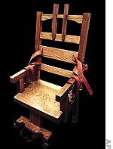
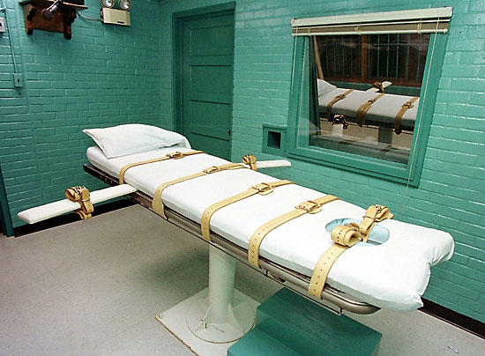
H. CLOSING ARGUMENTS
  STATE ARGUES FIRST
  DEFENSE HAS LAST WORD
I. JURY INSTRUCTIONS
J. JURY DELIBERATIONS AND RESULTING NON-BINDING ADVISORY OPINION
K. SENTENCE ALTERNATIVES
  FOLLOW JURY’S
  RECOMMENDATION
  JURY OVERRIDE

Slide 17
L. DEATH SENTENCE REQUIRES EXTENSIVE AND DETAILED SENTENCING ORDER
M. APPEAL
  DIRECTLY TO FLORIDA SUPREME COURT

Slide 18
THE END

