Slide 1

Utrecht European University Network, IP Summer School
Brno
Cluster Two: Recurrent Nationalisms
National Narcissism and Pan Europeanism
John A. McCarthy
Vanderbilt University/Universiteit Utrecht

Slide 2
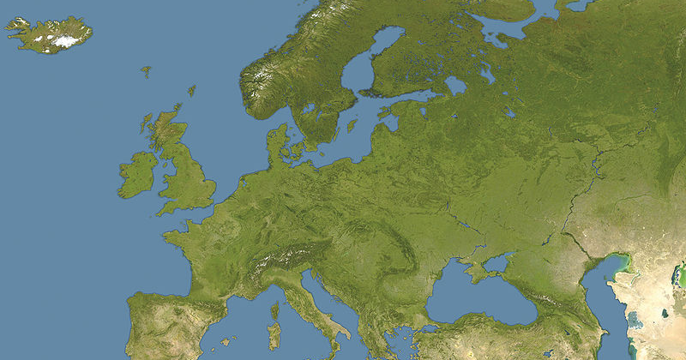

Slide 3
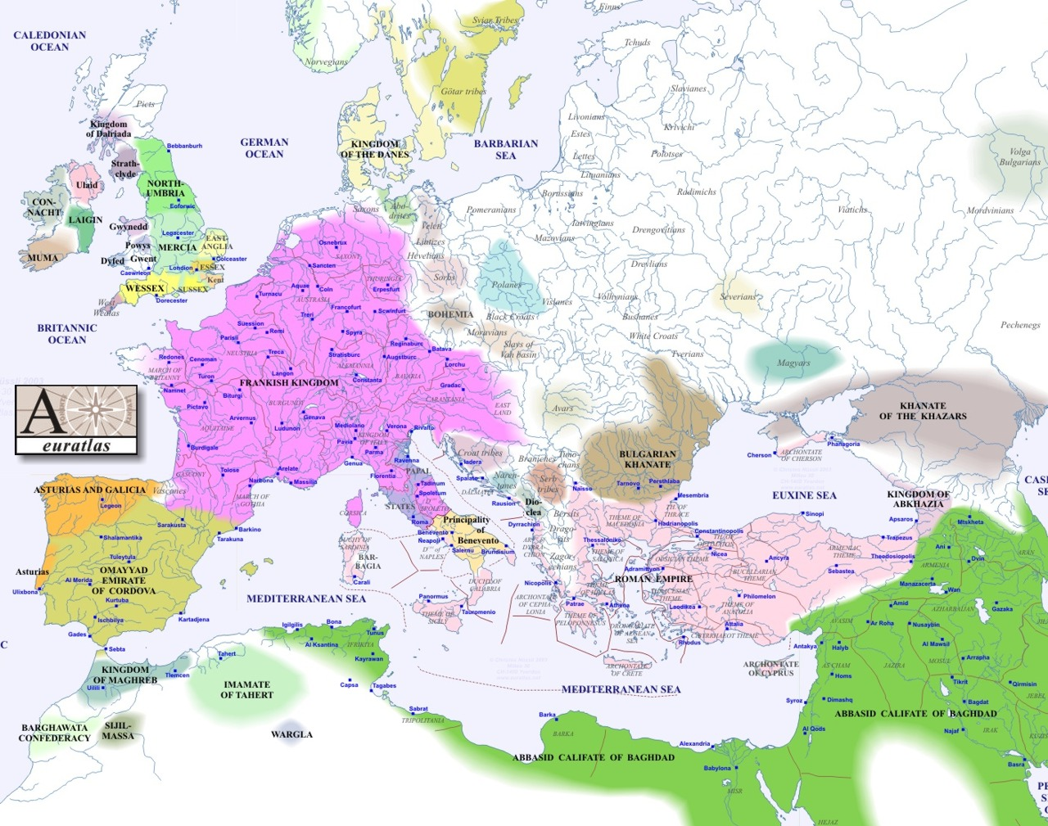
Europe ca. 800
Europe ca 800
Notes:
Europe ca. 1900

Slide 4
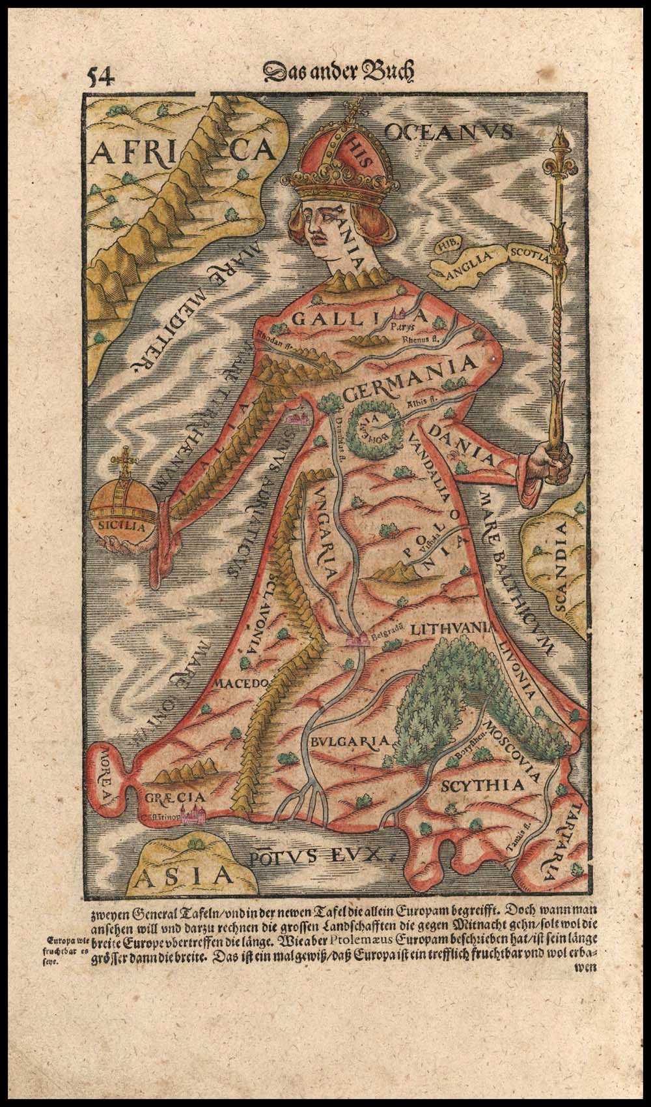

Slide 5
Sebastian Munster, Europa (1570)
Notes:
The map was made in 1570 in Basel (Switzerland) by cartographer Sebastian Munster. In their description of this map, the sellers add: “During the late 16th century, a few map makers created these now highly prized map images, wherein countries and continents were given human or animal forms. Among the earliest examples is this map of Europa by Munster, which appeared in Munster’s Cosmography.

Slide 6
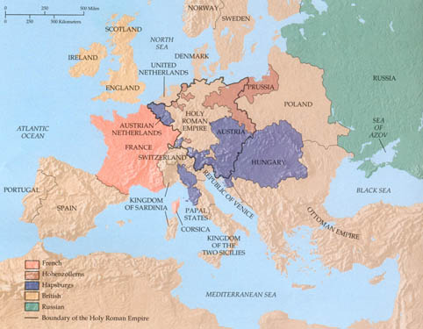
Europe 1763 - 1789
Nationalism - “In spite of the existence of an intellectual community, “European” did not mean anything other than French, English, Spanish and so on” (Fontana 119).
European nations
Separate entities
Connected by Commerce
Divided by:
Economic
Dynastic
Territorial Rivalries
Necessarily competitive
“to love one’s country meant necessarily to militate against the success of other nations” (Biancamaria Fontana, “The Napoleonic Empire and the Europe of Nations,” Pagden [2007], 119).
Notes:
So, Europe at the time of Napoleon was a group of distinct monarchies or dynasties rather than a larger political entity. As Fontana states, “In spite of the existence of an intellectual community, “European” did not mean anything other than French, English, Spanish and so on.” Connected through cultural and commercial trade, the European nations were still divided by economic, dynastic, and territorial forces. The environment was necessarily competitive. It could be said that nations, in their origins, are often defensive – formed by fighting the enemy and defending the homeland. In turn, there is a heroic need to expand that nation culturally and territorially, which turns into an offensive nationalism. That is why Fontana states that, “to love one’s country meant necessarily to militate against the success of other nations.” For these reasons, the great powers believed in stability throughout the balance-of-power system. So, the 18th century saw some vague sense of a larger European identity, but none that people would ascribe to as equally as their national identities.
6

Slide 7
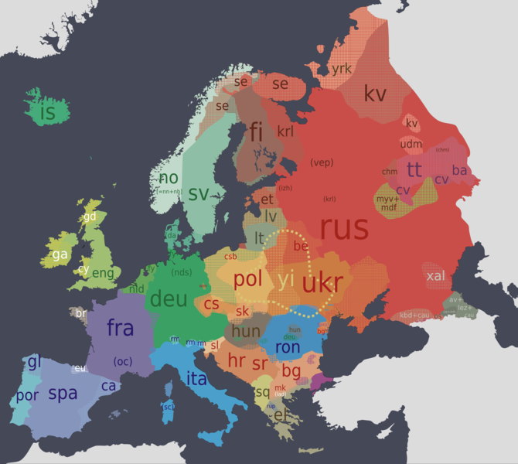
Linguistic Diversity
Operative principle of “diversity of cultures, customs and beliefs. This includes languages.”
The official languages of the EU are drawn from three language families:
  Indo-European
  Finno-Ugric
  Semitic
Other continents boast many more language families
Article 21 of the EU Charter of Fundamental Rights prohibits discrimination based on language
Article 22 requires the EU to respect linguistic diversity
Notes:
Original: 2006-03-09 Vector version: 2007-03-09
AUTHOR: Urion Argador (Urion Argador) [ http://www.argador.info ]. Vectorization: Chabacano from Image:Europe continents.svg by Júlio Reis
This file is licensed under the Creative Commons Attribution ShareAlike 2.5 License. In short: you are free to share and make derivative works of the file under the conditions that you appropriately attribute it, and that you distribute it only under a license identical to this one. Official license

Slide 8
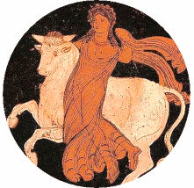
Geography--Language--Diversity
Article 22 of the European Charter of Fundamental Rights states: “The Union respects cultural, religious, and linquistic diversity.”
“Today the European Union is home to 450 million people from diverse ethnic, cultural and linguistic backgrounds.
The linguistic patterns of European countries are complex - shaped by history, geographical factors and the mobility of people.
At present, the European Union recognizes 23 official languages and about 60 other indigenous and non-indigenous languages are spoken over the geographical area.”
(Special EUROBAROMETER 243 “EUROPEANS AND THEIR LANGUAGES,” February 2006.)
Notes:
The European Union has 23 official and working languages. They are: Bulgarian, Czech, Danish, Dutch, English, Estonian, Finnish, French, German, Greek, Hungarian, Irish, Italian, Latvian, Lithuanian, Maltese, Polish, Portuguese, Romanian, Slovak, Slovene, Spanish and Swedish.

Slide 9
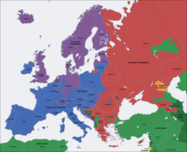
Predominant religions in Europe and neighboring regions:
Roman Catholic Christianity Eastern Orthodox Christianity Protestant Christianity Sunni Islam Shia Islam Buddhism Judaism

Slide 10
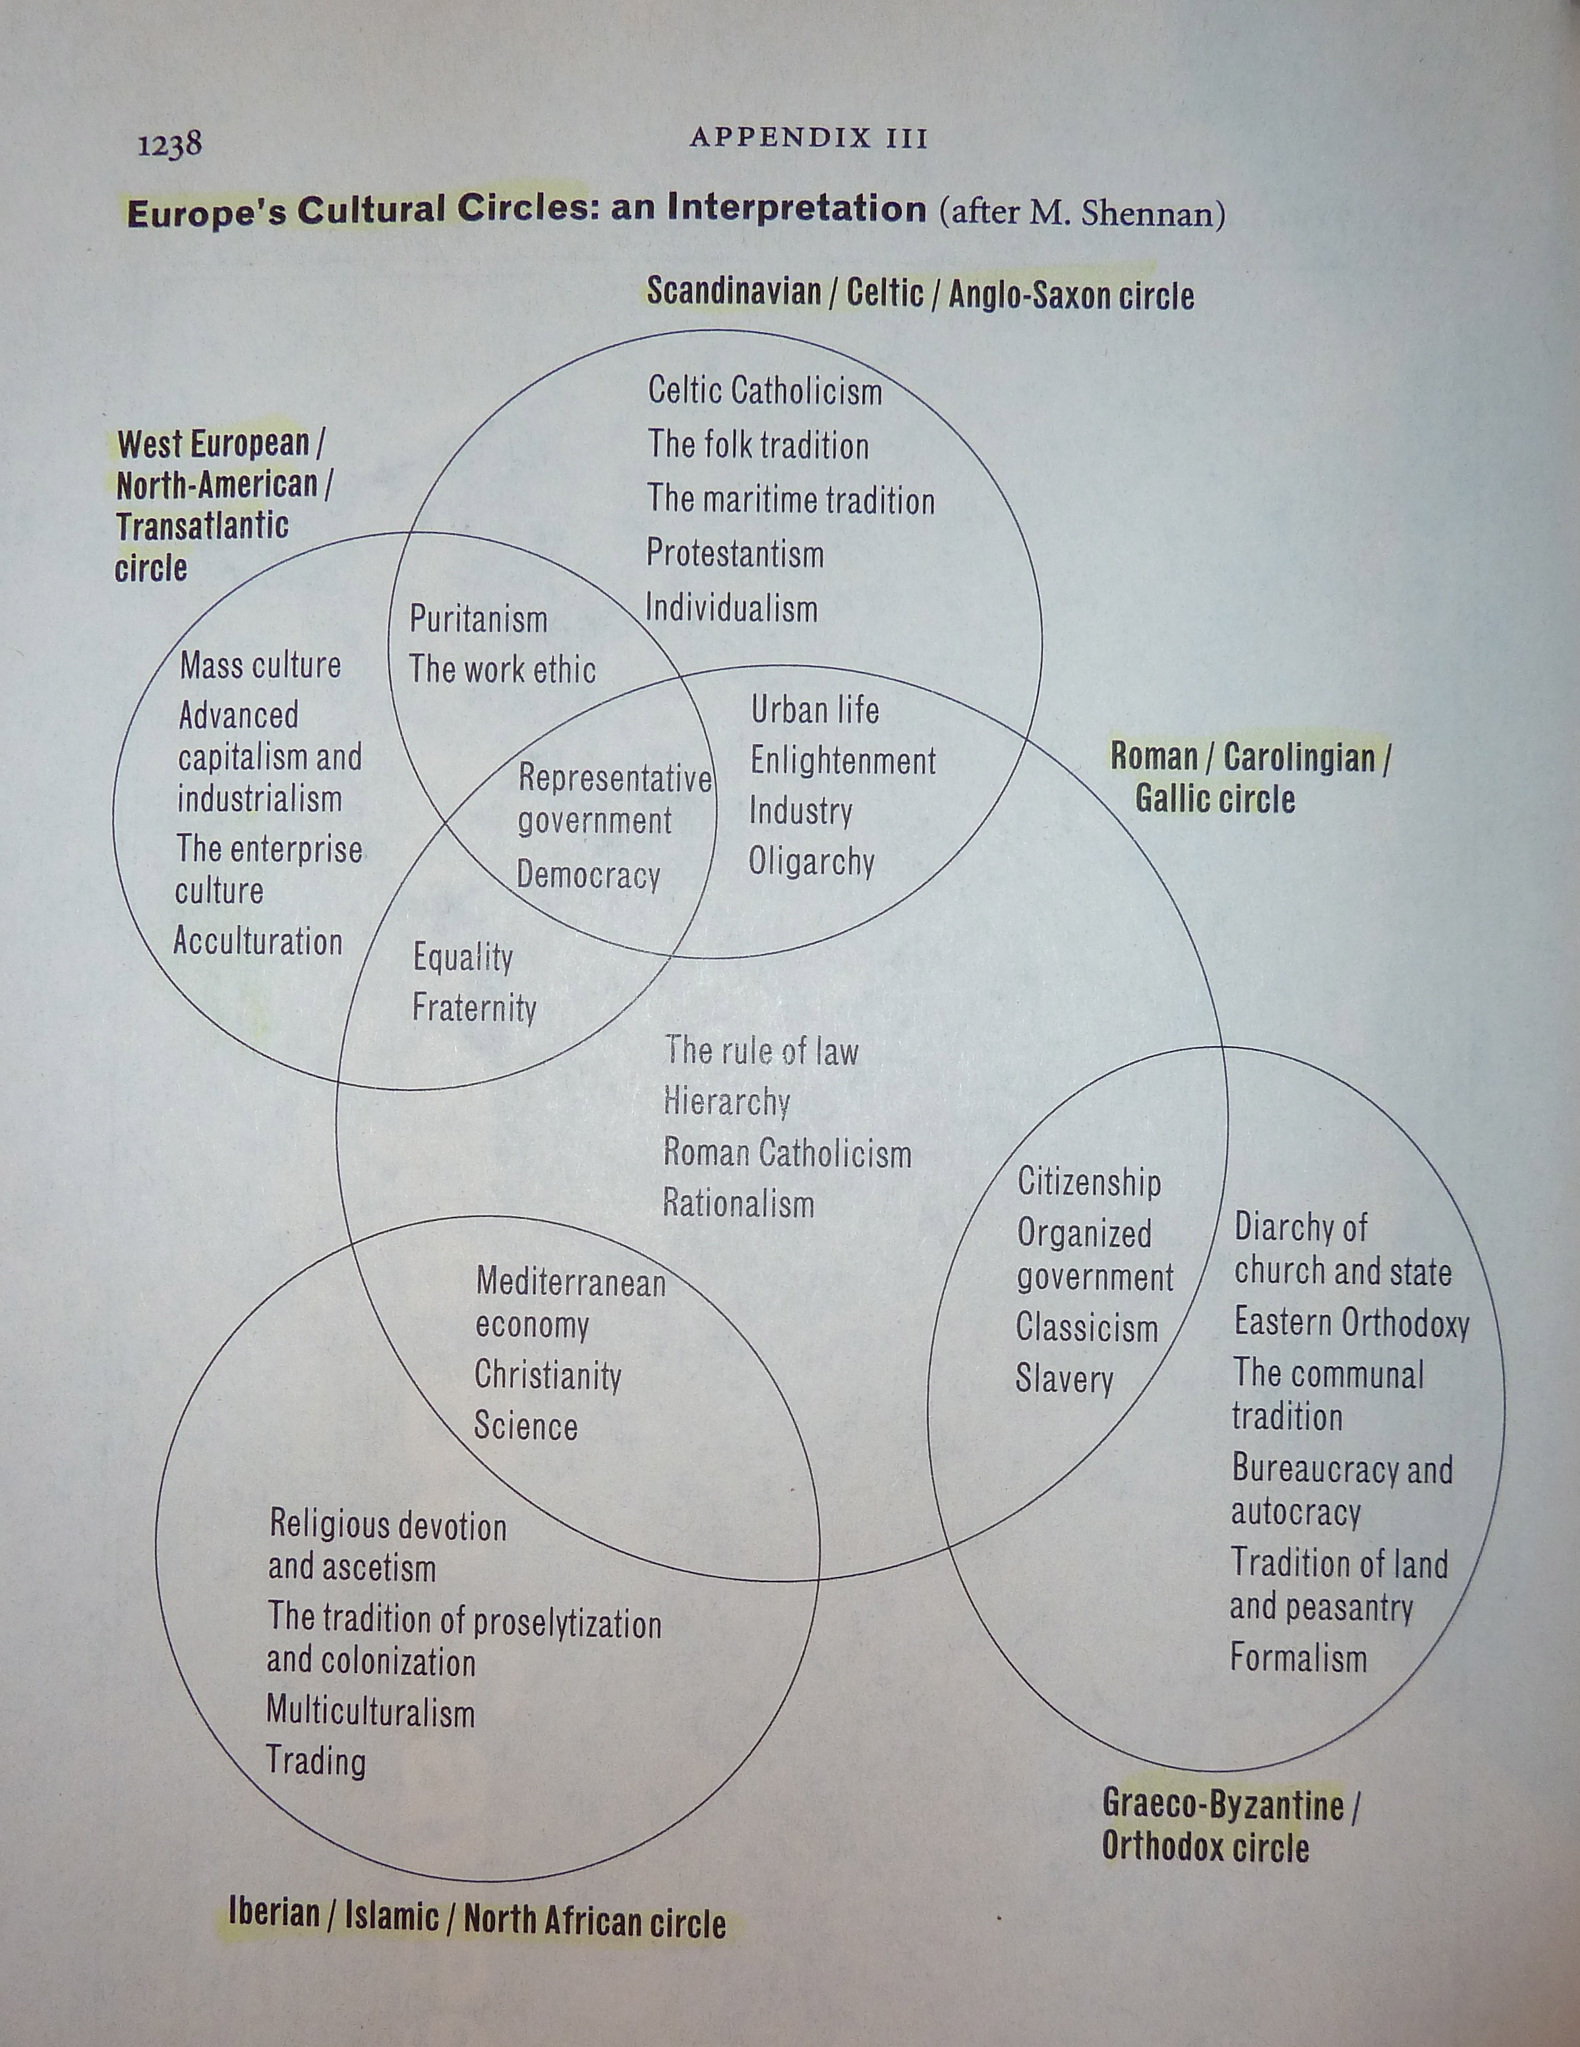
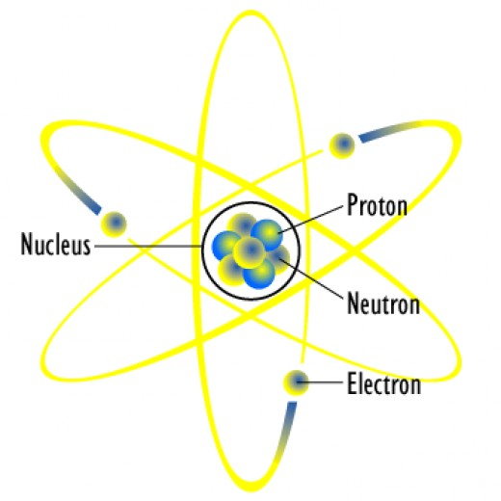
Fields of Tension
http://www.solarsystemscope.com/

Slide 11
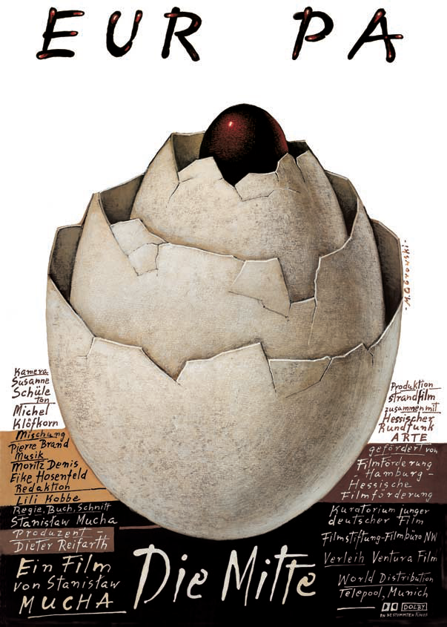
The Idea of Europe
Stanislaw Mucha, Die Mitte (2004)
Notes:
Stansilaw Mucha’s entertaining travel documentary in search of Europe’s center is quite representative of the difficulty Europeans have in deciding not only where the outer boundaries of their geographical region are, but also where its center is.
This semester we will search for Europe’s defining center, that point from which we can trace outward its defining territory and its defining cultural characteristics.

Slide 12
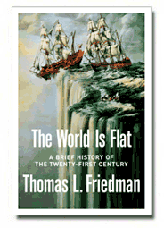
A Flat World. Tops among Friedman’s ten flatteners is
#1: Collapse of Berlin Wall – 11/9/89
The event not only symbolized the end of the Cold War, it allowed people from other side of the wall/iron curtain to join the economic mainstream. [economic]
"11/9/89" is a discussion about the Berlin Wall coming down, the "fall" of communism, and the impact that Windows powered PCs (personal computers) had on the ability of individuals to create their own content and connect to one another. [technical]
At this point, the basic platform for the revolution to follow was created: IBM PC, Windows, a standardized graphical interface for word processing, dial up modems, a standardized tool for communication, and a global phone network. [communication]
2005
"I Told You So" by Ed Miracle
Notes:
1st edition, Farrar, Straus and Giroux, 2005, ISBN 0-374-29288-4 – The original jacket illustration, reproducing a painting called "I Told You So" by Ed Miracle, depicting a sailing ship falling off the edge of the world, was changed during the print run due to copyright issues

Slide 13
“Europas blinde Sterne”
SZ Nr. 72, Seite 4, 20.April 2012
Der Artikel behandelt die “temporären Grenzschließungs-programme” (etwa Dänemark)
“Ganz Europa ist Inland”
der Euro und die offenen Grenzen machen Europa “zur Gewohnheit und zur Gewissheit”
aus Sicherheitsgründen jedoch wollen einige Mitgliedstaaten ihre Grenzen zeitweilig schliessen. Somit wird die kleine Welt des Nationalstaats der grossen Welt Europa vorgezogen.
Antieuropäische, popullistische und rechtsextreme Parteien kommen fast überall in Europa voran
Notes:
– dieser Satz steht an der Spitze aller europäischen Bekenntnisse – vgl. Schengen!
Schengen in der Krise: immer mehr Politiker profilieren sich auf Kosten Europas
Schengen sieht eine vorübergehende Binnengrenzkontrolle vor, begrenzt auf 30 Tage. Diese Klausel ist berufen worden, und zwar bei Großereignissen, etwa dem NATO Gipfel (Straßbourg) oder der Fußball WM

Slide 14
Fussball und Nationalismus
EM
EM Motto: RESPECT
Paradox: integrated teams versus national patriotism (Comic Strip in der FAZ am 2. Juli)
EM = subtitute for historical wars
Migrants as Merceneries?

Slide 15
Recurring Tensions
Human Rights
Democratization
Loss of Heimat
decline of elite groups
Xenophobia

Slide 16
Public Opinion http://ec.europa.eu/public_opinion/index_en.htm
Since 1973, the European Commission has been monitoring the evolution of public opinion in the Member States
Helps in the decision-making process
EU surveys and studies address major topics: European citizenship: enlargement, social concerns, health, culture, information technology, environment, the Euro, defense

Slide 17
First Annual Survey
EU Communication and the citizens
Decision Makers
Analytical Report
  Fieldwork: October 2006
  Report: January 2007

Slide 18
Flash Eurobarometer Series #189b (2006)
EU Communication and the Citizens. Decision Makers
  By The Gallup Organization Hungary
  Survey organised and managed by Directorate-General Communication
  This document does not reflect the views of the European Commission. The interpretations and opinions contained in it are solely those of the authors. The Gallup Organization Hungary

Slide 19
“European decision makers are frustrated that citizens are not provided with sufficient information about the EU. 72% agree that the national media provides “too little” EU-related information. Less than a quarter of European decision makers think that people in their country are sufficiently well-informed. Hardly any EU decision makers (2%) feel that their citizens are over-supplied with such information.”

Slide 20
Future of Europe
Future of Europe
A Eurobarometer on the « Future of Europe » was published today [2012] to coincide with a workshop of the European Commission’s Bureau of European Policy Advisers (BEPA). Perhaps unsurprisingly, citizens feel there is a gap between public opinion and the decisions taken by political leaders. However, over half of Europeans express confidence in the ability of political leaders in the EU to face the main global challenges. More than six in ten Europeans agree that the EU has sufficient power and tools to defend Europe’s economic interests in the global economy, even if the proportion of Europeans who disagree has increased since spring 2011. The survey also reveals that Europeans agree that globalisation requires common global rules.

Slide 21
Belfast (1-12 August 2011) http://www.bordersofeurope.eu/Theme2011/
In Belfast we focused on migration anf cultural identity.
What does "Europeanness" mean today? How has migration affected Europe’s sense of self? Who is European
Historically mobility has figured centrally in commerce, intellectual exchange. art, tourism.
But the external borders of European nations were less mobile and did not always take ethnic difference into account.
By contrast, Culture is marked by internal borders; these include questions of race and racialization, access to internal markets, and social constructions within a state.
questions of minority rights are central to broader sociological discussions of multiculturalism and cultural protectionism.
Notes:
Nonetheless, the historical facts of migration and demographic change are of importance to us. Access to universal human rights is central to today’s discussions. However, human rights are related, I suggest, to the hospitality one had to extend to travellers, even to one’s enemies, in times past.

Slide 22
CULTURA:
Space / Time/ Value
We will speak of cultural landscapes (Kulturlandschaften) because the term “landscape” contains the following elements:
  Regional differences (demographic change; urban, small town, rural)
  Dependence on climate, soil pecularities, vegetation (“Bodenbeschaffenheit”)
  Determinants of terrain (rivers, mountains, plains)
What is the ideal climate for culture vis a vis nationalism?
  Extremes or Moderation?
  Sameness or Seasonal Change?
  Homogeneity or Diversity?
Notes:
Space has emerged as a major concept in theoretical thinking about cultural issues.

Slide 23
Reason and Classification
= best-selling topics
Daniel Kehlmann, Die Vermessung der Welt (2005)
A novel combining the fictive double biography of the Mathematician Carl Friedrich Gauß (1777–1855) and the natural scientist/explorer Alexander von Humboldt(1769–1859).
It quickly became a bestseller, reaching top spot on the Spiegel best seller list and remaining their for 37 weeks.
The New York Times listed it in April 2007 as the second most sold book of the year 2006.
By 2008 it has sold 1.4 million copies in German.

Slide 24
Europeanization and the Nation State:
The Three Ps
How do people interact in a nation state and on what levels to establish a sense of belonging? Of community?
        Politics
        Polity
        Policy
Notes:
The Language of Art & Music - "A Three Piece Puzzle: The Relationship between Culture, International Relations and Globalization over the next Two Decades"
(International Conference, London, August 25th - 29th, 2011 - Held Parallel to “The Notting Hill Carnival 2011”)
www.icd-languageofartandmusic.org

Slide 25
Europeanization as Sensitizing Discourse
Europeanization defines processes of
Construction
Diffusion
Institutionalization
It involves formal and informal ways of doing things, shared beliefs, policies and strategies
Notes:
Source: Constance Pary Baban, “The Idea of the European Union as an Area of Freedom, Security, and Justice: Exploring the Europeanization of Germany’s Domestic Security Policy,” AICGS Transatlantic Perspectives (Nov. 2010). 10 pp. www.aicgs.org
Avalable as a PDF.

Slide 26
Europeanization as Sensitizing Discourse
EU sets the policy and instigates the politics, which then enters the national discourse on policy, structural transformation, and identity
Discourse (in social sciences) is an ensemble of concepts, ideas, and categories through which meaning is given to phenomena
In the humanities, discourse is the means by which new ideas take shape, consolidate, disseminate, and recalibrate sensitivities and ultimately reconfigure social norms
Self-reflexivity and tolerance of differing opinions and beliefs are sine qua non.

Slide 27
Identity: Theoretical Considerations
European identity complements but does not displace national and regional identities (7). European integration opens up the possibility of multiple identities across national borders. The context (of political identification) is the crucial factor.
In this way, “national identity is a springboard, not the gravedigger, of European identity, with national identity providing a model of what it is to belong to a remote political community” (8).

Slide 28
Theoretical Considerations
The socialization process and trust development –fostering multiple identities, and European identity in particular – could be enhanced by several factors:
expanding media impact coming from and reporting about the European level (9),
increasing free movement of people across European borders (tourism, work)
increasing number of students in university exchange programs
fast-growing daily [digital] communication across borders.

Slide 29
Theoretical Considerations on Identity
mythological deep structure of cultural memory (“Erinnerungskulturen”) Jan Assmann, “Collective Memory and Cultural Identity,” New German Critique 65 (1995): 125-33; Matgorzata Pakier und Bo Stråth, A European Memory: Contested Histories and Politics of Remembrance (2010)
Cultural Patterns: “Kulturmuster […] sind im wesentlichsten Perzeptions- und Handlungsmuster” und sorgen für Reaktivierbarkeit (Werner Rossade, “Kulturmuster in der DDR. Ein Werkstattbericht,” in: Lebenstile und Kulturmuster in sozialistischen Gesellschaften, 1990)
“Europe [is] a society of exchange, transfer, communication, and commingling” Wolfgang Kaschuba, “Old and New Europe: Representations, Imaginations, Stagings,” in: Representations on the Margins of Europe (2007), 28.
“Kulturmuster sorgen für die Reaktivierbarkeit von Verhaltens-mustern, für die Reaktivierbarkeit etwa von Rollen und einzelnen Handlungstypen in zeitlich weit auseinander liegenen Situtationen.” Nik. Luhmann, Einführung in die Systemtheorie, hg.von Dirk Baecker (Heidelberg 2002), S.32.
Notes:
Stefan Matuschk, Mythologisierung als Kulturmuster der Aufklärung,” in: Kulturmuster der Aufklärung, Kleine Schriften der IZEA 2/2010 S.34-52.
Nikolas Luhman writes that “Kulturmuster sorgen für die Reaktivierbarkeit von Verhaltensmustern, für die Reaktivierbarkeit etwa von Rollen und einzelnen Handlungstypen in zeitlich weit auseinander liegenen Situtationen.” Nik. Luhmann, Einführung in die Systemtheorie, hg.von Dirk Baecker (Heidelberg 2002), S.32.

Slide 30
Cultural Borders: Summary
Migration patterns / Cultural and linguistic diversity
Nature of “Europeanness”
Nature of Integration
Cultural Capital / Kulturkampf / Kleinstaaterei
Social Cohesion (Christianity, social conscience, humanism)
Families, Communities, Countries
The Limits of Tolerance

Slide 31
Defining “European” as Unifying Concept cf. Anthony Pagden
The History of the Idea of Europe;
The Role of Christianity;
Cultural and linguistic diversity;
European Democratic Values.
However, the rise of the individual, focus on personal merit, and human rights since the Enlightenment complicates matters, because culture is collective by nature.
Globalization complicates matters too by moving in the opposite direction.
Notes:
Relevant factors include the following.
The Enlightenment was a watershed moment/movement. It introduced a new set of values that focused on individual improvement. To be sure, this improvement was to benefit society as well as self. However, the strong emphasis on individualism since the Beat generation of the 1950s and especially since the cultural revolutions of the late 1960s has loosened the traditional ties of societal and cultural identification. The dilemma posed by the rise of individual freedom for defining “European” is this: how can individual freedom and cultivation of the self serve to bond newcomers to European society?

Slide 32
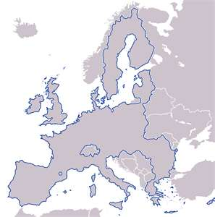
Cultural Maps:
The “C” Approach
Commerce
Concern
Communication, types of
Community, levels of
Cohesion Factors
Clash of Civilizations
… and Culture?
Notes:
The emergence of socially excluded communities across Europe, particularly in urban areas, has far-reaching consequences for the social fabric of the EU member states. This is already clear in the make-up of the national teams (Germany, Italy, France)

Slide 33
EU Commission on Culture
Directorate General for Education and Culture http://ec.europa.eu/culture/our-programmes-and-actions/culture-programme-%282007-2013%29_en.htm
Androulla Vassiliou, Commissioner for Education, Culture, Multilingualism, Youth
The EU’s Culture programme (2007-2013) has a budget of €400 million to celebrate Europe’s cultural diversity and enhance Europe’s shared cultural heritage through the development of cross-border co-operation between cultural operators and institutions.

Slide 34
EU Culture
The Culture programme has 3 main objectives:
to promote cross-border mobility of those working in the cultural sector;
to encourage the transnational circulation of cultural and artistic output;
and to foster intercultural dialogue.

Slide 35
EU Cultural Policy
The unit ‘Culture Policy and Intercultural Dialogue supports new approaches for cultural involvement.
It views culture as a vital part of the EU’s external relations.
It seeks to accord culture a more prominent role in the European Union as a tool for social change.
This unit of the Directorate General for Education and Culture is charged with implementing the European agenda for culture, as approved by the Council in November 2007, with its three main objectives.

Slide 36
Culture Program & Actions Unit
Its main task is to put into effect the Culture Program (2007-2013) in co-operation with the Education, Audiovisual and Culture Executive Agency.
finances hundreds of projects promoting the transnational mobility of cultural actors, encouraging the transnational flow of art works and of cultural and artistic products, as well as encouraging intercultural dialogue.
also manages the “European Capitals of Culture” scheme and European prizes in the field of culture (esp. cultural heritage), contemporary architecture, literature and contemporary music.

Slide 37
EU Award for Contemporary Music/The European Border Breakers Awards (EBBAs)
modern popular music and the repertoire of emerging European artists showcases Europe's rich cultural diversity. The circulation of the new repertoire is important developing new attitudes.
the European Border Breakers Awards aim to stimulate the cross-border circulation of new music. Popular access points are crucial for the artists' capacity to build up relations with the wider European public. The EC acknowledges that European music contributes significantly to the economy, together with its other creative industries.
The 2012 ceremony was hosted by British musician and broadcaster Jools Holland on the opening night of the Eurosonic festival in Groningen, Netherlands, on 11 January 2012. The ceremony was recorded and broadcast by the Dutch National Television (NOS/NTR)

Slide 38
European Border Breakers Awards http://ec.europa.eu/culture/our-programmes-and-actions/prizes/songs-ebba-2012_en.htm
Selah Sue (Belgium)
  http://www.europeanborderbreakersawards.eu/content/selah-sue-ebba-awards-2012-artist-video
Afrojack (Netherlands)
  http://ec.europa.eu/culture/our-programmes-and-actions/prizes/european-border-breakers-awards_en.htm
  Boy (Switzerland, Germany)
Anna Calvi (UK)
  Agnes Obel (Denmark)
  Swedisch House Mafia (Sweden)
  Alexandra Stan (Romania)

Slide 39
EU Prize for Literature
EUPL
EUP was established in 2010 to celebrate the diversity of European literary life by selecting emerging writers from around Europe and taking their work beyond national and linguistic borders.
The aim of the European Prize for Literature is to put the spotlight on the creativity and diverse wealth of Europe’s contemporary literature in the field of fiction, to promote the circulation of literature within Europe and encourage greater interest in non-national literary works.
The selected countries for the European Prize for Literature in 2012 are Austria, Croatia, France, Hungary, Ireland, Italy, Lithuania, Norway, Poland, Portugal, Slovakia and Sweden.

Slide 40
…and Literature?
Not as easy to combat prejudice with literature
Literature is a much more private matter. Compared to music that speaks directly to the emotions, the printed word gets filtered through the brain.
Literature requires a special kind of focus and time for reflection
Pascale Casanova, “The Assimilated,” in: P. C., The World Republic of Letters, trans. M. B. Debevoise (Cambridge MA: Harvard U P, 2004), 205-219
LITERATURE European Literature Links: http://www.lit-across-frontiers.org/links.php

Slide 41
YOUTUBE EUROPE http://www.youtube.com/eutube/
Europeana = 1,381 viewshttp://www.youtube.com/watch?v=qN1N9sQyWOM&feature=plcp
World literature = 5,000 views
Naked bikini prank = 11 million views!
Dumb European = 9 million

Slide 42
EUPL
Three of past EUPL winners, Kalin Terziyski (Bulgaria), Rǎzvan Rǎdulescu (Romania) and Tomáš Zmeškal (Czech Republic) discussed how the prize “makes literature travel” and what it means to be translated into other languages at the Prague Book Fair “Debate with EUPL Winners” on May 18
In 2011 winners came from: Bulgaria, The Czech Republic, Greece, Iceland, Latvia, Liechtenstein, Malta, Montenegro, Serbia, The Netherlands,Turkey and United Kingdom
In 2010, countries of origin: Belgium, Cyprus, Denmark, Estonia, Finland, Germany, Luxembourg, Romania, Slovenia, Spain and The Former Yugoslav Republic of Macedonia
2009: Austria , Croatia , France , Hungary , Ireland , Italy, Lithuania, Norway, Poland , Portugal, Slovakia and Sweden
European Literaure Links: http://www.lit-across-frontiers.org/links.php
Notes:
Selection Process
The winning authors are selected by qualified juries set up in each of the countries participating in the award.
The new emerging talents will be selected on the basis of requirements stipulated by the European Commission. and fulfill in particular the following requirements:
1. Be a citizen of one of the 12 countries selected
2. To have published between 2 and 4 books of fiction
3. The books should have been published during the five years before the prize

