Slide 1
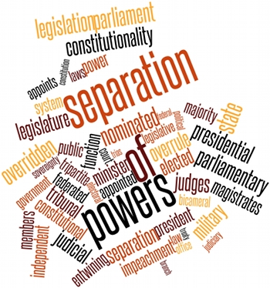
Comparison of the USA, UK and Czech Republic
Aneta Štěpánková

Slide 2
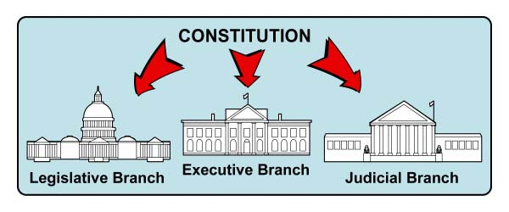
Definition
Separation of powers
    = the trias politica principle
    = the tripartite system
  a model for the governance of a state
    under this model, the state is divided into branches, each with separate, independent and unique powers and areas of responsibility
        These branches are :

Slide 3
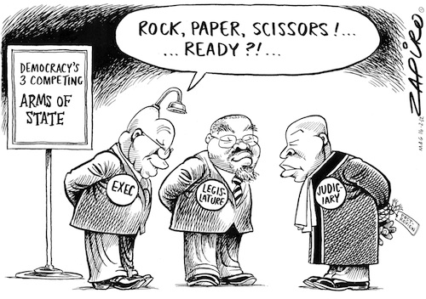

Slide 4
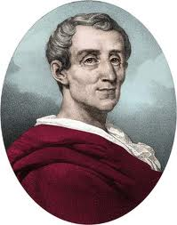
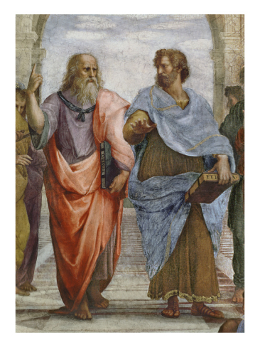
History of the term
Baron de Montesquieu (1689-1755)
  Charles-Louis de Secondat, Baron de La Brède et de Montesquieu
  French Enlightenment political philosopher
The „separation of powers“ model was based on:
  the British constitutional system
  the Constitution of the Roman Republic
      Aristotle – „Mixed government (constitution)“
      a form of government that integrates elements of democracy, aristocracy, and monarchy
      some issues are decided by the majority of the people, some other issues by few, and some other issues by a single person

Slide 5
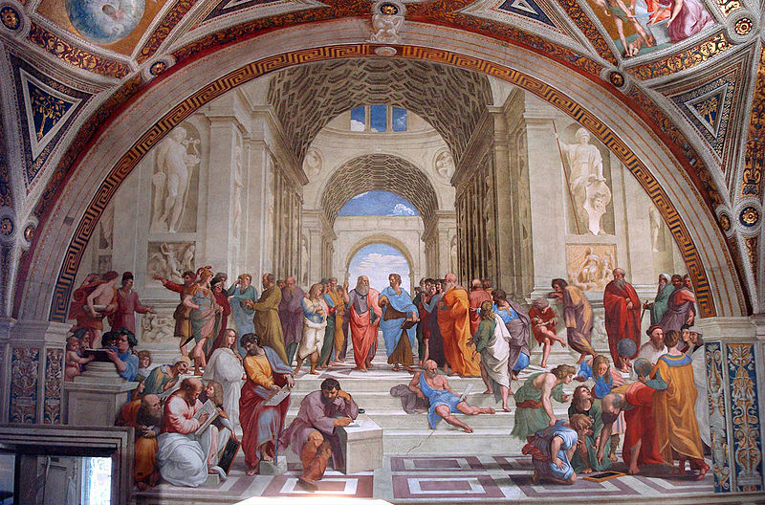
Raphael : The School of Athens in the Apostolic Palace in the Vatican

Slide 6
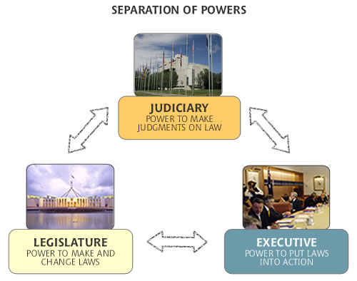
Responsibility of the branches

Slide 7
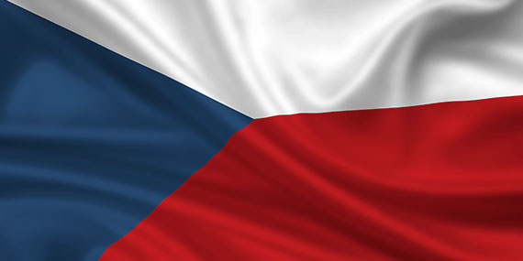


Legislature
The Parliament of the Czech Republic
  Bicameral type of parliament:
    The Upper House : The Senate
      81 Senators
      President of the Senate
      voting system – two-round
    The Lower House: The Chamber of Deputies
      200 Deputies
      Chair of the Chamber of Deputies
      voting system – proportional representation
  Functions:
    it holds and passes bills
    the right to modify the Constitution
    ratifies international agreements

Slide 8
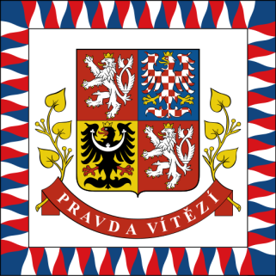
Executive
Government of the Czech Republic
  14 Ministries
  Prime Minister
President
  Direct election
  Countersigning of both himself and the Prime Minister of the Czech Republic
  A veto
    = the power to unilaterally stop an official action, especially the enactment of legislation
  Appointment of persons to key high offices
    the Supreme and Constitutional Courts judges (with the permission of the Senate)
    members of the Bank Board of the Czech National Bank
  Ceremonial powers

Slide 9
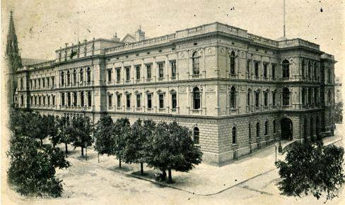
Judiciary
the protection of rights in a manner defined by legislation
responsibility for deciding guilt and penalty
administered by the Ministry of Justice.
professional judges,
  named for life by the President
  may not be recalled or transferred without their will
a four-tier system of courts and two-instance proceedings:
    2 supreme courts (nejvyšší soudy)
        one for ordinary and one for administrative matters
    2 high courts (vrchní soud)
        one in Prague and one in Olomouc
    8 regional courts (krajské soudy)
    86 district courts (okresní soudy)
3 types of jurisdiction:
  courts of general jurisdiction
  Administrative courts
  the Constitutional Court of the Czech Republic

Slide 10
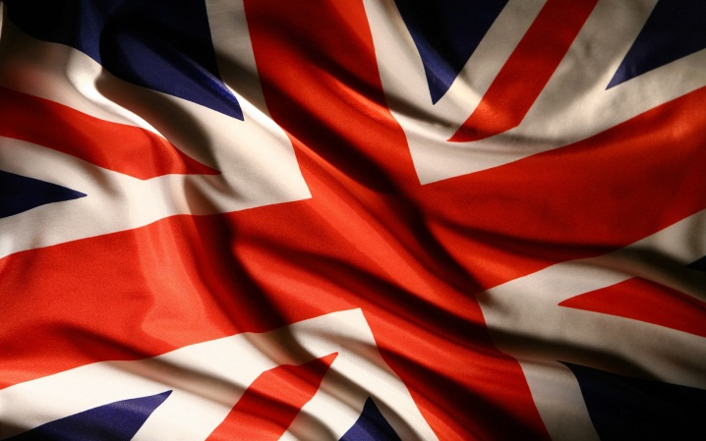
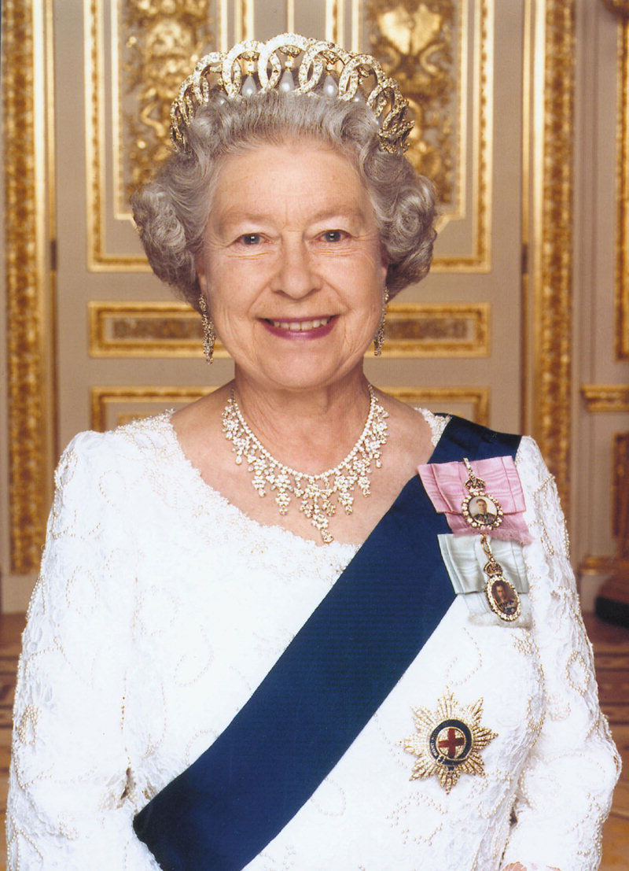
Role of the Sovereign
  Important, but formal
  Legislature
    Royal Assent to all Bills to became Acts
  Executive
    appointment of all ministers of His/Her Majesty's Government
    government in the name of the Crown
  Judiciary
    appointment of all senior judges
Fusion of powers – „a weak separation of powers“
  a feature of parliamentary democracies, wherein the executive and legislative branches are mixed

Slide 11
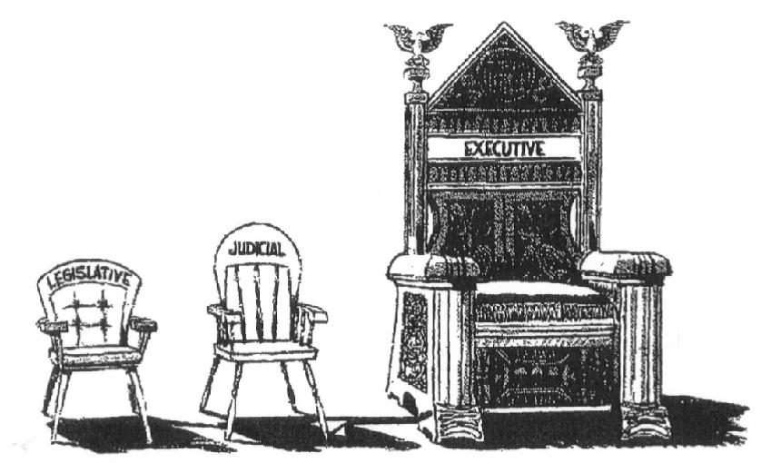
Royal Prerogative powers
Domestic powers
The power to dismiss and appoint a Prime Minister.
The power to dismiss and appoint other ministers. This power is exercised by the Prime Minister alone.
The power to grant Royal Assent to bills, making them valid laws
  no Monarch has refused assent to a bill passed by Parliament since Queen Anne in 1708.
The power to command the Armed Forces of the United Kingdom.
  In fact, the power is exercised by the Defence Council in the Queen's name.
The power to issue and withdraw passports
The power to grant Prerogative of mercy
  used to remedy errors in sentence calculation
The power to grant honours
Foreign powers
The power to ratify and make treaties
The power to deploy the Armed Forces overseas
The power to recognize states
The power to credit and receive diplomats
The power to declare war and conclude peace with other nations

Slide 12

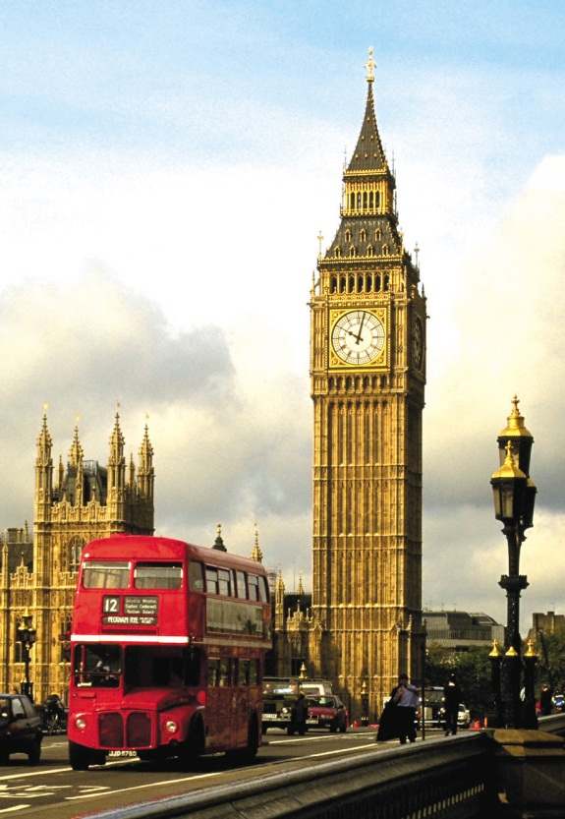
Legislature
Parliament
  The Parliament of the United Kingdom of Great Britain and Northern Ireland,
  the UK Parliament
  the British Parliament
  the Westminster Parliament
  Bicameral type of parliament:
    Total : 1,431 seats
    The Lower House : the House of Commons
      650 Members of Parliament (MPs)
      presiding officer : Speaker of the House of Commons
      voting system – simple plurality
    The Upper House: the House of Lords
      781 Lords Temporal and Spiritual
        the Lords Spiritual (the senior bishops of the Church of England)
        the Lords Temporal (members of the British nobility)
      presiding officer : Lord Speaker
      No election – appointment by the Sovereign

Slide 13
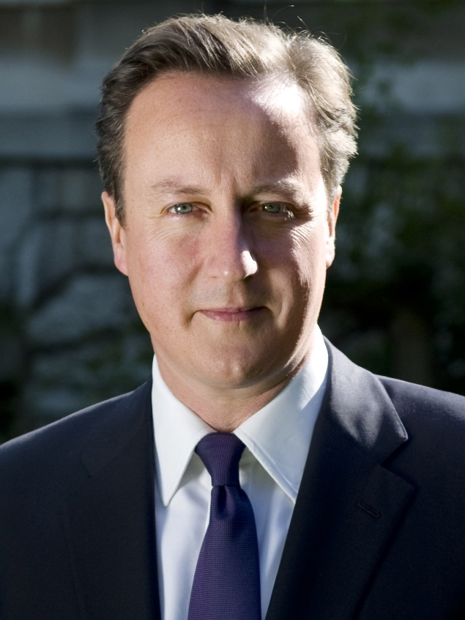
Executive
Government
      Her Majesty's Government (HMG)
      The Prime Minister and Cabinet are collectively accountable for their policies and actions to the Sovereign, to Parliament, to their political party and ultimately to the electorate
Prime Minister
  the head of Her Majesty's Government in the United Kingdom
  David Cameron
  10 Downing Street
  weekly meetings with the monarch
Cabinet
  the ultimate collective decision-making body of Her Majesty's Government, composed of the Prime Minister and some 22 Cabinet ministers, the most senior of the government ministers.
Government Departments
  24 Ministerial Departments (ministerstva)
  23 non-Ministerial Departments (ústřední orgány státní správy)

Slide 14

Judiciary
the three legal systems in England and Wales, Northern Ireland and Scotland
The UK-wide jurisdiction:
  the Special Immigration Appeals Commission
  Employment Tribunals
  Employment Appeal Tribunal
  the Supreme Court of the United Kingdom
    the highest appeal court in almost all cases in England and Wales
England and Wales:
  The Senior Courts of England and Wales
    Court of Appeal
      the Civil Division
        the High Court and County Court
      Criminal Division
        the Crown Court
    High Court
      a civil court of first instance and a criminal and civil appellate court for cases from the subordinate courts
    Crown Court
      a criminal court of both original and appellate jurisdiction
  Subordinate courts
    Magistrates´Courts
      a criminal court of first instance
    Family Proceedings Courts
    Youth Courts
    County Courts
      a purely civil jurisdiction, sitting in 92 different towns and cities across England and Wales.

Slide 15
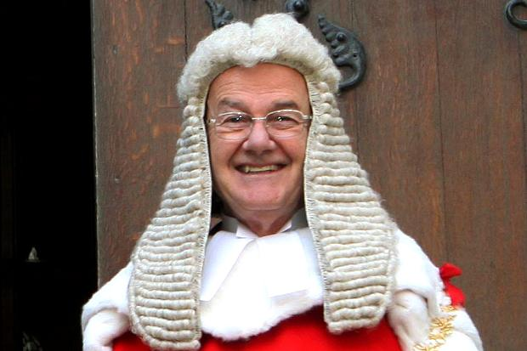
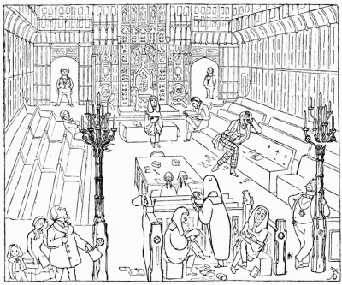
The Lord Chief Justice
MANNERS AND CUSTOMS OF YE ENGLYSH IN 1849
Highest Court of law in ye kyngdom. Ye Lords hearyng appeals.

Slide 16

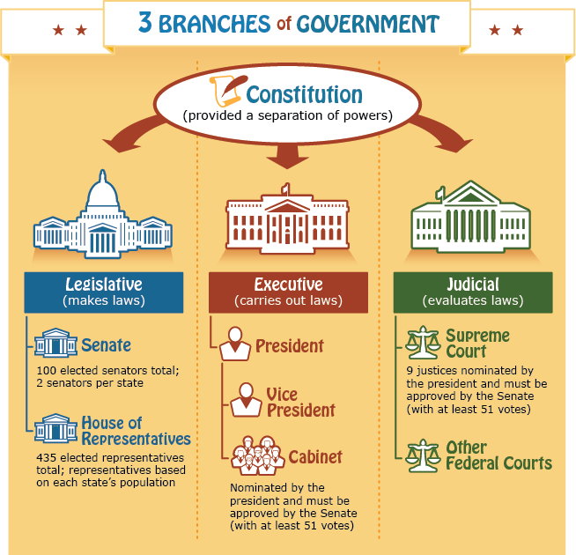

Slide 17

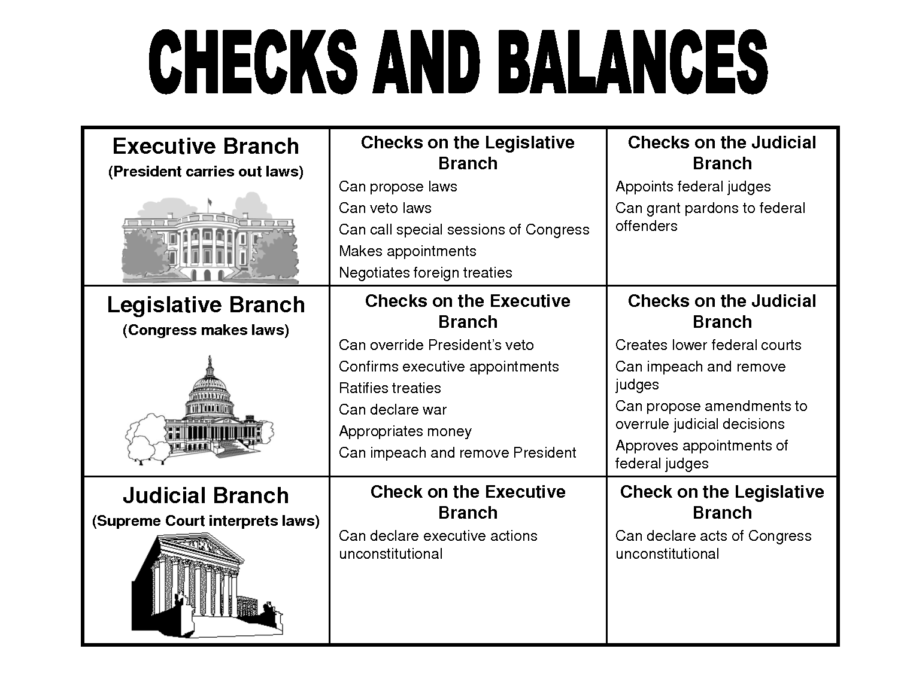

Slide 18

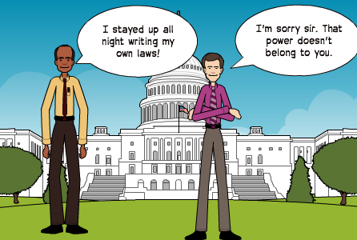
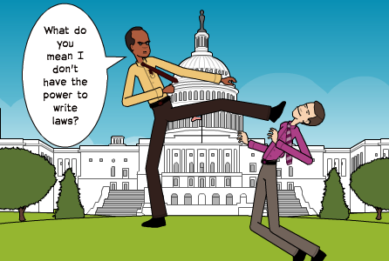

Slide 19
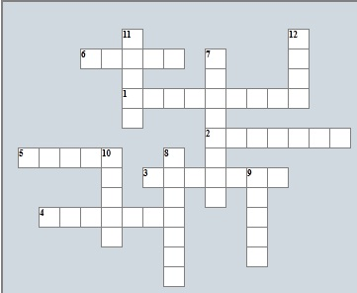
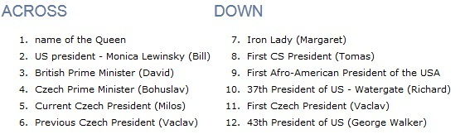

Slide 20
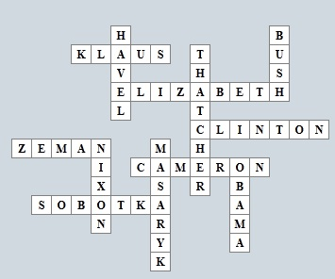

Slide 21
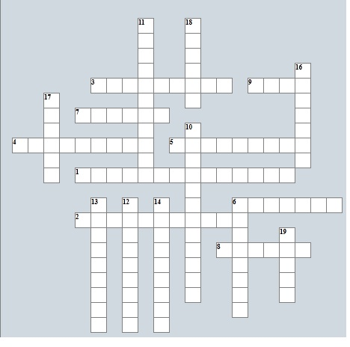
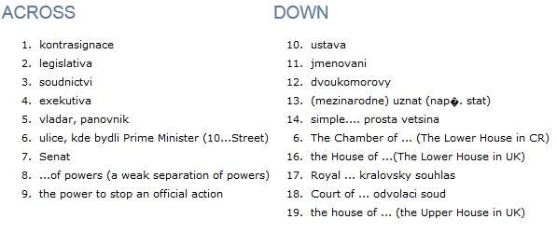

Slide 22
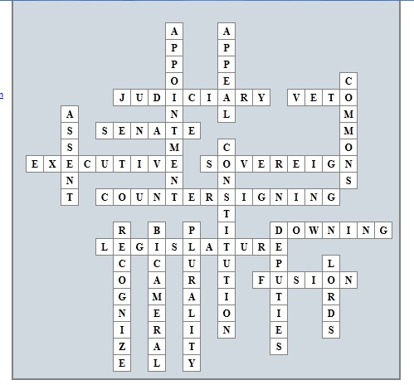

Slide 23
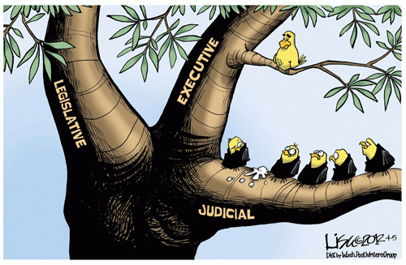


Slide 24
Sources
https://archive.org/details/mannerscustomsof00doyl
http://www.docstoc.com/docs/95141737/Checks-and-Balances-Chart---PowerPoint
Wikipedia.org

