Slide 1
TORTS II

Slide 2


Try to think of the best English or Czech equivalents to the following collocations
The group with the highest number of correct collocations is the winner

Slide 3
What is the English equivalent?
1. Poškozená strana
2. Bezohledné chování
3. Škodlivé následky
4. Předvídatelná újma
5. Údajná nedbalost
6. Ušlé mzdy
7. Léčebné náklady
8. Nepřiměřené zasahování
9. Pomlouvačné tvrzení
10. Poškodit pověst
11. Utrpět újmu
12. Být shledán odpovědným
13. Být na vině
14. Žalovatelné tvrzení
15. Dobrá víra

Slide 4
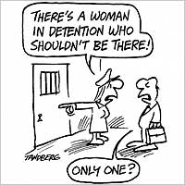
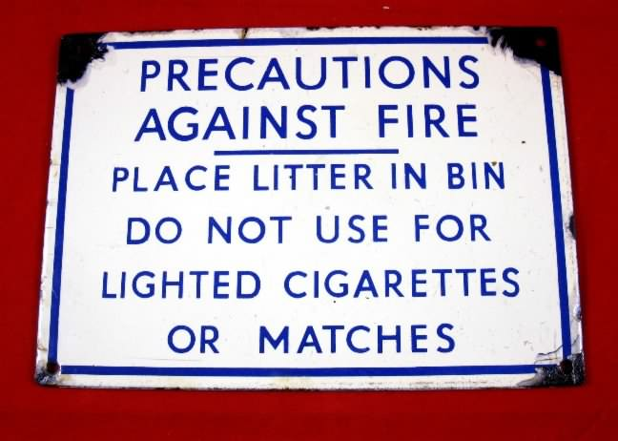
What is the Czech equivalent?
16. Consent of the detainee
17. Duty owed to the plaintiff
18. Take all possible precautions
19. Proximate causation of harm
20. Reasonable care
21. Liability arising from the violation
22. Without reasonable grounds
23. At the discretion of the judge

Slide 5
What is the English equivalent? Key
1. Poškozená strana
Injured party/party harmed
2. Bezohledné chování
Reckless conduct/careless behaviour
3. Škodlivé následky
Harmful consequences
4. Předvídatelná újma
Foreseeable harm/damage/loss/injury
5. Údajná nedbalost
Alleged negligence
6. Ušlé mzdy
Lost wages
7. Léčebné náklady
Medical expenses
8. Nepřiměřené zasahování
Unreasonable interference
9. Pomlouvačné tvrzení
Defamatory statement

Slide 6
What is the English equivalent? Key
10. Poškodit pověst
Harm the reputation
11. Utrpět újmu
Suffer harm/damage/loss/injury
12. Být shledán odpovědným
Be found/held liable
13. Být na vině
Be at fault
14. Žalovatelné tvrzení
Actionable statement
15. Dobrá víra
Good faith

Slide 7
What is the Czech equivalent? Key
16. Consent of the detainee
Souhlas zadrženého
17. Duty owed to the plaintiff
Povinnost vůči žalobci
18. Take all possible precautions
Učinit veškerá opatření
19. Proximate causation of harm
Bezprostřední příčina škody
20. Reasonable care
Náležitá péče
21. Liability arising from the violation
Odpovědnost vznikající z porušení
22. Without reasonable grounds
Bez dostatečného důvodu
23. At the discretion of the judge
Dle uvážení soudce

Slide 8
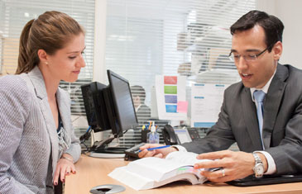
Case Study
You work as a student assistant for the Legal Advice Centre, offering free advice to ordinary people. It´s good practice and it will look great on your CV.
More information about the Legal Advice Centre at http://www.advicecentre.law.qmul.ac.uk/about/index.html

Slide 9
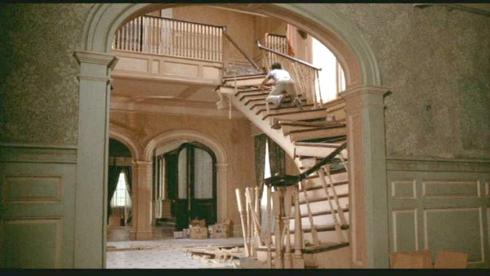
Case Study – Stairs collapse
The name of your client is Bert Simpson. You have already interviewed him. You promised that you will go through the case and you will write an e-mail to Bert with some advice.

Slide 10
Case Study – Stairs collapse
First, read the facts of the case. p.15/2
( based on https://www.dlsweb.rmit.edu.au/lsu../content/D_BUS/law/negligence_LL/casestudy.html)
What tort is involved?
What are the elements required for negligence?
negligence
Presence of duty of care
Breach of the duty of care
Proximate causation of harm

Slide 11
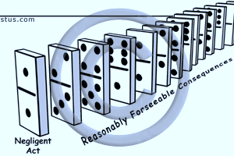
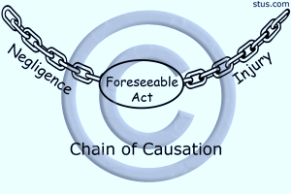
In groups analyze the case trying to identify the key legal issues.
Useful expressions and phrases
Premises (a building and the area of land that it is on)
Duty owed to the injured party
Reasonable care
Reasonable person
Foreseeable harm
Should have foreseen
Take all possible precautions
Failure to take care
Suffer injuries due to
Medical expenses
Recover damages
Legal grounds
Be held/found liable
Defenses (how to avoid liability)

Slide 12
Case Study – Issues to be identified
Was a duty of care owed?
Occupiers owe a duty of care to entrants because of their control over the premises.
GC is an occupier of premises and thus owes a duty of care to those coming on to the premises.

Slide 13
Case Study – Issues to be identified
What was the standard of that duty of care?
The standard of care owed by GCS is reasonable care to avoid foreseeable risks of harm to entrants (not just shoppers) of the premises.

Slide 14
Case Study – Issues to be identified
Was the duty of care breached?
Allowing too many people to climb the stairs at the same time.
GCS should have foreseen that an opening sale would attract a huge crowd to the store.
Possible precautions not taken
signs reminding shoppers not to rush up the stairs
hiring extra staff to control the customer flow at the stairs
…
It appears that GCS has breached its duty of care to Bert.

Slide 15
Case Study – Issues to be identified
Causation (Was the damage a direct result of the defendant´s actions?)
If GCS had not breached its duty of care to Bert, Bert would not have suffered extensive injuries.

Slide 16
Case Study – Issues to be identified
Defences
GCS could probably claim that Bert was partly liable for his injury due to his failure to take reasonable care of himself on the stairs.
If Bert was held partly liable for his injury, he might be able to recover only part of the damages.

Slide 17
Writing in groups
Write a letter of advice to Mr. Simpson (discussion forum IS)
Summarise the case and legal issues you have discussed
Outline possible steps to be taken next
Use the language phrases listed in your handout p.17

Slide 18

Homework
Choose a letter filed by another group and comment on it (50-70 words).
In your comments consider the following aspects
Content (as a client would you be satisfied with the advice?)
Structure (clear, logical, linking words, …)
Style (appropriate, formal, …)
Vocabulary (range, accuracy, collocations, …)
Grammar (range, accuracy – especially a word order)

Slide 19
A tort, in common law jurisdictions, is a civil wrong which 1. _______ causes someone else to suffer 2. _______ or harm resulting in legal liability for the person who commits the 3. _______ act, called a tortfeasor. Tort is a 4. _______ of some duty clearly set by law, not by a 5. _______ agreement between two parties, as in breach of contract. When such a duty is breached, the injured party has the right to institute suit for 6. _____________ damages. Torts may be 7. ___________ in several ways, with a particularly common 8. _______ between negligent and intentional torts. Intentional torts include, among others, certain torts 9. _______ from the occupation or use of land. The tort of nuisance, for example, involves strict liability for a neighbor who interferes with another's 10. ___________ of his real property. Trespass allows owners to sue for 11. __________ by a person on their land. Several intentional torts do not involve land. Examples include false imprisonment - the tort of 12. __________ arresting or detaining someone, and libel, where a 13. ___________ statement is published and damages the plaintiff's reputation. | FAIR LOSE TORT 4. VIOLATE 5. SPECIFY 6. COMPENSATE 7. CATEGORY 8. DIVIDE 9. ARISE 10. ENJOY 11. ENTER 12. LAW 13. DEFAME
unfairly
loss
tortious
violation
specific
compensatory
categorized
division
arising
enjoyment
entrances
unlawfully
defamatory

Slide 20
Compulsory assignment
Instructions - Handout p.18
Number of words 150-200
To “odevzdávárna“
Deadline – 26/4

