Slide 1
TORTS III

Slide 2
Letters of Advice
Content
Outlining options - the client can choose
(out of court settlement x lawsuit)
Structure
Paragraphs – introduction, conclusion (if you have any questions, do not hesitate to …)
Linking words (therefore, however, clearly, in my view,…)
Style – formal, polite
No contractions!!! (did not, was not, …)

Slide 3
Letters of Advice
Vocabulary
Nice use of collocations
Right x law – “the right is on your side“
Advice – uncountable
Grammar
Should have foreseen/could not have foreseen
If you agree (if + present)
If they had not allowed that many people on the stairs, the stairs would not have collapsed.
To sue the building company, who renovated …
No comma before THAT!!! (I have come to the conclusion, that there is …)
law
that

Slide 4
Compulsory assignment
Instructions - Handout p.18
Number of words 150-200
To “odevzdávárna“
Deadline – 26 April

Slide 5
Frivolous lawsuit p.19
Pre-listening vocab
What´s the difference?
Punitive damages x Compensatory damages
Providing a plaintiff with the monetary amount necessary to replace what was lost.
Compensatory damages
Punishing a defendant for his or her conduct as a deterrent to the future.
(“Quasi-criminal“)
Punitive damages

Slide 6
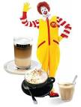
What does Fabio mean by frivolous lawsuit?
The lawsuit is not to be taken seriously; the amount of damages awarded is far too high for the injury suffered.

Slide 7
What injury did the plaintiff suffer?
The plaintiff received third-degree burns from spilled coffee.
She had to undergo a medical
treatment for 2 years.

Slide 8
Why did McDonald’s refuse to settle out of court?
McDonald’s refused to settle because they most likely thought the plaintiff could not win the case, as in other cases the courts had ruled that coffee burns were an open and obvious danger.

Slide 9
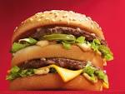
How much did the court award Liebeck in compensatory and punitive damages?
At first, Liebeck was awarded $200,000 in compensatory damages, which was reduced by 20% to $160,000.
The judge also awarded her 2,7million in punitive damages, which was then reduced to $480,000.

Slide 10
What was the reasoning of the court?
Gross negligence – coffee was “defectively manufactured“
Evidence showed that MacDonald’s serve coffee much too hot (1982-1992 700+ people burned)

Slide 11
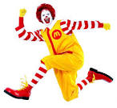
How much did Liebeck finally receive in damages?
We do not know, but it is thought that the amount was under $600.000.

Slide 12
Mistakes
79-year-old
Stella Liebeck
Coffee
McDonald´s
She wasn´t driving

Slide 13
CASE: Liebeck v. McDonalds’s Restaurant
placed
spilled
determined
suffered
treated
settlement
7. defendant
8. found for
9. awarded
10. damages
11. punitive
12. appealed

Slide 14
True or made up?
Case No. 1
Case No. 2
Case No. 3
Case No. 4
Case No. 5
Case No. 6
Case No. 7
Fabricated
True
Fabricated
Fabricated
True
Fabricated
Fabricated from a very old urban legend!

Slide 15
Lawyer-client interview
“In many ways for lawyers the initial client interview is like a first date. You do not know each other that well and hope to get better acquainted.“
Jim Calloway, Director of the Oklahoma Bar Association's Management Assistance Program
What are important skills/qualities for a lawyer when dealing with a client in an interview?
And what should s/he avoid?

Slide 16
A successful lawyer-client interview
+
active listening
effective questioning
empathy
giving feedback
patience
clear explaining
knowledge of law
correct application of law
logical thinking
timing
-
judgemental
impolite
arrogant

Slide 17
Lawyer – Client interview p. 11
OPENING
• Greeting the client, preliminary small talk
1. O. I hope you had no trouble finding our office.
• getting an overview of the case, explaining circumstances and structure of the interview
2. E. Let me assure you that everything you tell me today will be held in strict confidence.
3. J. I understand that you would like some advice on your employment situation.

Slide 18
LISTENING AND QUESTIONING
• listening actively to establish facts of events, checking for understanding
4. I. Mmm…I see.
5. K. OK, we’ve identified three issues which we need to focus on. These are…Is that how you see it?
• identifying aims of the client
6. H. What would be an ideal outcome for you?
7. L. Perhaps you could let me know what your priorities are in this matter.

Slide 19
SUMMARIZING
• summarizing the client’s concerns and goals
8. G. If I understand you correctly, you’re saying that …
9. M. Allow me to summarize what you’ve said.
• seeking further information from the client
10. F. I need to know more about…

Slide 20
ADVISING
• giving a brief outline of the relevant law and applying the law to the client’s problem
11. N. The legal position is as follows…
12. P. I am sorry to inform you that there is no legal ground for this claim.
• outlining available options, helping the client reach a decision if appropriate
13. D. I have to warn you that proving that …will be extremely difficult.
14. A. You have two or three options here. The first... the second... and the third is to....

Slide 21
CONCLUDING
• describing the follow-up action to be taken by lawyer and by client
15. C. Let me go through the file and read through the contract. Then I’ll prepare the complaint.
• concluding the interview appropriately
16. B. Thanks for coming in to see us today. Don’t hesitate to phone or send me an email if you have any questions.

Slide 22
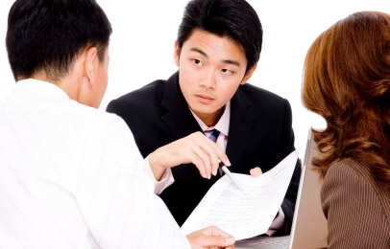
Case Study - Instructions
You work as a novice lawyer in a prominent law firm. You have your first client coming for an interview and your supervisor is going to assess your performance during the interview.
Do your best! Good luck!

Slide 23
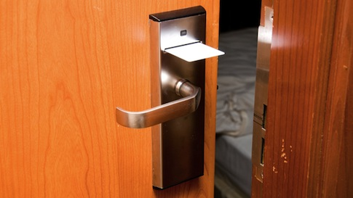
Case study 1
Theft In a Hotel Room p.13
Groups of three
- lawyer
- his/her supervisor
- client

Slide 24
When you finish, the supervisor gives the lawyer feedback.
Be diplomatic and friendly!
Feedback is not only listing the mistakes.

Slide 25
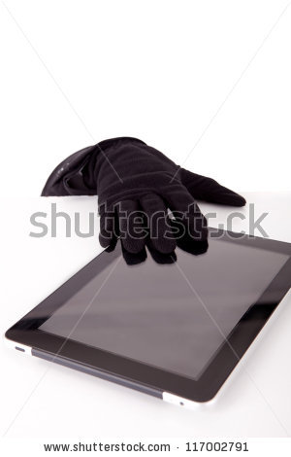
Case study 2
Missing Tablet in a Hotel Lobby p.14
Supervisor -> Client
Lawyer -> Supervisor
Client -> Lawyer

Slide 26
A tort, in common law jurisdictions, is a civil wrong which 1. _______ causes someone else to suffer 2. _______ or harm resulting in legal liability for the person who commits the 3. _______ act, called a tortfeasor. Tort is a 4. _______ of some duty clearly set by law, not by a 5. _______ agreement between two parties, as in breach of contract. When such a duty is breached, the injured party has the right to institute suit for 6. _____________ damages. Torts may be 7. ___________ in several ways, with a particularly common 8. _______ between negligent and intentional torts. Intentional torts include, among others, certain torts 9. _______ from the occupation or use of land. The tort of nuisance, for example, involves strict liability for a neighbor who interferes with another's 10. ___________ of his real property. Trespass allows owners to sue for 11. __________ by a person on their land. Several intentional torts do not involve land. Examples include false imprisonment - the tort of 12. __________ arresting or detaining someone, and libel, where a 13. ___________ statement is published and damages the plaintiff's reputation. | FAIR LOSE TORT 4. VIOLATE 5. SPECIFY 6. COMPENSATE 7. CATEGORY 8. DIVIDE 9. ARISE 10. ENJOY 11. ENTER 12. LAW 13. DEFAME
unfairly
loss
tortious
violation
specific
compensatory
categorized
division
arising
enjoyment
entrances
unlawfully
defamatory

