Slide 1
Elements of unfair competition and personal rights, comparison of UDRP and Czech rules
Pavel Loutocký

Slide 2
Plan?
UDRP – some aspects
.cz domain – more in detail
.eu domain – chosen aspects
Comparision of rules and the differences

Slide 3
In general

Slide 4
Personal rights – UDRP
1.5.1 Personal names that have been registered as trademarks would provide standing for a complainant to file a UDRP case.
1.5.2 The UDRP does not explicitly provide standing for personal names which are not registered or otherwise protected as trademarks. In situations however where a personal name is being used as a trademark-like identifier in trade or commerce, the complainant may be able to establish unregistered or common law rights in that name for purposes of standing to file a UDRP case where the name in question is used in commerce as a distinctive identifier of the complainant’s goods or services.
Merely having a famous name (such as a businessperson or cultural leader who has not demonstrated use of their personal name in a trademark/source-identifying sense), or making broad unsupported assertions regarding the use of such name in trade or commerce, would not likely demonstrate unregistered or common law rights for purposes of standing to file a UDRP complaint.

Slide 5
Company name - UDRP
Elan, LLC v. Al Perkins, FA1705001731999 (Forum June 26, 2017) ("Elan Studio" and <elanstudionola.com>), or using the first part of its company name
Caldsoft Way3D Sistemas Eireli EPP v. JInsoo Yoon, D2016-2514 (WIPO January 23, 2017) (<caldsoft.com>), or visually distinctive spellings of words
Nu Mark LLC v. Bui, Long, D2013-1785 (WIPO December 22, 2013) ("Nu Mark" and <numarkcigs.com>).
NuMark: "Complainant's trade name . . . had become a distinctive identifier associated with its business and products on its website and thus demonstrated complainant's unregistered trademark rights.“
It is however always better to have trademark (then it is clear)

Slide 6
Unfair competition - UDRP
UDRP not dealing with such a term (it is always hidden under 3 elements but not expressly mentioned)
UDRP is saying it is subject of national law
„Also noting the availability of trademark-like protection under certain national legal doctrines (e.g., unfair competition or passing-off) and considerations of parity, where acquired distinctiveness/secondary meaning is demonstrated in a particular UDRP case, unregistered rights have been found to support standing to proceed with a UDRP case including where the complainant is based in a civil law jurisdiction. “ (WIPO guide 3.0)

Slide 7
.cz domain

Slide 8
Registry/Admin
CZ.NIC, z. s. p. o.,
operation of the domain name registry for the .CZ domain
member of the EURid association

Slide 9
Number of domains
 | Domains in total | Domains in zone | In protection period
1999 | 48,136 | 47,295 | 0
2000 | 83,304 | 80,704 | 0
2001 | 126,293 | 117,383 | 0
2002 | 171,100 | 128,546 | 0
2003 | 156,676 | 153,518 | 0
2004 | 186,469 | 183,862 | 0
2005 | 226,074 | 223,427 | 0
2006 | 282,057 | 278,348 | 0
2007 | 370,480 | 366,544 | 5,169
2008 | 501,422 | 496,655 | 8,067
2009 | 629,327 | 623,642 | 12,946
2010 | 748,801 | 741,273 | 15,350
2011 | 880,708 | 865,687 | 25,060
2012 | 1,010,325 | 992,370 | 30,506
2013 | 1,044,518 | 1,023,099 | 41,342

Slide 10
Changes in domains
Year | Cancelled registration | Entered protection period | Registration | Revoked (did not pass tech. check) | Revoked (maintenance fee not paid) | Revoked (registration fee not paid) | Revoked by CZ.NIC | Revoked by owner
1999 | 0 | 0 | 10,010 | 451 | 0 | 303 | 0 | 70
2000 | 0 | 0 | 69,453 | 7,686 | 11,775 | 13,095 | 35 | 1,694
2001 | 0 | 0 | 141,850 | 47,236 | 9,135 | 42,274 | 98 | 119
2002 | 0 | 0 | 292,262 | 14,207 | 11,899 | 221,127 | 68 | 154
2003 | 25 | 28,507 | 399,723 | 0 | 14,024 | 400,106 | 28 | 173
2004 | 84 | 71,228 | 48,042 | 0 | 18,104 | 0 | 0 | 61
2005 | 95 | 57,857 | 57,464 | 0 | 17,843 | 0 | 0 | 63
2006 | 75 | 70,437 | 78,390 | 0 | 22,276 | 0 | 0 | 56
2007 | 43 | 82,358 | 115,719 | 0 | 27,198 | 0 | 2 | 35
2008 | 0 | 106,236 | 166,393 | 0 | 35,298 | 0 | 0 | 0
2009 | 0 | 153,167 | 190,681 | 0 | 62,260 | 0 | 0 | 0
2010 | 0 | 205,144 | 209,884 | 0 | 88,928 | 0 | 0 | 0
2011 | 0 | 241,549 | 233,879 | 0 | 100,006 | 0 | 0 | 0
2012 | 0 | 273,736 | 251,778 | 0 | 119,878 | 0 | 0 | 0
2013 | 0 | 97,295 | 74,409 | 0 | 39,544 | 0 | 0 | 0

Slide 11
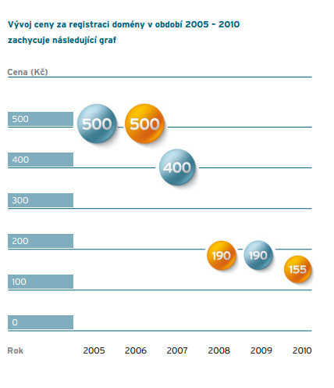
Screen clipping taken: 17.4.2012; 21:44

Slide 12
Geographic indication
Žádná

Slide 13
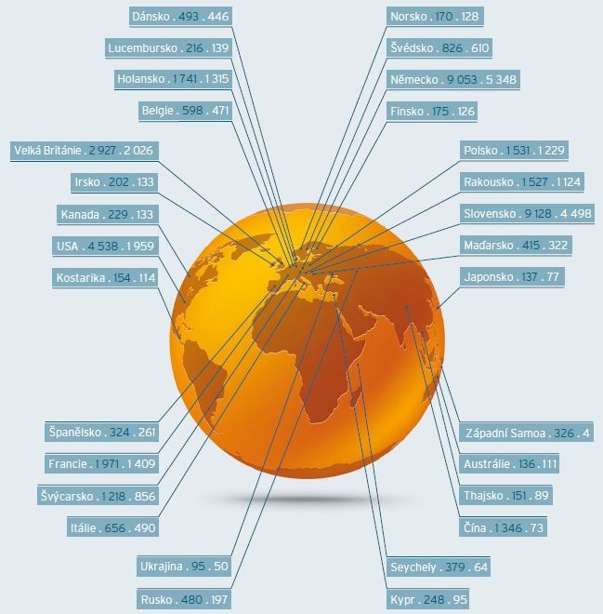

Slide 14
Rules of registration

Slide 15
Registration
Domain Names are registered through a Registrar
Registered for 1-10 years
applicant has to agree with
Rules of Registration
Rules of Alternative Dispute Resolution;
Renewal on request

Slide 16
Rules for a domain name
Only characters [a-z,0-9,-];
The maximum Domain Name Length is 63 characters;
must not begin or end with “-“ character;
must not contain two characters “-“ in sequence.

Slide 17
Terminology
By registering the Domain Name, the Applicant will become the Holder and the Domain Name will be reserved for them for the specified period of time.

Slide 18
PRICE
The price of the services provided by the Registrar to the Holder, including the price for the registration of the Domain Name or other services, is set by an agreement between the Registrar and the Holder.

Slide 19
RENEWAL
5.1. Domain Name registration may be renewed through the Appointed Registrar.
5.2. Domain Name registration may be renewed for whole years, also repeatedly, but for no more than 10 years.
request for registration renewal at the latest on the Day of Expiration
Holder agreed with the current version of the Rules of Registration
CZ.NIC Association receives the respective price at the same time.

Slide 20
Transfers
upon request submitted through the Registrar
The Registrar is obliged to acquire the consent of the future Holder to the current version of the Rules of Registration and the Rules of Alternative Dispute Resolution
The transfer of the Domain Name does not affect the latter’s Day of Expiration

Slide 21
Termination
Upon request (cancellation)
Expiration
Protection period „60 days“
the information is untrue, incomplete or misleading
endangers the national or international computer security
Violation of rules

Slide 22
RIGHTS AND DUTIES OF CZ.NIC
perform the Domain Name registration and maintain such a registration in compliance with defined conditions
keep record of a registered Domain Name in the Central Register
keep a record of the delegated Domain Name in the CZ zone; and
make every effort that may be reasonably required to ensure a fault-free and smooth operation of the Central Register and the primary name server

Slide 23
Legal solution in czechIA

Slide 24
Three alternatives
Trademark dispute
The trademark owner has the exclusive right to use the trademark in connection with the goods or services for which it is protected.
The owner of the registered trademark shall prove his right by an extract from the register or by a certificate of registration. The trademark owner may use the trademark together with the trademark
Unfair competition
Whoever gets into competition in contravention of the morality of competition by acting to cause harm to other competitors or customers will commit unfair competition.
Personal rights (company name)
A person whose personality has been affected has the right to request that the unauthorized intervention shall be abandoned or its consequence removed.
The protection of business name rights belongs to the person who used it for the first time. Whoever has been affected in his / her right to a business name has the same rights as in the protection against unfair competition.

Slide 25
Remedies Trademark
Information right
Abstain from activity:
a) withdrawing products from the market,
b) the permanent disposal or destruction or
c) the removal or destruction of materials, tools and equipment intended or used exclusively or principally in infringing activities.
damages,
unjust enrichment received by the infringer as a result of a threat or violation of the law,
reasonable satisfaction, if non-material damage was caused by interference with the rights.
Could be also in money.

Slide 26
REMEDIES Unfair competition
A person whose law has been compromised or violated by unfair competition may require the infringer to refrain from unfair competition or to remove the defective condition.
Furthermore, the person may require:
adequate satisfaction,
damages a
unjust enrichment.
+ personal rights (company name)

Slide 27
Important Case 23 Cdo 3407/2010 - Globtour
Courts incorrectly confuse declaratory decisions with constitutive decisions (decisions to change domain holders).
Constitutive desicions are an exception and can only be issued when the law of a court expressly grants the right to establish a legal relationship (rights and obligations) between the parties.
If, in the present case, the court had to determine who should be entitled to the domain (whether the plaintiff or the first defendant), the plaintiff would have to bring a court of law claim in accordance with Section 80 (a). c) o., under which an action may be brought in order, in particular, to determine whether or not a legal relationship or right is there, where there is an urgent legal interest.
What it means? Passive or active legitimation of CZ.NIC
CZ.NIC nowadays follows the ruling of the court on the basis of its rules.

Slide 28
Main diference
ADR
Transfer
Nothing else
Court
Everything (Money, Information, Satisfaction)
But not the transfer (however the authority cooperates)

Slide 29
Dispute resolution

Slide 30
Obligation
The Holder is obliged to make every effort that may reasonably be required from him to achieve an amicable settlement of disputes concerning Domain Names and/or their registrations that might arise between the Holder and other persons. If the litigants do not settle the dispute in an amicable way, they are free to settle their dispute within the scope of valid legal regulations, i.e. through arbitration, municipal courts or dispute resolution under the Rules of Alternative Dispute Resolution.

Slide 31
How will CZ.nic behave?
The CZ.NIC Association will cancel the delegation and/or the registration of a Domain Name, transfer the Domain Name to a different person and suspend the option to transfer the Domain Name to another person if this is stipulated in an executable decision, even if CZ.NIC itself has not been a party to the proceedings in which such a decision was made.

Slide 32
How will CZ NIC Behave?
If the decision pursuant to Article 19 stipulates the obligation to cancel the registration of the Domain Name but not the duty to transfer the Domain Name, the CZ.NIC Association will not, for the period of 1 month, permit a repeated registration of the same Domain Name by a person other than the person who requested the cancellation of registration for Holder

Slide 33
The change
23 Cdo 3407/2010 (Globtour)
23 Cdo 3895/2011 (Suzuki)
It was arbitration in the past
After that decision it is contractually binding out-of-court dispute resolution

Slide 34
BETWEEN HOLDER AND CZ.NIC
Before
The CZ.NIC association shall accept the jurisdiction of the arbitration court provided that the arbitration will be conducted in HK AK CR
Other disputes between the Holder and the CZ.NIC association are subject to the jurisdiction of general courts of the Czech Republic.
Now
The Holder is obliged to submit to the dispute resolution under the Rules of Alternative Dispute Resolution in relation to all domain names of the Holder listed in the electronic database of the domain names in the .cz ccTLD administered by the CZ.NIC Association, subject to the conditions specified in the Rules of Alternative Dispute Resolution.

Slide 35
DISPUTES BETWEEN HOLDER AND THIRD PARTIES
The Holder is irrevocably and publicly subject to the authority of the Arbitration Court attached to the Economic Chamber of the Czech Republic and the Agriculture Chamber of the Czech Republic

Slide 36
The proceedings are initiated by filing a complaint in accordance with the .CZ Rules. The proceedings are conducted in electronic form described in the .CZ Rules using the on-line platform available at domeny.soud.cz; the arbitration proceedings shall be held in Prague, Czech Republic.

Slide 37
Arbitration
Rules of Alternative Dispute Resolution - until 30. March 2015 (arbitration)
RULES OF ALTERNATIVE DISPUTE RESOLUTION 1. april 2015
However if the parties individually agree, they can still use the arbitration

Slide 38
Arbitrators (Tribunal) - FORMER
The disputes shall be decided by the sole Arbitrator appointed by the President of the Arbitration Court
Dispute may be decided by three Arbitrators if the Parties agree thereon and if the Party making such proposal pays the increased fee
no personal or economic interests in the the dispute
the Parties can also challenge the appointment of an Arbitrator

Slide 39
Powers of tribunal (former)
The Arbitral Tribunal is not obliged, but is permitted, to conduct its own investigations
The Arbitral Tribunal shall ensure that the Proceeding takes place with due expedition
There shall be no in-person hearings
(unless exceptional circumstances)

Slide 40
Expenses (former)
In addition to expenses connected with the payment of fees for the arbitration proceeding, parties in the dispute may also incur legal fees and other possible expenses resulting from participating in the arbitration proceeding.
The winning party could be awarded compensation of these expenses, and the losing party could be ordered to pay this compensation to the winning party.

Slide 41
CHANGE !
Instead of „Arbitration clause“ we have „alternative resolution clause“
Instead of „arbitrator“ we have „expert“
Instead of „finding“ we have „Experts professional decision“.
Instead of legal rules, the decision arises from the Rules
The decision is not enforceable by national authorities
The costs are covered by each party

Slide 42
The Holder agrees to submit to the dispute resolution if the petitioner lodges complaint that:
A) Domain Name is identical with or confusingly similar to a Protected Designation
B1) such Domain Name has been registered or acquired without the Holder holding the right to the Domain Name
B2) Domain Name has been registered, acquired or is being used other than in good faith

Slide 43
Holder can keep the domain if
the Holder holds the right to the Protected Designation which is identical with the Domain Name,
the Holder used the Domain Name before being notified of the initiation of the dispute, for fair dealing in connection with the offering of goods or services, or demonstrably made arrangements for such use,
the Holder is generally known under the Domain Name, even in the event that the Holder does not enjoy the right to the Protected Designation,
the Holder uses the Domain Name for fair dealing without intending to mislead third parties or to harm the reputation of the Petitioner or its Protected Designation

Slide 44
Bad faith
the Domain Name was registered or acquired in order to prevent the Petitioner from using such Protected Designation :
(i) the Holder engaged in such wrongdoing repeatedly; or
(ii) the Domain Name was not properly used for at least two years from the date of its registration,
the Domain Name was registered or acquired primarily with the intention to disrupt the economic activities of the Petitioner,
The Domain Name was intentionally used to direct Internet users to a website or some other online resource for the purpose of achieving profits, by creating a likelihood of confusion with the Protected Designation belonging to the Petitioner

Slide 45
.eu domain
Established „by law“
733/2002/EC (4 other Regulations)
To accelerate e-commerce
Promote common market
Accelerate benefits of information society

Slide 46
Structure of the .eu domain
REGISTRY (authority)
REGISTRARS
USERS

Slide 47
REGISTRY (Authority)
Administers the .eu domain
EURid
Non profit company
Established under Belgian law

Slide 48
Registrars
Independent entities
Have to be accredited by the registry
Currently more than 700 accredited registrars
https://eurid.eu/en/find-a-registrar/

Slide 49
USERS - Eligibility criteria (Art 3)
Any person, company or organisation based in the European Union, Iceland, Norway or Liechtenstein can register a domain name under .eu or .ею (Cyrillic script).

Slide 50
Policy rules (874/2004)
Requirements for domain name applications
Requirements for registrars
Requirements for registrar accreditation
Languages
Registration procedures

Slide 51
Language
For any communication by the Registry that affects the rights of a party in conjunction with a registration, such as the grant, transfer, cancellation or revocation of a domain, the Registry shall ensure that these communications are possible in all official languages.

Slide 52
Protection of rights
1. “sunrise perionds”
2. Alternative dispute resolution

Slide 53
Sunrise periods
1st period
only registered national and Community trademarks, geographical indications, public authorities
2nd period
names that can be registered in the first part as well as names based on all other prior rights
3rd period – all other users
From 7 December 2005 (1st), but the first four months are reserved for holders of trademarks, public bodies or holders of other “prior rights” (2nd).
Registration for “everybody” begins on 7 April 2006. (3rd)

Slide 54
Alternative dispute resolution

Slide 55
2 POSSIBLE ADR PROCEDURES
Rightholder vs. domain name holder
Domain name applicant vs. registry

Slide 56
Rightholder vs. User
Compulsory for the holder of a domain name and the Registry.
Not for the Rightholder
Question of “speculative or abusive registration”

Slide 57
Speculative or abusive registration Is
When a domain name (identical, conusingly similar)
a) has been registered by its holder without rights or legitimate interest in the name;
or
(b) has been registered or is being used in bad faith.

Slide 58
Legitimate interest
(a) the holder has used the name for the offering of goods or services
(b) the holder has been commonly known by the name,
even in the absence of a right recognised by law
(c) the holder is making a legitimate and non-commercial or fair use of the domain name,
without intent to mislead consumers
or harm the reputation of a name on which a right is recognised or established by national and/or Community law.

Slide 59
Bad faith
(a) registered primarily for the purpose of selling, renting, or transferring to the holder of a protected name
(b) prevent the holder from reflecting this name in a corresponding domain name,
provided that:
(i) a pattern of such conduct by the registrant can be demonstrated;
(ii) the domain name has not been used in a relevant way for at least two years
(c) primarily for the purpose of disrupting the professional activities of a competitor; or
(d) intentionally used to attract Internet users, for commercial gain, by creating a likelihood of confusion
(e) the domain name registered is a personal name for which no demonstrable link exists

Slide 60
Comparison ADR and UDRP
UDRP
ADR
1.Confusing similirarity
2. No legitimate interest
3. Bad faith
1. Confusing Similarity
2 No legitimate interest
or
1 Confusing Similarity
2 Bad Faith

Slide 61
LANGUAGE
Language of the proceedings is the language of the agreement between the registrar and the user

