Slide 1
The proposed Belgian ‘trust’ (and why it didn’t make it)
Prof. dr. Niels Appermont

Slide 2
Some background

Slide 3

Some background…

Slide 4

Some background…

Slide 5

Some background…

Slide 6
Some background…
Belgium is currently (still) in the midst of fundamental legal reforms
Code Napoléon → New Civil Code
Significant changes to Belgian property law
    Draft Bill, approved by Council of Ministers on 4 May 2018
    Entered info force on 1 September 2021
    Draft Bill on law of obligations approved on 22 March 2022
Guiding principles
    Integrated approach in one Code; instrumentalisation; modernisation; flexibility; comparative law approach

Slide 7
Some background…
Arguably one of the most innovative ideas: the introduction of a Belgian ‘trust’: the fiducie
Currently, Belgian law does not know ‘a trust’; however….
    Trusts are recognized by the Belgian Code of Private International Law 2004
    Belgian law already knows some ‘trust-like figures’: third-party accounts, fideïcommis de residuo, certification of securities, the civil society, …
    Belgium has also introduced a special tax regime for trusts and similar legal concepts, the so-called Cayman-Tax (multiple amendments)
    The first proposal to introduce a type of ‘bewind’ in Belgian law already dates back to the 1960ies.
    Proposal heavily inspired by the French fiducies, introduced in 2007

Slide 8
The proposal
A fiducie à la belge?

Slide 9
The proposal
Draft article 3.38: definition
“de fiducie ontstaat door een contract wanneer één of meer personen goederen, of een geheel van goederen, overdragen aan één of meer bewindvoerders die deze goederen gescheiden houden van hun persoonlijke vermogen en handelen in overeenstemming met een bepaald doel in het belang het één of meerdere begunstigden”
Draft article 3.39: the fiduciary patrimony
- Fiduciary goods are separated from the patrimony of the ‘trustee’
- Only ‘fiducie-creditors’ may attach to these goods
- However, a number of exceptions exist
- The fiduciary patrimony is not affected by bankruptcy of the ‘trustee’
- If insufficient, the fiduciary patrimony will be divided among the beneficiaries in accordance with their interest in the fiduciary patrimony

Slide 10
The proposal
Draft article 3.40: liability of the ‘settlor’
  - If the fiduciary patrimony is insufficient to pay all creditors who may attach to the fiduciary patrimony, the ‘settlor’ becomes personally liable
  - The ‘trustee’ will not be personally liable
  - Inspired by article 2025 of the French Code civil
Draft article 3.41: the ‘trustee’
- Only certain persons and entities are allowed to fulfil the role of trustee
- Banks, insurance companies, investment funds, attorneys, notaries and bailiffs
- Also inspired by the French Code civil
- Main concern: transparency towards third parties
- Also: solvency concerns?
Draft article 3.42: real subrogation
- Compare to the doctrines of overreaching and ‘tracing’ within the fiduciary patrimony

Slide 11

The proposal
Draft article 3.43: prohibition of ‘fiducie-liberalité’
- Heavily inspired by article 2013 Code civil
- No ‘donation’ or ‘gift’ allowed via a fiducie
- According to the Explanatory Memorandum: tax-related reasons

Slide 12
The proposal
Draft article 3.45: solemn contract
- Again, inspired by the French Code civil…
- The fiducie-contract must satisfy some minimal requirements
- It may not last for more than 99 years, it has to refer to the identity of the ‘settlor’, ‘trustees(s)’ and ‘beneficiary/ies’, it has to refer to the goods which are contained in the fiduciary patrimony and has to state the mission of the ‘trustee’
Draft article 3.46: publicity
- The existence of the fiducie has to be made public via registration in a national register, at least as far as certain moveables are concerned
- Publicity depends on the nature of the goods transferred
- Inspired by art. 1263 Code civil Québec
Draft article 3.47: further publicity
- ‘Trustee’ of a fiducie is obliged to disclose his/her capacity

Slide 13
The proposal
Draft article 3.48: powers of the ‘trustee’
- Even when the ‘trustee’ acts ultra vires, the actions are opposable to the beneficiaries
- Unless it can be proven that the third party with whom the ‘trustee’ acted has (constructive) notice of the specific mission awarded to the ‘trustee’
- Inspired by art. 2023 Code civil
Draft article 3.49: breach of contract by ‘trustee’
- ‘Duty of care’
- In case of breach of contract by the ‘trustee’ or when the ‘trustee’ endangers the interests of the beneficiaries, a new ‘temporary administrator’ can be appointed, notwithstanding other remedies awarded by law or by contract

Slide 14
The proposal
Draft article 3.50: termination
- The fiducie-contract may terminate because of multiple reasons, in accordance with the common civil law principles of Belgian law: the death of the ‘settlor’; the realisation of the goal of the contract; insolvency of the ‘trustee’; when the ‘beneficiary’ renounces any claim towards the fiduciary patrimony; expiration of the contract
- Again… inspired by article 2029 Code civil
Draft article 3.51: revocability?
- Inspired by article 2028 Code civil
- The fiducie-contract can be revoked by the ‘settlor’ until the time when the beneficiary implicitly or explicitly accepts his/her interest
- Afterwards, the agreement of the beneficiary is required to revoke the fiducie or to change the terms of the contract

Slide 15
Why didn’t the fiducie make it?

Slide 16
Why didn’t the fiducie make it?
Tax-related fears
  The introduction of a fiducie in the New Civil Code failed
  Amendment nr. 10, Doc. 55-0173/002
  Fear that the fiducie would cause ‘tax-related problems’
  However, no less than 4 transparency obligations
    Cayman tax: filing in annual tax return
    UBO-Register
    Belgian ‘Crossroads Bank for Enterprises’
    Mention in Hypothecary Register for immoveable property or ‘Registre des Gages’ for moveable property

Slide 17
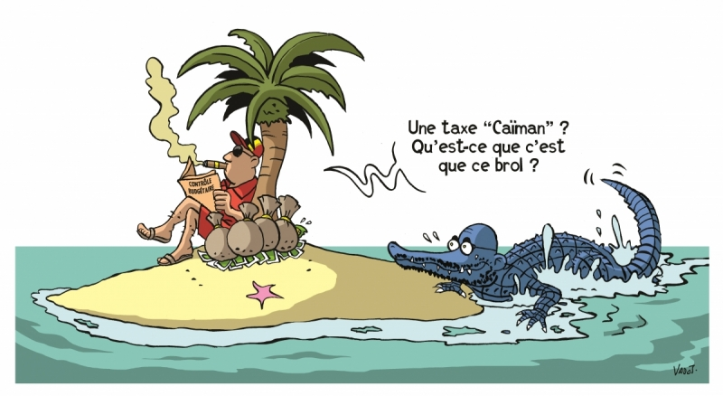
However…

Slide 18
Fiducie & income taxation
Since 2015: Cayman Tax
  In 2013: duty to declare the existence of ‘foreign legal constructs’ to Belgian tax authorities
  Specific Belgian tax regime, akin to a CFC-regime
  Introduced to end the use of ‘floating wealth’-structures
  Applies when a Belgian ‘founder’ can be linked to a ‘legal construct’
  Conceived as an ‘anti-abuse’-regime, but nowhere made explicit in the law
    E.g. ‘Abuse’ is not required for the application of the Cayman Tax
  December 2017 amendment: ‘fight against the use of legal constructs’

Slide 19
Fiducie & income taxation
Trusts as ‘legal construct type A’
  Art. 2, §1, 13°, a) BITC
  Definition of legal construct based on art. 122 of the PIL Code; description of the trust concept
  Slight changes in order to use ‘system-neutral’ language, in order to target ‘fiduciary legal constructs’ in general
  Definition does not state that the legal construct should be ‘foreign’
    Problematic in the light of the possible introduction of a Belgian fiducie…

Slide 20
Fiducie & income taxation
Definitions of the concept of ‘founder’
  The ‘actual founders’ (art. 2, §1, 14° BITC)
    The natural person or legal person taxed in ‘legal persons tax’ who founded the legal construct, outside the scope of a professional activity
    The natural person or legal person taxed in ‘legal persons tax’ on whose behalf the legal construct was founded and who inserted goods or rights into it
  The founder-heirs (art. 2, §1, 14° BITC)
    The natural persons who are the direct or indirect heirs of the ‘actual founders’, unless they demonstrate that they will never receive any advantage from the legal construct
  Founder-holders (art. 2, §1, 14° BITC)
    Holders of legal or economic rights of the legal construct
    Application to trusts?

Slide 21
Fiducie & income taxation
Application of the Cayman Tax
  ‘Look-through taxation’ (art. 5/1, §1 BITC)
  Income acquired by the trust are taxed in the head of the founder(s), in accordance to their interest in the construct or by equal parts
  Applies only if relevant income is not distributed within the same fiscal year as it was received by the trust
    In which case it is taxed as a dividend in the head of the founder
  Total fiscal transparancy: types of income received by the trust, retain their tax qualification in the head of the founder
    E.g. income received from immoveables, income received from moveables, diverse income (incl. tax exemption for certain capital gains), …

Slide 22
Fiducie & income taxation
Application of the Cayman Tax
  Taxation at the moment of distribution (art. 18 BITC)
  Qualification as dividend, no matter the content of the distribution: 30% tax rate
  Priority-rule vis-à-vis the transparant taxation (for founder)
  Art. 22 BITC: prevention of double taxation
    No tax if the distribution by the legal construct has already ‘undergone its tax regime in Belgium’
    E.g. distribution of income which underwent transparant taxation in a previous fiscal year
    FIFO-rule, oldest income of legal construct deemed to be distributed first (targeting ‘historical reserves’)
    No tax to the degree that the distribution consists of assets which the founder ‘inserted’ into the legal construct (last out + BoP on taxpayer)

Slide 23
Fiducie & income taxation
Application of the Cayman Tax
  Special ‘Cayman exit tax’ (art. 5/1, §2 BITC)
  In order to facilitate ‘repatriation’ of historical reserves of legal constructs
  When the tax is triggered, all historical reserves of the trust which has not yet been taxed in Belgium will be deemed to have been distributed to the persons who are deemed to be the founders
    Trigger 1: when ‘shares, economic rights or the assets’ of a legal construct are ‘inserted’ into another legal structure; mere creation of an additional legal structure suffices
    Trigger 2: transfer of ‘the assets’ of a legal construct to a non-qualifying jurisdiction
  Newly realized capital gains? Partial transfers?

Slide 24
Some questions
Why…
  So many tax avoidance/evasion concerns?
  Not include the fiducie in the (2019) Code of Companies and Associations, which includes e.g. partnerships and other low-threshold company forms?
  Such restrictions on the use of the fiducie?
  No amendments to the Cayman Tax (! Panayi-case CJEU) ?
  Not try again?

Slide 25
Thank you for your attention!
Prof. dr. Niels Appermont
Law, Tax & Business Unit
Faculty of Law
niels.appermont@uhasselt.be

