Slide 1

Introduction to alternative dispute resolution and ODR, Domain names within the .cz domain and .eu domain
Pavel Loutocký

Slide 2

Domain name disputes

Slide 3
MAIn principle
First comes – first served
The domain name is immediately registered
What if the holder of domain name is not the one who should own it?
Cybersquatting, typosquatting, etc.

Slide 4
The Structure
Top level domain names (TLDs)
  Generic .com, .gov, .org, .biz, .edu
  National .cz, .uk, .de, .sk, .ru
  Specific .eu
Subdomains
  muni.cz, seznam.cz, google.com
Lower Subdomains
  law.muni.cz, mail.google.com

Slide 5
New GTLDS
New top level domain names (TLDs) from 2013
  https://newgtlds.icann.org/en/
  List of all generic domain names (more than 1500):
  http://data.iana.org/TLD/tlds-alpha-by-domain.txt

Slide 6

Sqautters allowed?

Slide 7
Sqautters allowed? NO!

Slide 8
How to be legally protected from Cybersquatters?
Competition law?
Trademark law?
Geographical indications?
Commercial name (firm)?
Right for privacy (e.g. EUHR)?
COURT?
ANOTHER MORE SUITABLE SOULUTION?
WHAT WOULD YOU DO?

Slide 9

Example
Someone would register the domain microsoft.cz
He does not use this domain and offers it for sale for €200 000
Can the trademark owner claim violation of his rights?
Can the trademark owner claim transfer of the domain name?
What if the owner is based in US, administrator is Czech and squatter Russian?

Slide 10
?
#WWYD

Slide 11


Slide 12

Alternative dispute resolution

Slide 13
What is ADR?

Slide 14
ADR
Out-of-court dispute settlement
Classical tool in history to settle commercial dispute
Evolved into another fields
Less formal than court proceedings
Faster in specific cases
Based on the agreement of the parties

Slide 15
ADR
Does not fit for „internet disputes“
Judicial proceedings are not convinient as well
EVOLUTION?

Slide 16

ADR is old
!! ODR should be the FUTURE !!

Slide 17
Reasons?
Increased volumes of squatting cases
Problems with international element
Insufficient national regulation
Low experience of judges with cybersquatting and IP law in general -> experts are deciding the case

Slide 18
Reasons!
Dispute settlement clause in the terms and conditions of registrations
Third parties have the right (not duty) to file a complaint at a selected institution
These clauses are contained in the majority of domain names
Usually it is not arbitration clause, but non-binding ADR clause!!!

Slide 19
The rules - TLDs
Uniform Domain-Name Dispute Resolution Policy (UDRP)
Top-level domain names
https://www.icann.org/resources/pages/help/dndr/udrp-en
List of providers:
https://www.icann.org/resources/pages/providers-6d-2012-02-25-en

Slide 20
ODR IN GENERAL not only domain names but all kinds of disputes

Slide 21
The notion that most people want black-robed judges, well-dressed lawyers, and fine paneled courtrooms as the setting to resolve their dispute is not correct. People with problems, like people with pains, want relief, and they want it as quickly and inexpensively as possible.
Warren E. Burger
Former judge at US Supreme Court

Slide 22
Background
Traditional judicial mechanisms... did not offer an adequate solution for cross – border electronic commerce disputes, and that the solution (providing a quick resolution and enforcement of disputes across borders) might reside in a global ODR system for small value, high volume ... disputes
Courts are resolving only a fraction of today‘s legal disputes (especially low - value) – PROBLEM!!

Slide 23
What is ODR?
It is difficult to provide a self - contained definition of ODR
Dispute resolution, which uses electronic communication to exchange every information between the parties
A growing number of cases (especially low – cost cases) are being resolved by online tools and sometimes lawyers and judges are not even involved

Slide 24
What is ODR?
Definitions:
  dispute settlement which may or may not involve a binding decision being made by a third party, implying the use of online technologies to facilitate the resolution of disputes between the parties
  dispute resolution carried out by combining the information processing powers of computers with the networked communication facilities of the Internet

Slide 25
What is ODR?
ODR is NOT only modified ADR (alternative dispute resolution)
The technology is the fourth party helping to settle the dispute
Triad:
  1) online communication
  2) dipute settlement
  3) software assisstance

Slide 26
History of ODR
The first ODR forms started to evolve between 1996 and 1997 (software assistance)
The first experiments were created at the University of Massachusetts in the USA and Canada
Those projects were later transformed for commercial use
One of the first official systems providing ODR was The Virtual Magistrate
  it never fulfilled expectations of the founders
  it was mainly caused by “limited scope of disputes, a lack of advertising and the fact that the project was voluntary so that the case managers had no way to force the defendant to take part in the proceedings or to enforce the decisions.”

Slide 27
Back to UDRP
What is it?
What it serves for?
Why is it binding (or is it)?

Slide 28
The rules - ccTLDs
National authorities (does not have to be governemental)
Contract with ICANN
In Czech Republic – CZ.NIC
https://www.nic.cz/page/314/pravidla-a-postupy/

Slide 29

The rules - .EU
Not an arbitration clause! (again)
Competence of arbitration courts enacted by regulation 874/2004/EC
https://eurid.eu/en/

Slide 30
The rules - .EU
Set of eu regulations:
http://ec.europa.eu/ipg/basics/urls/doteu_en.htm

Slide 31
Legal Framework in EU
Regulations
  733/2002/EC; 874/2004/EC; 1654/2005/EC; 1255/2007; 560/2009
  http://ec.europa.eu/ipg/basics/urls/doteu_en.htm
Including
  .eu domain name registration rules
  Domain Name Registration Terms and Conditions
  Sunrise period Rules for .eu domains
  .eu Domain Dispute Resolution Rules (ADR Rules)
Rules of Procedure of the ADR provider (adr.eu - based in Prague!)

Slide 32
Domains .eu
boost e-commerce in the EU
create a clearly identifiable link between the domain name holder and the EU
EURid administrator

Slide 33
Authorised users
entrepreneurs with their registered office or place of business within the EU
organisations established in the EU
natural persons permanently resident in the EU

Slide 34
Domain name disputes in .eu
Litigation against speculators
Active legitimation: trade mark owner
Passive legitimation: Domain holder
Disputes against the domain administrator
Active legitimation: Domain name registrant
Passive legitimation: Domain administrator

Slide 35
Disputes against speculators
Article 21 of Commission Regulation (EC) No 874/2004 of 28 April 2004 laying down public policy rules concerning the implementation and functions of the .eu Top Level Domain and the principles governing registration
A registered domain name shall be subject to revocation, using an appropriate extra-judicial or judicial procedure, where that name is identical or confusingly similar to a name in respect of which a right is recognised or established by national and/or Community law, such as the rights mentioned in Article 10(1), and where it:
has been registered by its holder without rights or legitimate interest in the name; or
has been registered or is being used in bad faith.

Slide 36
Legitimate interest
X
Bad Faith
Article 21/2,3
https://eur-lex.europa.eu/legal-content/en/ALL/?uri=celex:32004R0874

Slide 37

Domain name disputes .CZ

Slide 38
Legal background
Primarily rules (binding between the parties)
https://www.nic.cz/page/314/pravidla-a-postupy/
The possibility of appealing to the courts afterwards:
  Usnesení Nejvyššího soudu ČR ze dne 26. ledna 2010, sp.zn. 29 Cdo 3580/2009
  Rozsudek Nejvyššího soudu ČR ze dne 17. prosince 2013. sp.zn. 23 Cdo 3895/2011

Slide 39
ANNEX 3: RULES FOR ALTERNATIVE DISPUTE RESOLUTION (Article 3)
The Holder agrees to submit to dispute resolution in accordance with these ADR Rules and the Regulations, in the event that the Complainant files a claim with the Administrator claiming that the Holder's Domain Name is identical or confusingly similar with the Protected Designation to which the Complainant has rights, if at the same time:
3. 1.1. such Domain Name has been registered or acquired without the Holder having rights to the Domain Name or Protected Marking pursuant to Section 3.3; or
3.1.2. such Domain Name has been registered, acquired or used in bad faith.

Slide 40
Czech court decisions
Suzuki.cz (sp. zn. 23 Cdo 3895/2011)
Globtour.cz (sp. zn. 23 Cdo 3407/2010)
Ceskapojistovna.cz (dostupné zde: http://www.itpravo.cz/index.shtml?x=218427)
And many more
https://ictjudikatura.law.muni.cz/wiki/Kategorie:Dom%C3%A9nov%C3%A1_jm%C3%A9na

Slide 41
http://www.adr.eu/

Slide 42
UDRP vs National solution or .eu?
Did you understand how it works?
What is the relationship?
Please discuss..

Slide 43
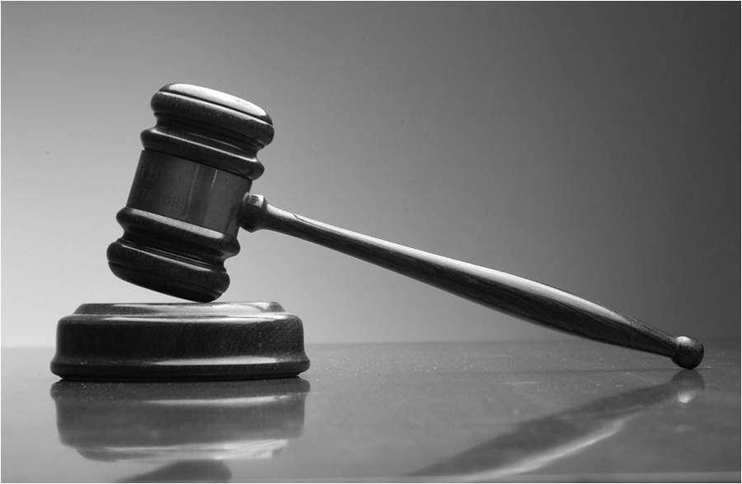
Thank you for your attention!
Questions?

