Slide 1
BASICS OF THE EU ENVIRONMENTAL LAW
ENVIRONMENTAL POLICY OF EU, ITS HISTORY AND DEVELOPMENT, AIMS AND INSTRUMENTS
THE ROLE OF THE ENVIRONMENTAL ACTION PLANS
Spring 2024
JUDr. Vojtěch Vomáčka, Ph.D., LL.M.

Slide 2
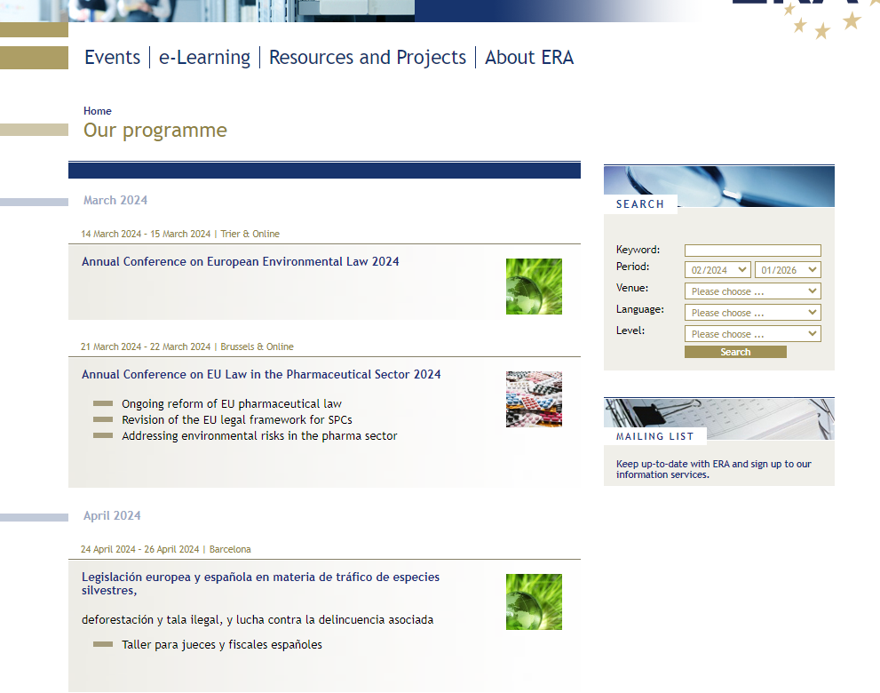
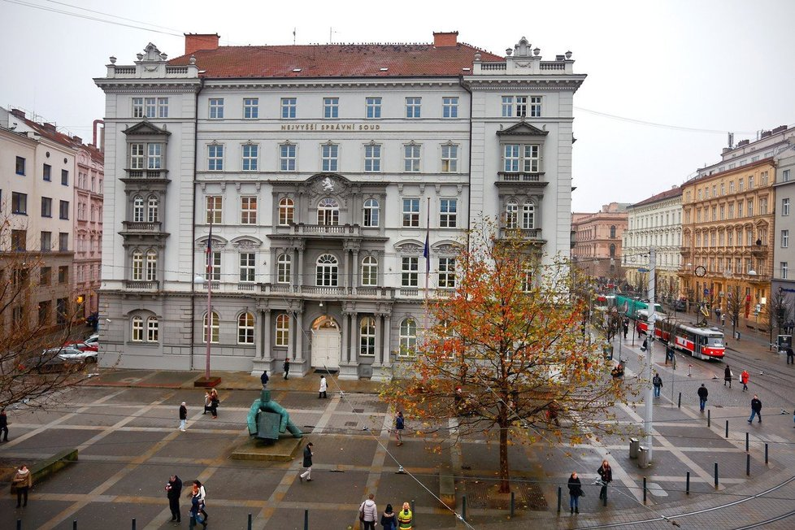

Slide 3
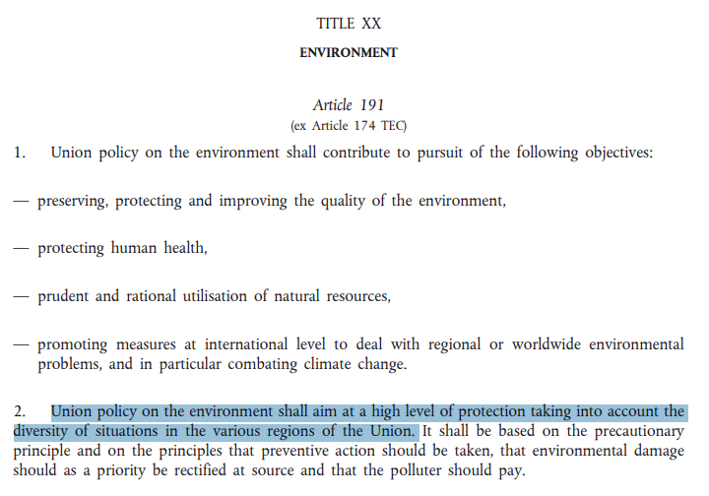

Slide 4
Course introduction
1. Environmental policy of EU, its history and development, aims and instruments. The role of environmental action plans.
2. EU environmental law - sources of law, system of environmental regulation and relation to other EU policies, environmental law
3. Harmonisation of environmental requirements. The role of the national courts and the CJEU. Case law and guidance: Where to get more information?
4. Access to environmental information, participation of public in environmental decision-making and access to justice - the 3 pillars of Aarhus Convention.
5. Environmental impact assessment.

Slide 5
Course introduction
6. Global climate change in EU environmental policy
7. Air protection.
8. Nature protection. Natura 2000.
9. Biodiversity protection. / Regulation of trade in endangered species of animals and plants.
10. Inland waters protection.
11. Waste management.
12. Environmental protection and human rights.

Slide 6
Requirements
Credit requirements: 1. presentation, 2. written test, 3. participation in lessons
The examination in the form of a written test (open book, 8 open questions)
Reading assignments and cases necessary for discussions will be specified during the course.

Slide 7
Structure and Contents
Why does the EU protect the environment?
What is the difference between the EU environmental policy and EU environmental law?
What are the main characteristics of the EU environmental law?
How does the EU engage in the global environmental protection?

Slide 8
What is environmental policy?

Slide 9
Why does the EU protect the environment?
Policy
Framework legislation,
specific legislation, binding plans and programmes…
Administrative and judicial decisions, direct action…

Slide 10
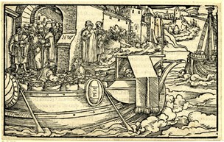
Marcus Tullius Cicero, De Officiis: Famine at Rhodes

Slide 11
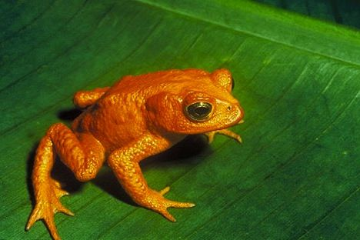
Golden toad

Slide 12
Pojetí práva

Slide 13
Pojetí práva

Slide 14
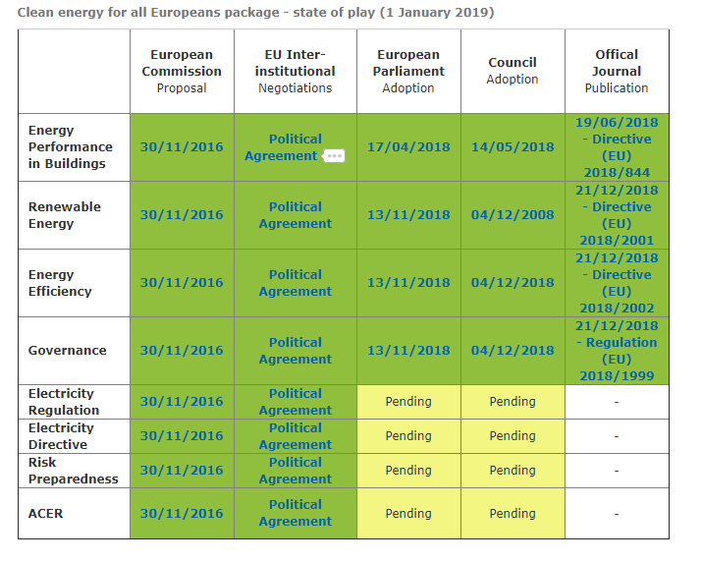
EU: Energetika x Životní prostředí

Slide 15
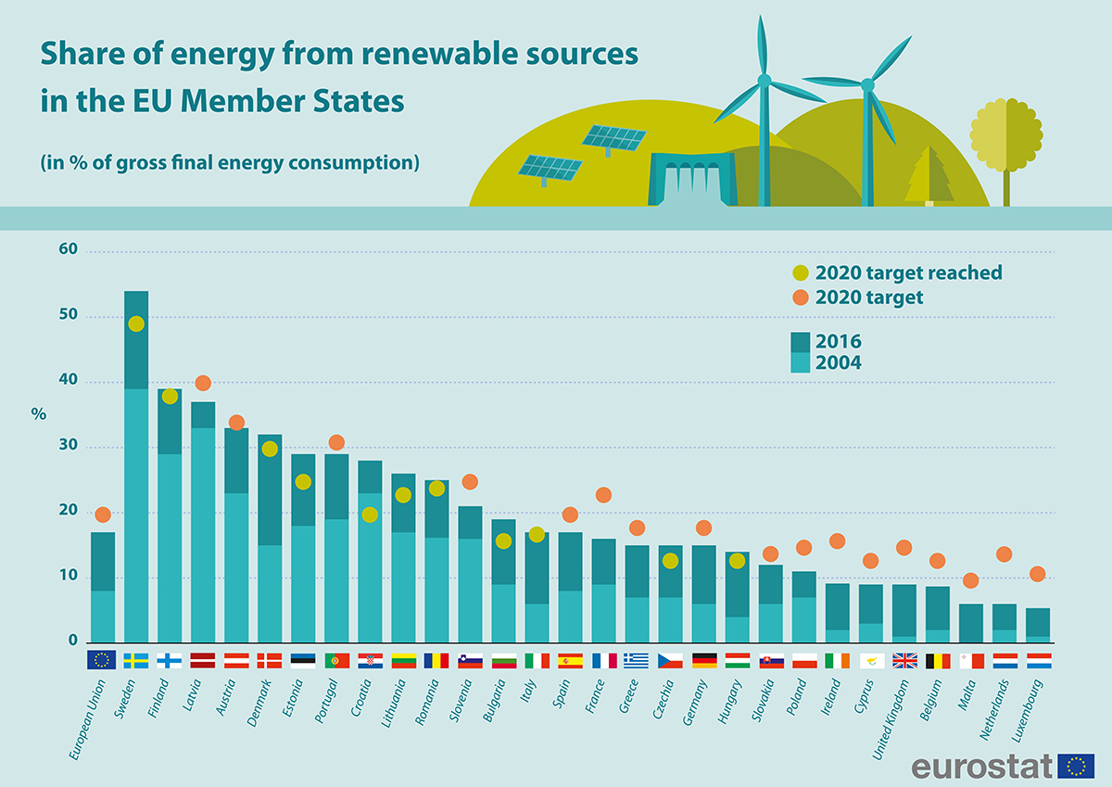

Slide 16
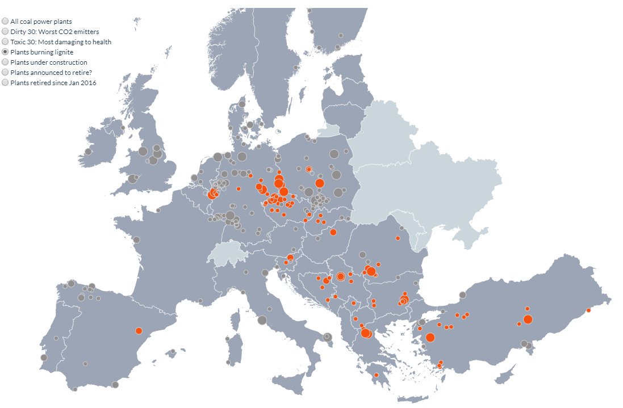
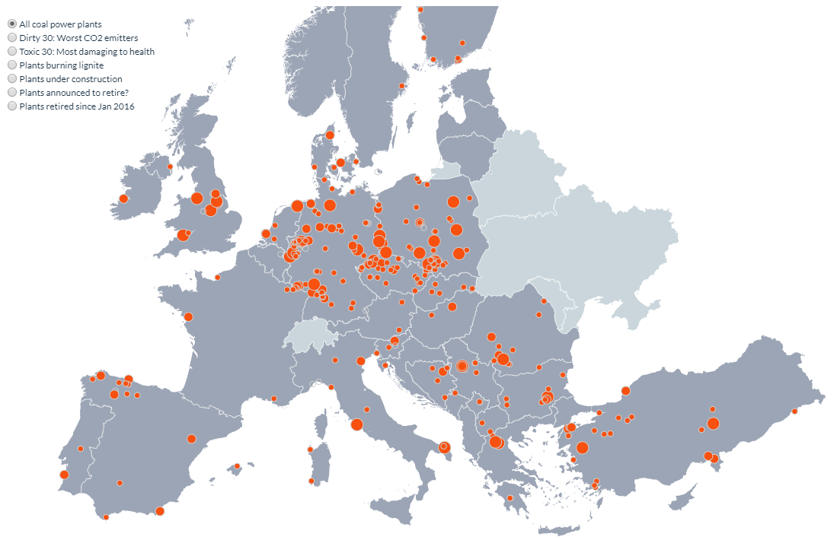
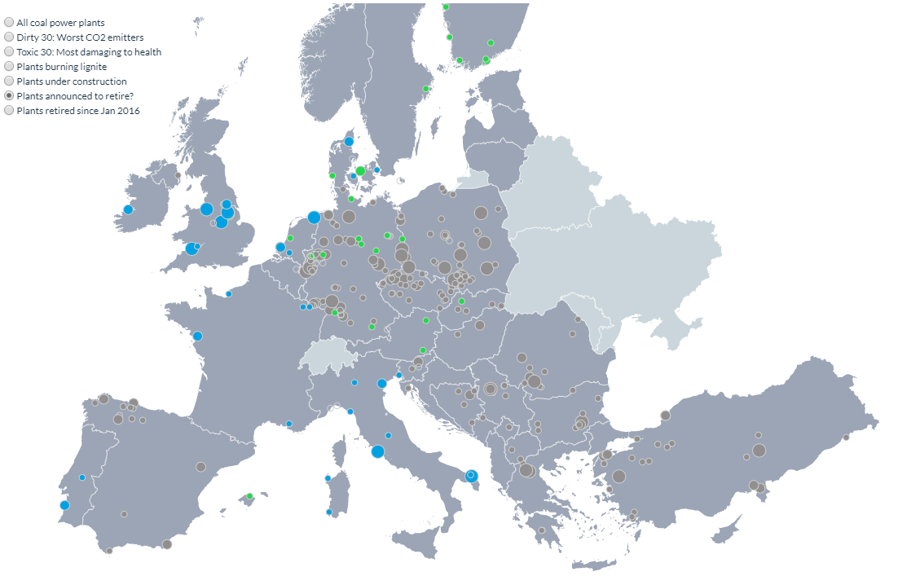
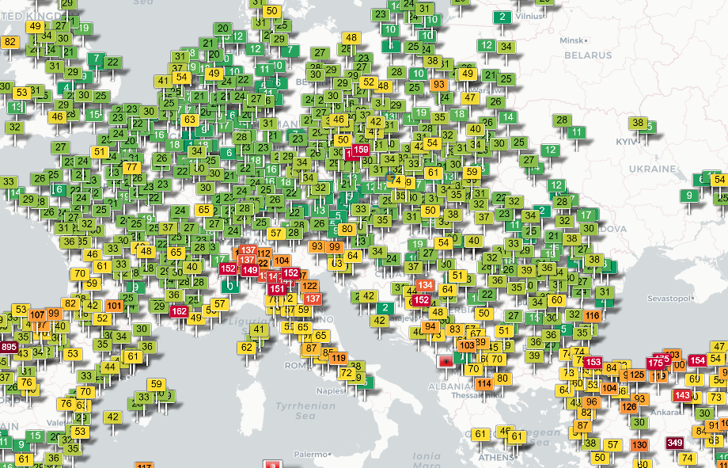

Slide 17
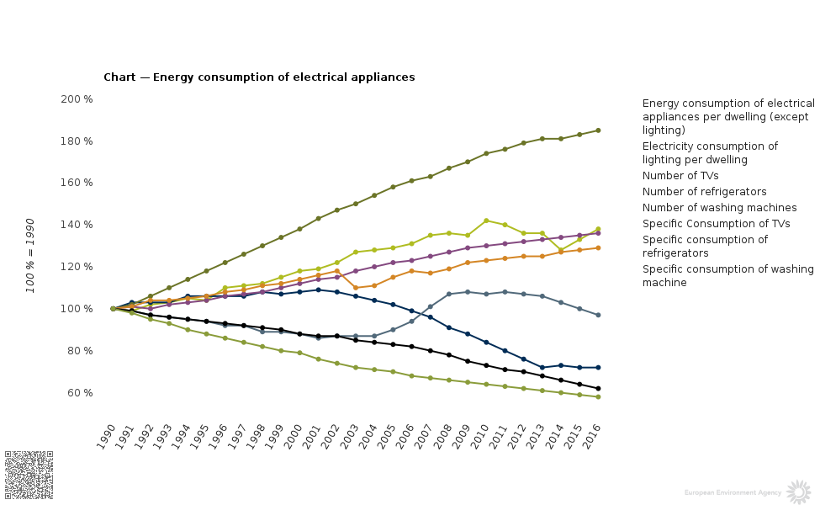

Slide 18
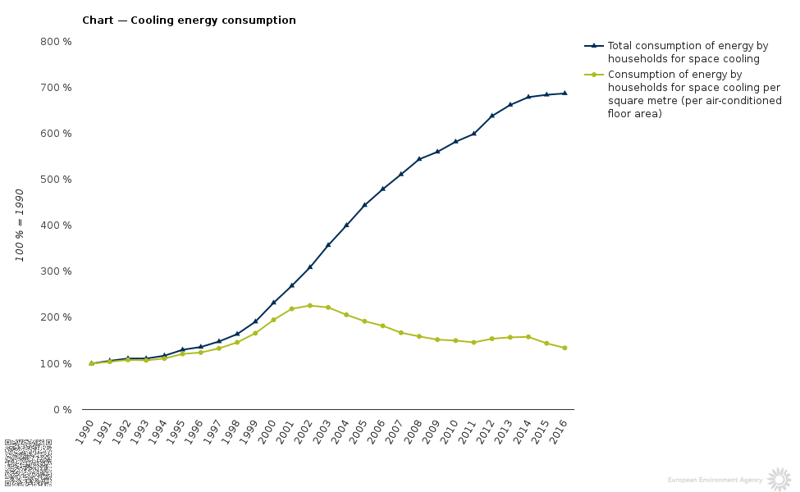

Slide 19
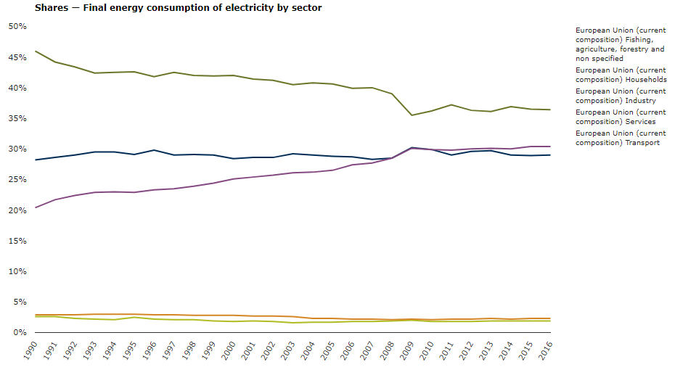

Slide 20
Why does the EU protect the environment?
PRIMARY LAW
(competence )
Policy
Framework legislation,
specific legislation, binding plans and programmes…
Administrative and judicial decisions, direct action…

Slide 21
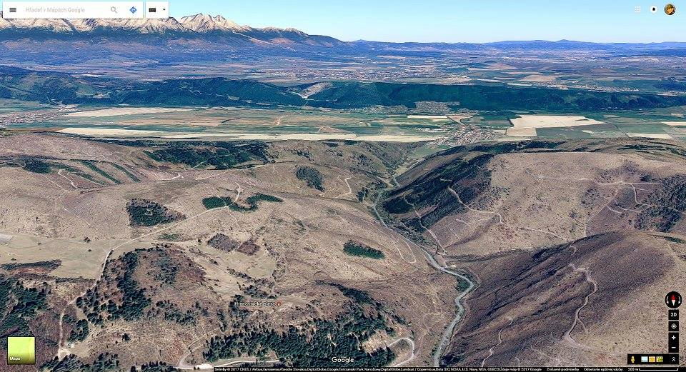
EKOPOLITIKA

Slide 22
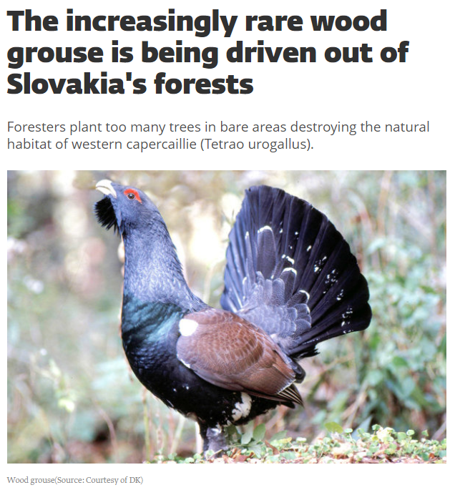
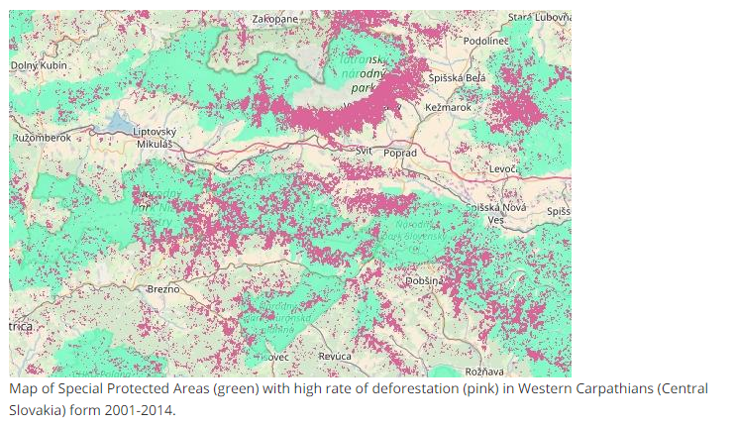
EKOPOLITIKA

Slide 23
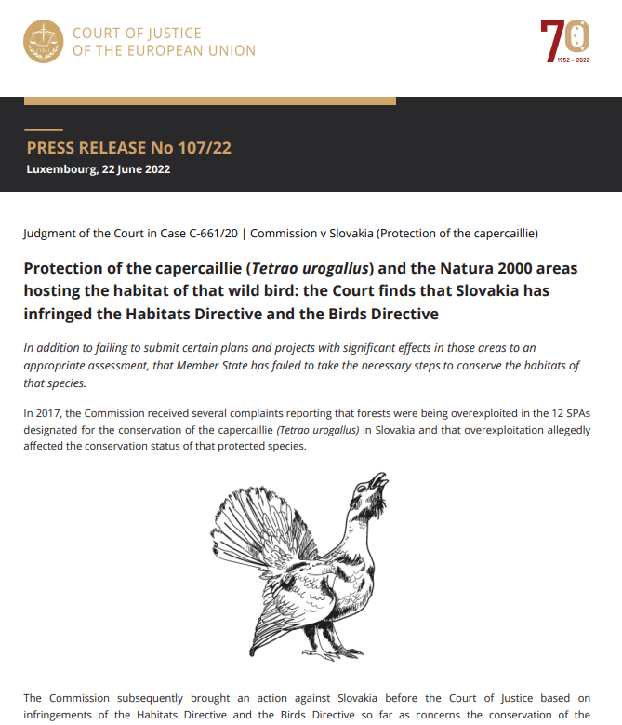
Article 6
1. For special areas of conservation, Member States shall establish the necessary conservation measures involving, if need be, appropriate management plans specifically designed for the sites or integrated into other development plans, and appropriate statutory, administrative or contractual measures which correspond to the ecological requirements of the natural habitat types in Annex I and the species in Annex II present on the sites.
2. Member States shall take appropriate steps to avoid, in the special areas of conservation, the deterioration of natural habitats and the habitats of species as well as disturbance of the species for which the areas have been designated, in so far as such disturbance could be significant in relation to the objectives of this Directive.
3. Any plan or project not directly connected with or necessary to the management of the site but likely to have a significant effect thereon, either individually or in combination with other plans or projects, shall be subject to appropriate assessment of its implications for the site in view of the site's conservation objectives. In the light of the conclusions of the assessment of the implications for the site and subject to the provisions of paragraph 4, the competent national authorities shall agree to the plan or project only after having ascertained that it will not adversely affect the integrity of the site concerned and, if appropriate, after having obtained the opinion of the general public.
4. If, in spite of a negative assessment of the implications for the site and in the absence of alternative solutions, a plan or project must nevertheless be carried out for imperative reasons of overriding public interest, including those of a social or economic nature, the Member State shall take all compensatory measures necessary to ensure that the overall coherence of Natura 2000 is protected. It shall inform the Commission of the compensatory measures adopted.
Where the site concerned hosts a priority natural habitat type and/or a priority species, the only considerations which may be raised are those relating to human health or public safety, to beneficial consequences of primary importance for the environment or, further to an opinion from the Commission, to other imperative reasons of overriding public interest.

Slide 24
What is the European Union?
EU as an actor of International law:
International Organization (with legal personality) of regional integration
EU law as a (self-contained) system of International Law:
concessions of sovereign powers by Member States through the international treaties
Set of independent rules
Institutions
Independent system of adjudication
The Union as a “sui generis” actor of international law:
intergovernmental and supranational features
Similarities with federal State (i.e.: division of competences)
A political internal and external dimension

Slide 25
What is the European Union?
Set of principles and rules that regulate the relationship among the Member States of the European Union
It derives from:
international treaties: founding treaties of the 3 communities + following treaties and amendements (primary law)
legal acts of the EU institutions (secondary law)
http://eur-lex.europa.eu/
http://curia.europa.eu/
https://www.youtube.com/watch?v=XgnXwrsMBUs

Slide 26
European Union environmental legislation has developed over the last 50 years.
Environmental policy was not regulated at the Community level in the beginning, the Treaty of Rome does not contain regulations regarding this. Economic integration was the focus.
Awareness about environmental pollution began to develop because of:
- Intensive economic growth
- The fast growth of industrialization
- Increasing energy consumption
- on the international level + national level

Slide 27
Phase 1: 1958 - 1972
1958 EEC Treaty
No specific attention to development of environmental policy
Minor measures (common market based – dangerous chemicals, motor vehicles, detergents)
Phase 2: 1972 - 1987
European Council Summit in 1972: Heads of States and Governments decided that a Community environmental policy was necessary
The basis of the environmental policy was established in the First Environmental Action Programme (1973). Basic goals, principles of environmental law, and activities regarding certain fields of the environment.
The main goal was the efficient operation of the Community and the Common Market – but extensive interpretation of economic expansion.

Slide 28
1970 The US Environmental Protection Agency is established.
1971 The international environmental organisation Greenpeace is founded in Vancouver, Canada.
1972 The United Nations Conference on the Human Environment is held in Stockholm. This leads to the creation of government environment agencies and the UN Environment Programme.
1972 The Club of Rome publishes The Limits to Growth. It stresses, for the first time, the importance of the environment, and the essential links with population and energy.
1973 In January, Denmark, Ireland and the United Kingdom join the European Community, bringing membership up to nine.
1973 A small Environment and Consumer Protection Service is set up and attached to the European Commission department for industrial policy and a Standing Committee on the Environment is created in the European Parliament.
1973 The Arab–Israeli war of October leads to an oil price shock and economic problems in Europe, sparking action on energy efficiency. Car-free Sundays are organised throughout Europe.
1974 Scientists suggest for the first time that chlorofluorocarbons (CFCs) may be causing a thinning of the ozone layer.
1975 The Community starts building its body of environmental legislation with the adoption of — among others — the Waste Framework Directive (1975), the Bathing Water Directive (1976) and the Birds Directive (1979).

Slide 29
1976 An explosion occurs on 10 July at a chemical plant near Seveso, north of Milan in Italy. A toxic cloud containing dioxin contaminates a densely populated area. In 1982, the Seveso Directive is issued to prevent major accidents with dangerous substances.
1978 Oil tanker Amoco Cadiz spills 68 million gallons off the coast of France.
1979 A partial meltdown of the Three Mile Island nuclear plant in USA puts the future of nuclear energy in question.
1979 The first World Climate Conference takes place in February in Geneva, Switzerland. A panel on climate change set up by the National Academy of Sciences in USA advises that ‘A wait-and-see policy may mean waiting until it is too late’ to avoid significant climate changes.
1981 The European Commission creates its Environment Directorate-General.
1985 First observation of an ozone hole over Antarctica.
1986 On 25 April, an uncontrolled chain reaction in a reactor in the Chernobyl nuclear power plant, 80 miles north of Kiev, blows off the reactor's lid. More than 31 workers die instantly and around 135 000 people are evacuated from the surrounding area. A plume of radioactive fall-out drifts over western Soviet Union, eastern and western Europe, and eastern North America.
1987 The Brundtland Commission’s report, Our Common Future, defines sustainable development as ‘development that meets the needs of the present without compromising the ability of future generations to meet their own needs.’

Slide 30
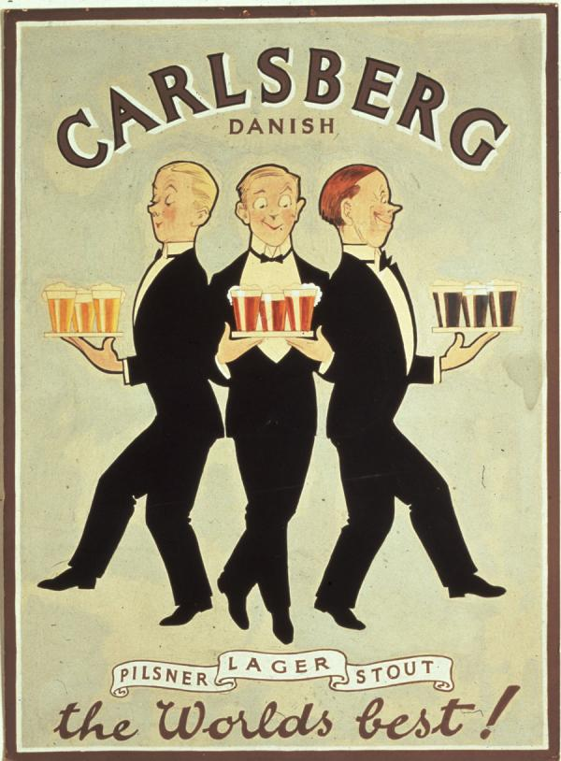
Major role of the Court of Justice
For example Case C-302/86 (Dannish bottles)
Dannish Order No 397 of 2. 7. 1981:
All containers for beer and soft drinks must be returnable and approved by a National Agency
(120/78, Cassis de Dijon): Obstacles to free movement of goods must be accepted when:
1. There is no EC rule regulating the marketing of the product in question, and
2. The rules apply to both domestic and imported products with no discrimination,
3. The rules satisfy mandatory requirements recognized by Community law, and
4. The measures taken are proportionate and necessary in view of their aim.

Slide 31
Major role of the Court of Justice
For example Case C-302/86 (Dannish bottles)
The protection of the environment is "one of the Community's essential objectives" which may as such justify certain limitations of the principle of the free movement of goods.
Article 35 :
Quantitative restrictions on exports, and all measures having equivalent effect, shall be prohibited between Member States.
Article 36: The provisions of Articles 34 and 35 shall not preclude prohibitions or restrictions on imports, exports or goods in transit justified on grounds of public morality, public policy or public security; the protection of health and life of humans, animals or plants; the protection of national treasures possessing artistic, historic or archaeological value; or the protection of industrial and commercial property. Such prohibitions or restrictions shall not, however, constitute a means of arbitrary discrimination or a disguised restriction on trade between Member States.

Slide 32
Phase 3: 1987 - 2008
1987 Single European Act
Independent title of environment was accepted
1993 Treaty on the European Union (Maastricht)
Protection of the environment became part of the internal common policy. The scope of environmental policy was enlarged and supplemented it with new objectives.
1997 Treaty of Amsterdam
„Environmental protection requirements must be integrated into the definition and implementation of the Community policies and activities referred to in Article 3, in particular with a view to promoting sustainable development.”

Slide 33
Phase 4: Lisbon and further
2009: Treaty of Lisbon
the 3 pillars structure disappears
TUE + TFUE (former TEC) + Nice into a single Treaty
Strengthened role of the EU Parliament
Broader Union’s competences
Birth of the European External Action Service (EEAS)
EU Charter
DG Environment
DG Energy
DG Climate Action

Slide 34
Before 1986 (Treaty of Rome) | Single European Act (1986) | Maastricht Treaty (Treaty of the Union - 1992) | Amsterdam Treaty (1999) | Lisbon Treaty (2009)
Art. 100 Harmonization (internal market) | ➔ Art 100a Harmonization + safeguard clause | ➔ Art 100a Harmonization + safeguard clause | ➔ Art 95 Harmonization + safeguard clause | ➔ Art 114 Harmonization + safeguard clause
Art. 235 Objectives of the Community | Art. 235 (not in use any longer!) | Art. 235 (not in use any longer!) | Art. 308 (not in use any longer!) | Art.352 (not in use any longer!)
- | Art. 130r - Objectives - Principles - Grounds - Int. coop. | ➔ Art. 130r - Objectives - Principles - Grounds - Int. coop. | ➔ Art. 174 - Objectives - Principles - Grounds - Int. coop. | ➔ Art. 191 - Objectives - Principles - Grounds - Int. coop.
- | Art. 130s Legal basis and procedure | ➔ Art. 130s Legal basis and procedure | ➔ Art. 175 Legal basis and procedure | ➔ Art. 192 Legal basis and procedure
- | Art. 130t Minimum stringency | ➔ Art. 130t Minimum stringency | ➔ Art. 176 Minimum stringency | ➔ Art. 193 Minimum stringency

Slide 35
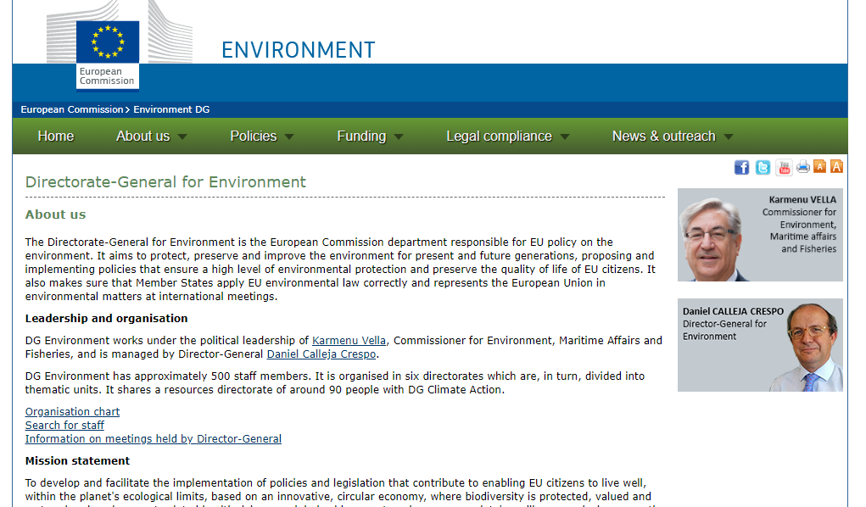

Slide 36
Virginijus Sinkevičius

Slide 37
Secondary law:
Around 1000 pieces of legislation
Highest number of infringments, petitions, citizen initiatives
80 % of national law
Addressee – both EU and member states
Not a comperhensive system – specific EU law
Regulation x Directive
EU administration

Slide 38
System and structure:
Sectoral legislation
Air pollution, Water pollution and quality, Waste, Chemicals, Nature and Biodiversity, Land and soil protection, Marine and Coast, Noise
Horizontal legislation - general environmental management issues rather than legislation regarding specific sectors, products or types of emissions.
Environmental impact assessment,
Public access to environmental information, participation in proceedings, access to justice,
Environmental liability,
Integrated pollution prevention and control,
Reports on the implementation.

Slide 39
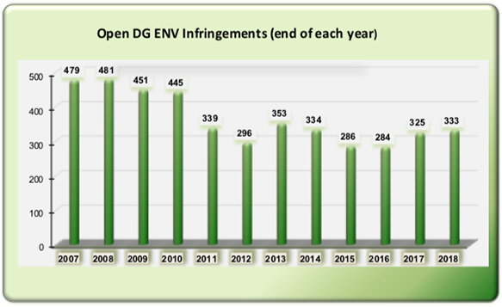
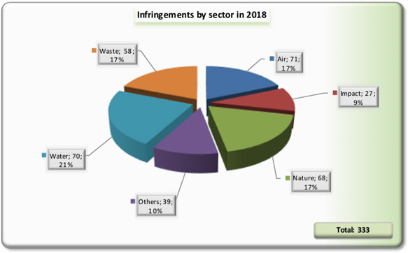

Slide 40
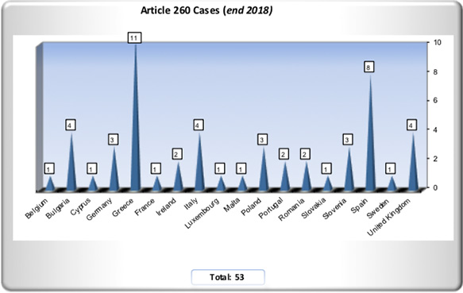
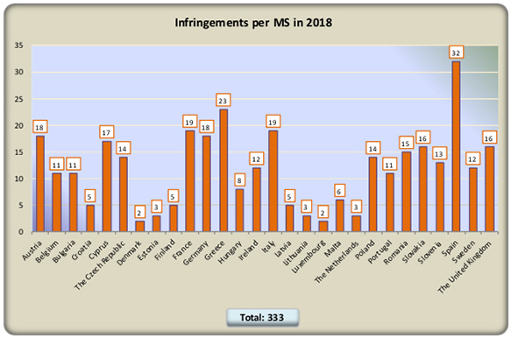

Slide 41
Environmental Action Programmes
= political declarations
EAPs define the framework of the EU environmental policy. They set up the challenges and priorities for a given period and create a frame for EU measures on the environment
The First Action Programme (1973 - 1977)
need for a comprehensive assessment of the impacts of other policies
ideas behind sustainable development
The Second Action Programme (1977 - 1981)
priority of the protection of water, air and noise
rational use of land, environment and natural resources
Limited success, critical evaluation, economic recession (75 - 78, 81 - 83)
Principles introduced, number of framework directives adopted (water and waste)

Slide 42
The Third Action Programme (1982 - 1986)
Change in emphasis from pollution control to pollution prevention
Land use planning (a tradition of strategic environmental planning from the Netherlands)
Integration of environment into other EC policies
Emissions control policy (Germany)
The Fourth Action Programme (1987 - 1992)
Emphasizes the analysis of benefits and cost, the polluter pays principle, responsibility in the environmental field
The Fifth Action Programme (1993 - 2000)
Sustainable development, sectoral approach
Pubic participation
Medium and long-term objectives

Slide 43
The Sixth Action Programme (2001 - 2010):
Climate change as an outstanding challenge
Protecting, conserving, restoring and developing the functioning of natural systems, natural habitats, wild flora and fauna
Contributing to a high level of quality of life and social well being for citizens
Better resource efficiency and resource and waste management
More stringent objectives
Critical review in 2007
Financial crysis
And then?

Slide 44
The Seventh Action Programme (2013 - 2020):
"Living well, within the limits of our planet„
No specific objectives (levels of pollution)
Towards a resource-efficient, low-carbon economy
2020 timeframe, 2050 vision, 9 priority objectives
3 Thematic priority objectives:
Protecting nature and strengthening
ecological resilience
Boosting sustainable, resource-efficient,
low-carbon growth, and
Effectively addressing environment-related
threats to health.

Slide 45
The Seventh Action Programme (2013 - 2020):
EU Environmental policy is linked to the EU budget:
Green funding, 5 % - 20 % GC
Private investors
Europe 2020 - the EU's growth strategy
2015 Action Plan on circular economy
to become a smart, sustainable and inclusive economy. These three mutually reinforcing priorities should help the EU and the Member States deliver high levels of employment, productivity and social cohesion.

Slide 46
Too vague? Example – air quality
The 5th EAP: “WHO values [on air quality] become mandatory et EU level” by the year 2000.
The 6th EAP declared that WHO standards, guidelines and programmes “will be taken into consideration”
The 7th EAP declared that by 2020, “outdoor air pollution is significantly improved”, without mentioning that the binding limit values had to be respected by 2010 already (by 2015 for PM2.5).
Question of nuclear safety and radiation protection, discussed in the 5th EAP, were altogether omitted in the 6th and 7th EAP, in the same way as specific measures aiming at industrial, agricultural, transport, energy and touristic activities which had been discussed in some detail in the 5th EAP. The 7th EAP vaguely referred to integration and coherence in general.

Slide 47
The Seventh Action Programme (2013 - 2020):
EU Environmental policy is linked to the EU budget:
Green funding, 5 % - 20 % GC
Private investors
Europe 2020 - the EU's growth strategy
2015 Action Plan on circular economy
to become a smart, sustainable and inclusive economy. These three mutually reinforcing priorities should help the EU and the Member States deliver high levels of employment, productivity and social cohesion.

Slide 48
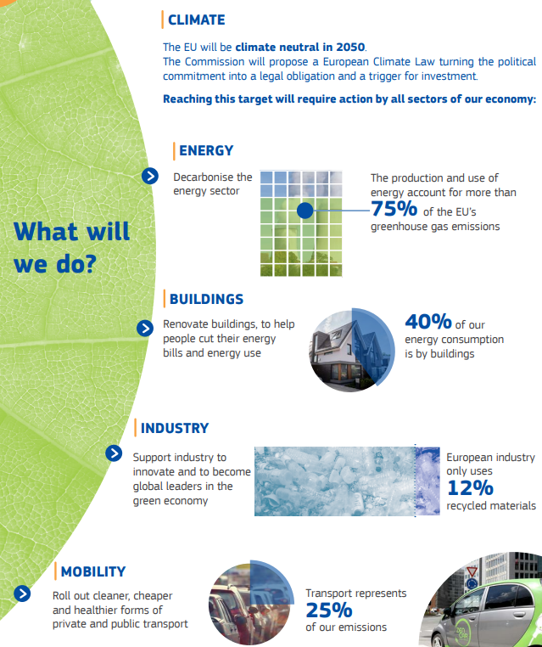
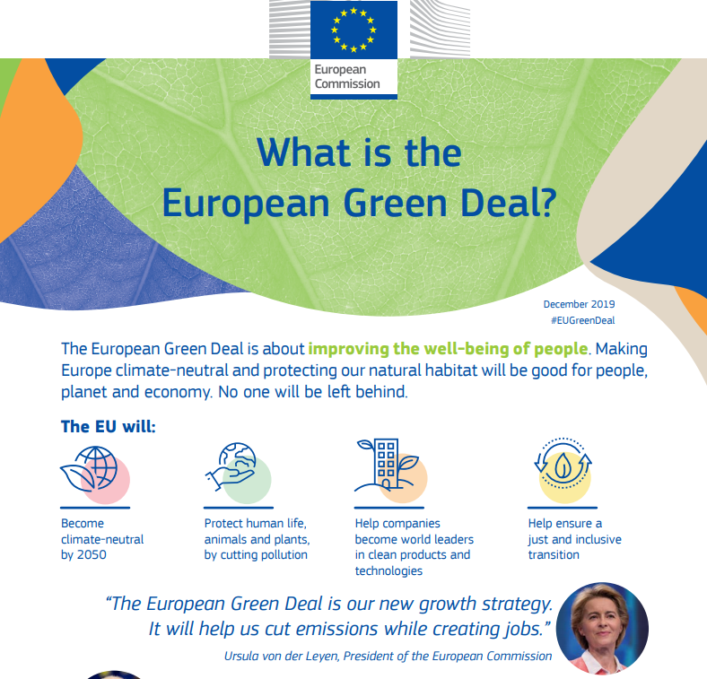
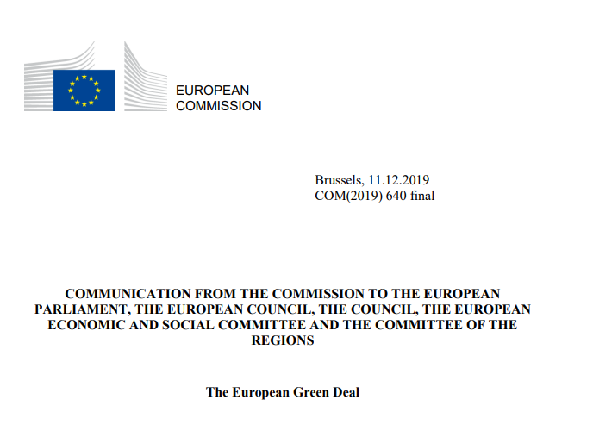

Slide 49
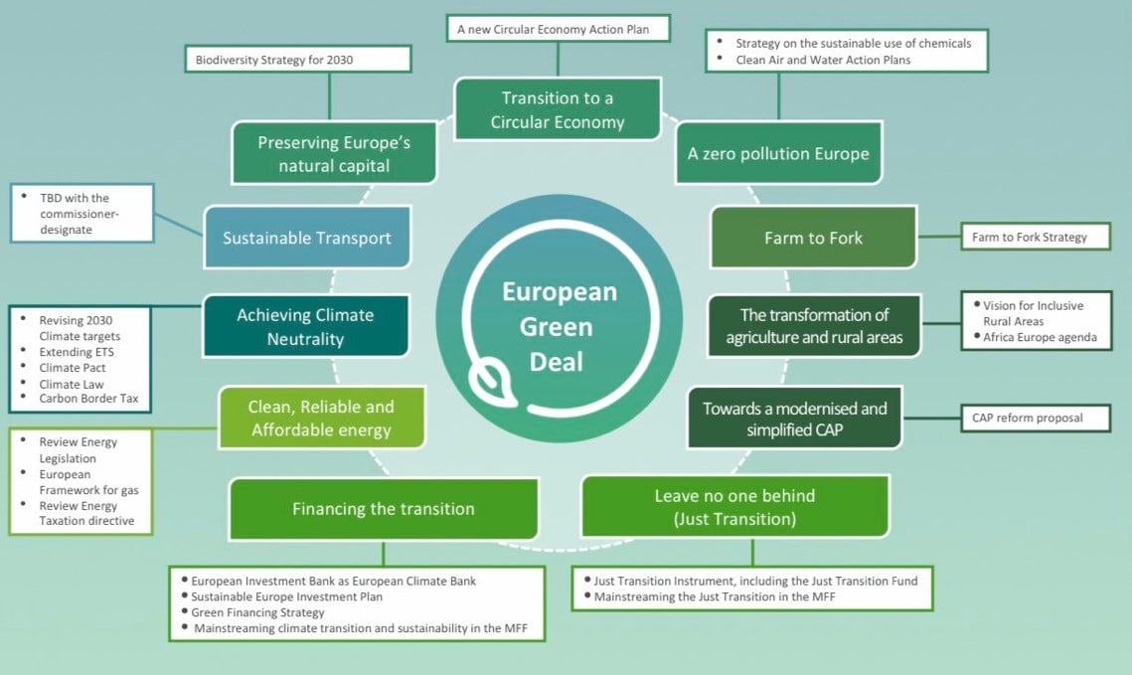

Slide 51
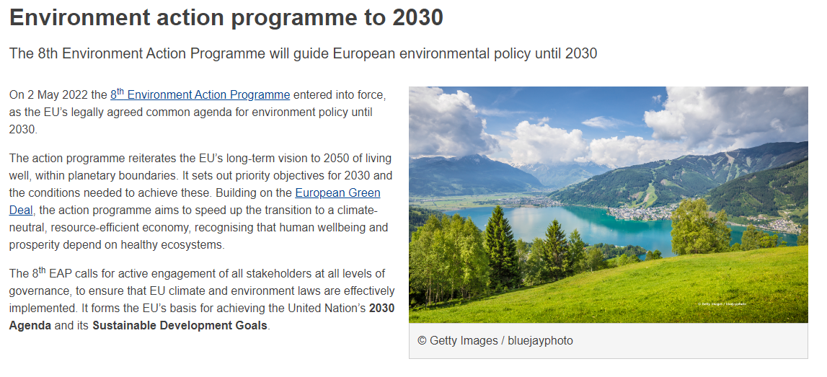

Slide 52
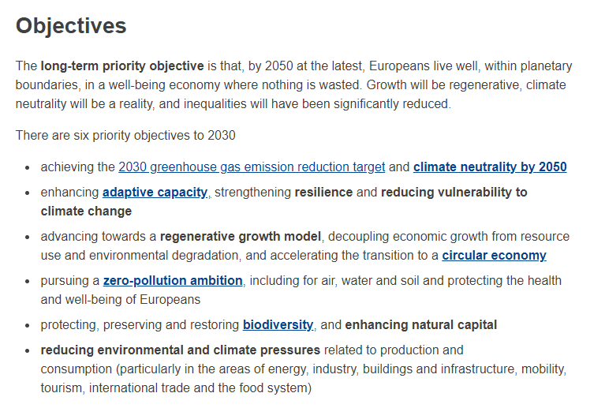

Slide 53
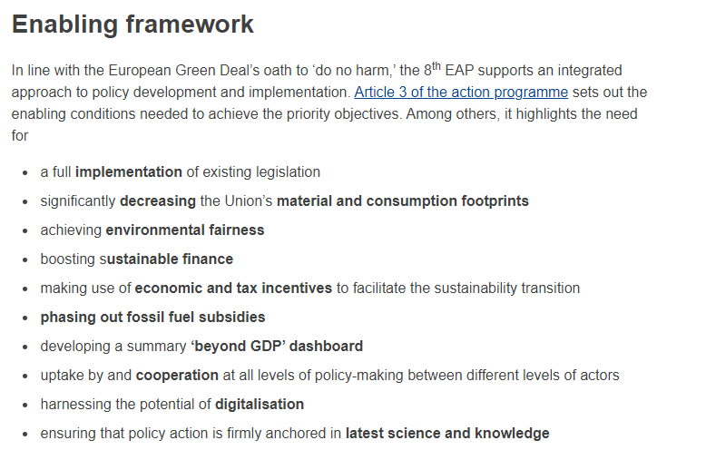

Slide 54
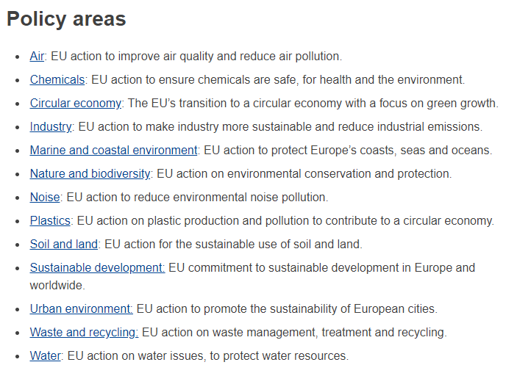

Slide 55
Limits of law as a tool for harmonising environmental policy in the EU
Formal law is limited in its capacity to harmonize environmental policy, e.g. of the different Member States in the EU
Political reasons:
difficulties of negotiating compromises that still have the capacity to harmonize, different cultures of public administration, different philosophies of environmental protection
Legal reasons: different legal systems (common law, civil law), different legal cultures (discretion vs. binding rules) Sociological reasons: - contrast ‘law in the books’ with ‘law in action’

Slide 56
THANK YOU FOR YOUR ATTENTION!
vomacka@mail.muni.cz

