Slide 1
Legal Philosophy
Introductory Lesson

Slide 2
Lectures
6/3 Legal Positivism
doc. JUDr. Tomáš Sobek, Ph.D.
13/3 Natural Law Theory
doc. JUDr. Martin Hapla, Ph.D.
20/3 Metaethics
doc. JUDr. Tomáš Sobek, Ph.D.
27/3 Normative Ethics
doc. JUDr. Martin Hapla, Ph.D.
3/4 Legal Philosophy and Problem of Free Will
doc. JUDr. Tomáš Sobek, Ph.D.
10/4 Justice
doc. JUDr. Martin Hapla, Ph.D.
17/4 Legal Philosophy and Problem of Truth
doc. JUDr. Tomáš Sobek, Ph.D.
24/4 Philosophy of Human Rights
doc. JUDr. Martin Hapla, Ph.D.
1/5 No Class
8/5 No Class
15/5 Traditional Challenges to the Right to Life
JUDr. PhDr. Jakub Valc, Ph.D.
22/5 Biomedicine as a Creator of New Human Rights Problems
JUDr. PhDr. Jakub Valc, Ph.D.

Slide 3
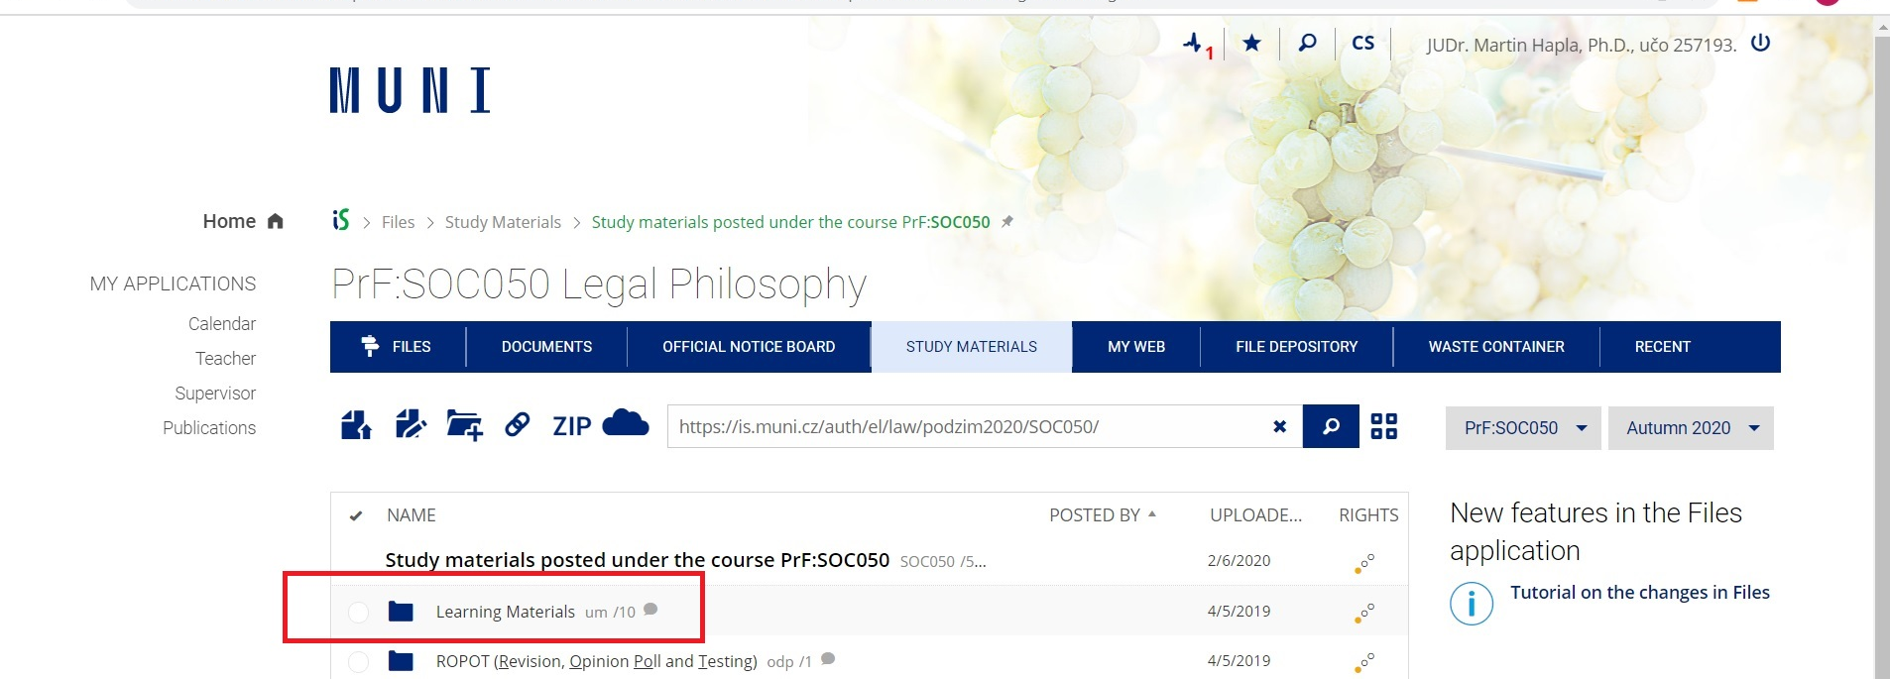
Where can I find texts and presentations?
https://is.muni.cz/auth/el/law/jaro2024/SOC050/um/?lang=en

Slide 4
What are the parts of the exam?
Online test (May 20-24)
Essay (min. 500 words)

Slide 5
Online test
The test will contain three of the following ten questions, which will be discussed in the lectures.
What is legal positivism?
What is natural law theory?
What is metaethics?
What are the main theories of normative ethics?
What is the problem of free will?
What are contemporary theories of distributive justice?
What is the truth?
What are human rights?
Can we describe the right to life as an absolute right and what does it mean?
What specific conflict of human rights or public interests can be discussed in relation to the application of biomedical (reproductive) technologies?
The test will be written online via the ROPOT application in IS MUNI in the last week of the teaching period (May 20-24).

Slide 6
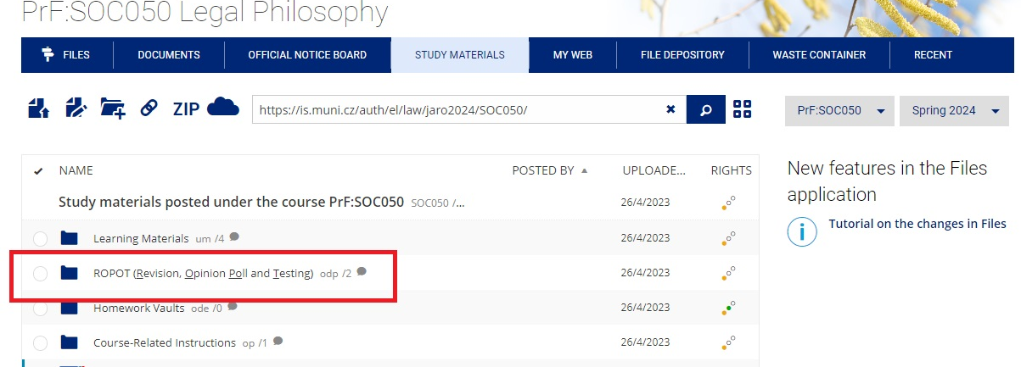
Where can I find ROPOT application?
https://is.muni.cz/auth/el/law/jaro2024/SOC050/odp/?fakulta=1422;obdobi=9283;kod=SOC050;predmet=1565793;lang=en

Slide 7
Online test evaluation
Points | Marks
9 | A
8 | B
7 | C
6 | D
5 | E
4 or less | F

Slide 8
Essay
Several questions are given on the topic of each lecture. The student chooses one topic and prepares answers to these questions in a minimum of 500 words.
This essay is uploaded to the Homework Vaults in IS MUNI no later than two days before the related lecture. The essay will serve as a basis for discussion in class.
The specific essay topic must be booked through the application available at this link: https://is.muni.cz/tudle/uoeo

Slide 9
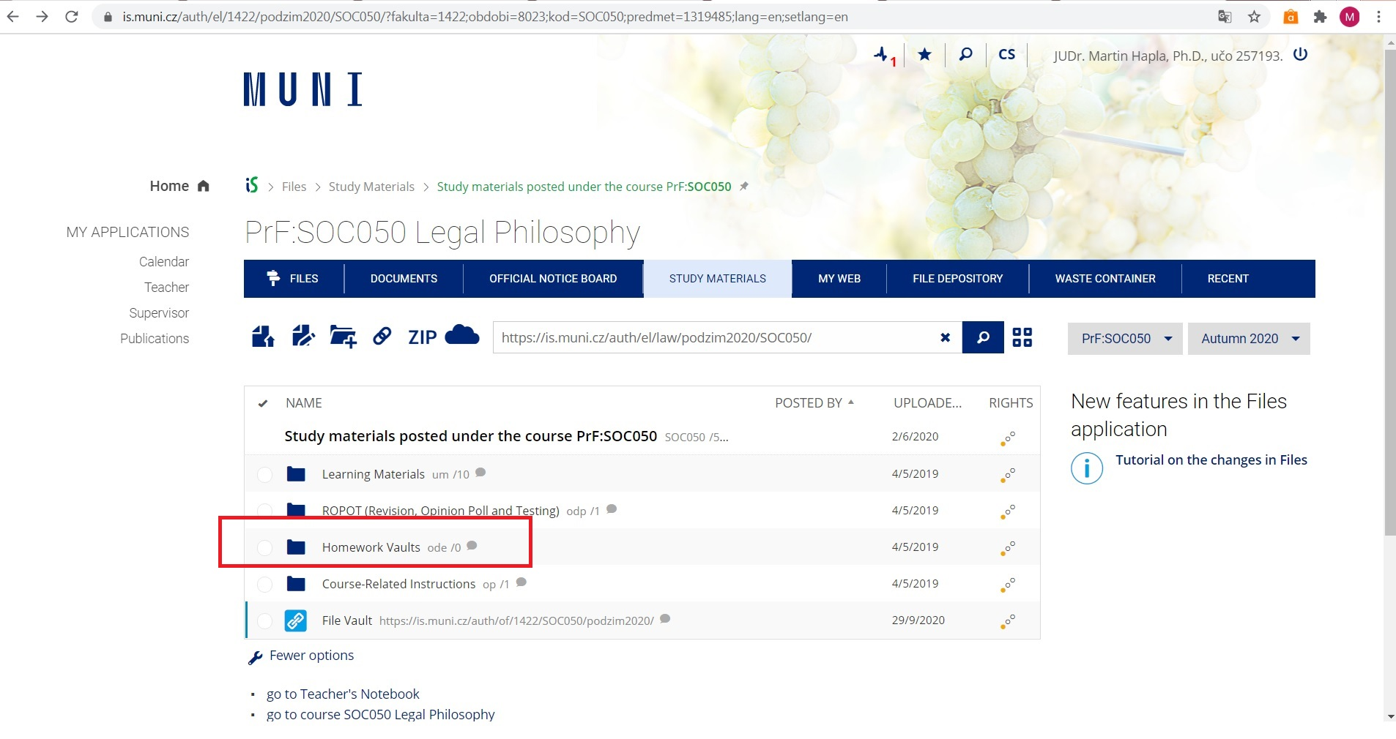
Where should I put the essay?
https://is.muni.cz/auth/el/law/jaro2024/SOC050/ode/?lang=en

Slide 10
Thank you for your attention.

