Slide 1
Internet and Free Speech (held on 2nd November 2010)
MVV60K Media Law

Slide 2
Lecturer
Mgr. Jaromír Šavelka
Institute of Law and Technology
Faculty of Law
Masaryk University
Room no. s61 (office hours Tue 14:30 – 16:30)
Email: jaromir.savelka@law.muni.cz Phone: +420 549 495 377

Slide 3
Overview of the lecture
Internet and Free Speech

Slide 4
OVERVIEW OF THE LECTURE
The Control over the Internet
Free Speech issues arising on the Internet

Slide 5
The control over the internet
Internet and Free Speech

Slide 6
The Control over the Internet Overview
Introduction to the history and workings of the Internet
„Golden Age“ of the Internet and its end (beginnings of the World Wide Web)
„Silver Age“ of the Internet (beginnings of the Internet Regulation)
Future –„Age of Steel“ at the Internet?

Slide 7
History of the Internet
„The applications of science have built man a well-supplied house, and are teaching him to live healthily therein. They have enabled him to throw masses of people against one another with cruel weapons. They may yet allow him truly to encompass the great record and to grow in the wisdom of race experience.“
VannevarBush, As WeMay Think (1945)

Slide 8
History of the Internet
First networks appear in the sixties of the 20th century
Experimental network in Great Britain (1968)
ARPANET in the USA (1969)
The development towards nowadays Internet follows
TCP/IP protocol (idea from 1973)
DNS (1984)
WWW (the proposal published in 1989)

Slide 9
History of the Internet
The Internet as we know it appears after 1993
Graphical browser MOSAIC (1992)
Netscape Communications (1993)
Netscape Navigator (1994)
Commercialization and wide introduction of the Internet
more then a billion of users (2006)

Slide 10
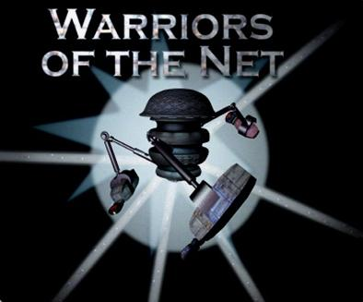
Workings of the Internet
Global system of interconnected computer networks
TCP/IP, WWW, e-mail, DNS
www.warriorsofthenet.net

Slide 11
History of the Internet
„The golden age was first; when man, yet new,
no rule but uncorrupted reason knew,
and, with a native bent, did good pursue.
Unforced by punishment, unawed by fear,
his words were simple, and his soul sincere;
Needless was written law, where none oppressed;
The law of man was written in his breast!“
PubliusOvidius Naso, Metamorphoses

Slide 12
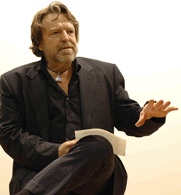
The Golden Age of the Internet
John Perry Barlow (USA)

Slide 13
The Golden Age of the Internet
John Perry Barlow
An advocate of separate legal regime for the Internet
Has popularized Internet
A co-founder of Electronic Frontier Foundation (EFF)
Has initiated the opposition agains „Communications Decency Act“
A Declaration of the Independence of Cyberspace

Slide 14
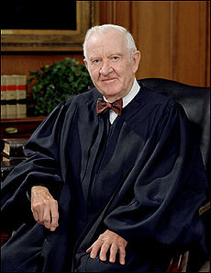
The Golden Age of the Internet
„Communication Decency Act …
… is unconstitutional!

Slide 15
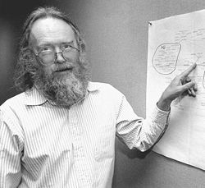
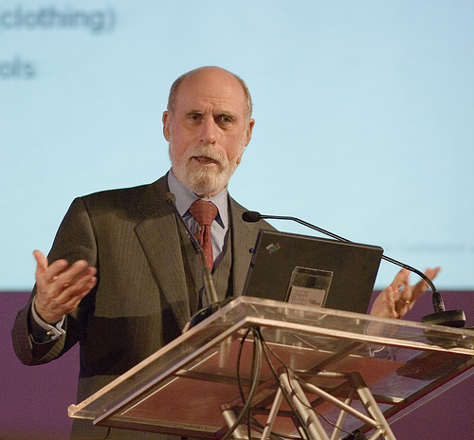
The Golden Age of the Internet
Jon Postel
Vint Cerf

Slide 16
The Golden Age of the Internet
„Founding fathers“ of the Internet – Larry Roberts, Robert Kahn, Vint Cerf, Jon Postel, Dave Clark
Academic workers sponsored by the government – engineers that have been given a task to create Internet
Authors of TCP/IP, SMTP
The originality of the Internet lies in its open, minimalistic and neutral nature
Internet Enginneering Task Force (IETF)
Decisions based on consensus

Slide 17
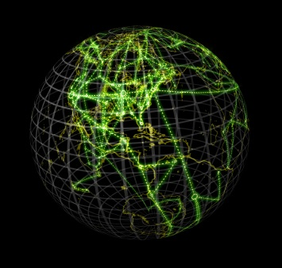
The Golden Age of the Internet
At the end of the eighties it was widely believed that the Internet has got a potential to erase national borders and substantially weaken the position of national governments.

Slide 18
History of the Internet
„Succeeding times a silver age behold, (…)
Then summer, autumn, winter did appear;
And spring was but a season of the year; (…)
And shivering mortals, into houses driven, (…)
And oxen laboured first beneath the yoke.“
PubliusOvidius Naso, Metamorphoses

Slide 19
The Silver Age of the Internet
The key point regarding the control of Internet is the management of DNS Servers (Internet Naming and Numbering Authority; root authority)
http://74.125.87.99/ = http://www.google.cz/
A domain name can be of incredible value

Slide 20
The Silver Age of the Internet
Initially the management of DNS servers had been in the hands of the „founding fathers“ – Jon Postel
Since 1990 the authority is shared with Network Solutions Inc. (NSI) – it is necessary to pay for a domain name!
The Internet turns into something the „founding fathers“ have never wanted it to be => they struggle to regain full control

Slide 21
The Silver Age of the Internet
The leader of the efforts – Vint Cerf
Internet Society (ISOC)
International Ad Hoc Committee (IAHC)
General TopLevel Domain Memorandum of Understanding (gTLD-MoU) – „MoUvement“
International Council of Registrars (CORE)

Slide 22
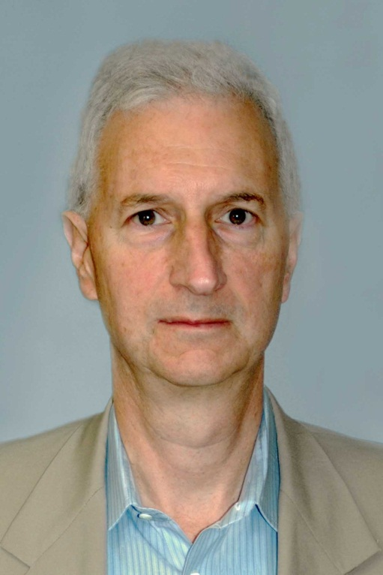
The Silver Age of the Internet
Ira Magaziner

Slide 23
The Silver Age of the Internet
Ira Magaziner
Assembled a team of negotiators and persuaded Vinton Cerf to give up MoUvement
Regularly visited IETF assemblies and eventually stopped MoUvement for good => CORE has not become the DNS authority

Slide 24
The Silver Age of the Internet
28th January1998
Hello.
As the Internet develops there are transitions in the management arrangements. The time has come to také a small step in one of those transitions. At some point on down the road it will be appropriate for the Root domain to be edited and published directly by the IANA.
As a small step in this direction we would like to have the secondaries for the Root domain pull the Root zone (by zone transfer)directly from IANA’s own name server.
This is „DNSROOT.IANA.ORG“ with address 198.32.1.98.
(…)
-jon.

Slide 25
The Silver Age of the Internet
Ira Magaziner calls Postel and informs him about the illegality of the deed
Postel claims it is just a test
Within several days the authority is returned to the servers within the control of USA
Similar „test“ would be considered a crimminal offence in the future
Jon Postel dies within 9 months

Slide 26
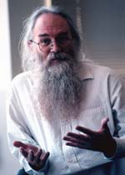
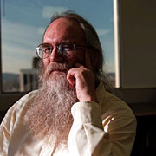
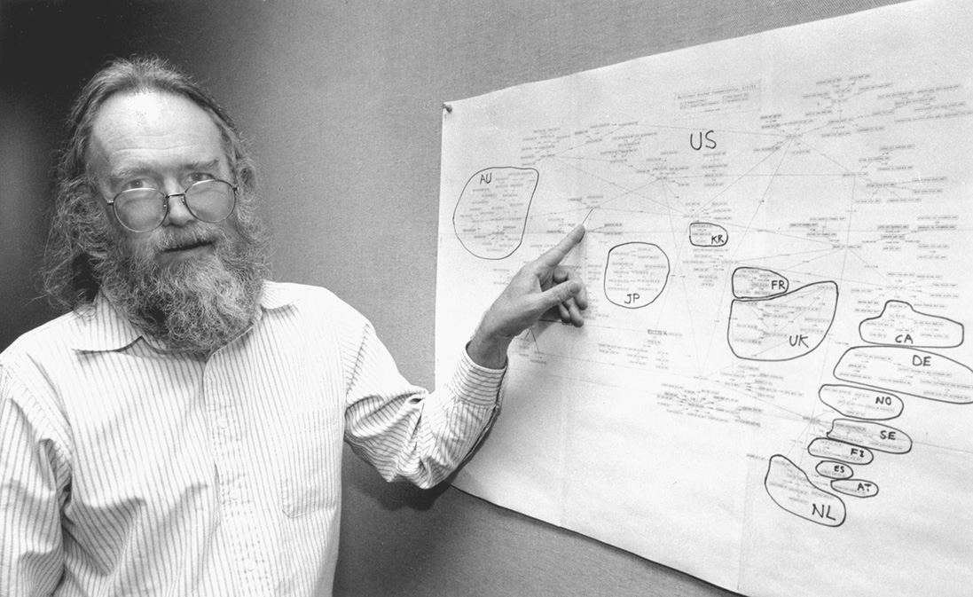
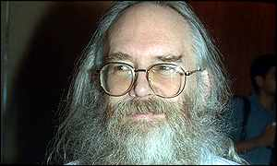
The Silver Age of the Internet
Jon Postel
(„God of the Internet“)

Slide 27
ICANN
Internet Corporation for Assigned Names and Numbers
New „root authority“
The control remained within the USA, but routine administrative tasks performed by ICANN
Opposition from Europe => an authority to over trade mark disputes transfered to WIPO

Slide 28
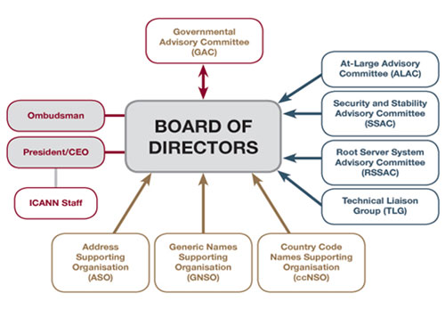
ICANN

Slide 29
ICANN
ICANN was able to accomplish for what it was initially set up:
Decentralization of domain names assignment
Substantial reduction of registration fees
An effective systém of trade mark disputes
No disturbances regarding the Internet

Slide 30
ICANN
The actual control over the Internet belongs to USA
UN struggles for the control, but unsuccessfully
The importance of the Internet is growing

Slide 31
National Borders Penetrate into the Internet
Grounds for the Internet „divide“
Languages
Geographical areas
Commerce – distribution of goods
Geolocation
„Choose your country“
Tracing packet – a list of computers visited on the way
99 % probability of correctness

Slide 32
Presence and the Future
„Hard steel succeeded then;
And stubborn as the metal were the men.
Truth, modesty, and shame, the world forsook;
Fraud, avarice, and force, their places took. (…)
Then landmarks limited to each his right;
For all before was common as a light.“
PubliusOvidius Naso, Metamorphoses

Slide 33
Thank you for your attention!
Time for your questions …
(jaromir.savelka@law.muni.cz)

