Slide 1
MVV60K Media Law Rights of Journalists

Slide 2
Restriction of speech
assessment of particular categories of speech (negative content regulation), e.g.:
indecency
protection of the state (public order)
protection of the state organs (incl. protection of the court proceedings)
regulation of elections
etc.
prior restraints (incl. general censorship)
incidental restrictions

Slide 3
Reality television – Big brother series
One of the key rationales for regulatory intervention refers to the power of broadcasting to intrude into people’s lives and to influence their lives.
Regulate such tv series?
regulate reality television?

Slide 4
Public order
Right to criticize the Government.
Castells v. Spain 23 April 1992:
In the case under review Mr Castells did not express his opinion from the senate floor, as he might have done without fear of sanctions, but chose to do so in a periodical. That does not mean, however, that he lost his right to criticize the Government.
Thorgeir Thorgeirson v. Iceland 25 June 1992:
Press as a public watchdog.
High protection of political dabates.

Slide 5
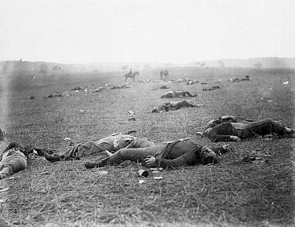
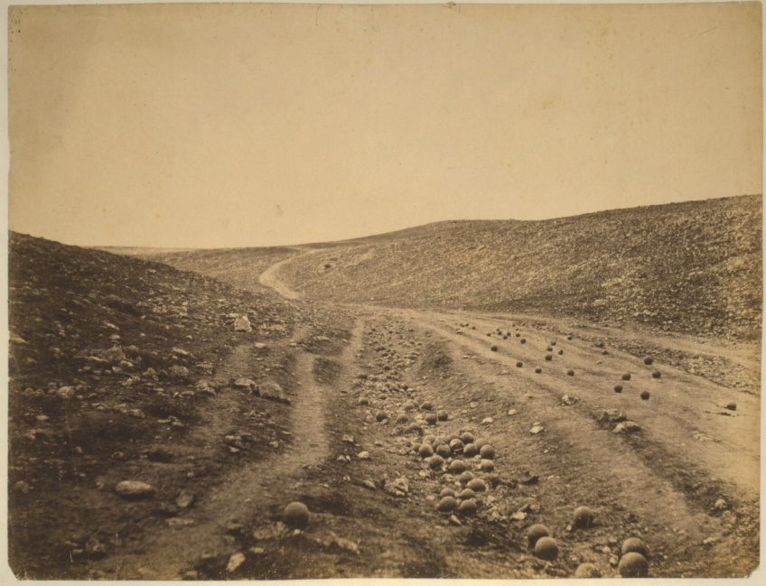
Public order – the question of war
Government propaganda
censorship
interest of people
interest of government

Slide 6
Contempt of court – problem of pretrial publicity
Should there be any restriction on the publication of matters relating to pending judicial proceedings?
The primary purpose is to ensure that a fair trial can be achieved.
Trial by media.
Scandalizing the court.
Contempt of Court Act 1981 (U.K.)
strict liability
Australia, New Zealand:
A finding of contempt… depends upon proof that the publication has, as a matter of practical reality, a real (or clear) and definite tendency to interfere with the administration of justice, that is, to prejudice a fair trial.

Slide 7
Contempt of court – U.S.A.
The general rule is that a publication cannot be punished for contempt unless there is a “clear and present danger” to the administration of justice.
Sheppard v. Maxwell 384 US 333 (1966):
A responsible press has always been regarded as the handmaiden of effective judicial administration, especially in the criminal field. Its function in this regard is documented by an impressive record of service over several centuries. The press does not simply publish information about trials but guards against the miscarriage of justice by subjecting the police, prosecutors, and judicial processes to extensive public scrutiny and criticism.
[l]egal trials are not like elections, to be won through the use of the meeting-hall, the radio, and the newspaper.

Slide 8
Contempt of court – Czech Republic – Criticizing the Court
IV. ÚS 23/05
In other words, each broadcaster, in connection with any programme broadcast, may claim protection by referring to the fundamental right to free expression, be it a political broadcast, a review programme addressing issues of public interest, or artistic and entertainment programming.
The petitioner is a journalist, the secondary party is a judge, and their professional honour is thus located within a sphere of involvement which is public, and that is why openness of information should apply to it. Reasoning on the impossibility of separating personal and professional lives cannot grant a judge any immunity against public interest in the judge's professional qualifications for holding such an office.

Slide 9
Prior restraints
Prior restraint in acts of expression, hindering the matters of expression, such as publication of newspapers, magazines and other publications and broadcasts, etc. from reaching free society, shutting the door on communication of its contents to readers or viewers, or delaying the communication and thus destroying its significance has the effect of reducing the opportunities for public criticism. Moreover, due to characteristics of prior control being such that it can not be but presupposed, it easily becomes more far-reaching than after-the-fact sanctions, and in addition to the possibility of its abuse, it is considered to have a more deterrent effect, in reality, than after-the-fact sanctions. Therefore ... prior restraint on acts of expression is allowed only under strict and definite requirements. (Japan; Constitutionality of prior restraint of a magazine 11 June 1986, Case No. 609 of 1981 (Supreme Court))
The dangers inherent in prior restraints are such that they call for the most careful scrutiny. [...] This is especially so as far as the press is concerned, for news is a perishable commodity and to delay its publication, even for a short period, may well deprive it of all its value and interest. (U.K.; Douglas and Others v. Hello! Limited 21 December 2000, 2001 2 All ER 289)
9

Slide 10
Prior Restraints
„Spycatcher Case“ (Observer and Guardian v. U.K.):
The dangers inherent in prior restraints are such that they call for the most careful scrutiny on the part of the Court. This is especially so as far as the press is concerned, for news is a perishable commodity and to delay its publication, even for a short period, may well deprive it of all its value and interest.
„Pentagon Papers“ (New York Times Co. v. United States):
Any system of prior restraints of expression comes to this Court bearing a heavy presumption against its constitutional validity" ... The Government "thus carries a heavy burden of showing justification for the imposition of such a restraint.

Slide 11
Incidental restrictions
The judicial character of the system of registration is a valuable safeguard of freedom of the press. However, the decisions given by the national courts in this area must also conform to the right to freedom of expression. The Court observes that in the present case this in itself did not prevent the courts from imposing a prior restraint on a printed media in a manner which entailed a ban on publication of entire periodicals on the basis of their titles. (Gaweda v. Poland)
An award of damages for defamation must bear a reasonable relationship of proportionality to the injury to reputation suffered. (Tolstoy Miloslavsky v. U.K.)
Costs of legal proceedings. (Campbell v. MGN Limited [2004] UKHL 22 – MGN Ltd. v U.K.)
11

Slide 12
Journalists
Who is journalist? Do we need any specific definition?
Switzerland: two years of prior experience in the media sector and the completion of a nine-week academic training course.
Greece: the conditions and qualifications requisite for the practice of the profession of journalist shall be specified by law. (Constitution; 14-8).
Spain, Italy: journalists entering the profession are required to pass an examination.
Journalists in social media…?

Slide 13
Journalists
Mark MADDEN. TITAN SPORTS, INC., v. TURNER BROADCASTING SYSTEMS, INC. (1998)
To summarize, we hold that individuals claiming the protections of the journalist's privilege must demonstrate the concurrence of three elements: that they:
1) are engaged in investigative reporting;
2) are gathering news; and
3) possess the intent at the inception of the newsgathering process to disseminate this news to the public.
Martha von BULOW, v. Claus von BULOW (1987)
On rare occasions the journalist's privilege has been invoked successfully by persons who are not journalists in the traditional sense of that term. In Silkwood v. Kerr-McGee Corp., 563 F.2d 433 (10 Cir.1977), the court was called upon to determine whether a documentary film maker, a third-party witness, was protected by a privilege from revealing confidential sources in his deposition. The witness was a film maker who organized a production company for the purpose of making a film having to do with the events surrounding the death of Karen Silkwood. The defendants sought to depose the film maker and, in connection with his deposition, subpoenaed documents and writings in connection with the film maker's investigation. The film maker appeared for the deposition but, invoking his First Amendment privilege, refused to answer questions which called for the disclosure of information given to him under agreements of confidentiality. The district court denied protective relief to the film maker. The Tenth Circuit first considered the effect on the validity of the journalist's privilege where the witness was not a regular newsman. It concluded that the fact that the film maker was not a salaried newspaper reporter did not, in and of itself, deprive him of the right to seek protective relief. The court therefore reversed the district court. The court reasoned that: "His mission in this case was to carry out investigative reporting for use in the preparation of a documentary film. He is shown to have spent considerable time and effort in obtaining facts and information of the subject of this lawsuit, but it cannot be disputed that his intention, at least, was to make use of this in preparation of the film."

Slide 14
Compulsory Membership in Associations
Costa Rica:
[J]ournalism is the primary and principal manifestation of freedom of expression of thought. For that reason, because it is linked with freedom of expression, which is an inherent right of each individual, journalism cannot be equated to a profession that is merely granting a service to the public through the application of some knowledge or training acquired in a university or through those who are enrolled in a certain professional „colegio“.
Canada:
Since the accreditation scheme operates as a restriction of article 19 rights, its operation must be shown as necessary and proportionate to the goal in question and not arbitrary. The Committee does not accept that this is a matter exclusively for the State to determine. The relevant criteria for the accreditation system should be specific, fair and reasonable, and their application should be transparent.
Sweden:
The purpose of the website as it is stated on the aforementioned and as have been unfolded by [the defendant] must in light of the circumstances be understood to fall within the ambit of a journalistic purpose to inform, exercise criticism and instigate debate on societal issues of importance for the general public.

Slide 15
Journalist as a public figure
Constitutional court (I.ÚS 453/03):
…of course, the arts, including journalistic activities and show business, and everything which attracts public attention, are also a public matter.
…journalist, is subject to heightened scrutiny, and must bear possible criticism for his opinions and positions;

Slide 16
Protection of sources - ECHR
Goodwin v. United Kingdom
Protection of journalistic sources is one of the basic conditions for press freedom as is reflected in the laws and professional codes of conduct in a number of Contracting States and is affirmed in several international instruments on journalistic freedoms. Without such protection, sources may be deterred from assisting the press in informing the public on matters of public interest. As a result, the vital public-watchdog role of the press may be undermined and the ability of the press to provide accurate and reliable information may be adversely affected. Having regard to the importance of the protection of journalistic sources for press freedom in a democratic society and the potential chilling effect an order of source disclosure has on the exercise of that freedom, such a measure cannot be compatible with Article 10 unless it is justified by an overriding requirement in the public interest.

Slide 17
Disclosure of journalists´ sources
Austria - Federal Act on the Press and other Publication Media (Media Act):
Protection of editorial confidentiality (§ 31)
(1) Media owners, editors, copy editors and employees of a media undertaking or media service as witnesses in a proceeding before court or an administrative authority have the right to refuse answering questions concerning the person of an author, sender or source of articles and documentation or any information obtained for their profession.
(2) The right as stated in para 1 must not be by-passed by requesting the person enjoying this right to surrender documents, printed matter, image, sound or data carriers, illustrations or other representations of such contents or confiscating them.
(3) The extent to which tapping of telecommunications of subscribers who are media undertakings or optical and acoustical observation of persons with technical devices on premises of a media undertaking are admissible, is governed by the Code of Criminal Procedure.

Slide 18
Sweden – Freedom of the Press Act
(Chapter 3) Art. 5. A person who, whether through negligence or by deliberate intent, inserts in printed matter the name, pseudonym or pen-name of the author, or, in a case under Article 1, the editor or source, against his wishes, or disregards a duty of confidentiality under Article 3, shall be sentenced to pay a fine or to imprisonment for up to one year. The same penalty shall apply to a person who, whether through negligence or by deliberate intent, publishes in printed matter as that of the author, editor or source, the name, pseudonym or pen-name of a person other than the true author, editor or source.

Slide 19
Protection of sources - Lithuania
THE CONSTITUTIONAL COURT OF THE REPUBLIC OF LITHUANIA:
The disclosure of information identifying a source should not be deemed necessary unless it can be convincingly established that the legitimate interest in the disclosure clearly outweighs the public interest in the non-disclosure. Where journalists respond to a request or order to disclose information identifying a source, the competent authorities should consider applying measures to limit the extent of a disclosure.

Slide 20
Protection of sources – U.S.A.
BRANZBURG v. HAYES (1972)
We are asked to create another by interpreting the First Amendment to grant newsmen a testimonial privilege that other citizens do not enjoy. This we decline to do. Fair and effective law enforcement aimed at providing security for the person and property of the individual is a fundamental function of government, and the grand jury plays an important, constitutionally mandated role in this process. On the records now before us, we perceive no basis for holding that the public interest in law enforcement and in ensuring effective grand jury proceedings is insufficient to override the consequential, but uncertain, burden on news gathering that is said to result from insisting that reporters, like other citizens, respond to relevant questions put to them in the course of a valid grand jury investigation or criminal trial.
Solers, Inc. v. Doe (2009)
When presented with a motion to quash (or to enforce) a subpoena which seeks the identity of an anonymous defendant, the court should:
(1) ensure that the plaintiff has adequately pleaded the elements of the defamation claim,
(2) require reasonable efforts to notify the anonymous defendant that the complaint has been filed and the subpoena has been served,
(3) delay further action for a reasonable time to allow the defendant an opportunity to file a motion to quash,
(4) require the plaintiff to proffer evidence creating a genuine issue of material fact on each element of the claim that is within its control, and
(5) determine that the information sought is important to enable the plaintiff to proceed with his lawsuit.

Slide 21
Question of sources
Elton John v. Express Newspapers plc (2000):
So that journalists can effectively discharge their right indeed their duty to expose wrongdoing, abuse, corruption and incompetence in all aspects of central and local government and of business, industry, the professions and all aspects of society, they have to receive information including confidential information from a variety of sources including seedy sources and disloyal sources.

Slide 22
Investigative Journalism
CUMPĂNĂ AND MAZĂRE v. ROMANIA:
…the Court would point out that the role of investigative journalists is precisely to inform and alert the public about such undesirable phenomena in society as soon as the relevant information comes into their possession.
RUMYANA IVANOVA v. BULGARIA:
… the applicant had still not adequately verified the facts from reliable sources and had thus failed to comply with the customary rules of investigative journalism, publishing facts which she knew or ought to have known were dubious (see paragraphs 26 and 30 above). The Court sees no reason to hold otherwise. Nor does it consider that the applicant was dispensed on other grounds from properly verifying her information.

