Slide 1
MVV60K
Media Law
Freedom of Speech

Slide 2
Role of mass media in society
Mass media influence society and people…
  but we do not know how.
    reason for regulation
Media can help understand specific issues in society.
Media can help not to understand specific issues in society.
Public debates on a political question of general importance.
  What is in public interest?
  Entertainment – infotainment…
  Is there anyone who wants to speak?

Slide 3
Stereotypes – responsibility of media
When they are not under-represented or invisible, women are often represented in the media in roles traditionally assigned by society, portrayed as passive and lesser beings, mothers or sexual objects. These sexist stereotypes in the media perpetuate a simplistic, immutable and caricatured image of women and men, legitimising everyday sexism and discriminatory practices and establishing a barrier to gender equality.
The media, a vital constituent of democracy, have a particular responsibility in this field to promote respect for human dignity, the fight against all forms of discrimination and equality between women and men.
Reference to Committee : Doc. 11714, Reference 3492 of 3 October 2008. „Combating sexist stereotypes in the media“

Slide 4
Marketplace idea – U.S.A. - Competition of ideas
„Persecution for the expression of opinions seems to me perfectly logical. If you have no doubt of your premises or your power and want a certain result with all your heart you naturally express your wishes in law and sweep away all opposition. To allow opposition by speech seems to indicate that you think the speech impotent, as when a man says that he has squared the circle, or that you do not care whole heartedly for the result, or that you doubt either your power or your premises. But when men have realized that time has upset many fighting faiths, they may come to believe even more than they believe the very foundations of their own conduct that the ultimate good desired is better reached by free trade in ideas-that the best test of truth is the power of the thought to get itself accepted in the competition of the market, and that truth is the only ground upon which their wishes safely can be carried out.“ (Abrams v. United States/Dissent Holmes)
The classroom is peculiarly the „marketplace of ideas“. The Nation's future depends upon leaders trained through wide exposure to that robust exchange of ideas which discovers truth 'out of a multitude of tongues, [rather] than through any kind of authoritative selection. (512) Tinker v. Des Moines School District

Slide 5
Marketplace - Europe
Importance of the free press
The Court emphasises that the promotion of free political debate is a very important feature of a democratic society. It attaches the highest importance to the freedom of expression in the context of political debate and considers that very strong reasons are required to justify restrictions on political speech. Allowing broad restrictions on political speech in individual cases would undoubtedly affect respect for the freedom of expression in general in the State concerned. (FELDEK v. SLOVAKIA)

Slide 6
Freedom of speech (expression)
Includes the right to express opinions, right to receive and impart information and to share such information.
  [The right] guarantees not only the freedom of the press to inform the public but also the right of the public to be properly informed. (Sunday Times v. U.K. 1979)
Open definition of the content of this right.
Limited through „non laedere“ - no one shall restrict anyone else.
Can be restraint by law.
The state shall not disturb anyone who realizes his/her freedom of expression.
No one is obliged to help to promote anyone's expression.
FoE has many aspects.

Slide 7
Convention for the Protection of Human Rights and Fundamental Freedoms – Article 10
1. Everyone has the right to freedom of expression. This right shall include freedom to hold opinions and to receive and impart information and ideas without interference by public authority and regardless of frontiers. This Article shall not prevent States from requiring the licensing of broadcasting, television or cinema enterprises.
2. The exercise of these freedoms, since it carries with it duties and responsibilities, may be subject to such formalities, conditions, restrictions or penalties as are prescribed by law and are necessary in a democratic society, in the interests of national security, territorial integrity or public safety, for the prevention of disorder or crime, for the protection of health or morals, for the protection of the reputation or rights of others, for preventing the disclosure of information received in confidence, or for maintaining the authority and impartiality of the judiciary.

Slide 8
[F]reedom of expression [...] constitutes one of the essential foundations of a democratic society and one of the basic conditions for its progress and for each individual's self-fulfilment. Subject to [restrictions] it is applicable not only to "information" or "ideas" that are favourably received or regarded as inoffensive or as a matter of indifference, but also to those that offend, shock or disturb; such are the demands of that pluralism, tolerance and broadmindedness without which there is no "democratic society". Article 10 protects not only the substance of the ideas and information expressed, but also the form in which they are conveyed. (Oberschlick v. Austria)

Slide 9
Universal Declaration of Human Rights – Article 19.
Everyone has the right to freedom of opinion and expression; this right includes freedom to hold opinions without interference and to seek, receive, and impart information and ideas through any media and regardless of frontiers

Slide 10
International Covenant on Civil and Political Rights – Article 19
1. Everyone shall have the right to hold opinions without interference.
2. Everyone shall have the right to freedom of expression; this right shall include freedom to seek, receive and impart information and ideas of all kinds, regardless of frontiers, either orally, in writing or in print, in the form of art, or through any other media of his choice.
3. The exercise of the rights provided for in paragraph 2 of this article carries with it special duties and responsibilities. It may therefore be subject to certain restrictions, but these shall only be such as are provided by law and are necessary:
(a) For respect of the rights or reputations of others;
(b) For the protection of national security or of public order (ordre public), or of public health or morals.

Slide 11
Expression
All verbal or non-verbal form s of communication by which is communicated some idea or opinion.
Symbolical expression:
  In deciding whether particular conduct possesses sufficient communicative elements to bring the First Amendment into play, we have asked whether "[a]n intent to convey a particularized message was present, and [whether] the likelihood was great that the message would be understood by those who viewed it. [Texas v. Johnson, 491 U.S. 397 (1989)]
„Right not to speak“ [West Virginia State Board of Education v. Barnette, 319 U.S. 624 (1943)]
free commercial speech [Casado Coca v. Spain]
Facts
Untrue statements
  False information is not a value worth protecting with respect to the freedom of expression. The deliberate expression of false facts is not protected. (CSU-NPD-decision (Wahlkampf case) BVerfGE 61, 1, 1 BvR 1376/79 of June 22, 1982
  even if there is no proof of the existence of the facts ... no crime of defamation was committed because of the absence of mens rea, when the publisher believed mistakenly in the existence of the facts and there was good reason for his mistaken belief on the basis of reliable information and grounds. (Japan; Katsuyoshi Kawachi (Judgment upon a case of defamation) 25 June 1969, Case Number (A) No. 2472 of 1966

Slide 12
Expression - ECHR
„information“ or „ideas“ that are favorably received or regarded as inoffensive or as a matter of indifference.
information or ideas that offend, shock or disturb the State or any sector of the population
„Expression“ is not restricted to verifiable, factual data, but also includes opinions, criticism and speculation, whether or not they are objectively „true“
political expressions
artistic expressions
commercial expressions
An extensive range of media for the production, transmission and distribution of information and ideas, including speech, print, radio and television broadcasting, artistic creations, film and electronic information systems, are protected.

Slide 13


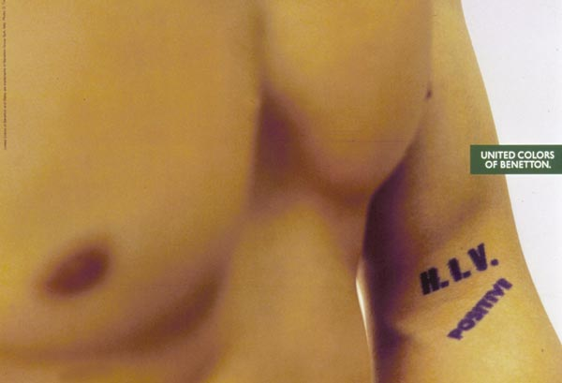

Expressions

Slide 14
Expression - ECHR
Written and spoken words (especially newspapers)
Television and radio broadcasting
Other symbols (peace symbol)
Non-verbal acts of protest
Clothes
Paintings
Video records
Cinematography

Slide 15
Restraints of freedom of expression I.
Provided by law:
  Firstly, the law must be adequately accessible: the citizen must be able to have an indication that is adequate in the circumstances of the legal rules applicable to a given case.
  Secondly, a norm cannot be regarded as a "law" unless it is formulated with sufficient precision to enable the citizen to regulate his conduct: he must be able - if need be with appropriate advice - to foresee, to a degree that is reasonable in the circumstances, the consequences which a given action may entail. Those consequences need not be foreseeable with absolute certainty: experience shows this to be unattainable.
The Sunday Times v. The United Kingdom - 26 April 1979, Application No. 6538/74

Slide 16
Restraints of freedom of expression II.
Legitimate aim
  In cases concerning the press, the national margin of appreciation is circumscribed by the interest of democratic society in ensuring and maintaining a free press. Similarly, that interest will weigh heavily in the balance in determining, as must be done under paragraph 2 of Article 10, whether the restriction was proportionate to the legitimate aim pursued. (Thoma v. Luxembourg, 2001)
Necessary in a democratic society
  The test of "necessity in a democratic society" requires the Court to determine whether the "interference" complained of corresponded to a "pressing social need", whether it was proportionate to the legitimate aim pursued and whether the reasons given by the national authorities to justify it are relevant and sufficient. (Feldek v. Slovakia, 2001)

Slide 17
Tests – Supreme court of the U.S.A.
Bad tendency doctrine
  Whitney v. California 274 U.S. 357 (1927)
  It is a fundamental principle, long established, that the freedom of speech and of the press which is secured by the Constitution, does not confer an absolute right to speak or publish, without responsibility, whatever one may choose, or an unrestricted and unbridled license that gives immunity for every possible use of language and prevents the punishment of those who abuse this freedom. […] It does not protect publications or teachings which tend to subvert or imperil the government or to impede or hinder it in the performance of its governmental duties. Gitlow v. New York (1925)
Clear and present danger doctrine
  I do not doubt for a moment that by the same reasoning that would justify punishing persuasion to murder, the United States constitutionally may punish speech that produces or is intended to produce a clear and imminent danger that it will bring about forthwith certain substantive evils that the United States constitutionally may seek to prevent. The power undoubtedly is greater in time of war than in time of peace because war opens dangers that do not exist at other times. ABRAMS v. U S, Holmes dissenting
Imminent lawless action
Preferred position doctrin
17

Slide 18
Tests– Supreme court of the U.S.A.
Schenck v. United States 249 U.S. 47 (1919)
„The question in every case is whether the words used are used in such circumstances and are of such a nature as to create a clear and present danger that they will bring about the substantive evils that Congress has a right to prevent. It is a question of proximity and degree.“
Brandenburg v. Ohio 395 U.S. 444 (1969)
„[T]he constitutional guarantees of free speech and free press do not permit a State to forbid or proscribe advocacy of the use of force or of law violation except where such advocacy is directed to inciting or producing imminent lawless action and is likely to incite or produce such action.“
Important is the content.
18

Slide 19
Fighting Words
Chaplinsky v. New Hampshire 315 U.S. 568 (1941)
  It is well understood that the right of free speech is not absolute at all times and under all circumstances. For example, lewd or obscene speech, profane or libelous speech may legitimately be limited. This also included 'fighting words': [Words] which by their very utterance inflict injury or tend to incite an immediate breach of the peace.
R.A.V. v. City of St. Paul 505 U.S. 377 (1992)
  Although the phrase in the ordinance, "arouses anger, alarm or resentment in others," has been limited by the Minnesota Supreme Court's construction to reach only those symbols or displays that amount to "fighting words," the remaining, unmodified terms make clear that the ordinance applies only to "fighting words" that insult, or provoke violence, "on the basis of race, color, creed, religion or gender." Displays containing abusive invective, no matter how vicious or severe, are permissible unless they are addressed to one of the specified disfavored topics. Those who wish to use "fighting words" in connection with other ideas - to express hostility, for example, on the basis of political affiliation, union membership, or homosexuality - are not covered. The First Amendment does not permit St. Paul to impose special prohibitions on those speakers who express views on disfavored subjects.
19

Slide 20
Restriction of speech
assessment of particular categories of speech (negative content regulation), e.g.:
  indecency
  protection of the state (public order)
  protection of the state organs (incl. protection of the court proceedings)
  regulation of elections
  etc.
prior restraints (incl. general censorship)
incidental restrictions

Slide 21
Obscenity, indecency,… in Europe
Handyside v. the United Kingdom 7 December 1976:
  In particular, it is not possible to find in the domestic law of the various Contracting States a uniform European conception of morals. The view taken by their respective laws of the requirements of morals varies from time to time and from place to place, especially in our era which is characterised by a rapid and far-reaching evolution of opinions on the subject. By reason of their direct and continuous contact with the vital forces of their countries, State authorities are in principle in a better position than the international judge to give an opinion on the exact content of these requirements as well as on the "necessity" of a "restriction" or "penalty" intended to meet them.
Open Door Counselling Ltd. and Dublin Well Woman v. Ireland (1992):
  This can be a political question.

Slide 22
Obscenity, indecency,… in Europe and elsewhere
"A ver" Case (Spain):
  public morality -- as a shared ethical component of social life -- is liable to take different forms across different periods and in different countries and is conventionally not immutable from a social point of view.
Korea:
  Obscenity is a sexually blatant and undisguised expression that distorts human dignity or humanity. It only appeals to prurient interests and, if taken as a whole, does not possess any literary, artistic, scientific, or political value.

Slide 23
Obscenity, indecency,… in the Europe
Obscene Publications Act 1959 (U.K.):
  For the purposes of this Act an article shall be deemed to be obscene if its effect or (where the article comprises two or more distinct items) the effect of any one of its items is, if taken as a whole, such as to tend to deprave and corrupt persons who are likely, having regard to all relevant circumstances, to read, see or hear the matter contained or embodied in it.
Czech Republic:
  IV. ÚS 606/03
  Incidence on person with common feelings
  question of art

Slide 24
Protection of youth and infancy
Council Directive 89/552/EEC (Television without frontiers).
  Article 22: Member States shall take appropriate measures to ensure that television broadcasts by broadcasters under their jurisdiction do not include programmes which might seriously impair the physical, mental or moral development of minors, in particular those that involve pornography or gratuitous violence. This provision shall extend to other programmes which are likely to impair the physical, mental or moral development of minors, except where it is ensured, by selecting the time of the broadcast or by any technical measure, that minors in the area of transmission will not normally hear or see such broadcasts.
Case E-8/97:
  The exception in the second sentence of Article 22, first paragraph does not extend to programmes 'which might seriously impair the physical, mental or moral development of minors` dealt with in the first sentence of Article 22, first paragraph.

Slide 25
Obscenity, indecency,… in the U.S.A.
JACOBELLIS v. OHIO, 378 U.S. 184 (1964):
  … I imply no criticism of the Court, which in those cases was faced with the task of trying to define what may be indefinable. I have reached the conclusion, which I think is confirmed at least by negative implication in the Court's decisions since Roth and Alberts, that under the First and Fourteenth Amendments criminal laws in this area are constitutionally limited to hard-core pornography. I shall not today attempt further to define the kinds of material I understand to be embraced within that shorthand description; and perhaps I could never succeed in intelligibly doing so. But I know it when I see it, and the motion picture involved in this case is not that.

Slide 26
Obscenity, indecency,… in the U.S.A.
Miller v. California 413 U.S. 15 (1973):
  Taken as a whole, appeals to the prurient interest in sex; portrays, in a patently offensive way, sexual conduct specifically defined by the applicable state law; and, taken as a whole, does not have serious literary, artistic, political or scientific value.
  (a) whether "the average person, applying contemporary community standards" would find that the work, taken as a whole, appeals to the prurient interests; (b) whether the work depicts or describes, in a patently offensive way, sexual conduct specifically defined by the applicable state law; and (c) whether the work, taken as a whole, lacks serious literary, artistic, political or scientific value.

Slide 27
Obscenity, indecency,… in the U.S.A.
UNITED STATES v. ONE BOOK CALLED "ULYSSES„:
  The reputation of "Ulysses" in the literary world, however, warranted my taking such time as was necessary to enable me to satisfy myself as to the intent with which the book was written, for, of course, in any case where a book is claimed to be obscene it must first be determined, whether the intent with which it was written was what is called, according to the usual phrase, pornographic, that is, written for the purpose of exploiting obscenity. If the conclusion is that the book is pornographic, that is the end of the inquiry and forfeiture must follow. But in "Ulysses," in spite of its unusual frankness, I do not detect anywhere the leer of the sensualist. I hold, therefore, that it is not pornographic.

Slide 28
Reality television – Big brother series
One of the key rationales for regulatory intervention refers to the power of broadcasting to intrude into people’s lives and to influence their lives.
Regulate such tv series?
  regulate reality television?

Slide 29
Public order
Right to criticize the Government.
Castells v. Spain 23 April 1992:
  In the case under review Mr Castells did not express his opinion from the senate floor, as he might have done without fear of sanctions, but chose to do so in a periodical. That does not mean, however, that he lost his right to criticize the Government.
Thorgeir Thorgeirson v. Iceland 25 June 1992:
  Press as a public watchdog.
  High protection of political dabates.

Slide 30
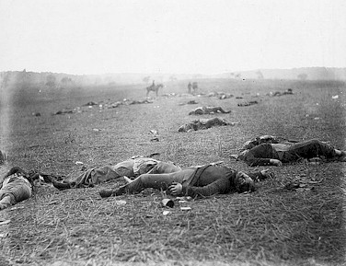
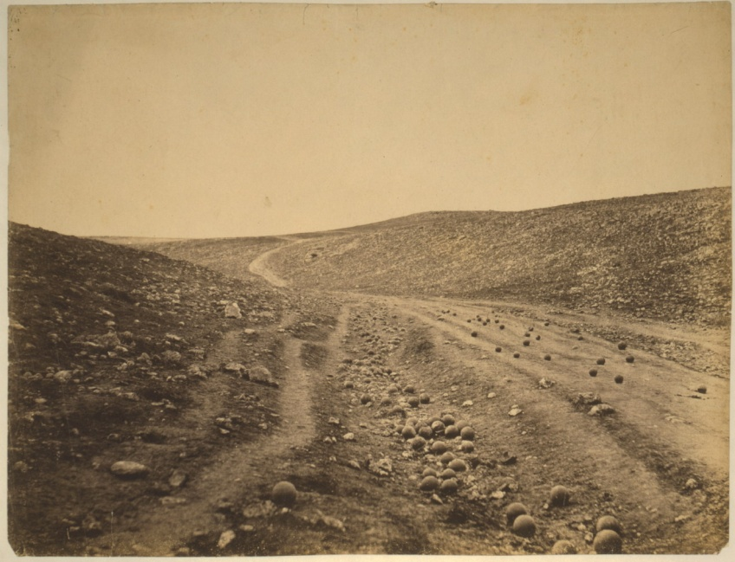
Public order – the question of war
Government propaganda
censorship
interest of people
interest of government

