Slide 1

Res incorporalis and the debate about the materiality of the object of property in the light of Roman-law tradition
Wojciech Dajczak
Adam Mickiewicz University, Poznań

Slide 2
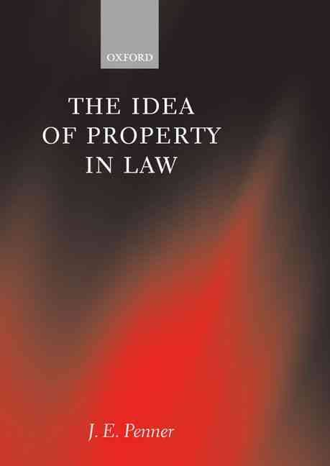
The object of property – a hard question
„Most persons familiar with philospohical treaties on property are never faced with the task of thinking about why some things are objects of property and others are not. Typically, phisosophical works purporting to concern property start with a kind of justibiable evasion of this task”.

Slide 3
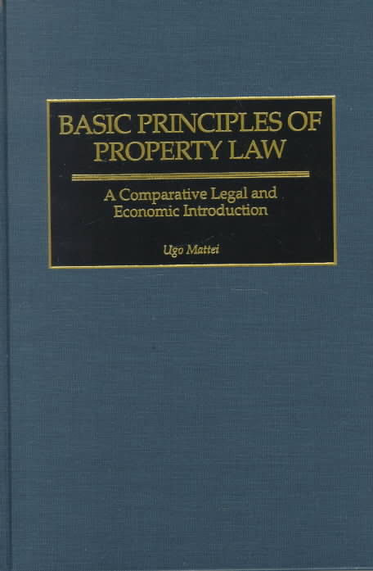
The object of property – a hard question
„Possibly in no area of the law does one find more diveristy among legal systems than in the domain that we may call <the object of property>”

Slide 4
The object of property – a hard question
Flemming v. Nestor 363 US (603) 1960)
Is the termination of benefits from the Social Seciurity program the case of a deprivation of property?
„The New Property”

Slide 5
The object of property – a hard question
The New Property
” As social or economic conditions change, elements of the existing conceptual apparatus of legal analysis become increasingly strained and eventually are unable to accomodate the new phenomena”
„ The political foundations of the new property idea are essentially those of the conventional or common-law conception of property, stripped of its formalistic dressing”
Gregory s. Alexander, The Concept of Property in Private ans Constitutional Law: The Ideology of Scientific Turn in Legal Analysis (CAL)

Slide 6
The object of property – a hard question
Res, Sache, bien/chose, věc, thing
proprietas, Eigentum, propriété, vlastnictví, property

Slide 7
The object of property – a hard question
Art. 45 Pol. CC Things in the meaning of this code are only corporeal objects
Par. 496 Cz.CC (1) Tangible thing is to handle part of the external world, which is the subject of a separate nature (2) Intangible things are right, the nature of it admits, and other things without physical substance

Slide 8
Division into tangible and intangible things in Roman legal sources
res corporales and res incorporales
G. 2,12 – 14 = EG 2,1,2
PS 3,6,11; UE 19,11;
I. 2,20,21
D.1,8,1

Slide 9
Roman law and the materiality of the object of property
Roman law – res corporales
German civil code
The perception of Roman law by modern experts in civil law – „limitation of thing as an object of property to material objects is a result of the impact made by the Roman law”.

Slide 10
Fundamental questions
- how important was the theoretical distinction of the materiality quality in the ancient Roman law for the idea of property ?
- what were the basic results of the division into res corporales and incorporales in the ius commune for the forming of fundamental notions of property law as bien in France or Sache in Germany and for development of dogmatic ideas of what may constitute the object of property ?

Slide 11
The meaning of division into res corporales and incorporales in the ancient Roman law
A. Seneca (Epist. 58,11)
        Corporalis
Quod est
        Incorporalis
A. Seneca
Epist. 58,11
Quintilianus
Inst. orat. 5,116
Gaius
Institutines
2,12

Slide 12
The meaning of division into res corporales and incorporales in the ancient Roman law
G. 1,12 – 14
Estate
res corporales
res incorporales

Slide 13
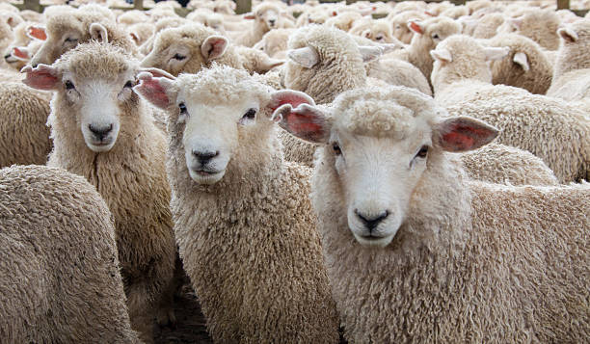
The meaning of division into res corporales and incorporales in the ancient Roman law
Pomponius , libro 30 Ad Sabinum (D.41,3,30pr.)
Corpus as the object of property
- uno spiritu
- quod ex contingentibus
- quod ex distantibus constat

Slide 14
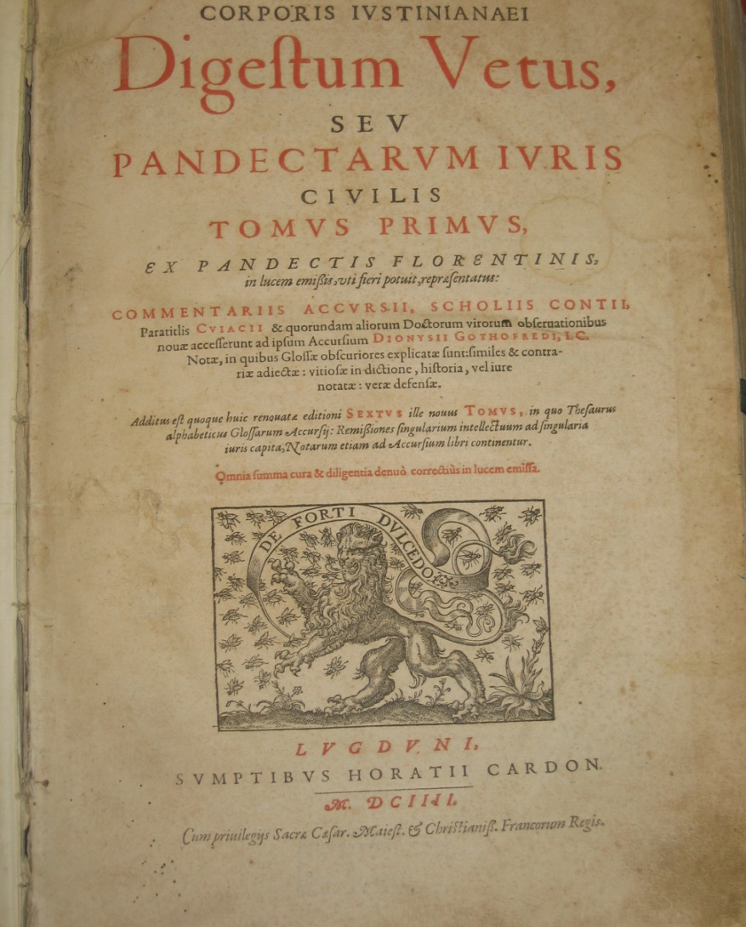
The issue of relation between res corporales and incorporales
The opposition model
Coordination
Model

Slide 15
The issue of relation between res corporales and incorporales – oppostion model
Gl. ad D.1,8,1,1 <nam> the purpose of this conujunction in to stress the difference between res incorporales (right to use) and res corporales (material objects that can be gained, e.g. fruits)
French legal humanism (16th century) – an idea of the „unreality” of res incorporales
German pandectistic and interpretation of BGB (19th-20th centuries) - the notion of res corporales as legitimization the limitation of objects of property to material objects.

Slide 16
The issue of relation between res corporales and incorporales - coordination model
The principle actio iudicatur mobilis vel immobilis secundum rei que in ea continetur (14th century, Batolus de Saxoferrato, Commentaria. Infortiatum, k. 23).
The rejection of the uniform approach to res incorporales (16th century, H. Donellus, Commentariorum iuris civilis, lib. V, cap. 1)
The idea of a dynamic nature of bien and chose (20th century, M. Planiol, Traite elementire de droit civil, t. 1)

Slide 17
The issue of relation between res corporales and incorporales - coordination model
Res corporales
Res incorporales
Obiectum iuris
(art. 516 CC; 285 ABGB)

Slide 18
A precise definition of the object of property
The idea of property as a legal control of material objects (F. K. Savigny, System des heutigen Roemischen Rechts, t. 1)
The doubts of pandectistic jurists concernig strict limitation object of property to material objects.
The definition of thing (Sache) in § 90 BGB

Slide 19
The Roman division into res corporales and incorporales and the criticism of a strict limitation of property to material objects
1.
Idea of reinterpretation of res incorporales in context of „new rights” such as copyright (E. I. Bekker)
2.
Problems concerned legal nature of electric current and software
3.
Citicisme of pandectistic vision „systems nature ” of the division into res corporales and incorporales

Slide 20
The Roman law tradition as an inspiraton for a discussion on the boundaries of the object of property
Scientific tradition of understanding the division into res corporales and res incorporales
Opposition model
Coordination model
Issues important for the definition of the object of property
with were grasped in the centuries –long discussion of Gaius’division

Slide 21
The Roman law tradition as an inspiraton for a discussion on the boundaries of the object of property
Vital issues important for the definition of the object of property which were grasped in the centuries-long discussion of division into res corporales and incorporales:
- question of the uniform approach to res incorporales (H. Donellus);
- dynamic character the notion of thing (M. Planiol)
- erroneus application of the division into res corporales and res incorporales in the pandectistic debate dedicated tto he system of private law

Slide 22
The Roman law tradition as an inspiraton for a discussion on the boundaries of the object of property
The historic and comparative reflection on the division into res corporales and res incorporales inspires to hypothesise that also non – material objects should be regarded as the object of legal power, i.e. object of property

Slide 23
The Roman law tradition as an inspiraton for a discussion on the boundaries of the object of property
The dicussion of the „new property”
When non-material object may be regarded as object of legal power, i.e. object od property
Inspiration from the civilian tradition

Slide 24
The Roman law tradition as an inspiraton for a discussion on the boundaries of the object of property
D.41,3,30,pr. (Pomponius, libro 30 ad Sabinum)
Rereum mixtura facta an usucapionem cuiusque praecedentem quaeritur. Tria autem genra sunt corporum; quod continetur uno spiritu (…)ut homo,tignum, lapis (…), alterum, quod ex contingentibus, hoc est pluribus inter se cohaerentibus constat, (…); ut aedificium, navis (…) tertium, quod ex distantibus constat, ut corpora plura non soluta, sed uni nomini subiecta veluti populus, legio, grex (…).
D.41,3,30pr. – 1. Pomponius, On Sabinus, Book XXX.
It is asked whether a mixture of different things interrupts the usucaption which has begun to run with reference to each of them. There are three kinds of things which can be divided; first, those which are included in a substance of the same nature,(…), as a slave, a piece of timber, a stone, and other property of this kind. Second, things which are joined by contact, that is to say, which have coherence, and are connected, as a house, a ship, a cupboard. Third, such as are formed of distinct objects, as different bodies which are not united but are included under a single appellation, for instance, a people, a legion, a flock. (…)

Slide 25
The Roman law tradition as an inspiraton for a discussion on the boundaries of the object of property
D.41,3,30,pr. – 1 (Pomponius, libro 30 ad Sabinum)
Rereum mixtura facta an usucapionem cuiusque praecedentem quaeritur. Tria autem genra sunt corporum; quod continetur uno spiritu (…)ut homo,tignum, lapis (…), alterum, quod ex contingentibus, hoc est pluribus inter se cohaerentibus constat, (…); ut aedificium, navis (…) tertium, quod ex distantibus constat, ut corpora plura non soluta, sed uni nomini subiecta veluti populus, legio, grex (…).
- the object may be individualised
- its individualisation can be put to practical use;
- its individualisation is in acordance with the law and good customs.

Slide 26
The end
Thank you fot the attention
Time to remarks from the Czech point of view
Any questions now?
Further questions:
dajczak@amu.edu.pl

