Slide 1


IEL + CEL - Aarhus Convention. The right to information on the environment and participation of the public in the environmental protection.
Autumn 2017
Mgr. Vojtěch Vomáčka, Ph.D., LL.M.

Slide 2

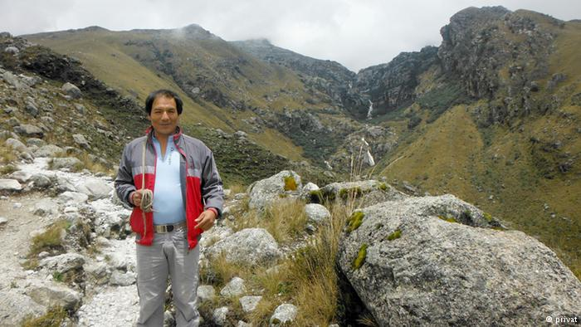
Saul Luciano Lliuya

Slide 3
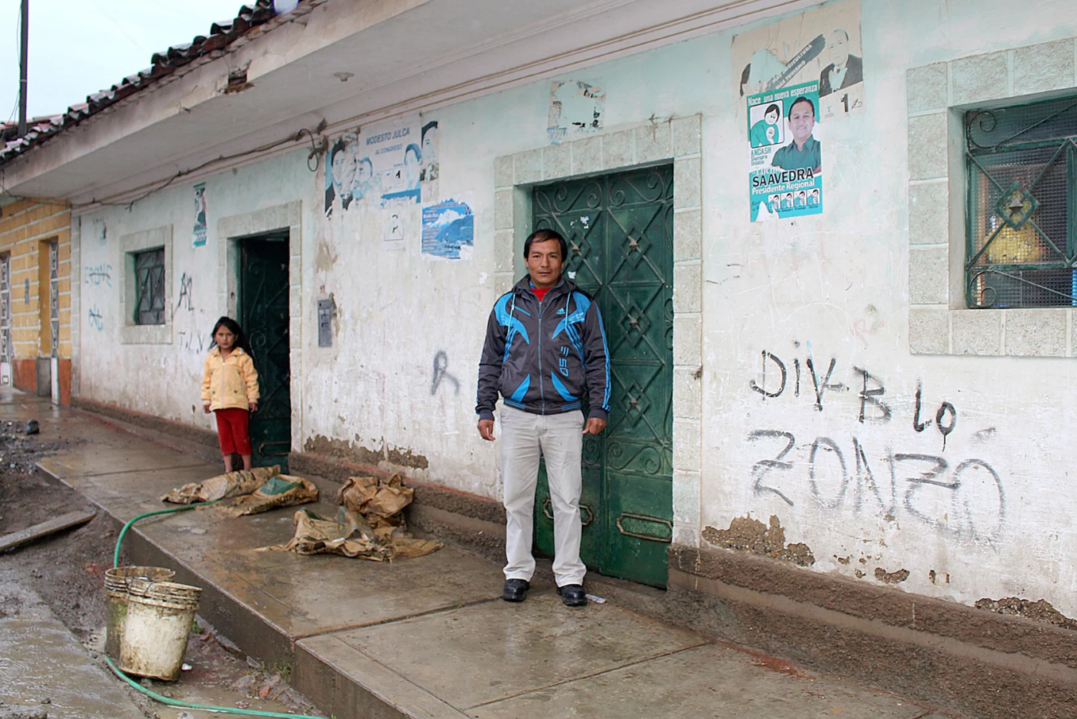

Slide 4
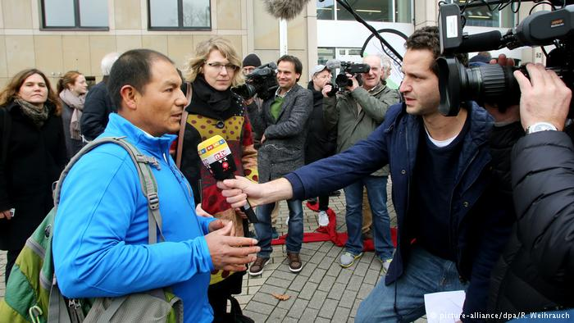
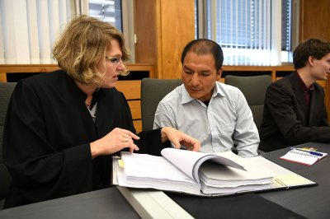

Slide 5
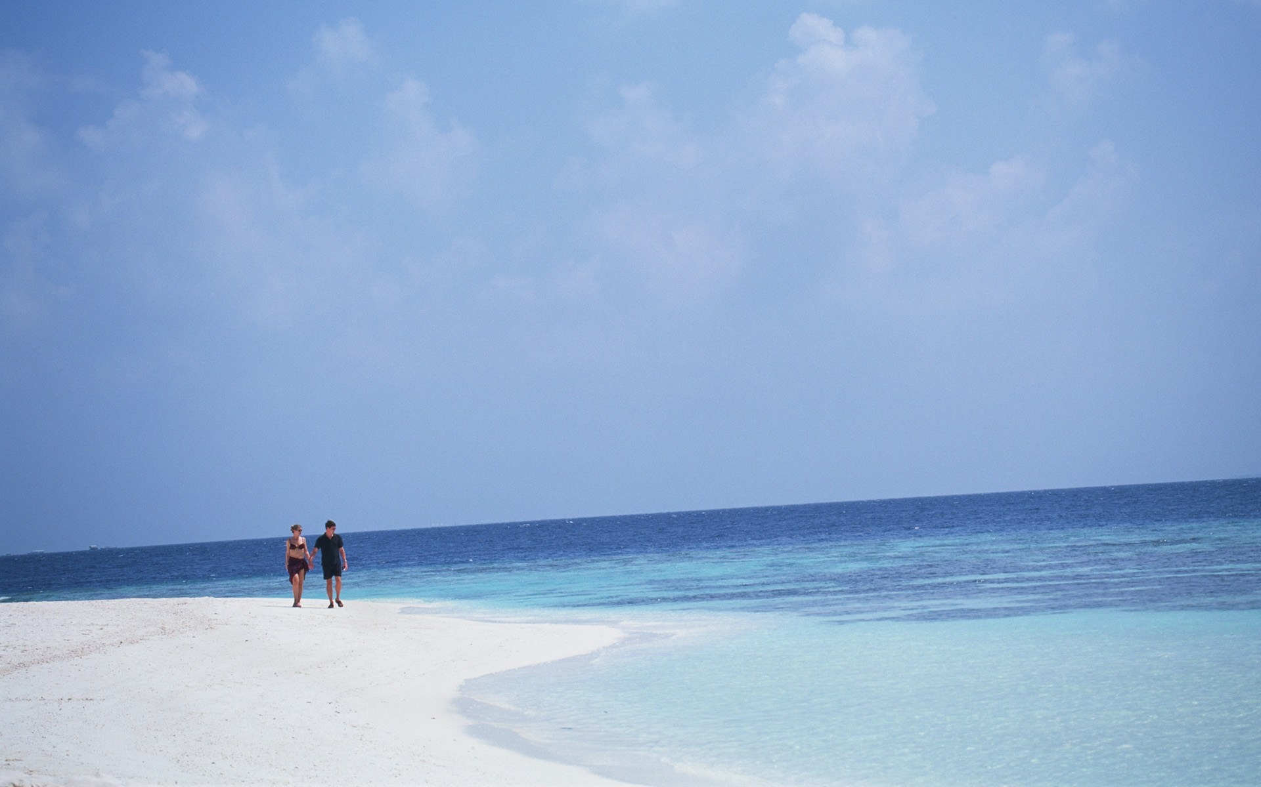
Pojetí práva

Slide 6
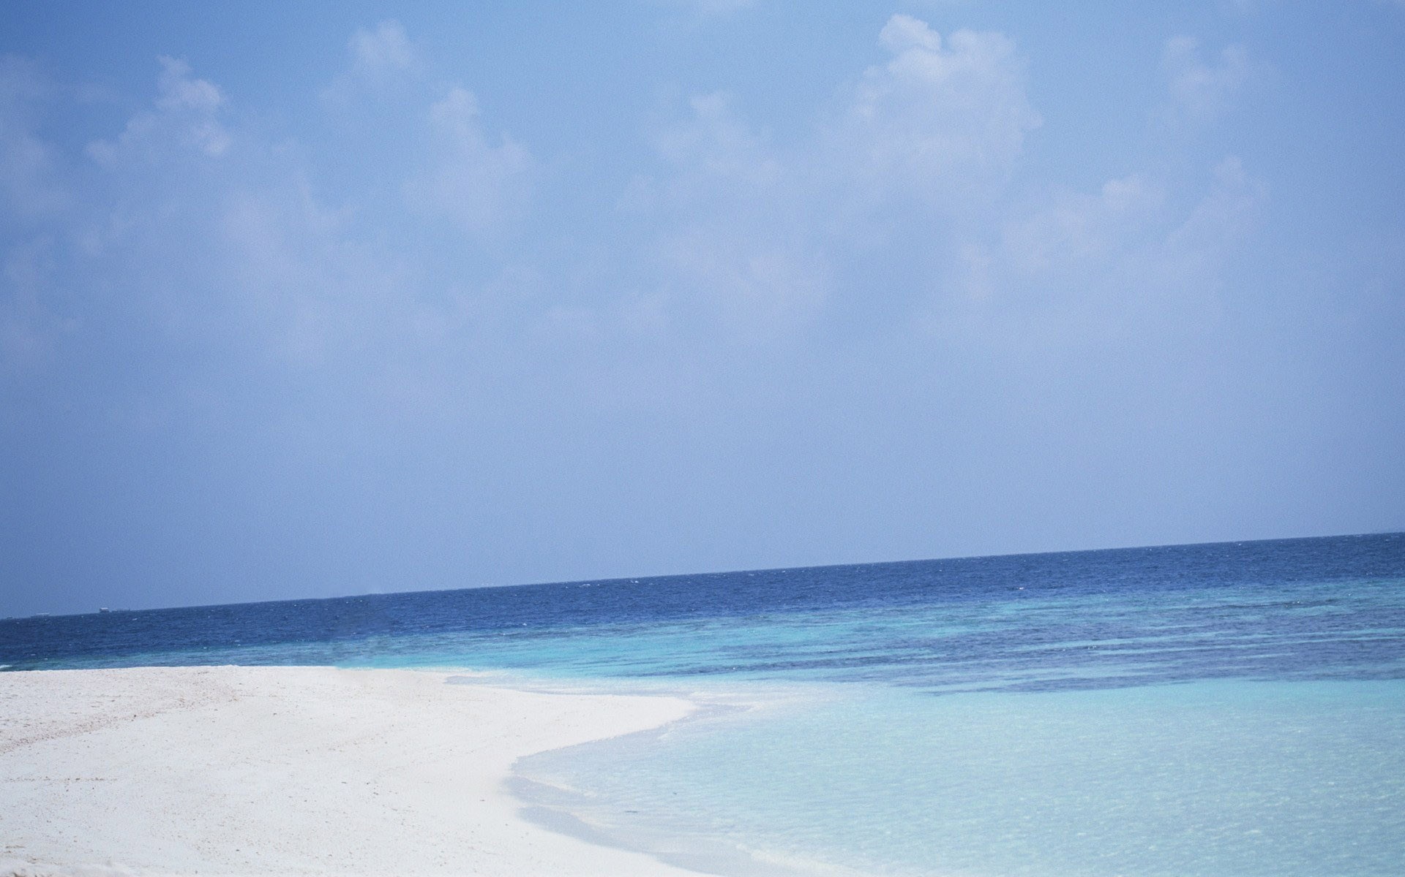
Pojetí práva
„The fish cannot go to court“

Slide 7
„The fish cannot go to court“
Solution:
Lets give rights to the environment itself
(Pacha Mama, Great Ape Project, Coral Reef)
Specific human right to favourable environment
Right to water, clean air
„Greening“ of existing human rights of natural persons (right to life and health, right to privacy)
Lets give rights to the NGOs
(permitting procedure, liability, but restricted in the field of civil disputes and traditional human rights)
Participatory rights
Combination of the above

Slide 8
Environmental Rights
Sustainable development
Rights of future generations
Rights of indigenous people
Environmental justice (environmental racism, equal env. protection)
Environmental migration

Slide 9
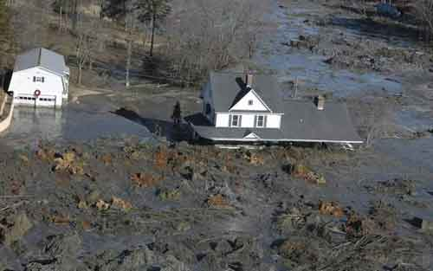
Environmental Law
Administrative Law
Criminal Law
Civil Law
Constitutional Law

Slide 10
Environmental rights
Why a human right approach?
Traditional protection = participation and access to justice (public law) + civil disputes (civil law)
Human right protection = last resort, wider scope, even if no participation is allowed
5 years ago – additional level (and discussions regarding specific rights)
Nowdays – climate changes cases opt for the traditional legal tools
But success?

Slide 11

Evropská občanská iniciativa

Slide 12
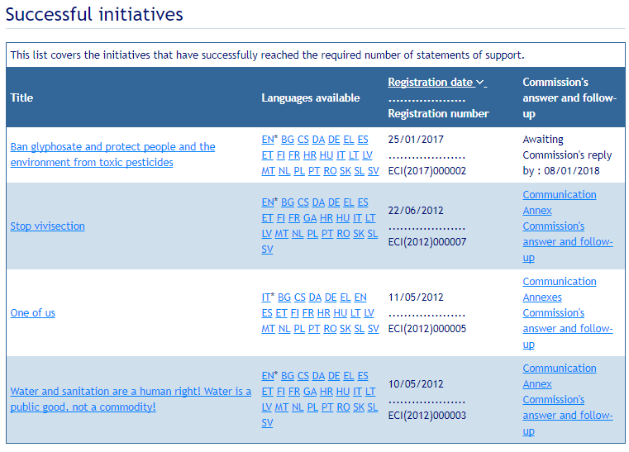
EUROPEAN CITIZENS' INITIATIVE

Slide 13
Environmental rights (in narrow sense)
Right to environment or rights which flow from the right to environment, such as the right to be free from pollution, access to safe water and food, etc.
Health and well-being: right to a healthy environment or the right to an environment adequate for the well-being of people.

Slide 14
All persons have the right to a secure, healthy and ecologically sound environment.
All persons shall be free from any form of discrimination in regard to actions and decisions that affect the environment.
All persons have the right to an environment adequate to meet equitably the needs of present generations and that does not impair the rights of future generations to meet equitably their needs.

Slide 15
Rights concepts
Divine rights
Societal, political rights
Individual rights x Community rights
ANTHROPOCENTRIC APPROACH
X
ECOCENTRIC APPROACH
(Environmental issues encompass a much wider range of actors, affecting a much larger category of species than human rights violations.)

Slide 16
3rd generation of human rights
Group and collective rights
Right to self-determination
Right to economic and social development
Right to a healthy environment
Right to natural resources
Right to communicate and communication rights
Right to participation in cultural heritage
Rights to intergenerational equity and sustainability

Slide 17
ENVIRONMENTAL RIGHTS
SUBSTANTIVE ER
SEPARATE, INDEPENDENT ER
PROCEDURAL ER

Slide 18
SUBSTANTIVE ER
the right to life,
the right to health,
the right to an adequate standard of living,
the right to cultural integrity,
the right to privacy,
the right to property,
self-determination,
working conditions.

Slide 19
There is no logical rationale for argument that a human right to a sound environment can be derived from existing rights to life, health and adequate standard of living.
These rights are obviously closely connected to the state of the environment because their realisation, in particular depends upon the protection of the environment.
Protection of the environment is a prerequisite to assuring all human rights.

Slide 20
SEPARATE, INDEPENDENT ER
right to a healthy/favourable/viable/decent environment
International law:
Soft law (Stockholm), international custom, principle?
Hard law: African charter, American charter
EU law: no
National law: constitutional right

Slide 21
NO UNIVERSAL RIGHT
1948 the Universal Declaration of Human Rights
no reference to environmental protection.
1972 Stockholm Declaration on the Human Environment the Preamble recognized the intimate relationship between environmental protection and the enjoyment of human rights
1982 World Charter for Nature – rights of nature distinct from human rights – adpoted by UN MS (111/1)
1993 Vienna Declaration on Human Rights
UN position: "all human rights are universal, inter-dependent and indivisible "
1992 Rio Declaration - "human beings are at the centre of concerns for sustainable development. They are entitled to a healthy and productive life in harmony with nature."

Slide 22
PROCEDURAL ER
Soft law (Rio, Agenda 21), Hard law (Espoo, Aarhus)
The Aarhus Convention
access to environmental information,
public participation in environmental decision-making,
access to justice in environmental matters
Others: Right to environmental and human rights education
Right to free and peaceful association for the purpose of protecting the environment or the rights of those affected by environmental harm

Slide 23
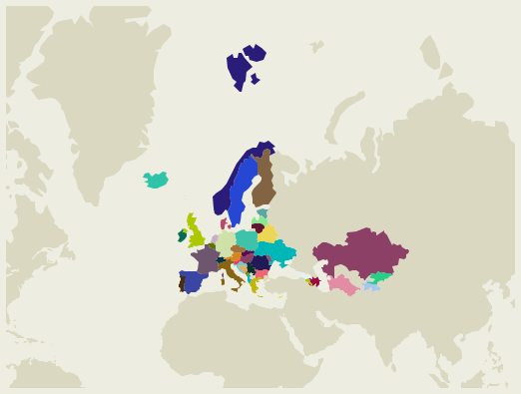

The Aarhus Convention on Access to Information, Public Participation in Decision-making and Access to Justice in Environmental Matters

Slide 24
The Aarhus Convention
Adopted on 25 June 1998 in the Danish city of Aarhus (Århus)
Entered into force in 2001
All Member States and EU are the Parties to the Convention
Links environmental rights and human rights
Acknowledges that we owe an obligation to future generations
Establishes that sustainable development can be achieved only through the involvement of all stakeholders
Links government accountability and environmental protection
Focuses on interactions between the public and public authorities in a democratic context.
But only procedural rights!

Slide 25
The Aarhus Convention
Three pillars of public participation
Access to information (Art. 5)
Mandatory systems, electronic databases, providing information in case of imminent threat to human health or the environment, wide access free of chargé.
Participation at decision-making (Art. 6)
with respect to decisions on whether to permit proposed activities listed in annex I
decisions on proposed activities not listed in annex I which may have a significant effect on the environment
Access to justice (Art. 9)
Following Art. 6, members of the public concerned (a) Having a sufficient interest or, alternatively, (b) Maintaining impairment of a right, where the administrative procedural law of a Party requires this as a precondition

Slide 26
The Aarhus Convention
A 'floor', not a 'ceiling'‚
Non-discrimination
Definition of environmental information, public authorities, public and public concerned
NGOs are considered public concerned
Non-compliance mechanism

Slide 27
The Aarhus Convention
“The public” means one or more natural or legal persons, and, in accordance with national legislation or practice, their associations, organizations or groups;
“The public concerned” means the public affected or likely to be affected by, or having an interest in, the environmental decision-making; for the purposes of this definition, non-governmental organizations promoting environmental protection and meeting any requirements under national law shall be deemed to have an interest.
https://www.unece.org/fileadmin/DAM/env/pp/documents/cep43e.pdf

Slide 28
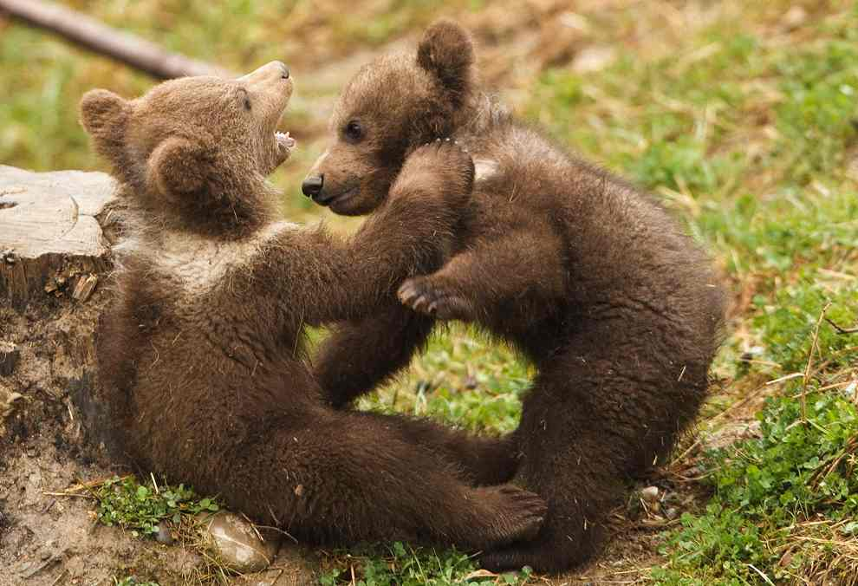
The Aarhus Convention
Binding nature? No direct effect but…
C-240/09 (Slovak Brown Bear):
…Interpretation as far as possible

Slide 29
Aarhus convention
Aarhus convention
EU law
National law

Slide 30
INTERNATIONAL LAW
Regional human rights treaties
the European Convention on Human Rights,
the American Convention on Human Rights,
the African Charter on Human's and Peoples’ Rights.
International conventions

Slide 31
The European Convention on Human Rights
Does not include a right specifically to protect the environment
ARTICLE 3 - prohibition of degrading treatment
- López Ostra: there has to be a serious risk to human health
ARTICLE 8
Everyone has the right to respect for his private and family life, his home and his correspondence.
(general principles of Aarhus)
ARTICLE 13
Everyone whose rights and freedoms as set forth in this Convention are violated shall have an effective remedy…

Slide 32
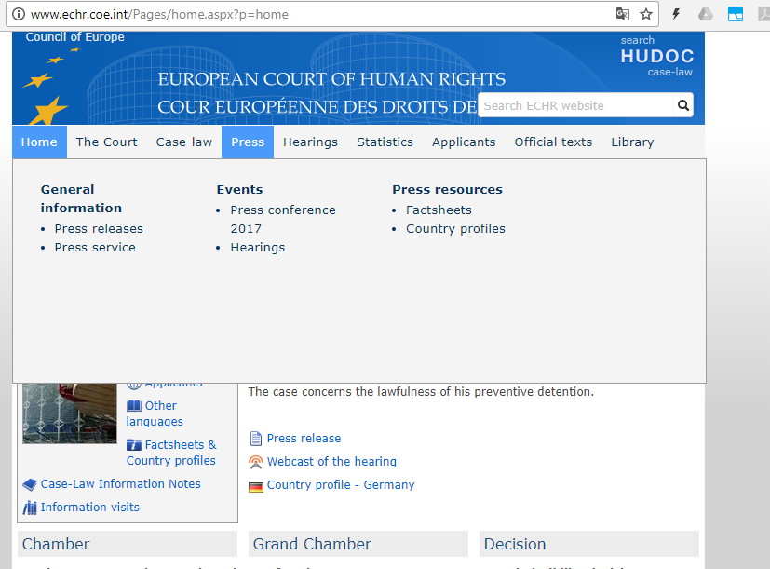
The European Convention on Human Rights

Slide 33
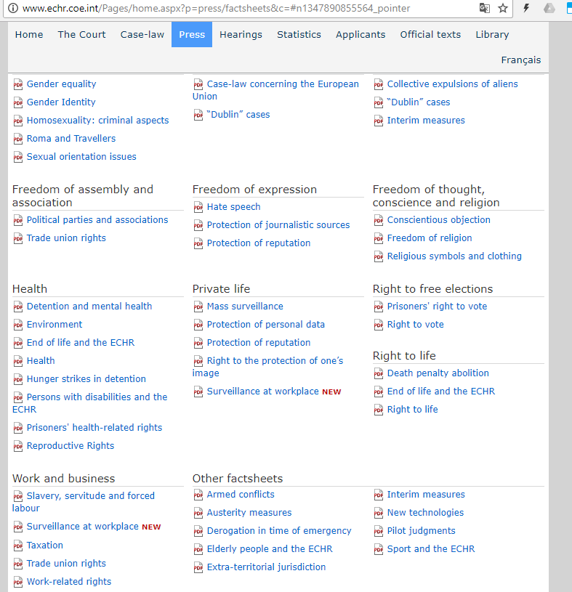
The European Convention on Human Rights

Slide 34
+ protection applies to "legal" situations
(Fadeyeva v Russia, 55723/00 [2005]),
decisions are respected, final and executed,
covers large number of countries

Slide 35
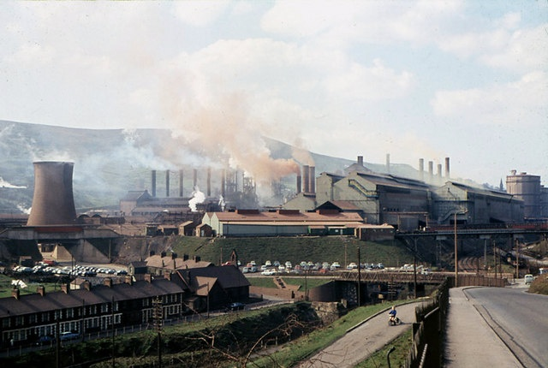
6280

Slide 36
- does not offer protection from general deterioration of the environment (Kyrtatos v. Greece, 41666/98 [2003])
Even clear violations of the rule of law cannot be remedied if the applicant is not sufficiently affected or if no direct link between the alleged victim and the violation can be proven.

Slide 37
Just satisfaction
immaterial damage
causal nexus
Tâtar v Romania (2007)
lived approximately 100 metres from a gold mine,
the authorisation permit placed the operator under a general duty to protect the environment.
no finding by the national authorities that the activity was harmful to the environment or that it was in violation of local environmental regulations

Slide 38
almost complete absence of official decisions or documentation which had taken into account the dangers to the public and the environment inherent in the activity being undertaken at the gold mine,
previous accidents,
the Court was unable to find any evidence to support that this deterioration had been caused by the activities at issue, the very existence of a serious and substantial risk to the health and well-being of the claimants placed an obligation on the state to adopt reasonable measures which were capable of protecting their private and family life.
Violation of Art. 8 – but NO JUST SATISFACTION

Slide 39
Taskin v Turkey (2004)
application was submitted by individuals living in the vicinity of a gold mine
the Supreme Administrative Court had found that the use of sodium cyanide in the mine posed a threat to the local environment and the health of the local population
the Council of Ministers adopted a decision that the gold mine should continue its activities
Violation of Art. 6 and 8
All 10 applicants received 3.000 EUR

Slide 40
Brânduse v Romania (2009)
serving a ten year sentence in a prison for fraud.
several complaints about the conditions in the prison, including over-crowding, poor food and invasion of privacy, all of which he alleged were violations of his Convention rights.
one of the complaints concerned the proximity of the prison to a rubbish dump.
8.000 EUR

Slide 41
Inter-American system
the 1989 protocol to the American Convention includes a right to a clean environment, this right is not amongst those that can be the subject of individual petitions against the acting state.
Yanomami Indians v. Brazil
Offices directly concerned with the living conditions of the Indians treated them as legitimate representatives
The Commission decided in favor of the petitioners and held that the Brazilian government had violated the Indians' right to life, liberty, and personal security by failing to take measures to prevent environmental damage which led to loss of life.

Slide 42
Additional Protocol to the American Convention on Human Rights in the Area of Economic, Social and Cultural Rights (1989)
Article 11 provides:
1. Everyone shall have the right to live in a healthy environment and to have access to basic public services.
2. The States Parties shall promote the protection, preservation and improvement of the environment.

Slide 43
The African system
features not only political and civil rights but also environmental, economic, social and cultural rights,
the Charter was also the first human rights treaty to include the right to a satisfactory environment, which has been categorised as a third generation right or a solidarity right.
Article 24 of the ACHPR: "all peoples shall have the right to a general satisfactory environment favourable to their development"
actio popularis possible
SERAC v Nigeria

Slide 44
1981 African Charter on Human and Peoples' Rights
Article 24: "all peoples shall have the right to a general satisfactory environment favourable to their development."
Article 21: "all peoples shall freely dispose of their wealth and natural resources. This right shall be exercised in the exclusive interest of the people. In no case shall a people be deprived of it.“

Slide 45
EU Law
CHARTER OF FUNDAMENTAL RIGHTS
Article 37 Environmental protection
A high level of environmental protection and the improvement of the quality of the environment must be integrated into the policies of the Union and ensured in accordance with the principle of sustainable development.
Court of Justice of the European Union
Art. 230 (4) EC Treaty (263 TFEU)
strict in granting access to justice
it is essential for the individual to be affected in his or her own subjective rights in a way sufficient to distinguish him or her individually in the same way as the addressee of a contested decision.

Slide 46
associations formed for the protection of collective interests are not considered to be directly and individually concerned by a measure affecting the general interest,
CJEU will not deal with direct claims of individuals
No procedural changes
Not all violations

Slide 47
National law
Bringing a claim before international bodies can not be said to constitute a major gain in democracy.
Council's final Recommendation on Environment and Human Rights:
recommends that the member states recognise a human right to a healthy, viable and decent environment which includes the objective obligation for states to protect the environment, in national laws, preferably at constitutional level.

Slide 48
INTERPRETATION
Supreme Court of India has adopted an expansive interpretation of the right to life clause in the Indian Constitution elevated the right to environment to the status of a fundamental right, a violation of which is actionable under the Constitution.
France: Sortir du Nucléaire

Slide 49
1. Everyone shall possess the right to a healthy and ecologically balanced human living environment and the duty to defend it.
2. In order to ensure enjoyment of the right to the environment within an overall framework of sustainable development, acting via appropriate bodies and with the involvement and participation of citizens, the state shall be charged with:
a) Preventing and controlling pollution and its effects and the harmful forms of erosion;
b) Conducting and promoting town and country planning with a view to a correct location of activities, balanced social and economic development and the enhancement of the landscape;
c) Creating and developing natural and recreational reserves and parks and classifying and protecting landscapes and places, in such a way as to guarantee the conservation of nature and the preservation of cultural values and assets that are of historic or artistic interest;
d) Promoting the rational use of natural resources, while safeguarding their ability to renew themselves and maintain ecological stability, with respect for the principle of inter-generational solidarity;
e) Acting in cooperation with local authorities, promoting the environmental quality of rural settlements and urban life, particularly on the architectural level and as regards the protection of historic zones;
f) Promoting the integration of environmental objectives into the various policies of a sectoral nature;
g) Promoting environmental education and respect for environmental values;
h) Ensuring that fiscal policy renders development compatible with the protection of the environment and the quality of life.

Slide 50
National law - constitutions
Right to a healthy environment ≠ protection of environment as a duty of the state
Direct effect x implementing legislation

Slide 51
CZECH CHARTER OF FUNDAMENTAL RIGHTS AND FREEDOMS
Article 35
(1) Everybody has the right to live a favourable living environment.
(2) Everybody is entitled to timely and complete information about the state of the living environment and natural resources.
(3) In exercising his or her rights nobody may endanger or cause damage to the living environment, natural resources, the wealth of natural species, and cultural monuments beyond limits set by law.
Article 41
(1) The rights listed ind Article 26, Article 27, par.4, Articles 28 to 31, Article 32, pars.1 and 3, and Articles 33 and 35 of the Charter may be claimed only within the scope of the laws implementing these provisions.

Slide 52
National law - constitutions
Environmental rights:
Portugal, France, Poland, Hungary, Romania, Slovenia, Spain, Czech Republic, Slovakia, Belgium

Slide 53
National law - constitutions
Duty of the state:
Germany, Austria, Bulgaria, Estonia, Latvia, Lithuania, Finland, Greece, Malta, Italy.
No environmental protection:
Cyprus (ECHR), Denmark, Luxembourg, Ireland, Sweden.

Slide 54
Pros and Cons
Pros
Complementary function
Effective
Living instruments GREENING of existing treaties
Supreme or specialized courts, international bodies
Publicity
State is the responsible person

Slide 55
Flexible (in theory)
Claimants can rely on the threshold limits created by the Environment Authority in their country or they may rely on generally accepted international standards, defined, for example, by the World Health Organization.
Victims do not have to wait until damage to their health materializes, which could take years in some instances. Instead, they could take action to stop a polluting activity from continuing and causing catastrophic damage later on by merely showing that the emissions have crossed the threshold levels established by law.

Slide 56
Pros and Cons
Cons
The actual subjects of the underlying rights are human beings, not the trees, not the ground, and not the water, vesting an environmental right in humans alone is morally incorrect
"victim" requirement,
narrow locus standi,
causal nexus, evidence
Bringing an application before the ECtHR or the IACtHR necessitates the exhaustion of all available national remedies.

Slide 57
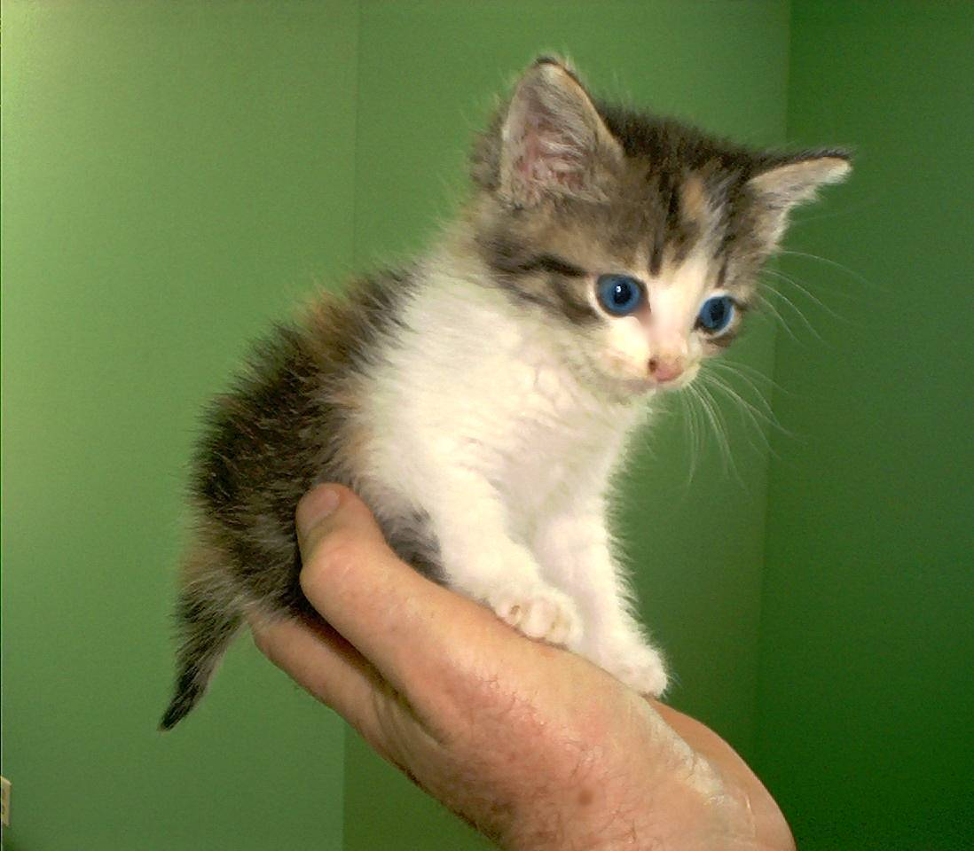
Thank you for your attention!

