Slide 1
SERVICE MARKETING
Lucie Kaňovská
Brno University of Technology
Faculty of Business and Management

Slide 2
Content
Services
Successful examples from Czech companies
Services in manufacturing
Successful examples from Czech manufacturers

Slide 3
What is „Service“?

Slide 4
Definition of “service”:
“…any act or performance that one party can offer to another that is essentially intangible and does not result in the ownership of anything. Its production may or may not be tied to a physical product”
        Kotler (1994)

Slide 5
Are Services important today?

Slide 6
“We live in a service economy.”
“Everybody is in service”
(Levitt, 1972)

Slide 7
What’s the Big Deal about Services?
Services sector is the largest sector of the world.
63.5 percent of total global wealth comes from services sector.
Services sector is the largest sector of 194 countries.
30 countries receive more than 80 percent of their GDP from services sector.
Source: http://statisticstimes.com/economy/countries-by-gdp-sector-composition.php

Slide 8
Do you know how important are services for your country? (GDP or labor force)

Slide 9
GDP according to purchasing power parity (bil. USD), 2015)
 | Prim. | Sec. | Tertiary
World | 6% | 30,9% | 63,2%
EU | 1,8% | 25% | 73,1%
USA | 1,1% | 22,1% | 77,7%
China | 10,2% | 49,6% | 43%
Germany | 0,9% | 27,8% | 71,3%
GB | 0,7% | 21,8% | 77,5%
France | 2% | 18,5% | 78,9%
Austria | 1,5% | 29,4% | 69,1%
Poland | 3,4% | 33% | 63,5%
CZ | 2,4% | 37,6% | 60%

Slide 10
GDP - composition, by sector of origin(%)
https://www.cia.gov/library/publications/the-world-factbook/fields/2012.html
http://statisticstimes.com/economy/countries-by-gdp-sector-composition.php

Slide 11
World famous service companies?

Slide 12








Slide 13
The most valuable companies
http://interbrand.com/best-brands/best-global-brands/2016/ranking/

Slide 14
Do you know some Czech service companies?

Slide 15



Famous companies
Škoda Auto
Tatra
Zetor
Linet

Slide 16


https://www.regiojet.com/en/services/

Slide 17


Slide 18
Air tickets
Bus tickets
Trains
Taxi in Prague http://www.ticktack.cz/en
Au-pair stay and Work & Travel
Holiday packages
Rent a bus
Language School in UK, Germany, Spain,..

Slide 19
The 3rd place Czech Top 100 (the most admired firm)
Mystery shopping
Searching for gaps – new services
High quality of services (bus, trains)
Be the best
and provoke sometimes ☺

Slide 20

AVAST Software s.r.o.
“AntiVirus Advanced SeT“

Slide 21

AVG
1991 Grisoft – Brno
(IT equipment, SW and product AVG Anti-Virus (AVG - Anti-Virus Guard)
1993 New logo AVG
1994 focus only on developemt of anti-virus products
2000 the first free of charge product
2016 Avast Software bought AVG for 31,7 bil. CZK

Slide 22


Slide 23

Y SOFT
OUR CORE VALUES
We believe that a positive attitude can change the
world. It’s part of our DNA.
Support services

Slide 24


Slide 25
Kofola is a carbonated soft drink produced in by Czech company Kofola
4 herbal and fruit ingredients (such as extracts from apple, cherry, currant, or herbal aroma), sugar and/or high fructose corn syrup (2014), and caramel.
In comparison with Pepsi or Coca-Cola it contains 30% less sugar, ~56% more caffeine (15 mg/100ml, Coca-Cola 9.6 mg/100ml) and it does not contain phosphoric acid.

Slide 26
http://www.kofola.cz/web/history
http://company.kofola.cz/
Could you imagine to launch Kofola in your country?

Slide 27
Major Services
Accounting
Advertising
Architecture
Banking and other financial services
Communications
Computers
Construction and engineering
Education and training
Equipment maintenance and repair
Franchising
Health care
Hospital management
Insurance
Leasing
Legal
Lodging
Management and catering
Management consulting
Publishing

Slide 28
Services Marketing x Product Marketing
All intangible All tangible
Tires and auto parts
Computer hardware
Computer software
Retailing
Professional services

Slide 29
What is
„Customer Service“?

Slide 30
Customer services
Customer services are everything, what company does for satisfaction of its customers.
They help to gain higher profit from sold products.
Customer services can be also an important competitive advantage.

Slide 31
Customer Services
customer service may be provided by
  a person or
  by automated means called self-service (web pages)
influence emotional experiences from purchase and help to increase of customer satisfaction
generate income and revenue
Notes:
Kone, HP, car companies

Slide 32
Customer services
Quality and customer services present strong barrier against the competition, ensure customer loyalty, differentiate product, decrease marketing costs and increase company profit.
(Bovée and Thill, 1992)

Slide 33
Customer services
LaLonde and Zinser (1976)
Services are the kind of activities between the organization and customers to improve or simplify sale and using of products.
They involve also operations of producers provided for customers during the whole transaction.

Slide 34
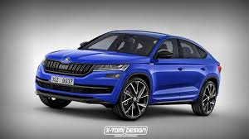
Customer Services
help to understanding of customers needs and wishes
customer service is the provision of service to customers
  before,
  during and
  after …. a purchase

Slide 35
How customer services are organized in companies?

Slide 36
Customer services
Companies can supply a lot of different types of services to their customers.
The supply usually depends on:
company management,
employees,
customers,
competitors or
the type of business.

Slide 37
Customer services
Today, manufacturing companies provide their services in different levels and ranges.
Which frequent examples of services do you know?

Slide 38



Customer services
Transport and product packaging

Slide 39
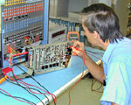
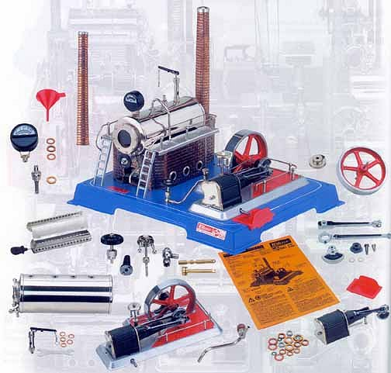
Customer services
Change of spare parts
Guarantee repairs

Slide 40

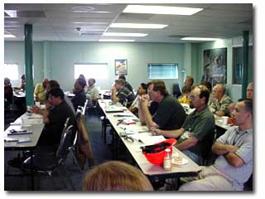
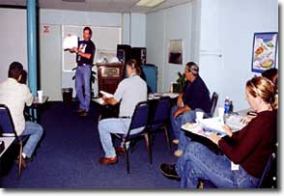
Customer services
Customer trainings

Slide 41
Customer services
Transport and packaging of products according to customer requirements
Replacement of spare parts
Maintenance services
Sufficient information about the company and its products
Training of customers
Payment conditions (paying by leasing)
Free phone connection (Green line)
Remote monitoring

Slide 42
How to offer
„customer service“?

Slide 43
How to offer customer services
1. Know your product
However, it is possible to say "I don't know", but it should always be followed up by...
"but let me find out"
make sure that you don't leave your customer with an unanswered question.

Slide 44
How to offer customer services
2. Body Language/Communication
Two of the most important parts of positive body language are smiling, and eye contact.

Slide 45
How to offer customer services
3. Anticipate customers needs
Nothing surprises your customer more than an employee going the extra mile to help them.
Always look for ways to serve your customer more than they expect.

Slide 46
Notifications for services
There are a lot of notifications describing services such as:
industrial services (Matthyssens, Vandenbempt, 1998);
product-related services (Matthyssens, Vandenbempt, 1998);
product-services or product services (Mathieau, 2001);
customer services (Richardson, 1995; Baggs, Kleiner, 1996; Leech, 1995; Leppard, Molyneuxe, 1994; Timm, 2001; Sterne, 2000; Bovée, Thill, 1992; Amico, Zikmund, 2001);
after-sale services (Richardson, 1995; Baggs, Kleiner, 1996; Leech, 1995; Leppard, Molyneuxe, 1994; Timm, 2001; Sterne, 2000; Bovée, Thill, 1992; Amico, Zikmund, 2001);
customer support (Armistead, 2001).
services supporting business needs (Fischer et al., 2012).

Slide 47
Examples of service support

Slide 48

Customer services or Service support for...
HP Total Care
„Find solutions & support for your product“
Source: http://www8.hp.com/cz/cs/home.html
Notes:
https://www.google.cz/search?q=notebook&source=lnms&tbm=isch&sa=X&ei=1zx7U9aALuyI7Aa674CoCw&ved=0CAYQ_AUoAQ&biw=1440&bih=707#facrc=0%3Bnotebook%20apple&imgrc=_

Slide 49
check your warranty and extend it
check your repair case
premium program
24/7 phone support with remote login assistance
software installation and setup
virus, spyware, and malware removal
HP Total Care
Find solutions & support for your product
Source: http://www8.hp.com/cz/cs/home.html
Notes:
https://www.google.cz/search?q=notebook&source=lnms&tbm=isch&sa=X&ei=1zx7U9aALuyI7Aa674CoCw&ved=0CAYQ_AUoAQ&biw=1440&bih=707#facrc=0%3Bnotebook%20apple&imgrc=_

Slide 50

Service support for...
“KONE provides world-class services and innovative solutions for new buildings and existing buildings – everything you need for smooth people flow.”
Source: http://www.kone.com/en/

Slide 51

KONE Care™ Solutions
The KONE Care service offering enables you to choose the level of service you need: Standard, Plus or Premium.
All three levels include KONE Modular Based Maintenance and access to the KONE Customer Care Center.
You can tailor the solution by adding other services from the KONE Care portfolio.
Source: http://www.kone.com/en/
Notes:
https://www.google.cz/search?q=notebook&source=lnms&tbm=isch&sa=X&ei=1zx7U9aALuyI7Aa674CoCw&ved=0CAYQ_AUoAQ&biw=1440&bih=707#facrc=0%3Bnotebook%20apple&imgrc=_

Slide 52
KONE Care™ Maintenance Method
KONE develops a unique maintenance plan for each piece of equipment. Maintenance is performed for each technical module of the equipment at the correct intervals.
This ensures quality and end-user safety, and minimizes equipment downtime.
Source: http://www.kone.com/en/
Notes:
https://www.google.cz/search?q=notebook&source=lnms&tbm=isch&sa=X&ei=1zx7U9aALuyI7Aa674CoCw&ved=0CAYQ_AUoAQ&biw=1440&bih=707#facrc=0%3Bnotebook%20apple&imgrc=_

Slide 53
Do you have some extraordinary experience with
„Customer Services
Service support“?

Slide 54
TASK
Try to find out / think about some famous company which provide excellent services.
Why are they excellent?
What services are the best for company and for their customers?
Which current trends do they use in its service strategy?
Do you have any recommendation?

Slide 55
Services in manufacturing

Slide 56
Services in manufacturing
WHY?

Slide 57
Services in manufacturing
“People say we can survive without manufacturing…that we can have a service economy. An awful lot of services now are linked to manufacturing” (Feike Sijbesma, CEO of DSM)
Notes:
Now I am working on research – electrotechnical companies and know their supply, strategy, services,….

Slide 58
Motivation for offering industrial services
Provider perspective:
Revenue and profit potential
Differentiation
Customer relationship
Positive image
Gather information
Lock out customers and Customer demand
Source: Aston Business School, SSC Conference 2014 – Daniela Buschak
Notes:
Aston Business School, PP, SSC Conference 2014 – Daniela Buschak

Slide 59
Motivation for offering industrial services
Customer perspective:
Reduction of costs
Higher flexibility
Higher performance
Risk reduction
Higher quality
Source: Aston Business School, SSC Conference 2014 – Daniela Buschak
Notes:
Aston Business School, PP, SSC Conference 2014 – Daniela Buschak

Slide 60
Services in manufacturing
1800s, International Harvester used services to help start their new reaping equipment among farmers in the American Midwest (Baines & Lightfoot, 2013).
Services offered by manufacturer are activities complementing the products they produce.
Mostly all current manufacturers provide services of some range, depth and quality, but some of them establish market differentiation.
Service strategies are based on extending services within the total offering (e.g. Vandermerwe & Rada, 1988; Mathieu, 2001; Oliva & Kallenberg, 2003; Gebauer, 2008).

Slide 61
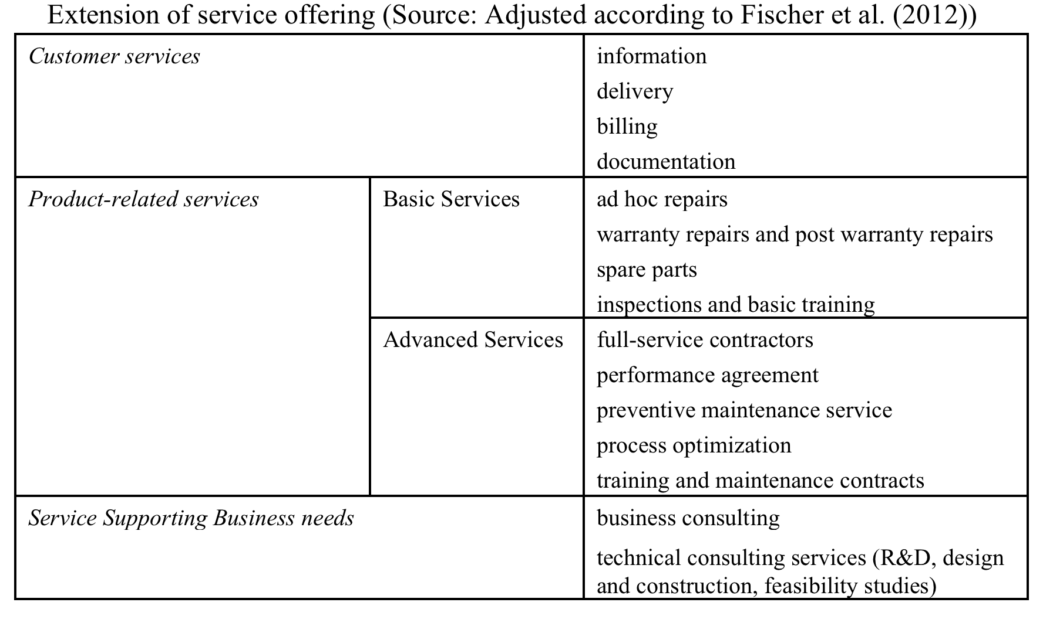
Services in manufacturing
Notes:
Now I am working on research – electrotechnical companies and know their supply, strategy, services,….

Slide 62
Adding services to the products
…to extend the total offering through services are possible ways of acting to eroding product margins and the loss of strategic differentiation through product innovation and technological superiority (Fischer et al., 2012).
The extension of the total offering via services has been conceptualized in the literature through some diffeants notions, such as:
1) “servitization” (Vandermerwe, Rada, 1988),
2) “transition from products to services” (Oliva, Kallenberg, 2003),
3) “going downstream in the value chain” (Wise, Baumgartner, 1999),
Notes:
Fischer, T., Gebauer, H. and Fleisch, E. (2012) Service business development: strategies for value creation in manufacturing firms. Cambridge: Cambridge University Press.

Slide 63
Adding services to the products
4) “product-service systems” (Tukker, 2004),
5) “moving towards high-value solutions, integrated solutions and system integration” (Davies, 2004) and
6) “manufacturing / service integration” (Schmenner, 2009).
These above mentioned views describing extension of total offering via services led to the concept called “service business development”, which can be defined as increasing value contribution of services in the capital goods industry (Fischer et al., 2012).
Notes:
Fischer, T., Gebauer, H. and Fleisch, E. (2012) Service business development: strategies for value creation in manufacturing firms. Cambridge: Cambridge University Press.

Slide 64
Do you know some Czech manufacturing companies?

Slide 65



Czech manufacturing companies

Slide 66

“We take care of people’s security and comfort all around the world.”
Source: https://www.jablotron.com/cz/

Slide 67
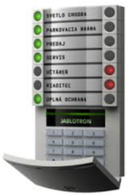

alarms (smart home)
vehicle monitoring
baby respiratory monitoring
https://www.jablotron.com/en/about-jablotron/

Slide 68
21 companies form the JABLOTRON Group
they are connected by the desire to be the leaders in respective fields, together with creating simple and understandable products using top technology.
employ more than 600 people.
the turnover in 2015 over 2.6 billion CZK.
Source: https://www.jablotron.com/cz/

Slide 69

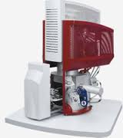
TESCAN is one of the global suppliers of scientific instruments.
The company is building its reputation and brand name in the field of designing and manufacturing scanning electron microscopes and system solutions for different applications.
Source: http://www.tescan.com/en-us/
Notes:
http://www.tescan.com/en-us/

Slide 70
Almost 2500 SEM installations in more than 80 countries prove the highest technical solution of TESCAN products.
TESCAN sales and service network covers countries all over the world. The team of sales representatives and well-trained service staff is capable to assure fast service and customer support as well as detailed product information. http://www.tescan.com/en-us/about-tescan
Source: http://www.tescan.com/en-us/
Notes:
http://www.tescan.com/en-us/

Slide 71


Source: https://www.robe.cz/

Slide 72
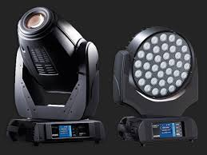
Robe lighting is based in the Czech Republic and manufactures innovative, high quality moving lights and digital lighting products.
Robe continues to focus on designing and producing well-engineered products utilising the very latest available technology to meet the creative, technical and practical demands of our wide range of users and investors.
Source: https://www.robe.cz/

Slide 73
Conclusions
There are no doubts that services play an important role in today's companies, also in industrial companies.
Services can be also perceived as a significant competitive advantage.
It is necessary to continuously improve customer services and know their customer perception.
The sooner companies adopt service strategy, the better for them and their customers.
Great services provides an experience that meets customer expectations. It produces satisfied customers!!!

Slide 74
Questions for discussion
Do you know some industrial company which is really strongly focused on services?
What do they provide exactly (products and services)?
Why they are different then competitors?
How customers evaluate their products (and services)?
Are they continuously improving the quality of products (and services)?

Slide 75
Conclusion
Services
Successful examples from Czech companies
Services in manufacturing
Successful examples from Czech manufacturers

Slide 76
Amico, M. D`, Zikmund, W. G. (2001). The power of marketing. Creating and keeping customers in an e-commerce world. 7th edition. Cincinnati: South-Western College Publishing, 689 p.
Armistead, C. (2001). The Customer Support Audit. Cambridge: Cambridge Strategy Publications.
Baggs, S. C., Kleiner, H. (1996). How to measure customer service effectively. Managing Service Quality, 6(1), pp. 36-39.
Baines, T., Lightfoot, H. (2013). Made to serve. How manufacturers can compete through servitization and product-service systems. 1st ed. Chichester: John Wiley and Sons, 254 p.
Bovée, C. L., Thill, J. V. (1992). Study guide to accompany Marketing, McGraw-Hill, 332 p.
Buschak, D. (2014). Benefits and sacri fices of after-sales services in the German machine building industry. Spring Servitization Conference 2014, Aston University, Birmingham, UK. Retrieved from: http://www.aston-servitiztion.com/publication/document/69/daniela-buschak-benefits-and-sacrifices-of-after-sales-services-in-the-german-machine-industry.
Davies, A. (2004), Moving base into high-value integrated solutions: a value stream approach,
Industrial and Corporate Change, 13(5), pp. 727-756.
Davies, A., Brady, T., Hobday, M. (2007). Organizing for solutions: Systems seller vs. systems inte-grator. Industrial marketing management, 36(2), pp. 183-193.
Fischer, T., Gebauer, H., Fleisch, E. (2012). Service business development: strategies for value crea-tion in manufacturing firms. 1st ed. Cambridge: Cambridge University Press, 298 p.
References
Amico, M. D`, Zikmund, W. G. (2001). The power of marketing. Creating and keeping customers in an e-commerce world. 7th edition. Cincinnati: South-Western College Publishing, 689 p.
Armistead, C. (2001). The Customer Support Audit. Cambridge: Cambridge Strategy Publications.
Baggs, S. C., Kleiner, H. (1996). How to measure customer service effectively. Managing Service Quality, 6(1), pp. 36-39.
Baines, T., Lightfoot, H. (2013). Made to serve. How manufacturers can compete through servitization and product-service systems. 1st ed. Chichester: John Wiley and Sons, 254 p.
Bovée, C. L., Thill, J. V. (1992). Study guide to accompany Marketing, McGraw-Hill, 332 p.
Buschak, D. (2014). Benefits and sacri fices of after-sales services in the German machine building industry. Spring Servitization Conference 2014, Aston University, Birmingham, UK. Retrieved from: http://www.aston-servitiztion.com/publication/document/69/daniela-buschak-benefits-and-sacrifices-of-after-sales-services-in-the-german-machine-industry.
Davies, A. (2004), Moving base into high-value integrated solutions: a value stream approach,
Industrial and Corporate Change, 13(5), pp. 727-756.
Davies, A., Brady, T., Hobday, M. (2007). Organizing for solutions: Systems seller vs. systems integrator. Industrial marketing management, 36(2), pp. 183-193.
Fischer, T., Gebauer, H., Fleisch, E. (2012). Service business development: strategies for value creation in manufacturing firms. 1st ed. Cambridge: Cambridge University Press, 298 p.
Kowalkowski, C., Windahl, C., Kindström, D., Gebauer, H. (2015). What service transition? Rethinking established assumptions about manufacturers' service-led growth strategies. Industrial Marketing Management, 45, pp. 59-69.
Leppard, J., Molyneux, L. (1994). Auditing your customer service. 1st edition. London: Routledge, 132 p.

Slide 77
Amico, M. D`, Zikmund, W. G. (2001). The power of marketing. Creating and keeping customers in an e-commerce world. 7th edition. Cincinnati: South-Western College Publishing, 689 p.
Armistead, C. (2001). The Customer Support Audit. Cambridge: Cambridge Strategy Publications.
Baggs, S. C., Kleiner, H. (1996). How to measure customer service effectively. Managing Service Quality, 6(1), pp. 36-39.
Baines, T., Lightfoot, H. (2013). Made to serve. How manufacturers can compete through servitization and product-service systems. 1st ed. Chichester: John Wiley and Sons, 254 p.
Bovée, C. L., Thill, J. V. (1992). Study guide to accompany Marketing, McGraw-Hill, 332 p.
Buschak, D. (2014). Benefits and sacri fices of after-sales services in the German machine building industry. Spring Servitization Conference 2014, Aston University, Birmingham, UK. Retrieved from: http://www.aston-servitiztion.com/publication/document/69/daniela-buschak-benefits-and-sacrifices-of-after-sales-services-in-the-german-machine-industry.
Davies, A. (2004), Moving base into high-value integrated solutions: a value stream approach,
Industrial and Corporate Change, 13(5), pp. 727-756.
Davies, A., Brady, T., Hobday, M. (2007). Organizing for solutions: Systems seller vs. systems inte-grator. Industrial marketing management, 36(2), pp. 183-193.
Fischer, T., Gebauer, H., Fleisch, E. (2012). Service business development: strategies for value crea-tion in manufacturing firms. 1st ed. Cambridge: Cambridge University Press, 298 p.
References
Leech, P. (1995). The importance of positive customer service to Ansells. Managing Service Duality, 5(4), pp. 31-34.
Mathieu, V. A. (2001). Product services: from a service supporting the product to a service supporting. The Journal of Business & Industrial Marketing, 16(1), pp. 39-58.
Matthyssens, P., Vandenbempt, K. (1998). Creating competitive advantage in industrial services. The Journal of Business & Industrial Marketing, 13(4/5), pp. 339-355.
Oliva, R., Kallenberg, R. (2003). Managing the transition from products to services. International Journal of Service Industry Management, 14(2), pp. 160-172.
Richardson, F. (1995). Creating competitive advantage via customer service: the RAC case study. Managing Service Duality, 5(4), pp. 12-15.
Schmenner, R. W. (2009). Manufacturing, service, and their integration: some history and theory. International Journal of Operations & Production Management, 29(5), pp. 431-443.
Sterne, J. (2000). Customer Service on the Internet. Building Relationships, Increasing Loyalty, and Staying Competitive. 2nd edition. New York: John Wiley and Sons, 351 p.
Timm, P. R. (2001). Customer service. Career success through customer satisfaction. 2nd edition. New Jersey: Prentice-Hall, 223 p.
Tukker, A. (2004). Eight types of product–service system: Eight ways to sustainability? Experiences from SusProNet. Business Strategy and the Environment, 13(4), pp. 246-260.
Vandermerwe, S. Rada, J. (1988). Servitization of business: adding value by adding services. European Management Journal, 6(4), pp. 314-24.
Wise, R. and Baumgartner, P. (1999). Going downstream: the new imperative in manufacturing. Harvard Business Review, 77(5), pp. 133-41.

Slide 78
Thanks for your attention!

