Slide 1


BASICS OF THE EU ENVIRONMENTAL LAW
Environmental policy of EU, its history and development, aims and instruments.
The role of the environmental action plans.
Autumn 2017
Mgr. Vojtěch Vomáčka, Ph.D., LL.M.

Slide 2

Course introduction
1. Environmental policy of EU, its history and development, aims and instruments. The role of environmental action plans.
2. EU environmental law - sources of law, system of environmental regulation and relation to other EU policies, environmental law
3. Harmonization of environmental requirements. EU law transposition and implementation. The role of national courts and the role of CJEU.
4. Access to environmental information, participation of public in environmental decision-makig and access to justice - the 3 pillars of Aarhus Convention.
5. Environmental impact assessment.

Slide 3
Course introduction
6. Air protection.
7. Ozone layer regulation / Global climate change in EU environmental policy.
8. Nature protection. Natura 2000.
9. Biodiversity protection. / Regulation of trade in endangered species of animals and plants.
10. Inland waters protection.
11. Waste management.

Slide 4
Course introduction
Reading assignments and cases necessary for discussions will be specified during the course.
Credit requirements: 1. semester paper/ppt. Presentation, 2. written test, 3. participation in lessons
The examination in the form of a written test and one semestral paper/ppt.presentation.

Slide 5
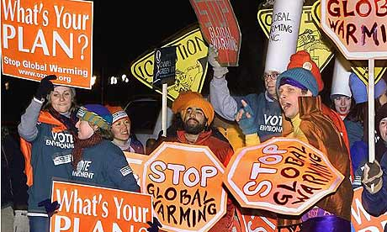
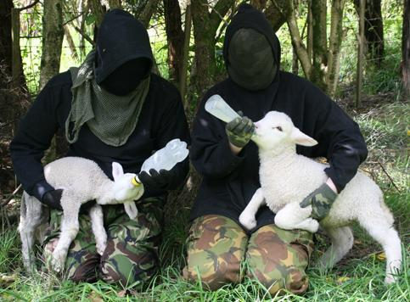
We are not eco-terrorists, but… C-379/87 (Anita Groener):
Teachers have an essential role to play, not only through the teaching which they provide but also by their participation in the daily life of the school and the privileged relationship which they have with their pupils.

Slide 6
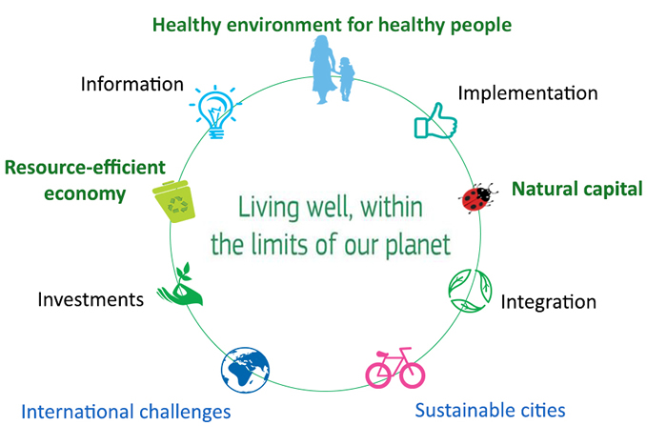
Introduction and basic info
Since when does the EU protect the environment?
And why?

Slide 7
Policy x Legal regulation
Policies
Plans, Programmes,
general legal regulation
Administrative and judicial decisions, direct action,…

Slide 8
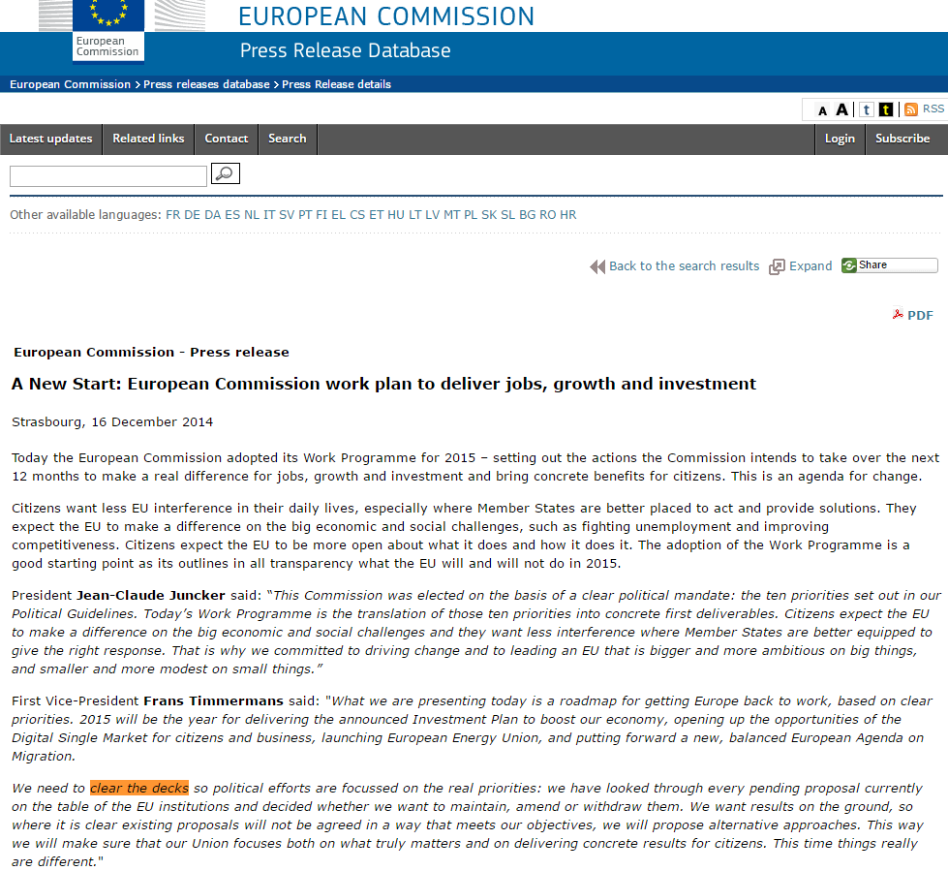
EKOPOLITIKA

Slide 9

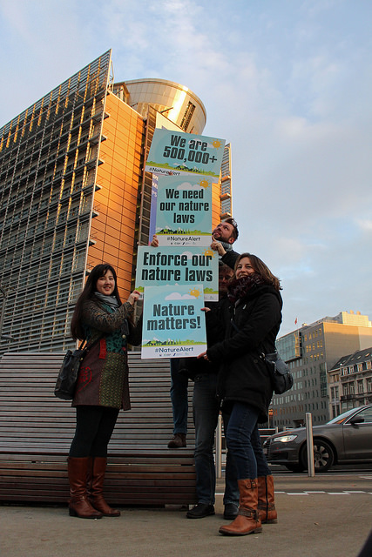

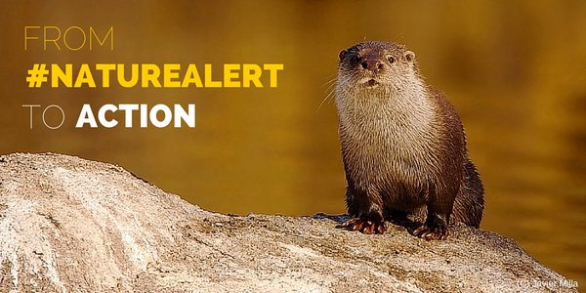

Slide 10
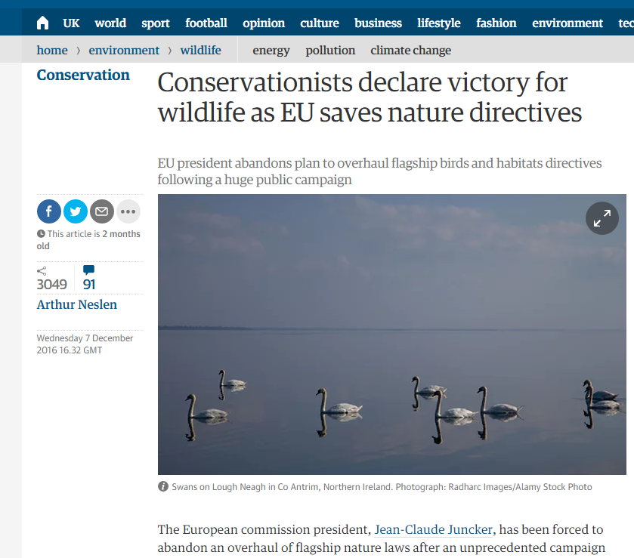

Slide 11
EU Environmental Policy - Principles
191 (2) TFEU: Community policy on the environment shall aim at a high level of protection taking into account the diversity of situations in the various regions of the Community. It shall be based on the precautionary principle and on the principles that preventive action should be taken, that environmental damage should as a priority be rectified at source and that the polluter should pay. Environmental protection requirements must be integrated into the definition and implementation of other Community policies.

Slide 12
Article 192
(1) The Council, consulting the Economic and Social Committee, shall decide what action is to be taken by the Community in order to achieve the objectives referred to in Article 191.
- provisions primarily of a fiscal nature;
- measures concerning town and country planning, land use with the exception of waste management and measures of a general nature, and management of water resources;
- measures significantly affecting a Member State's choice between different energy sources and the general structure of its energy supply.
(2) Without prejudice to certain measures of a Community nature, the Member States shall finance and implement the environment policy.
(3) Without prejudice to the principle that the polluter should pay, if a measure based on the provisions of paragraph 1 involves costs deemed disproportionate for the public authorities of a Member State, the Council shall, in the act adopting that measure, lay down appropriate provisions in the form of:
- temporary derogations and/or
- financial support from the Cohesion Fund

Slide 13
Article 193
The protective measures adopted pursuant to Article 192 shall not prevent any Member State from maintaining or introducing more stringent protective measures. Such measures must be compatible with this Treaty. They shall be notified to the Commission.
Gold-plating?

Slide 14
C-141/14 (European Commission v Republic of Bulgaria)
Member States shall classify in particular the most suitable territories in number and size as special protection areas for the conservation of these species in the geographical sea and land area where this Directive applies.

Slide 15
C-141/14 (European Commission v Republic of Bulgaria)
Member States shall take appropriate steps to avoid pollution or deterioration of habitats or any disturbances affecting the birds, in so far as these would be significant having regard to the objectives of this Article.

Slide 16
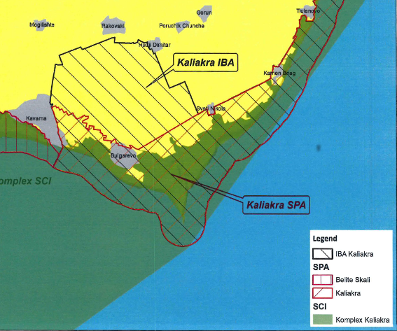
C-141/14 (European Commission v Republic of Bulgaria)

Slide 17
C-141/14 (European Commission v Republic of Bulgaria)
Any plan or project not directly connected with or necessary to the management of the site but likely to have a significant effect thereon, either individually or in combination with other plans or projects, shall be subject to appropriate assessment of its implications for the site in view of the site’s conservation objectives. In the light of the conclusions of the assessment of the implications for the site and subject to the provisions of paragraph 4, the competent national authorities shall agree to the plan or project only after having ascertained that it will not adversely affect the integrity of the site concerned and, if appropriate, after having obtained the opinion of the general public.

Slide 18
C-141/14 (European Commission v Republic of Bulgaria)

Slide 19
C-243/15 (Lesoochranárske zoskupenie VLK)
It would be incompatible with the binding effect attributed to a directive by Article 288 TFEU to exclude, in principle, the possibility that the obligations which it imposes may be relied on by those concerned. The effectiveness of Directive 92/43 and its aim, which is recalled in the previous paragraph of the present judgment, require that individuals be able to rely on it in legal proceedings, and that the national courts be able to take that directive into consideration as an element of EU law in order, inter alia, to review whether a national authority which has granted an authorisation relating to a plan or project has complied with its obligations under Article 6(3) of the directive, recalled in paragraph 42 of the present judgment, and has thus kept within the limits of the discretion granted to the competent national authorities by that provision.

Slide 20
What is the European Union?
EU as an actor of International law:
International Organization (with legal personality) of regional integration
EU law as a (self-contained) system of International Law:
concessions of sovereign powers by Member States through the international treaties
Set of independent rules
Institutions
Independent system of adjudication
The Union as a “sui generis” actor of international law:
intergovernmental and supranational features
Similarities with federal State (i.e.: division of competences)
A political internal and external dimension

Slide 21
What is EU law?
Set of principles and rules that regulate the relationship among the Member States of the European Union
It derives from:
international treaties: founding treaties of the 3 communities + following treaties and amendements (primary law)
legal acts of the EU institutions (secondary law)
http://eur-lex.europa.eu/
http://curia.europa.eu/
https://www.youtube.com/watch?v=XgnXwrsMBUs

Slide 22
3 levels of policy and regulation
IL
EU
MS
http://www.un.org/en/sections/observances/international-days/

Slide 23
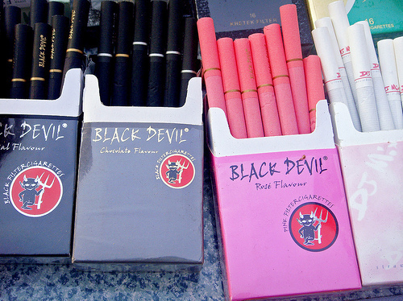
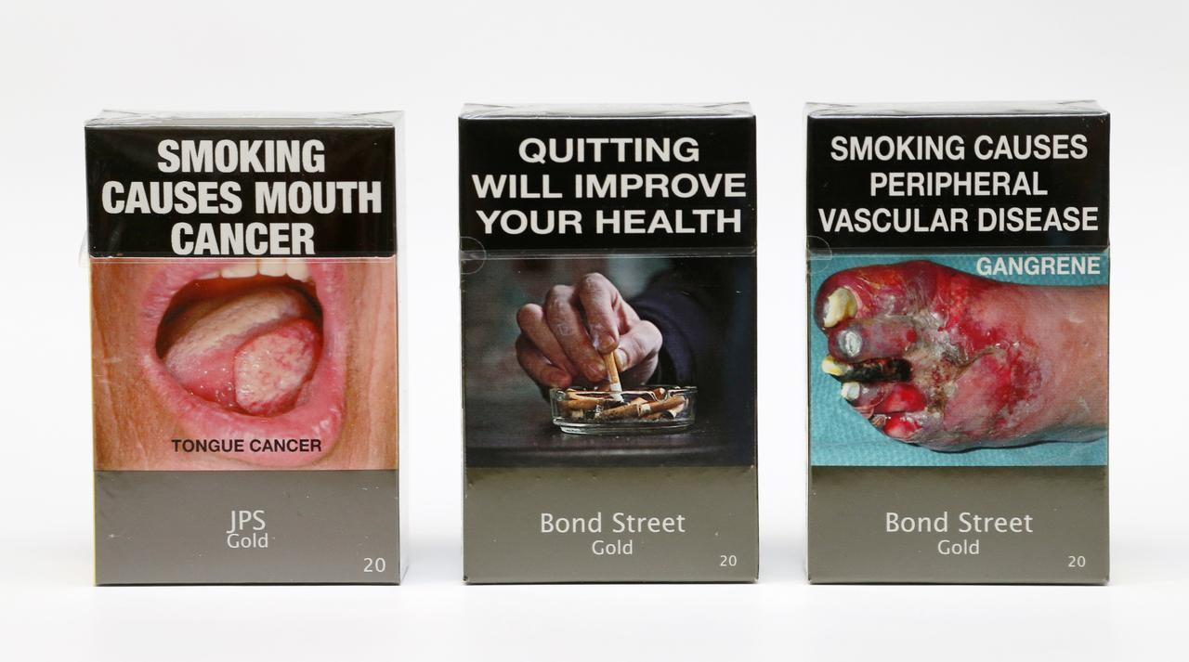
3 levels of policy and regulation
IL
EU
MS

Slide 24
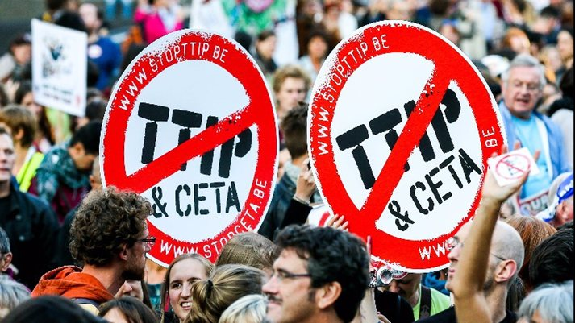
Between the Law and the Policy
CETA, TTIP

Slide 25
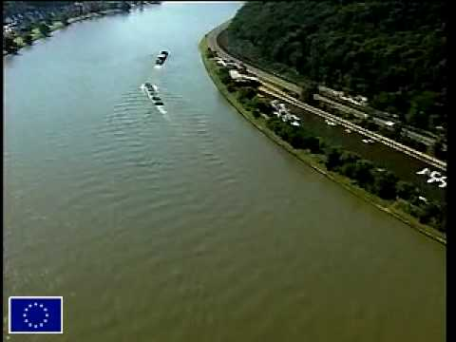
http://www.youtube.com/watch?v=T8gvH52dYAI

Slide 26
EU and environmental protection
European Union environmental legislation has developed over the last 30 years.
Environmental policy was not regulated at the Community level in the beginning, the Treaty of Rome does not contain regulations regarding this.
In the beginning, economic integration was the focus.
Awareness about environmental pollution began to develop because of:
Intensive economic growth
The fast growth of industrialization
Increasing energy consumption
These circumstances led to the regulation and protection of the environment at the community level.
https://www.youtube.com/watch?v=uTEMFKKuKxE

Slide 27
Phase 1: 1958 - 1972
1958 EEC Treaty
No specific attention to development of environmental policy
Minor measures (common market based – dangerous chemicals, motor vehicles, detergents)

Slide 28
Phase 2: 1972 - 1987
European Council Summit in 1972: Heads of State and Government decided that a Community environmental policy was necessary
The basis of the environmental policy was established in the First Environmental Action Program (1973). Basic goals, principles of environmental law, and activities regarding certain fields of the environment.
The main goal was the efficient operation of the Community and the Common Market – but extensive interpretation of economic expansion.
Major role of the Court of Justice.

Slide 29
Phase 3
1987 Single European Act
Independent title of environment was accepted
1993 Treaty on the European Union (Maastricht)
Protection of the environment became part of the internal common policy. The scope of environmental policy was enlarged and supplemented it with new objectives.
1997 Treaty of Amsterdam
„Environmental protection requirements must be integrated into the definition and implementation of the Community policies and activities referred to in Article 3, in particular with a view to promoting sustainable development.”

Slide 30
Phase 4 – Lisbon and further
2009: Treaty of Lisbon
the 3 pillars structure disappears
TUE + TFUE (former TEC) + Nice into a single Treaty
Strengthened role of the EU Parliament
Broader Union’s competences
Birth of the European External Action Service (EEAS)

Slide 31
Phase 4 – Lisbon and further
THE TREATY ON THE FUNCTIONING OF THE EUROPEAN UNION
TITLE XX. ENVIRONMENT
Art. 191 TFEU:
(1) Community policy on the environment shall contribute to pursuit of the following objectives:
- preserving, protecting and improving the quality of the environment;
- protecting human health;
- prudent and rational utilization of natural resources;
- promoting measures at international level to deal with regional or worldwide environmental problems.

Slide 32
Phase 4 – Lisbon and further
(2) Community policy on the environment shall aim at a high level of protection taking into account the diversity of situations in the various regions of the Community. It shall be based on the precautionary principle and on the principles that preventive action should be taken, that environmental damage should as a priority be rectified at source and that the polluter should pay. Environmental protection requirements must be integrated into the definition and implementation of other Community policies.

Slide 33
Phase 4 – Lisbon and further
(3) In preparing its policy on the environment, the Community shall take account of:
- available scientific and technical data;
- environmental conditions in the various regions of the Community;
- the potential benefits and costs of action or lack of action;
- the economic and social development of the Community as a whole and the balanced development of its regions.
(4) Within their respective spheres of competence, the Community and the Member States shall cooperate with third countries and with the competent international organizations.

Slide 34
Environmental action programme
Define the framework of the EU environmental policy.
The action programmes set up the challenges and priorities for a given period and create a frame for EU measures on the environment
These include legislation of common policy.
“The action programmes are political declarations of intent which take all the measures planned for a certain period, place them in an overall context, set priorities and, if necessary, introduce or explain changes in due course. They do not constitute a legal basis for Community environment measures.“ Ludwig Krämer

Slide 35
The First Action Programme (1973-1977)
emphasised the need for a comprehensive assessment of the impacts of other policies, in an effort to avoid damaging activities.
already contained, in an embryonic form, many of the later ideas behind "sustainable development".
proposed a gradual approach to defining environmental quality objectives
At the end of this process a definition of product and environmental quality norms was put forward.

Slide 36
The Second Action Programme (1977-1981)
This programme wanted to ensure the continuousness of the projects started under the first action programme.
Objectives:
  Priority of the protection of water, air and noise
  Rational use of land, environment and natural resources

Slide 37
First period – limited success
The evaluation of the practical success of this first period of environmental policy making is, in general, relatively critical. Initial enthusiasm declined considerably during the periods of economic recession (1975 - 1978, 1981 - 1983). Nevertheless a number of framework directives, especially for water and waste, were adopted during this period.

Slide 38
First period – limited success
  Principles introduced:
  Prevention is better than cure
  Subsidiary principle - action at appropriate level
  Environmental impacts to be accounted at earliest possible stage
  Avoidance of significant damage to ecological balance
  Improvement of scientific knowledge
  Polluter pays principle
  Activities in one member state should not cause deterioration in another, interests of developing countries
  Promotion of protection through international organisations

Slide 39
The Third Action Program (1982-1986)
Recognized the environmental policy as a separate policy:
Change in emphasis from pollution control to pollution prevention
Land use planning (a tradition of strategic environmental planning from the Netherlands)
  Integration of environment into other EC policies
  Emissions control policy
  During the 1980s, to avoid distortions in competition, German industries and the government successfully lobbied for a harmonised European emissions control policy, a culture of participatory environmental policies came from many of the smaller countries, a focus on setting environmental quality objectives from the UK and more recently the reform of chemicals policies in Scandinavian countries

Slide 40
The Fourth Action Program (1987 - 1992)
Emphasizes the analysis of benefits and cost, the polluter pays principle, responsibility in the environmental field
    Effective implementation of existing Community legislation
    Regulation of all environmental impacts of 'substances' and 'sources' of pollution
    Increased public access to and dissemination of information
  Job creation

Slide 41
The Fifth Action Program (1993-2000)
Sustainable development
Reference to the sectoral approach
The emphasis on new instruments.
The new consensus-oriented approach taking into account the crucial role of non-governmental protagonists and local/regional authorities to represent the general interest of the environment.
The setting of medium and long-term objectives

Slide 42
The Sixth Action Program (2001 - 2010):
  Four priority areas :
  emphasizing climate change as an outstanding challenge
  protecting, conserving, restoring and developing the functioning of natural systems, natural habitats, wild flora and fauna
  contributing to a high level of quality of life and social well being for citizens
  better resource efficiency and resource and waste management

Slide 43
A review in 2007
Underlines that the EU is still not on the way to sustainable development
It states that the domestic legislation of the MSs is influenced by the EU law at least to an extent of 80 %
The major conclusion is that there is an urgent need for better integration, and environmental policy must be revised in 2012

Slide 44

The 7th EAP
Covers the period 2013-2020
Towards a resource-efficient, low-carbon economy
"Living well, within the limits of our planet„
https://www.youtube.com/watch?v=T28MW67OSDI

Slide 45

The 7th EAP
2020 timeframe, 2050 vision, 9 priority objectives
Commitment by EU and its Member States
3 Thematic priority objectives:
  Protecting nature and strengthening ecological resilience
  Boosting sustainable, resource-efficient, low-carbon growth, and
  Effectively addressing environment-related threats to health.
Notes:
45

Slide 46
The 7th EAP
Notes:
46

Slide 47

7th EAP
An enabling framework with 4 further priority
objectives:
Promote better implementation of EU environment law
Ensure that policies benefit from state of the art science
Secure the necessary investments in support of environment and climate change policy
Improve the way environmental concerns and requirements are reflected in other policies

Slide 48
7th EAP
2 more priority objectives focus on:
Enhancing the sustainability of EU cities
Improving the EU's effectiveness in addressing regional and global challenges related to environment and climate change

Slide 49
7th EAP
Priority objective 4: To maximise the benefits of EU environment legislation
63. In order to maximise the benefits of EU environment legislation, the programme shall ensure that by 2020:
(a) EU citizens have access to clear information showing how EU environment law is being implemented.
(b) The implementation of specific environment legislation is improved.
(c) Respect for EU environmental law at all administrative levels is reinforced and a level playing field in the internal market is guaranteed.
(d) Citizens’ trust and confidence in EU environment law is enhanced.
(e) The principle of effective legal protection for citizens and their organisations is facilitated.

Slide 50
7th EAP
EU Environmental policy is linked to the EU budget:
Green funding, 5 % - 20 % GC
Private investors
Europe 2020 - the EU's growth strategy
to become a smart, sustainable and inclusive economy. These three mutually reinforcing priorities should help the EU and the Member States deliver high levels of employment, productivity and social cohesion.
2015 Action Plan on circular economy

Slide 51
EU environmental policy and law
limits of law as a tool for harmonizing environmental policy in the EU
Formal law is limited in its capacity to harmonize environmental policy, e.g. of the different Member States in the EU
political reasons:
difficulties of negotiating compromises that still have the
capacity to harmonize, different cultures of public
administration, different philosophies of environmental
protection
legal reasons:
different legal systems (common law, civil law), different
legal cultures (discretion vs. binding rules)
sociological reasons:
- contrast ‘law in the books’ with ‘law in action’

Slide 52
EU environmental policy and law
Harmonization, in terms of uniformity of environmental laws, is no longer a key aim of the European Commission in the field of environmental policy
But a ‘unity in diversity’ approach is flawed because it can mask severe implementation deficits of EU environmental law in some Member States and it glosses over the continuing political tensions between EU supranational governance and the Member States’ wish to retain sovereignty over their environmental policies.
What is the relationship between environmental policy and environmental law?
-transmission belt
-broken chain, complex interactions
- sidelining law

Slide 53
Treaties – a summary of the major provisions
Before 1986 (Treaty of Rome) | Single European Act (1986) | Maastricht Treaty (Treaty of the Union - 1992) | Amsterdam Treaty (1999) | Lisbon Treaty (2009)
Art. 100 Harmonization (internal market) | ➔ Art 100a Harmonization + safeguard clause | ➔ Art 100a Harmonization + safeguard clause | ➔ Art 95 Harmonization + safeguard clause | ➔ Art 114 Harmonization + safeguard clause
Art. 235 Objectives of the Community | Art. 235 (not in use any longer!) | Art. 235 (not in use any longer!) | Art. 308 (not in use any longer!) | Art.352 (not in use any longer!)
- | Art. 130r - Objectives - Principles - Grounds - Int. coop. | ➔ Art. 130r - Objectives - Principles - Grounds - Int. coop. | ➔ Art. 174 - Objectives - Principles - Grounds - Int. coop. | ➔ Art. 191 - Objectives - Principles - Grounds - Int. coop.
- | Art. 130s Legal basis and procedure | ➔ Art. 130s Legal basis and procedure | ➔ Art. 175 Legal basis and procedure | ➔ Art. 192 Legal basis and procedure
- | Art. 130t Minimum stringency | ➔ Art. 130t Minimum stringency | ➔ Art. 176 Minimum stringency | ➔ Art. 193 Minimum stringency

Slide 54
Legal base
Article 3 TEU Objectives
New Article 4(2)(e) Shared competence
New Article 13 TFEU Animal Welfare
Article 191(2) – New - Climate change
New Title XXI Energy
Article 194 TFEU

Slide 55
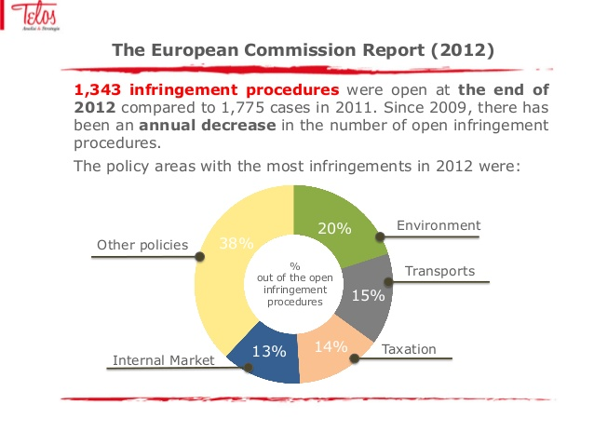
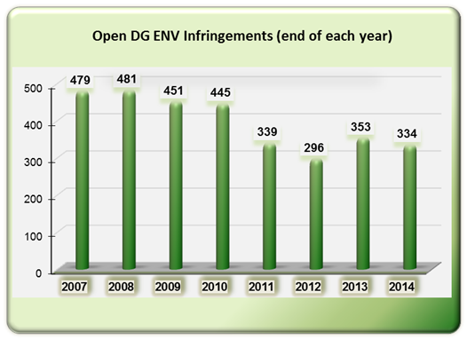

Slide 56
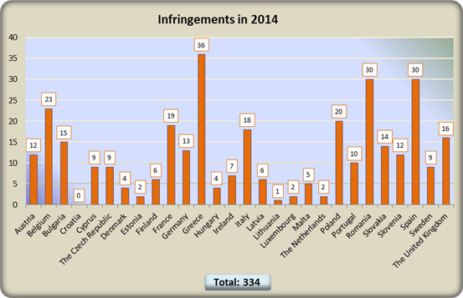

Slide 57
Thank you for your attention ☺
To be continued…

