Slide 1



Aarhus Convention. The right to information on the environment and participation of the public in the environmental protection.
12th December 2018
Dominik Židek

Slide 2


Content
Environmental Rights
Public participation in environmental matters at the international level
The Aarhus Convention (and the European Union law)
European Convention on Human Rights and European Court of Human Rights
Environmental management instruments incorporating access rights
Czech environmental law and access rights

Slide 3
Environmental Rights
Look at the video (next step) and prepare answers to the following questions:
  Try to define basic human rights related to the environment.
  What is environmental justice and how did it redefine the concept of environment?
  Why is environmental justice important?
  What is the goal of environmental justice and how does it want to achieve this goal?

Slide 4

Environmental Rights
Video:
https://www.youtube.com/watch?v=ISlZKIjS10o

Slide 5
Environmental Rights
Sustainable development
Rights of future generations
Rights of indigenous people
Environmental justice
Environmental migration
Right to environment or rights which flow from the right to environment, such as the right to be free from pollution, access to safe water and food, etc.
Health and well-being: right to a healthy environment or the right to an environment adequate for the well-being of people.

Slide 6
Environmental Rights
All persons have the right to a secure, healthy and ecologically sound environment.
All persons shall be free from any form of discrimination in regard to actions and decisions that affect the environment.
All persons have the right to an environment adequate to meet equitably the needs of present generations and that does not impair the rights of future generations to meet equitably their needs.

Slide 7
Environmental Rights
Environmental justice
  „Environmental justice is the fair treatment and meaningful involvement of all people regardless of race, colour, national origin, or income with respect to the development, implementation, and enforcement of environmental laws, regulations, and policies. EPA has this goal for all communities and persons across this Nation. It will be achieved when everyone enjoys the same degree of protection from environmental and health hazards and equal access to the decision-making process to have a healthy environment in which to live, learn, and work.“ (The United States Environmental Protection Agency definition)
=> Public participation in environmental matters at the international level

Slide 8
International level
1948 Universal Declaration of Human Rights
  no direct reference to environmental protection, but there are universal human rights standards (which may be) related to environmental protection
1966 International Covenant on Civil and Political Rights
  no direct reference to environmental protection, but there are universal human rights standards (which may be) related to environmental protection
1972 Stockholm Declaration on the Human Environment
  the Preamble recognized the intimate relationship between environmental protection and the enjoyment of human rights
1982 World Charter for Nature
  rights of nature distinct from human rights
1992 Rio Declaration
  "human beings are at the centre of concerns for sustainable development. They are entitled to a healthy and productive life in harmony with nature“
  Agenda 21: Non-binding action plan for sustainable development. Chapters 23 to 40 address issues related to access to information and civil society participation in decision-making.
1993 Vienna Declaration on Human Rights
  "all human rights are universal, inter-dependent and indivisible“

Slide 9
International level
Universal human rights standards related to environmental protection
The right to information
The right to participation
The right to justice

Slide 10
International level
The right to information
Article 19 of the Universal Declaration of Human Rights: “Everyone has the right to freedom of opinion and expression; this right includes freedom to hold opinions without interference and to seek, receive and impart information and ideas through any media and regardless of frontiers.”
Article 19 of the International Covenant on Civil and Political Rights: “2. Everyone shall have the right to freedom of expression; this right includes freedom to seek, receive, and impart information and ideas of all kinds, regardless of frontiers, either orally, in writing, in print, in the form of art, or through any other medium of one’s choice.”

Slide 11
International level
The right to participation
Article 21 of the Universal Declaration of Human Rights: “1. Everyone has the right to take part in the government of his country, directly or through freely chosen representatives.”
Article 25 of the International Covenant on Civil and Political Rights: “Every citizen shall have the right and the opportunity, without any of the distinctions mentioned in article 2 and without unreasonable restrictions: (a) To take part in the conduct of public affairs, directly or through freely chosen representatives.”

Slide 12
International level
The right to justice
Article 2 of the International Covenant on Civil and Political Rights: “3. Each State Party to the present Covenant undertakes: (a) To ensure that any person whose rights or freedoms as herein recognized are violated shall have an effective remedy, notwithstanding that the violation has been committed by persons acting in an official capacity; (b) To ensure that any person claiming such a remedy shall have his right thereto determined by competent judicial, administrative or legislative authorities, or by any other competent authority provided for by the legal system of the State, and to develop the possibilities of judicial remedy; (c) To ensure that the competent authorities shall enforce such remedies when granted.”
Article 14 of the International Covenant on Civil and Political Rights: “1. All persons shall be equal before the courts and tribunals. In the determination of any criminal charge against him, or of his rights and obligations in a suit at law, everyone shall be entitled to a fair and public hearing by a competent, independent and impartial tribunal established by law. The press and the public may be excluded from all or part of a trial for reasons of morals, public order (ordre public) or national security in a democratic society, or when the interest of the private lives of the parties so requires, or to the extent strictly necessary in the opinion of the court in special circumstances where publicity would prejudice the interests of justice; but any judgement rendered in a criminal case or in a suit at law shall be made public except where the interest of juvenile persons otherwise requires or the proceedings concern matrimonial disputes or the guardianship of children.”

Slide 13

The Aarhus Convention
The Aarhus Convention

Slide 14
;
The Aarhus Convention
Look at the 2 videos (next step) and prepare answers to the following questions:
  What rights do we have based on environmental democracy? (3 pillars of the Aarhus Convention)
  In what year was the Aarhus Convention adopted, how many signatories does it have and in which organization was it adopted?
  Is the European Union also a signatory to this Convention? If so, since when?
  What was the key case that the Court of Justice of the European Union dealt with environmental NGO‘s access to court according to the Aarhus Convention and what are its conclusions?
  What are the problems in the „EU – Aarhus Convention relationship“? Is the same standard of protection available in all EU countries?

Slide 15

The Aarhus Convention
Videos:
https://www.youtube.com/watch?v=uyhE9v2UnEQ
https://www.youtube.com/watch?v=2UvwbKCjmjA

Slide 16
The Aarhus Convention
Universal human rights standards related to environmental protection
The right to information
The right to participation
The right to justice
public participation in environmental decision-making
access to justice in environmental matters
access to environmental information
The Aarhus Convention

Slide 17
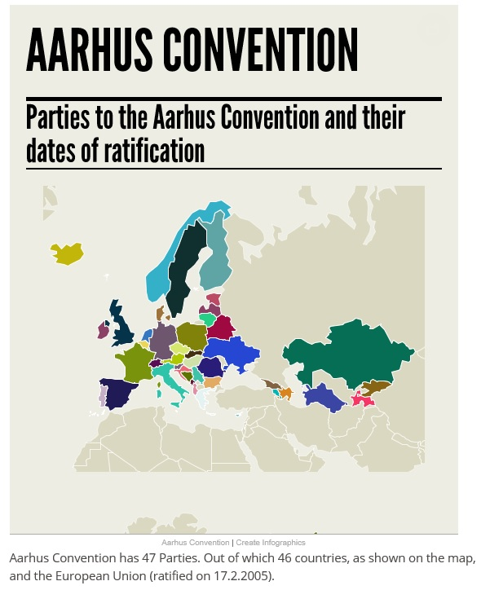
The Aarhus Convention
Adopted on 25 June 1998 in the Danish city of Aarhus (Århus).
Entered into force in 2001.
Adopted by The United Nations Economic Commission for Europe (UNECE) which was set up in 1947 by ECOSOC. It is one of five regional commissions of the United Nations.

Slide 18
The Aarhus Convention
All Member States of the EU and EU (itself) are the Parties to the Convention
Links environmental rights and human rights
Acknowledges that we owe an obligation to future generations
Establishes that sustainable development can be achieved only through the involvement of all stakeholders
Links government accountability and environmental protection
Focuses on interactions between the public and public authorities in a democratic context.
But only procedural rights!
http://live.unece.org/fileadmin/DAM/env/pp/documents/cep43e.pdf

Slide 19
The Aarhus Convention
Access to information
Article 5: Collection and dissemination of environmental information – Mandatory systems, electronic databases, providing information in case of imminent threat to human health or the environment, wide access free of charge.
Article 6: Public participation in decisions on specific activities
Article 7: Public participation concerning plans, programmes and policies relating to the environment
Article 8: Public participation during the preparation of executive regulations and/or generally applicable legally binding normative instruments
  with respect to decisions on whether to permit proposed activities listed in annex I
  decisions on proposed activities not listed in annex I which may have a significant effect on the environment
Access to public participation

Slide 20
The Aarhus Convention
Access to justice
Article 9: Access to justice – Following Art. 6, members of the public concerned
  (a) Having a sufficient interest or, alternatively
  (b) Maintaining impairment of a right, where the administrative procedural law of a Party requires this as a precondition
“The public” means one or more natural or legal persons, and, in accordance with national legislation or practice, their associations, organizations or groups;
“The public concerned” means the public affected or likely to be affected by, or having an interest in, the environmental decision-making; for the purposes of this definition, non-governmental organizations promoting environmental protection and meeting any requirements under national law shall be deemed to have an interest.
Public and public concerned
NGOs are considered public concerned

Slide 21
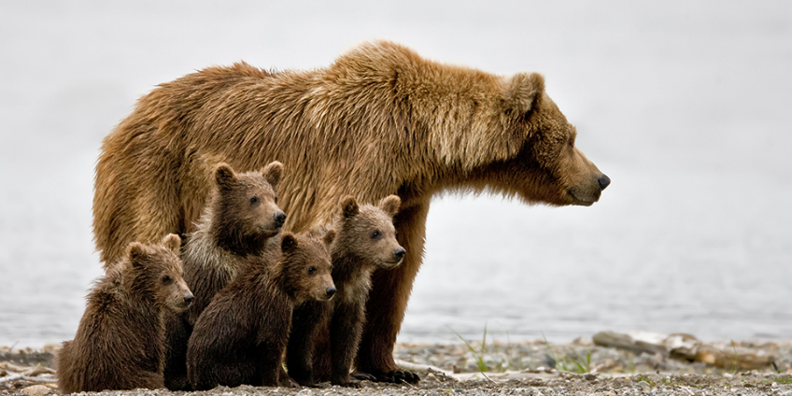
The Aarhus Convention
Aarhus Convention
European Union (european law)
Direct effect?
EU Member state (national law)

Slide 22
The Aarhus Convention
C-240/09 – The Slovak Brown Bear Case
No direct effect but...
The national courts must interpret their national law in accordance with the objectives of this provision (article 9 of the Aarhus Convention) and that of effective judicial protection of the rights conferred by European Union law, so as to enable an environmental NGOs to challenge before a court a decision taken following administrative proceedings liable to be contrary to European Union environmental law.
Judgment: https://eur-lex.europa.eu/legal-content/EN/ALL/?uri=CELEX%3A62009CJ0240
Summary: http://ec.europa.eu/dgs/legal_service/arrets/09c240_en.pdf

Slide 23
The Aarhus Convention
Is the same standard of protection available in all EU countries?
Right to a healthy environment ≠ protection of environment as a duty of the state
The national laws of individual Member States are based on a framework pursuant to the Aarhus Convention and European law (and the case law of CJEU), but the specific protection mechanisms are different in the ranks of national regulations, even to a large extent => also problems with the implementation of legislation.
Member states do not always apply the conventions provisions in the same way and sometimes they don‘t even fully comply with the conventions requirements.
One of the most important issue – legal standing which determines who and under what conditions is allowed to bring a complaint and to be heard in court.
Environmental rights: Portugal, France, Poland, Hungary, Romania, Slovenia, Spain, Czech Republic, Slovakia, Belgium, Croatia
Duty of the state: Germany, Austria, Bulgaria, Estonia, Latvia, Lithuania, Finland, Greece, Malta, Italy
No environmental protection: Cyprus, Denmark, Luxembourg, Ireland, Sweden
National law – constitutions

Slide 24
European Union law
Charter of Fundamental Rights of the European Union
  Article 37: Environmental protection: A high level of environmental protection and the improvement of the quality of the environment must be integrated into the policies of the Union and ensured in accordance with the principle of sustainable development.
Court of Justice of the European Union
  strict in granting access to justice
    it is essential for the individual to be affected in his or her own subjective rights in a way sufficient to distinguish him or her individually in the same way as the addressee of a contested decision
    associations formed for the protection of collective interests (typically NGOs) are not considered to be directly and individually concerned by a measure affecting the general interest
    CJEU will not deal with direct claims of individuals

Slide 25

The European Convention on Human Rights
European Convention on Human Rights and European Court of Human Rights

Slide 26
The European Convention on Human Rights
Article 3: Prohibition of degrading treatment
Article 6: Right to a fair trial
Article 8: Everyone has the right to respect for his private and family life, his home and his correspondence.
Article 13: Everyone whose rights and freedoms as set forth in this Convention are violated shall have an effective remedy.
Does not include a right specifically to protect the environment => does not offer protection from general deterioration of the environment (Kyrtatos v. Greece, 41666/98 [2003]) – Even clear violations of the rule of law cannot be remedied if the applicant is not sufficiently affected or if no direct link between the alleged victim and the violation can be proven.

Slide 27
European Court of Human Rights
Tătar v. Romania, 67021/01 (2007)
lived approximately 100 metres from a gold mine
the authorisation permit placed the operator under a general duty to protect the environment
no finding by the national authorities that the activity was harmful to the environment or that it was in violation of local environmental regulations
almost complete absence of official decisions or documentation which had taken into account the dangers to the public and the environment inherent in the activity being undertaken at the gold mine
the Court was unable to find any evidence to support that this deterioration had been caused by the activities at issue, the very existence of a serious and substantial risk to the health and well-being of the claimants placed an obligation on the state to adopt reasonable measures which were capable of protecting their private and family life
=> Violation of Article 8 – but no justification

Slide 28
European Court of Human Rights
Taşkin v. Turkey, 46117/99 (2004)
application was submitted by individuals living in the vicinity of a gold mine
the Supreme Administrative Court had found that the use of sodium cyanide in the mine posed a threat to the local environment and the health of the local population
the Council of Ministers adopted a decision that the gold mine should continue its activities
=> Violation of Article 6 and 8 – All 10 applicants received 3.000 EUR
Brânduşe v. Romania, 39951/08 (2009)
serving a ten year sentence in a prison for fraud
several complaints about the conditions in the prison, including over-crowding, poor food and invasion of privacy, all of which he alleged were violations of his Convention rights
one of the complaints concerned the proximity of the prison to a rubbish dump
=> Violation of Article 3 – justification 1.500 EUR

Slide 29
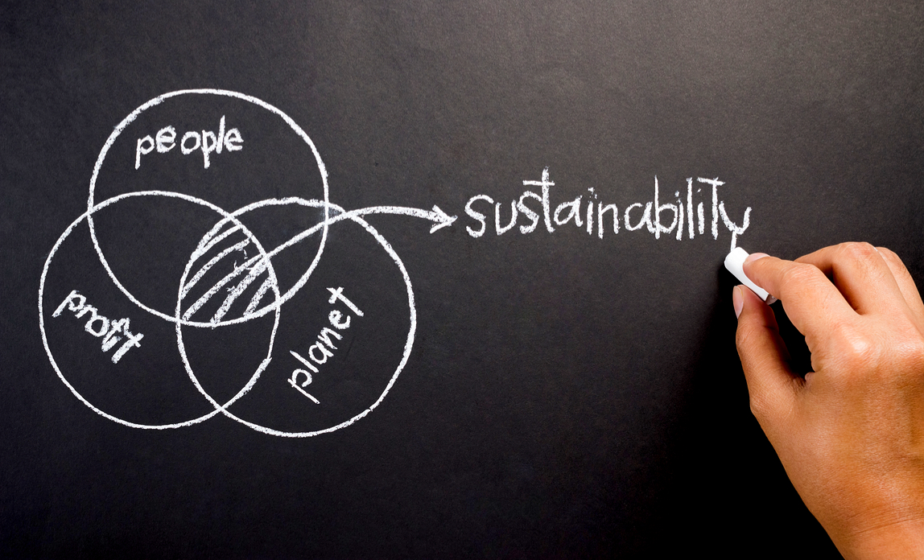
Environmental management instruments
Environmental management instruments incorporating access rights

Slide 30
Environmental management instruments
Environmental management instruments incorporating access rights
Environmental information systems
Periodic reporting on the state of the environment
Inventories of toxic emissions, pollutant release and transfer registers
Emergency and disaster risk information systems
Systematized environmental quality monitoring systems (urban, national)
Access to information

Slide 31
Environmental management instruments
Environmental management instruments incorporating access rights
Environmental impact assessment
Strategic environmental assessment
Public hearings on permits, authorizations and licences and for planning purposes
Advisory councils involving multiple actors
Legislative hearings
Preparation of emissions and environmental quality standards
(Environmental) land-use planning
Public consultations on standards, strategic instruments, and prevention and decontamination plans
Access to public participation
see previous lesson

Slide 32
Environmental management instruments
Environmental management instruments incorporating access rights
Administrative mechanisms and judicial actions
(Environmental courts)
Ordinary and administrative courts of justice specializing in the environment
Complaints to sectoral agencies with environmental competencies
Alternative conflict resolution
Access to justice

Slide 33
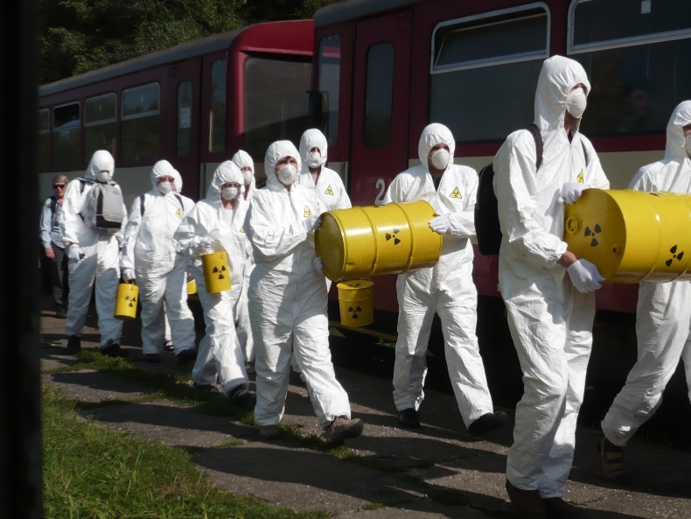
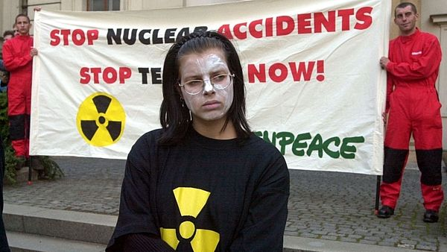
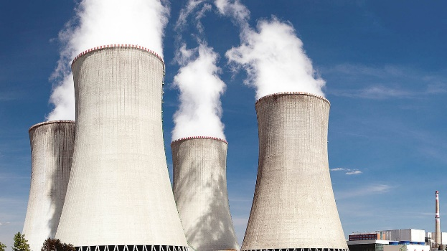
Czech environmental law and access rights
Czech environmental law and access rights

Slide 34
Czech environmental law and access rights
Charter of Fundamental Rights and Freedoms
Article 35
  (1) Everybody has the right to live a favourable living environment.
  (2) Everybody is entitled to timely and complete information about the state of the living environment and natural resources.
  (3) In exercising his or her rights nobody may endanger or cause damage to the living environment, natural resources, the wealth of natural species, and cultural monuments beyond limits set by law.
Article 41
  (1) The rights listed in ... Article 35 of the Charter may be claimed only within the scope of the laws implementing these provisions.

Slide 35
Czech environmental law and access rights
Universal human rights standards related to environmental protection
The right to information
The right to participation
The right to justice
especially Act No. 114/1992 Coll., on Nature and Landscape Protection, Act No. 100/2001 Coll., on Environmental Impact Assessment and Act No. 183/2006 Coll., Building Act
and other legislation
especially Act No. 123/1998 Coll., on the right to information on the environment
and other legislation
especially Act No. 150/2002 Coll., Code of Administrative Justice
and other legislation

Slide 36
Sources
Literature in IS MU – Full Information on the Course „SOC002“
Ludwig Krämer: EU environmental law. 7 ed. London: Sweet & Maxwell; University edition, 2012. 566 s. ISBN: 978-0-4140-2331-4.
J. Foti and others: Voice and Choice: Opening the Door to Environmental Democracy. Washington, D.C., World Resources Institute (WRI), 2008.
David R. Boyd: The Status of Constitutional Protection for the Environment in Other Nations. David Suzuki Foundation.
Office of the United Nations High Commissioner for Human Rights (ECLAC/OHCHR). Society, rights and the environment: international human rights standards applicable to access to information, public participation and access to justice (LC/W.712). Santiago, 2016.
Economic Commission for Latin America and the Caribbean (ECLAC). Access to information, participation and justice in environmental matters in Latin America and the Caribbean: towards achievement of the 2030 Agenda for Sustainable Development (LC/TS.2017/83). Santiago, 2018.

