Slide 1
Middle ages

Slide 2
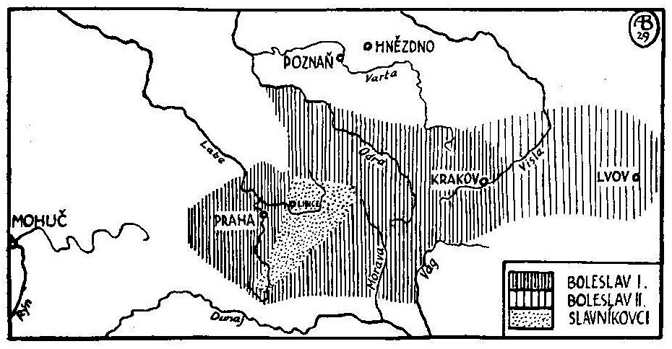
Early Middle Ages
Bohemia part of Great Morava – around 867
Bohemian principality
935 – constituation of the teritory
995 – liquidation of Slavník family
1029 – Moravia a part of our state
1035 – Statutes of Gniezdno (Břetislav decree)
1085, 1158 Kings tittle for Vratislav II. and Vladislav II.

Slide 3
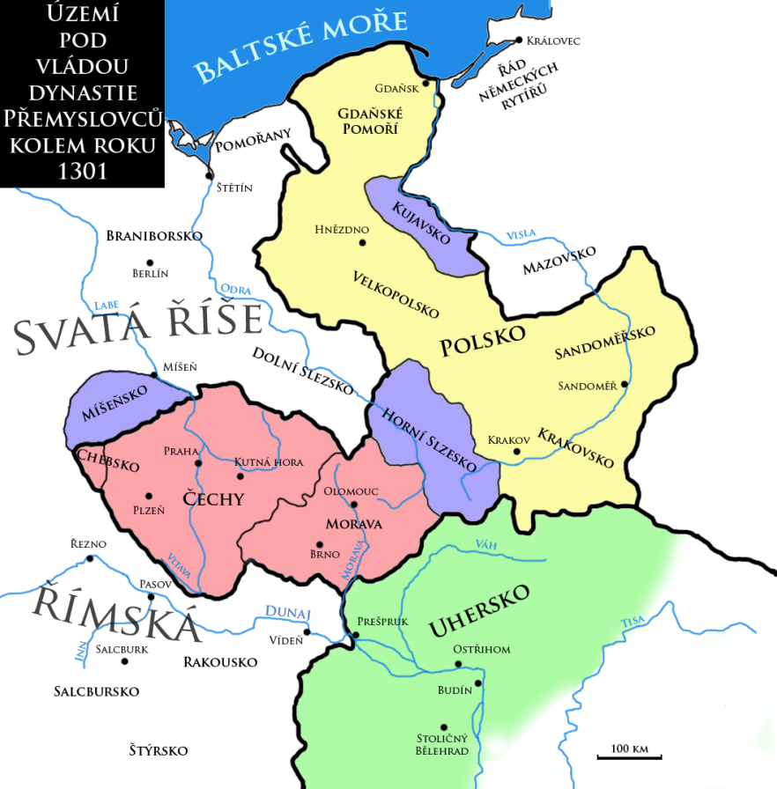
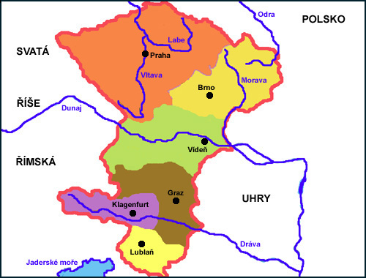
Bohemian kingdom 13th century
1212 Bohemian kingdom
Strong kings Přemysl I. Otakar, Vaclav I., Přemysl II. Otakar (not succefull candidate on emperor title – competitor of Habsburg)
Václav II. – king of Bohemia and Poland
Václav III. – King of Bohemia, Poland and Hungary

Slide 4
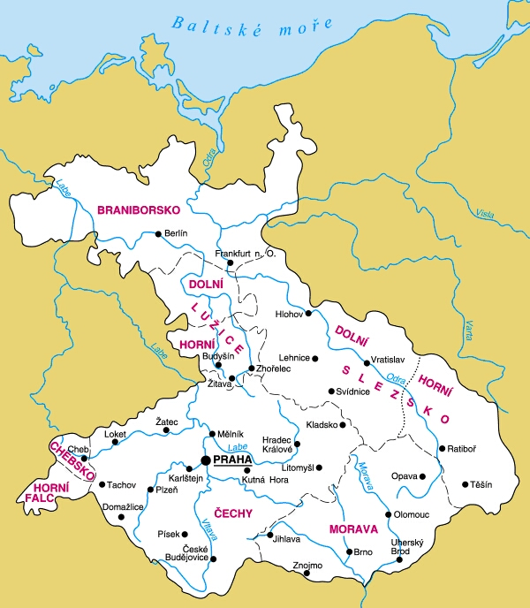
Bohemian kingdom 14th century
Václav II.
Reforms – finances (Prague penny, „groš“)
Ius regale montanorum 1300
Václav III. assassinated
Interregnum (Henry of Kärten, Rudolph Habsburg, Henry of Kärten)
1310- 1346 John of Luxemburg
1346 -1378 Charles IV
Majestas Carolina – draft of codification of the Land Law order (not successfull)
1378-1419 Václav IV

Slide 5
Bohemian kingdom 15th century
1415 – Jan Hus burned in Kostnice as a heretic
His followers revolting
1419 – defenestration in town hall in New City of Prague, king Václav IV died x czechs will not to have as king his brother Zikmund (king of Hungary)
Start of the „hussit revolution“
1421 – Council in Čáslav – towns have a share on the state affairs, beginning of a state of professions
1432 Battle of Domažlice – last cruciate was defeed – begin of negotiations with Concil in Basel
1437 „Basilejská kompaktáta“ – recognitions of hussits, with reservations – both hussits „utrakvists“ and catholics (sub una specie)
2 half of 15th century – conflict with Hungary
Bohemian King Jiří of Poděbrady (an effort to unite the Europe against the Turks, not succesful)
Jagello dynasty – catholic, but toleration of utrakvists and lutherans

Slide 6
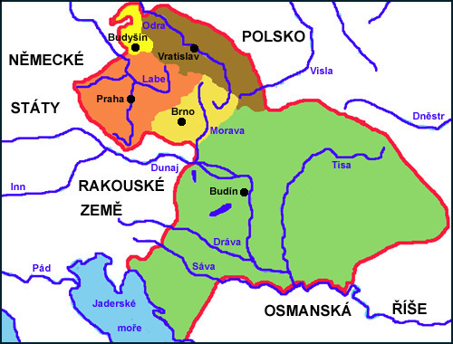
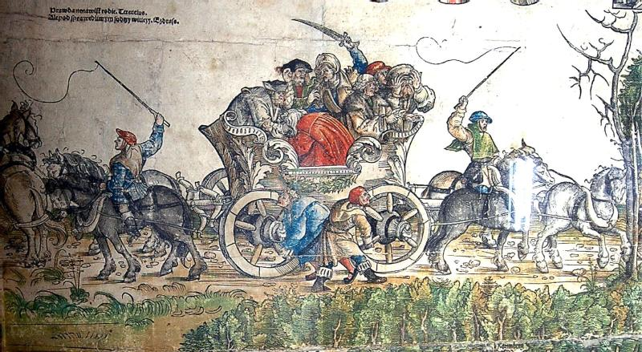
Bohemian Kingdom in 16th century
1526 – Ludvík Jagellonský died in battle of Moháč Hungary) – bohemian and hungarian kingdom without the king
Vote of Habsburg dinasty in both kindoms
Ferdinand I. tended to centralisation
1547 – 1st. Revolution of professions x defeated, less power for towns
1609 – Majesty of Rudolf II. – guarantee of religious freedom
1618 – catholics with a support of a king restricting non-catholics – third defenestration in Prague – the beginning of 30-years war (to be continued….)

Slide 7
The relationship of the Czech state and the Holy Roman Empire

Slide 8
Holy Roman Empire and Bohemia
935- Death of Václav I. (Hl. Wenceslaus)
935-972? – Bolesav I. – constituing of Czech state
Conflict with Saxony x ended in 950 – then cooperation with empor Oto (955 battle on Lech)
1002-1003 polish invasion by Boleslav the Brave – czech duke Jaromír aks for feud the empor of Holy roman Empire

Slide 9
Holy roman Empire and Bohemia II.
Begin of 11 century – part of Empire
Rex pro persona grata:Vratislav II (around 1087 – by empor Heinrich IV) Vladislav II (1157 – Barbrarossa battle of Milan)
End 12th century: century – Moravian Markgraf
1212 – Golden Bula of Sicily – Czech Kingdom
end of 13 century – Bohemian King one of Kurfürts
Begin of 14. century – The Přemysl dinasty death by sword (+Wencel III. assassinated In Olomouc) – the Bohemian Kingdom is free for feud – the Epmor Fridrich give it to his son Rudolf of Habsburg (he died one year later)
Golden bula of Charles IV – privileged position of Bohemian Kingdom – the king has full jurisdiction on the teritory of kingdom

Slide 10
Civitas – the town in legal sense
Half of 13th century – creation of the first towns in legal sense
Created by a monarch (1222 Uničov)
Rights
Political – self-goverment and own court (not a kings official as a judge)
Economical – the right to make beer, the right of a mile (banning the crafts withing 1 mile of the town, approx. 13 kilometers)
Legal families – Magdeburg and „Nürberg“ family
Schöppenbuch (Notarius Johannes – Brno, half 14th Century)
Efforts for codification
Beginning of 16th century, protection against nobility
Pavel of Koldín – the rights of the Prague Old Town – „Nürberg legal family“
1579 – Rights of towns in Czech kingdom

Slide 11
Important legal monuments
Ius regale montanorum – mining code for Kutná Hora (used by mining Court in Jihlava), influence on codification in Hungary, Spain and South America
„Vladislavské zřízení zemské“ – only codification of the law of the land, that was initiated by nobility and not by the king
Rights of towns in Czech kingdom – Pavel of Koldín, unification of the rights of towns in Czech lands, Moravia and from the beginning of 18th century partially in Silesia, in force up to 1811 (ABGB)

