Slide 1
Data, Information. Illusion of Privacy?
Jakub Míšek

Slide 2
Data and Information
Data v. Information
Many theories:
  Claude Shanon: Information as a way to lower entropy
  Luciano Floridi: Information consists of structured data
  Michael Keeble Buckland: Information
  BUCKLAND, Michael Keeble. Information as a Thing. Journal of the American Society for Information Science and Technology. 1991, Vol. 42, No. 5
    Information as knowledge: Knowledge (Intangible, Entity)
    Information as process: Becoming informed (Intangible, Process)
    Information as thing: Data, document (Tangible, Entity)
    Information processing: Data processing (Tangible, Process)
ADRIAANS, Pieter. Information. In: ZALTA, Edward N. (ed.). The Stanford Encyclopedia of Philosophy [online]. Stanford: Metaphysics Research Lab, Stanford University, 2013. Online: https://plato.stanford.edu/entries/information/

Slide 3
Data and Information
Norbert Wiener: Information as a basic premise of life
  Assumption: Everything decays into entropy
  Information is a way, how this decay slow or divert
  The true information = information which has an organising effect
  Basic notions:
    Information is an opposite of entropy
    Living organisms have more than critical amount of information
    Living organisms (or their parts) react on a change of conditions with production of information
  Examples: Ants, Justice
The Law as an Information system
  The law as a way how to lower entropy in the society

Slide 4
Law and Information
Presumption: The centrality of a human
Information rights - 3 basic rights
  Obtain information
    To get the information from outside
  To have information
    Have control over information
    Process information
  Create, share and communicate information
Regulation of Information
  Duties correlating to these rights
  Regulation of the environment

Slide 5
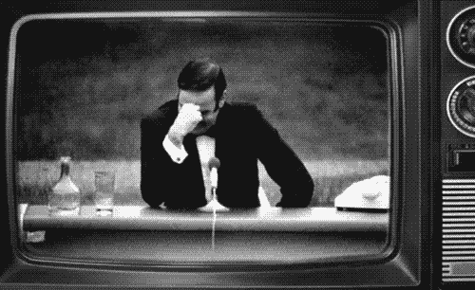

Slide 6
Privacy v. Personal Data
Why this question?
Personal data protection as an independent fundamental right
  Different purposes
    Protection of privacy v. Protection of rights and interests of natural persons in relation with processing of their personal data (+ purpose of enabling a fair processing)
  Different means of protection
    Private v. Public law
    Restitutive v. Preventive
    Court v. DPA
    Distributive v. Non-distributive right

Slide 7
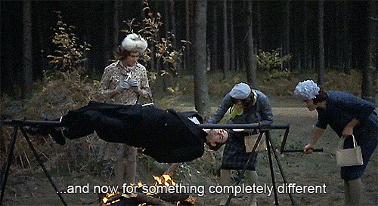

Slide 8
Is there still privacy?
Privacy is dead!
  The new world paradigm
  Social networks
    Surveillance Capitalism
  Massive surveillance
    If you do not do anything bad, you do not have to be afraid!
    Automated face recognition
    Social credit systems
    Snowden revelations
  Cambridge Analytica
  Data breaches

Slide 9
But!
Privacy is the essential value for free democratic liberal society.

Slide 10
Thank you for your attention.
Questions?
@jkb_misek

