Slide 1
Three ships doc. JUDr. Pavel Salák jr., Ph.D. Katedra dějin státu a práva PrF MU

Slide 2
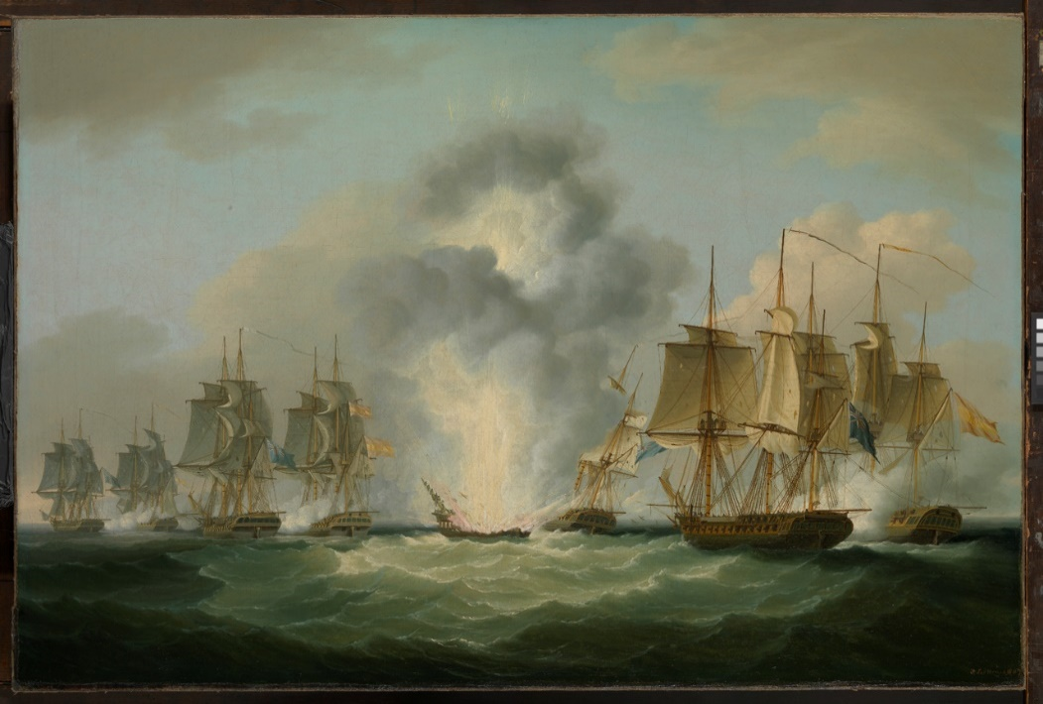
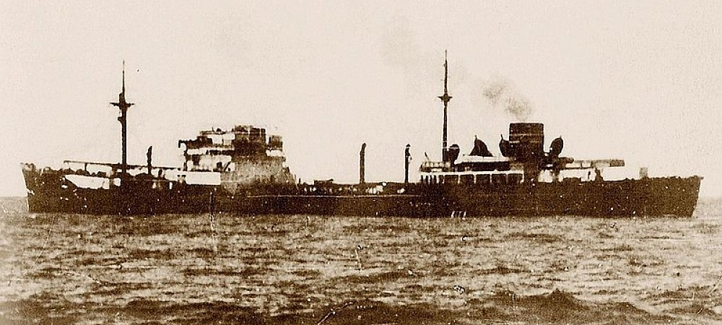
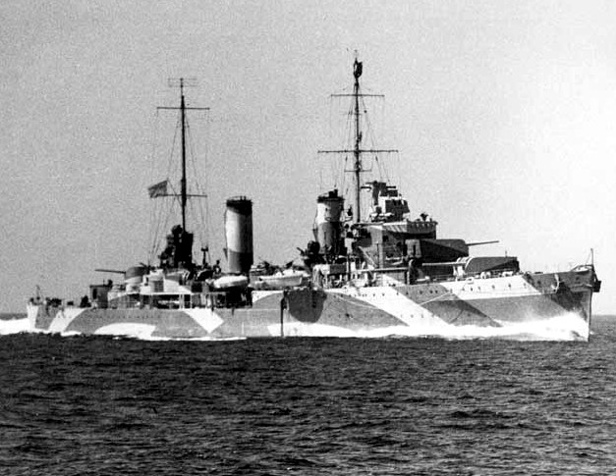
Three ships – three stories
Nuestra Señora de las Mercedes Franken,
HMAS Perth

Slide 3
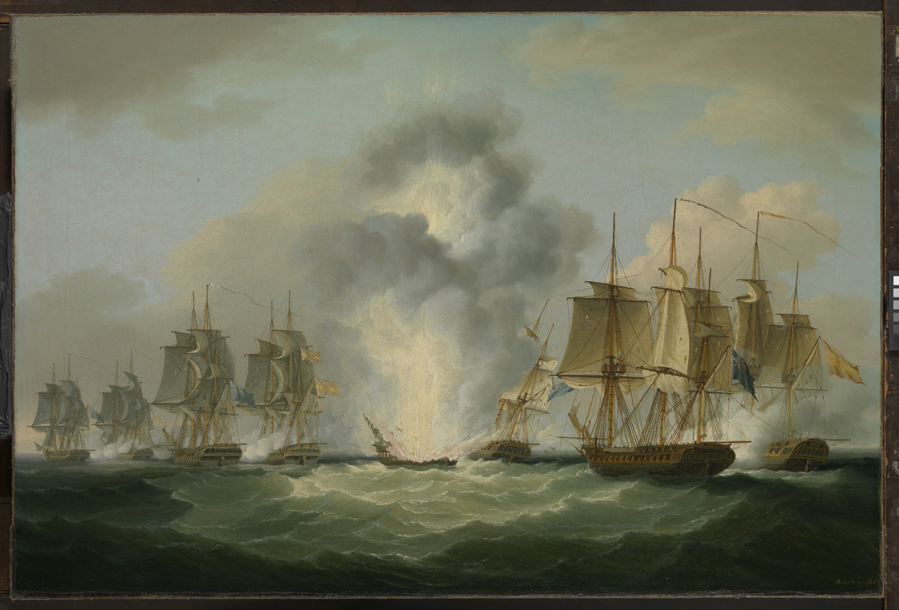
Nuestra Señora de las Mercedes (Our Lady of Mercy in English, a title of the Virgin Mary)
Four frigates capturing Spanish treasure ships (5.October 1804) by Francis Sartorius, National Maritime Museum, UK

Slide 4
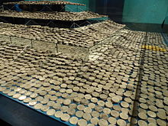
Nuestra Señora de las Mercedes Black Swan project
Was a Spanish Navy frigate which was sunk by the British off the south coast of Portugal on 5 October 1804 during the Battle of Cape Santa Maria.
At the time of the naval action Spain and England were at peace with each other.
A single shot from HMS Amphion, commanded by Samuel Sutton, hit the ship's magazine, causing an explosion that sank the ship.
250 Spanish crewmen were lost, and 51 survivors were rescued from the sea and taken as prisoner. The other three vessels were interned in Britain. Her wreck has been compared with that of USS Arizona at Pearl Harbor
The Spanish frigate was part of a small flotilla sailing from Montevideo (Uruguay) to Cadiz(Andalusia, Spain), transporting silver, gold, vicuna, cinnamon and quinoa.

Slide 5
Black Swan project
The Black Swan Project is the project name given by Odyssey Marine Exploration for its discovery and recovery of an estimated US$500 million (£314 million) worth of silver and gold coins from the ocean floor. Initially Odyssey kept the origin of the treasure confidential.
Knowledge of the recovery became public on May 18, 2007 when the company flew 17 tons of coins, mostly silver, from Gibraltar to a secure location of unknown address in Florida, USA. The company did not release the type, date, or nationality of the coins, while a rumor attributed it to the Merchant Royal, which sank near Land's End in 1641.
Salvage law in international waters - could award 90% of recovered treasure to the salvage firm x Spain claimed the entire ownership of the wreck and cargo, saying that it would pay no salvage award at all for the recovery because the cargo of the Mercedes would be protected by sovereign immunity, which supersedes admiralty law
Odyssey was sued by the Spanish government in U.S. courts, which eventually ordered the treasure to be returned to Spain. Odyssey pursued all legal avenues, even taking the case to the U.S. Supreme Court and losing. On February 27, 2012 the ship's treasure was flown back to Spain where the coins and other artifacts from the shipwreck are now exhibited in public museums. In 2015 a U.S. district court ordered Odyssey to pay Spain $1 million for "bad faith and abusive litigation.
The Court's decision rested mainly on its interpretation of the Foreign Sovereign Immunities Act (FSIA) and on the principle of comity. It said, "We do not hold the recovered [treasure] is ultimately Spanish property. Rather, we merely hold the sovereign immunity owed the shipwreck of the Mercedes also applies to any cargo the Mercedes was carrying when it sank.“

Slide 6
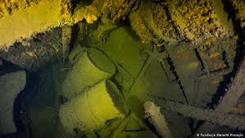
Case Franken
German tanker used during WW2
Sunk on 8th April 1945 near Danzig (Gdansk, Poland) by Soviet submarine
Cargo: cca 10.000 tons of petrol (60% still there – cca 3136 m³ petrol)
German ship sunk by a soviet submarine in (today) Polish teritorial water is – POLISH PROBLEM
German position „we can help you but through EU not as Germany, we deny any responsibility – it could be dangerous precedent
Nairobi International Convention on the Removal of Wrecks 2007 x few signatories

Slide 7
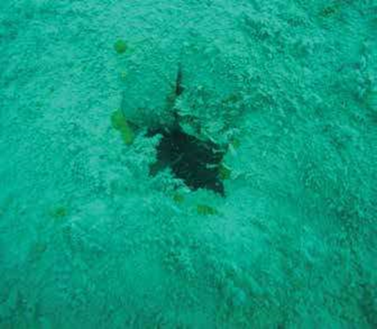
HMAS Perth – light cruiser
HMAS Perth (I) was one of three Leander class light cruisers commissioned into the Royal Australian Navy (RAN) in 1939
Following the capture of Singapore on 15 February 1942, Perth was ordered to join the American, British, Dutch and Australian (ABDA)
ABDA was formed in an attempt to block an anticipated Japanese invasion of the Dutch East Indies (Indonesia)
Fleet - two heavy cruisers, two light cruisers, 14 destroyers and 10 transports. X the ABDA force was hampered by language differences, communication problems and a lack of air support
On 27 February 1942 - Battle in Java sea – 7hours battle - Perth and Houston were the only two large Allied ships to survive the battle
At around 2300 on 28 February 1942, Perth and HoustAfter three more torpedo strikes, the cruiser heeled over to port and sank around 00.25 on 1 March 1942 with the loss of 353 crewon encountered a second Japanese invasion fleet

Slide 8
Discovered…
In 1967, Perth’s wreck site was discovered by Australian diver David Godwin Burchell about three nautical miles (4.8 kilometres) north-east of St Nicholas Point. In his book The Bells of Sunda Strait, Burchell reported that Perth lay almost intact – except for shell and torpedo damage – on its port side on a relatively flat sandy bottom in about 35 metres of water
Working with members of the Indonesian Navy, and with the permission of both the Australian and Indonesian Governments, Burchell recovered a number of items from Perth - Additional salvage work, including removal of all of Perth’s 4-inch guns, some of the bridge structure, and at least two of the cruiser’s four phosphor-bronze propellers, occurred in the early 1970s. The ship’s bell was also recovered around the same time and presented to the Australian War Memorial in 1974
With the advent of scuba diving and cheaper international airfares, Perth and Houston became popular technical diving attractions. In late 2013 recreational divers notified the Australian government that Perth was being salvaged by commercial divers. (Most of the cruiser’s superstructure had been removed, along with both forward 6-inch gun turrets, the amphibious aircraft catapult, portside crane and forward deck)

Slide 9
And then…
The story was immediately picked up by national and international media, and many people – including those whose family members died on the cruiser – were dismayed to learn that Perth was not protected under heritage legislation. Further, because Perth was a shipwreck, it was not considered an official ‘war grave’.
Since 2015, Perth’s internal compartments have been systematically salvaged, and its bulkheads, decks and internal fittings removed.
While Perth has been extensively damaged, there is some good news. Since the survey concluded, we have written a technical report of investigations that illustrates the threat posed to this significant historical and archaeological site. ARKENAS has proposed that the site be declared a Situs Cagar Budaya (Cultural Heritage Site) under Indonesian cultural heritage legislation, while the Ministry of Marine Affairs and Fisheries also intends to list the site as a Marine Conservation Zone.

Slide 10
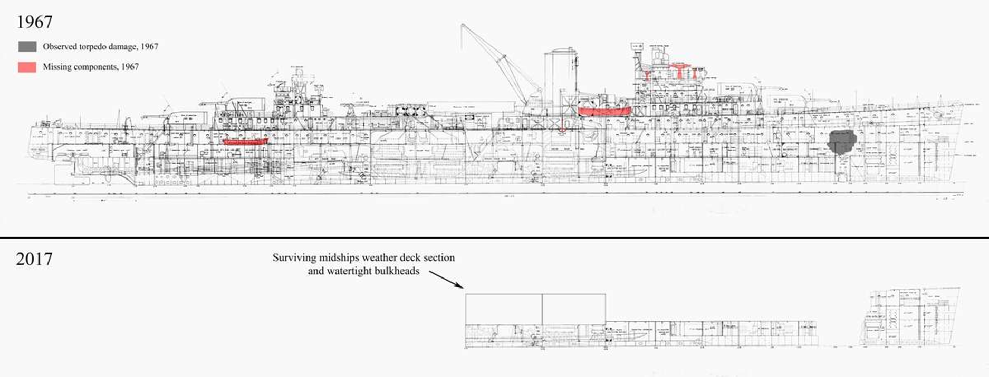
No comment necessary…
An estimated 3,000 tonnes of metal has been removed from the wreck. Most of the illegal salvage has occurred since 2013.

Slide 11
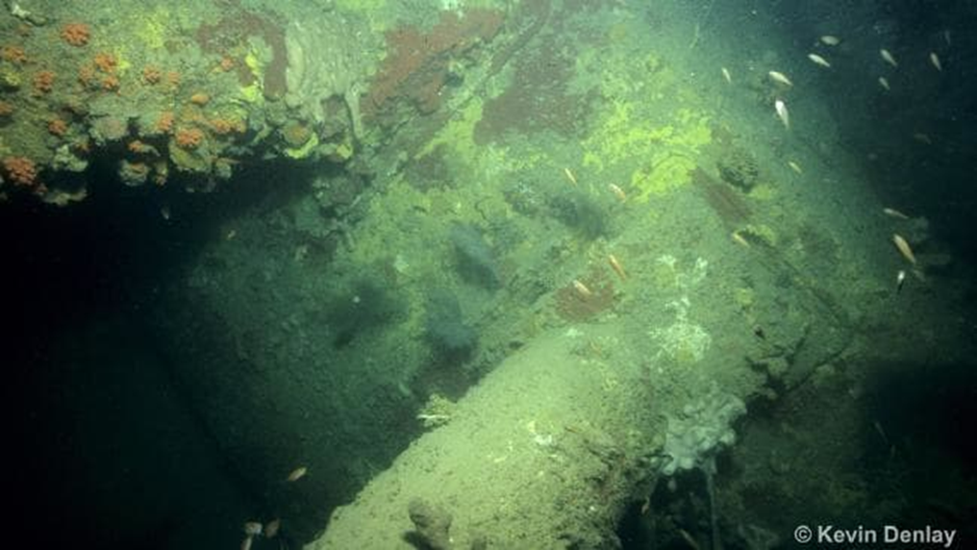
HMS Exeter.........HNLMS De Ruyter

Slide 12
https://www.theguardian.com/world/ng-interactive/2017/nov/03/worlds-biggest-grave-robbery-asias-disappearing-ww2-shipwrecks

Slide 13
Why?
Historic shipwrecks – particularly those of large, steel-hulled warships sunk before July 1945 – are one of the world’s few reliable sources of ‘low background’ steel, lead and copper alloys. These sites contain thousands of tons of metal that has been isolated from increasing amounts of atmospheric radiation caused by above-ground atomic detonations that commenced with the Trinity atomic bomb test in July 1945.

Slide 14
Děkuji za pozornost Thank You for Attention doc. JUDr. Pavel Salák jr., Ph. D.

