Slide 1
Marketing for Lawyers
Romana Buzková
Romana.Buzkova@law.muni.cz

Slide 2
Seminar 2 December 2019
Services, global brands
Successful examples
Service marketing
Customer service
Services in legal context

Slide 3
What is a service?
Any act or performance that one party can offer to another that is essentially intangible and does not result in the ownership of anything. Its production may or may not be tied to a physical product (Kotler 1994).
Service-based business x product-based business.

Slide 4
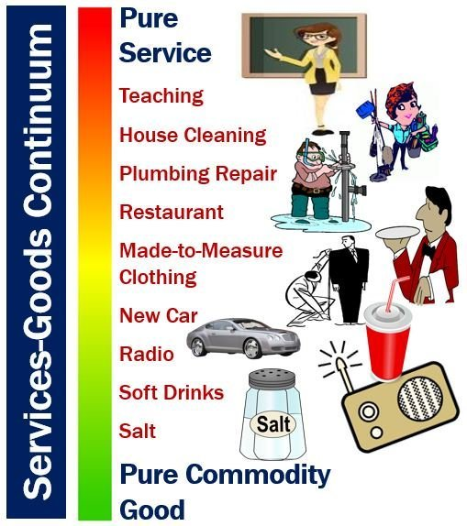
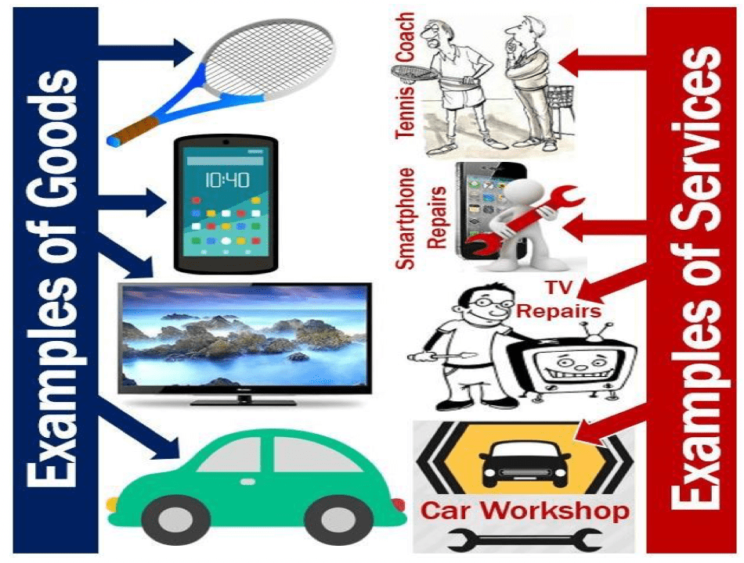
Service x product

Slide 5
Some examples of services
Accounting
Advertising
Banking and financial services
Communications
Consulting
Education and training
Health care
Leasing
Legal services
Maintenance and repair
Management and catering
Publishing
Transportation

Slide 6
Why is it important?
Services play an important role in today's world of business – we live in a service economy.
Services sector is the largest sector in the world.
Today, over two-thirds of GDP and four-fifths of employment in the OECD countries are in the services sector.

Slide 7




Examples

Slide 8
Best global brands
Which companies do you think that belong to top 3 in the world?
  …
  …
  …
https://www.interbrand.com/best-brands/best-global-brands/2019/ranking/

Slide 9






Do you know any Czech companies/brands?

Slide 10
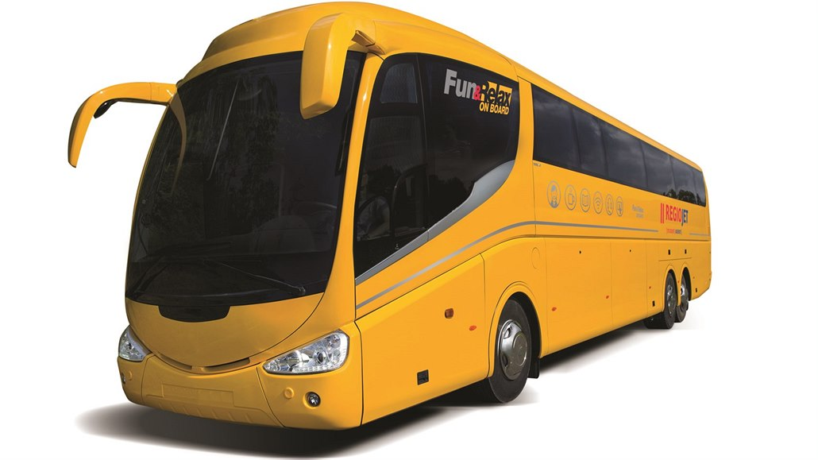

RegioJet (Czech example)
https://www.regiojet.com/

Slide 11
Share your story ☺
Find a (successful) example from your country.
Prepare a short description of the company and its services.
What makes it special? Why do you like it?
Is there anything you do not like?
Do you have any recommendations for improvement?

Slide 12
Service marketing
Smart ways to market a service business: https://www.youtube.com/watch?v=O7iGZ9hpPjg
Service marketing triangle: https://www.youtube.com/watch?v=BhY5OAz4vIA
Discussion
How would you describe the marketing strategy of your company?

Slide 13
Customer service
Everything what a company does for satisfaction of its customers.
Helps to gain higher profit from sold products.
Customer services can be also an important competitive advantage.
Why customer service matters: https://www.youtube.com/watch?v=nxtaMdu55Ug

Slide 14
Customer service
May be provided by a person or by automated means.
Understanding of customers' needs and wishes.
Influences emotional experiences from purchase and helps to increase the satisfaction of customers.
Generates income and revenue.

Slide 15
Customer service
Before, during and after the purchase.
Examples of customer services:
  Providing sufficient information about the company and its products
  Payment options
  Transport and packaging of products according to customers' preferences
  Maintenance services
  Free phone connection
  Online helpdesk
  Others

Slide 16
Customer service
How to offer it:
Know your product (do not leave a customer with an unanswerened question).
Body language/communication (smile, keep an eye contact).
Anticipate customers‘ needs (go the extra mile).

Slide 17
Tasks in groups ☺
Think about any kind of service that can be provided in addition to standard legal services.
Try to find a legal office from your country which in your opinion provides good (accompanying) services.

Slide 18

Thank you for your attention!

Slide 19
References
Lucie Kaňovská: Service Marketing, 2017 (Brno University of Technology, Faculty of Business and Management)
https://marketbusinessnews.com/financial-glossary/services/

