Slide 1


BASICS OF EU ENVIRONMENTAL LAW
Harmonization of environmental requirements. EU law transposition and implementation. The role of national courts and the role of CJEU.
5. 3. 2018
Mgr. Vojtěch Vomáčka, Ph.D., LL.M.

Slide 2
Last lecture summary
Protection of the environment is "one of the Community's essential objectives" which may as such justify certain limitations of the principle of the free movement of goods.
Sources: Primary legislation – Treaties (TEU, TFEU, Charter) = base for legislation, principles, Secondary legislation – regulations, directives, decisions, opinions and recommendations, Conventions and Agreements, Supplementary law

Slide 3
Article 191
1. Union policy on the environment shall contribute to pursuit of the following objectives:
- preserving, protecting and improving the quality of the environment,
- protecting human health,
- prudent and rational utilisation of natural resources,
- promoting measures at international level to deal with regional or worldwide environmental problems, and in particular combating climate change.
2. Union policy on the environment shall aim at a high level of protection taking into account the diversity of situations in the various regions of the Union. It shall be based on the precautionary principle and on the principles that preventive action should be taken, that environmental damage should as a priority be rectified at source and that the polluter should pay.

Slide 4
Last lecture summary
Secondary legislation: Horizontal legislation, Sectoral legislation
Around 1000 pieces of legislation (200 important) targeted at both EU and member states, not a comprehensive system

Slide 5
Last lecture summary
Aims of EU environmental policy:
High level of protection
Integration
Sustainable development
(Public participation)
Environmental principles (in narrow sense):
Prevention
Precautionary principle
Polluter pays
Rectification at source

Slide 6
Characteristics
MULTI-LAYERED SYSTEM
Where the EU regulation does not specifically provide any specific means of enforcement or refers for that purpose to national laws, regulations and administrative provisions, the Member States are required to take all measures necessary to guarantee the application and effectiveness of EU law.
For example, the sanction provided for must be analogous to those applicable to infringements of national law of similar nature and importance, and must be effective, proportionate and dissuasive.

Slide 7
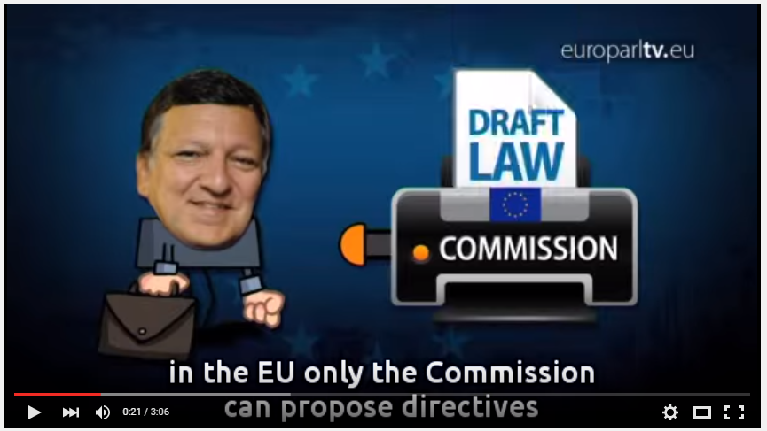
https://www.youtube.com/watch?v=ypMvDKW5qm0

Slide 8
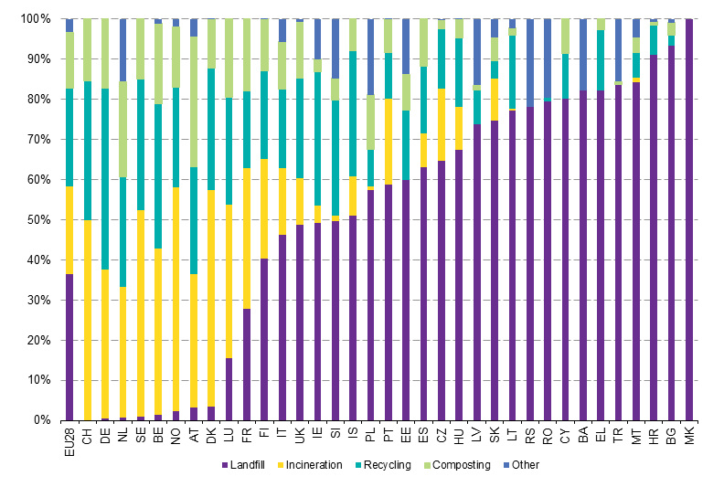
Harmonization of environmental requirements

Slide 9
Harmonization of environmental requirements
Reasons:
Environmental and safety reasons: facing transboundary or global problems (ozone depletion, climate change, biodiversity, air and water pollution, etc.).
Market and economy reasons.
Avoiding freeruners: same rules, principles and sanctions (existing discrepancies).
Lobby and policy, international obligations.

Slide 10
Transposition and implementation
Art. 4 (3) TEU:
Pursuant to the principle of sincere cooperation, the Union and the Member States shall, in full mutual respect, assist each other in carrying out tasks which flow from the Treaties.
The Member States shall take any appropriate measure, general or particular, to ensure fulfilment of the obligations arising out of the Treaties or resulting from the acts of the institutions of the Union.
The Member States shall facilitate the achievement of the Union's tasks and refrain from any measure which could jeopardise the attainment of the Union's objectives.

Slide 11
      EXAMPLE: SANCTIONS
1) Particular requirements
Numerous directives require MS to establish 1) effective system of sanctions, 2) effective system of sanctions with particular sanctions and measures (withdrawal of permit, measures to ensure that compliance is restored within the shortest possible time)
2) Duty of cooperation of the member states
Geelhoed in C-304/02:
Member States are under a general obligation under Article 10 EC to take all measures necessary to ensure that Community law is applied and enforced effectively and that its ‘effet utile’ is achieved.(…) to ensure ‘that infringements of Community law are penalised under conditions, both procedural and substantive, which are analogous to those applicable to infringements of national law of a similar nature and importance and which, in any event, make the penalty effective, proportionate and dissuasive.
- Taken as a whole, the system of remedies must be dissuasive (see C‑565/12)

Slide 12
Transposition and implementation
Result: environmental policy is highly decentralised when it comes to implementation and enforcement:
The control over its implementation is left, by virtue of Article 192(4) TFEU, to the Member States.
Implementation and the enforcement of the EU harmonised measures is entirely left to the Member States – control and punishment
Decisions as to whether to grant a license for operating a plant, to conduct an EIA, to regulate waste are matters for national, regional and even to local authorities, not for the Commission

Slide 13

The main characteristics of the EU environmental law
Correct application = protection of the environment
(specific measures, quality of air or water)
Caretta caretta (C-103/00)

Slide 14
      HARMONISATION OF INSPECTIONS (CONTROLS)
1) Direct inspections by the EU authorities
a) Without a necessary consent of the MS
Art. 101 and 102 TFEU (Competition law), gas trade, fuels and biofuels, pharmaceutics
Regulation 2185/96 (Customs)
Regulation 1073\/1999 (OLAF economic crimes)
ENVIRONMENTAL LAW:
DIRECT CONTROLS: Regulation 1224/2009 (common fisheries policy)
CONTROL OF CONTROLS: Directive 2010/64/EU, Art. 35/1 (protection of animals used for scientific purposes) – competence of the Commission to carry out inspection provided there are reasonable doubts
COOPERATIVE CONTROL BUT SEPARATE COMPETENCE TO GATHER INFORMATION: Regulation 1005/09, Art. 28 (protection of the ozone layer)
b) With the consent of the MS
Fact finding missions (126, 258 TFEU), no framework, C-387/97 (Waste in Crete), C-103/00 (Caretta caretta).

Slide 15
      HARMONISATION OF INSPECTIONS (CONTROLS)
1) Inspections by the national authorities
Comperhensive directive proposed by the Parliament but denied by the Council and the Commission
Sophisticated rules concerning food safety (Regulation 882/2006, Directive 90/425/EEC)
ENVIRONMENTAL LAW:
Art. 20 Directive 2012/18/EU on the control of major-accident hazards involving dangerous substances
Art. 23 Directive 2012/19/EU on waste electrical and electronic equipment (WEEE)
Art. 23 Directive 2010/75/EU on industrial emissions (IED)
Art. 34, 35 Directive 2010/64/EU on protection of animals used for scientific purposes
Art. 15 Directive 2009/31/EC on the geological storage of carbon dioxide
Art. 28 Regulation 1005/2009 on substances that deplete the ozone layer
Specific procedural requirements:
Council Directive 1999/31/EC of 26 April 1999 on the landfill of waste Art. 13(b) a landfill or part of it may only be considered as definitely closed after the competent authority has carried out a final on-site inspection (see C-498/17 – Italy, C‑626/16 - Slovakia)

Slide 16
Transposition and implementation
The adequacy of enforcement still remains a major issue
The European Commission only exercises a relatively marginal control over the proper implementation of EU secondary law
additional control over financing from EU funds
Important role of national courts and the role of CJEU.

Slide 17
CONTROL EXCERCISED BY THE COMMISSION
Non-communication
Non-conformity (non-transposition: delayed, incorrect)
Bad application (non-enforcement: no monitoring, no sanctions, non-application)
Commission gets information from reports, petitions, complaints, press, previous proceedings
EU Pilot: scheme designed to resolve compliance problems without having to resort to infringement proceedings
Only a few cases end up before the CJEU.

Slide 18
Transposition and implementation
C-126/96 (Inter-Environnement Wallonie)
The Belgian Conseil d'État referred to the Court for a preliminary ruling
Proceedings brought by an NGO for annulment of the Order of the Walloon Regional Executive on toxic or hazardous waste
Part of the Order infringes (?) the EU directives as it excludes from the permit system the operations of setting up and running an installation intended specifically for the collection, pre-treatment, disposal or recovery of toxic or dangerous waste, where that installation forms an integral part of an industrial production process.

Slide 19
Transposition and implementation
During the period laid for implementation? C-129/96
Since the purpose of such a period is, in particular, to give Member States the necessary time to adopt transposition measures, they cannot be faulted for not having transposed the directive into their internal legal order before expiry of that period.
Nevertheless, it is during the transposition period that the Member States must take the measures necessary to ensure that the result prescribed by the directive is achieved at the end of that period.
Although the Member States are not obliged to adopt those measures before the end of the period prescribed for transposition, it follows from the second paragraph of Article 5 in conjunction with the third paragraph of Article 189 of the Treaty and from the directive itself that during that period they must refrain from taking any measures liable seriously to compromise the result prescribed.

Slide 20
Transposition and implementation
During the period laid for implementation? C-151/14
Article 6(2) and (3) of the Habitats Directive provides:
2. Member States shall take appropriate steps to avoid, in the special areas of conservation, the deterioration of natural habitats and the habitats of species as well as disturbance of the species for which the areas have been designated, in so far as such disturbance could be significant in relation to the objectives of this Directive.
3. Any plan or project not directly connected with or necessary to the management of the site but likely to have a significant effect thereon, either individually or in combination with other plans or projects, shall be subject to appropriate assessment of its implications for the site in view of the site’s conservation objectives. In the light of the conclusions of the assessment of the implications for the site and subject to the provisions of paragraph 4, the competent national authorities shall agree to the plan or project only after having ascertained that it will not adversely affect the integrity of the site concerned and, if appropriate, after having obtained the opinion of the general public.

Slide 21
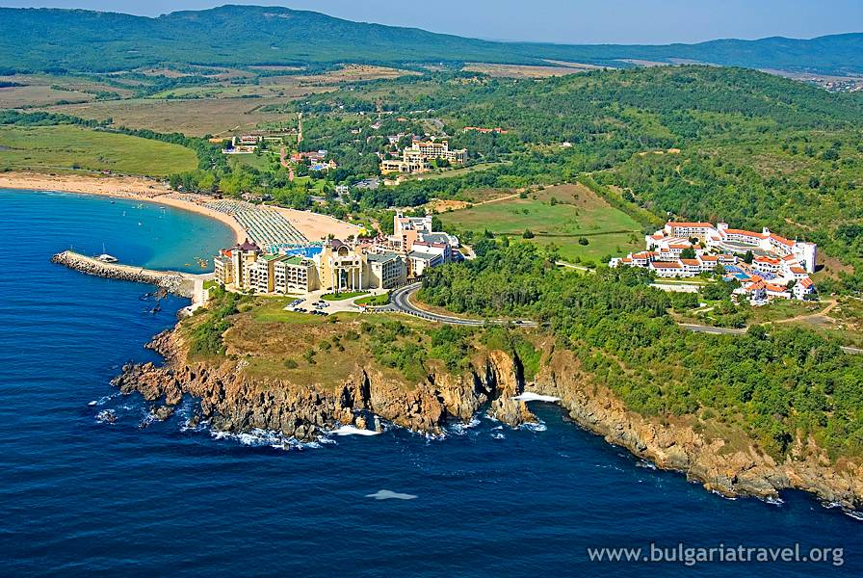
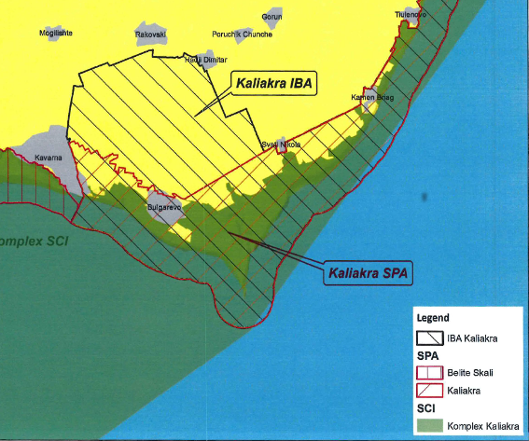
Transposition and implementation (C-141/14)

Slide 22
Transposition and implementation (C-141/14)
In that respect, it is clear from the Court’s case-law that Article 6(2) of the Habitats Directive also applies to installations the project for which was approved by the competent authority before the protection provided for in that directive became applicable to the protection area concerned.
Although such projects are not subject to the requirements relating to the procedure for prior assessment of the implications of the project for the site concerned, laid down by the Habitats Directive, their implementation nevertheless falls within the scope of Article 6(2) of that directive.

Slide 23
Transposition and implementation (C-141/14)
Conflicting national law?
Annulment
Non-application
C-41/11 (Inter-Environnement Wallonie II)
The referring court can, given the existence of an overriding consideration relating to the protection of the environment, exceptionally be authorised to make use of its national provision empowering it to maintain certain effects of an annulled national measure, in so far as the following conditions are met…

Slide 24
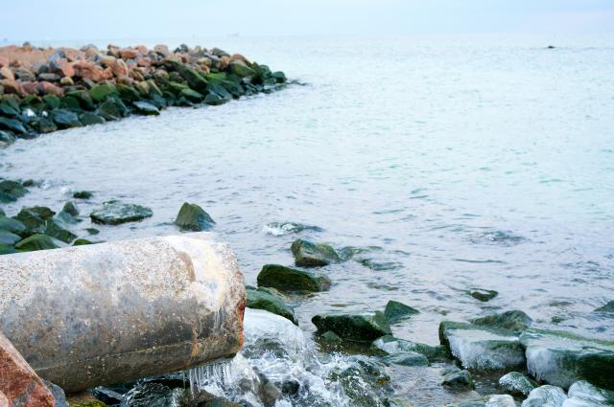
Correct application
Burden of proof - science comes to play
C-335/07, C-438/07: Treatment of urban waste water - Failure to require more stringent treatment of nitrogen in all treatment plants of urban waste water.

Slide 25
Correct application
Burden of proof - science comes to play
37 The submissions made by the parties indicate that, in general, one of the nutrients, whether it be phosphorus or nitrogen, is present (…).
38 In such circumstances, it is necessary to adopt different measures to reduce eutrophication in one part of the Baltic Sea as compared with another part. Directive 91/271 provides in this respect that the Member States are to assess, on the basis of the local situation, the substances – phosphorus and/or nitrogen – which contribute to eutrophication and, in accordance with that assessment, adopt appropriate treatment measures.

Slide 26
Correct application
Burden of proof - science comes to play
Eutrophication is one of the most widespread environmental problems of inland waters, and is their unnatural enrichment with two plant nutrients, phosphorus and nitrogen. One important result of lake and reservoir enrichment is increased growth of microscopic floating plants.

Slide 27
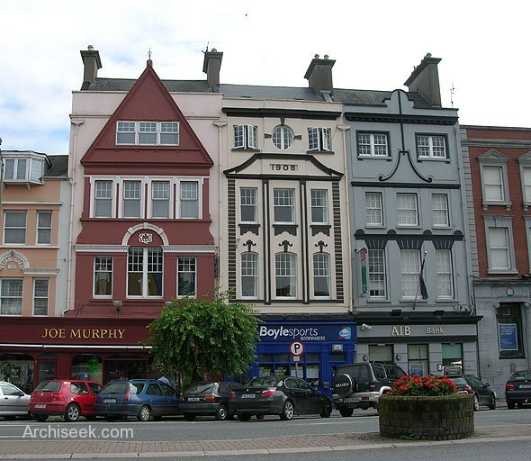
Correct application
Systematic failure of a Member State to fulfil obligations
C-494/01: waste operation at Fermoy, County Cork

Slide 28
Correct application
C-494/01:
“…in principle nothing prevents the Commission from seeking in parallel a finding that provisions of a directive have not been complied with by reason of the conduct of a Member State’s authorities with regard to particular specifically identified situations and a finding that those provisions have not been complied with because its authorities have adopted a general practice contrary thereto, which the particular situations illustrate where appropriate.“

Slide 29

Correct application
Consistent and general nature:
C‑342/05:
- Commission has never pleaded a lack of sincere cooperation by the Finnish authorities as regards the communication of decisions relating to the issuing of hunting permits
- in spite of the wolf hunting authorised by way of derogation in Finland, the conservation status of the species concerned substantially and consistently improved

Slide 30
Correct application
Systematic failure of a Member State to fulfil obligations – how long, how many times
C-420/02 – ‘Pera Galini’ site of waste: 4 years:
The direct inference may not in principle be drawn that the Member State concerned has necessarily failed to fulfil its obligations under that provision to take the requisite measures to ensure that waste is disposed (…). However, if that situation persists and leads in particular to a significant deterioration in the environment over a protracted period without any action being taken by the competent authorities, it may be an indication that the Member States have exceeded the discretion conferred on them by that provision.
C- 248/05 - While the extracts from the reports quoted by the Commission emphasise the contamination of water supplies, they do not establish to the requisite legal standard a causal link between that contamination and the presence of substances in list II.

Slide 31
Court of Justice (CJEU)
Moving the environmental protection further:
Interpretation of EU Law
Procedure: Art. 258 – 260 TFEU
Maastricht Treaty: Financial sanctions

Slide 32
Court of Justice (CJEU)
Article 260
1. If the Court of Justice of the European Union finds that a Member State has failed to fulfil an obligation under the Treaties, the State shall be required to take the necessary measures to comply with the judgment of the Court.
2. If the Commission considers that the Member State concerned has not taken the necessary measures to comply with the judgment of the Court, it may bring the case before the Court after giving that State the opportunity to submit its observations. It shall specify the amount of the lump sum or penalty payment to be paid by the Member State concerned which it considers appropriate in the circumstances. If the Court finds that the Member State concerned has not complied with its judgment it may impose a lump sum or penalty payment on it.
This procedure shall be without prejudice to Article 259.
3. When the Commission brings a case before the Court pursuant to Article 258 on the grounds that the Member State concerned has failed to fulfil its obligation to notify measures transposing a directive adopted under a legislative procedure, it may, when it deems appropriate, specify the amount of the lump sum or penalty payment to be paid by the Member State concerned which it considers appropriate in the circumstances. If the Court finds that there is an infringement it may impose a lump sum or penalty payment on the Member State concerned not exceeding the amount specified by the Commission. The payment obligation shall take effect on the date set by the Court in its judgment.

Slide 33
Court of Justice (CJEU)
Moving the environmental protection further:
Interpretation of EU Law
Procedure: Art. 258 – 260 TFEU
Maastricht Treaty: Financial sanctions
(C-304/02: both lump sum and a penalty payment)
– the seriousness of the infringement,
– its duration,
– the need to ensure that the penalty itself is a deterrent to further infringements.

Slide 34
Court of Justice (CJEU)
Seriousness of the infringement:
– the loss of Community own resources,
– the impact of the infringement on the way the Community functions,
– serious or irreparable damage to human health or the environment,
– economic or other harm suffered by individuals and economic operators, including intangible consequences, such as personal development,
– the financial sums involved in the infringement,
– any possible financial advantage that the Member State gains from not complying with the judgment of the Court,
– the relative importance of the infringement taking into account the turnover or added value of the economic sector concerned in the Member State in question,
– the size of the population affected by the infringement (the degree of seriousness could be considered less if the infringement does not concern the whole of the Member State in question),
– the Community’s responsibility with respect to non-member countries,
– whether the infringement is a one-off or a repeat of an earlier infringement (for example, repeated delay in transposing directives in a certain sector).

Slide 35
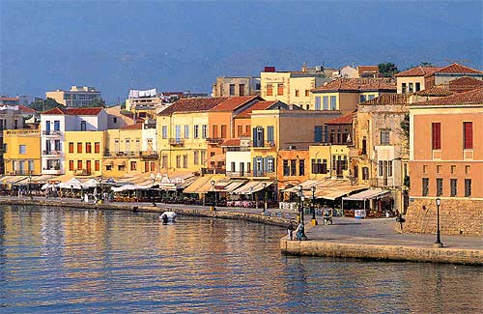
Court of Justice (CJEU)
C-387/97 – first fine
Waste management in Chania (Crete), problems known from 1987, first judgment C-45/91
24.600 EUR/day requested

Slide 36
Thank you for your attention

