Slide 1
Codifications of Privat Law

Slide 2
Basic overveiw
Koldín´s codification of Town law
GBGB
ABGB (1811, valid from 1.1.1812)
OZO (ABGB novelizated after 1918)
CC 1950
CC1964
CC2012 (valid from 1.1.2014)

Slide 3

Middle age
Land law
  Based on customs, very few influence of roman law
  Using of terminoligy x but other word meaning: medival „testament“
Towns law – stronger influence of roman law
  Schöppenbuch (Brno 14th century)
  Práva městská království českého (Koldín´s codification )
  – Bohemia 1571 (1610) Těšín (1598) Moravia (1680 subsidiary, 1697 full) valid until 1811

Slide 4
ABGB
Codex Theresianus
  Joseph Azzoni (Prague)
  1753-1766 Commission in Brno
Horten´s Draft – 1772-1776 (1780)
  Revision of Codex Theresianus
Josephinisches Gesetzbuch 1787 – 1. Part
Martini´s Draft 1790- 1793-1796
  Based on Horten s Draft
  Inspiration in ALR – Allgemeines preussisches Landesrecht (1794)
GBGB - (West)galizisches Bürgerliches Gesetzbuch 1797
ABGB 1811
  After 10 years of using of WGGB
  F. von Zeiller
  In Austria valid until today (big novelizations in WW1, 70-80ties – family law, 2015 law of succession)

Slide 5
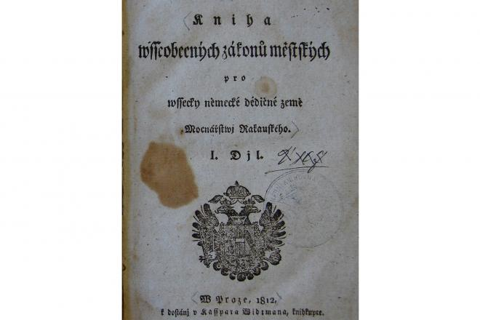
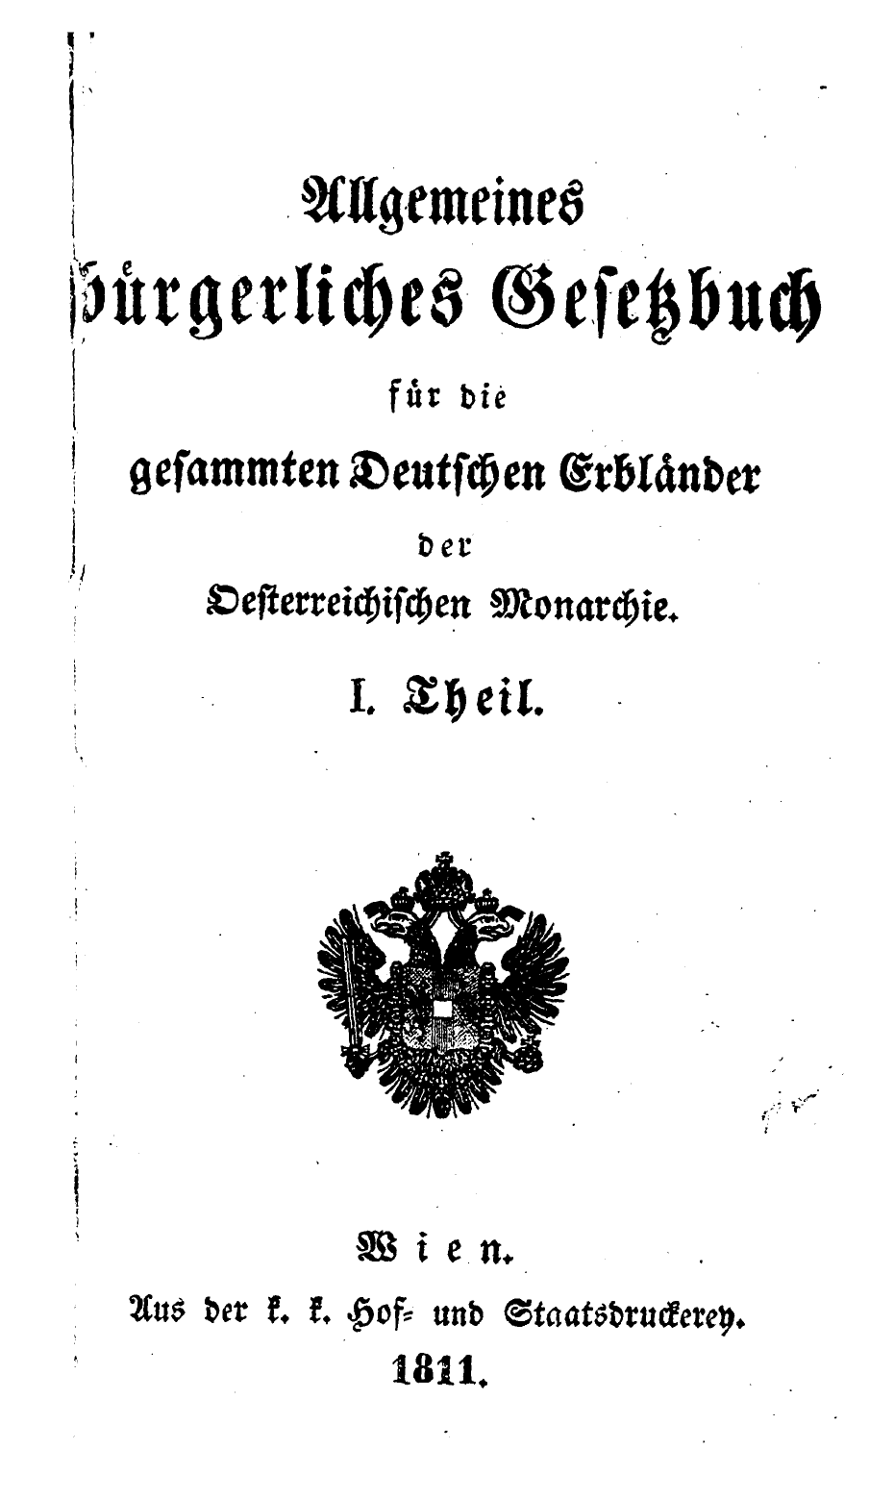
ABGB - characteristic
Three parts:
Law of persons
Rights to things (absolut and relativ)
General part
Sec. 7
the original proposal intended to embody secondary application of general law, but this provision was later abandoned and replaced by a reference to natural law

Slide 6
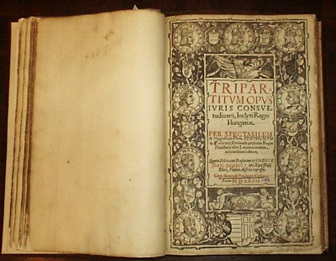
Hungary
Custom law
Tripartitum Opus Iuris – draft of codification by Stephan Verböczy
Acts x until half 19th century has custom law priority
End of custom law after the WW2

Slide 7
Interwar period - Civil law in Czechoslovakia
11/1918 Sb. – The Reception Norm / the law about the inception of the independent Czechoslovak state, 28.10.1918 / art. 2 “All existing laws and regulations have still remained in force.”
Czechia, Moravia, Silesia – Austrian laws – ABGB
Teritorry of Hlučín - Prussian laws /BGB x only short time – then the Austrian law/
Slovakia, Subcarpathian Ruthenia – Hungarian law norms
New codification is neccessary for unification of law - possibilities:
Translation of ABGB in czech and extension on the teritory of Slovakia an S. ruthenia x Slovak politics protest + ABGB need novelization to
Brand new codification x to long time for preparing
Code based od ABGB with novelizations and taking into account the law in force in Slovakia - the best idea for politics

Slide 8
Interwar codification - overview
1921-1924 – 5 Subcomitee
  Family law, Law of property, Law of inheritens, Obligation general part (and generel part of the code), Obligation – special part
  each subcommittee was headed by a professor of law and was composed of representatives of the Ministry of Justice and unification and practitioners (notaries, lawyers and judges)
  1924 – publication of proposed text – following the comments of the professional public, Commission of Slovak lawyers
Draft 1931 – final work of „Superrevission commission“
  followed by commentary by the authorities and ministries
Draft 1937 – final draft
  on the begining of the year 1937 started the legislativ procedure x stopped after Munich Dictate (1938) and WW2
  Draft 1937 is one of the sources of inspirations for Civil Code 2012
Draft 1946 – (not very known)
  an attempt to continue the legislative procedure after the WW2 x was halted after the Communists took office in February 1948

Slide 9
Civil Law 1948-1989 – Communist period
“Publication” of Civil law
- restriction on freedom of contract and volitive discretion with a property – e.g. preferences for the intestate succession prior to the property /
Ownership
- Distribution of the property institute with elimination of the private ownership and preferences for the state ownership
Separation of substance in more regulations - formation of new branches
– family law,
- land law
- economic legislation /planed economy/

Slide 10
OZ 1950
Civil code 1950 /Střední občanský zákoník/ - middle civil code
It was considered as a relatively good-class work x only thanks to the “quality” of the subsequent Civil Code from the year 1964.
It observed the terminology and features of “bourgeois” civil codexes x a number of terms expressed a different meaning
A negative demarcation against the Roman law in the explanatory report was very often
Provisions were very brief - then an extensive domain for an interpretation of the court

Slide 11
OZ 1964
More socialistic then the exemplary Soviet civil code
Abandonment of traditional terminology
Privat ownership – not regulated in part Property law – one section in „transitional and final provisions“
Abolishment of regulation of possession , usucaption and easements
Big novelization in 1982 – trying to eliminate the biggest problems (forced by lawyers from practice)
Zákon o mezinárodním obchodu – international trade act (101/1963) – reacted to the capitalist part of the word

Slide 12
After 1989
CC 1964 does not suit the ratios x there were bigger problems (commercial law)
Only novelizations(1990-1993) – biggest inspiration CC 1950
Several proposals for recodification x neuspěli
CC 2012 –main author prof. Eliáš
  without reference to previous proposals
  success thanks to ministre of justice

Slide 13
Thank You for Your attention

