Slide 1
Social Rights

Slide 2
Historical Context
Reaction to social changes in 19th and early 20th century.
Related to the evolution of “welfare state” (first traces in late 19th century in Germany, early 20th century in the UK)

Slide 3
Political and Philosophical Context
Relation to human dignity
At the same time politically controversial (mostly the extent of social rights and level of their protection, not their very existence)

Slide 4
Social Rights as Fundamental Rights
Social rights as constitutional rights (some southern European states, CEE, South Africa etc., generally newer constitutions
Sometimes protected as part of classical rights

Slide 5
The Problem of „Positive Rights“
Criticized by economic liberals
According to some not suitable for constitutional protection (political question, enforceability)
What can be described as a positive right? (social rights, fair trial, shift from negative rights to positive rights in the case-law)

Slide 6
International Protection
ICESCR
ESC
Social aspects of classical fundamental rights (e. g. ECtHR cases like Moldovan II, Larioshina or Lopez Ostra)

Slide 7
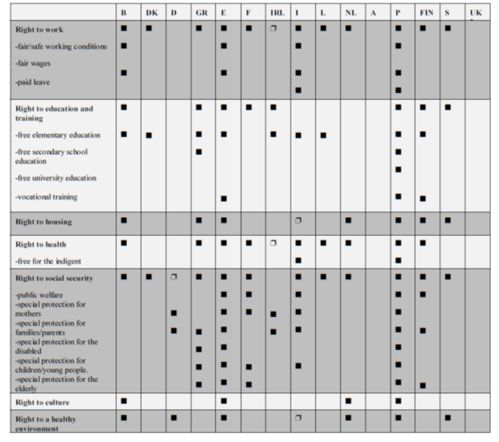
Constitutional protection

Slide 8
Examples of Social Rights Protection - Working conditions
Czech Charter (art. 28): „Employees have the right to fair remuneration for their work and to satisfactory work conditions. Detailed provisions shall be set by law.“
Old Hungarian Constitution (art. 70/B/3): „Everyone who works has the right to emolument that corresponds to the amount and quality of the work performed.“

Slide 9
Examples of Social Rights Protection – Working conditions
ESC: „With a view to ensuring the effective exercise of the right to a fair remuneration, the Parties undertake:
to recognise the right of workers to a remuneration such as will give them and their families a decent standard of living;
to recognise the right of workers to an increased rate of remuneration for overtime work, subject to exceptions in particular cases;
to recognise the right of men and women workers to equal pay for work of equal value;
to recognise the right of all workers to a reasonable period of notice for termination of employment;
to permit deductions from wages only under conditions and to the extent prescribed by national laws or regulations or fixed by collective agreements or arbitration awards.
The exercise of these rights shall be achieved by freely concluded collective agreements, by statutory wage-fixing machinery, or by other means appropriate to national conditions.“

Slide 10
Examples of Social Rights Protection – Health System
Czech Charter: „Everyone has the right to protection of his/her health. Citizens shall have the right, on the basis of public insurance, to free medical care and to medical aids under conditions provided for by law.“
ESC: „With a view to ensuring the effective exercise of the right to protection of health, the Parties undertake, either directly or in cooperation with public or private organisations, to take appropriate measures designed inter alia: to remove as far as possible the causes of ill-health; to provide advisory and educational facilities for the promotion of health and the encouragement of individual responsibility in matters of health; to prevent as far as possible epidemic, endemic and other diseases, as well as accidents.“

Slide 11
Social security
With a view to ensuring the effective exercise of the right to social security, the Contracting Parties undertake:
1 to establish or maintain a system of social security;
2 to maintain the social security system at a satisfactory level at least equal to that required for ratification of International Labour Convention (No. 102) Concerning Minimum Standards of Social Security;
3 to endeavour to raise progressively the system of social security to a higher level;
4 to take steps, by the conclusion of appropriate bilateral and multilateral agreements, or by other means, and subject to the conditions laid down in such agreements, in order to ensure: a equal treatment with their own nationals of the nationals of other Contracting Parties in respect of social security rights…

Slide 12
Free Education
CC: „Citizens have the right to free elementary and secondary school education, and, depending on particular citizens’ ability and the capability of society, also to higher education.“
What does it mean to be “free”

Slide 13
Enforceability
Much lower than in case of „real“ fundamental rights – limited judicial review.
International enforceability is almost non-existent (no courts, no complaint procedure with the exception of optional protocol to the ESC)
Common standards are unlikely to be introduced; migration of ideas (like proportionality or in dubio pro mitius in case of first-generation rights) is very limited.

Slide 14
Social Rights and Proportionality
Use of proportionality is limited, even though it is generally one of the most important HR concepts (Kai Moller labels it part of “global model of rights”).
Various approach of national courts, but proportionality is used only exceptionally (Latvia) and even then it is highly problematic.

Slide 15
Cf. Latvian CC judgement 2009-08-01
The persons summoned by the Constitutional Court have also indicated to alternative solutions to the Contested Norm. M. Hansen maintains that it would be possible cancel examination of pensions only in the case if this would ensure even greater budget deficit or budget expenses would be even more reduced, or budget incomes would be increased at the expense of increased tax rate. He rejects the above mentioned alternatives since they are less favourable if compared with the Contested Norm (see: case materials, Vol. 2, pp. 60 – 61). However, the School of Economics indicates that the legislator would have succeeded to reach the same effect as the one guaranteed by the Contested Norm if pensions were taxed...

Slide 16
Alternatives to proportionallity
Czech version of “rational basis + essentiality” test.
1) defining the significance and essence of the social right, that is a certain essential content.
2) evaluating whether the statute does not affect essential content. If not, then
3) evaluating whether the statutory framework pursues a legitimate aim 4) weighing the question of whether the statutory means used to achieve it is reasonable, even if not necessarily the best, most suitable, most effective, or wisest.

