Slide 1

Personal data protection – Specific cases I
Smart everything
MVV1368K Privacy and Personal Data
František Kasl

Slide 2
Structure of the seminar
1) Essays
  Basic info + readings
2) Topics
  Smart home, still my home?
  Smart city for proper citizens only?
  Privacy by design in smart environments
3) Slides
  Title – Question – Discussion - Information

Slide 3
Essays - Topics
Essay Deadline: 18 December, 8:00 AM
approx. 10 500 - 16 000 characters long (+ footnotes) = 5-8 pages
For further essay requirements see interactive sylabus
Presentation day (only students with Presentation No. 3): 19 December
Smart home, still my home?: How ubiquitous sensory data collection sneaks upon spatial privacy
Smart industry, customized surveillance?: How do personalized products and individualized production process personal data?
Privacy by design and other instruments of the current European legal framework for personal data protection in smart environments

Slide 4
Obligatory readings
These readings are the prerequisite for the understanding of the concept of the internet of things and its potential impact on privacy and data protection.
  WEBER, Rolf H. Cybersecurity in the Internet of Things: Legal aspects. Computer Law & Security Review. 2016, Vol. 2016, No. 32. Available (through university computers) at: https://www.sciencedirect.com/science/article/pii/S0267364916301169
  COMMISSION STAFF WORKING DOCUMENT. Advancing the Internet of Things in Europe. SWD/2016/0110 final. 2016. Available at: https://eur-lex.europa.eu/legal-content/EN/TXT/?uri=CELEX:52016SC0110
  JOHNSON, Graham. Privacy and the Internet of Things: Why Changing Expectations Demand Heightened Standards. Washington University Jurisprudence Review. 2018, 11. Available through university computers) at Heinonline.org

Slide 5
Voluntary readings
These readings provide additional insight into the challenges related to the various smart environments.
  SUN, Wencheng et al. Security and Privacy in the Medical Internet of Things: A Review. Security and Communication Networks. 2018 Available at: https://www.hindawi.com/journals/scn/2018/5978636/abs/
  MINERVA, Roberto; BIRU, Abyi; ROTONDI, Domenico. Towards a definition of the Internet of Things (IoT). IEEE. 2015. Available at: https://iot.ieee.org/images/files/pdf/IEEE_IoT_Towards_Definition_Internet_of_Things_Revision1_27MAY15.pdf
  EDWARDS, Lilian. Privacy, Security and Data Protection in Smart Cities: A Critical EU Law Perspective. European Data Protection Law Review. 2016, Vol. 2, No. 1. Available through university computers) at Heinonline.org
  KASL, František. Cybersecurity of Small and Medium Enterprises in the Era of Internet of Things. The Lawyer Quarterly, Praha: Institute of State and Law of the Academy of Sciences of the Czech Republic, 2018, Vol. 8, No. 2, pp. 165-188. Available at: https://tlq.ilaw.cas.cz/index.php/tlq/article/view/281/260
  SCHNEIER, Bruce. The Internet of Things That Talk About You Behind Your Back. Motherboard. 2016. Available at:https://www.schneier.com/essays/archives/2016/01/the_internet_of_thin_1.html

Slide 6
Additional readings
These readings provide broader context and up-to-date examples of situations, where privacy and personal data protection are being challenged by smart environments.
  DABBAGH, Mehiar; RAYES, Ammar. Internet of Things Security and Privacy. In: RAYES, Ammar; SALAM, Samer (eds.) . Internet of Things From Hype to Reality: The Road to Digitization. Springer International Publishing, 2019, 211–238. ISBN 978-3-319-99516-8.
  SCHNEIER, Bruce. Click Here to Kill Everybody: Security and Survival in a Hyper-connected World. W. W. Norton & Company. 2018, 978-0393608885, 288 p.
  BENEDIKT, Olesya. The Valuable Citizens of Smart Cities: The Case of Songdo City. Graduate Journal of Social Science. 2016, Vol. 12, No. 2. Available at: http://gjss.org/sites/default/files/issues/chapters/papers/GJSS%20Vol%2012-2%201%20Benedikt_0.pdf
  COSTA, Luiz. Virtuality and Capabilities in a World of Ambient Intelligence: New Challenges to Privacy and Data Protection. Law, Governance and Technology Series, Vol. 32, Springer International Publishing Switzerland, 2016, ISBN: 978-3-319-39197-7, 199 p. Available in the university library.

Slide 7
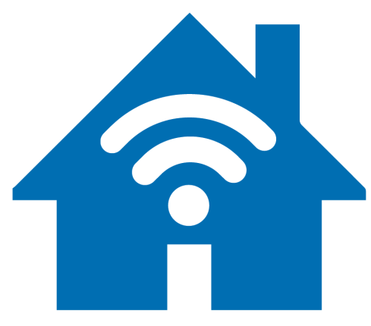
Smart home, still my home?

Slide 8
Super quick recap:
By this point in the course, you should know...
What is privacy and why does it matter?
What are personal data?
What is surveillance?
How do these concepts collide?
What does technology bring to this mix?
Notes:
pre-crime – minority report
minitrue – ministry of truth - orwell

Slide 9
Future is now
What is Internet of things?
Small environment with low complexity scenario
  network that connects uniquely identifiable things to the Internet
  these things can sense and collect / perform activity based on program/profile
Large environment with high complexity scenario
  self-configuring, adaptive, complex network that interconnects things to the Internet
  the things get unique „virtual identities“ and „profiles“
  part of the environment = ambient
  provide services tailored to the user = personalized
  adapt and learn from available data = intelligent
  available anywhere, anytime, and for anything = ubiquitous
Examples
  Interesting / Curious / Practical / Crazy / Scary / Weird / Unthinkable

Slide 10
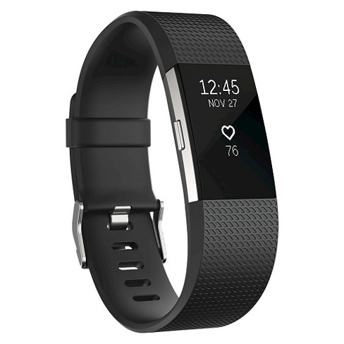
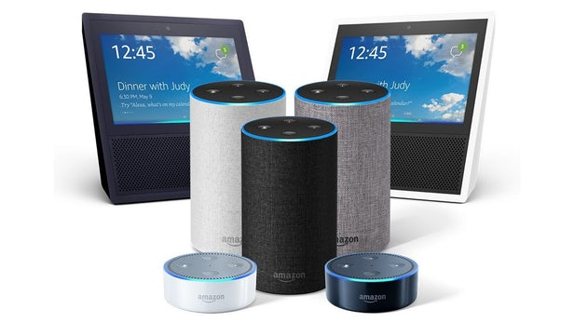
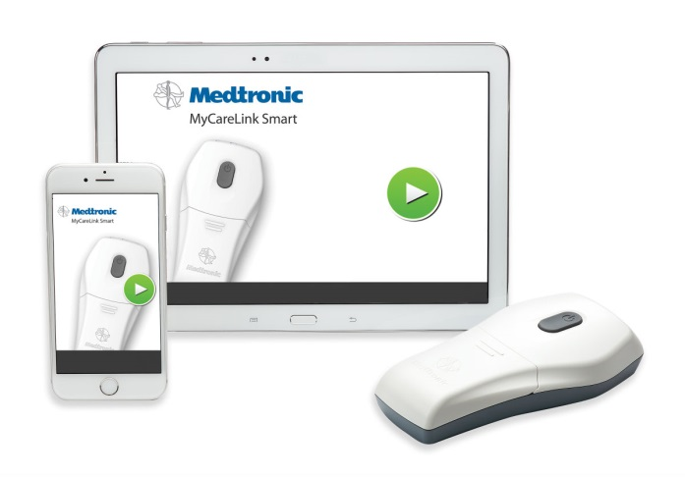
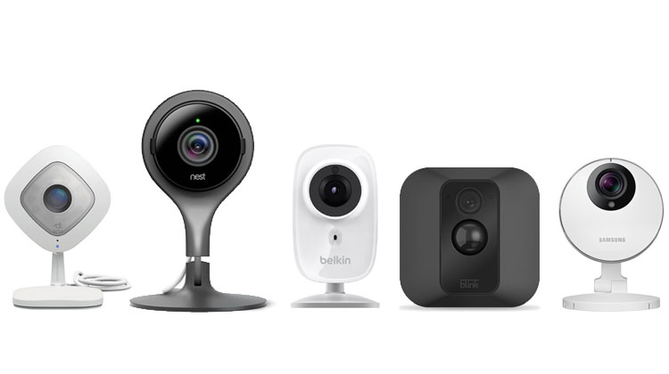
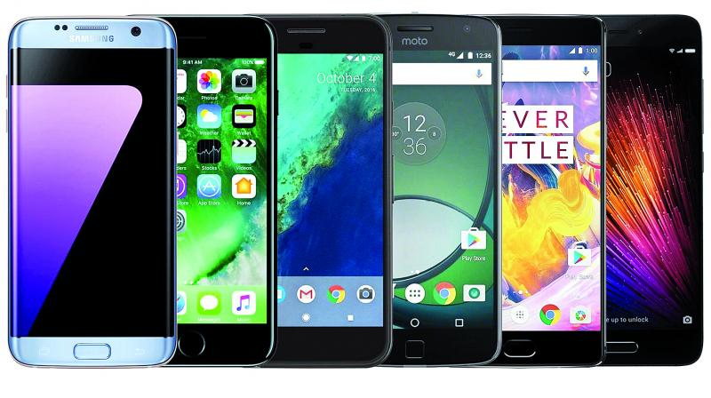
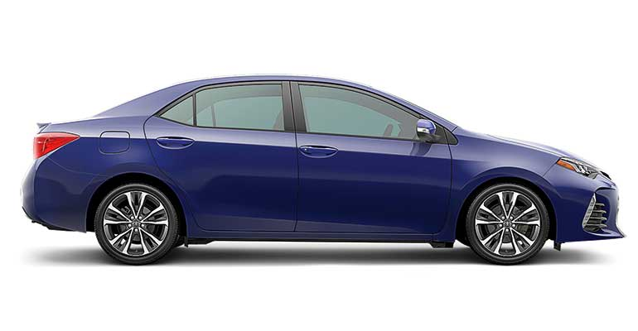
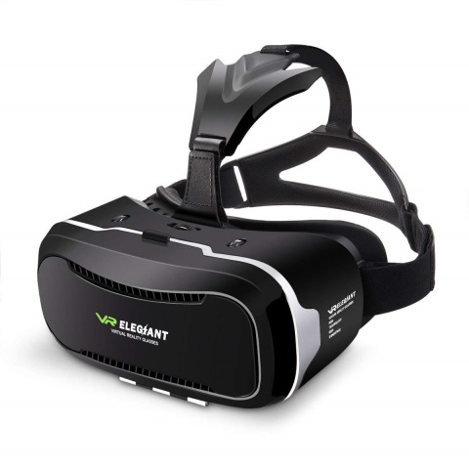

Slide 11
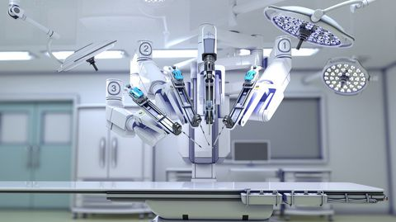
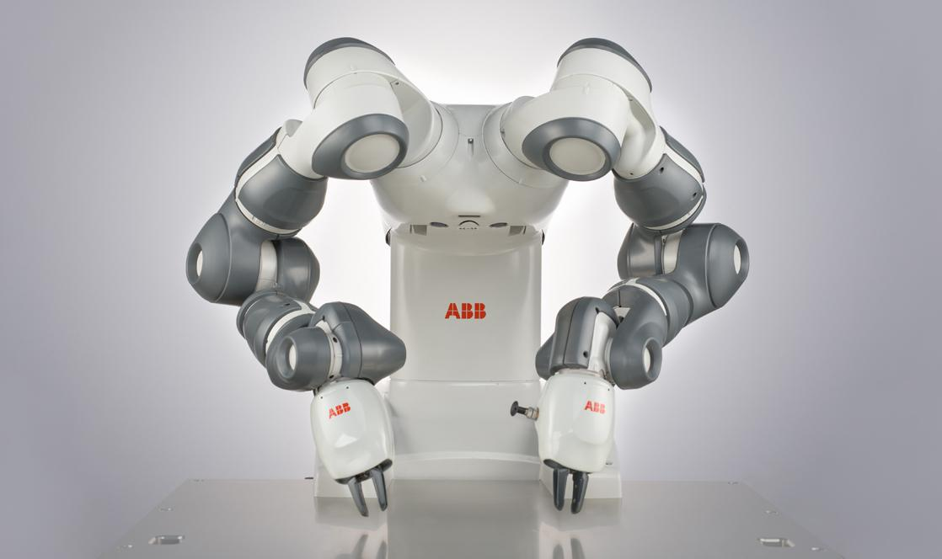
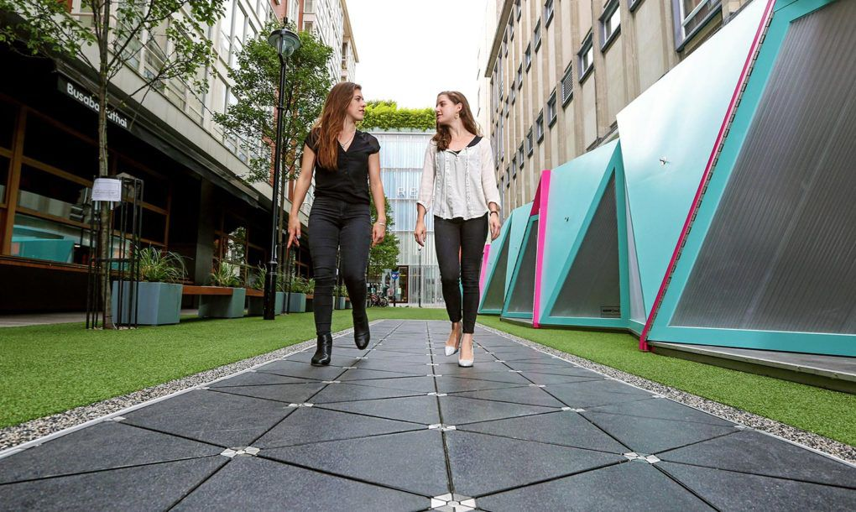
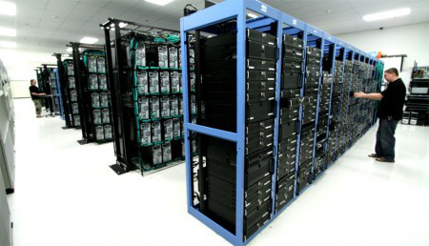

Slide 12
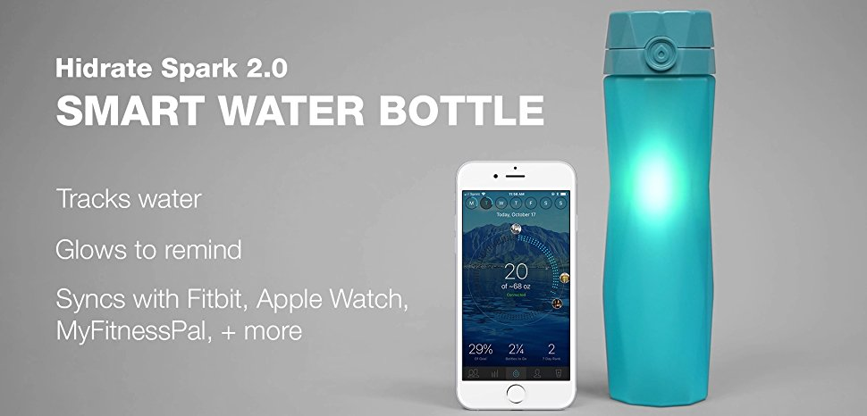
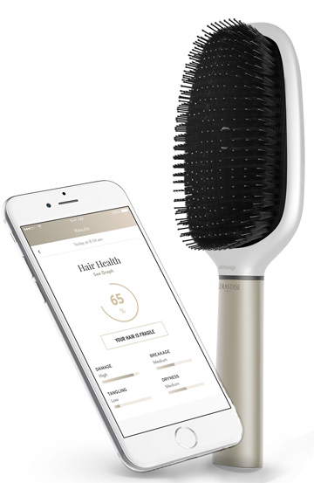
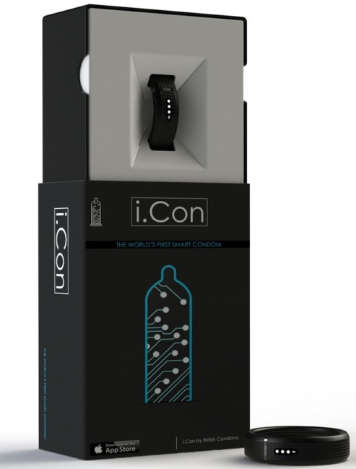
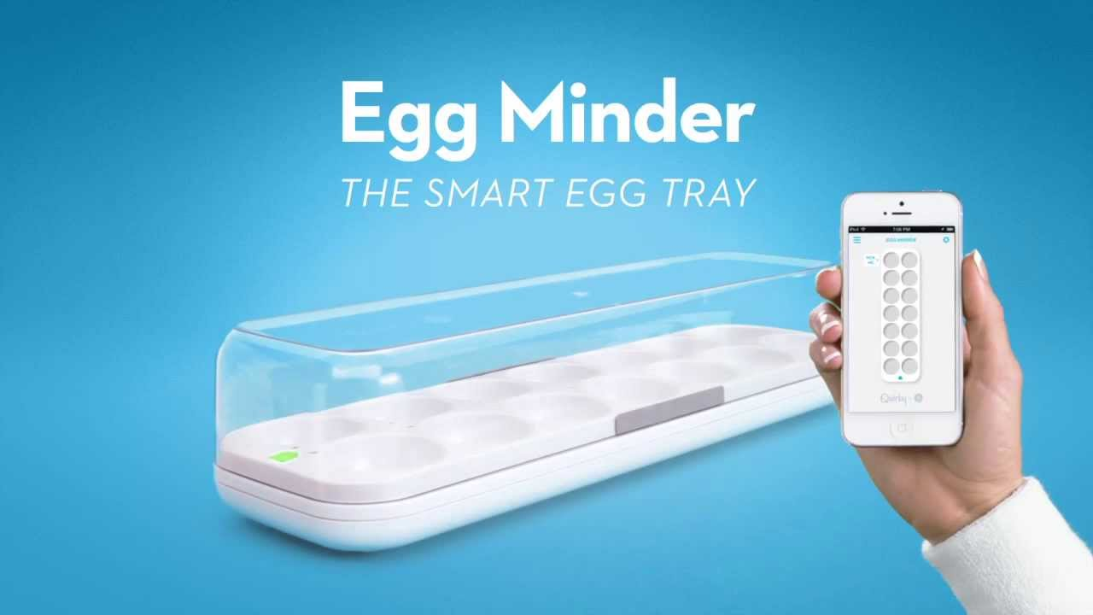
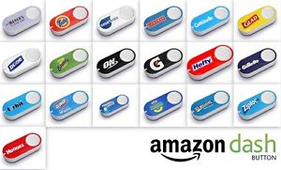
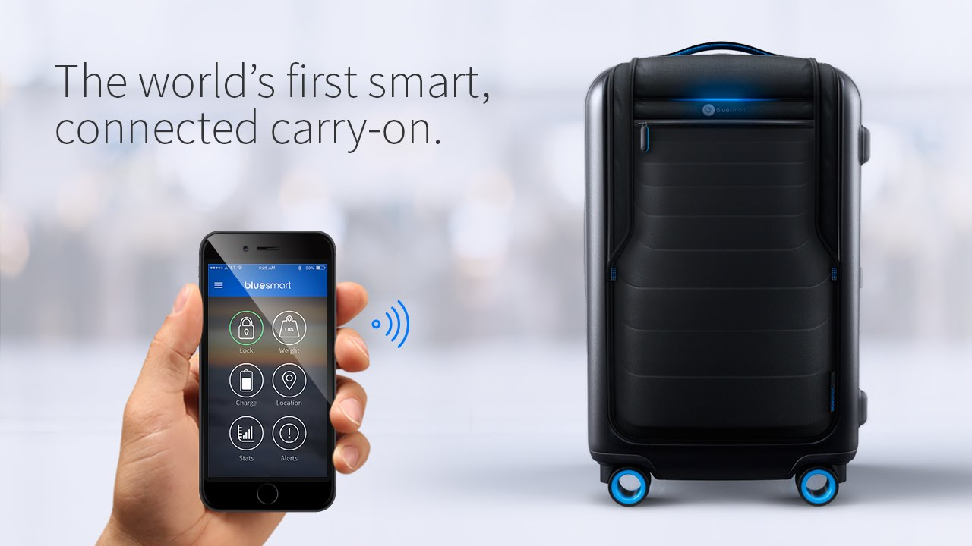

Slide 13
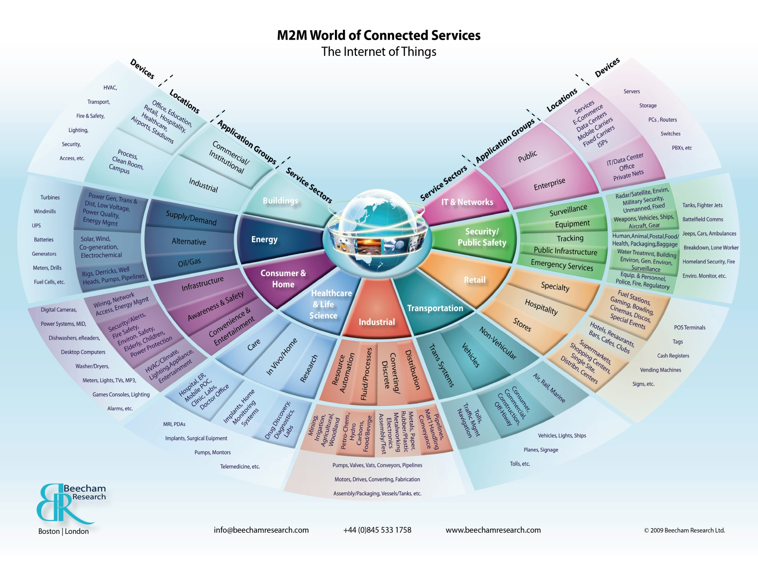

Slide 14
Smart home
What should your house know about you?
Smart home
  IoT embedded in home environment
  optimisation, customisation, innovation
  new features for the user = convenience
  new data for the provider = profiling
Limits of data collection
  protection of spatial privacy X consent?
  protection of personal data X performance of contract?
  human intimacy / special categories of personal data
  legal X moral X philosophical X practical perspective

Slide 15
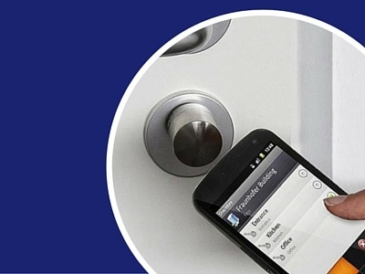
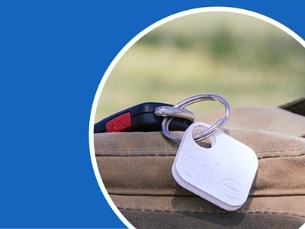
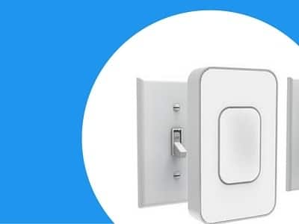
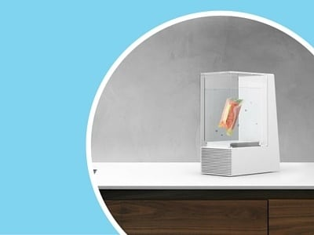
Smart Door Locks
Smart Bluetooth Trackers
Smart Home Retrofit
Smart Kitchen
Notes:
https://www.postscapes.com/internet-of-things-award/winners/

Slide 16
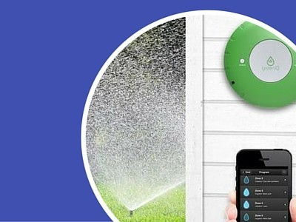
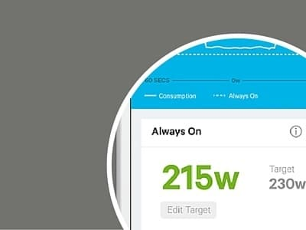
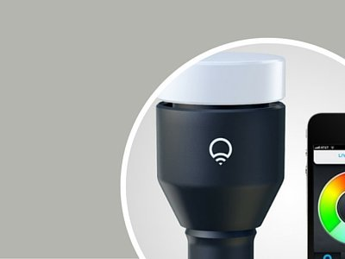
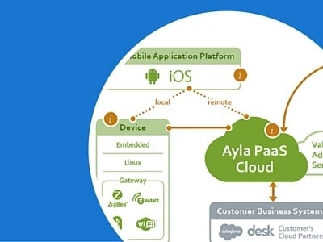
Smart Irrigation Controllers
Wireless Home Energy Monitors
Wifi Lighting
IoT Cloud Platforms

Slide 17
Specific challenges brought by IoT environment
Is „smart“ always smart?
Features: ubiquitous profiling, big data mining, machine learning, M2M communication, possible omnipresence, mesh connectivity...
Challenges
A) higher likelyhood, frequency and severity of cyber incidents
  increased data flow complexity
  ‘weaponized IoT devices’ for DDoS attacks or other illicit activities
  increased attack surface - variety creates in combination new vulnerabilities
  limited security features and posibilities for advanced security countermeasures
B) new forms of data breaches, increased frequency, severity and volume
  data collected - omnipresence of IoT sensors => increased detail of all aspects of documented activities
  new forms of data, metadata and derived data (by combination of the collected data)

Slide 18

Smart city for proper citizens only?

Slide 19
Smart city
What changes and challenges can we expect?
synergy between Internet of Things, Big Data and Cloud
  model of connected urban environment
  => advanced sustainability
  => improved resilience
  => better urban living
technology X social X political X economic factors
  A) implementation of ICT solutions
  B) multi-stakeholder socio-economic transformations of the urban ecosystem

Slide 20
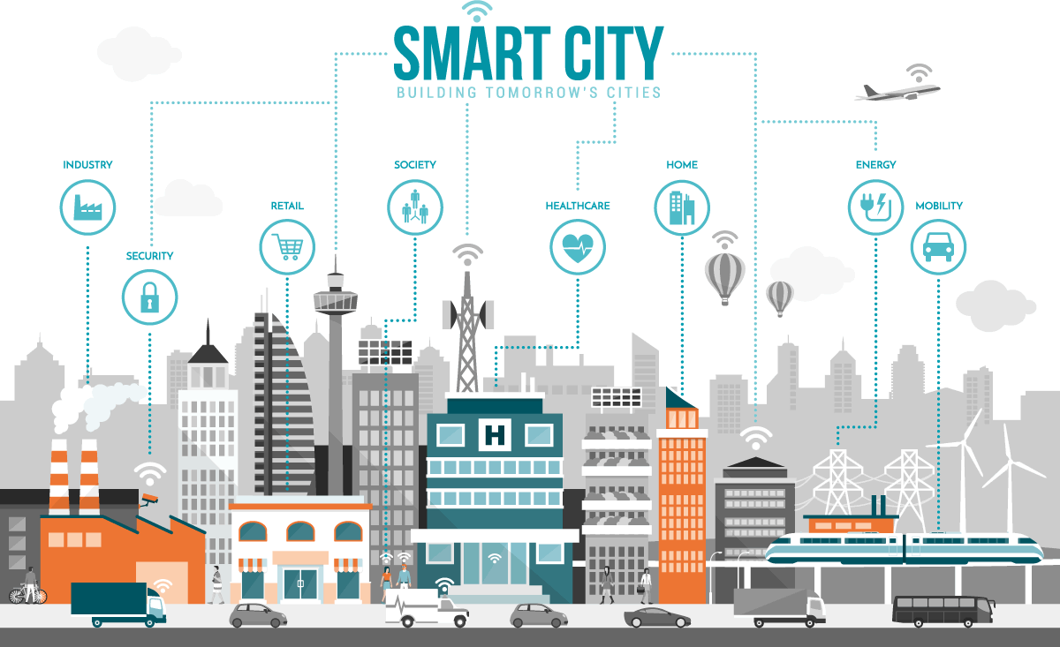

Slide 21
Road to a smart city
How does city become „smart“?
A) built fully anew with integrated smart architecture
  Songdo – Soul – South Korea
  Makkah project – Saudi Arabia
  Masdar City – United Arab Emirates
B) transformation of existing neighbourhoods by a series of projects incorporating smart modules
  Smart Cities Mission – India – 100 cities
  London
  Barcelona
  New York City

Slide 22
Every step you take
How to provide guarantees of privacy?
smart street surveillance
  X facial recongition + AI + state control (..China..)
smart traffic
  optimisation + traffic jams X tracking + database
smart devices for wifi access
  X security / data traffic surveillance
future hidden dangers?
  social credit system – ranking of the citizens

Slide 23
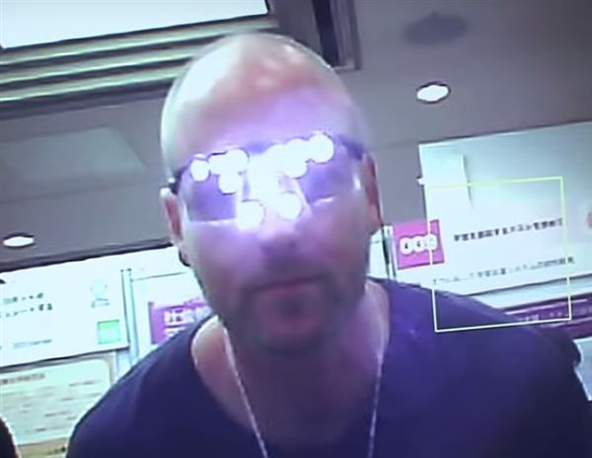
Privacy by design in smart environments

Slide 24
EU legal toolbox for privacy
Nominal right X practical enforcement?
GDPR
  accountability + rights of the data subject + principles
  data protection by design / by default
  data breach notification obligation
ePrivacy directive / regulation
  new players – traditional telecom x new telecom (message apps)
  communication content / metadata / cookies
Public procurement
  price X quality => security / data protection / integrity / data control
Cybersecurity
  critical infrastructure / CSIRT (Cyber Security Response Team)
Product standards and market access control
  CE marking / product safety rules / IoT standards and protocols
  Liability for emerging digital technologies

Slide 25
Risk assessment in IoT data processing
New environment = new frame of mind?
new factors
  cyberphysical; indirect interconnection...
  increased frequency, scope, variety
challenges for unified or comprehensive classification of risk
  ambiguous terms and fluctuant environment
  risk-based approach missing adequade guidance in measures and indicators => need for flexible adaptation to IoT
need for
  automated reporting and monitoring
  adjustment of risk scales
  broad adoption of adequate methodology

Slide 26
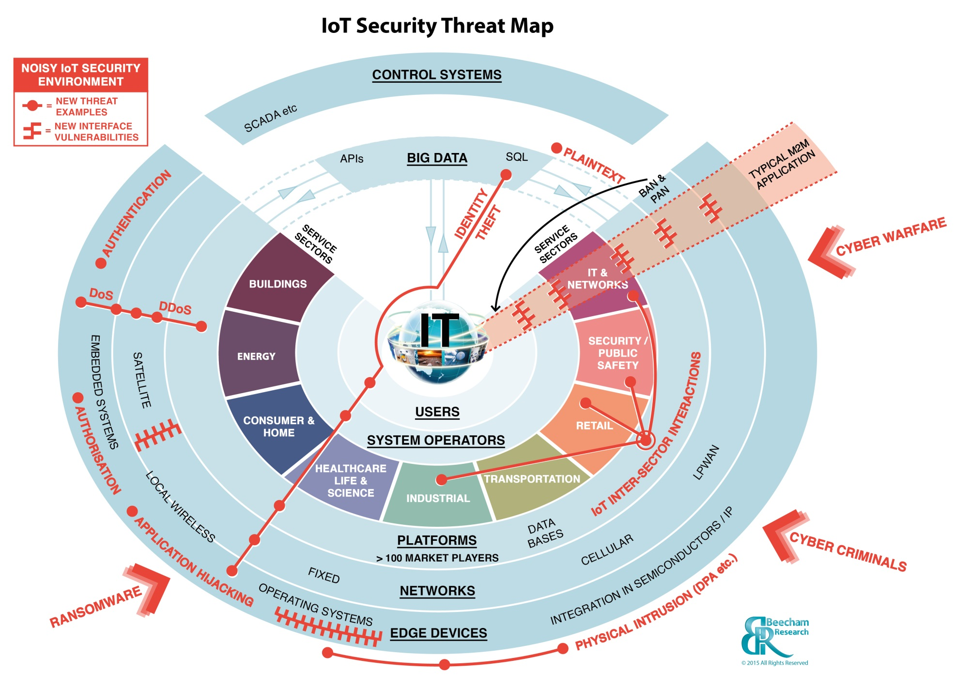

Slide 27
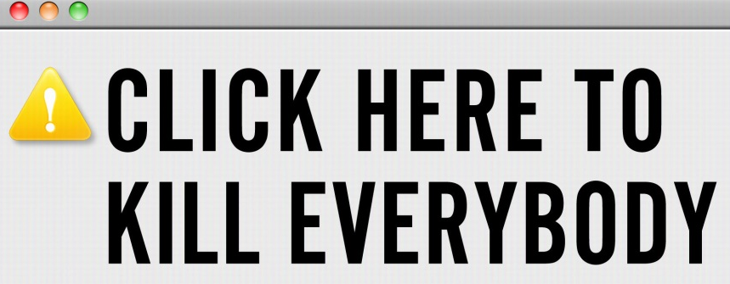
Thank you for your attention!
Questions?
Ideas?
Answers?
Looking forward to your essays!

