Slide 1

Privacy protection online I Surveillance
MVV1368K Privacy and Personal Data
František Kasl

Slide 2
Structure of the seminar
1) Essays
  Basic info + readings
2) Topics
  Surveillance then and now
  Chilling effect
  New surveillance
3) Slides
  Title – Question – Discussion - Information

Slide 3
Essays - Topics
Essay Deadline: 30 October, 8:00 AM
approx. 10 500 - 16 000 characters long (+ footnotes) = 5-8 pages
For further essay requirements see interactive sylabus
Presentation day (only students with Presentation No. 1): 31 October
  Surveillance then and now: Development of the issue of state surveillance in the privacy context
  Chilling effect: How lack of privacy affects the political freedom and social dissent
  New surveillance: From pursuit of national security to erosion of privacy for commercial purposes

Slide 4
Obligatory readings
These readings are the prerequisite for the understanding of the concept of surveillance and its historical development.
  CLARKE, Roger. Introduction to Dataveillance and Information Privacy, and Definitions of Terms, 1997. Available at: http://www.rogerclarke.com/DV/Intro.html
  MARX, Gary T. What’s new about the “new surveillance”?: Classifying for change and continuity, Knowledge, Technology & Policy. 2004, Vol. 17, No. 1, pp. 18–37. Available (through university computers) at: https://link.springer.com/article/10.1007%2FBF02687074

Slide 5
Voluntary readings
These readings provide additional insight into the challenges related to the conflict of surveillance and privacy.
  STUART, Avelie; Mark Levine. Beyond ‘nothing to hide’: When identity is key to privacy threat under surveillance. European Journal of Social Psychology. 2017, Vol. 47, 694-707. Available (through university computers) at: https://onlinelibrary.wiley.com/doi/abs/10.1002/ejsp.2270
  MILAJ, Jonida. Privacy, surveillance, and the proportionality principle: The need for a method of assessing privacy implications of technologies used for surveillance, International Review of Law, Computers & Technology, 2016, Vol. 30, No. 3, pp. 115-130. Available (through university computers) at: https://www.tandfonline.com/doi/abs/10.1080/13600869.2015.1076993
  POSNER, Richard A. Privacy, Surveillance, and Law, The University of Chicago Law Review. 2008, Vol. 75, No. 1, pp. 245-260. Available (through university computers) at: https://www.jstor.org/stable/20141907?seq=1#page_scan_tab_contents
  PENNEY, J. W. Chilling Effects: Online Surveillance and Wikipedia Use. Berkeley Technology Law Journal. 2016, Vol. 31, No. 1. Available (through university computers) at: https://heinonline.org/HOL/LandingPage?handle=hein.journals/berktech31&div=6&id=&page=
  ZUBOFF, Shoshana. Big other: surveillance capitalism and the prospects of an information civilization. Journal of Information Technology. 2015, Vol. 30, No. 1, pp. 75-89. Available (through university computers) at: https://link.springer.com/article/10.1057/jit.2015.5

Slide 6
Additional readings
These readings provide broader context and up-to-date examples of situations, where privacy is being challenged by surveillance.
  BUNIN, G. ‘We’re a people destroyed’: why Uighur Muslims across China are living in fear. The Guardian. 7. 8. 2018. Available at: https://www.theguardian.com/news/2018/aug/07/why-uighur-muslims-across-china-are-living-in-fear
  SCHNEIER, Bruce. It's Not Just Facebook. Thousands of Companies are Spying on You. CNN. 2018. Available at: https://www.schneier.com/essays/archives/2018/03/its_not_just_faceboo.html
  SCHNEIER, Bruce. Security vs. Surveillance. Don't Panic: Making Progress on the 'Going Dark' Debate. 2016. Available at: https://www.schneier.com/essays/archives/2016/02/security_vs_surveill.html
  SCHNEIER, Bruce. The Era Of Automatic Facial Recognition And Surveillance Is Here. Forbes. 2015. Available at: https://www.schneier.com/essays/archives/2015/09/sep_29_2015_0930_am_.html
  CLARKE, Roger. Risks Inherent in the Digital Surveillance Economy: A Research Agenda. 2017. Available at: http://www.rogerclarke.com/EC/DSE.html
  CLARKE, Roger. Data Retention as Mass Surveillance: The Need for an Evaluative Framework. International Data Privacy Law, 2015, Vol. 5, No. 2, pp. 121-132. Also available at: http://www.rogerclarke.com/DV/DRPS.html .
  CLARKE, Roger; Marcus WIGAN. You Are Where You've Been The Privacy Implications of Location and Tracking Technologies. Journal of Location Based Services, 2011, Vol. 5, No. 3-4, pp. 138-155. Also available at: http://www.rogerclarke.com/DV/YAWYB-CWP.html
  CLARKE, Roger. From Dataveillance to Ueberveillance. 2013. Available at: http://www.rogerclarke.com/DV/DV13.html
  SOLOVE, Daniel J.; Paul. M. SCHWARTZ. Privacy, Law Enforcement and National Security. 2014, Wolters Kluwer Law & Business, 978-1454861539, 233 p.
  SCHNEIER, Bruce. Data and Goliath: The Hidden Battles to Collect Your Data and Control Your World. 2016, W. W. Norton & Company, 978-0393352177, 448 p.

Slide 7

Surveillance then and now

Slide 8
Quick recap:
Privacy and why does it matter?
control over self-determination
  freedom to choose one´s future – „freedom to make mistakes“
  expression and development of unique personality + social profile
  control over one´s outside image – self-esteem/self-representation
personal data = data about an individual
private sphere = intimate / vulnerable / „true self“
types of privacy – spatial x social x intellectual x informational
levels of privacy - solitude x intimacy x anonymity x reserve
=> surveillance = attempts to profile for outside control = public – excessive behaviour / private – customer behaviour
data profile + data processing
  control over profile => categorization => prediction („pre-crime“ / „minitrue“ / „what is not on the menu?“)
  control over individual - capacity for discrimination / normalization / manipulation
Notes:
pre-crime – minority report
minitrue – ministry of truth - orwell

Slide 9
Surveillance
What does it mean?
„close observation, especially of a suspected person“
  Concise Oxford Dictionary
X
„systematic investigation or monitoring of the actions or communications of one or more persons“
  Roger Clarke, 1997
  X
„the use of technical means to extract or create personal data“
  New Surveillance – G.T.Marx 2004

Slide 10
Technology and surveillance
New tools = less privacy?
surveillance = ever present part of social organisation – need for information / control
changes in form and content
  tax surveillance
  religious surveillance
  political surveillance
  policed society surveillance
  work/market/medical surveillance
self-surveillance X outside surveillance
direct X indirect surveillance
New tools and techniques => new countermeasures = constant struggle
  observation X closed door / eavesdropping X coded language / wiretapping X encryption

Slide 11
Big data and surveillance
How did modern ICT change surveillance?
electronic communication = exponential increase in data = new information potential
Dataveillance
  "systematic use of personal data systems in the investigation or monitoring of the actions or communications of one or more persons"
    Roger Clarke, 1997
  significantly less expensive - can be automated => mass scale surveillance
  wide range of techniques
    Front- End Verification (transactions)
    Computer Matching (big data combination)
    Profiling (categorisation)
=> Data Trail = person´s informational tracks in cyberspace

Slide 12
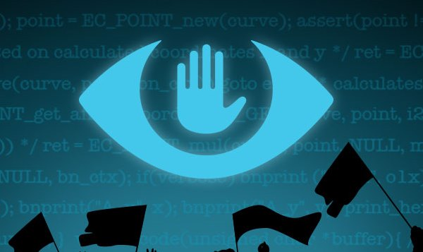
Chilling effect

Slide 13
National security and state interests in surveillance
For the greater good – justification of state surveillance?
surveillance in public interest
  airport security / public places / counter-terorism / data retention / public health / social unrest
surveillance = tool
  morality depends on the one who wields it
    NSA PRISM (counterterorism surveillance program)
    China - Xinjiang region – Uighur minority normalisation
  X
    Energy distribution efficiency – Smart grid
    Enviromental monitoring
    Optimisation of public services
    Epidemiological disease monitoring

Slide 14
Panopticon
State´s watchful eye = good citizens?
Panopticon prison as "a mill for grinding rogues honest"
  Jeremy Bentham (1748-1832)
you never know, if someone is not watching
  mass surveillance
  omnipresent surveillance in public places
  monitoring of employees through ICT
  surveillance through private online activities
impact on behaviour = chilling effect
  social conformity = normalisation / preemptive self-regulation / supression of individuality / no space to revolt

Slide 15
Mass surveillance and data retention
Wider net = better catch?
targeted surveillance – wiretapping / observation
  criminal procedure – court order – limited to suspect
X
mass surveillance - data retention tools
  systematic use of personal data systems in the investigation or monitoring of the actions or communications of groups of people.
  Non-discriminatory retention of data
  Preventive = not based on suspicion/investigation
  Full-scope = collect first – sort out later
  Evidence into the past = continuous process

Slide 16
Data retention vs. Privacy
How to find the balance?
Data retention = panopticon of public surveillance
  combating terrorism x orwellian society
Surveillance slack = differentiation between potential of the tool and its actual use
  consideration of practical limits = budget / manpower / focus / priorities...
legal challenges to data retention through protection of privacy
  retention by providers + access by criminal investigation units
  need for proportionality = effective tools + minimal intrusion
  Data Retention Directive 2006/24/EC – invalidated 2014
    CJEU 2014 – case Digital Rights Ireland - C-293/12
    CJEU 2016 – case Tele2 Sverige - C-203/15
    National constitutional courts => modified data retention approach
      retention within limits justifiable by service provider interests (technical/billing)
      access limited by court order / surpervision + list of criminal offences

Slide 17
Legal framework for surveillance
Public oversight through transparency vs. enforcement efficiency?
Standard surveillance = e.g. security check on airport
X
Hidden surveillance = secret services/national security agencies X whistleblowers
European legal framework
  complex / state specific – conflicting interests
Explanatory example
  ECHR case of Big Brother Watch v. UK (Applications nos. 58170/13, 62322/14 and 24960/15) - 13 September 2018 (212) pages

Slide 18
Surveillance in the workplace
Employer´s assets vs. Employee´s privacy?
justifiable interest X appropriate means
Grand Chamber judgment - Bărbulescu v. Romania (application no. 61496/08) - 2017
  proportionality criteria
    i) preceding notification about monitoring
    ii) adequate limitation of scope
    iii) legitimate interest
    iv) level of intrusion in private sphere
    v) capacity to achieve the goal
    vi) adequate guarantees for employees interests and rights

Slide 19

New surveillance

Slide 20
Surveillance capitalism
Do you like the likes?
Freemium business model
  profit seeking + information asymetry + unclear value of personal data
Early internet = encouraged model – infant industry protection
  X current situation changed – „puppy“ => „beast“
New challenges
  omnipresence = big data = profiling
  informational bubble effect = polarization and fragmentation
  manipulative power = marketing x fake news x propaganda
  increasing importance of individuals virtual identities =>
    abuse of the tools = hate speech / cybercrime / cyberstalking / identity theft
    modification of personal perception = self-identification with virtual profile => impact on personality development – habits, opinions, preferences, choices
New tool of social control
  China/Tencent – Social credit system => reward system for „good citizens“

Slide 21
Belly of the big data beast
How does the freemium business model generate profit?
Metadata => profiling => targeted advertisement
„Half the money I spend on advertising is wasted; the trouble is I don't know which half.“
  John Wanamaker (1838-1922)
Indirect payment for the services = illusion of „free“
  Just access to internet? Income inequality x we all „are data“
Complex system = big data – max. revenue from available information
  Invisible infrastructure = trackers and cookies
  Algorithmic marketing tools = profiling + real time bidding

Slide 22
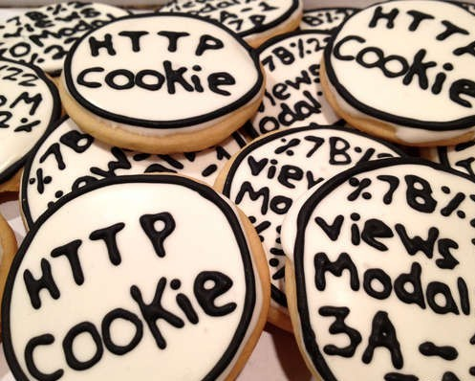
The magic that makes it work

Slide 23
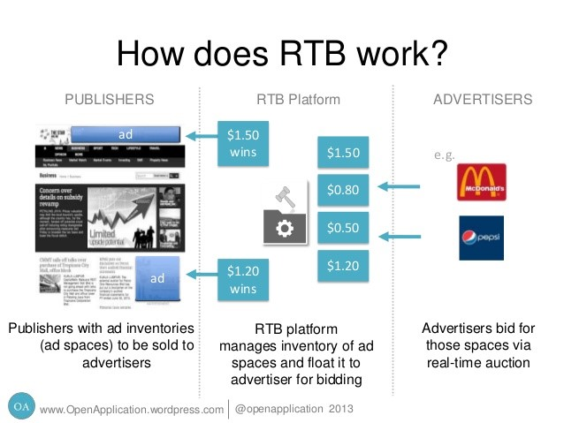

Slide 24
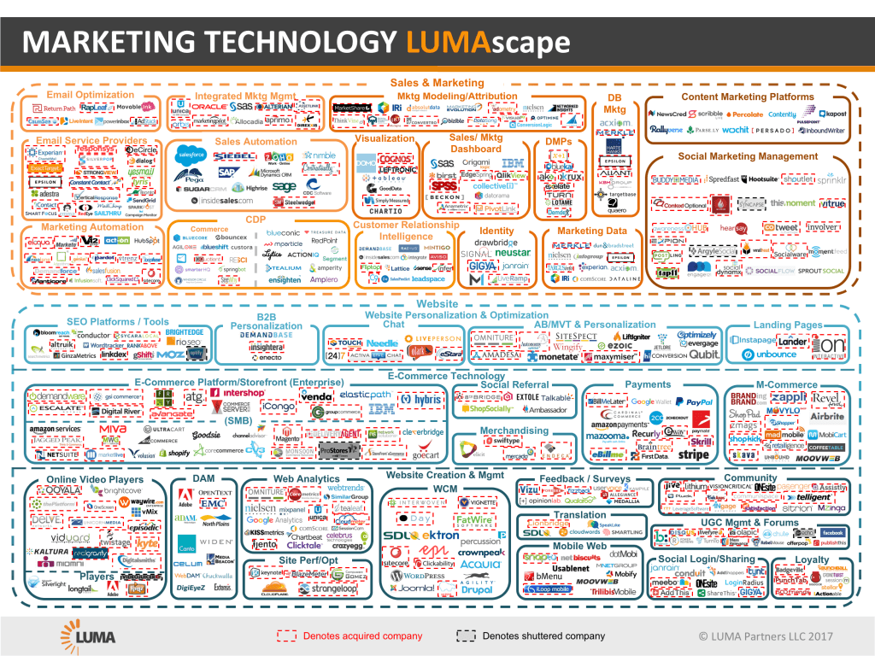

Slide 25
Regulation of cookies
How to tame the cookie monster?
ePrivacy directive = transparency
  informed consent – opt in (X Czech opt-out)
  right to refuse
  cookie policy - data minimisation + privacy by design
X regulatory gap behind technology
  new forms of cookies
    zombie cookies / flash cookies / ever cookies
Proposal of ePrivacy Regulation

Slide 26
Platforms and illicit content
Private censorship vs. protection from „info-pollution“?
ISP liability – eCommerce directive
  notice and action
  no obligatory general monitoring of content
  terms and conditions
  supranational entities - conflicting obligations
    privacy vs. surveillance (EU vs. US laws)
terorist propaganda, hate speech, fake news
  legal tools X state enforcement in cyberspace
  technical tools X enforcement through private entities
cooperation in criminal matters – access to data
notice-and-action framework = delegated enforcement
  adjudication of content through private entity X court remedy available
  urgent issue = search for least imperfect tool that is effective

Slide 27
Future of surveillance – Smart everything
New tools = less privacy - ver. 2.0?
internet of things / smart city / ambient intelligence
  ubiquity – „nowhere to hide“
    new countermeasures = privacy as commodity
  ambience – „everyday surveillance“
    new social standard = change in the concept of privacy?
  automated profiling – „you are your data“
    individualisation of offer (services, goods) and opportunity (actions, decisions, rights)
  enhanced reality – merger of the real and virtual identity
    creation of new social gap? freedom on the fringes of society?
dystopian scenarios (cyberpunk) x solution to everything
  past as guidance X certain aspects enhanced by new tech reality

Slide 28
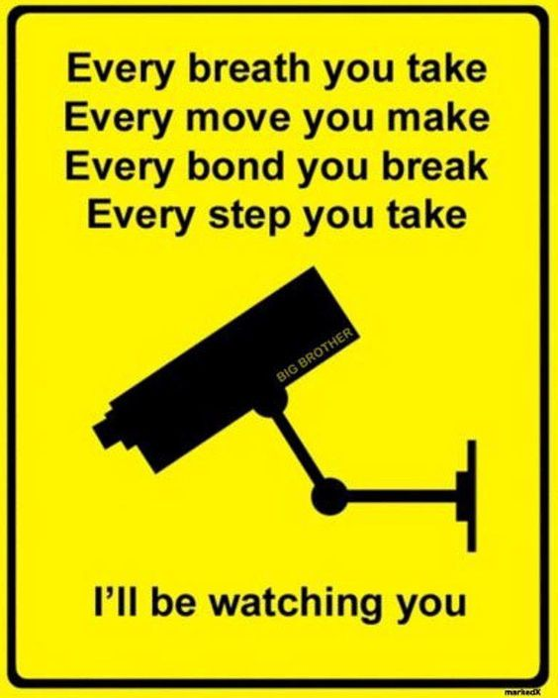
Thank you for your attention!
Questions?
Ideas?
Answers?
Looking forward to your essays!

