Slide 1

Symmetrical
Proportionality Test
Brno, 24th November 2022
Martin Abel (PhD candidate, Charles University, Faculty of Law) GAUK No. 304521

Slide 2

Claims
A. There are at least two conceptions of rights (as principles).
B. The proportionality test can effectuate the conception which respects deontological limits of rights.
(the Third Way Thesis)

Slide 3

The Structural Theory
Rights are principles.
Principles are norms that require that something be realized to the greatest extent possible given the legal and factual possibilities.
(„the optimisation requirement”)
The nature of principles implies the principle of proportionality.
R. Alexy, A Theory of Constitutional Rights (1985/2002)
Alexy’s followers:
There is only one structure of constitutional rights clauses worldwide
(„the Single Conception Thesis”)

Slide 4
Optimisation requirement
„On any sensible interpretation, the greatest possible extent can only mean the correct extent. If data protection and security come into conflict, and we know how to resolve the conflict correctly, then this resolution will realize both principles to the greatest possible extent. This becomes clear in the negative hypothesis. When we resolve the conflict between data protection and security in any morally or legally wrong way, either or both will be realized to an extent less than what is possible.”
„Alexy’s theory would hold true only if making the moral argument always implied balancing the two competing principles.“ (See Dworkin, Nozick, …)
- K. Möller, Balancing and the Structure of Constitutional Rights (2007)

Slide 5
The Global Model
dominant narrative vs. global model
moral reconstruction of the practice
foundation of rights = right to personal autonomy
against a ‘morality filter’ for evil activities
- K. Möller, The Global Model of Constitutional Rights (2012)

Slide 6
The Single Conception Thesis
A. There are at least two conceptions of rights as principles (rather than one).

Slide 7
The French Declaration of the Rights of Man and Citizen (1789)
Article 4
„Liberty consists in being able to do anything that does not harm others: thus, the exercise of the natural rights of every man has no bounds other than those that ensure to the other members of society the enjoyment of these same rights. These bounds may be determined only by Law.”
Individual will vs. General will
=> Rousseau’s footprint

Slide 8
ECHR (the same structure)
Article 8
„1. Everyone has the right to respect for his private and family life, his home and his correspondence.
2. There shall be no interference by a public authority with the exercise of this right except such as is in accordance with the law and is necessary in a democratic society in the interests of national security, public safety or the economic wellbeing of the country, for the prevention of disorder or crime, for the protection of health or morals, or for the protection of the rights and freedoms of others.”

Slide 9
US Bill of Rights (1791)
… the philosophical origins
1950s: the liberal consensus
1960s: rediscovery of classical republican politics (Bailyn, Wood, Pocock)
1980s onward: Locke’s comeback: the republican synthesis brought to light important features, but Locke was the most frequently cited author in the American political writings from 1760 to 1775.

Slide 10
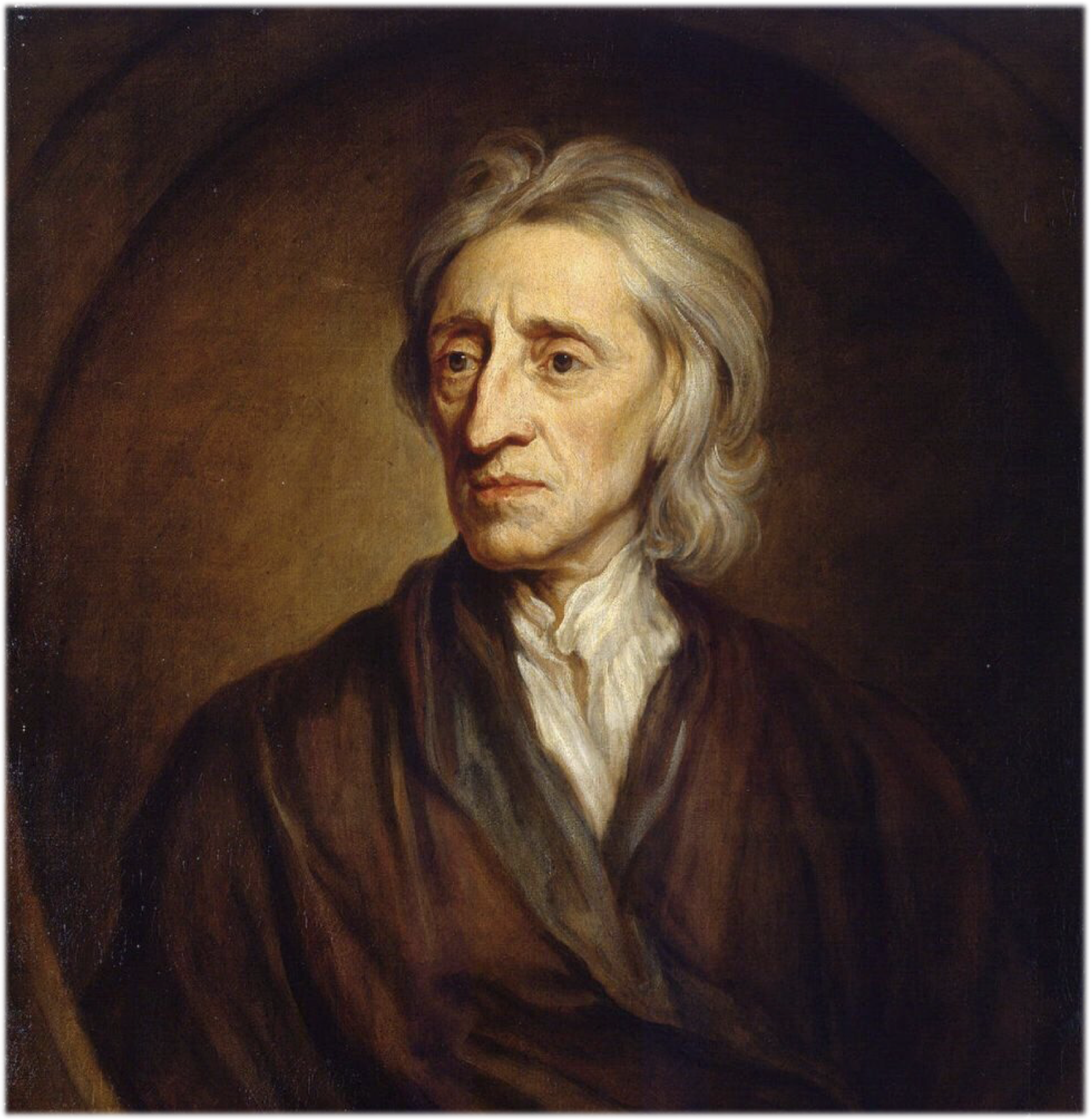
John Locke
„The state of nature has a law of nature to govern it, which obliges every one: and reason, which is that law, teaches all mankind, who will but consult it, that being all equal and independent, no one ought to harm another in his life, health, liberty, or possessions.” (sec. 6)
J. Locke, Second Treatise on Government (1691)

Slide 11
Limitations on rights in the law of nature
Men naturally owe each other not only reciprocal obligations, but also obligations that constitute rights:
„As justice gives every man a title to the product of his honest industry, and the fair acquisitions of his ancestors descended to him; so charity gives every man a title to so much out of another’s plenty as will keep him from extreme want, where he has no means to subsist otherwise.” (I:42)
Likewise, the right to unlimited acquisition is ultimately directed toward maximalisation of „the public good”, not individual preference.
For Locke, like S. Pufendorf or J. Tyrrell, natural rights and obligations were justly distributed in the state of nature.

Slide 12
Limitations on rights in the law of nature
Men naturally owe each other not only reciprocal obligations, but also obligations that constitute rights:
„As justice gives every man a title to the product of his honest industry, and the fair acquisitions of his ancestors descended to him; so charity gives every man a title to so much out of another’s plenty as will keep him from extreme want, where he has no means to subsist otherwise.” (I:42)
„If the owner of a large manor bequests in his last will the whole estate to his first-born, leaving only a tiny annual rent to his wife and daughters, the bequest is void by natural law.” (Kendrick 2011)
Likewise, the right to unlimited acquisition is ultimately directed toward maximalisation of „the public good”, not individual preference.
For Locke, like S. Pufendorf or J. Tyrrell, natural rights and obligations were justly distributed in the state of nature.

Slide 13
US Bill of Rights: a different conception
For the founding generation, rights were anchored in the moral order and limited by their communal purpose.
This is consistent with the communitarian ethic typical for the colonies and based on shared religious beliefs.
The conception survived the 19th century.

Slide 14
US Bill of Rights: a different conception
1900s: US courts balanced rights against public policy objectives.
But the deontological limits remained
    First Amendment (free speech clause): unprotected speech
    Fifth Amendment (due process clause): limited by
    the police power (West Coast Hotel)
Rights need not be realized to the greatest possible extent, but to the extent that is just.

Slide 15
Two conceptions of rights
In continental Europe, the I-conception unleashed the individual from moral bonds in the law of nature (teleological limits), except for those recognised by law as the expression of general will.
In USA, the We-conception did not release the right-holder from moral bonds in the law of nature and the government serves both to protect and police the boundaries of natural rights.
Both can be worked out as rules and/or principles.

Slide 16
Compatibility of Alexy’s and Moller’s theories with the two conceptions

Slide 17
Conceptions of rights in Alexy and Möller
Möller’s compatible only with the I-conception
  the first-person perspective
  admits that his model does not fit the US constitutionalism
Alexy - neutral perspective?

Slide 18
Conceptions of rights in Alexy and Möller
The I-conception conceives of rights as resources of abstracted right-holders that ought to be maximised.
This is exactly what the structural theory’s optimisation is about.
It means to make the best or most effective use of resources.
Optimisation vs. moral requirement: morally right solution must be found
„[J]ustice is not about aggregating or maximizing preferences or interests effectively or efficiently, but about distribution, i.e., about who is entitled to what.” (Urbina 2012, see also Tsakyrakis 2009, Webber 2013, Kyritsis 2014, Letsas 2018, Zanghellini 2019)

Slide 19
Optimisation ~ I-conception
For Locke, it makes no sense to think of two abstracted individuals as right-holders whose interests the law serves
to protect, no matter the moral obligations they have toward each other.
The objections against the optimisation requirement are an attack on the I-conception, because the proportionality test serves first and foremost for evaluating the constitutionality of legal restrictions of preference satisfaction, rather than for finding what justice demands.

Slide 20
Proportionality = I-conception?
B. The proportionality test can be construed from the conception which respects deontological limits of rights.

Slide 21
Asymmetrical Proportionality Test:
Stage I (Interference): Does the policy infringe upon one of the rights?
Symmetrical Proportionality Test:
Stage I (Interference): Does the policy infringe upon one of the rights?
Was the right exercised for a legitimate reason?
Stage II (Justification): Was the interference in accordance with law?
Did it pursue a legitimate aim? Was it proportionate?

Slide 22
Conclusion
The Single Conception Thesis is wrong. There are at least two conceptions of rights. Neither conception necessarily follows from the nature of principles. One could be morally superior.
Abandoning the I-conception does not mean abandoning the model of principles and proportionality. The symmetrical proportionality test gives effect to the We-conception of rights.
Question remains what the illegitimate/excluded reasons should be?

Slide 23
Bibliography
R. Alexy, A Theory of Constitutional Law (1985/2003)
A. Barak, Proportionality (2012)
S. Banner, The Decline of Natural Law. How American Lawyers Once Used Natural Law and Why They Stopped (2020)
R. Boyd, The Calvinist Origins of Lockean Political Economy (2002)
K. Douzinas, The Radical Philosophy of Rights (2019)
P. J. Galie, B. Kirschner and C. Bopst, Bills of Rights Before the Bill of Rights: Early State Constitutions and the American Tradition of Rights, 1776-1790 (2020)
S. Gregg, Metaphysics and modernity: Natural law and natural rights in Gershom Carmichael and Francis Hutcheson (2009)
R. H. Helmolz, Natural Law in Court A History of Legal Theory in Practice (2015)
J. Hutson, The Emergence of the Modern Concept of a Right in America: The Contribution of Michel Villey (1994)
V. Jackson, Constitutional Law in an Age of Proportionality (2015)
L. Kendrick, The Lockean Rights of Bequest and Inheritance (2011)
D. Kyritsis, Whatever Works: Proportionality as a Constitutional Doctrine (2014)
M. Kumm, Political Liberalism and the Structures of Rights, in: George Pavlakos (ed.), Law, Rights and Discourse (2007)
G. Letsas, Proportionality as Fittingness (2018)
D. H. Mayer, The English Radical Whig Origins of American Constitutionalism (1992)
A. J. Menéndez, Some Elements of a Theory of European Fundamental Rights, in Menéndez & Eriksen, Arguing Fundamental Rights, 2006)
K. Möller, Balancing and the Structure of Constitutional Rights (2007)
K. Möller, The Global Model of Constitutional Rights (2012)
S. Moyn, The Last Utopia (2011)
W. J. Novak, The Peoples Welfare Law and Regulation in Nineteenth-Century America (1996)
G. Pavlakos, Constitutional Rights, Balancing and the Structure of Autonomy (2011)
C. Pierson, Just Property: A History in the Latin West (2013)
R. H. Pildes, Avoiding Balancing (1994)
F. Schauer, A Comment on the Structure of Rights (1993)
L. Strauss, Natural Right and History (1953)
F. Urbina, A Critique of Proportionality (2009)
A. Vermeule, Common Good Constitutionalism (2022)
L. Ward, The Politics of Liberty in England and Revolutionary America (2004)
G. Webber, On the Loss of Rights (2013)
A. Zanghellini, Why rights are not optimisation requirements (2019)
M. Zuckert, Natural Rights and the New Republicanism (1994)

Slide 24
Objections

Slide 25
Who cares?

Slide 26
Thank you for your attention.
abel@prf.cuni.cz

