Slide 1
Basics of EU Environmental Law
Environmental impact assessment
26 October 2022

Slide 2
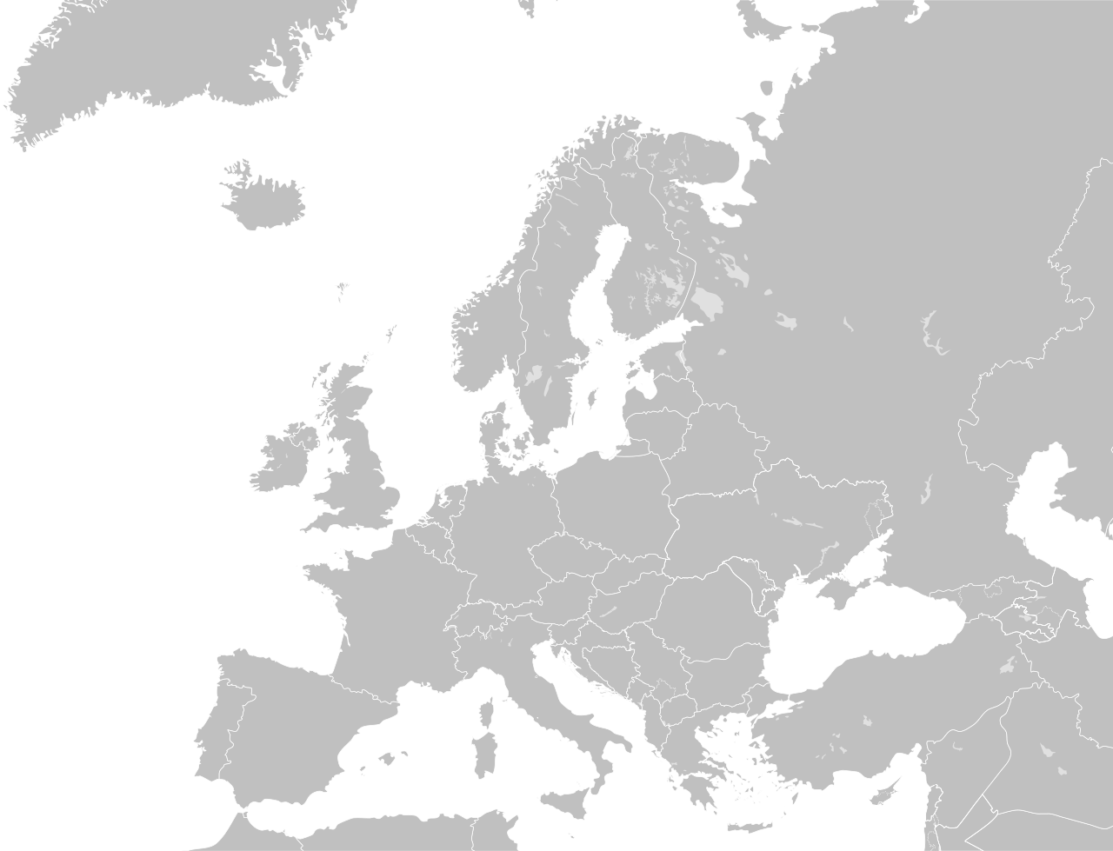
Last lecture summary
Aarhus
(officially spelled Århus)

Slide 3
The three-pillar structure

Slide 4
The three-pillar structure
Access to information Public participation in decision-making Access to justice
public
passive obligation
active obligation
public concerned
Annex I and other activities with significant effects
plans and programmes
general legal regulation
public concerned
denied information
decisions from
pillar II
violation of (other) provisions of the national law relating to the environment

Slide 5
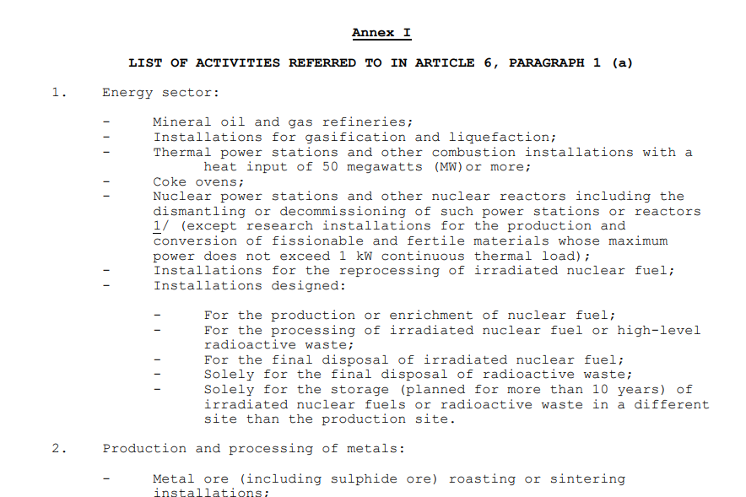

Slide 6
Last lecture summary
Public participation in general
- Procedural rights, often constitutional, sources: IL, EU, NL
2) The Aarhus Convention (1998)
- Parties: MSs + EU + more, the three pillars: information, participation, justice; non-compliance mechanism, a 'floor', not a 'ceiling'‚ interest and rights, important definitions (the public, the public concerned), list of projects, GMO amendment
3) EU level
- Regulation for the EU institutions, directives in first two pillars for the MSs (EIA, IPPC), restrictive interpretation (CJEU – individual concern)
4) National level
- The Aarhus Convention is not directly applicable (but as far as possible), EU directives are directly applicable, but do not deal with much with specific conditions (scope of review, costs and fees, size and activity of the NGOs)

Slide 7
Today
EIA and SEA in general
EU level
Case law

Slide 8
EIA/SEA
EIA is “the process of identifying, predicting, evaluating and mitigating the biophysical, social, and other relevant effects of development proposals or projects prior to major decisions being taken and commitments made.”
(www.unesco.org)
”SEA is a systematic process for evaluating the environmental consequences of proposed policy, plan or programme initiative in order to ensure they are fully included and appropriately addressed at the earliest appropriate stage of decision making on par with economic and social consideration”
(Sadler,Verheem 1996)

Slide 9
Environmental Assessment
Policies
Plans & Programmes
covered by SEA Directive
Projects covered by EIA Directive

Slide 10
EIA/SEA
Policies – Plans - Programmes
Projects
How
Where
If
Why
SEA
EIA

Slide 11
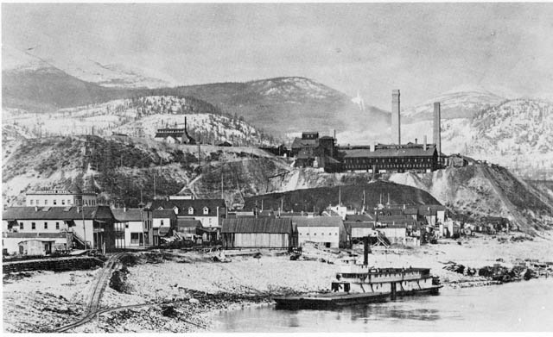
Impact assessment?
International law – Customary law, Espoo convention (transboundary assessment)…
EU law – EIA Directive (2011/92/EU), SEA Directive (2001/42/EC).
National law

Slide 12
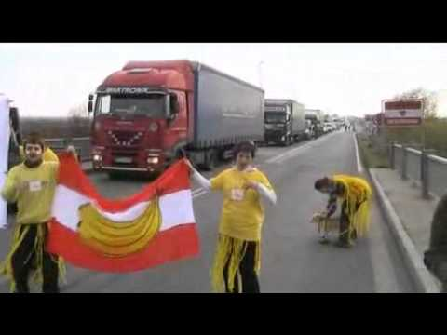
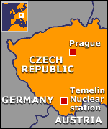
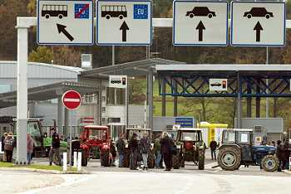
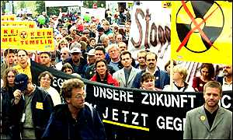
Customary international law?

Slide 13
SEA
ZÚR
OOP
SEA
ÚP
OOP
EIA
ZS
IPPC
(povolení, závazná stanoviska a stanoviska podle některých zvl. Předpisů - , OvzdZ, OdpZ, Vodz, VeřZd)
Územní řízení
R
R
R
Stavební řízení
Řízení o zkušebním provozu
Kolaudační rozhodnutí
R
Povolení, závazná stanoviska a stanoviska podle zvláštních předpisů (ZOPK, ZPF, LesZ)
R

Slide 14
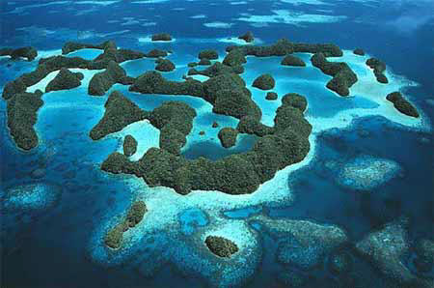
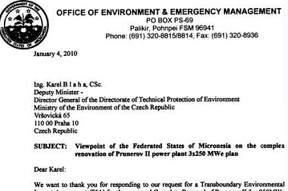
Customary international law?

Slide 15
Impact assessment?
https://www.youtube.com/watch?v=RCg800TYf4k

Slide 16
EIA - General objective
What does the EIA Directive apply to?
projects likely to have significant effects on the environment (by virtue, inter alia, of their characteristics, size and location)
What are these projects subject to?
a requirement for development consent
an assessment of their effects
When?
before consent is given

Slide 17
EIA - What assessment?
EIA must identify, describe, assess
likely direct and indirect environmental effects of activities on
human beings,
fauna, flora, soil, water, air, climate, landscape,
material assets, cultural heritage
the interaction between those factors

Slide 18
EIA - What projects?
Annex I projects
Annex II projects
Mandatory
EIA
Screening
by Competent authorities to decide if
EIA needed or not
http://eur-lex.europa.eu/legal-content/EN/TXT/PDF/?uri=CELEX:32011L0092&from=EN

Slide 19
EIA - examples
ANNEX I
Long-distance railway lines
Motorways, express roads, roads of four lanes or more (of at least 10Km)
Waste disposal installations
for hazardous waste
for non hazardous waste (above 100 tonnes/day)
Waste water treatment plants (above 150000 p.e.)
[+ changes or extensions of Annex I projects meeting Annex I thresholds]
….
ANNEX II
Construction of railways and roads not included in Annex I
Waste disposal installations and waste water treatment plants not included in Annex I
Urban development projects
Changes or extensions of Annex I and II projects that may have adverse environmental effects
[+ modifications not included in Annex I]
….

Slide 20
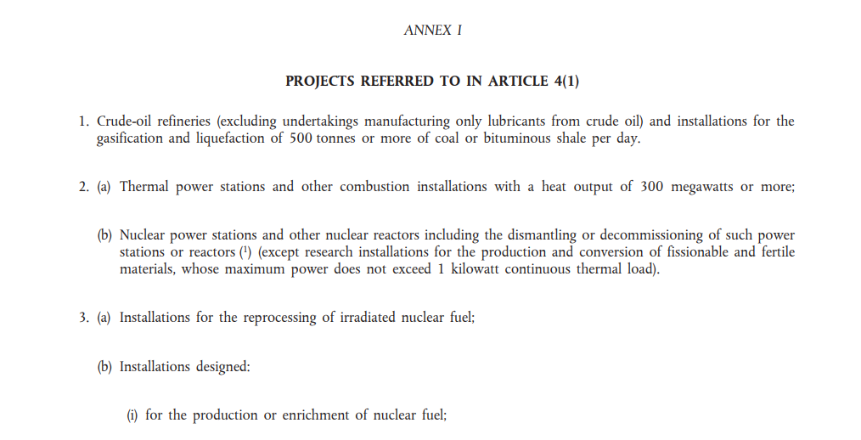

Slide 21
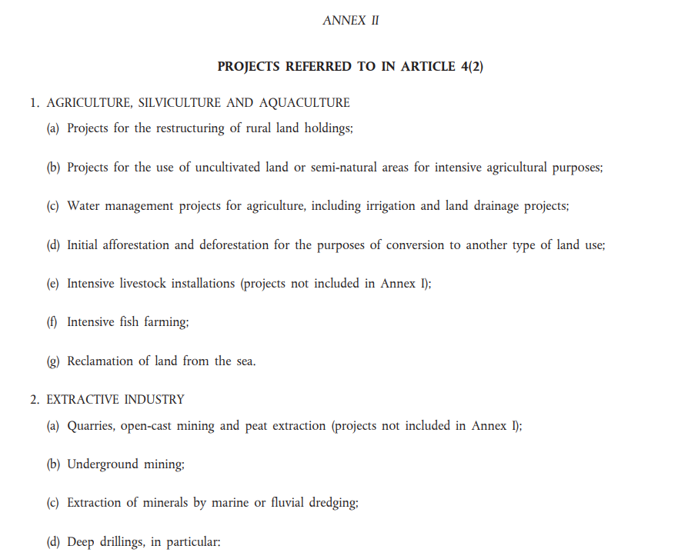

Slide 22
EIA - What assessment?
EIA directive:
Article 2/1:
Member States shall adopt all measures necessary to ensure that, before development consent is given, projects likely to have significant effects on the environment by virtue, inter alia, of their nature, size or location are made subject to a requirement for development consent and an assessment with regard to their effects on the environment.
Article 4/1.
Subject to Article 2(4), projects listed in Annex I shall be made subject to an assessment in accordance with Articles 5 to 10. 2. Subject to Article 2(4), for projects listed in Annex II, Member States shall determine whether the project shall be made subject to an assessment in accordance with Articles 5 to 10. Member States shall make that determination through: (a) a case-by-case examination; or (b) thresholds or criteria set by the Member State.

Slide 23
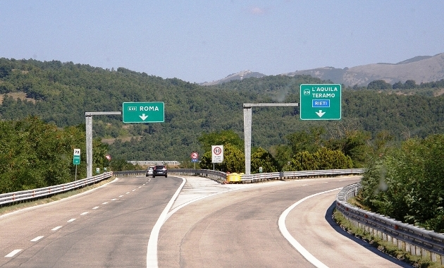
Italy C-87/02 (Lotto zero-Variante, tra Teramo e Giulianova, alla strada statale SS 80’)
Projects of the classes listed in Annex II shall be made subject to an assessment, in accordance with Articles 5 to 10, where Member States consider that their characteristics so require.

Slide 24
Italy C-87/02
MSs have discretion about the methods they use to specify whether a project is subject to EIA.
But this method must not undermine the Directive’s objective.
A decision that a project does not require EIA must contain or be accompanied by all the information that makes it possible to check that it is based on adequate screening, compliant with the Directive.

Slide 25
Ireland C-392/96
Thresholds cannot exclude all projects of a certain type UNLESS, when viewed as a whole, they would not be likely to have significant environmental effects.
Small-scale projects can have significant effects on the environment.
Thresholds are to help in screening, not exempt classes.
Cumulative effects of projects must be taken into account.

Slide 26
Impact assessment?
https://www.youtube.com/watch?v=0uReVJYe0qw

Slide 27
EIA - procedure
Screening
Only for Annex II projects
Scoping
Upon request of the developer
Environmental information
The “Report”
Public, Env. Authorities...
Consultation on environmental information
Decision
Takes account of env.inf and consultations

Slide 28
EIA - screening
Screening
Answers the question: is EIA required? (Annex II projects)
The guiding principle: are significant environmental effects likely?
If yes ⇨ EIA needed
If no ⇨ no EIA needed
Scoping
Env. info
Consultation on env.info
Decision

Slide 29
EIA - screening
Determination through:
Case by case examination
and / or
Thresholds or criteria
Annex III criteria must always be taken into account – characteristics, location, potential impact
⇨ avoid “salami slicing”!
Screening determination made available to the public
Screening
Scoping
Env. info
Consultation on env.info
Decision

Slide 30
EIA - scoping
Screening
Interaction between competent authority, developer, environmental authorities
Before development consent application is submitted
Answers the question “what should be covered by the environmental information?”
Opinion by the competent authority
By request of developer
Scoping
Env. info
Consultation on env.info
Decision

Slide 31
EIA - Environmental information “the report”
Screening
Project description
Likely significant environmental effects (and forecasting methods)
Main alternatives and reasons for the choice taking account of the environmental effects
Cumulative effects
Short term and temporary effects
Mitigation measures
Non-technical summary
Scoping
Env. info
Consultation on env.info
Decision

Slide 32
Informing and consulting
Environmental authorities (Art. 5,6)
(scoping, env.information)
Public concerned (Art. 4,6,10)
Other Member States affected by the project (incl. env. authorities and public concerned in those MSs) (Art. 7,9)

Slide 33
Informing and consulting the public concerned
Screening determination to be made available
Public can express an opinion :
on environmental information
on the development consent request
When final decision is taken, public must be informed of:
its contents and reasons,
attached conditions and mitigation measures
information about public participation process

Slide 34
SELECTED
CASE-LAW

Slide 35
CJEU – Basic principles
The meaning of the EIA Directive is not static
Affected by technical development
The EIA Directive has “a wide scope and a broad purpose” (Kraaijeveld).
Member States’ discretion is limited.
Consistent emphasis on the likely environmental effects of proposed projects.
Exemptions to be interpreted narrowly.

Slide 36
The Kraaijeveld case C-72/95 (South Holland Provincial Executive approved a zoning plan „Partial modification of zoning plans in connection with dyke reinforcement“)
“The wording of the directive indicates that it has a wide scope and a broad purpose.”
Consistently quoted in subsequent cases by the Court (eg Bozen, Ireland).
Uniform interpretation cannot be determined by one language.
Some good news: criteria and thresholds have a role.

Slide 37
Linster C-287/98
Individuals can rely on a Directive that has not been transposed on time.
National courts are not restricted to the national law but can use the directive itself.
Need for uniform application and principle of equality require autonomous uniform meanings for expressions in EC law.

Slide 38
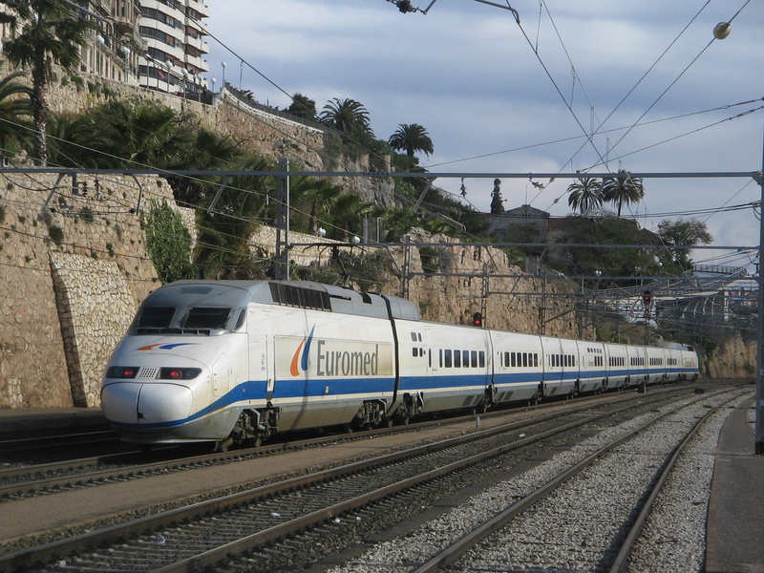
Spain C-227/01 - Valencia-Tarragona railway line, Las Palmas-Oropesa section

Slide 39
Spain C-227/01 - Valencia-Tarragona railway line, Las Palmas-Oropesa section
Annex I point 7 must be understood to include the doubling of an existing track, and not a mere modification.
That the case concerned a short section of a long distance route is not relevant: If the argument of the Spanish Government were upheld, the effectiveness of Directive 85/337 could be seriously compromised, since the national authorities concerned would need only to split up a long-distance project into successive shorter sections in order to exclude from the requirements of the Directive both the project as a whole and the sections resulting from that division.
The new track would obviously create significant new nuisances, so no need to prove the existence of concrete negative effects – likelihood is sufficient.
Note: this case pre-dates amendments by Directive 97/11.

Slide 40
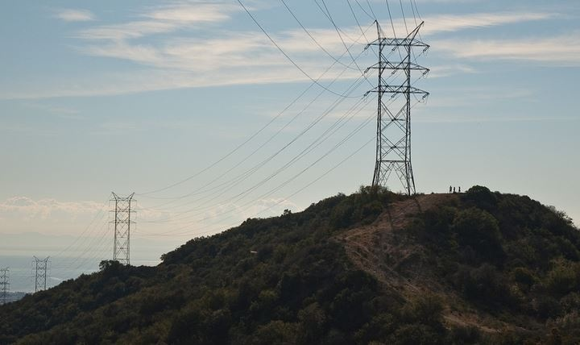
Salami slicing
Shrnutí minulého semináře

Slide 41
Transboundary EIA/SEA
Shrnutí minulého semináře

Slide 42
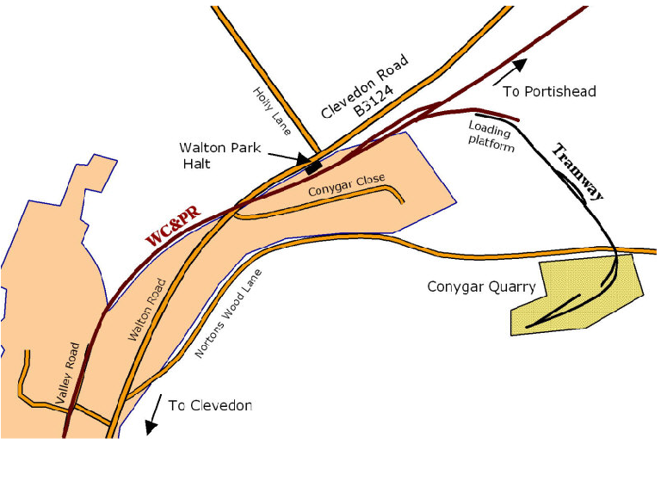
Delena Wells C-201/02
Grant of a new consent for mining operations at Conygar Quarry without an environmental impact assessment having first been carried out

Slide 43
Delena Wells C-201/02
In two (or more) stage consent procedures, assessment of environmental effects must be as soon as they can all be identified and assessed.
If MSs fail to carry out EIA, they must take measures to remedy that failure. These might include the revocation or suspension of a consent, or compensation if an individual has suffered harm.

Slide 44
Practical application
CJEU and Commission rely on EU law – ie the Directive, not the national transpositions.
In considering difficult cases, such as many infrastructure projects, reflect on the approach the Court would take.
Consider the context and purpose of the legislation.

Slide 45
Strategic Environmental Assessment Directive 2001/42/EC
Applicable from 21st July 2004

Slide 46
What is a plan or programme? (Article 2)
prepared and/or adopted by an authority at national, regional or local level AND;
required by legislative, regulatory or administrative provisions.
Definition includes:
co-financed by the EC, modifications.
Typically urban plans, waste management plans,…

Slide 47
Which plans and programmes require SEA?
Article 3(2) - plans and programmes that always require environmental assessment:
(a) prepared for agriculture, forestry, fisheries, energy, industry, transport, waste/ water management, telecommunications, tourism, town & country planning or land use
AND
which set the framework for future development consent of projects listed
in the EIA Directive.
(b) which, in view of the likely effect on sites, have been determined to require an assessment under Article 6 or 7 of the Habitats Directive.

Slide 48
Which plans and programmes require SEA?
Article 3(9) - Exemptions:
National defence, civil emergency, financial or budget plans/programmes
Structural Funds Regulations (inc EAGGF) for current programming period 2000-2006/7

Slide 49
Thank you for your attention ☺
To be continued…

