Slide 1


Basics of EU Environmental Law
BIODIVERSITY/CITES
29 November 2023
JUDr. Vojtěch Vomáčka, Ph.D., LL.M.

Slide 2
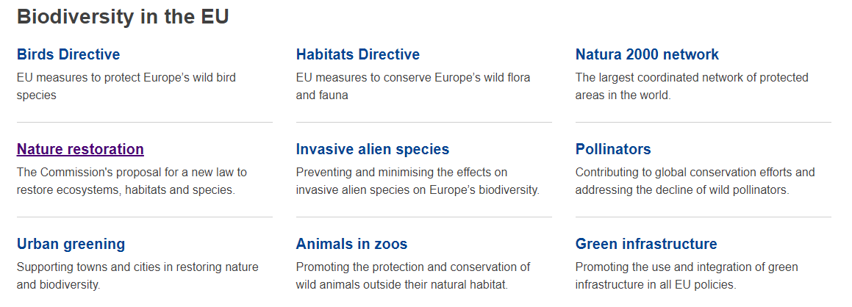

Slide 3

TRADE IN ENDANGERED SPECIES
International Law:
Convention on International Trade in Endangered Species of Wild Fauna and Flora (CITES - 1975)
Difficult nature - binding international convention, but instruments contained therein are not binding until they become part of national law
Large number of Parties lack regulations prohibiting illegal trade or imposing sanctions or allowing seizure of specimens or defining professional conservation authorities
Possibility of bilateral "sanctions" (e.g. certification)
Does not protect habitats, does not address causes of illegal trade
Within biodiversity conservation, the focus of CITES is paradoxically narrow
EU Law:
Council Regulation (EC) No 338/97 of 9 December 1996 on the protection of species of wild fauna and flora by regulating trade therein + amendments and implementing regulations
Regulation (EC) No 1007/2009 of the European Parliament and of the Council on trade in seal products

Slide 4
TRADE IN ENDANGERED SPECIES
‘Specimen’
shall mean any animal or plant, whether alive or dead, of the species listed in Annexes A to D, any part or derivative thereof, whether or not contained
in other goods, as well as any other goods which appear from an accompanying document, the packaging or a mark or label, or from any other circumstances, to be or to contain parts or derivatives of animals or plants of those species, unless such parts or derivatives are specifically exempted from the provisions of this
Regulation or from the provisions relating to the Annex in which the species concerned is listed by means of an indication to that effect in the Annexes concerned.

Slide 5
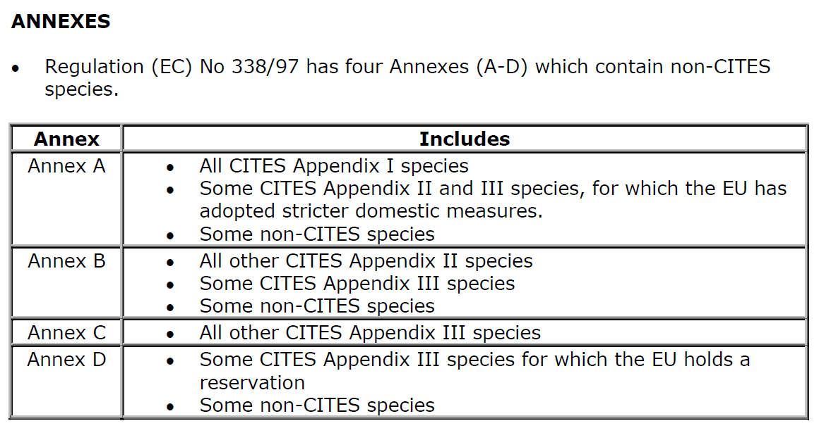
TRADE IN ENDANGERED SPECIES

Slide 6
TRADE IN ENDANGERED SPECIES
ART. 8 OF REGULATION 338/97
(1) The purchase, offer to purchase, acquisition for commercial purposes, display to the public for commercial purposes, use for commercial gain and sale,
keeping for sale, offering for sale or transporting for sale of specimens of the species listed in Annex A shall be prohibited.
(2) This prohibition shall also apply to specimens of species listed in Annex B except where it can be proved that such specimens were acquired in accordance with the legislation in force.

Slide 7
TRADE IN ENDANGERED SPECIES
ART. 8 OF REGULATION 338/97
(3) Exemption from the prohibitions referred to in paragraph 1 may be
granted by issuance of a certificate to that effect by a management
authority of the Member State in which the specimens are located, on
a case-by-case basis where the specimens:
(a) were acquired in, or were introduced into, the Community before the
provisions relating to species listed in Appendix I to the Convention or in
Annex C1 to Regulation (EEC) No 3626/82 or in Annex A became applicable to
the specimens; or
(b) are worked specimens that were acquired more than 50 years
previously; or
(c) were introduced into the Community in compliance with the provisions of
this Regulation and are to be used for purposes which are not detrimental to
the survival of the species concerned; or
(d) are captive-born and bred specimens of an animal species or artificially
propagated specimens of a plant species or are parts or derivatives of such
specimens; or

Slide 8
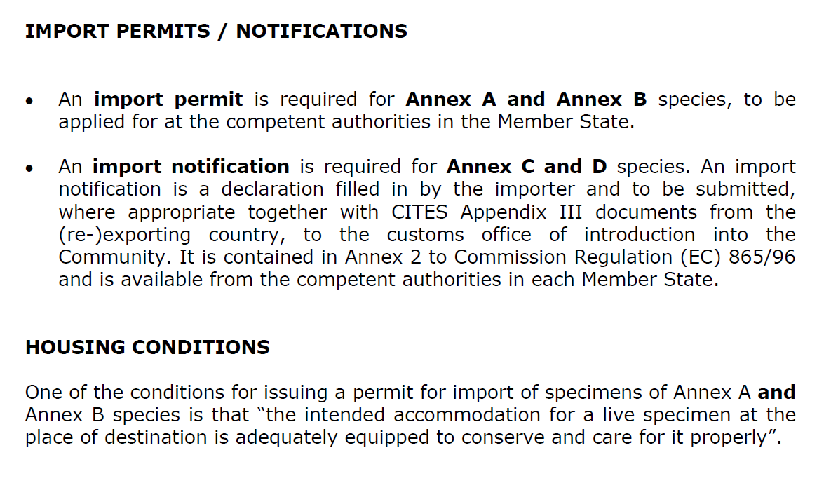
TRADE IN ENDANGERED SPECIES

Slide 9
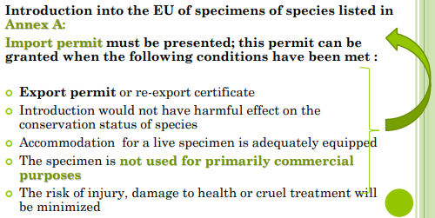
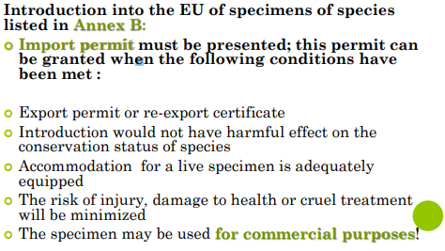
TRADE IN ENDANGERED SPECIES
A bred in captivity = B
Introduction into the EU of specimens of species listed in Annex C: At the border customs office at the point of introduction the importer must present
○ Import notification
○ Export permit / re-export certificate / certificate of
Origin
species listed in Annex C: notification

Slide 10
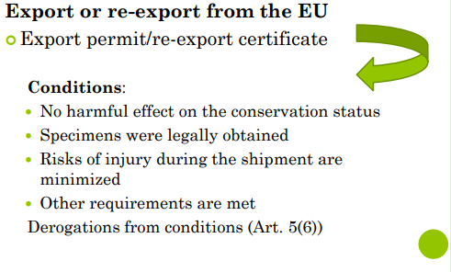
TRADE IN ENDANGERED SPECIES
Intra EU trade: notifications, documents…

Slide 11
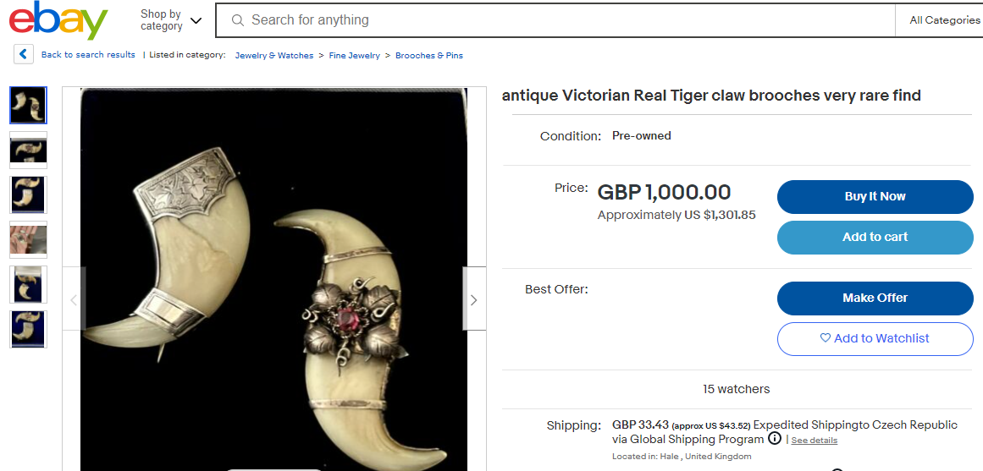
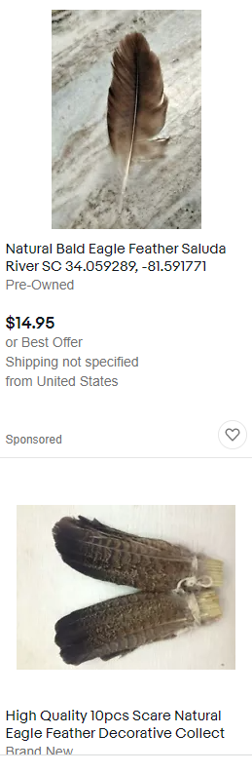
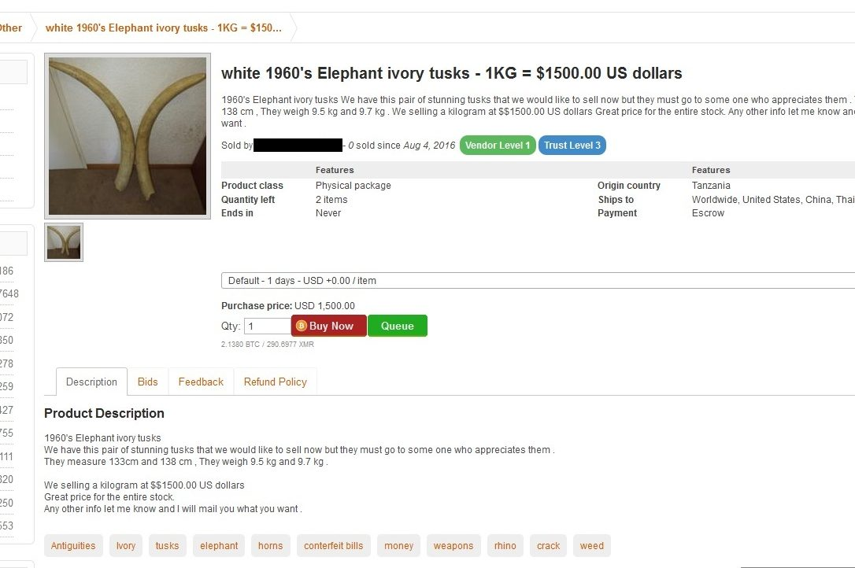
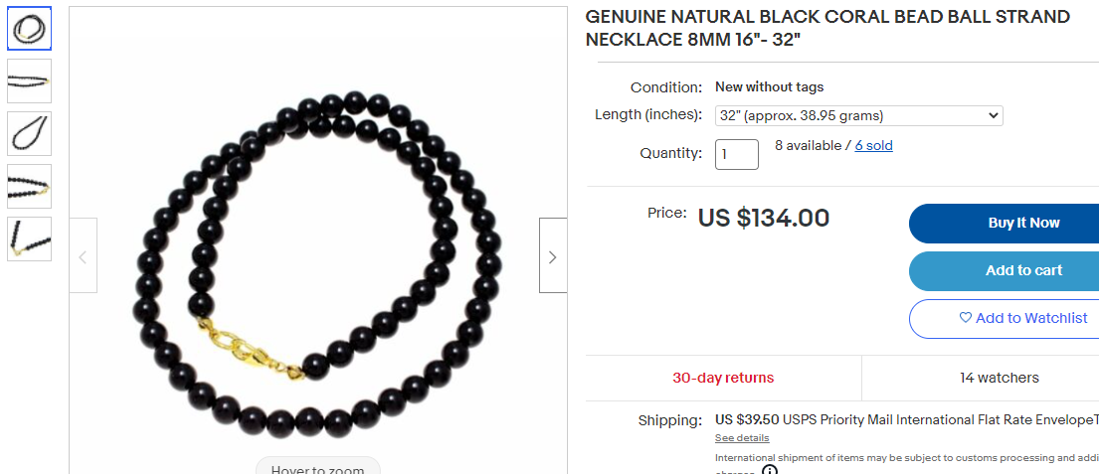
11

Slide 12
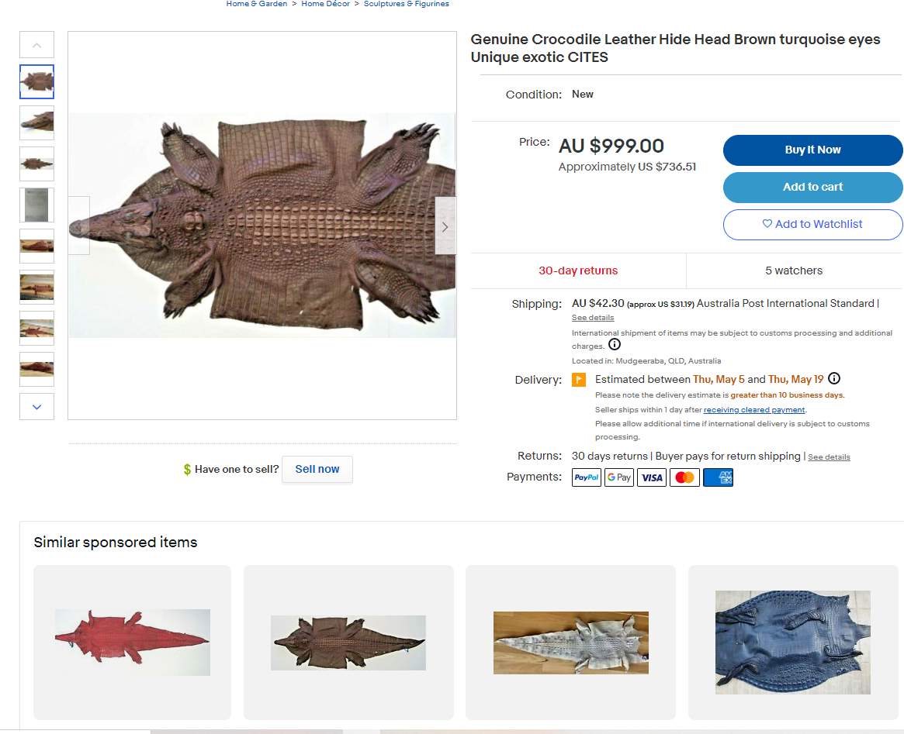
12

Slide 13

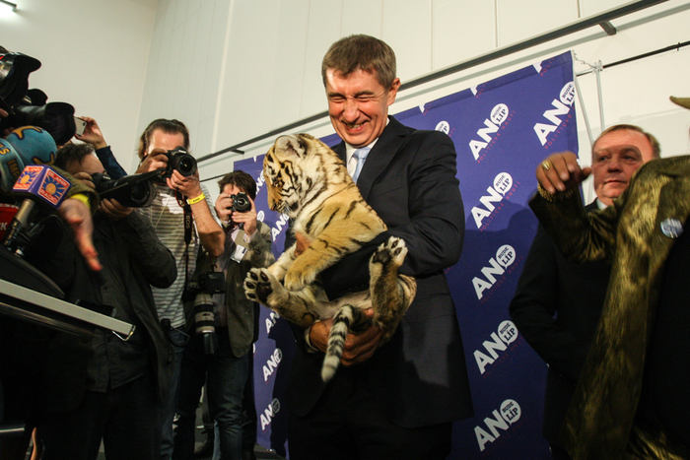
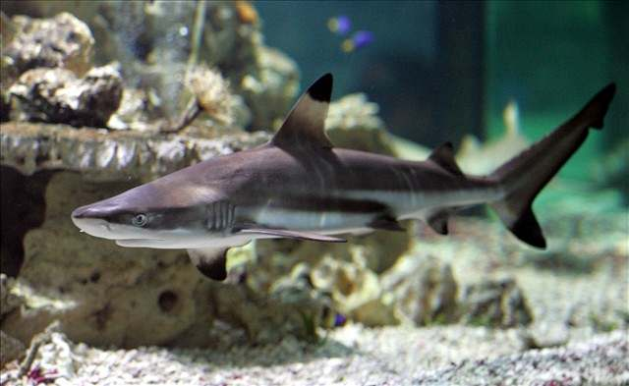
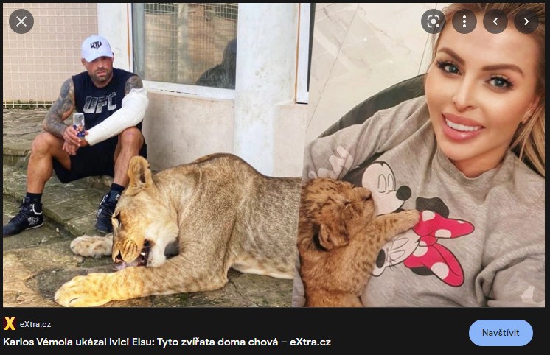

???

Slide 14
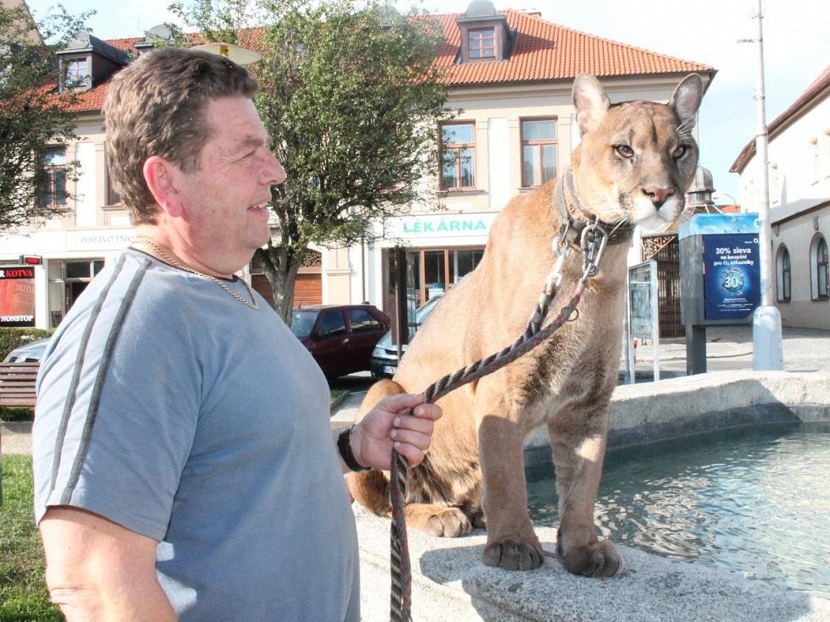
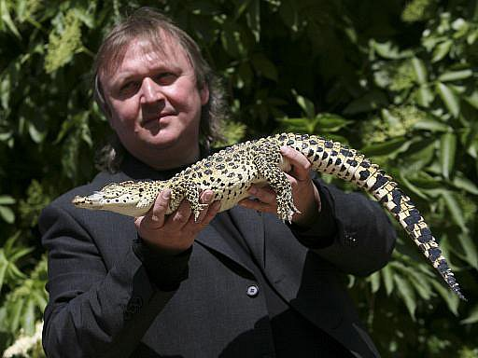
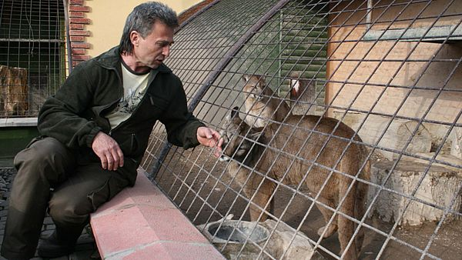
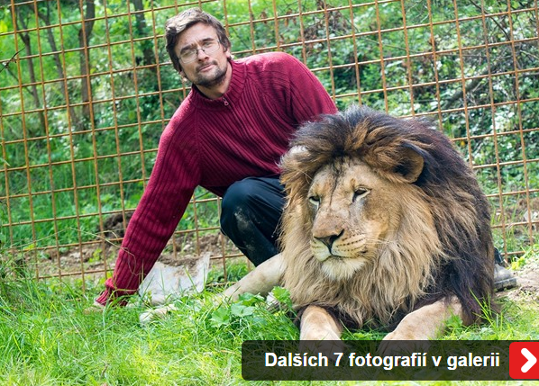
???

Slide 15
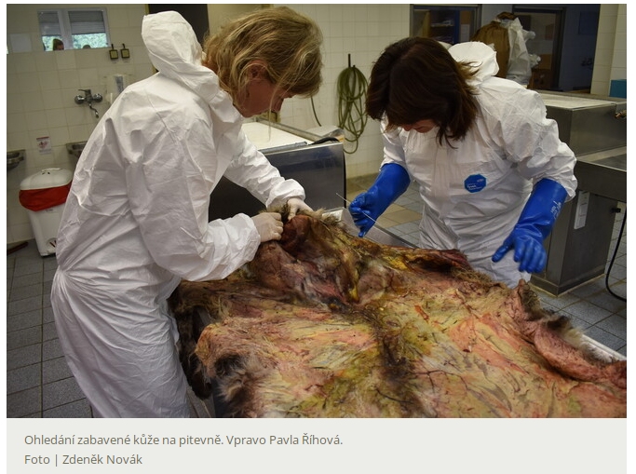
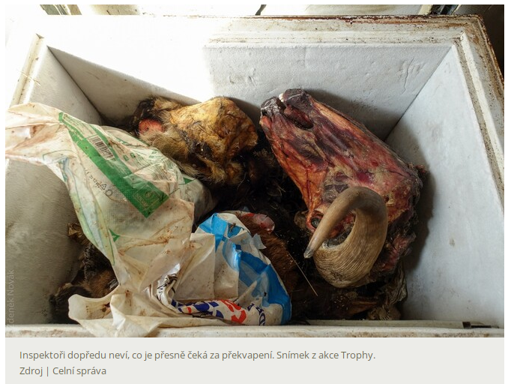
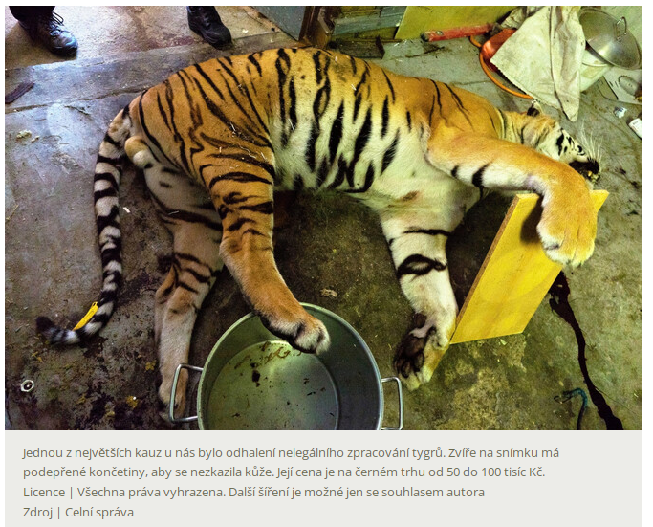
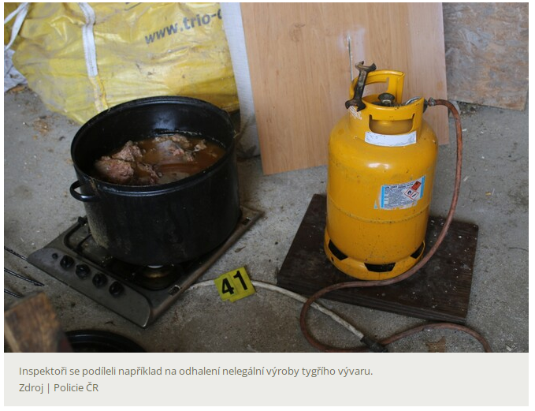

Slide 16
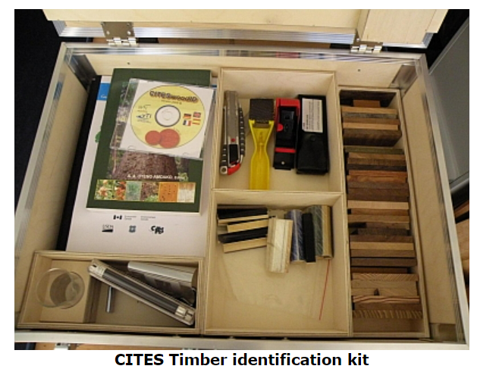
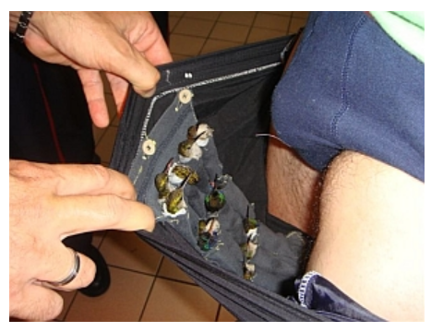

Slide 17
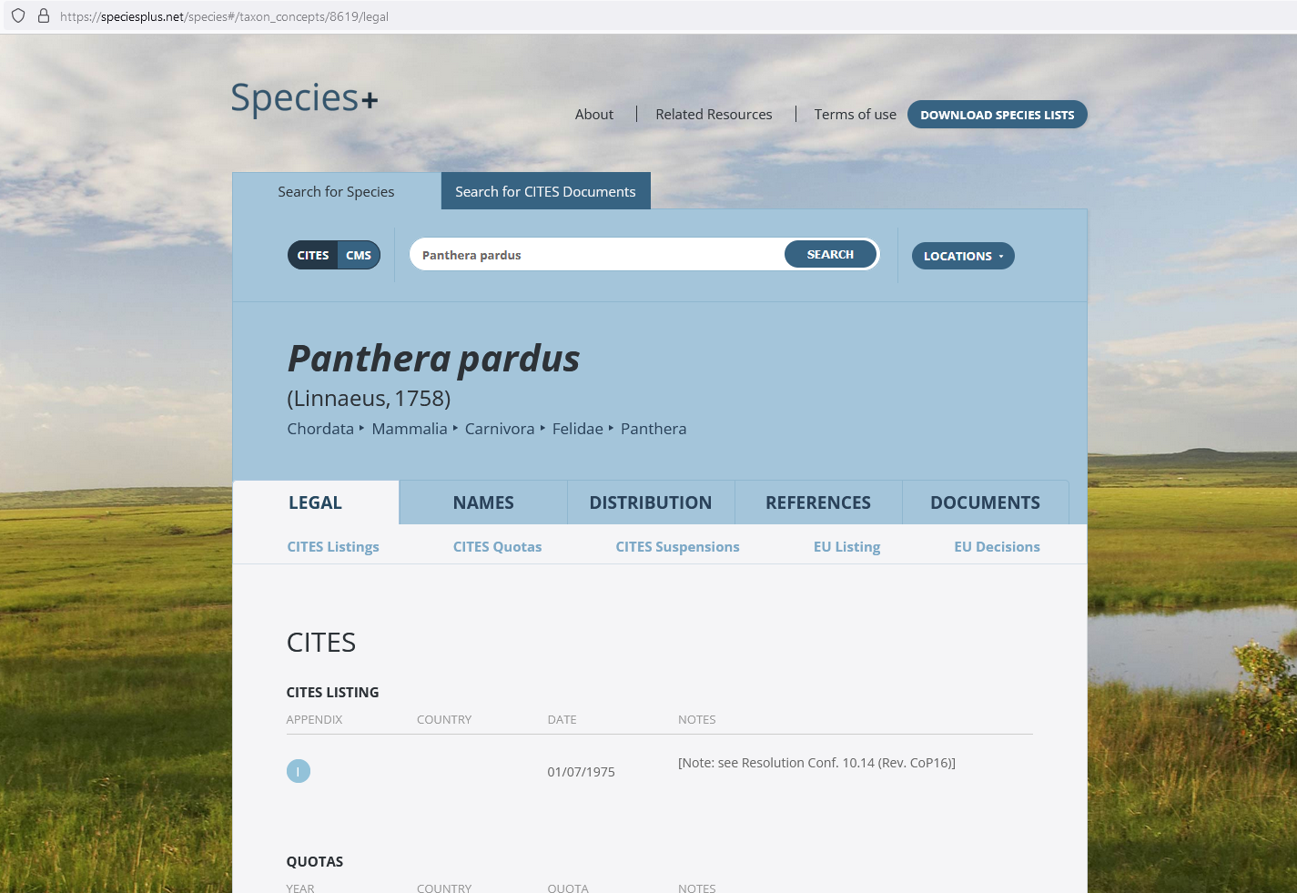
17

Slide 18
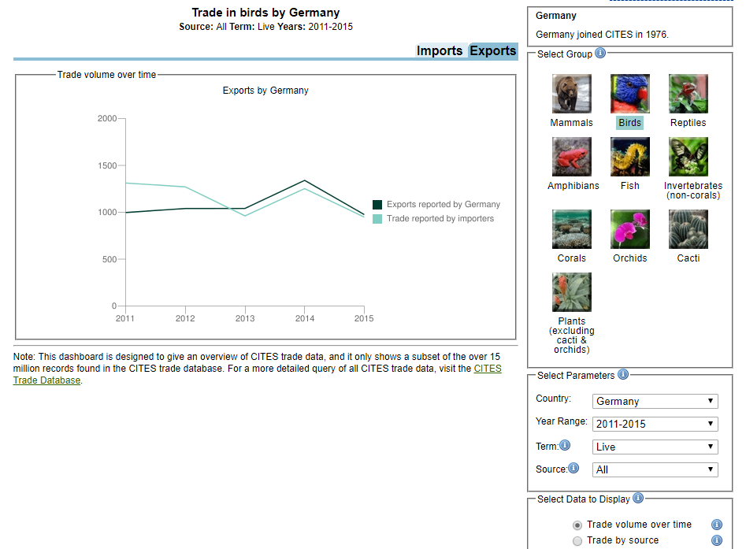

Slide 19
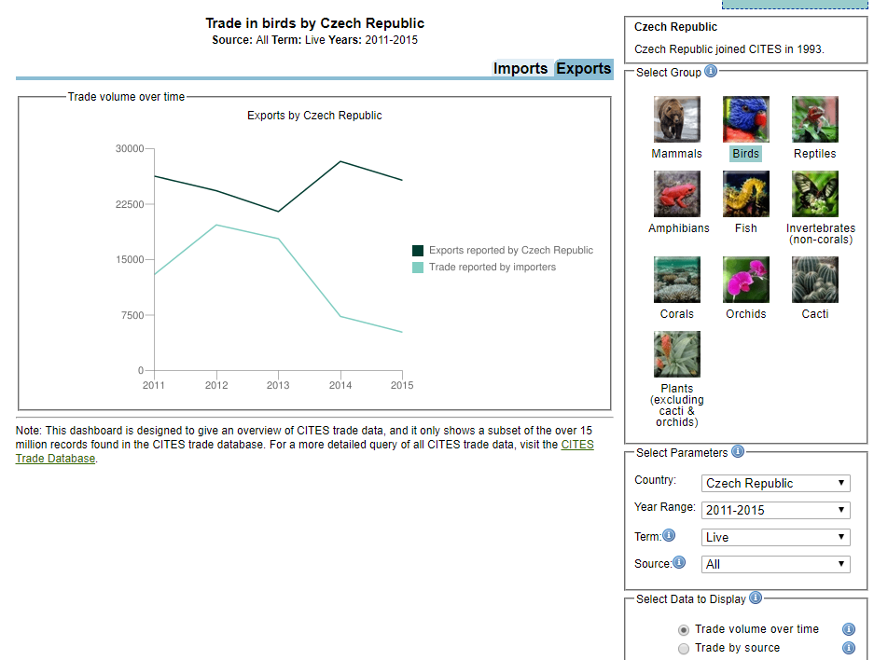

Slide 20
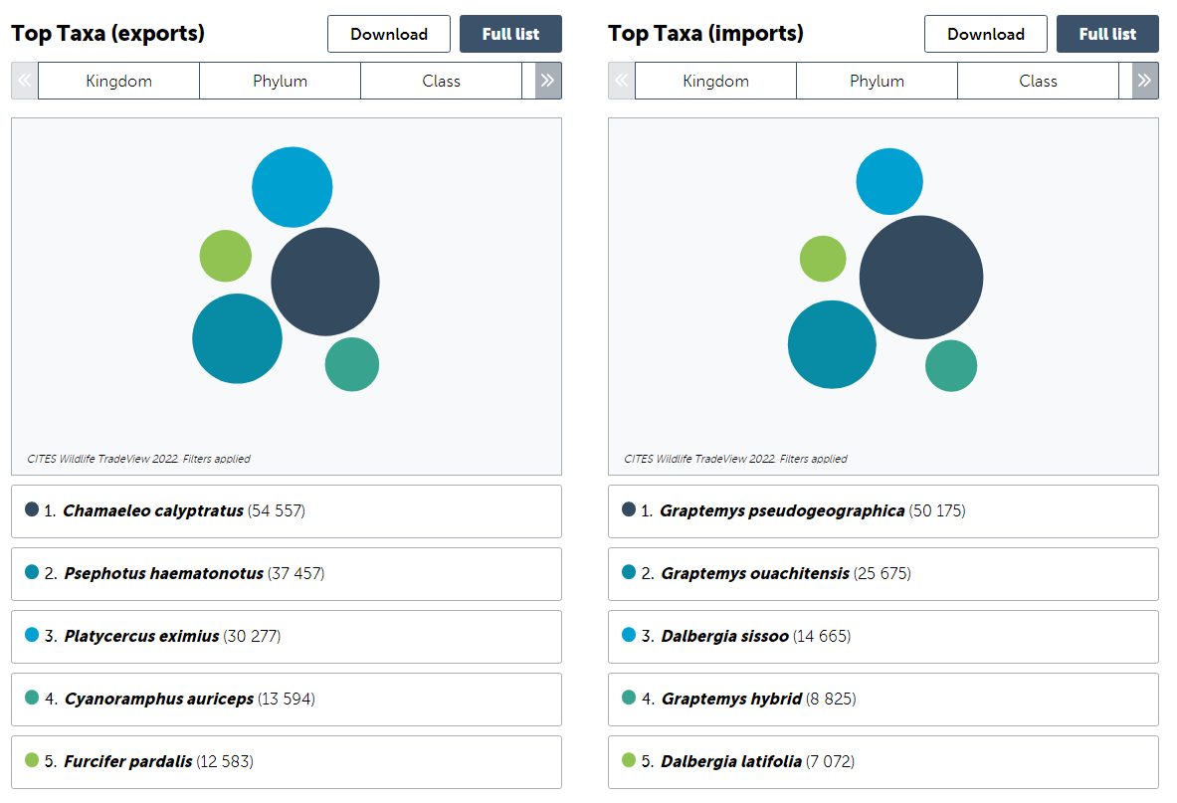
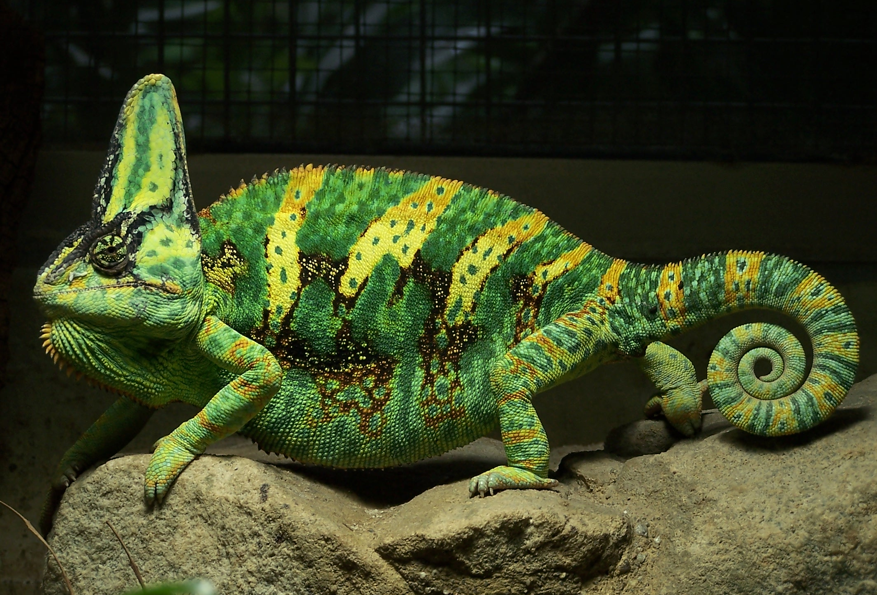
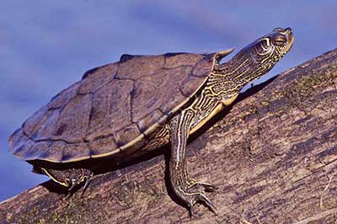

Slide 21
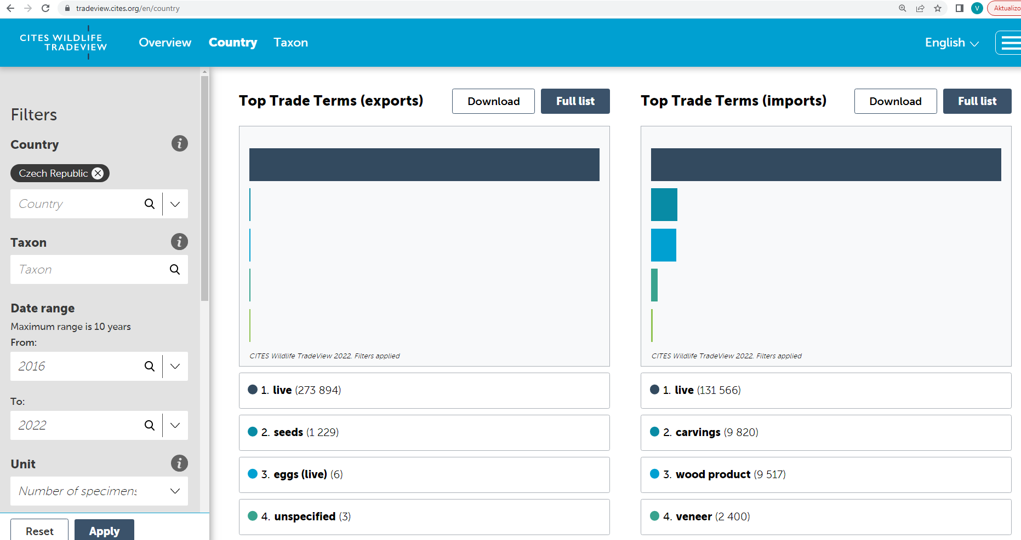
https://tradeview.cites.org/

Slide 22
Practical task
Which species are most frequently imported to your country?
Which species are most frequently exported from your country?
In which quantity)condition are these species transported?

Slide 23
Thank you for your attention!

