Slide 1

EU Air Protection
Jiri Vodicka, Ph.D. 15. 11. 2023

Slide 2

Structure
Introduction
Pillars of EU Air Protection
  National emissions
  Sources of pollution
  Air quality
CJEU Case Law
Tato fotka od autora Neznámý autor s licencí CC BY-NC-ND

Slide 3
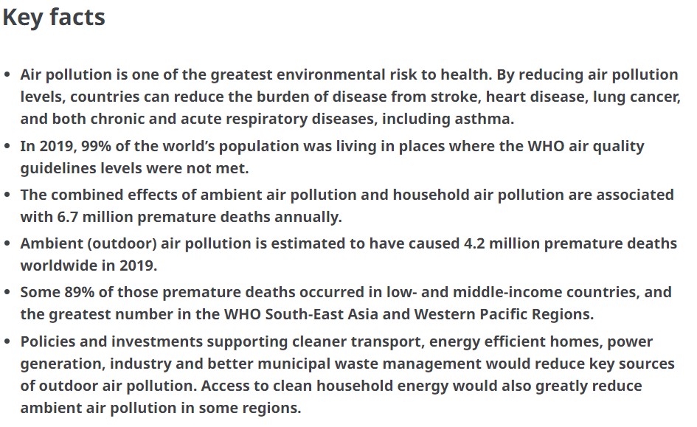
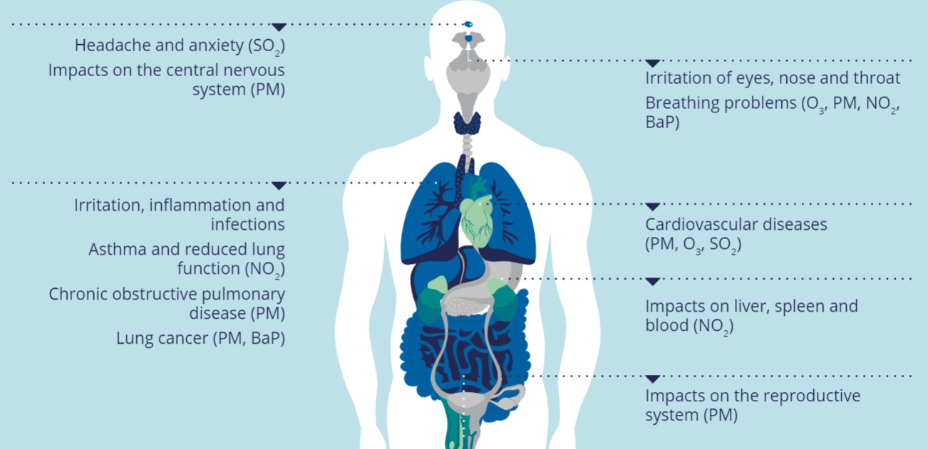
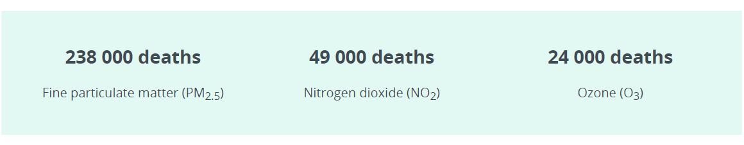

Introduction
The EU's general objective is to achieve pollution levels that do not have a significant impact on human health and the environment
Air quality declines or stagnates (still outside WHO limits)
Direct and indirect effects on human health
300 000 x 23 394
Notes:
https://www.who.int/news-room/fact-sheets/detail/ambient-(outdoor)-air-quality-and-health

Slide 4
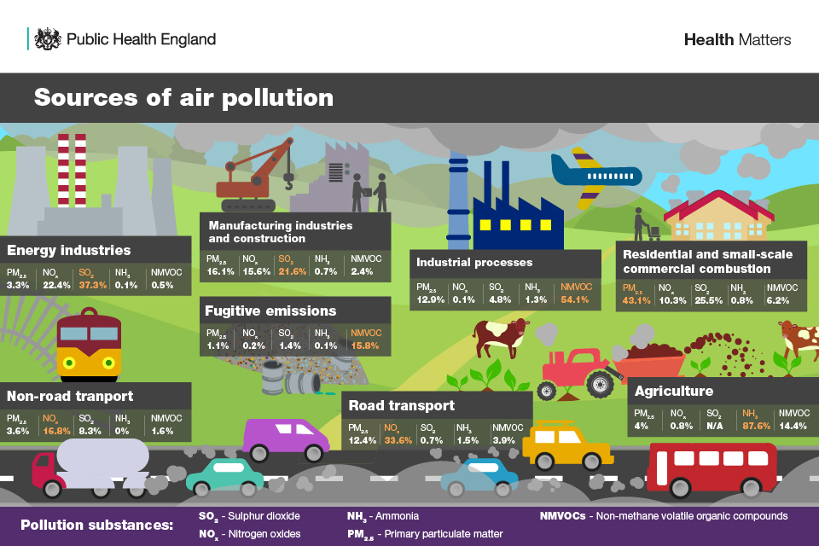
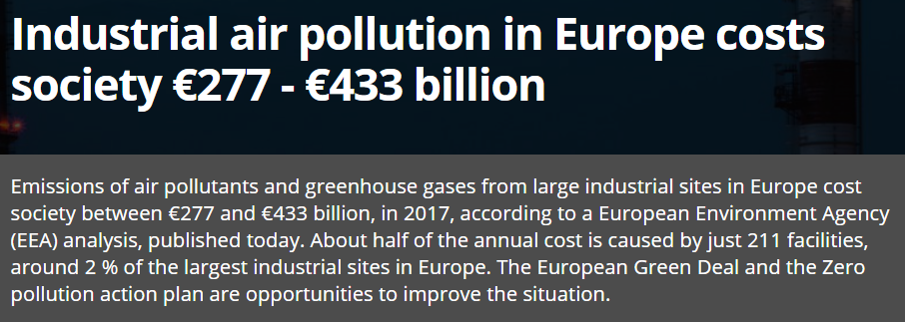
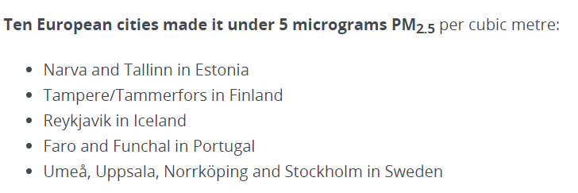

Introduction
SOx
NOx
PM10
PM2,5
VOC
NH3
O3
Economic aspects of air pollution?
  Health Care
  Agriculture
  Forestry and ecosystem functions
Which substances/activities to regulate and how?
Are you satisfied with air quality in your city?
  https://aqicn.org/map/world/
  https://airindex.eea.europa.eu/Map/AQI/Viewer/
Main air pollutants
Notes:
https://www.statista.com/chart/20804/costs-of-air-pollution-from-fossil-fuels/
https://www.eea.europa.eu/highlights/industrial-air-pollution-in-europe

Slide 5
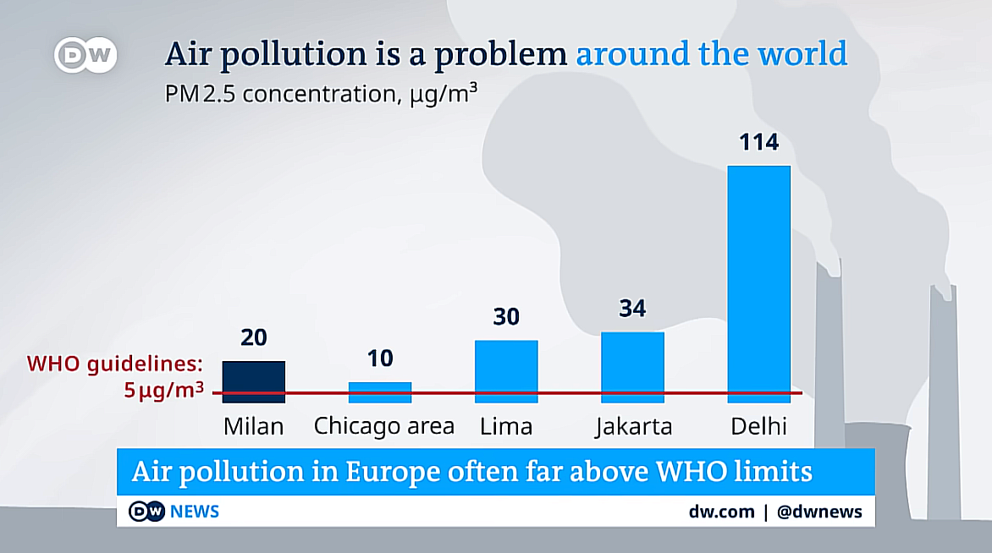
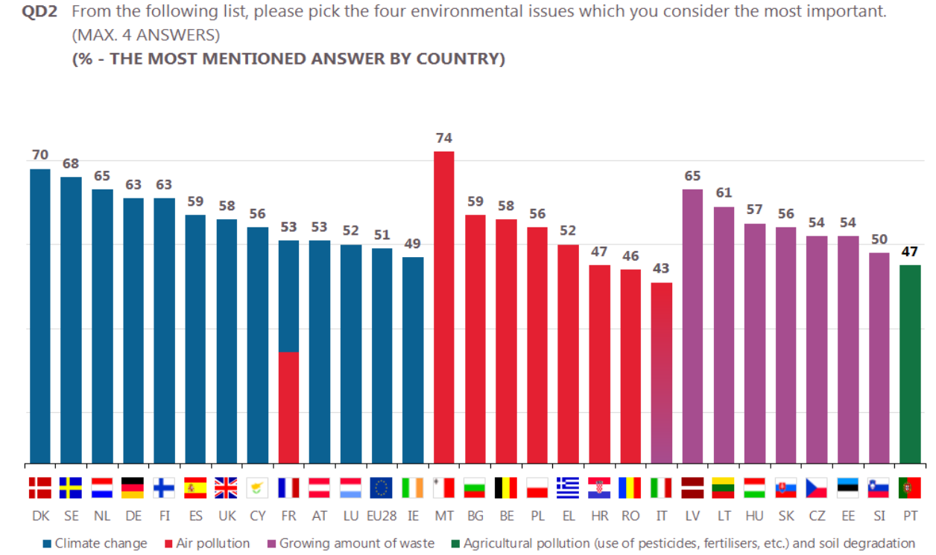

Slide 6

Notes:
https://www.youtube.com/watch?v=FkjtCKZx06E

Slide 7
Pillars of EU Air Protection

Slide 8
EU Air protection
I. Ambient air quality standards
II. National Emission Ceilings (NEC)
III. Emission standards for selected sources
International cooperation on ambient air quality
Notes:
https://www.consilium.europa.eu/en/policies/air-quality/

Slide 9
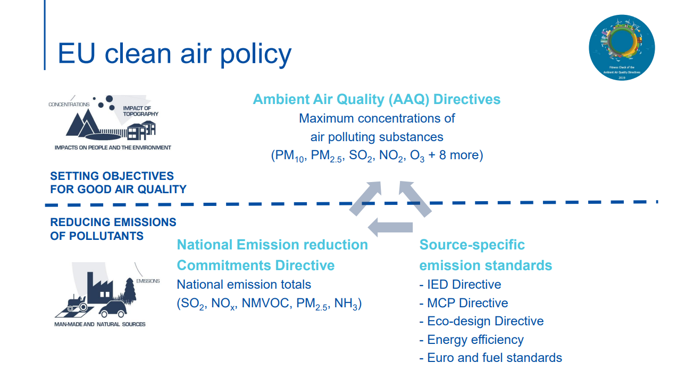

Slide 10
Ambient air quality standards
Historical overview:
1980 Directive on air quality limit values and guide values for sulphur dioxide and suspended particulates (80/779/EEC)
1982 Directive on a limit value for lead in the air (82/884/EEC)
1985 Directive on air quality standards for nitrogen dioxide (85/203/EEC)
1992 Directive on air pollution by ozone (92/72/EEC)

Slide 11
Ambient air quality standards
The first framework
directive
Directive on ambient air quality assessment and management (96/62/EC):
Unified measurement system (technology and location)
Results regularly transmitted to the Commission
Air quality information made available to the public
Plans and programmes for zones or agglomerations with exceedances

Slide 12
Ambient air quality standards
The First Framework Directive does not contain limit values!
Directive relating to limit values for sulphur dioxide, nitrogen dioxide and oxides of nitrogen, particulate matter and lead in ambient air (1999/30/EC)
Directive relating to limit values for benzene and carbon monoxide in ambient air (2000/69/EC)
Directive relating to ozone in ambient air (2002/3/EC)
Directive relating to arsenic, cadmium, mercury, nickel and polycyclic aromatic hydrocarbons in ambient air (2004/107/EC)

Slide 13
Ambient air quality standards
(Second) Framework Directive on ambient air quality and cleaner air for Europe (2008/50/ES)
Existing objectives remain the same
New target for PM2.5
Merges previous directives (except one)
Possibility to deduct natural sources
Introduced threshold and limit values for individual substances + possible extension of exemptions
x anthropogenic
sources

Slide 14


Air Quality Directive (2008/50)
Types of air quality standards:
  Limit values: to be attained within a given period and not to be exceeded once attained
  Target values: to be attained where possible over a given period
  Critical levels: direct adverse effects may occur on ecosystems
  Alert thresholds: risk to human health from brief exposure for the population as a whole + immediate steps are to be taken
  Information thresholds: risk to human health from brief exposure for particularly sensitive sections of the population + immediate and appropriate information necessary
  Long-term objectives (LTO), National Exposure Reduction Target (NERT), Exposure Concentration Obligation (ECO)

Slide 15
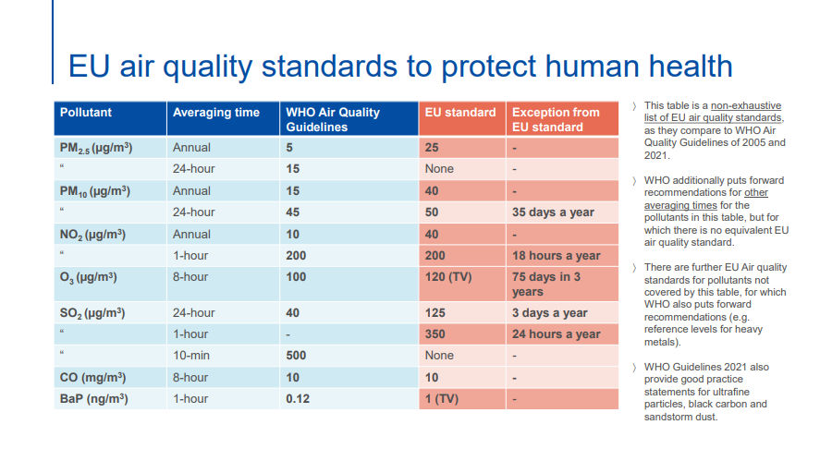

Slide 16
Air Quality Directive (2008/50)
MS are to:
  establish zones and agglomerations in their territory
  ensure a good quality of the ambient air (e.g. not to exceed limit values) throughout all zones and agglomerations
  establish air quality plans for zones and agglomerations where the levels of pollutants in ambient air exceed the limit value plus relevant margin of tolerance (AQPs)
Notes:
Art. 13 and 23

Slide 17
Air Quality Directive (2008/50)
Air quality plans
  SO2, NO2, benzene, carbon monoxide, lead, PM10,(limit values) and PM2,5 (target value)
  Air quality plans must set out appropriate measures, so that the exceedance period can be kept as short as possible
Requirements for AQP
  Identification of possible measures to improve air quality
  Detailed description of measures adopted in the plan
  Timetable for implementation of each measure
  Assessment of the estimated impact of each measure and of the whole plan including the identification of the expected compliance date
The AQP must demonstrate how conformity
with the limit values will be achieved
The duty not to exceed limit values is based
on art. 13(1)

Slide 18
National Emission Ceilings
Transposition of international commitments
  Convention on Long-Range Transboundary Air Pollution (1979)
  Götenburg Protocol (1999, amended 2012)
Reducing national emissions of atmospheric pollutants (2030 target)
  5 pollutants (SO2, NOx, NMVOC, NH3, PM2,5)
Directive on the reduction of national emissions of certain atmospheric pollutants (2016/2284/EU)

Slide 19
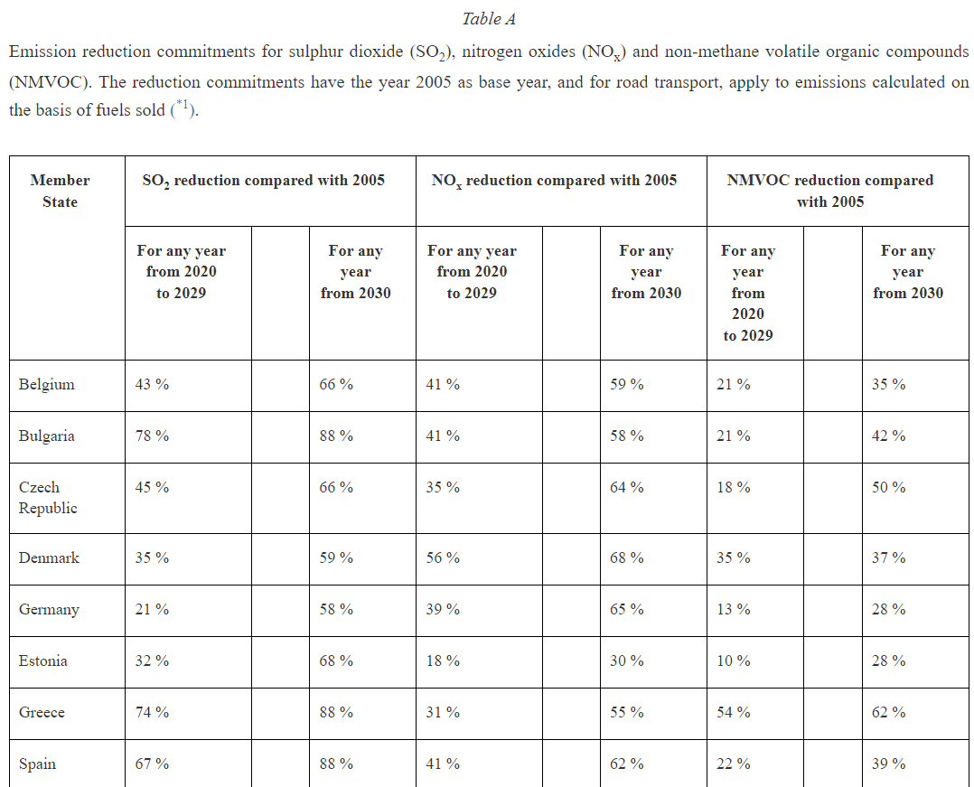
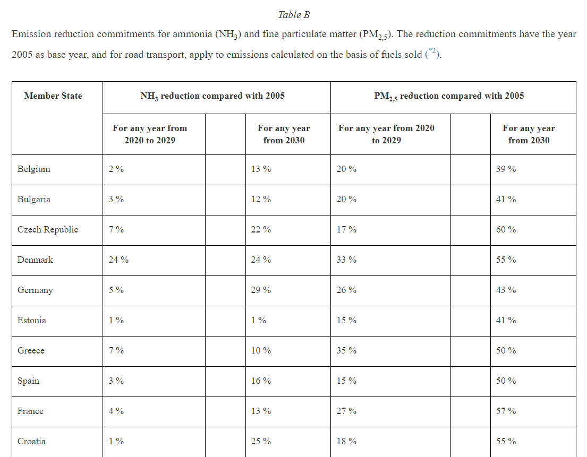
National Emission Ceilings
Directive 2016/2284
Art. 2(1):
  This Directive shall apply to emissions of the pollutants referred to in Annex I from all sources occurring in the territory of the Member States, their exclusive economic zones and pollution control zones
National air pollution control programmes – art. 6
Reduction targets in Annex II

Slide 20
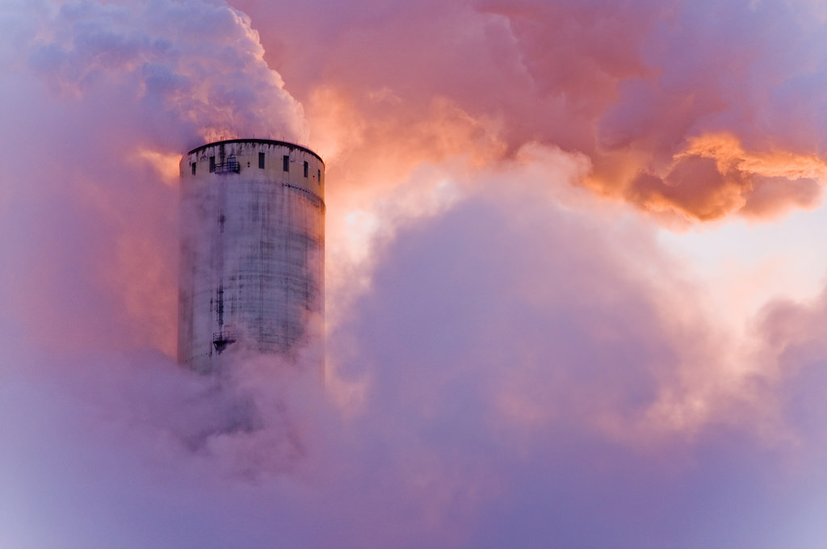
Emission standards for other sources
Transport
Agriculture
Electricity production and industry
e.g. Regulation 2018/858 +
Regulation No. 715/2007
Directive 2010/75
on industrial emissions (IED)
Tato fotka od autora Neznámý autor s licencí CC BY
Directive 2015/2193
medium sized
Directive 2010/75
on industrial emissions (IED)

Slide 21
Enforcement of Air quality

Slide 22
Infringement procedure
Art. 258 TFEU
118 cases on air quality (24 active)
The most recent and frequent ambient air quality cases at the Commission:
  Exceeding limits for specific substances:
    NO2
    SO2
    PM10
  Missing transposition
    Noise (directive 2021/1226)
    Noise (directive 2020/367)

Slide 23
CJEU Case law
Huge number of Court cases
  Directly concerned: 1. framework directive (16) + 2. framework directive (25)
Two types
Air quality legislation
  Interpretation of various provisions in AQD
Access to justice
  Legal standing
  Access to courts

Slide 24
CJEU Case law
C-237/07 – Janecek
  Legal standing + Action plans requirements
„Thus, the Court has held that, whenever the failure to observe the measures required by the directives which relate to air quality and drinking water, and which are designed to protect public health, could endanger human health, the persons concerned must be in a position to rely on the mandatory rules included in those directives (see Case C‑361/88 Commission v Germany; Case C‑59/89 Commission v Germany; and Case C‑58/89 Commission v Germany) “
„It follows from the foregoing that the natural or legal persons directly concerned by a risk that the limit values or alert thresholds may be exceeded must be in a position to require the competent authorities to draw up an action plan where such a risk exists, if necessary by bringing an action before the competent courts.“

Slide 25
CJEU Case law
C-404/13 – ClientEarth
  Legal standing + AQP requirements + role of national courts
„the natural or legal persons directly concerned by the limit values being exceeded ... must be in a position to require the competent authorities, if necessary by bringing an action before the courts having jurisdiction, to establish an air quality plan which complies with the second subparagraph of Art. 23(1) of Directive 2008/50“
„As regards the content of the plan, it follows from the second subparagraph of Article 23(1) of Directive 2008/50 that, while Member States have a degree of discretion in deciding which measures to adopt, those measures must, in any event, ensure that the period during which the limit values are exceeded is as short as possible.“

Slide 26
CJEU Case law
C-404/13 – ClientEarth
„where a Member State has failed to comply with the requirements of the second subparagraph of Article 13(1) of Directive 2008/50 […], it is for the national court having jurisdiction, should a case be brought before it, to take, with regard to the national authority, any necessary measure, such as an order in the appropriate terms, so that the authority establishes the plan required by the directive in accordance with the conditions laid down by the latter“

Slide 27
CJEU Case law
C-723/17 – Craeynest
  Location of sampling points & compliance with limit values
„…put into concrete terms the EU’s obligations concerning environmental protection and the protection of public health, which stem, inter alia, from Article 3(3) TEU and Article 191(1) and (2) TFEU, according to which Union policy on the environment is to aim at a high level of protection […] and is to be based, inter alia, on the precautionary principle and on the principle that preventive action should be taken“

Slide 28
CJEU Case law
C-723/17 – Craeynest
(rules on on the use and location of sampling points) „contain clear, precise and unconditional obligations, which means that they can be invoked by individuals against the State“
„it is for a national court, hearing an application submitted for that purpose by individuals directly affected by the exceedance of the limit values referred to in Article 13(1) of that directive, to verify whether the sampling points located in a particular zone have been established in accordance with the criteria laid down in paragraph 1(a) of Section B of Annex III to the directive and, if they were not, to take all necessary measures in respect of the competent national authority, such as, if provided for by national law, an order, with a view to ensuring that those sampling points are sited in accordance with those criteria“

Slide 29
CJEU Case law
C-723/17 – Craeynest
That interpretation of Article 13(1) and Article 23(1) of Directive 2008/50 is confirmed by the purpose of the directive. As is apparent from recital 2 and Article 1 thereof, that directive aims to protect human health and, to this end, provides for measures to combat emissions of pollutants at source. In accordance with that objective, it is necessary to determine the actual air pollution to which the population or part of it is exposed and to ensure that appropriate measures are taken to combat the sources of such pollution. Consequently, the fact that a limit value has been exceeded at a single sampling point is sufficient to trigger the obligation to draw up an air quality plan, in accordance with Article 23(1) of Directive 2008/50.

Slide 30
CJEU Case law
C-177/19 P – Ville de Paris and Others
  Legal standing of municipalities and:
Air Quality Directive 2008/50
Type-approval Regulation 2018/858 + Regulation No. 715/2007 (Euro 5 & 6)
„legalisation“ of illegal vehicles (= non-complying)

Slide 31
CJEU Case law
C-61/21 – Ministre de la Transition écologique and Premier ministre
  State‘s liability
It is true that it follows that Article 13(1) and Article 23(1) of Directive 2008/50 […] lay down fairly clear and precise obligations as to the result to be achieved by Member States.
However, those obligations pursue, as is apparent from Article 1 of the directives mentioned in the previous paragraph, as well as, in particular, recital 2 of Directive 2008/50, a general objective of protecting human health and the environment as a whole.

Slide 32
CJEU Case law
Failed Frankovich
Liability test
C-61/21
Thus, besides the fact that the provisions concerned of Directive 2008/50 and the directives which preceded it do not contain any express conferral of rights on individuals in that respect, it cannot be inferred from the obligations laid down in those provisions, with the general objective referred to above, that individuals or categories of individuals are, in the present case, implicitly granted, by reason of those obligations, rights the breach of which would be capable of giving rise to a Member State’s liability for loss and damage caused to individuals.
It should be added that the conclusion set out in paragraph 57 above does not mean that a Member State cannot incur liability under less strict conditions on the basis of national law […] nor does it prevent, where appropriate, a failure to fulfil the obligations resulting from Article 13(1) and Article 23(1) of Directive 2008/50 or the other provisions of EU law referred to in paragraph 42 above from being taken into account in that regard as a factor which may be relevant for the purposes of establishing the liability of public authorities on a basis other than EU law.

Slide 33
Air Quality and Green Deal

Slide 34

Green Deal and Air Quality
Zero pollution action plan: Towards zero pollution for air, water and soil (2050).
The zero pollution vision for 2050 is for air, water and soil pollution to
be reduced to levels no longer considered harmful to health and natural
ecosystems, that respect the boundaries with which our planet can
cope, thereby creating a toxic-free environment.

Slide 35
Green Deal and Air Quality
Zero pollution action plan: Towards zero pollution for air, water and soil.
2030 targets:
  Improving air quality to reduce the number of premature deaths caused by air pollution by 55%
  Improving water quality by reducing waste, plastic litter at sea (by 50%) and microplastics released into the environment (by 30%)
  Improving soil quality by reducing nutrient losses and chemical pesticides’ use by 50%
  Reducing by 25% the EU ecosystems where air pollution threatens biodiversity;
  Reducing the share of people chronically disturbed by transport noise by 30%,
  Significantly reducing waste generation and by 50% residual municipal waste

Slide 36
Final remarks
We need to use all available instruments to protect air quality
  Emission standards, AQPs, low-emission zones etc.
MS should make bigger and better effort
Proposal for a new AQD „in pipelines“
Notes:
https://eur-lex.europa.eu/legal-content/EN/TXT/?uri=COM:2022:542:FIN

Slide 37

Questions?

Slide 38
Thank you for your attention!
Jiri.Vodicka@law.muni.cz

Slide 39
Sources
Jakir, V. Introduction to EU Clean Air Policy, ERA, 2022
Jakir, V. Limit and Target Values, ERA, 2022
Jancarova, I. EU Air protection effort: Significance of air quality plans in EU MS, MU, 2022.
European Commission (https://ec.europa.eu/environment/air/index_en.htm)
ERA: EU Air Quality Law and the Right to Clean Air – Focus on Access to Justice

