Slide 1


BASICS OF THE EU ENVIRONMENTAL LAW
ACCESS TO ENVIRONMENTAL INFORMATION, PARTICIPATION OF PUBLIC IN ENVIRONMENTAL DECISION-MAKING AND ACCESS TO JUSTICE - THE 3 PILLARS OF AARHUS CONVENTION.
8 November 2023
JUDr. Vojtěch Vomáčka, Ph.D., LL.M.

Slide 2
Last lecture summary - Harmonization of environmental requirements
1) Correct transposition + application + information
2) Obligation to refrain from any measure which could jeopardise the attainment of the Union's objectives
3) Implementation and the enforcement: member states, problems of EU control: remote, burden of proof
4) The role of national courts and the role of CJEU.
CJEU: interpretation, systematic failures, financial sanctions
national courts: a) consistent interpretation, b) conflict: annulment, non-application (exemptions), direct effect?, c) state liability

Slide 3
Today
Public participation in general
The Aarhus Convention
Three pillars at the EU level
Three pillars at the national level

Slide 4
Public participation?
Environmental democracy
Affected and close to the source
Fundamental rights
(to be able to assert this rights, citizens must participate)
Helping hand
    to further the accountability of and transparency
to strengthen public support for decisions
to promote environmental education
Negatives?
„Only“ procedural rights
Wide scope
Free or almost free of charge
Not necessarily protection of environment – personal interests

Slide 5

Public participation? How?
Petition
Demonstration
Referendum
Access to information
Participation in proceedings
Judicial Protection

Slide 6
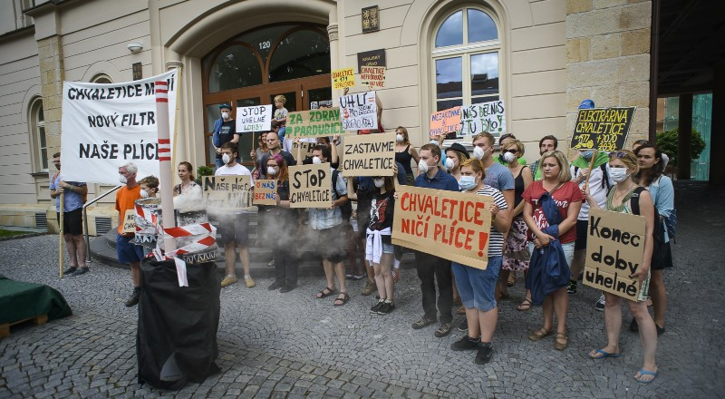
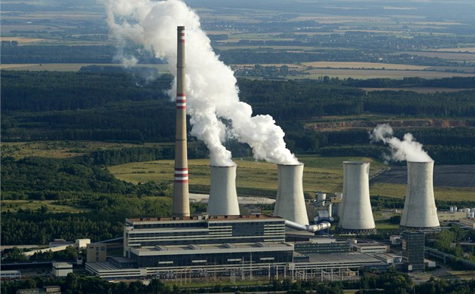
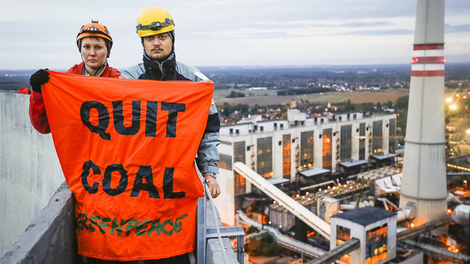
Effective public participation?

Slide 7

Public participation? Balancing the system
C-115/09 Bund für Umwelt und Naturschutz Deutschland, Landesverband Nordrhein-Westfalen eVvBezirksregierung Arnsberg Trianel Kohlekraftwerk Lünen
The German system of judicial review
involves a “careful and detailed” scrutiny of administrative decisions,
admissibility criteria are such that few are able to access this system, particularly groups bringing actions alleging environmental harm.

Slide 8
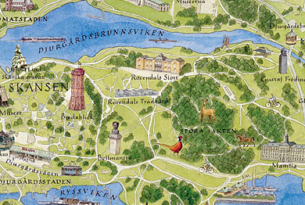
The Aarhus Convention – NATIONAL level
Various restrictions:
C-263/08 (Djurgården-Lilla Värtans)
– only NGOs with environmental objectives
- active for 3 years
    - 2.000 members

Slide 9
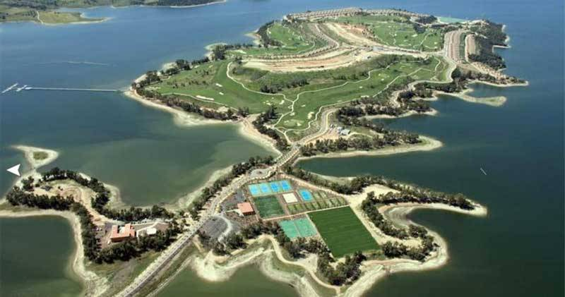
Public participation? Balancing the system
Marina Isla de Valdecañas

Slide 10
Public participation? Balancing the system
Marina Isla de Valdecañas
The tourist resort in the province of Caceres, which comprises hotels, 200 luxury villas, a golf course and a marina.
It was declared illegal by a Spanish Supreme Court ruling of 6 February 2014. The resort is located within a Natura 2000 protected area.
The ruling comes after almost a decade of court proceedings, and at this stage the resort is already close to completion.

Slide 11
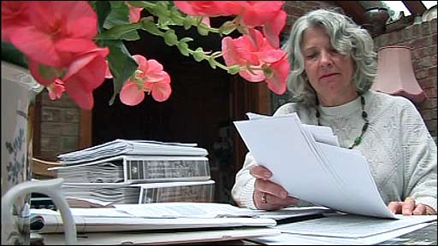
Public participation? Balancing the system
Various restrictions:
Costs of the proceedings? Costs follow the event rule?
Lilian Pallikaropoulos from Rugby – £ 90.000
Maximum, legal aid, moderation, C-260/11 (Edwards)

Slide 12
Sources of legal regulation: International level
Principle l of the Stockholm Declaration on the Human Environment (1972)
Principle 10 of the Rio Declaration on Environment and Development
UN General Assembly resolutions (1982) on the World Charter for Nature and (1990) on the need to ensure a healthy environment for the well-being of individuals
Customary international law?
Human Right treaties
The Aarhus Convention

Slide 13

The Convention on Access to Information, Public Participation in Decision-making and Access to Justice in Environmental Matters
https://www.youtube.com/watch?v=uyhE9v2UnEQ
https://www.youtube.com/watch?v=2UvwbKCjmjA

Slide 14
The Aarhus Convention
the most ambitious venture in environmental democracy undertaken under the auspices of the United Nations (Kofi Annan)
the world’s foremost international instrument that links environmental and human rights
a unique international treaty regime, combining notions from environmental as well as human rights law
Almost mature, yet not always respected*
* by Austria, Bulgaria, Czechia, Romania, Slovakia, Spain, United Kingdom, Croatia, Germany, Lithuania and the European Union
Notes:
The adoption of the Aarhus Convention was heralded as a major breakthrough in international law. The then UN Secretary General Kofi Annan described it as “the most ambitious venture in environmental democracy undertaken under the auspices of the United Nations”.

Slide 15
Development
Before the 1990’s international law did not pay much attention to domestic procedures - domestic law- and policy-making only
Principle l of the Stockholm Declaration on the Human Environment (1972) – Both aspects of man's environment, the natural and the man-made, are essential to his well-being and to the enjoyment of basic human rights the right to life itself.
UN General Assembly resolutions (1982) on the World Charter for Nature and (1990) on the need to ensure a healthy environment for the well-being of individuals
Customary international law?
Human Right treaties – access to justice and effective remedies
The EU:
The EIA Directive (85/337/EEC), Directive on the freedom of access to information on the environment (90/313/EEC ), The Habitats Directive (92/43/EEC),
CJEU: elements of individual rights to rely on environmental laws before courts, e.g. with respect to environmental quality standards (C-59/89, Commission v Germany; C-361/88, Commission v Germany; and C-64/90, Commission v France).
Notes:
With the exception of international human rights law, before the 1990’s international law did not pay much attention to domestic procedures for decisions-making, citizens’ access to documents or citizens’ access to court. Today, it may appear surprising that at that time only few multilateral environmental agreements addressed the engagement of members of the public in environmental matters at all; accordingly these matters remained essentially for domestic law- and policy-making only.
The EU was a different case. Not only it adopted some pieces of legislation, in particular Directive 85/337/EEC on the assessment of the effects of certain public and private projects on the environment, and Directive 90/313/EEC on the freedom of access to information on the environment, which oblige the Member States to promote access to information and some degree of public participation in decision-making. The European Court of Justice had also highlighted elements of individual rights to rely on environmental laws before courts, e.g. with respect to environmental quality standards. (C-59/89, Commission v Germany; C-361/88, Commission v Germany; and C-64/90, Commission v France.)

Slide 16
United Nations Framework Convention on Climate Change (1992, 197 Parties):
Art. 6 (a) Promote and facilitate at the national and, as appropriate, subregional and regional levels, and in accordance with national laws and regulations, and within their respective capacities:
(ii) public access to information on climate change and its effects;
(iii) public participation in addressing climate change and its effects and developing adequate responses;
Convention on Environmental Impact Assessment in a Transboundary Context (Espoo Convention, 1991, 45 Parties):
    Art. 2(2): Each Party shall take the necessary legal, administrative or other measures to implement the provisions of this Convention, including (...) the establishment of an environmental impact assessment procedure that permits public participation.
    Art. 2(6): The Party of origin shall provide, in accordance with the provisions of this Convention, an opportunity to the public in the areas likely to be affected to participate in relevant environmental impact assessment procedures regarding proposed activities and shall ensure that the opportunity provided to the public of the affected Party is equivalent to that provided to the public of the Party of origin.
    Art. 3(8): 8. The concerned Parties shall ensure that the public of the affected Party in the areas likely to be affected be informed of, and be provided with possibilities for making comments or objections on, the proposed activity, and for the transmittal of these comments or objections to the competent authority of the Party of origin, either directly to this authority or, where appropriate, through the Party of origin.
    Art. 4 (2): ... The concerned Parties shall arrange for distribution of the documentation to the authorities and the public of the affected Party in the areas likely to be affected...
    Declaration of France: The Convention implies that it is the responsibility of each Party to ensure the public distribution within its territory of the environmental impact assessment documentation, inform the public and collect its comments, except where different bilateral arrangements apply

Slide 17
The Aarhus Convention: Development
Principle 10 of the 1992 Rio Declaration on Environment and Development (UN Doc. A/Conf.151/26):
Environmental issues are best handled with the participation of all concerned citizens, at the relevant level. At the national level, each individual shall have appropriate access to information concerning the environment that is held by public authorities, including information on hazardous materials and activities in their communities, and the opportunity to participate in decision-making processes. States shall facilitate and encourage public awareness and participation by making information widely available. Effective access to judicial and administrative proceedings, including redress and remedy, shall be provided.”
Agenda 21: “One of the fundamental prerequisites for the achievement of sustainable development is broad public participation in decision-making
Political changes in Europe in the beginning of the 1990’s influenced the perception of what are international and national legal issues. New matters, such as civic society, democratisation, environmental human rights and globalisation, transcended state borders, entered the international arena, and expanded into international discourse, law, and policy-making in a way that had previously not been possible.
Notes:
While international human rights law and EU law was important for the Aarhus Convention, it would not have come into being were it not for two important circumstances.
The first is the outcome of the 1992 UN Conference on Environment and Development in Rio de Janeiro 1992. More specifically, through the Rio Declaration on Environment and Development, Principle 10 (United Nations Declaration on Environment and Development; UN Doc. A/Conf.151/26.), it was agreed at the conference that:
“Environmental issues are best handled with the participation of all concerned citizens, at the relevant level. At the national level, each individual shall have appropriate access to information concerning the environment that is held by public authorities, including information on hazardous materials and activities in their communities, and the opportunity to participate in decision-making processes. States shall facilitate and encourage public awareness and participation by making information widely available. Effective access to judicial and administrative proceedings, including redress and remedy, shall be provided.”
Principle 10 nicely frames what was to become the Aarhus Convention; it highlights access to information, public participation in decision-making, and effective access to judicial and administrative proceeding, including redress and remedy, ie access to justice.

Slide 18
The Aarhus Convention: Negotiations
1995: The Third “Environment for Europe” Ministerial Conference endorsed the UNECE Guidelines on Access to Environmental Information and Public Participation in Environmental Decision-making, which drew on and developed Principle 10. The Ministerial Conference also decided to consider the drafting of a convention.
1996: The UNECE Committee on Environmental Policy established the mandate for an ad hoc working group to conduct the negotiations for a new instrument.
June 1996 - March 1998: Over ten sessions of the working group. The NGOs engaged (‘friends of the secretariat’). The EU (EC) did not have a negotiating mandate, but increasing EU coordination and presentation of a single EU position. The US and Canada opted out of the negotiations at an early stage. Russia and Turkey played an active role, with many of their textual proposals being accommodated by the other negotiating parties, but did not sign or accede to the Convention.
25 June 1998 (Aarhus, Denmark): The Convention was adopted within the framework of the Fourth Ministerial ‘Environment for Europe’ conference.
30 October 2001: The Convention entered into force.
Since 2012, all EU Member States and the EU itself are parties to the Aarhus Convention.
4 March 2018: Escazú (Costa Rica) - Regional Agreement on Access to Information, Public Participation and Justice in Environmental Matters in Latin America and the Caribbean
Notes:
Soon after the Rio Conference, in 1995, the Third “Environment for Europe” Ministerial Conference endorsed the UNECE Guidelines on Access to Environmental Information and Public Participation in Environmental Decision-making, which drew on and developed Principle 10. The Ministerial Conference also decided to consider the drafting of a convention.
In January 1996, the UNECE Committee on Environmental Policy established the mandate for an ad hoc working group to conduct the negotiations for a new instrument, to be chaired by Willem Kakebeeke, a senior official from the Netherlands. The negotiations took place from June 1996 to March 1998 over ten sessions of the working group. For most of the negotiating period, the EU (then called the European Community) did not have a negotiating mandate and its Member States intervened directly in the negotiations, often with divergent positions. Towards the conclusion of the negotiations (and even more subsequently), there was increasing EU coordination and presentation of a single EU position. The US and Canada opted out of the negotiations at an early stage. Russia and Turkey played an active role, with many of their textual proposals being accommodated by the other negotiating parties, but did not sign or accede to the Convention.
The level and depth of NGO engagement in the negotiations, while following a tradition established in the ‘Environment for Europe’ process, was unprecedented in the context of the formulation of an international environmental treaty and possibly any legally binding treaty. Even before the formal negotiations began, NGOs were represented in a small ‘friends of the secretariat’ group that assisted the secretariat with preparing draft elements for the Convention text. Thereafter, environmental NGOs were able to be involved not just in the plenary but in every small drafting group. As the NGOs had the relevant experience and would end up being, on behalf of the public, the main ‘clients’ of the Convention, their active participation was not only justified from a principle standpoint but contributed materially to the relevance and robustness of the text.
The Convention was adopted on 25 June 1998 in Aarhus, Denmark, within the framework of the Fourth Ministerial ‘Environment for Europe’ conference. The same day, it was signed at the Conference by 35 States and the European Community, with four more States signing in December 1998 before the Convention was no longer open for signature.

Slide 19
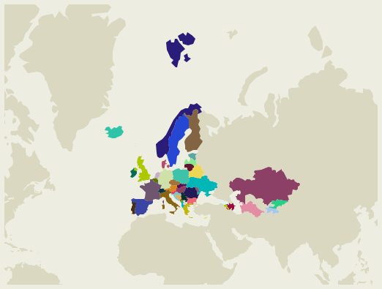
The Aarhus Convention on Access to Information, Public Participation in Decision-making and Access to Justice in Environmental Matters

Slide 20
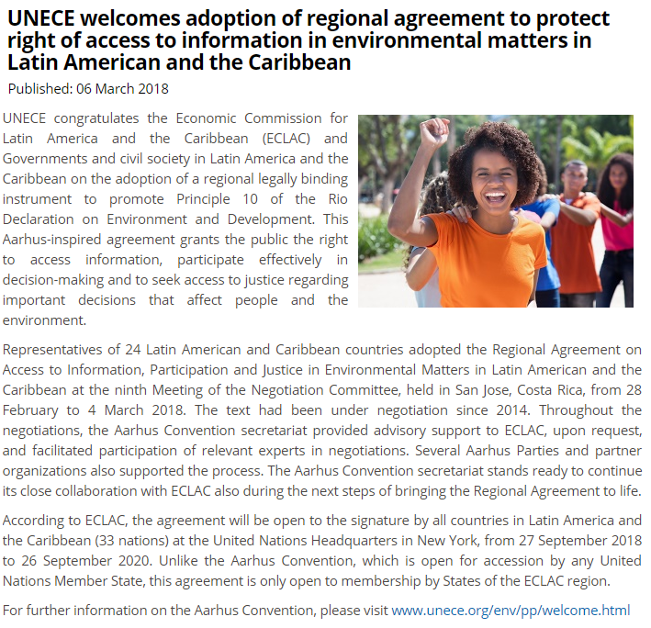

Slide 21
The Aarhus Convention on Access to Information, Public Participation in Decision-making and Access to Justice in Environmental Matters
Adopted on 25 June 1998 in the Danish city of Aarhus (Århus)
Entered into force in 2001
All Member States and EU are parties
Links environmental rights and human rights
Acknowledges that we owe an obligation to future generations
Establishes that sustainable development can be achieved only through the involvement of all stakeholders
Links government accountability and environmental protection
Focuses on interactions between the public and public authorities in a democratic context.

Slide 22
The Aarhus Convention on Access to Information, Public Participation in Decision-making and Access to Justice in Environmental Matters
Rights-based approach
A 'floor', not a 'ceiling'‚
Non-discrimination
Definition of public authorities
Non-compliance mechanism
    Meeting of the Parties
Bureau
Working Group of the Parties
Compliance Committee
GMO amendment

Slide 23
The Aarhus Convention on Access to Information, Public Participation in Decision-making and Access to Justice in Environmental Matters
“The public” means one or more natural or legal persons, and, in accordance with national legislation or practice, their associations, organizations or groups;
“The public concerned” means the public affected or likely to be affected by, or having an interest in, the environmental decision-making; for the purposes of this definition, non-governmental organizations promoting environmental protection and meeting any requirements under national law shall be deemed to have an interest.
https://www.unece.org/fileadmin/DAM/env/pp/documents/cep43e.pdf

Slide 24
The three-pillar structure
Access to information Public participation in decision-making Access to justice
public
passive obligation
active obligation
public concerned
Annex I and other activities with significant effects
plans and programmes
general legal regulation
public concerned
denied information
decisions from
pillar II
violation of (other) provisions of the national law relating to the environment

Slide 25
The Aarhus Convention implementation in EU law
Directive 2003/4/EC of the European Parliament and of the Council of 28 January 2003 on public access to environmental information
Directive 2003/35/EC of the European Parliament and of the Council of 26 May 2003 providing for public participation in respect of the drawing up of certain plans and programmes relating to the environment and amending with regard to public participation and access to justice Council Directives 85/337/EEC (EIA) and 96/61/EC (IPPC/IED)
Proposal for a Directive of the European Parliament and of the Council on access to justice
Regulation (EC) N° 1367/2006 of the European Parliament and of the Council on the application of the provisions of the Aarhus Convention on Access to Information, Public Participation in Decision-making and Access to Justice in Environmental Matters to Community institutions and bodies
(information - extends Regulation (EC) No 1049/2001)

Slide 26
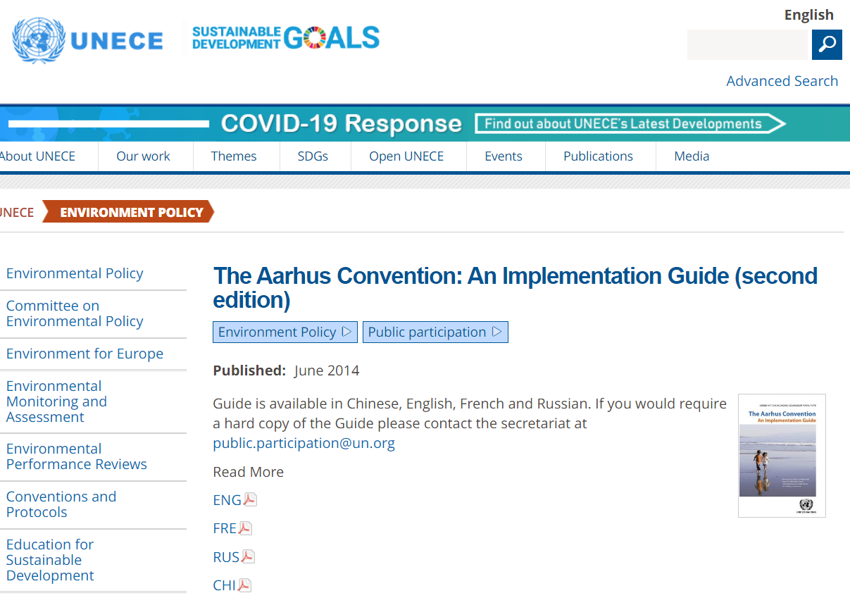
https://unece.org/environment-policy/publications/aarhus-convention-implementation-guide-second-edition
Implementation guide – summary of the findings of the Aarhus Convention Compliance Committee – in English/French/Russian/Chinese
26

Slide 27
The three-pillar structure – PILLAR I
Access to information (Art. 4 – 5)
a “passive” obligation - the environmental information possessed by public authorities should be provided to members of the public on request “as soon as possible” and at the latest within a month. Requests for information can only be refused if any of the listed grounds for refusal apply. Even when they do, the grounds for refusal shall be interpreted in a restrictive way, taking into account the public interest served by disclosure and taking into account whether the information requested relates to emissions into the environment. Any refusal must be reasoned and in writing.
an “active” obligation - the Parties must actively ensure that public authorities possess and update relevant environmental information, and that mandatory systems are established, providing for an adequate flow of information. Electronic databases shall be publicly accessible and the Parties are to set up nationwide systems of pollution inventories and registers. This part has been further developed through the 2003 Kiev Protocol on Pollution Release and Transfer Registers.

Slide 28
The Aarhus Convention in practice: Definitions
Defines “public authority” broadly, so as to include not only governments at different levels, but also private actors performing public administrative functions under national law, or having public responsibilities or functions or providing public services in relation to the environment.
Defines “environmental information” broadly so as to include not only information on the state of elements of the environment, but also on factors, activities, measures, international agreements, laws, policies etc. likely to affect elements of the environment and the state of the human health.
Art 4(4) d): A request for environmental information may be refused if the disclosure would adversely affect: The confidentiality of commercial and industrial information, where such confidentiality is protected by law in order to protect a legitimate economic interest. Within this framework, information on emissions which is relevant for the protection of the environment shall be disclosed.
Is intended to provide for wide public participation and wide access to justice. For that reason, it defines “the public concerned” rather broadly
“The public” means one or more natural or legal persons, and, in accordance with national legislation or practice, their associations, organizations or groups;
“The public concerned” means the public affected or likely to be affected by, or having an interest in, the environmental decision-making; for the purposes of this definition, non-governmental organizations promoting environmental protection and meeting any requirements under national law shall be deemed to have an interest

Slide 29
CJEU CASE-LAW
public authority
C-204/09 (Flachglas Torgau)
bodies or institutions acting in a legislative capacity: ministries to the extent that they participate in the legislative process, in particular by tabling draft laws or giving opinions
C-515/11 (Deutsche Umwelthilfe)
bodies or institutions acting in a legislative capacity: not ministries when they prepare and adopt normative regulations which are of a lower rank than a law (The Aarhus Convention distinguishes between the rules for legislative acts and those for regulatory acts)
C-470/19 (Friends of the Irish Environment)
The Directive does not govern access to environmental information contained in court files, where neither the courts nor the bodies or institutions under their control, which thus have close links with those courts, constitute ‘public authorities’

Slide 30
C-279/12 (Fish Legal and Shirley)
Water and sewerage undertaker: Although it is a commercial company which is, moreover, subject to a special regulatory regime for the sector concerned, its control within the meaning of Directive 2003/4 is not excluded:
…it should be examined whether those entities are vested, under the national law which is applicable to them, with special powers beyond those which result from the normal rules applicable in relations between persons governed by private law. Undertakings, such as United Utilities Water plc, Yorkshire Water Services Ltd and Southern Water Services Ltd, which provide public services relating to the environment are under the control of a body or person, and should therefore be classified as ‘public authorities’, if they do not determine in a genuinely autonomous manner the way in which they provide those services since a public authority covered by Article 2(2)(a) or (b) of the directive is in a position to exert decisive influence on their action in the environmental field.
Kazakhstan ACCC/C/2004/1
The State-owned Kazatomprom performing administrative functions under national law, including activities in relation to the environment, and performing public functions under the control of a public authority.
Hungary ACCC/C/2004/4
A special state-owned company for construction of expressways established by law would fall under the definition of the public authority
Belarus ACCC/C/2009/37
National legislation delegates some functions related to maintenance and distribution of environmental information to private entities. These should be treated as falling under the definition of a “public authority”

Slide 31
CASE-LAW - environmental information
information submitted within the framework of a national procedure for the authorisation or the extension of the authorisation of a plant protection product with a view to setting the maximum quantity of a pesticide, a component thereof or reaction products which may be present in food or beverage (C-266/09, Stichting Natuur en Milieu and Others)
‘emissions into the environment’ covers the release into the environment of products or substances such as plant protection products or biocides and substances contained in those products, to the extent that that release is actual or foreseeable under normal or realistic conditions of use;
‘information on emissions into the environment’ covers information concerning the nature, composition, quantity, date and place of the ‘emissions into the environment’ of those products or substances, and data concerning the medium to long-term consequences of those emissions on the environment, in particular information relating to residues in the environment following application of the product in question and studies on the measurement of the substance’s drift during that application, whether the data comes from studies performed entirely or in part in the field, or from laboratory or translocation studies. (C-442/14, Bayer CropScience)
data relating to the location of permanent sample plots for the statistical forest inventory? (C-234/22, Roheline Kogukond and Others )
records of formal meetings of the executive branch of government of a Member State? (C-84/22 Right to Know)

Slide 32
CASE-LAW - environmental information
exceptions:
Balancing exercise between the public interest served by the disclosure of environmental information and the specific interest served by a refusal to disclose must be carried out in each individual case (C-266/09, Stichting Natuur en Milieu and Others)
the term ‘internal communications’ covers all information which circulates within a public authority and which, on the date of the request for access, has not left that authority’s internal sphere, after being received by that authority, provided that it was not or should not have been made available to the public before it was so received
+ the exception is not limited in time. However, it can apply only for the period during which protection of the information sought is justified. (C-619/19 , Land Baden-Württemberg)
Does the ground of ‘the protection of the environment [in question]’ justify restricting access to environmental information in order to ensure the reliability of State statistics? (C-234/22, Roheline Kogukond and Others )
Documents relating to infringement proceedings during the preliminary proceedings may be subject to a general presumption of confidentiality, since the dissemination of documents relating to the infringement proceedings during those proceedings could be presumed to alter the nature of those proceedings and affect their conduct (C-514/11 P and C-605/11 P, LPN and Finland v Commission, C-562/14 P, Sweden v Commission)

Slide 33
The three-pillar structure – PILAR II/A
II. Public participation - three categories of decision-making (Art. 6 – 8)
Decision-making concerning specific activities listed in Annex I and other activities which may have a significant effect on the environment.
Annex I:
Energy sector
Production and processing of metals
Mineral industry
Chemical industry
Waste management:
Waste-water treatment plants
Industrial plants
Construction of railways, motorways, express roads, roads
Inland waterways, trading ports, piers
Groundwater abstraction or artificial groundwater recharge schemes
...
20. Any activity not covered by paragraphs 1-19 above where public participation is provided for under an environmental impact assessment procedure in accordance with national legislation.

Slide 34
The three-pillar structure – PILAR II/A
II. Public participation - three categories of decision-making
Decision-making concerning specific activities listed in Annex I and other activities which may have a significant effect on the environment.
The Parties must ensure:
Early information and notification about the decision-making procedure, in an effective, adequate and timely manner;
Reasonable time-frames to prepare and participate effectively;
Early and effective public participation when all options are open;
All relevant information is made available at the time of the public participation procedure;
The public is allowed to submit comments, information, analyses or opinions in writing or at public hearings;
Due account is taken of the outcome of public participation;
Publicly accessible decisions with reasons and consideration.

Slide 35
The three-pillar structure – PILAR II/B
II. Public participation - three categories of decision-making
b) Decision-making concerning plans and programmes.
Practical or other provisions shall be made for public participation during preparations of plans and programmes relating to the environment;
This should be provided in a transparent and fair framework with necessary information;
Reasonable time-frames must be ensured to prepare and participate effectively;
Early and effective public participation must be provided when all options are open; and
Due account shall be taken of the outcome of public participation
The Parties must endeavour to provide for public participation when preparing policies relating to the environment (Art 7).

Slide 36
The three-pillar structure – PILAR II/C
II. Public participation - three categories of decision-making
c) Executive regulations and generally applicable legal instruments
The Parties are obliged to strive to promote effective public participation, at an appropriate stage. To this end, certain requirements are set out (Art 8):
Time-frames sufficient for effective participation should be fixed;
Draft rules should be published or otherwise made publicly available; and
The public should be given the opportunity to comment, directly or through representative consultative bodies.
  The result of the public participation shall be taken into account as far as possible.
In addition, the 2nd Meeting of Parties (MoP) decided to amend the Convention in order to provide for public participation with respect to deliberate release into the environment and the placing on the market of genetically modified organisms.

Slide 37
Public participation provisions under the EU environmental law
1) Directives explicitly implementing the Aarhus Convention (decision-making)
EIA Directive – environmental impact assessment (construction and other activities)
IED Directive – industrial emmissions (permits for industrial activities)
Seveso III Directive - major accident hazards
2) Directives implementing the Aarhus Convention according to the CJEU (decision-making)
The Habitats Directive (Natura 2000) – assessment of plans and projects: Art. 6(3)
Participation required as a condition for access to justice (C-664/15)
3) Directives focused on participation in the elaboration of plans
SEA Directive, Water Framework Directive, Air Quality Directive, Waste Framework Directive, Environmental Noise Directive

Slide 38
The Habitats Directive (92/43/EEC)
Article 6(3) Any plan or project not directly connected with or necessary to the management of the site but likely to have a significant effect thereon, either individually or in combination with other plans or projects, shall be subject to appropriate assessment of its implications for the site in view of the site's conservation objectives. In the light of the conclusions of the assessment of the implications for the site and subject to the provisions of paragraph 4, the competent national authorities shall agree to the plan or project only after having ascertained that it will not adversely affect the integrity of the site concerned and, if appropriate, after having obtained the opinion of the general public.
C-243/15 (Lesoochranárske zoskupenie II, para. 45 - 48): the project of constructing an enclosure on a protected site, at issue in the main proceedings, is not among the activities listed in Annex I to the Aarhus Convention, the fact that the competent national authorities decided to initiate an authorisation procedure for that project pursuant to Article 6(3) of Directive 92/43 permits, however, the inference that those authorities considered it necessary to assess the significance of the project’s effect on the environment, within the meaning of Article 6(1)(b) of the Aarhus Convention. It is true that the latter provision states that the application of Article 6 of the Aarhus Convention is governed by the domestic law of the contracting party concerned. However, that statement must be understood as relating solely to the manner in which the public participation specified by Article 6 is carried out, and does not call into question the right to participate which an environmental organisation such as LZ derives from that article.

Slide 39
Case-law on the scope of the Directives II: Who is affected?
C-570/13 (Gruber):
42 Having regard to that provision’s terms, it appears that persons falling within the concept of ‘neighbour’ may be part of the ‘public concerned’, within the meaning of Article 1(2) of Directive 2011/92. Those ‘neighbours’ can bring an action only against a consent granted for the construction and operation of a facility. Since they are not parties to the procedure examining whether an EIA need be carried out, they cannot challenge that decision in the context of an action against the development consent decision. Thus, by restricting the right to bring an action against decisions examining whether an EIA need be carried out in relation to a project only to the project applicants, the participating authorities, the ombudsman for the environment (Umweltanwalt) and the municipality concerned, the UVP-G 2000 deprives a large number of individuals from exercising that right to bring an action, including, in particular, ‘neighbours’ who may meet the conditions laid down in Article 11(1) of Directive 2011/92.
43 That near general exclusion restricts the scope of Article 11(1) and is accordingly incompatible with Directive 2011/92.
Requirements on the NGOs
Previous activity, number of members, but Aarhus must be respected (wide A2J)
C-115/09 (Bund für Umwelt und Naturschutz Deutschland),
C-263/08 (Djurgården-Lilla Värtans Miljöskyddsförening)

Slide 40
Obstacles to participation in decision-making?
Costs: C-216/05 (Commission v Ireland): Although Directive 85/337 does not preclude fees such as those charged under the national legislation at issue in the present case, they cannot, however, be fixed at a level which would be such as to prevent the directive from being fully effective, in accordance with the objective pursued by it (see, to that effect, Case C‑97/00 Commission v France [2001] ECR I‑2053, paragraph 9). This would be the case if, due to its amount, a fee were liable to constitute an obstacle to the exercise of the rights of participation...
Publication of the decision on the internet?
C-280/18 (Flausch and Others): 1. Article 6 of Directive 2011/92/EU of the European Parliament and of the Council of 13 December 2011 on the assessment of the effects of certain public and private projects on the environment must be interpreted as precluding a Member State from carrying out the procedures for public participation in decision-making that relate to a project at the level of the headquarters of the competent regional administrative authority, and not at the level of the municipal unit within which the site of the project falls, where the specific arrangements implemented do not ensure that the rights of the public concerned are actually complied with, a matter which is for the national court to establish.
2. Articles 9 and 11 of Directive 2011/92 must be interpreted as precluding legislation, such as that at issue in the main proceedings, which results in a period for bringing proceedings that starts to run from the announcement of consent for a project on the internet being relied on against members of the public concerned where they did not previously have an adequate opportunity to find out about the consent procedure in accordance with Article 6(2) of that directive.

Slide 41
Participation in decision-making ≠ access to justice
C-263/08 (Djurgården-Lilla Värtans Miljöskyddsförening, para. 38): ...participation in an environmental decision-making procedure under the conditions laid down in Articles 2(2) and 6(4) of Directive 85/337 is separate and has a different purpose from a legal review, since the latter may, where appropriate, be directed at a decision adopted at the end of that procedure. Therefore, participation in the decision-making procedure has no effect on the conditions for access to the review procedure.
C-137/14 (Commission v Germany):
80 As regards the argument concerning the efficiency of administrative procedures, although it is true that the fact of raising a plea in law for the first time in legal proceedings may, in certain cases, hinder the smooth running of that procedure, it is sufficient to recall that the very objective pursued by Article 11 of Directive 2011/92 and Article 25 of Directive 2010/75 is not only to ensure that the litigant has the broadest possible access to review by the courts but also to ensure that that review covers both the substantive and procedural legality of the contested decision in its entirety.
81 None the less, the national legislature may lay down specific procedural rules, such as the inadmissibility of an argument submitted abusively or in bad faith, which constitute appropriate mechanisms for ensuring the efficiency of the legal proceedings.

Slide 42
LEGAL STANDING: Preconditions and wide access to justice
Stichting Varkens in Nood and Others (C-826/18, Admissibility of the action subject to prior participation in the decision-making procedure):
Art. 9(2) regime: participation in the administrative procedure is not a suitable condition for the admissibility of the judicial proceedings brought by NGO, even though that condition does not apply where such organisations cannot reasonably be criticised for not having participated in that procedure.
However, Article 9(3) AC does not preclude the admissibility of judicial proceedings to which it refers from being made subject to the participation of the applicant in the procedure preparatory to the contested decision, unless the applicant cannot reasonably be criticised, in the light of the circumstances of the case, for not having intervened in that procedure
42

Slide 43
The three-pillar structure – PILAR III
III. Access to justice (Art. 9)
Denied information
Anyone who is denied access to environmental information shall have access to a review procedure before a court of law or another independent and impartial body established by law.
Standing should be granted to anyone whose request has been ignored, wrongfully refused or otherwise not dealt with in accordance with the Convention. In certain cases, the Parties should also provide for expeditious procedures for reconsideration by a public authority.
Decision-making concerning specific activities
access to court or another independent and impartial body of law should also be granted with respect to decision-making concerning specific activities for members of the public concerned who either have a sufficient interest or, where so required in national law, maintain impairment of a right.
These criteria should be determined in accordance with national law and consistently with the objective of giving the public concerned wide access to justice. To this effect, environmental NGOs are deemed to have a sufficient interest to be granted standing.
This right to access to justice pertains to challenging the substantive as well as procedural legality of any decision, act or omission concerning specific activities

Slide 44
The three-pillar structure – PILAR III
III. Access to justice (Art. 9)
c) Violation of provisions of the national law relating to the environment
Access to administrative or judicial procedures to members of the public, meeting the criteria in national law, “if any”, to challenge other acts and omissions by private persons and public authorities “which contravene provisions of its national law relating to the environment” (Art 9(3)).
EU law relating to the environment should also be considered to be part of the domestic, “national law”.
Contrary to the first and the second categories, it may suffice to ensure access to administrative review procedures to challenge acts and omissions in the third category.
Access to justice must not be pro forma only. Therefore, all procedures referred to above under the three categories, including any administrative procedure, must provide “adequate and effective remedies, including injunctive relief as appropriate, and be fair, equitable, timely and not prohibitively expensive”

Slide 45

The Convention on Access to Information, Public Participation in Decision-making and Access to Justice in Environmental Matters (The Aarhus Convention)
Access to information Public participation in decision-making Access to justice
public concerned
Annex I and other activities with significant effects
(EIA, IED, Natura 2000, SEVESO III)
plans and programmes
general legal regulation
public (concerned)
denied information
decisions from
pillar II (EIA, IED, NATURA 2000, SEVESO III)
violation of (other) provisions of the national law relating to the environment
public
passive obligation
active obligation

Slide 46
LINK BETWEEN THE ENVIRONMENTAL PROTECTION AND RIGHTS OF INDIVIDUALS
The air quality legislation (other than the IED) does not contain comprehensive rules as regards access to justice.
However, there is a link between the air protection and rights of individuals which satisfies the conditions for direct applicability of certain provisions of directives which do not contain requirements on access to justice – such as the AQD or the NEC Directive.
This is because the quality (concentration) limit values aim at the protection of human health. Thus, they have the objective to protect the individual right to health. They are sufficiently precise and unconditional to be of direct application.
This means that the individual person has a right to trace back the limit values in his national legislation; it follows from this that Member States are obliged to transpose the limit values of the air pollution directive into their national law (C-361/88, Commission v. Germany)
C-237/07 (Janecek):
"whenever the failure to observe the measures regarded by the directives which relate to air quality and drinking water and which are designed to protect public health, could endanger human health, the persons concerned must be in a position to rely on the mandatory rules included in those directives".

Slide 47
Direct effect: From EIA to AIR to WATER…
Janecek (C-237/07), ClientEarth (C-404/13, ambient air quality assessment and management): The affected individuals must be able to require adoption of air-pollution action plans
Folk (C-529/15, Environmental Liability Directive): Persons with a fishing licence must be able to initiate review proceedings before a court or other competent public authority in accordance with Articles 12 and 13 of the Directive
Protect Natur-, Arten- und Landschaftschutz Umweltorganisation (C-664/15, Water Framework Directive): The NGO must be able to challenge a permit for a project of abstracting water from the river to produce snow for a ski resort under the EU law
Land Nordrhein-Westfalen (C-535/18, EIA, Water Framework Directive): Members of the public concerned by a project must be able to assert, before the competent national courts, that there has been a breach of the requirements to prevent the deterioration of bodies of water; EU law permits Member States to provide that, when a procedural defect vitiating the decision approving a project does not alter the meaning of that decision, an application for annulment of that decision is admissible only if the irregularity at issue has denied the claimant his or her right to participate in the environmental decision-making process
Wasserleitungsverband Nördliches Burgenland and Others (C-197/18, Nitrates Directive): Affected natural and legal persons, such as the applicants in the main proceedings (incl. municipality and a water distribution association), should be in a position to require the competent national authorities to amend an existing action programme or adopt additional measures or reinforced actions
if not... direct effect
47

Slide 48
TIMELINESS, EFFICIENCY AND COSTS
Klohn (C-167/17, EIA): No direct effect of EU law implementing Art. 9(4) of the Aarhus Convention (requirement for a procedure which is not prohibitively expensive)
C-470/16 (North East Pylon, EIA): ...but it is for the national court to give an interpretation of national procedural law which, to the fullest extent possible, is consistent with the Aarhus Convention
East Sussex (C-71/14), Gruber (C-570/13), Mellor (C-75/08): The requirement of effectiveness covers the judge’s examination of the assessment of the merits of a decision, act or omission, such as in the case as well the scrutiny of national legislation and regulatory acts (C-41/11, Inter-Environnement Wallonie)
Leth (C-420/11): A national court dealing with a dispute governed by EU environmental law must be in a position to order interim measures as well as to award compensation for pecuniary damages, provided the three conditions for state liability are met
48

Slide 49
TIMELINESS, EFFICIENCY AND COSTS
Vereniging Hoekschewaards Landschap (C-281/16): A national court must be in a position to ask the CJEU to examine the validity of acts adopted by EU institutions and bodies
Uniform interpretation of EU law by the CJEU is ensured by the possibility for national courts to submit questions concerning the validity and interpretation of EU law (Article 267 of the TFEU)
'Commission Implementing Decision (EU) 2015/72 of 3 December 2014 adopting an eighth update of the list of sites of Community importance for the Atlantic biogeographical region is invalid, in so far as, by that decision, the Haringvliet site (NL 1000015) was placed on that list without the inclusion of the Leenheerenpolder'.
49

Slide 50
THE CONTENT OF THE RIGHT – AIR QUALITY PLANS
An individual person (and also an NGO) has a right to see the action plan elaborated, since the key element in the AQD is the setting of binding limit values together with the obligation to adopt air quality plans containing adequate measures to achieve compliance in the shortest time possible.
In Case C-404/13 (ClientEarth), the CJEU confirmed that the national court should order any measure necessary to bring the air pollution plan into line with EU air quality legislation.
The Court of Justice limited the right of persons to request a specific content of a plan. It held that the public authorities were to take measures to keep the time of (the risk of) exceedance as short as possible, but that they benefitted of a large amount of discretion, so that specific measures could not be asked for (C-237/07).
Similar approach applies to the obligations in the NEC Directive. The natural and legal persons directly concerned must be able to require the competent authorities, if necessary by bringing the matter before the national courts, to observe and implement such rules of EU law – for example to draw up national programmes for the progressive reduction of national emissions of inter alia SO2 and NOx (Joined Cases C-165/09, C-166/09 and C-167/09)

Slide 51
THE CONTENT OF THE RIGHT – AIR POLLUTION MONITORING SYSTEM
The individuals must be able to challenge the air pollution monitoring system in their cities because the AQD lays down detailed rules concerning the use and location of sampling points to measure air quality in zones and agglomerations comprising the territory of each Member State (Case C-723/17 Craeynest and Others)
The obligation to establish sampling points in such a way that they provide information on the most polluted locations, and the obligation to establish at least a minimum number of sampling points are clear, precise and unconditional.
It is for the national courts to verify whether those obligations have been complied with. In this respect, the average values across a whole zone or city are insufficient as they may underestimate the actual exposure to polluted air.

Slide 52
THE CONTENT OF THE RIGHT – APPROVAL OF VEHICLES
C-873/19 (Deutsche Umwelthilfe )
Will be decided soon.
Opinion: Article 9(3) of the Aarhus Convention read in conjunction with Article 47 of the Charter of Fundamental Rights of the European Union, must be interpreted as meaning that an approved environmental association, which is entitled to bring legal proceedings under national law, must be able to challenge before a national court an administrative decision granting EC type-approval of vehicles which may be contrary to Article 5(2) of Regulation (EC) No 715/2007 of the European Parliament and of the Council of 20 June 2007 on type approval of motor vehicles with respect to emissions from light passenger and commercial vehicles (Euro 5 and Euro 6) and on access to vehicle repair and maintenance information, a provision which prohibits, subject to certain exceptions, the use of defeat devices which reduce the effectiveness of emission control systems.

Slide 53
THE CONTENT OF THE RIGHT – DAMAGES
C-61/21 (Ministre de la Transition écologique a Premier ministre)
Will be decided soon.
Due to the non-adoption of air quality improvement plans (for almost ten years), individuals living in the affected area are seeking compensation for the damage caused. They invoke, inter alia, the Aarhus Convention.
OPINION: The limit values laid down for pollutants in ambient air and the obligations to improve ambient air quality laid down in Articles 7 and 8 of Directive 96/62, read in conjunction with Directive 1999/30, and Articles 13 and 23 of Directive 2008/50 are intended to confer rights on individuals.
A claim for compensation for damage resulting from health problems caused by the exceedance of limit values set for PM10 and nitrogen dioxide in ambient air (…) is that the injured party proves the existence of a direct link between that injury and his or her residence in a place where the relevant limit values were exceeded without an air quality improvement plan having been drawn up…

Slide 54
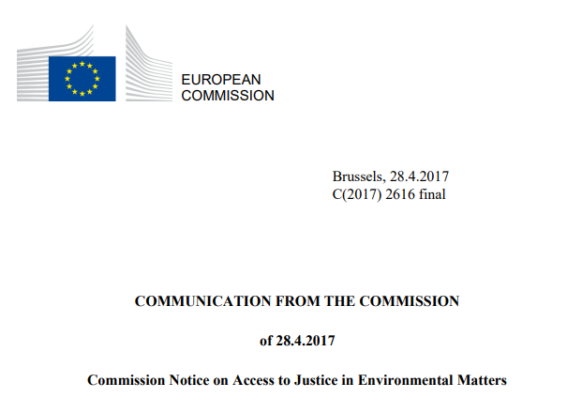
Commission Notice on Access to Justice in Environmental Matters
54

Slide 55
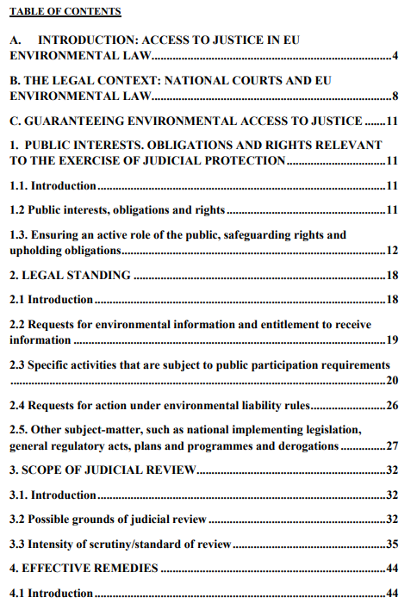
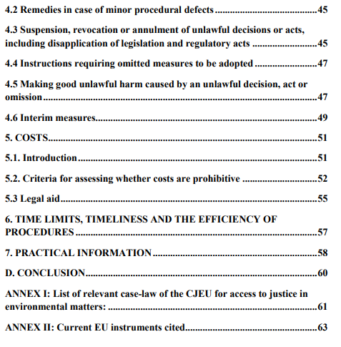
55

Slide 56

http://www.justiceandenvironment.org/fileadmin/user_upload/Publications/2018/JE_Comments_EC_Notice_A2J_FINAL.pdf
56

Slide 57
Thank you for your attention

