Slide 1
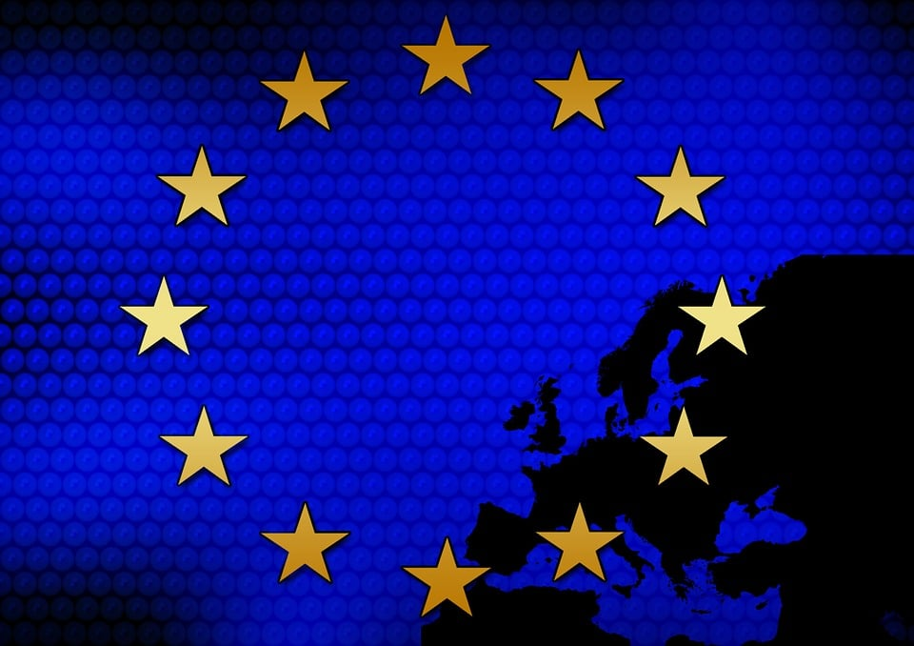
European Law
Czech Law in Global Context
JUDr. Radovan Malachta, Ph.D.
11/08/2024

Slide 2
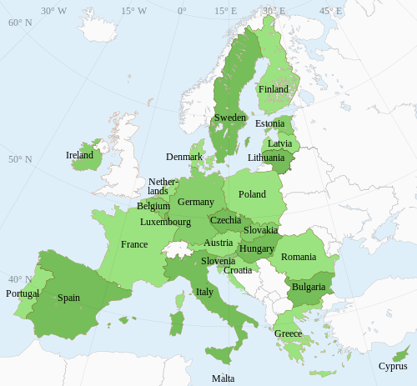
Why European Law?
Czech Republic is a member of the EU
  Since when?
27 members
bound by the law that EU creates
a direct influence on various aspects of our daily lives
  Examples?

Slide 3





How EU Law Affects Our Everyday Life

Slide 4
NATIONAL
LAW
CZECH REPUBLIC
EU
LAW
INTERNATIONAL
LAW

Slide 5
The Nature/Essence of the EU
EU is a supranational organization
superior, „above“ the Member States
Member States VOLUNTARILY TRANSFERRED CERTAIN POWERS TO THE EU IN SPECIFIC AREAS
  EU exercise authority on their behalf in certain areas/fields – EU can create laws and rules
  EU does not have authority in some areas – EU are free to set their own laws and rules

Slide 6
The Nature/Essence of the EU
European Union
voluntary transfer of powers to the EU
Member States
Etc.
customs
union
competion
rules
agriculture
enviroment
transport
industry
culture
education
tourism

Slide 7
The Nature/Essence of the EU II
inequality among Member States
  MS are not equal to each other
the decision-making bodies of the EU
  European Parliament
  Council of the European Union
based on the population size of each state
European Union
MS
MS
MS
MS

Slide 8
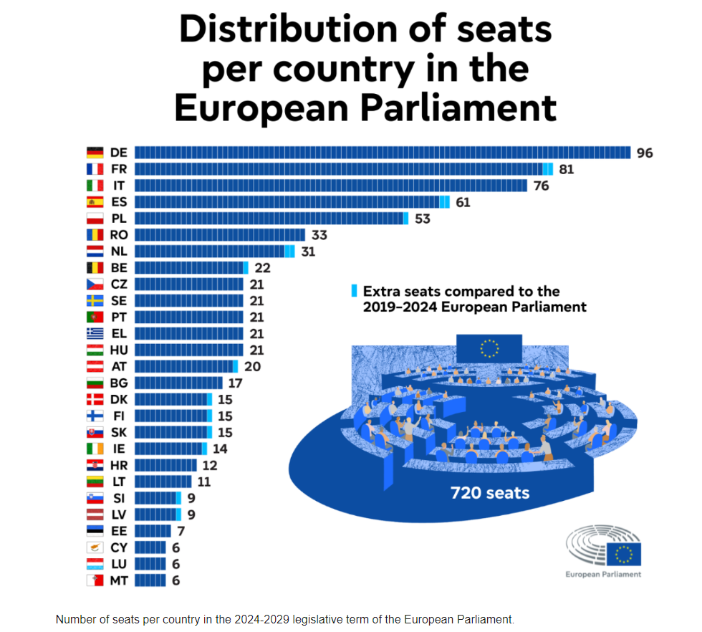

Slide 9
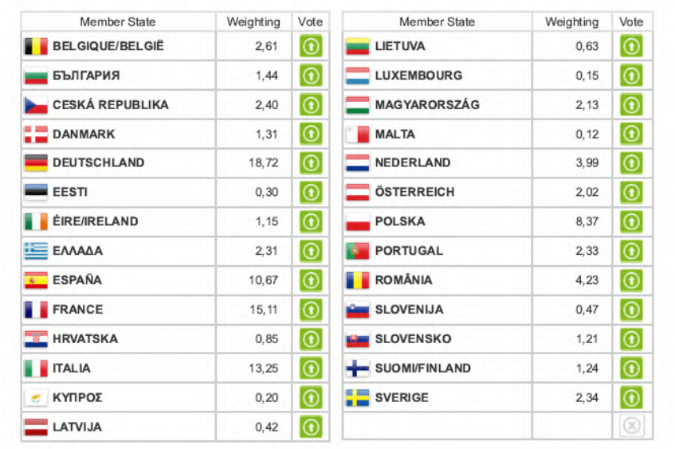

Slide 10
How EU Legal Acts (Secondary Law) are adopted in the EU?
ordinary legislative procedure
  European Commission: proposes a legal act
  European Parliament and Council of the EU: share decision-making authority
  European Parliament: a simple majority
  Council of the EU: a qualified majority – at least 55 % of MS vote in favour (15 out of 27) + these votes must also represent at least 65 % of the EU´s population
special legislative procedure
  European Commission: proposes a legal act
  Council of the EU: adopts by a unanimous decision (all votes are in favour)
  European Parliament: may be consulted but does not participate
primary EU Law: all Member States agree

Slide 11
EU Law
Primary EU Law
Secondary EU Law

Slide 12
Primary Law (at present)
Form of international treaties – concluding between states
Foundational Treaties (founding)
  Treaty on European Union (TEU)
  Treaty on the Functioning of the European Union (TFEU)
  Charter of Funfamental Rights of the European Union
„Amendment“ Treaties
  Amsterdam Treaty
  Nice Treaty
  Lisbon Treaty
Budgetary Treaties
Accession Treaties
  with a new MS

Slide 13
Primary Law
legal basis of the EU and its functioning, fundamental rules on which the EU is based
internatinal treaties
Treaty on European Union (TEU)
  55 articles
  defines the values and objectives of the EU, democratic principles, membership conditions (accession, withdrawal)
  general provisions on the EU´s external activities, common foreign and security policy
  other matters (EU institutions, enhanced cooperation, etc.)
Treaty on the Functioning of the European Union (TFEU)
  358 articles
  sets out principles (EU competencies), internal policies and actions, association with overseas territories, external actions of the EU, institutional and financial provisions (EU institutions, budget)
Charter of Fundamental Rights of the EU
  protection of fundamental human rights and freedoms where EU law is applied

Slide 14
Secondary Law
regulation
recommendations
opinions
directive
decision
is issued on the basis of primary law

Slide 15
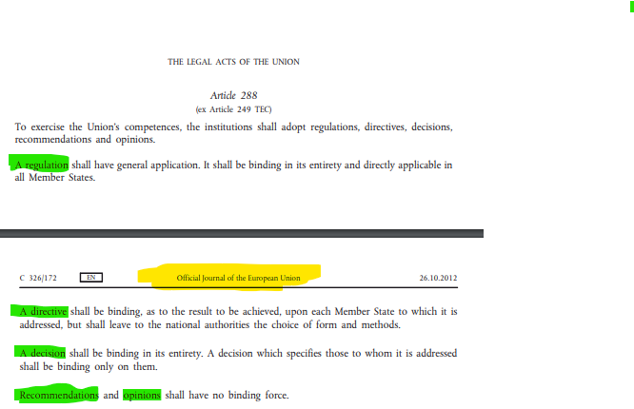

Slide 16
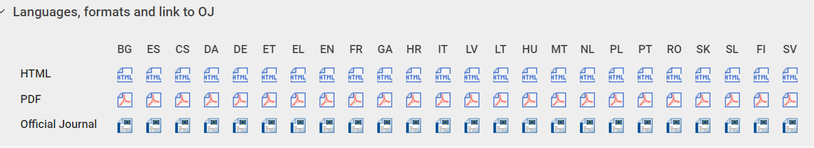

Slide 17




Regulation vs. Directive
REGULATION
DIRECTIVE
unification
it binds MS, individuals
directly applicable
individuals
harmonization
it binds MS
it is not directly applicable
Regulation
Directive
implementation
a deadline for transposition
National Law
individuals

Slide 18
Regulation
„A regulation shall have general application. It shall be binding in its entirety and directly applicable in all Member States.“
- unification (standardization) of EU law = the need for a uniform approach
- general scope = applicable across the entire Union
- binding in full = applicable to both member states and individuals, as well as EU institutions
- an individual can invoke the protection of their individual rights before the national courts of member states
- this typically applies where there are exclusive competences.
- it is not implemented into national law (e.g., into legislation) – the regulation applies directly

Slide 19
Directive
„A directive shall be binding, as to the result to be achieved, upon each Member State to which it is addressed, but shall leave to the national authorities the choice of form and methods.“
addressed exclusively to member states – they must implement it into national law
transposition, implementation - a deadline is set for this (both transposition and implementation deadlines)
harmonization (approximation) of national legal frameworks
sets the result to be achieved (framework, principles, standards)
the method of implementation (in the form of legal provisions) – MS
this typically applies where there are shared competences, but also in areas of exclusive competence
failure to implement properly and on time – violation of obligations by MS

Slide 20
Decision
„A decision shall be binding in its entirety. A decision which specifies those to whom it is addressed shall be binding only on them.“
similar effects to the Regulation
sometimes addressed only to certain entities (MS, EU institutions)
Recommendations and Opinions
no binding force

Slide 21
Categories and Areas of Union Competence
Exclusive competence
Shared competence
Support competence

Slide 22
Exclusive competence
customs union;
the establishing of the competition rules necessary for the functioning of the internal market;
monetary policy for the Member States whose currency is the euro;
the conservation of marine biological resources under the common fisheries policy;
common commercial policy
only the Union may legislate and adopt legally binding acts
the Member States being able to do so themselves only if so empowered by the Union or for the implementation of Union act

Slide 23
Shared competence
internal market;
social policy, for the aspects defined in this Treaty;
economic, social and territorial cohesion;
agriculture and fisheries, excluding the conservation of marine biological resources;
environment;
consumer protection;
transport;
trans-European networks;
energy;
area of freedom, security and justice;
common safety concerns in public health matters, for the aspects defined in this Treaty
shared competence between the Union and the Member States
both can adopt legal acts, with the primacy of EU law (MS can act where the EU does not wish to or has ceased to exercise its competence)

Slide 24
Support competence
protection and improvement of human health;
industry;
culture;
tourism;
education, vocational training, youth and sport;
civil protection;
administrative cooperation
to carry out actions to support, coordinate or supplement the actions of the Member States
not binding acts

Slide 25
EU Citizenship

Slide 26
EU Citizenship
was formalized with the Maastrich Treaty in 1992
a status conferred upon every individual who holds the nationality of a MS
is additional to and not replace national citizenship
EU citizens enjoy several rights and privileges – no obligations

Slide 27
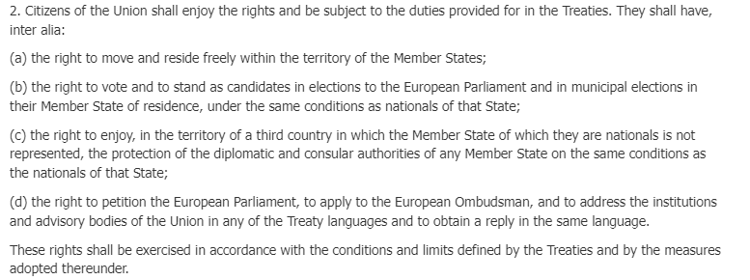

Slide 28
Citizenship
Do you have EU citizenship? How did you acquire it?
You are a citizen of the Czech Republic. You move to France and have been living in the French city of Lyon for the third year. Could you be elected in Lyon's municipal elections and become a representative of the city?
You enjoy unconventional vacations and decide, as a citizen of the Czech Republic, to go on holiday to Benin (Africa), where you get arrested or lose your travel documents. You want help, but unfortunately, the Czech diplomatic mission is not in Benin; it's in Nigeria. However, you cannot get to Nigeria, especially without any documents. You find out that there is a French embassy in Benin. Can you seek its assistance?
As an EU citizen, you can move freely not only within EU member states but also in non-member states solely due to your EU citizenship. Is this statement true?
Can you contact the European Commission with an inquiry in Czech?

Slide 29
Right to move and reside freely within the territory of the MS
DIRECTIVE 2004/38/EC OF THE EUROPEAN PARLIAMENT AND OF THE COUNCIL of 29 April 2004 on the right of citizens of the Union and their family members to move and reside freely within the territory of the Member States

Slide 30
Three types of residence
based on the length of stay in another MS
Right of residence for up to three months
Right of residence for more than three months
Right of permanent residence

Slide 31
Short-term residence
EU citizens - without any conditions or any formalities other than the requirement to hold a valid identity card or passport
for stays of up to 90 days
usually applies to tourists or individuals on short business trips
it also applies to family members in possession of a valid passport who are not nationals of a Member State, accompanying or joining the Union citizen

Slide 32
Temporary residence
applies to stays that exceed 90 days
is necessary to meet one of the three conditions
1) be workers or self-employes person in the host MS; or
2) have sufficient resources for themselves and their family members (not to become a burden on the social assistance system of the host MS) + have comprehensive sickness insurance cover in the host MS
3) students under the conditions set out in the Directive
it also applies to family members accompanying or joining a EU citizen who satisfies the conditions referred to in points 1, 2 or 3

Slide 33
Permanent residence
EU citizens who have resided legally for a continuous period of five years in the host MS (it also applies to family members)
  continuity of residence shall not be affected by temporary absences not exceeding a total of six months a year
enjoy full rights of residence and access to social benefits within the MS
shall be lost only through absence from the host Member State for a period exceeding two consecutive years

Slide 34
Family member means
the spouse
the partner with whom the Union citizen has contracted a registered partnership
the direct descendants who are under the age of 21 or are dependants
the dependent direct relatives in the ascending line

Slide 35


