Slide 1
Moderní metody analýzy genomu
- analýza
Mgr. Nikola Tom
Brno, 22.4.2015

Slide 2
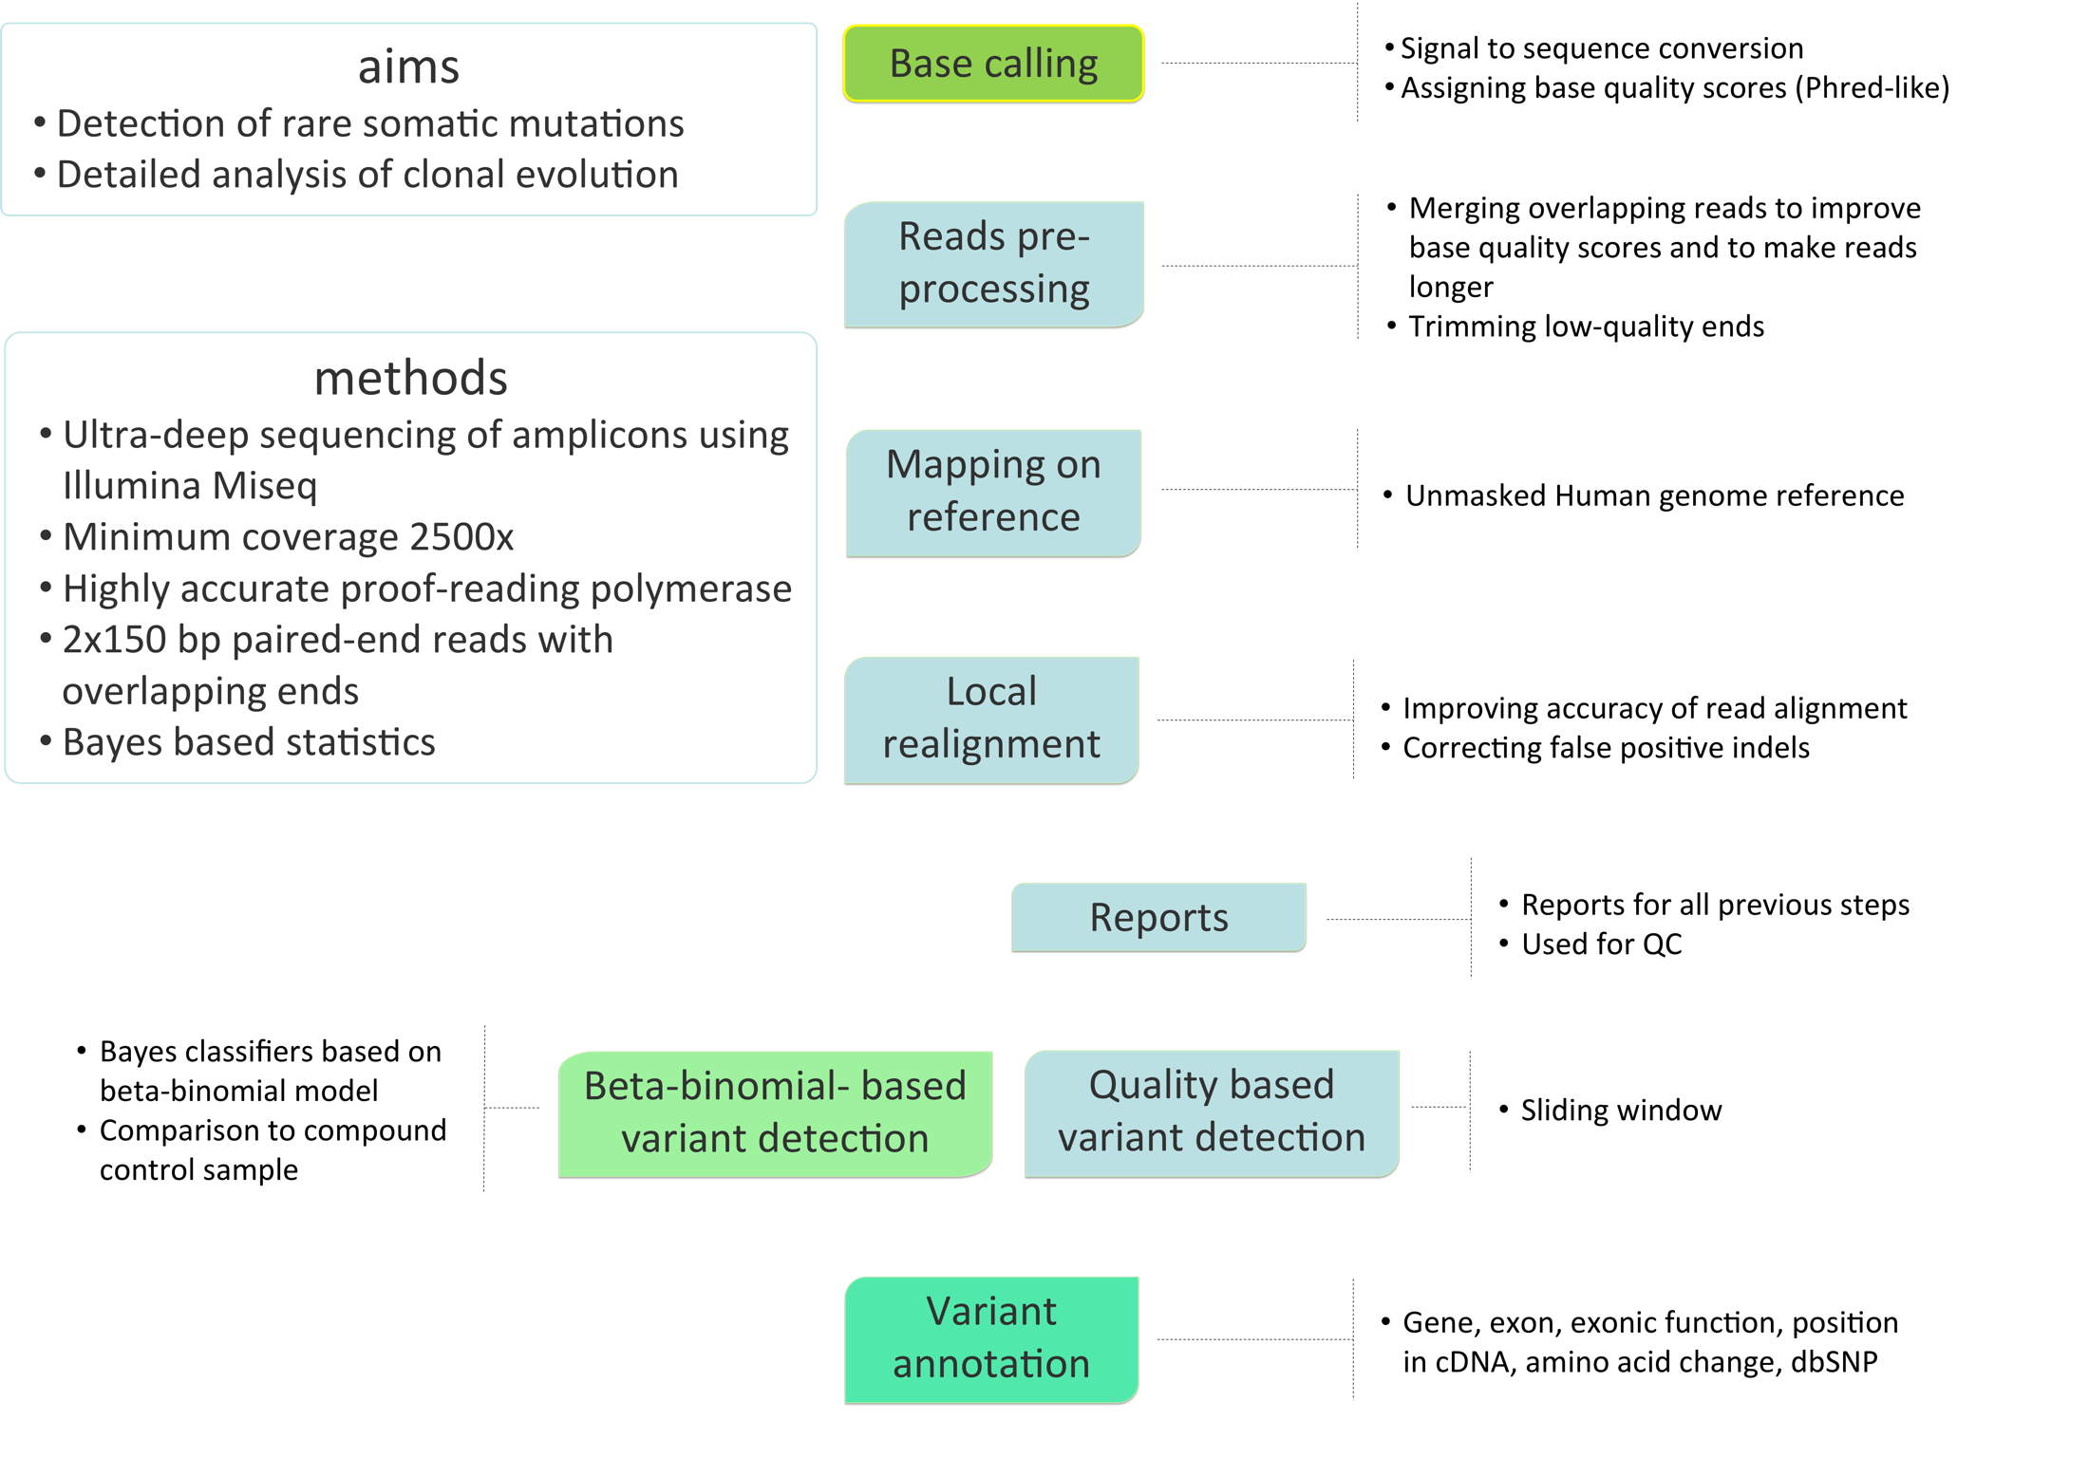
Deep-seq Workflow/Pipeline

Slide 3
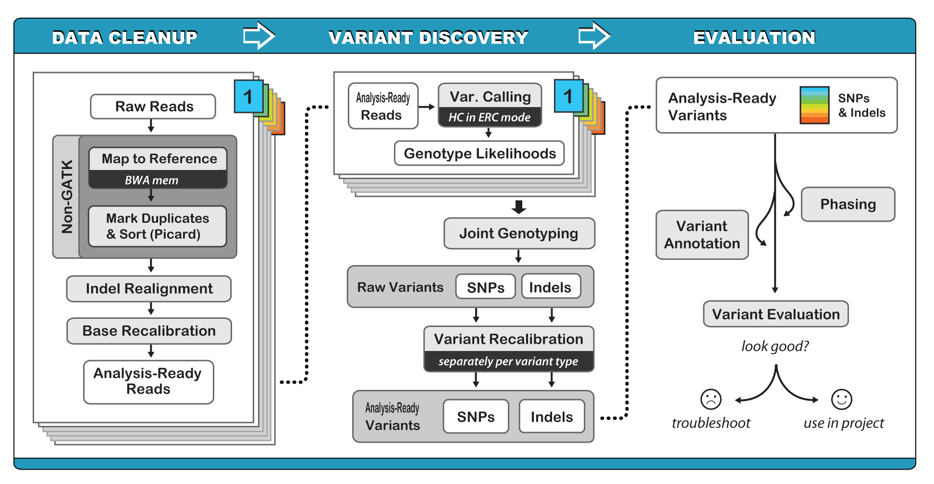
GATK Workflow/Pipeline
https://www.broadinstitute.org/gatk/guide/best-practices

Slide 4
Raw sequence = fastq
Biological sequence
Corresponding quality scores
ASCII character
(fasta+ qual, csfasta + csqual, sff)
@
SEQ_ID GATTTGGGGTTCAAAGCAGTATCGATCAAATAGTAAATCCATTTGTTCAACTCACAGTTT
+
!''*((((***+))%%%++)(%%%%).1***-+*''))**55CCF>>>>>>CCCCCCC65

Slide 5
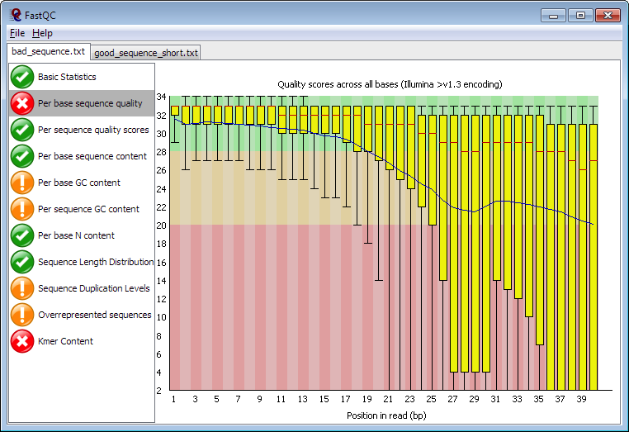
FastQC

Slide 6
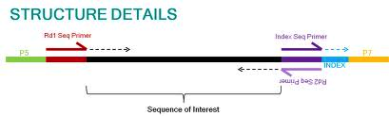
Cutadapt
Adaptor trimming (miRNA)
Quality filtering
Length filtering

Slide 7
Read mapping => SAM, BAM
Usually mapping reads on reference
miRNA - special case
  Grouping and annotate against mirBase
DNA
  BWA, Bowtie, Bfast, SHRiMP, CLC
RNA
  TopHat (de novo splice aligner)
Commercial
  CLC Genomics Workbench
De novo assembly – unknown genomes

Slide 8
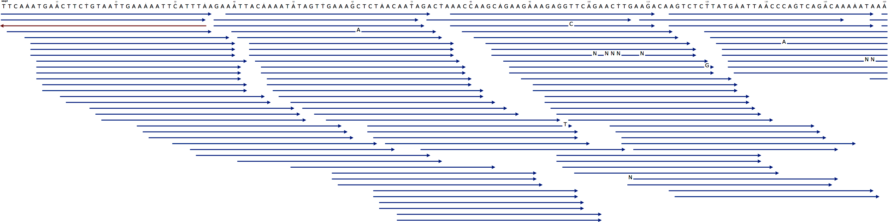
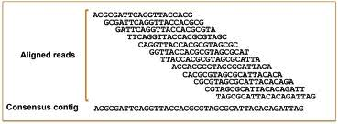
Alignment

Slide 9
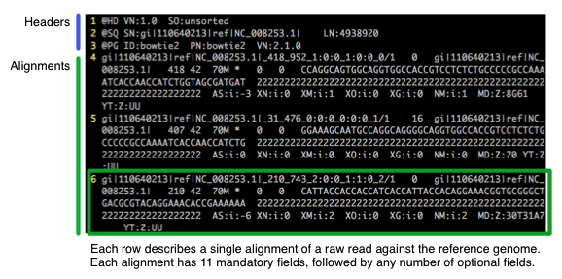
SAM

Slide 10
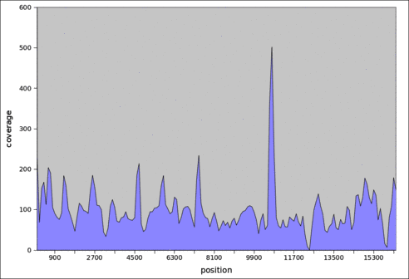
Mapping, Coverage reports
Important checkout for lab protocol
Specificity of PCR
Normalization
Settings of variant calling threshold, CNV

Slide 11
SNV and small InDel Calling
Coverage
Frequency
Base quality
!!!
Genomic context (homopolymers)
Nucleotide type
Position in read (errors at the read end)
Alignment errors

Slide 12
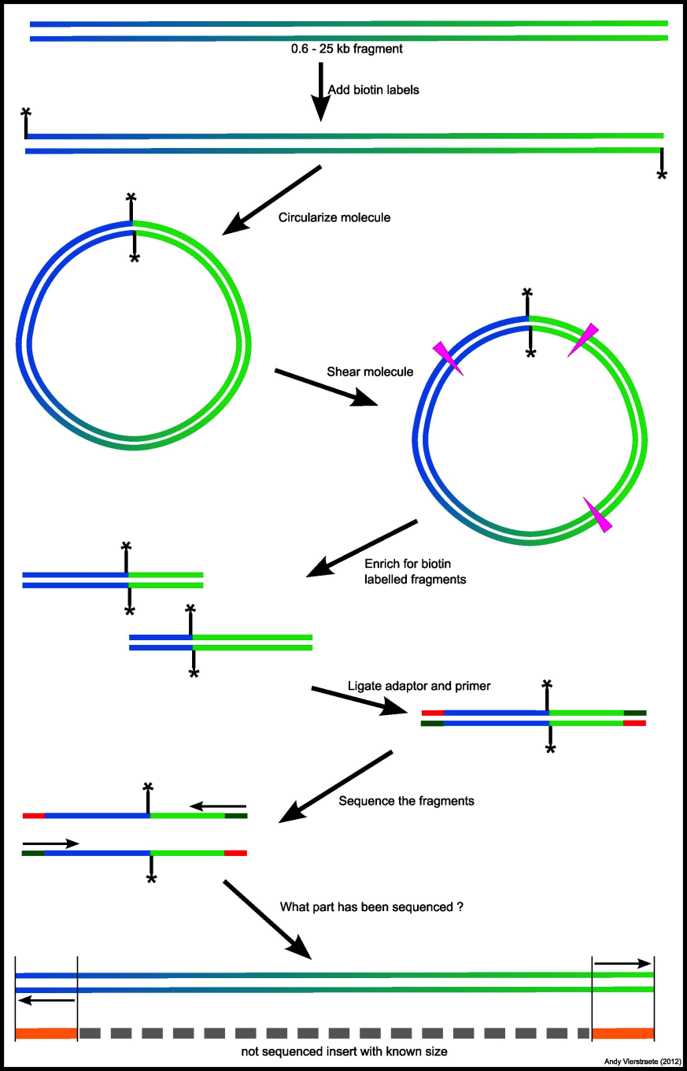
Structural variations
Mate-pair library
Long InDel
Translocation

Slide 13
Annotating and filtering
Gene
Transcript
dbSNP
Regulation
Comparative genomics
Repeats
Functional
Gene ontology
miRNA targets
Etc.

