Slide 1
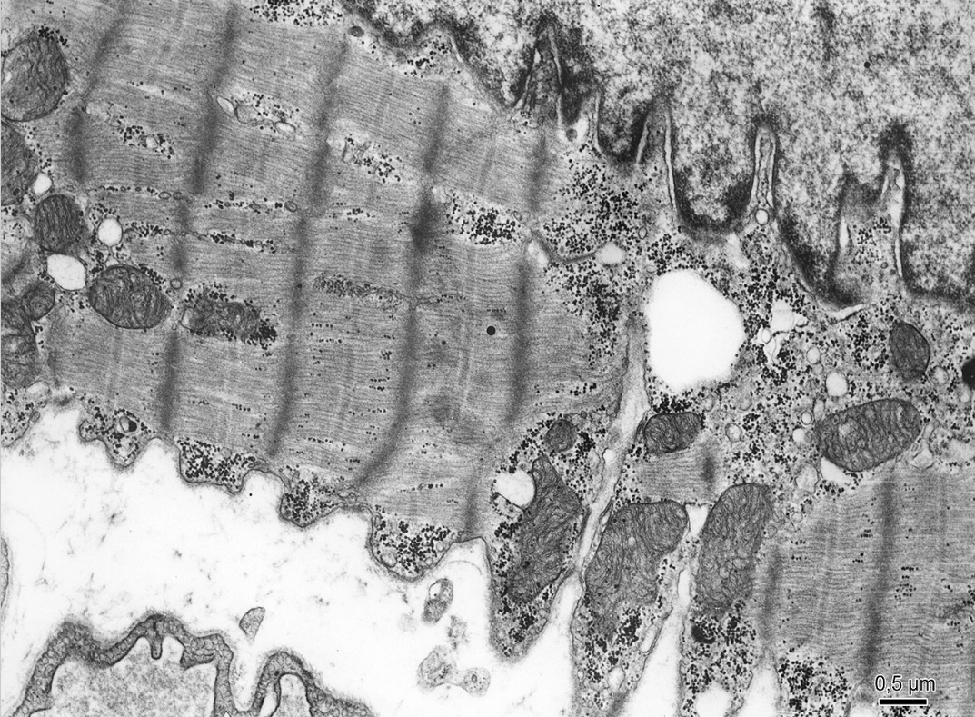
1
2
Notes:
1 – sarcomere
2 – Z-lines

Slide 2
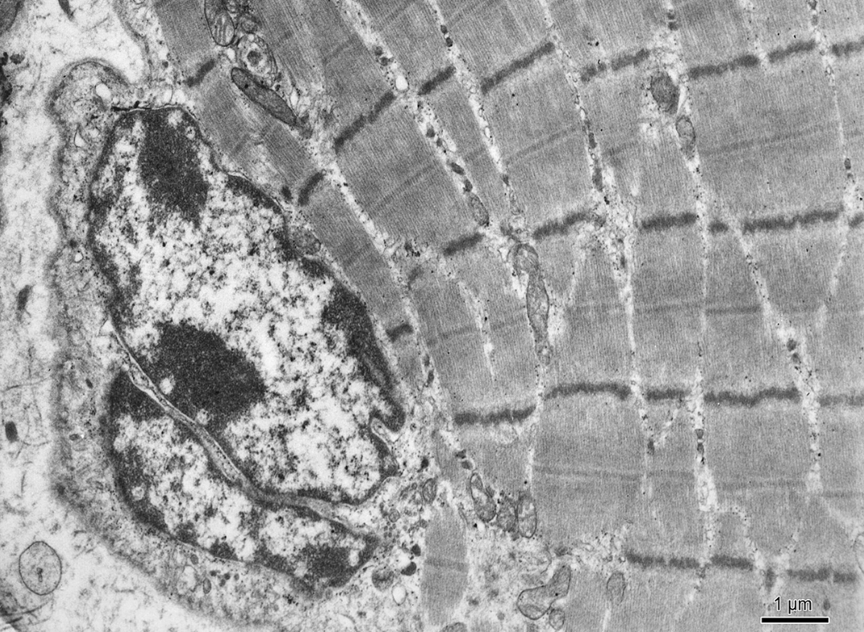
1
2
Notes:
1 – Z-lines
2 - sarcomere

Slide 3
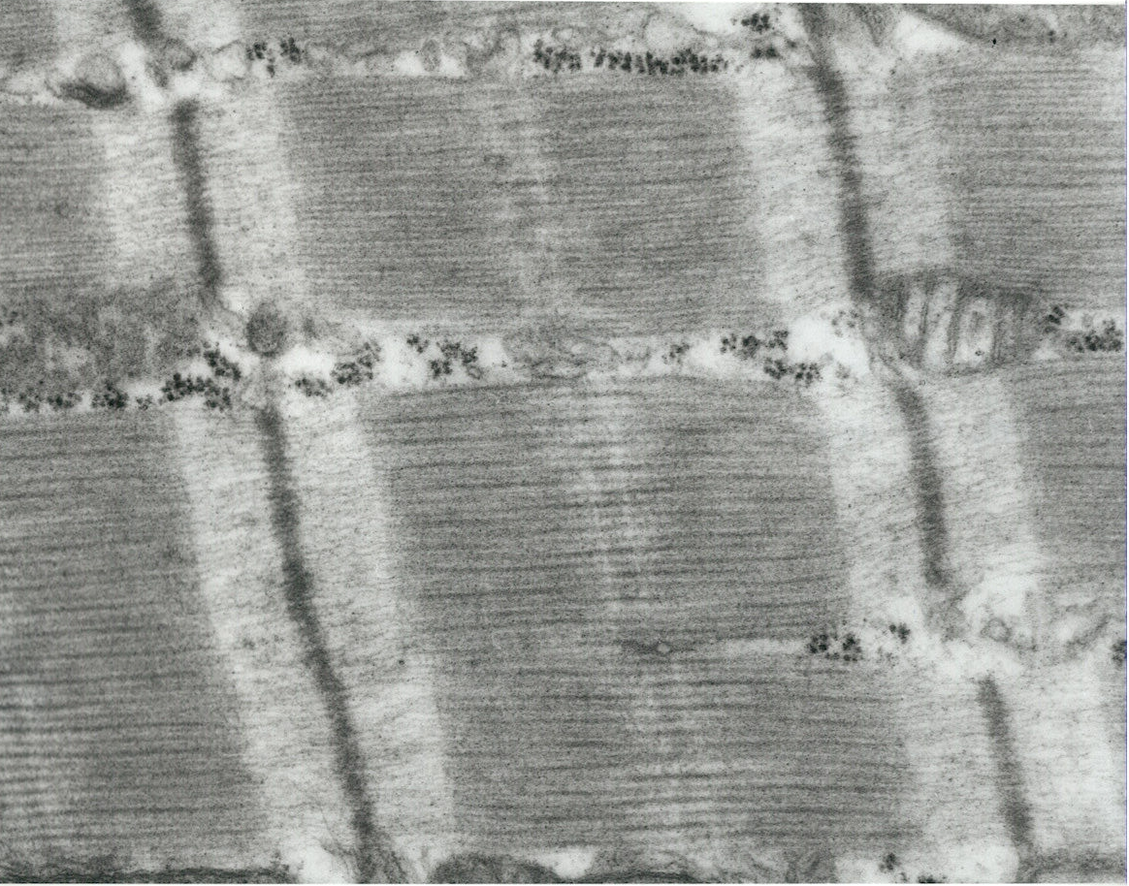
2
1
4
3
Notes:
1 – Z-line
2 – myofibril
3 – isotropic band
4 – anisotropic band

Slide 4
Notes:
Skeletal muscle tissue

Slide 5
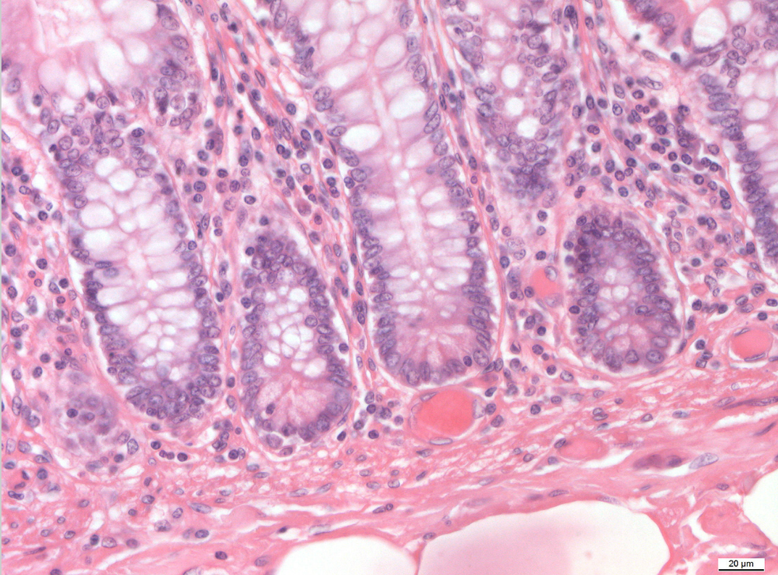
1
2
Notes:
1 – Goblet cells
2 – Paneth cells

Slide 6
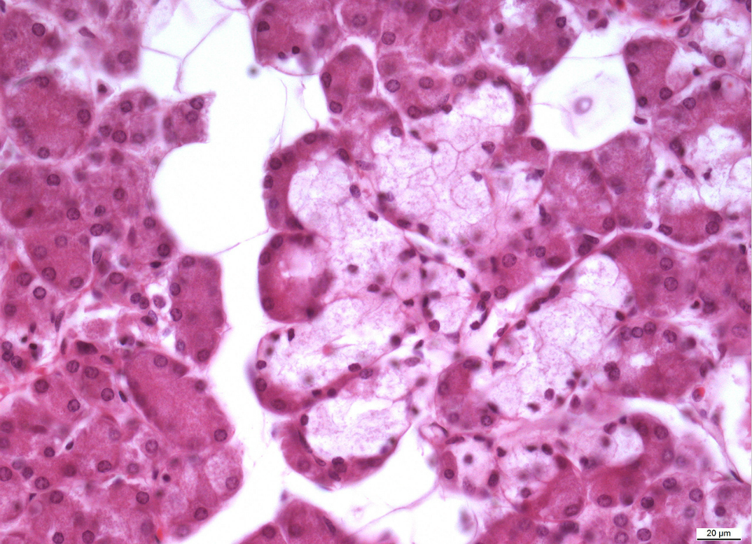
1
2
3
Notes:
Gl. submandibularis
1 – serous acini
2 – mucous tubules
3 - lunulae (demilune) of Giannuzzi

Slide 7
1
Notes:
1 – Goblet cells

Slide 8
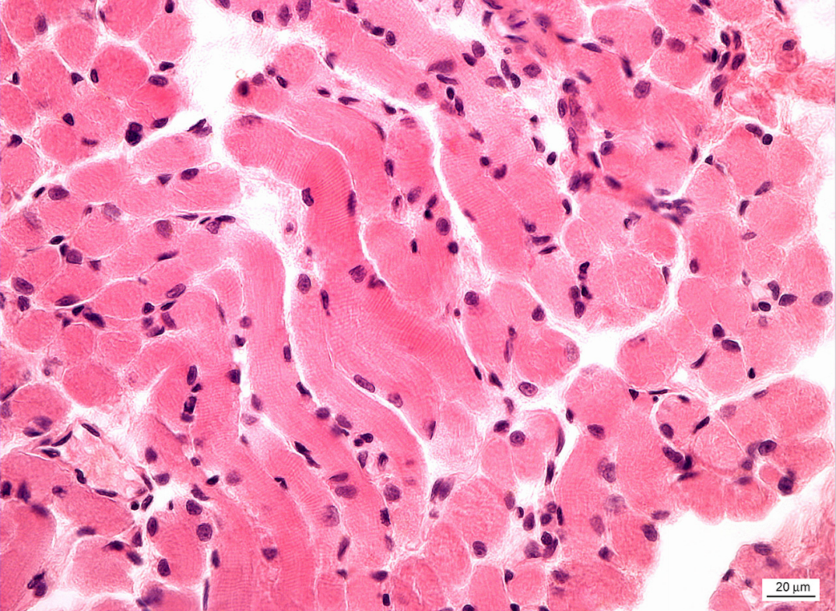
Notes:
Skeletal muscle tissue

Slide 9
1
2
3
Notes:
1 – serous acini
2 – ducts
3 - adipocytes

Slide 10
Notes:
Cardiac muscle tissue

Slide 11
1
Notes:
1 – Paneth cells

Slide 12
1
Notes:
1 – smooth muscle tissue

Slide 13
2
1
Notes:
1 – smooth muscle tissue
2 – Paneth cells

Slide 14
2
1
Notes:
1 – smooth muscle tissue
2 – Paneth cells

