Slide 1

New from VDW!!

Slide 2
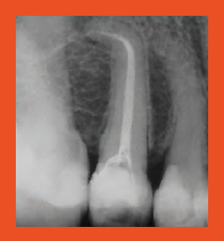
RECIPROC® one file endo
A Brand New Concept of Root Canal Preparation
With one file only
In reciprocation
No hand filing in the majority of cases
RECIPROC® -
An innovation in drive systems and clinical procedures
Tooth 25 without manual instrumentation,
Dr. Ghassan Yared, Canada
Notes:
No hand instrumentation means that there was no preparation of the root canal with a hand instrument.
It is not necessary to create an initial glide path to either working length or to 2/3 of the working length.
Exceptions:
1. Should RECIPROC® not be able to advance in the canal or should the advancement become difficult, it is necessary to create a glide path.
2. If the ISO 10 hand instrument used for working length determination after preparation of 2/3 of the length will only go to working length if it is pre-curved, a glide path must be prepared.

Slide 3
Benefits of the RECIPROC® concept
Simplicity
  No need to change instruments
  Ready to use, sterile single-use instruments
  No hand filing in the majority of cases
Safety:
  Reduced risk of instrument fracture
  Minimised risk of contamination
Notes:
No need to worry about when to change to the subsequent instrument
Easy to learn (own tests under standard conditions with 13 users working on 520 plastic blocks showed that, after a short training period, 92% of the users were able to prepare three consecutive plastic blocks without procedural errors with RECIPROC, compared to 31% using a leading rotary NiTi system).
Reduced risk of instrument fracture thanks to:
a. Single use – no risk of over-use
b. Reciprocation - the instrument does not rotate past its individual
elastic limit thanks to its specific motor settings
c. Improved material - M-Wire offers greater resistance
to cyclic fatigue than traditional nickel-titanium
Thanks to single-use, cross-contamination among patients is eliminated and cross-contamination involving the staff is minimised
Less procedural errors compared to rotary preparation (own tests)

Slide 4
Benefits of the RECIPROC® concept
Time-saving
  Less work steps
  Faster preparation
  No cleaning or sterilisation

Slide 5
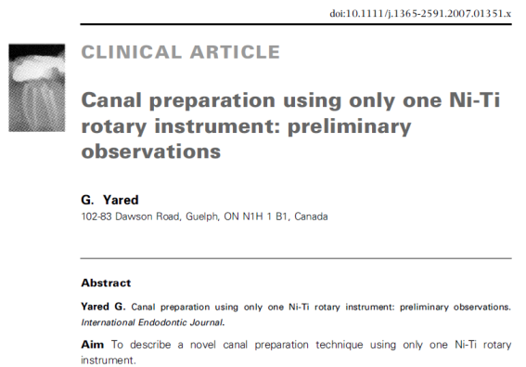

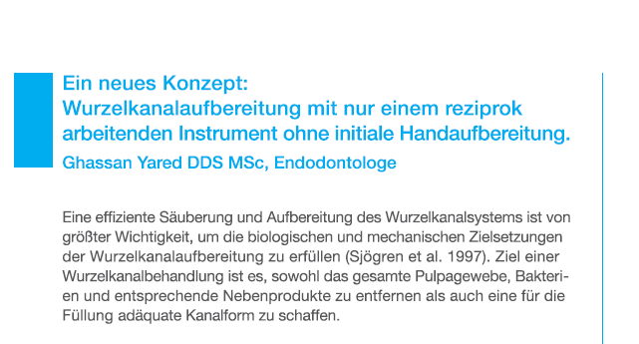
Basis of the treatment concept
Article by Dr. Ghassan Yared, JOE 2008
Article by Dr. Ghassan Yared for the RECIPROC® launch
Ghassan Yared DDS MSc, Endodontist
Notes:
Dr. Yared has 12 years of clinical experience with reciprocation.
He invented the concept "single file reciprocation" and introduced it in 2008 in an article published in the JOE.
He developed the RECIPROC concept in cooperation with VDW and is considered the pioneer of reciprocation systems.

Slide 6
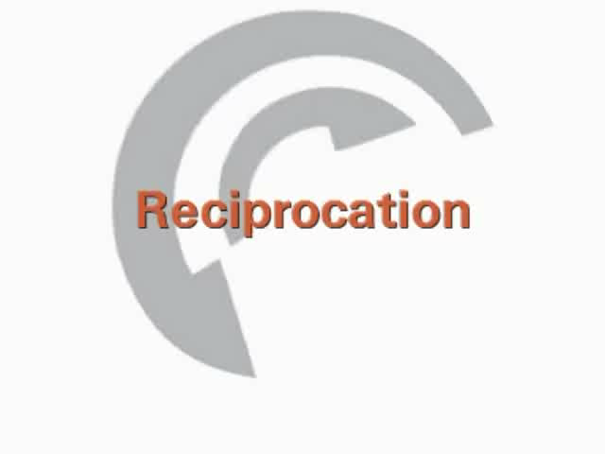
Reciprocation
Notes:
Instrument is first driven in a cutting direction
The subsequent reverse rotation releases the instrument
This allows the instrument to advance automatically towards the apex.
10 reciprocation cycles per second correspond to approx. 300 rpm. One complete rotation of 360° is completed in three reciprocating movements.

Slide 7
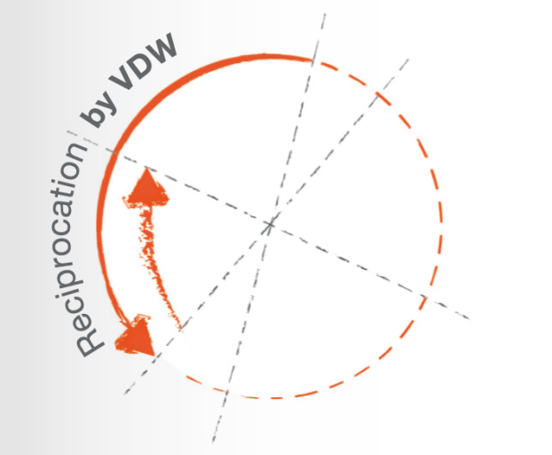
Reciprocation
Benefits
  Root canal preparation with one single
  instrument
  Minimisation of instrument fractures
Notes:
The instrument works within its elastic phase, and so, therefore, relatively stress-free. Due to the fact that the angle in the cutting direction is greater than the reverse angle, the instrument progresses from apically almost automatically.
Causes for instrument fractures are:
Torsional stress
Cyclic fatigue caused by tension and compression
The angles of reciprocation are specific to the design of the RECIPROC® instrument so that the instrument does not rotate past its individual elastic limit.

Slide 8
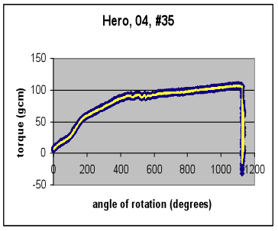
Reciprocation
Benefits
NiTi instruments in reciprocation
Elastic Limit
Plastic phase
Elastic phase
Dr. Ghassan Yared, Canada
Notes:
Explanation of the graph:
If an instrument binds in the root canal and is further rotated, it will be subjected to stress in torsion, torque. The structure of the metal will undergo changes. These changes can be reversible or irreversible depending on the amount of the rotation when the instrument is binding. In this example, any rotation between 0 and 400 degrees will not cause irreversible changes to the structure of the metal. Any rotation beyond 400 degrees when the instrument is binding will cause irreversible changes in the structure of the metal. In the end, the instrument in this example fractures at approximately 1100 degrees of rotation. This zone between 0 and 400 degrees where the changes are reversible is called the elastic phase. The zone from 400 degrees to the point of fracture at around 1100 degrees is to the plastic phase. The point of transition between the elastic phase and the plastic phase is called the elastic limit. In this example the elastic limit is at approximately 400 degrees. If a rotary instrument engages dentine and the motor keeps rotating it, the metal of the instrument will undergo irreversible changes. This happens a first time, a second time and a third time and so on... every time the metal will undergo irreversible changes which will cause torsional fatigue and eventually lead to fracture. In reciprocation, the clockwise and counterclockwise angles of rotation should preferably be set at a level lower than the elastic limit (at a level which will not subject the instrument to a torque / stress exceeding the elastic limit). The lower the angles of rotation the safer the procedure, as long as the instrument can still cut dentine, advance apically in the canal and remove the cutting debris in a coronal direction).

Slide 9
Cyclic fatigue
RECIPROC® shows high resistance to cyclic fatigue
60° angle of curvature, 5 mm radius
ProTaper® F2, 25/.08
Mtwo® 25/.07
RECIPROC® R25, 25/.08
Dr. Nicola Grande, University of Rome La Sapienza, Rome, Italy
Notes:
RECIPROC was measured in reciprocating mode, Mtwo and ProTaper in continuous rotary mode
ProTaper and Mtwo are made of traditional NiTi alloy, RECIPROC of M-Wire
Result is significant compared to the two instruments Mtwo and ProTaper
The measurement was carried out in a curved metal pipe
Abstract of Dr. Nicola Grande's lecture at the AAE in April 2011:
New reciprocating nickel-titanium instruments have been recently introduced in the market, designed to be used with a patented reciprocating motion (ReciprocTM, VDW-GmbH), that makes 10 alternations per second (approx. 300 clockwise and 300 counterclockwise partial rotations per minute). This study aimed to compare the cyclic fatigue resistance of Reciproc files used with the patented reciprocating motion with conventional nickel-titanium rotary files used in continuous rotation (300 rpm). The following groups were tested: Reciproc R25, tip size #25 and variable taper (.08 apical taper, decreasing coronally), MtwoTM (VDW-GmbH) tip size #25 taper .07 and ProTaperTM F2 (Dentsply-Maillefer). Ten instruments of each group were driven until fracture using a cyclic fatigue device with 60° degrees angle of curvature and a 5-mm radius. Time to fracture in seconds was registered. Mean values and standard deviations (SD) were calculated. Data were analyzed by one-way ANOVA and Tukey HSD test. Reciproc R25 fractured after a mean of 130 seconds (SD 15,7) while Mtwo after 101 sec. (SD 12,4) and ProTaper after 58 sec. (SD 11,2). There were statistical significant differences among all the groups (p<0.05). Since Reciproc files are very similar in cross-sectional and flute design to Mtwo, and very similar in dimensions to Protaper, the influence of the reciprocating movement on cyclic fatigue resistance measured in seconds seems to be significant. This could be a relevant clinical issue, if time of instrumentation needed to complete root canal shaping by Reciproc is similar to those of conventional nickel-titanium instruments used in continuous rotation.

Slide 10
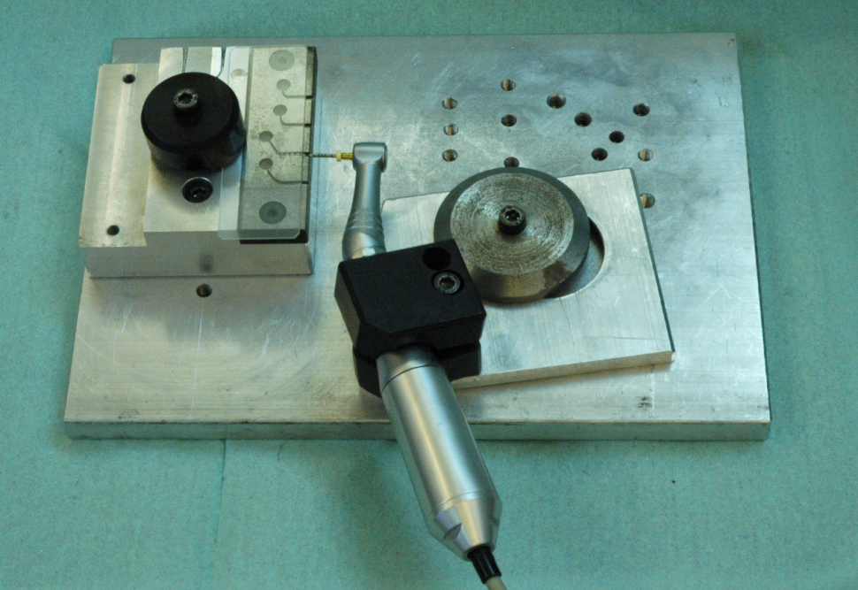
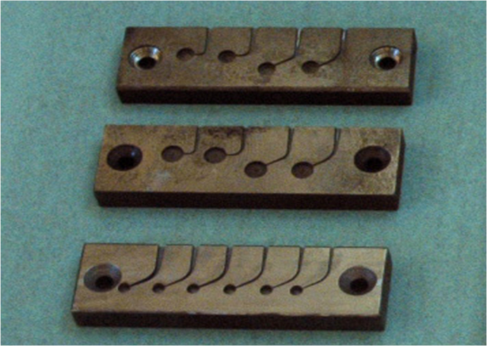
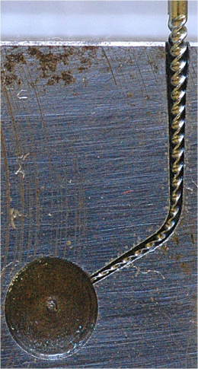
Test equipment to determine cyclic fatigue, Dr. Nicola Grande, Rome
Illustration above
Test device to determine
cyclic fatigue
Illustrations below:
Steel plate with artificial root canals with diameter and taper corresponding to the instrument to be tested

Slide 11

Reciprocation in vitro with RECIPROC® R25
Dr. Ghassan Yared, Canada

Slide 12
Nickel-Titanium instruments in continuous rotary
Dr. Ghassan Yared, Canada
Notes:
This graph illustrates what happens when an instrument binds in the canal and the motor keeps rotating it until fracture. The x-axis shows the degree of rotation until fracture occurs... in this case at around 1100 (almost 3 full rotations). When the instrument is binding in the canal and is being rotated by the motor, it will be subjected to a force that we call torque. The motor continues rotating the instrument, and the torque will increase until the instrument fractures. The instrument in this example fractured at a force of almost 100 gcm. This is what we call the torque at fracture of the instrument. This instrument fractured after almost 3 rotations or 1100 degrees. This is what we call the angle at fracture of the instrument. The torque and the angle at fracture of an instrument are usually measured at the tip of the instrument, the most common area of instrument fracture. Each instrument has a specific torque and angle at fracture.

Slide 13
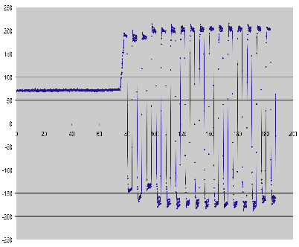
Dr. Ghassan Yared, Canada
Notes:
The next few slides explain why a glide path is not required with the Single File Reciprocation.
If a rotary instrument binds in the canal, it will fracture. A glide path is required before using the rotaries to minimize the incidence of binding and therefore the risk of fracture.
In reciprocation, CW and CCW angles determine the amplitude of reciprocation, the right and left rotations. The reciprocating instrument will rotate CW; once it reaches the angle set on the motor, it will rotate CCW until the CCW angle set on the motor is reached and then it will rotate CW and so on.
Each instrument has a specific angle at fracture. The reciprocating instrument in this example has an angle at fracture equal to 1100 degrees, almost 3 full turns. This means that if the instrument is held tightly at its tip and rotated, it will fracture after 3 full turns. The angles set on the motor are much lower than the angle at fracture of the reciprocating instrument. The angles on the motor in this example are set at 200 degrees CW and CCW. When the instrument rotates 200 degrees in one direction it will rotate into the other direction and so on, the angles of rotation in both directions never exceed 200 degrees. So the instrument will never reach in any direction the point of fracture which is 1100 degrees. This means that if the instrument binds in the canal, it will never fracture. This is why a glide path is not required with the Single File Reciprocation technique. The purpose of the glide path is to obtain a minimal canal enlargement to minimize the risk of binding and therefore the risk of fracture. It is needed with the rotaries, because if a rotary instrument binds it will fracture; it is not needed with the SFR because if the instrument binds it will not fracture.

Slide 14









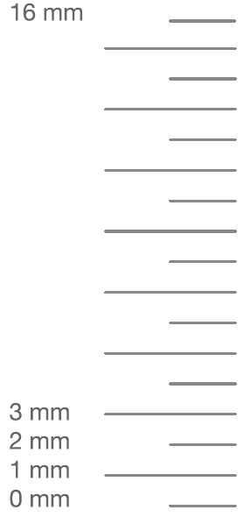
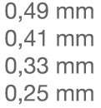
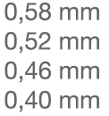
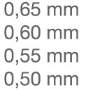
The RECIPROC® system
Sizes and dimensions of instruments
Narrow canals
Medium canals
Large canals
Notes:
Sizes/taper: working part: 16 mm
R25 – ISO 25 taper .08
R25 – ISO 25 taper .08
R50 – ISO 50 taper .05
Regressive taper
A regressive taper allows for coronal shaping without unnecessary loss of tooth substance, compared to instruments with constant taper such as e.g. Mtwo (25/.06 has a diameter at the end of the working part of 1.21 mm, WaveOne 25/.08 measures 1.22 mm at the end of the working part)
Info buttons:
Left: dimensions RECIPROC / Mtwo
Right: dimensions RECIPROC / WaveOne

Slide 15
The RECIPROC® system
Sizes and dimensions of instruments
Regressive taper for a preparation without unnecessary loss of tooth substance
  RECIPROC® instruments have a smaller instrument diameter at the end of the working part than most other conical NiTi instruments of equal size at the tip e.g.:
 | Mtwo® | RECIPROC®
after 16 mm | 25/.06 Ø 1.21 mm | R25 Ø 1.05 mm
after 16 mm | 40/.06 Ø 1.36 mm | R40 Ø 1.10 mm

Slide 16







The RECIPROC® system
Instruments
Benefits:
    Higher flexibility
    Reduced cyclic fatigue
Notes:
Compared to a standard nickel-titanium alloy
M-Wire is thermally treated nickel-titanium

Slide 17
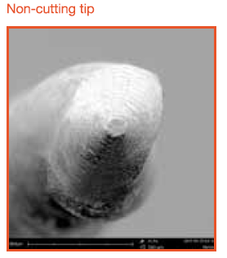
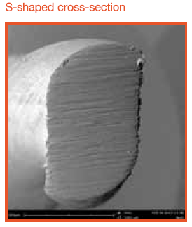
The RECIPROC® system
Design
Dr. David Sonntag, University of Düsseldorf

Slide 18

The RECIPROC® system
Why a "mirrored" design?
RECIPROC® cuts in a counter-clockwise direction
  Safety aspect
  Certification of instrument for use
  in reciprocation with VDW motors
  e.g. VDW.SILVER® RECIPROC®
Notes:
Rotary instruments cannot be used in reciprocation by accident
Current VDW NiTi systems as well as competitive products cannot be used in reciprocation with VDW.SILVER®RECIPROC®
Statement regarding competitive motors with reciprocating mode:
Only VDW and Maillefer motors have been tested and approved for these instruments
It is not merely the angles of reciprocation which are important, but also how precisely the motor controls the changes of direction (timing) and the acceleration rate of the motor
Angles of reciprocation are not disclosed.

Slide 19
The RECIPROC® system
Development
Project start:
Summer 2008
2009 - 2010
Prototype tests
Launch IDS 2011
RECIPROC® system
Developement and design projects
Endo motor
Instruments
Obturation accessories
More than 20 prototypes
Numerous motor settings
Instruments
VDW.SILVER® RECIPROC® motor
RECIPROC® Gutta-Percha
RECIPROC® Paper Points
Specification for GP and PP
  Tests with existing rotary systems
  Conclusion:
  None of the continuous rotary instruments on the market allow for safe and reproducible single-file preparation in reciprocation
Notes:
Existing rotary systems had weak points when used in reciprocation:
e.g. untwisting and instrument fractures; working length could not be reached

Slide 20
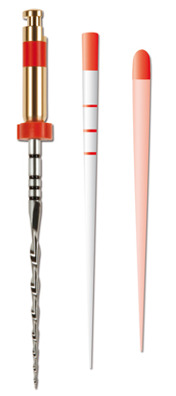
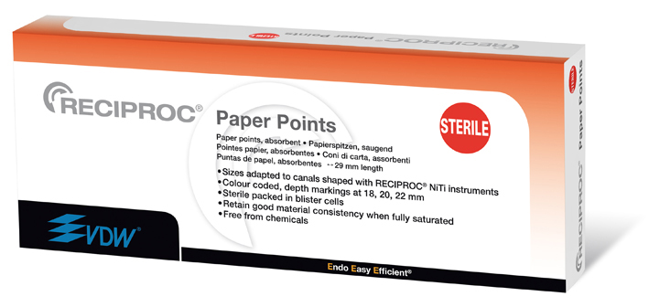
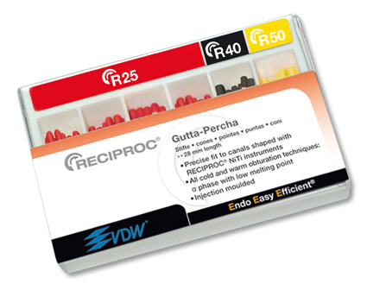
The RECIPROC® system
Obturation products
RECIPROC® Paper Points, sterile
RECIPROC® Gutta-Percha
  Alpha-phase - suitable for:
    Single cone technique
    Vertical compaction
Notes:
GP quality and fit:
Gutta-percha manufactured by injection moulding procedure

Slide 21
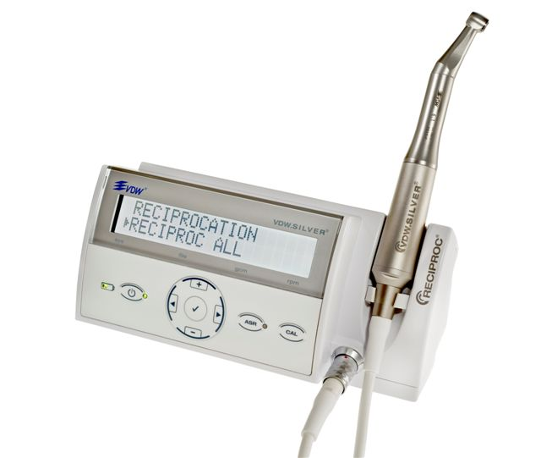
The RECIPROC® system
VDW.SILVER® RECIPROC® motorC
New endo motor for reciprocating and continuous rotary NiTi systems
File library:
  Reciprocating systems
    RECIPROC®, WaveOneTM
  Rotary systems
    Mtwo®, FlexMaster®, ProTaper®,
    K3TM, Gates, Dr.`s Choice

Slide 22
The RECIPROC® system
Benefits
Root canal can be prepared with only one instrument
Time-saving due to less work steps
              *Checking patency, rinsing canal, changing
              instrument and preparing root canal
Total working time*
Time saved: 75%
Internal studies VDW Munich, 2010
Notes:
- No need to clean or sterilise instruments in the practice
- No need to change instruments during root canal treatment
- Pre-sterilised instruments make for single-use convenience

Slide 23
The RECIPROC® system
Benefits
Easy to learn
Less procedural errors for less experienced practitioners
Percentage of users who, after a short training period, managed to prepare three consecutive canals under standard conditions without procedural errors
Internal studies , VDW Munich, 2010

Slide 24
The RECIPROC® system
Benefits
Safe preparation thanks to:
  Minimised risk of instrument fracture due to precise angles of reciprocation specific to the instrument design
  Cyclic fatigue resistance thanks to single-use
No hand filing in the majority of cases
  "The reciprocation technique’s centring ability together with the design of the RECIPROC® instrument and its increased cutting ability render establishing a glide path unnecessary." Dr. Ghassan Yared, Ontario

Slide 25
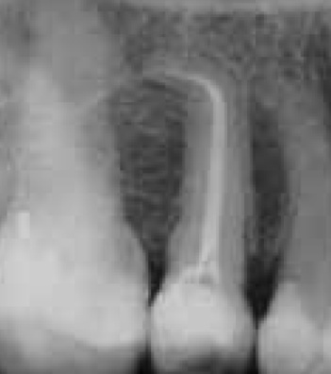
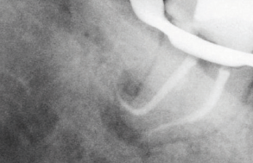
The RECIPROC® system
Benefits
Preparation of narrow and severely
curved canals due to the centring ability
of the instrument
The shape obtained by RECIPROC®
enables cold and warm obturation
techniques
Dr. Ghassan Yared, Kanada, Teeth 25 (left), Teeth 37 (right)

Slide 26

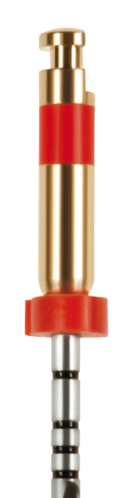

The RECIPROC® system
Specifics
Sterile instruments
Single use:
  Subject to higher stress compared to rotary systems
  1 instrument instead of 4-5 instruments
  Max. one treatment
  Max. one molar
Cannot be autoclaved!
Notes:
Instruments are gamma-sterilised
Plastic band on the instrument shaft is not heat resistant and will be deformed by heat. The instrument will no longer fit into the contra-angle.
Safety measures:
- Protection from material fatigue caused by material stress
- One RECIPROC instrument does the job of several hand or rotary instruments and is
therefore subject to a considerably higher material stress than during
traditional preparation with 4-5 instruments per canal.
- VDW as a manufacturer has the responsibility to ensure safe root canal preparation
with its instruments (which also includes the determination of the frequency of use as well as the use of an appropriate endo motor)
- Price discussion in this context: Price for RECIPROC is justified due to investment costs, see chart “Development“

Slide 27
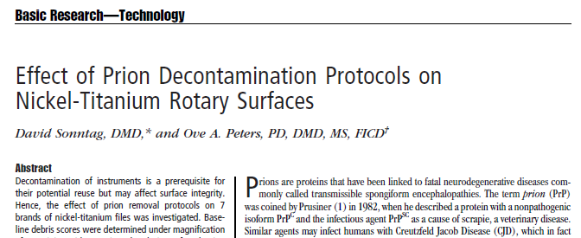
Trend towards single-use
Requirements regarding root canal preparation with rotary instruments (class B critical) are increasing.
Studies have shown that current cleaning and decontamination procedures could not completely remove remnants of tissue adhering to instruments (Dr. David Sonntag, 2009).

Slide 28
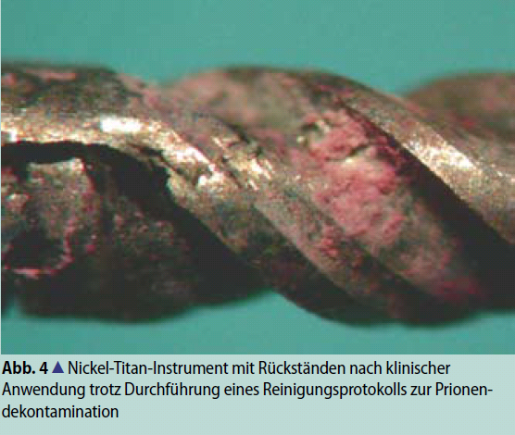
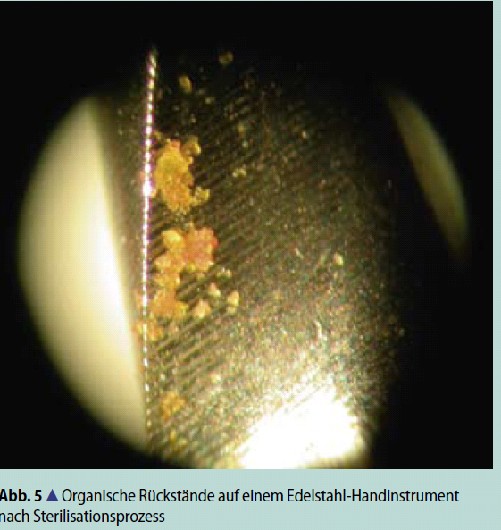
Remnants of tissue after cleaning and sterilisation
Dr. David Sonntag, University of Düsseldorf
Notes:
Picture left side:
Fig. 4: Nickel-titanium instrument with remnants of tissue after clinical use despite correct cleaning protocol to ensure prion decontamination
Picture right side:
Fig. 5: Organic remnants on stainless steel hand instrument after sterilisation procedure

Slide 29
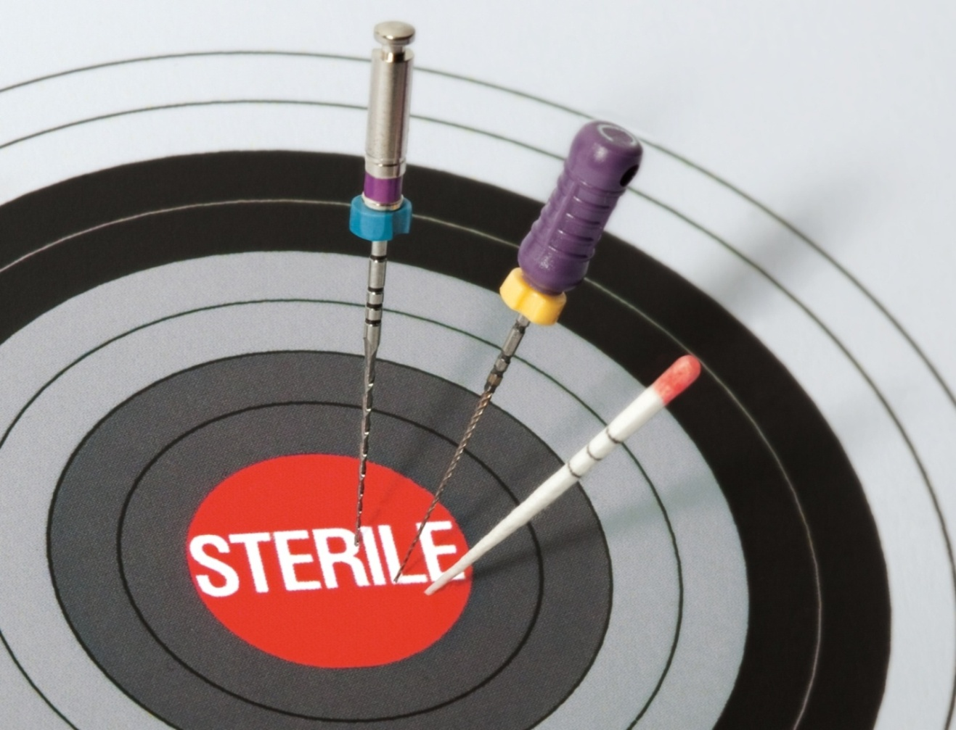
Industrially cleaned and gamma-sterilised endodontic instruments by VDW
Notes:
VDW has been distributing industrially cleaned, blistered and gamma-sterilised endodontic instruments since the 1980s.
VDW therefore plays a leading role among all manufacturers of endodontic instruments.

Slide 30

Validated processes and TÜV certified quality management at VDW
VDW is a certified manufacturer of medical devices in accordance with ISO 13485 medical devices - quality management systems
VDW strictly adheres to the regulations of DIN EN ISO:
  [EN ISO 11607-1] Packaging of medical devices for sterilisation, requirements for materials, sterile barrier systems and packaging systems
  [EN ISO 11137-1] Sterilisation of health care products - radiation - requirements for development, validation and routine control of a sterilisation process for medical devices
Notes:
This leading role is further emphasised by numerous measures in connection with the required DIN EN ISO standards.
Prior to distribution, all VDW endodontic instruments are cleaned during the manufacturing process.
Upon arrival at VDW's packaging department, all instruments pass through another extensive cleaning process (validated washing process).
Only after the final washing process are VDW instruments transferred through a double door system into the clean room and packaged in blister cell packaging.
The blisters (primary packaging) are then packed in boxes (secondary packaging) and gamma-sterilised (radiation).
In order to ensure that only clean and hermetically sealed blister packages are delivered to dentists, regular tests are carried out, such as cytotoxicity tests, endotoxin tests, particle determination and bioburden tests.
Only after close examination by an independent certified company can VDW products subsequently be distributed.

Slide 31
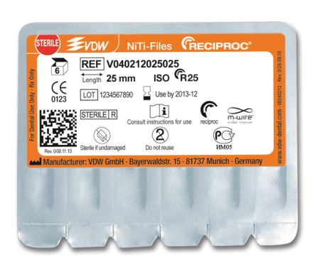
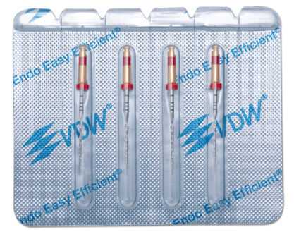
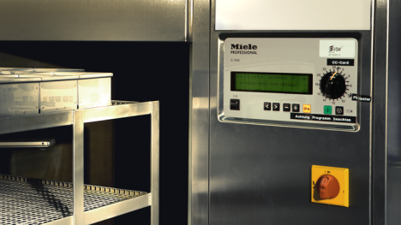
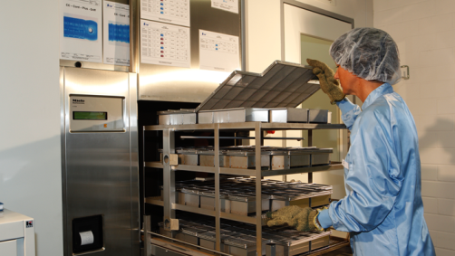
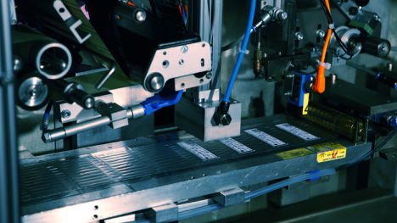
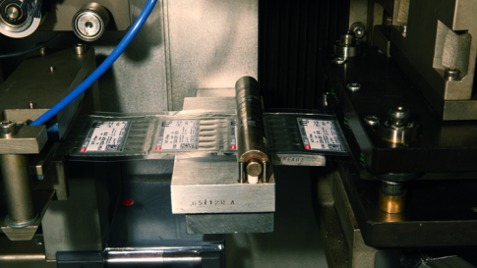
Validated processes and TÜV certified quality management at VDW
Washing machine for endodontic instruments
Cleaned, blister packed and gamma-sterilised end product, e.g. RECIPROC®
Cleaned endodontic instruments are transported through a double door system into the clean room
Instruments are inserted mechanically into blister packaging and sealed
Blister packaged instruments
Notes:
Validated processes are a must for VDW's production: this has contributed for years to the successful adherence to all required standards and to delivering exclusively cleaned and gamma-sterilised, ready to use endodontic instruments.

Slide 32
Enhanced safety for patients, practitioners and practice personnel
No sterilisation prior to first use
Ready to use instruments, individually packed
Sterile assortment: stainless steel instruments, rotary and reciprocating NiTi instruments, obturation accessories
Notes:
Industrially cleaned and gamma-sterilised endodontic instruments offer further advantages:
Assistance with correct fulfilment of all legal requirements, guidelines and recommendations
-Safety in case of legal disputes
Enable a simplified workflow in the dental practice with regard to quality management and infection control requirements.

Slide 33

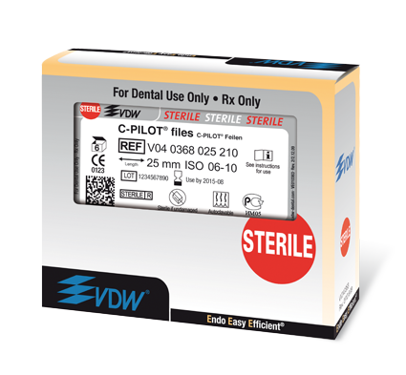
Enhanced safety for patients, practitioners and practice personnel
Sterile endodontic instruments will support compliance with infection control regulations in your dental practice.
The sterilisation procedure applied to VDW endodontic instruments
has been developed and validated for sterilisation in accordance
with [EN ISO 11137-1]. Sterile endodontic instruments
are furthermore labelled with the symbol STERILE R to indicate
their sterilisation with gamma radiation.
The red dot on each instrument package further helps
differentiation between sterile and non-sterile
instruments.
Notes:
Industrially cleaned and gamma-sterilised endodontic instruments offer further advantages:
Assistance with correct fulfilment of all legal requirements, guidelines and recommendations
-Safety in case of legal disputes
Enable a simplified workflow in the dental practice with regard to quality management and infection control requirements.

Slide 34

Notes:
VDW STERILE slogan - our promise: Look for the red dot. Over thirty years' experience in sterile endo products.
Endo
Easy
Efficient

Slide 35
Single-use convenience
Easy and safe
No change of instrument characteristics due to material wear
Elimination of cross-contamination
Avoidance of fatigue fractures
Time- and cost-efficiency due to the fact that root canal instruments do not need to be cleaned and sterilised
No need to document frequency of use
No need for endo boxes

Slide 36
Costs of single-use
Single-use of rotary NiTi instruments is expensive:
generally min. 5 instruments à € 6.50 (Ø value) equals € 32,50
In comparison, root canal preparation with a RECIPROC® instrument costs only € 13.00
Saving per tooth € 19.50

Slide 37
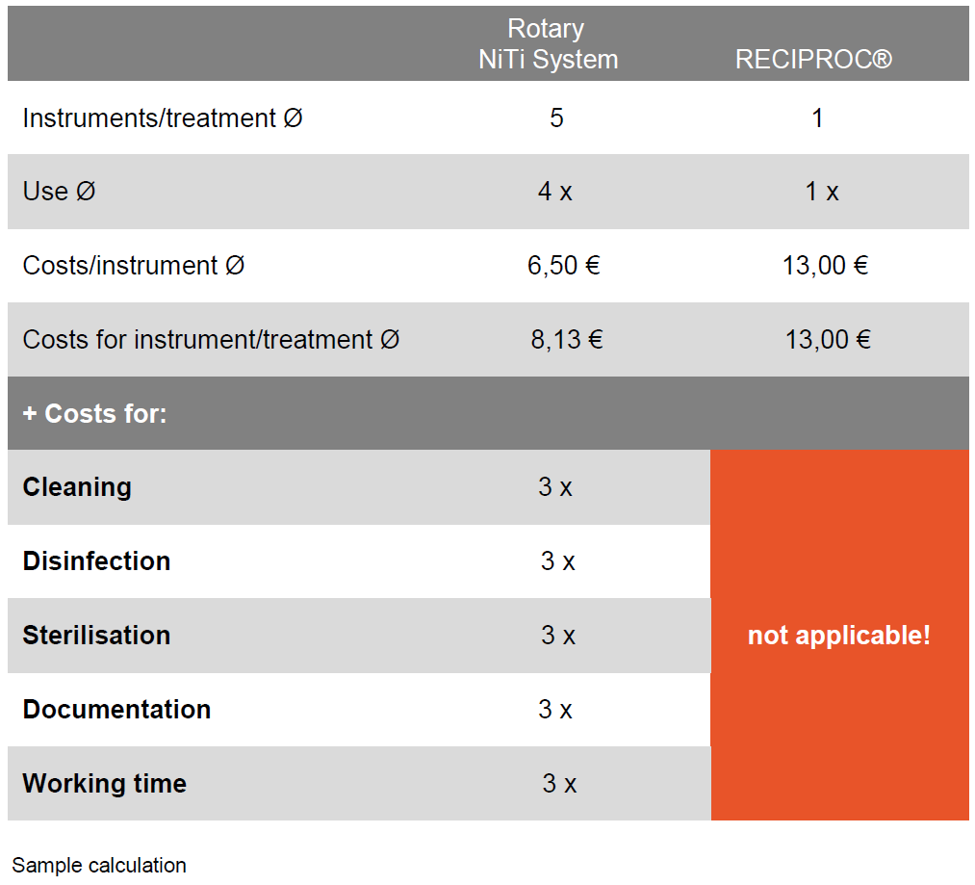

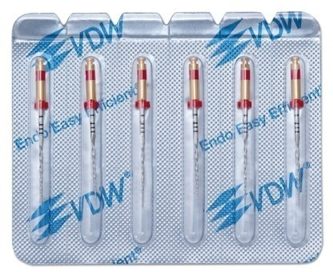
Affordable single-use

Slide 38
RECIPROC® clinical procedure
Procedure remains unchanged in comparison with traditional rotary systems:
  Pre-operative radiograph
  Straight canal access
  During root canal preparation, make sure the canal is free with a hand instrument
  Irrigation protocol

Slide 39
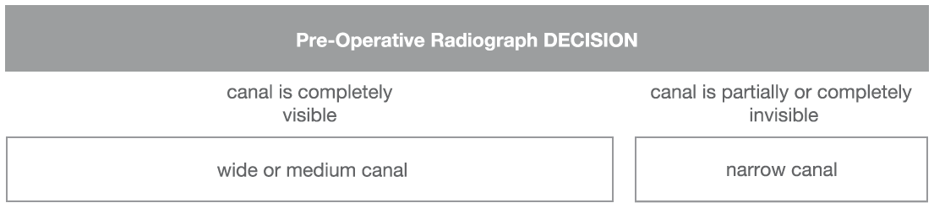
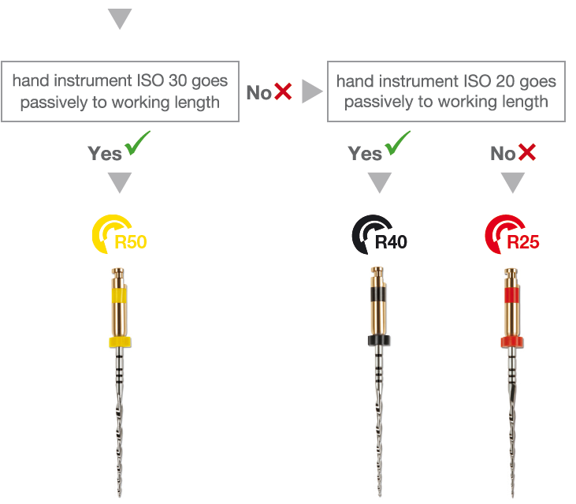
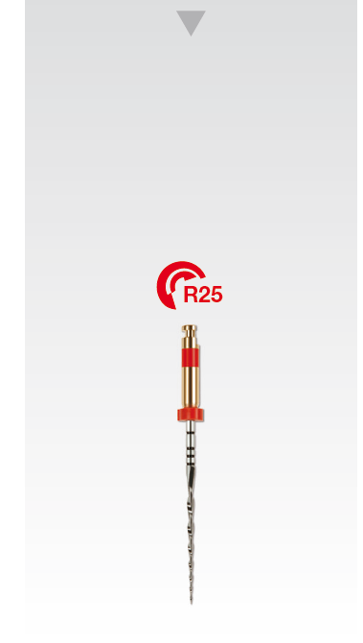
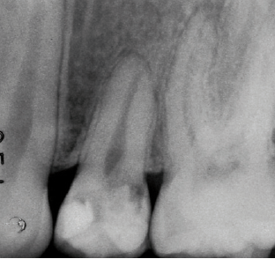
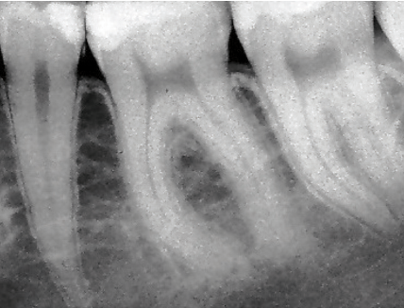
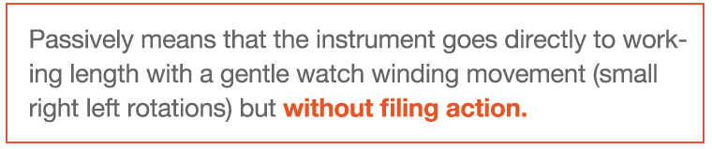
Clinical procedure
Selecting the correct RECIPROC® instrument

Slide 40

Clinical procedure
Estimation of working length based on a pre-operative radiograph
Set stopper at approx. 2/3 of estimated working length

Slide 41
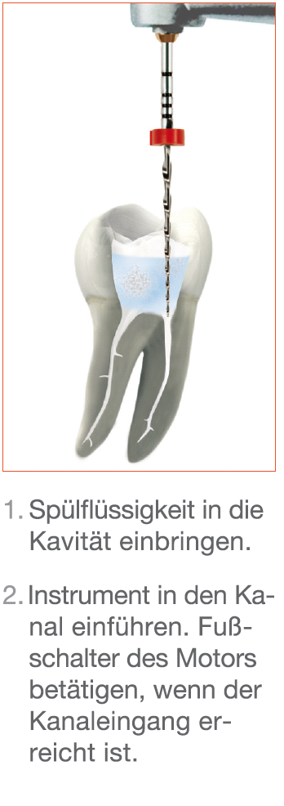
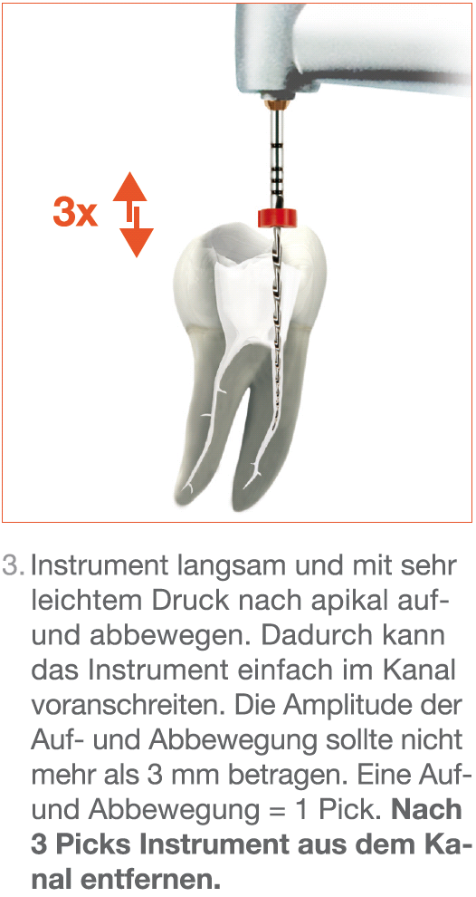
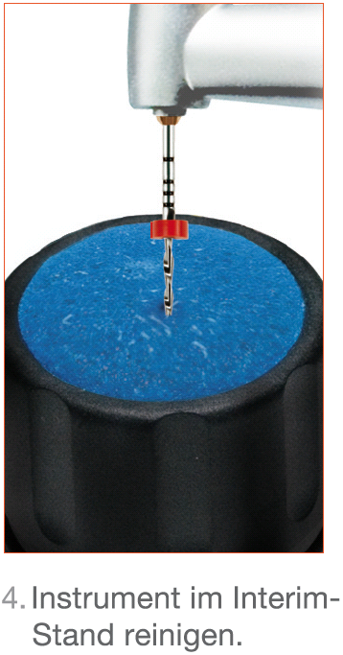
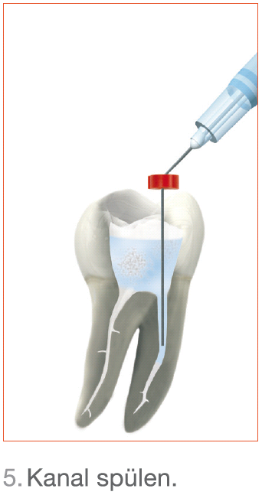
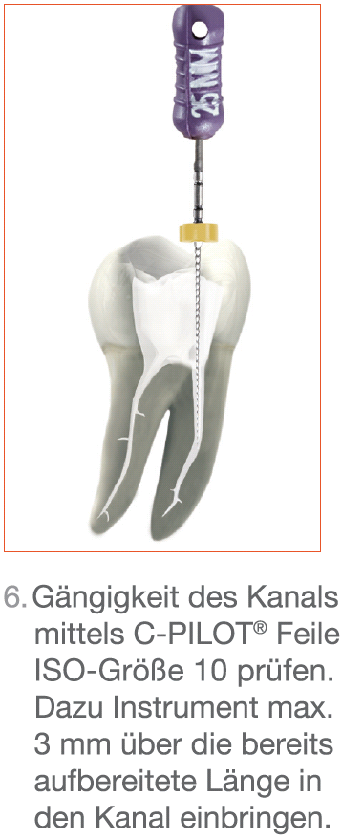
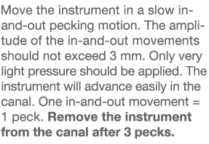
Clinical procedure
In this way, continue root canal preparation with RECIPROC® until approx. 2/3 of the working length has been reached
Notes:
No additional coronal enlargement necessary with RECIPROC (e.g. with a Gates Glidden drill)
Importance of the three peck movement
Difference to rotary preparation:
The three peck movement is important for practitioners switching from rotary to reciprocating systems. The amplitude of the in-and-out movement should not exceed 3 mm. The instrument should be cleaned after three pecks.
Reasons:
The instrument does the job of 4-5 rotary instruments and works from crown towards apex without instrument change. If the instrument is not cleaned regularly as it works towards the apex, the flutes will become blocked due to the high cutting efficiency. Friction would increase and the instrument would not be able to work adequately within the canal.
This is the reason why the instrument needs to be cleaned in the interim stand after 3 pecks at the latest.
Important! Even if the practitioner is of the opinion that the instrument advances easily within the canal, the instrument needs to be cleaned regularly.
This is contrary to rotary preparation, whereby the instrument is often allowed to continue to work and penetrate as deeply into the canal as it can advance automatically. With rotary preparation, the instrument is only withdrawn to prepare the canal walls with lateral brushing movements (e.g. Mtwo or ProTaper).
Checking if the canal is free with an hand instrument:
A hand instrument is inserted to max. 3 mm past the prepared length of the canal.
Especially at the beginning of a root canal preparation, the length has not yet been determined. Therefore, the instrument should not be brought to working length. In the majority of cases, the hand instrument is only inserted to full length for exact working length determination after preparation of approx. 2/3 of the estimated working length!

Slide 42
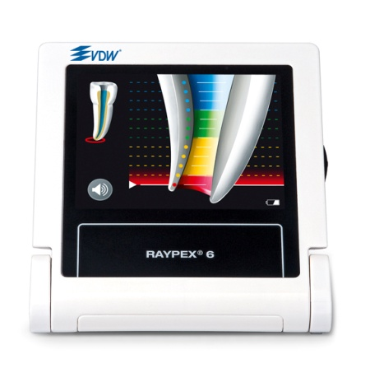
Clinical procedure
Electronic length determination
After preparation of approx. 2/3 of the root canal length, the working length is determined.
Notes:
A radiograph is recommended based on forensic reasons:
With silver point after an ISO 10 hand instrument has reached the working length. The silver point has a higher radiographic opacity than a size 10 hand instrument.
Radiograph of the master point after instrumentation

Slide 43
Clinical procedure after reaching 2/3 of the working length with R25
Hand instrument ISO size 10 used for working length determination goes to working length without being pre-curved
Preparation can be finished with R25.
Gradual curvature tooth 25
Dr. Ghassan Yared
Gradual curvature tooth 37
Dr. Ghassan Yared
Notes:
Reasons why the creation of a glide path is not necessary:
Instrument's centring ability based on reciprocation
Instrument design (instrument tip)
RECIPROC's cutting efficiency
Definition: gradual curvature
If a hand instrument size 10 goes to working length even in radiographically strongly curved root canals without being pre-curved, the curvature is classified as gradual. The radius of curvature can be easily managed with a hand instrument even in case of a strong angle of curvature (see illustrations).
If the hand instrument needs to be pre-curved, this could be an indication that there is an abrupt curvature. The radius of curvature is so small that the hand instrument can only pass if pre-curved.

Slide 44
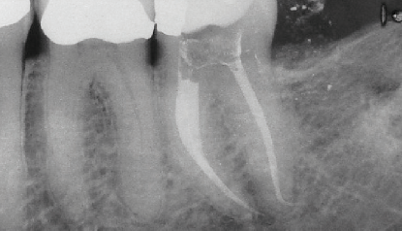
Clinical procedure
Glide path management
Hand instrument ISO size 10 used for working length determination only goes to working length if it is pre-curved
→ Glide path up to ISO 15
If the ISO size 15 hand instrument goes
to working length without being pre-curved, finish root canal preparation with R25.
If not, complete preparation with hand instruments
Abrupt curvature tooth 47, root canal preparation was finished manually
Dr. Ghassan Yared
Notes:
For creating a glide path, hand files ISO sizes 10 und 15 should be used to prepare the full working length.

Slide 45
Clinical procedure
Glide path management with complex anatomies
Should RECIPROC® stop advancing in the canal or should its advancement become difficult,
do not exert any apical pressure!!
→ Glide path up to ISO 15
  If the ISO 15 hand instrument goes to working length without being pre-curved, finish root canal preparation with R25.
In case of a complex canal anatomy: the section of a root canal where an ISO 15 hand instrument can be brought without pre-curving can be prepared with R25 to that point.
Notes:
The concept of root canal preparation without hand filing in the majority of cases is based on Dr. Yared's positive practical experience. It is also based on his teaching experience and studies which show that many during root canal preparation are caused by initial manual preparation.
If root canal preparation is possible without initial hand filing, why risk procedural errors by creating a glide path prior to instrumentation?

Slide 46

Clinical procedure
When is it necessary to create a glide path?
Notes:
If the ISO 15 hand instrument does not go to working length without being pre-curved, root canal preparation needs to be finished manually.
This limitation also applies to root canal preparation with rotary NiTi instruments!

Slide 47

Clinical procedure
Selecting the correct RECIPROC® instrument

Slide 48

Clinical procedure
Electronic length determination
Initial working length determination
Set the stopper at approx. 2/3 of the estimated working length
After preparation of 2/3 of the working length, the exact working length is determined.
Notes:
A radiograph is recommended based on forensic reasons:
With silver point after an ISO 10 hand instrument has reached the working length. The silver point has a higher radiographic opacity than a size 10 hand instrument.
Radiograph of the master point after instrumentation

Slide 49
What to observe when preparing a root canal with RECIPROC® !
Do not put pressure on the instrument if it does not advance in the canal!
Do not forget to clean the flutes regularly during preparation!
Make sure RECIPROC® never rotates in one place should it not be able to advance apically!
RECIPROC® instruments are sterile single-use instruments which cannot be re-used!
Inspect the instrument visually after each work step for signs of wear!
It is not recommended to use RECIPROC® or a continuous rotary system if the root canal has an abrupt curvature in the apical section!

Slide 50
Clinical procedure
Brushing file movement
  Oval canals
  Enlargement of the canal orifice
  In general: to enlarge the root canal as necessary

Slide 51




Clinical procedure
What has been achieved?
Conical shape
  Suitable for optimum irrigation up to shortly before the apex
  Suitable for cold and warm obturation techniques
What is the benefit?
  Easier and safer preparation using just one instrument instead of 4-5 rotary NiTi instruments + hand instruments

Slide 52
Clinical procedure
Apical enlargement
Recommendations for apical enlargement after R25 and R40
  Apical gauging with hand file ISO 30 to check the diameter, if required use R40
  Apical gauging with hand file ISO 45 to check the diameter, if required use R50
Notes:
Apical enlargement with rotary instruments is possible but not recommended for a dentist (GP) as it would mean mastering both reciprocation and rotary systems.
If the apex is enlarged with rotary or manual instruments, RECIPROC gutta-percha points will no longer be suitable

Slide 53
Clinical procedure
Irrigation management
Time saved for final irrigation
Ultrasound activated irrigation
R25 complies with requirements for shaping prior to ultrasonic irrigation

Slide 54

Clinical procedure
Step by Step - RECIPROC® R25
Dr. Ghassan Yared, Canada

Slide 55
Preparation Result
Preparation with R25, lower molar
Prof. Sergio Kuttler, USA

Slide 56


Preparation Result
Preparation with R25, lower molar
before
after
Prof. Sergio Kuttler, USA

Slide 57

FAQ for the dentist
FAQs

Slide 58

Studies
Gustavo De-Deus et al., OOOOE, September 2010
►No significant difference was found in the amount of the debris extruded between conventional sequence of the ProTaper Universal NiTi files and the single-file ProTaper technique. In contrast, the hand instrumentation group extruded significantly more debris than both NiTi groups.

Slide 59

Studies
Gustavo De-Deus et al., IEJ, November 2010
► Reciprocating movement resulted in a significant longer cyclic fatigue life.

Slide 60

Studies
Gustavo De-Deus et al., JOE, November 2010
► The debridement quality of the single-file F2 ProTaper technique was suboptimal in oval canals. The debridement quality of single-file F2 ProTaper was similar to the full range of ProTaper instruments in round canals.

Slide 61

Studies
You, et al., JOE, Dezember 2010
► One F2 file can be safely used to working length of curved canals at least six times under reciprocating motion.

Slide 62

Studies
Valera-Patino et al., JOE, Januar 2010
► The results indicate that instruments used with alternating rotation have a higher mean number of uses compared with the continuous rotation group.

Slide 63




Products

Slide 64



Products

Slide 65



Products

Slide 66






Products

