Slide 1
CONTINUING EDUCATION
CLINICAL EDUCATION
Shaping with Protaper
- Rotary and Hand use
- Protaper Obturators
MODULE 5

Slide 2
The “Eiffel –Tower” shape Instrument

Slide 3
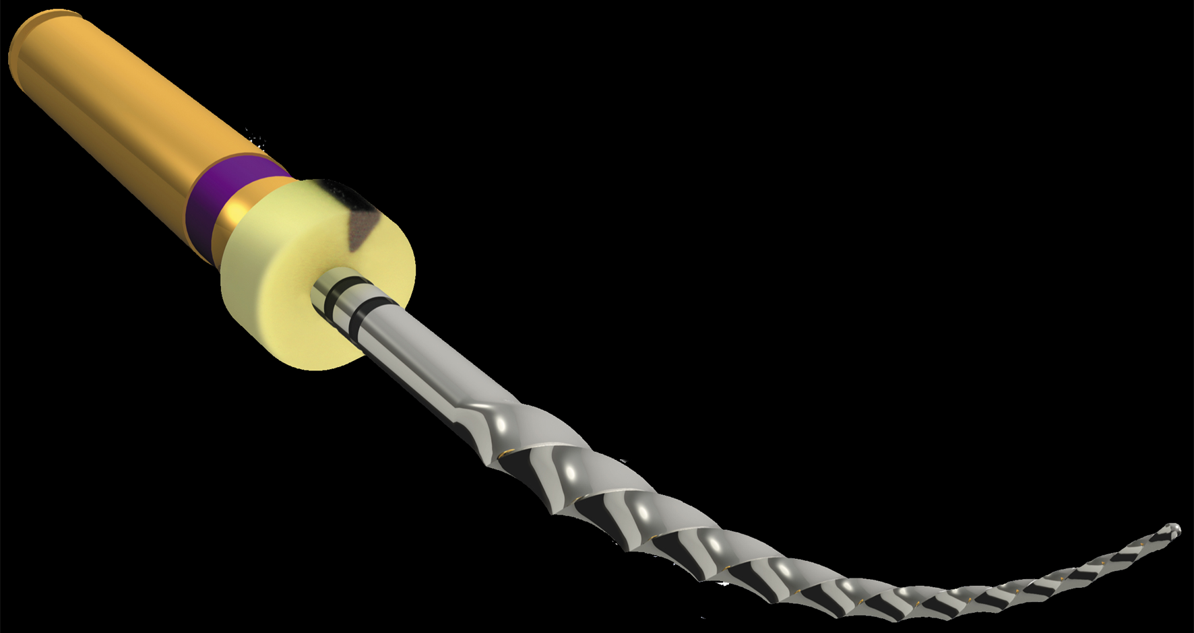
VARIABLE TAPERED INSTRUMENTS
Variable Taper:
Prevents screw-in effect
Allows increased apical tapers (Finishing Files)
Allows excellent shaping with few instruments

Slide 4
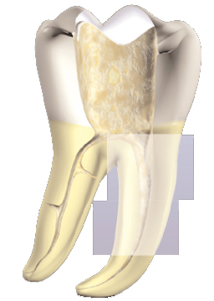
Shaping Files (S1 & S2 – Accessory Sx)
Shape the coronal and the middle third of the canal

Slide 5
Shaping Files
Variable Increasing Taper
(Eiffel Tower shape)
S2
S1
18
S2
20
Sx
19

Slide 6
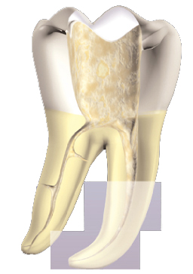
Finishing Files F1, F2, F3, F4, F5
Shape the Apical part of the canal

Slide 7
Finishing Files
(Variable Decreasing Taper)
F1
3mm
20-7%
F2
25-8%
F3
30-9%
F4
40-6%
F5
50-5%

Slide 8
ProTaper Universal
Flexibility
Fixed Taper
Flexibility
Resistance
Shaping Files
Finishing Files

Slide 9
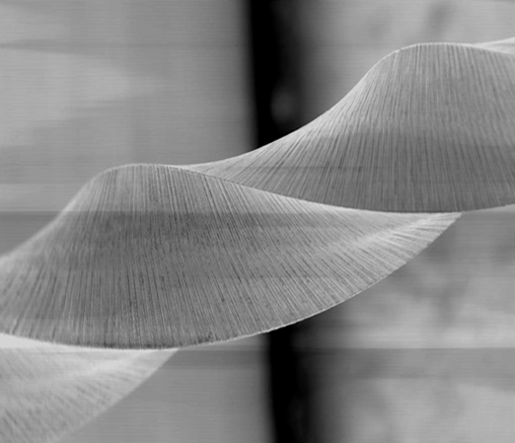
ProTaper Universal
Characteristics
Cutting blade (no radial land) : Efficiency

Slide 10
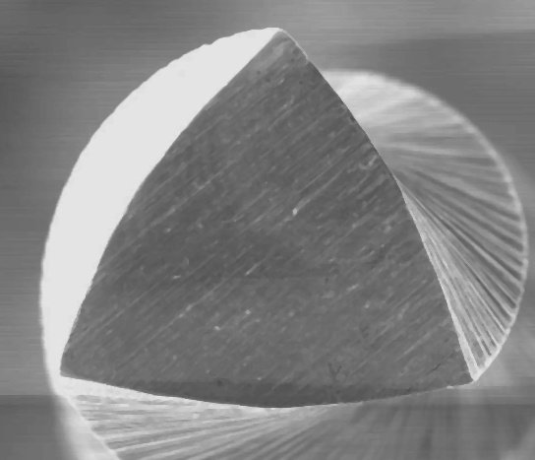
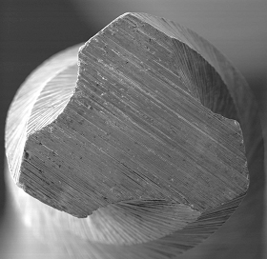
Characteristics
« Triangular » Cross-Section
Convexe : S1, S2, SX, F1, F2
Concave : F3, F4, F5
Triangular concave cross-section : Flexibility
Triangular convexe cross-section : Resistance

Slide 11
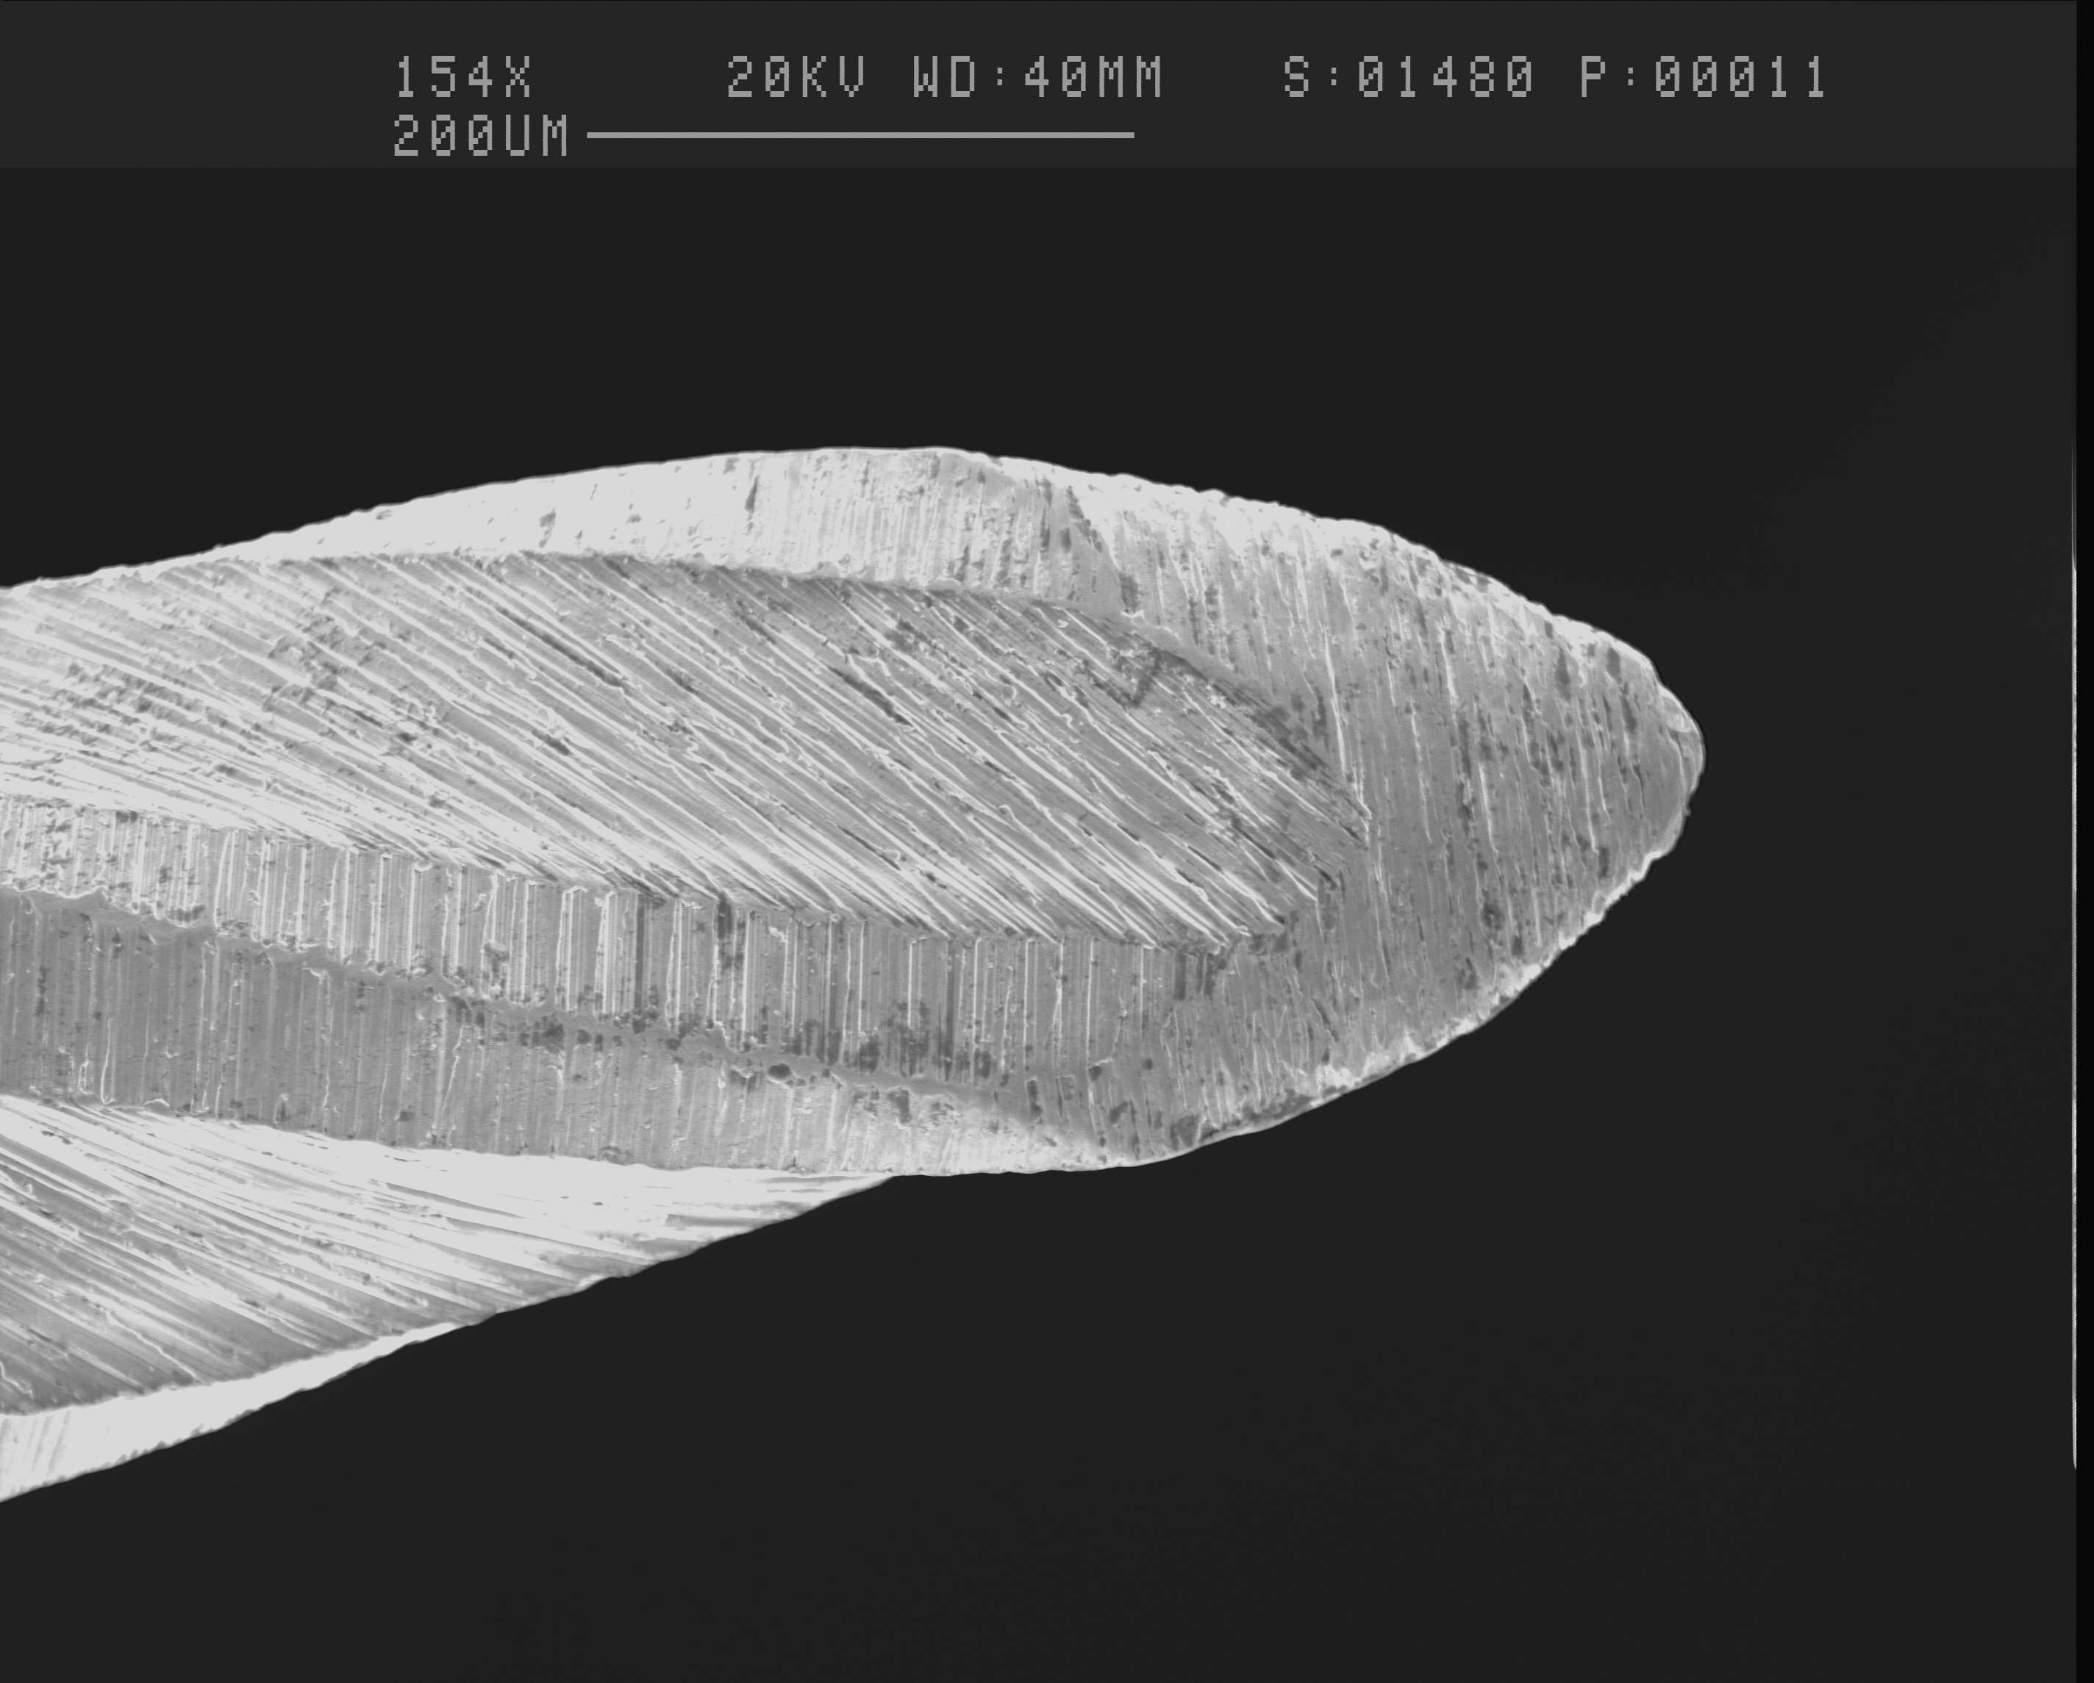
Characteristics
Safe non cutting tip : acts as a guide

Slide 12
SHAPING SX
(accessory)
19
For Relocating Canal Orifice
(only when needed)

Slide 13
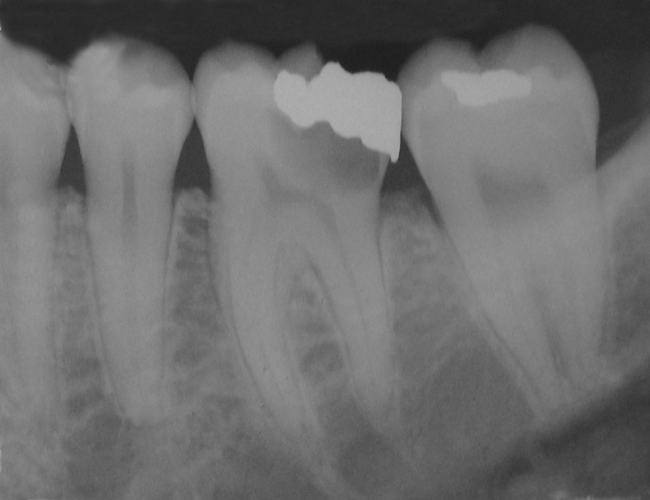
Sx is used with a brushing motion
to relocate
the orifice and insure a straight line access

Slide 14
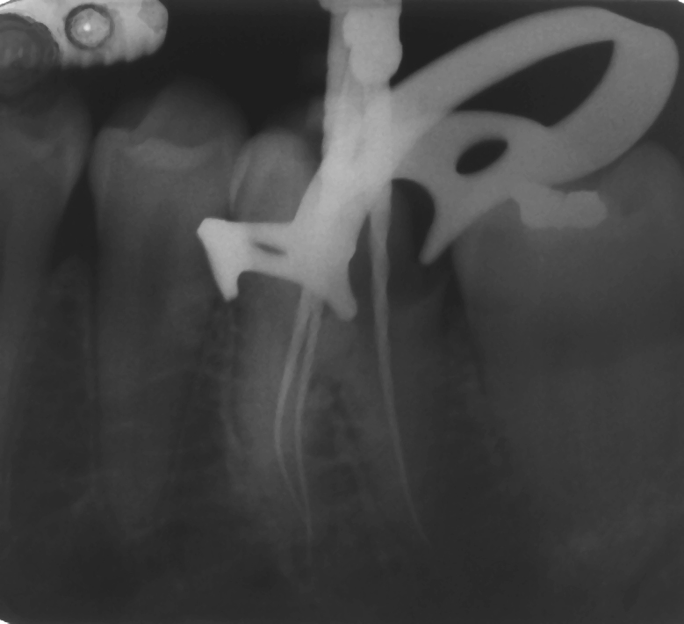
Dr. WJ Pertot

Slide 15
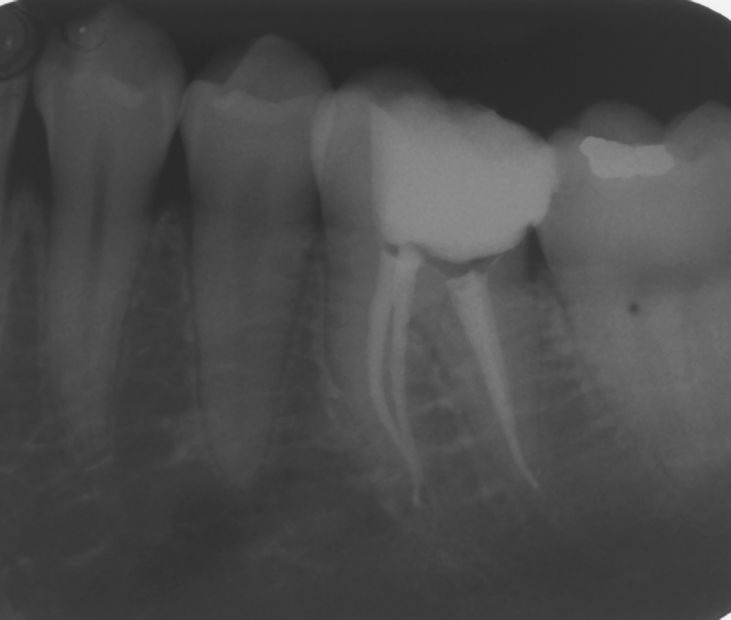
Dr. WJ Pertot

Slide 16
CONTINUING EDUCATION
CLINICAL EDUCATION
Treatment Sequence

Slide 17
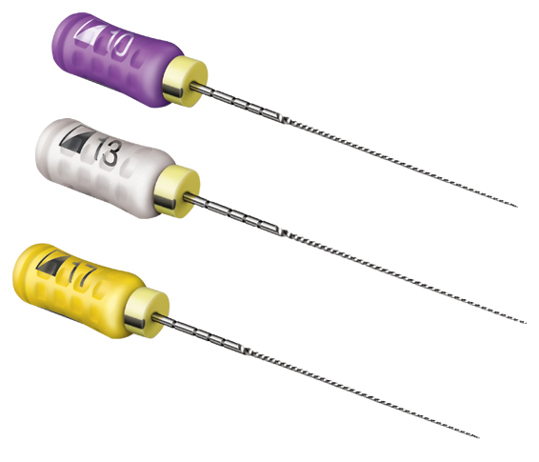
SCOUTING THE CANAL :
Stainless steel
K-File 008 or 010
Then hand instruments
to the level they are accepted in the canal.
Stainless steel
ProFinder Files 10,13,17
C+ File
08,10,15
Stainless steel
OR NiTi ROTARY INSTRUMENTS : Pathfiles

Slide 18
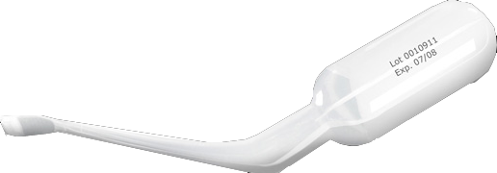
PathFile™ #013 to working length
PathFile™ #016 to working length
PathFile™ #019 to working length
NiTi Rotary
Establish WL before
The lubricating action of Glyde helps
the instruments to slide in the canal

Slide 19
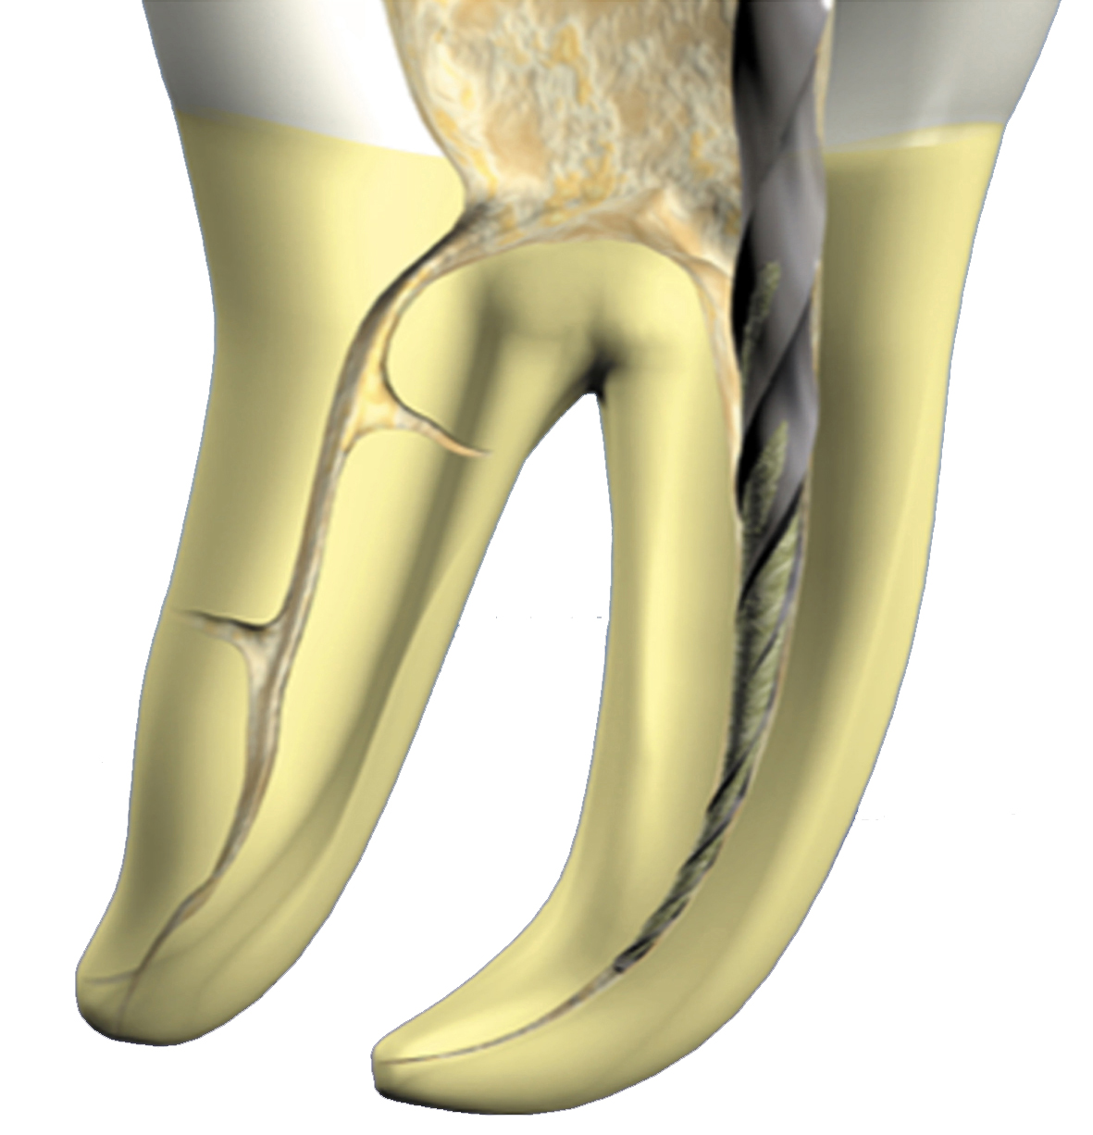
If needed, use SX with a brushing motion to relocate the orifice of the canal and create a straight line access
(don’t use Sx deep in the canal)

Slide 20
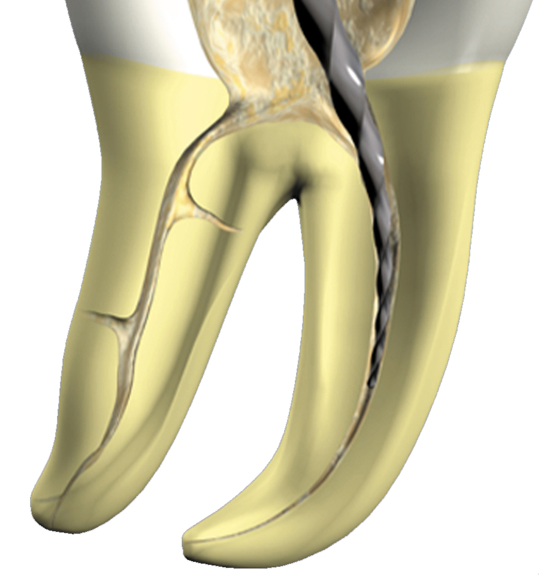
Use S1 with a brushing motion
and enlarge the canal, no deeper than the level of the penetration of the scouting file
(to make sure that the tip of S1
is never blocked)
Using Pathfile, go to working length that you established right before

Slide 21
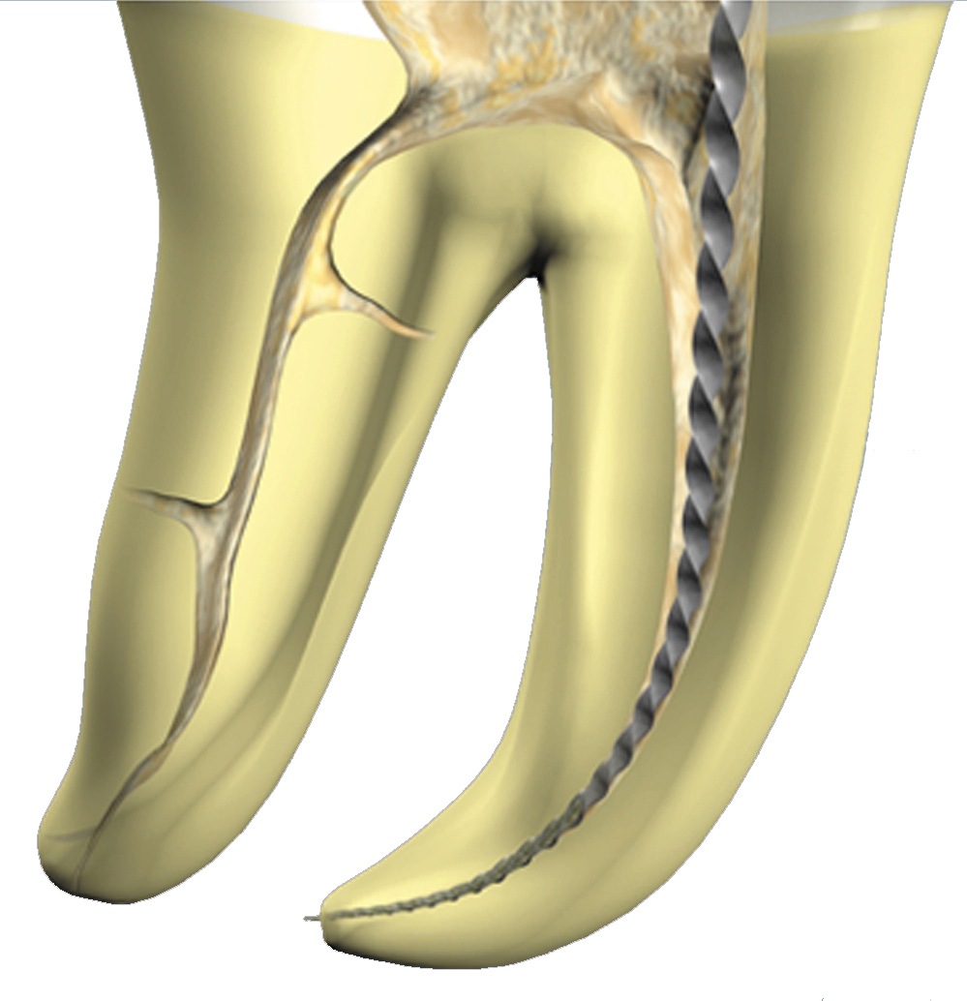
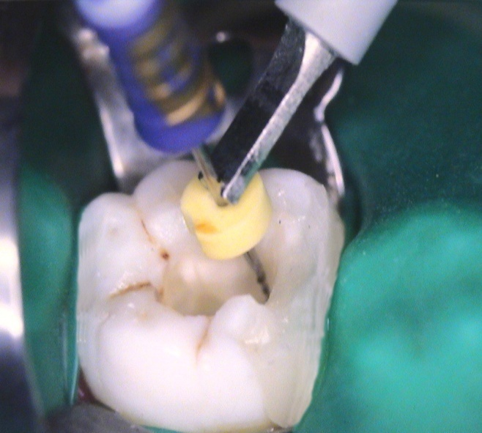
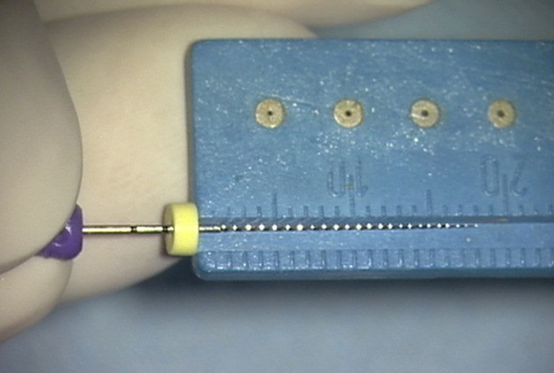
Determine WL
1
Apex Locator
2

Slide 22
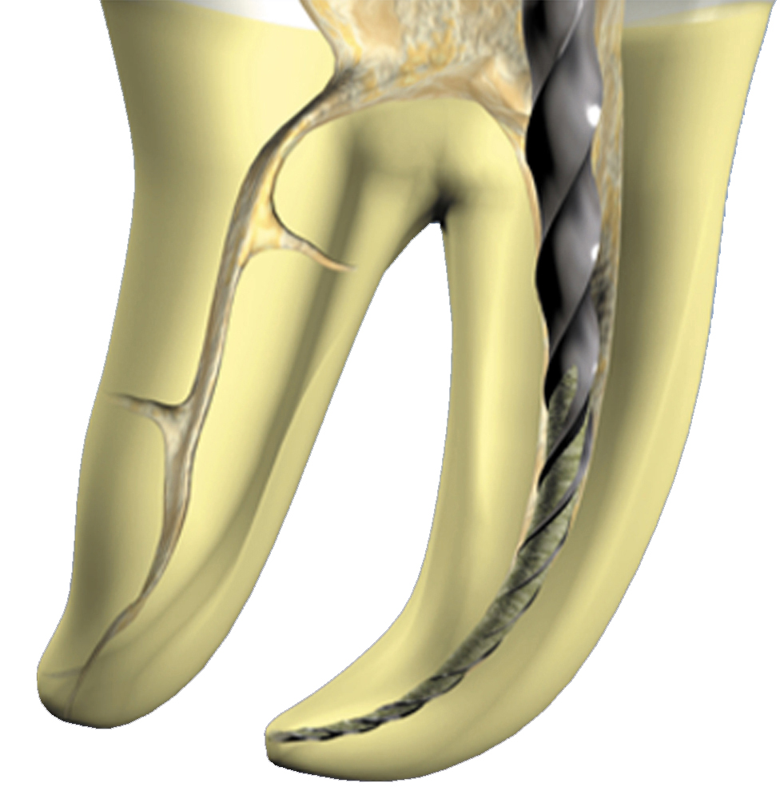
After going to length with a stainless steel file size 15, use :
S1 to working length
with a brushing motion.
Using Pathfile this step is skipped

Slide 23
When S1 reaches working length, use :
S2 to working length
with a brushing motion

Slide 24
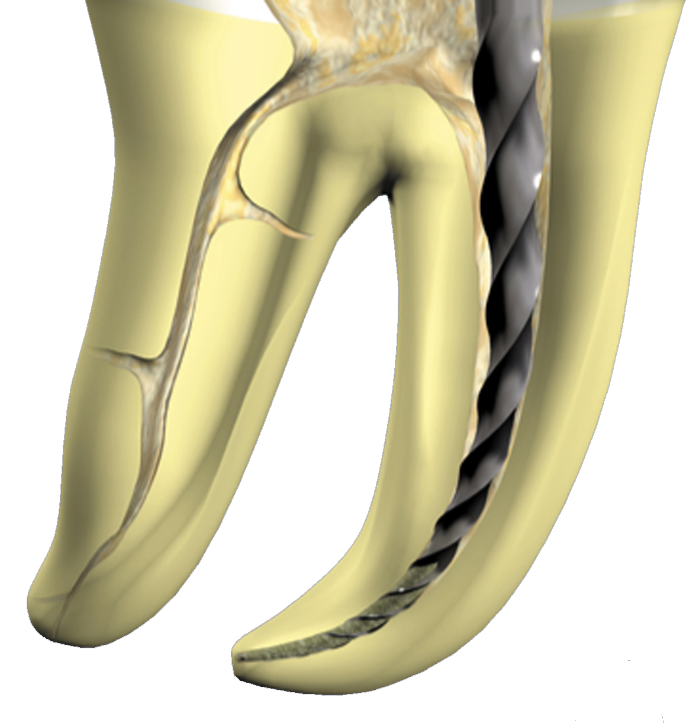
When S2 reaches working length, use :
F1 to working length.
CAUTION !
NEVER USE A BRUSHING ACTION
WITH THE FINISHING FILES !!!
When a finishing file reaches the working length,
It is immediately withdrawn.

Slide 25
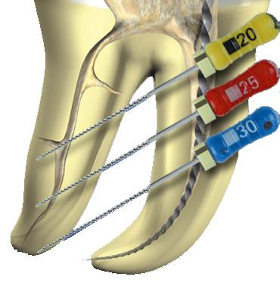
Gauge the diameter of the foramen with stainless steel files and if the foramen is larger than 20, use F2, F3, F4 or F5 to working length, according to the real apical diameter.
If Necessary
CAUTION !
NEVER USE A BRUSHING ACTION WITH THE FINISHING FILES !!!
When a finishing file reaches length, it is immediately withdrawn.

Slide 26
Rotary Instruments sequence
VIDEO

Slide 27
CONTINUING EDUCATION
CLINICAL EDUCATION
Treatment Sequence

Slide 28
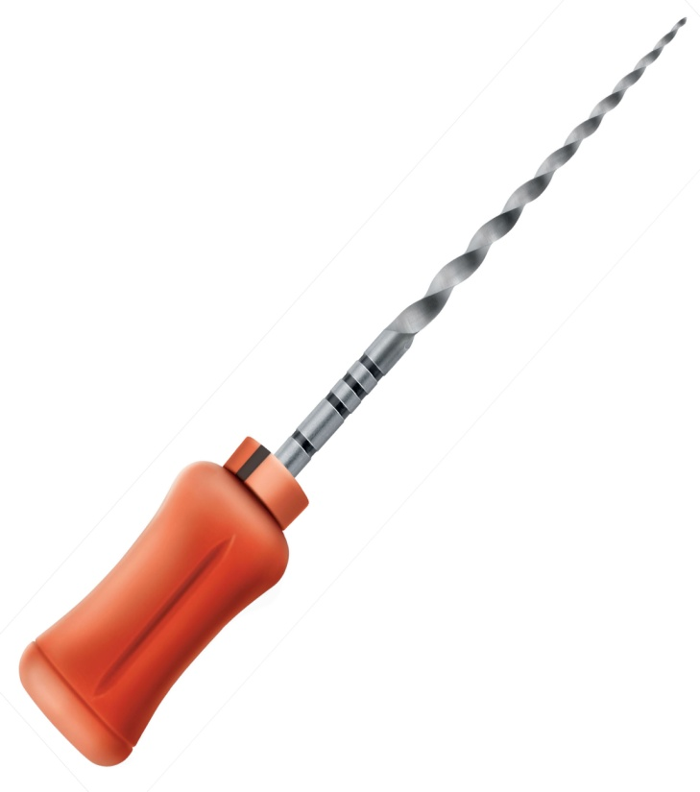
For Hand SS File Users
For NiTi Rotary Users
- Less Instruments - No Canal Transportation - Less Extruded Debris - Excellent Apical Taper
In Case of Contra Indication to Continuous Rotation. (Example : Apical Hooks, joined canals)

Slide 29
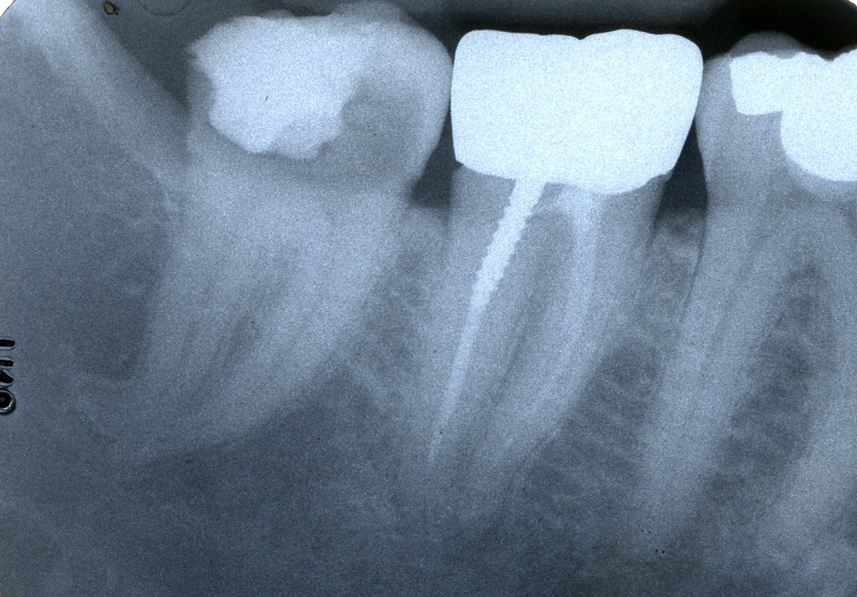
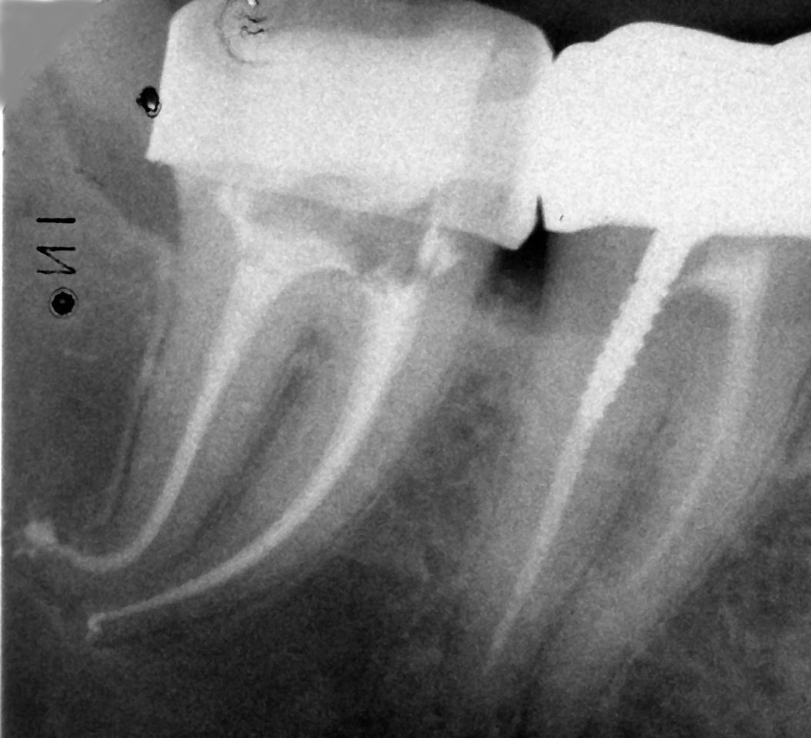
Dr. Ludovic Pommel

Slide 30
S1
18
S2
20
Sx
19

Slide 31
3mm
F1
20-7%
F2
25-8%
F3
30-9%
F4
40-6%
F5
50-5%

Slide 32
VIDEO
VIDEO

Slide 33
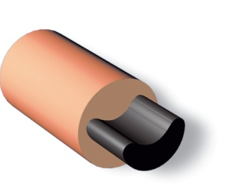
Core-Carrier (PP) - Gutta-Percha
Filling Technique

Slide 34
Obturators PROTAPER
Core-Carrier Gutta-Percha
Filling Technique
F1
F2
F3
F4
F5

Slide 35
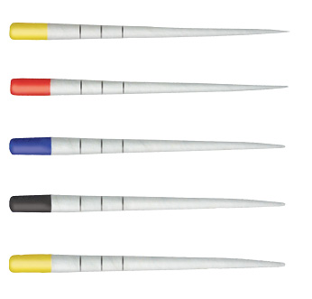
Finishing Files (Apical shape)
Calibrated Gutta-Percha Cones
F1
F2
F3
F4
F5
Sterile Paper Points
Obturators - Protaper sizes
F1
F2
F3
F4
F5
Paper points - Protaper sizes

Slide 36
ProTaper Obturator calibrated
to each Finishing File
F2
F1
F2
F3
F4
F5

Slide 37
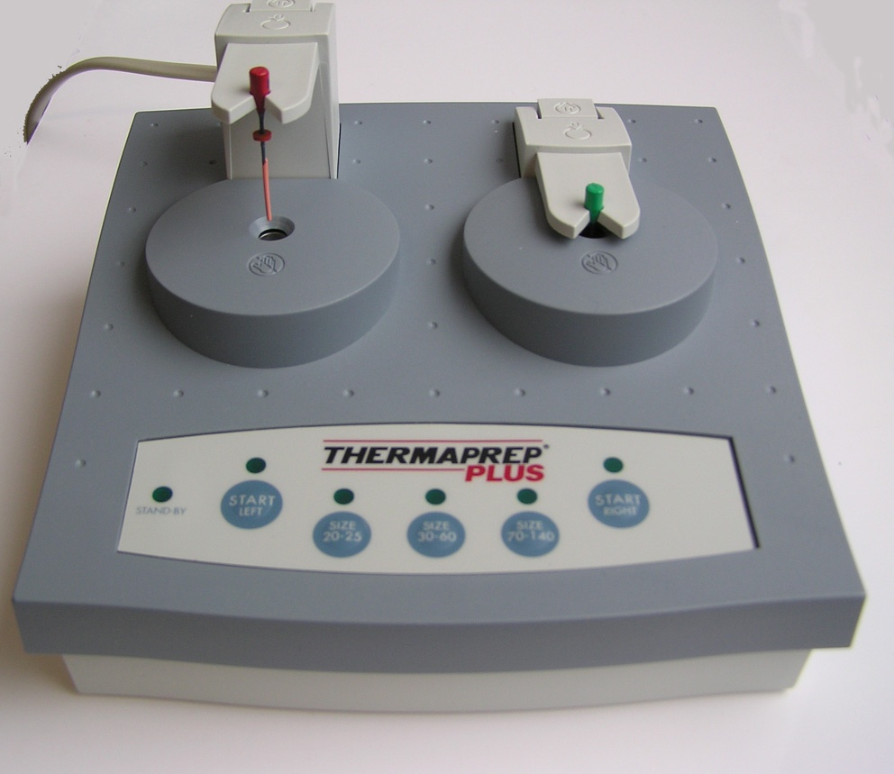
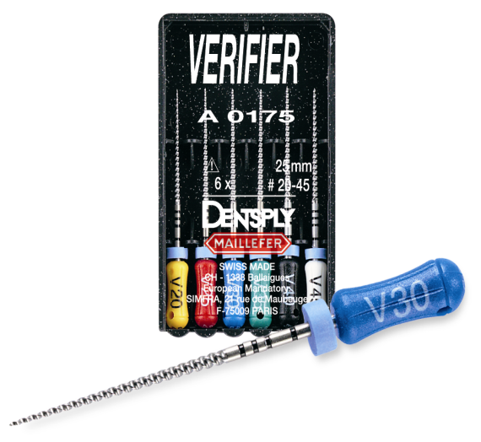
3D Filling of the Root-Canal System with
THERMAFIL
Or
PROTAPER OBTURATOR
Thermaprep Oven
Thermacut bur
Size verifier to measure the apical size
Post space bur

Slide 38
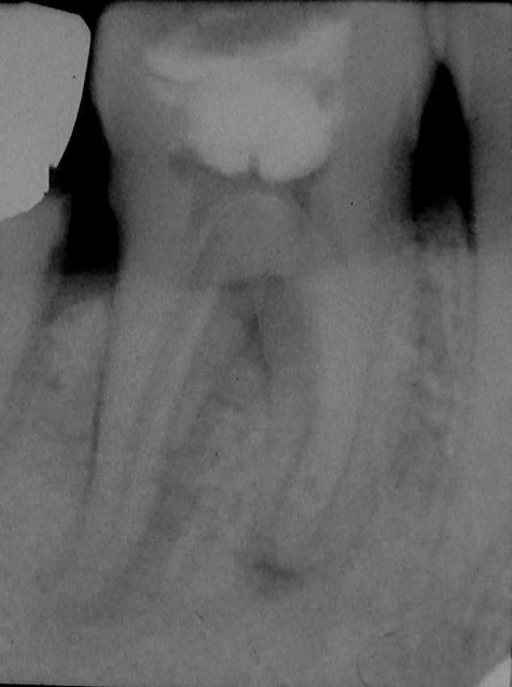
Core-Carrier Obturator Technique
1st step :
Opening
cleaning
Shaping …

Slide 39
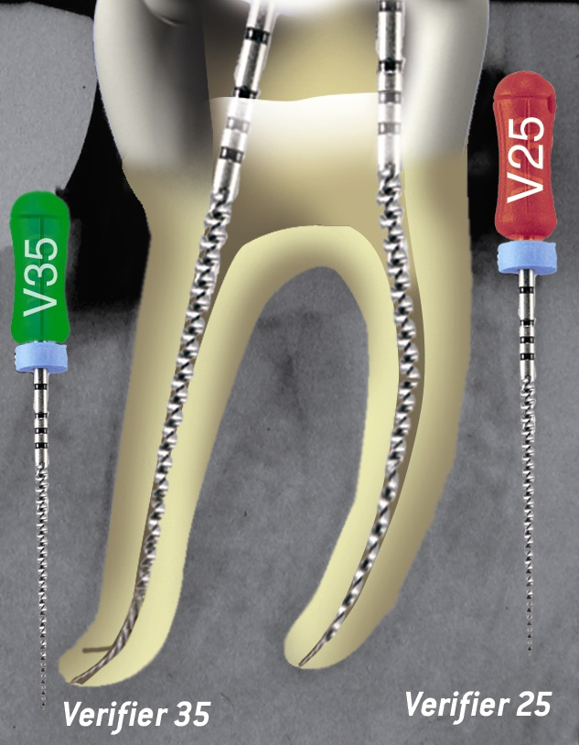
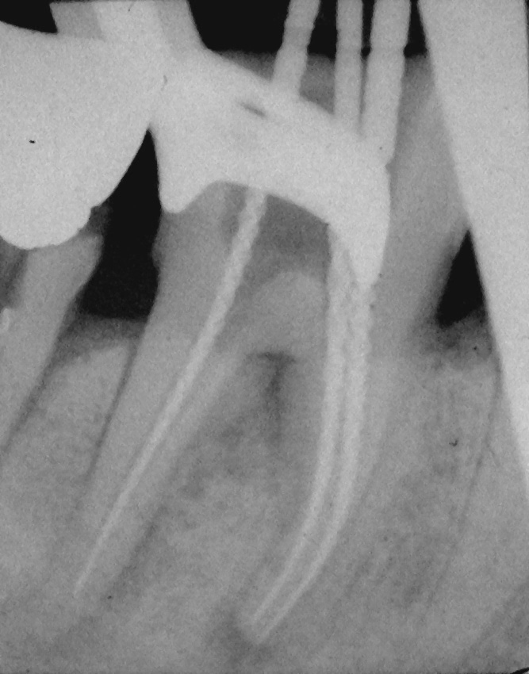
Gauge the Canal with Verifiers, which should snug within 0,5mm form Working Length

Slide 40
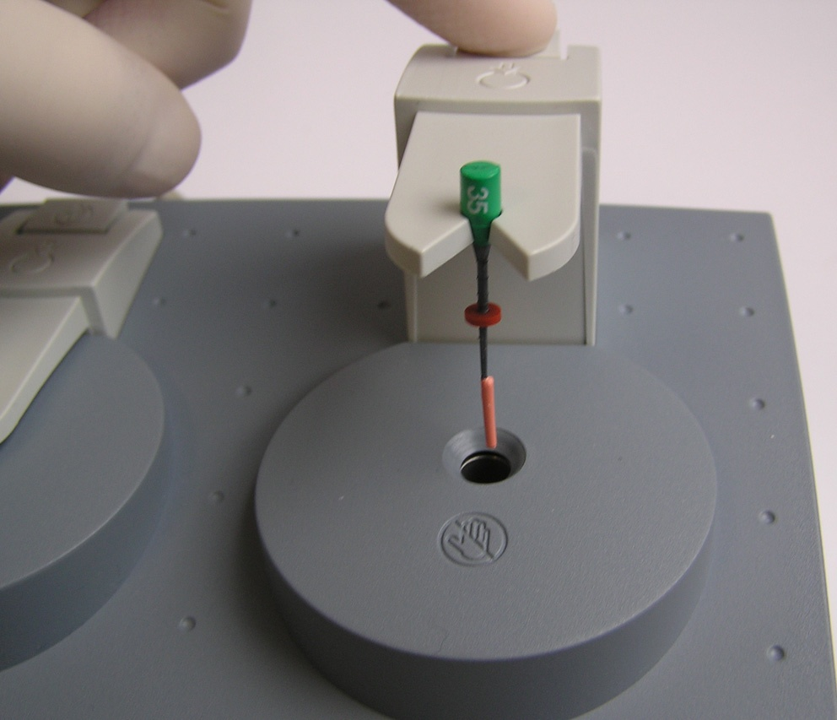
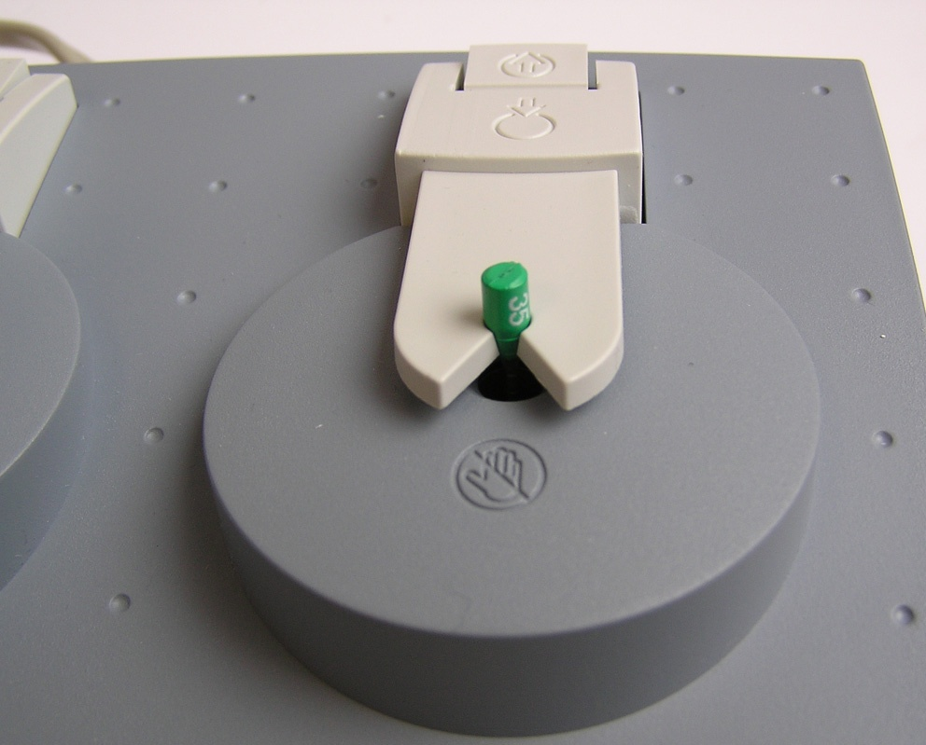
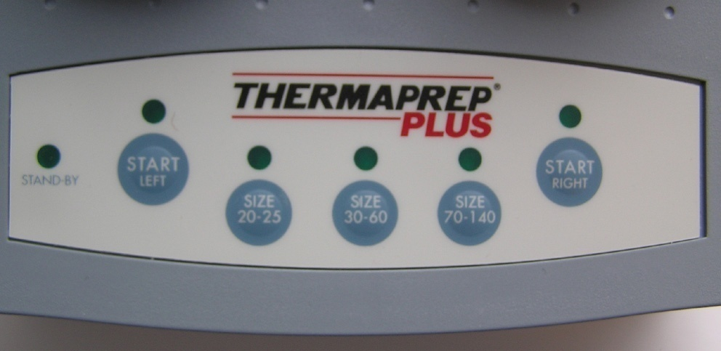
Place the Obturators
1
2
Heat The Obturator
3
Select the right size and start

Slide 41
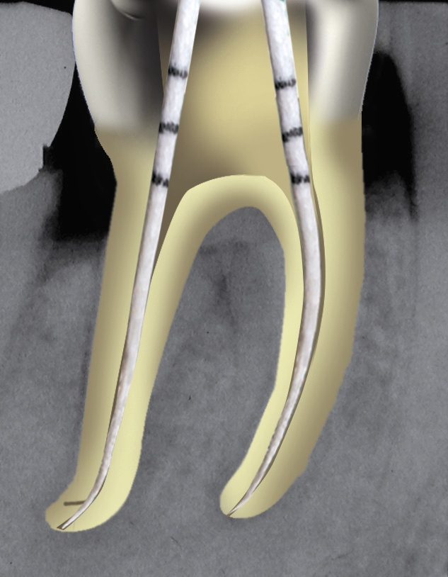
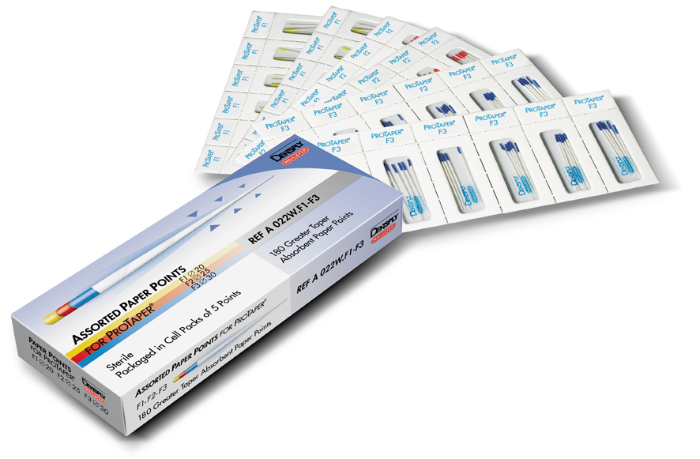
Dry the Canals with Sterile Paper Points

Slide 42
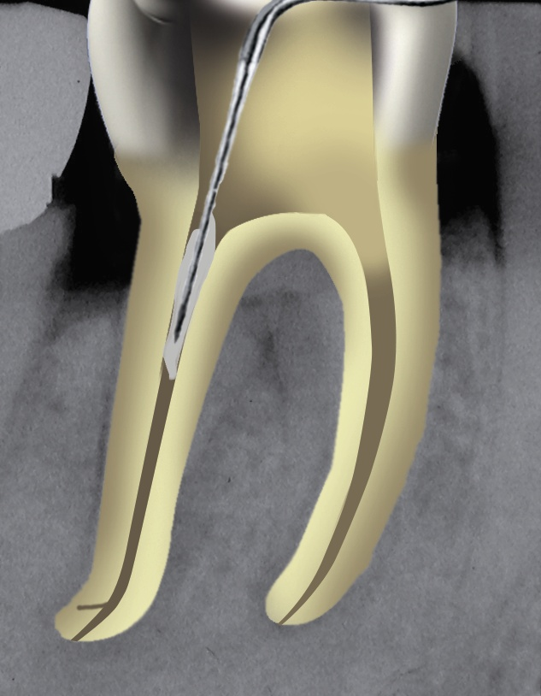
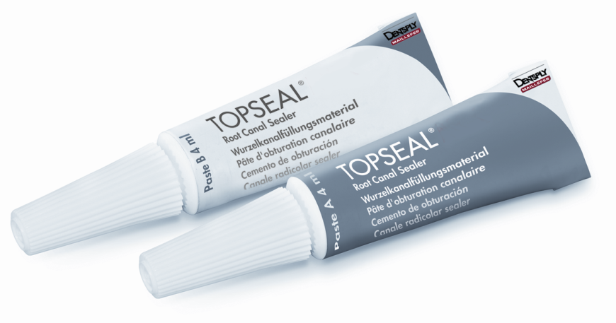
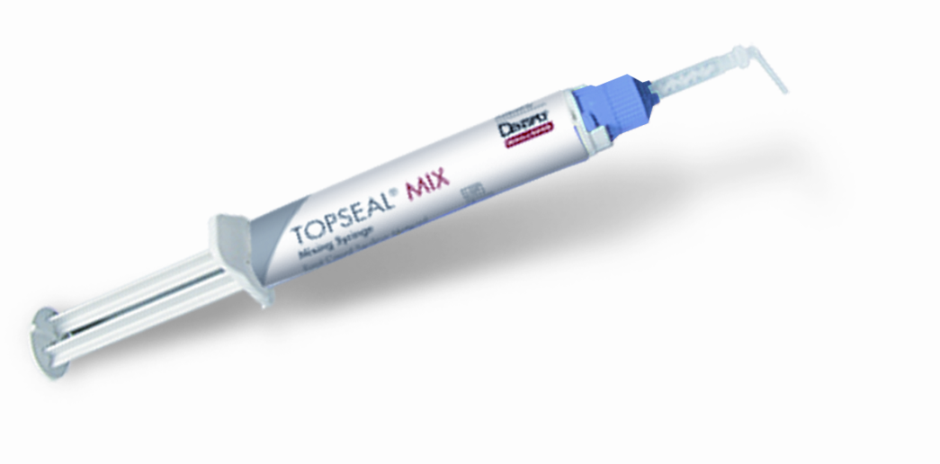
Mix the Sealer and coat thewalls of the canal with a thin layer using a Probe or a paper point
Topseal MIX

Slide 43
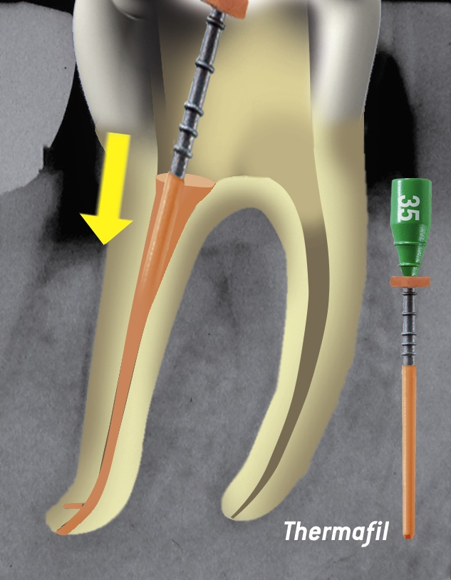
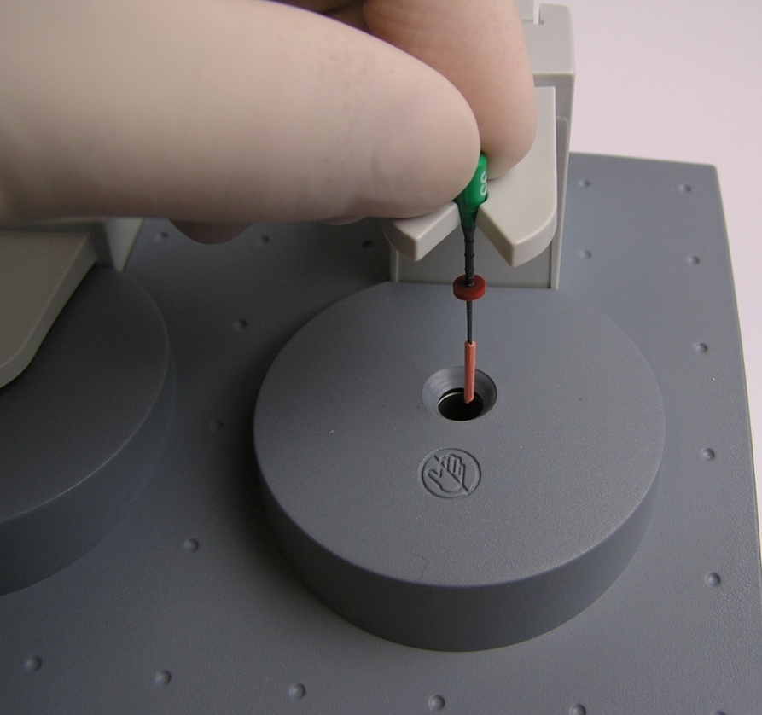
1
3
Take it out
and insert it in the canal
2

Slide 44
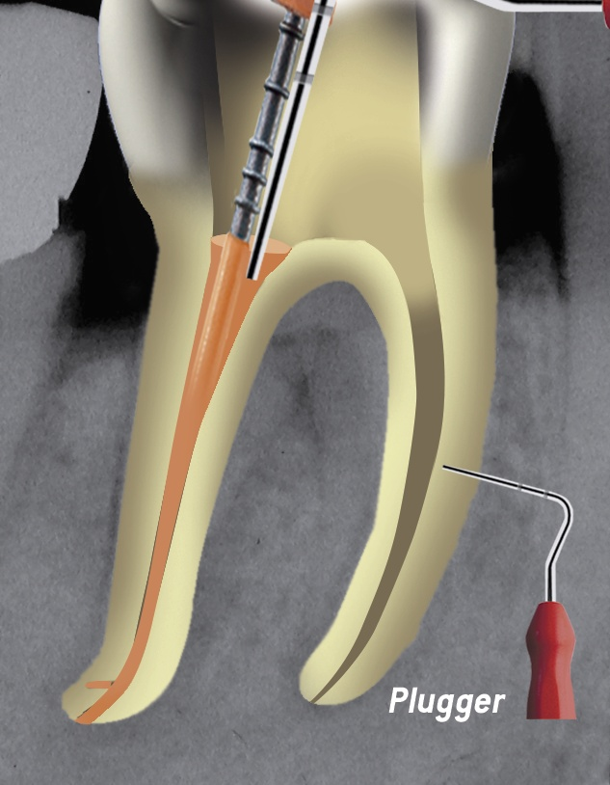
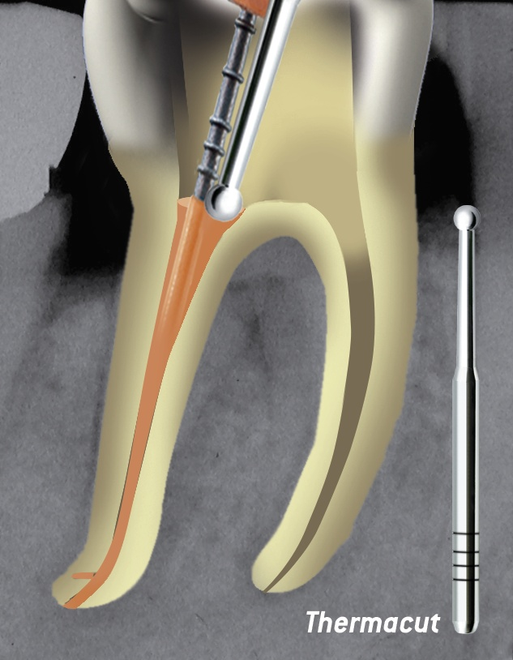

Slide 45
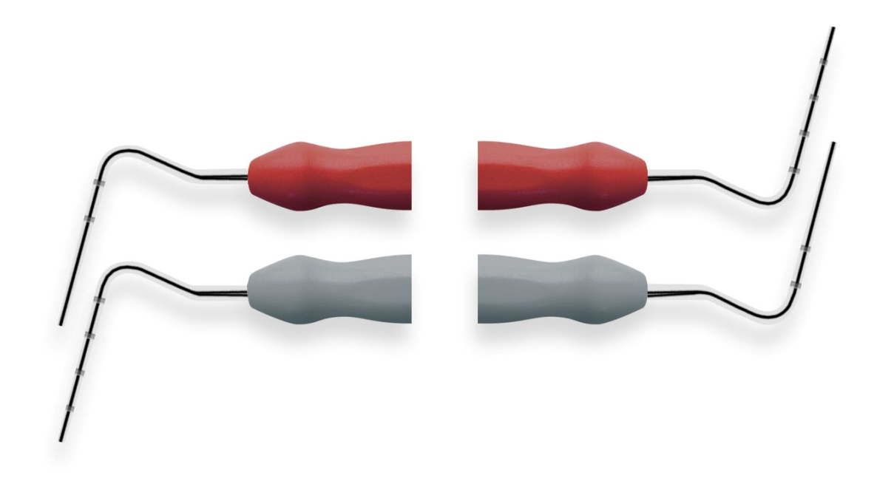
Use of a selected Plugger to ensure homogeneity of the filling.
0,6
Plugger Dr P.Machtou
1.0
Plugger Dr. Schilder
0.5
0,8
Heat Carrier
Plugger

Slide 46
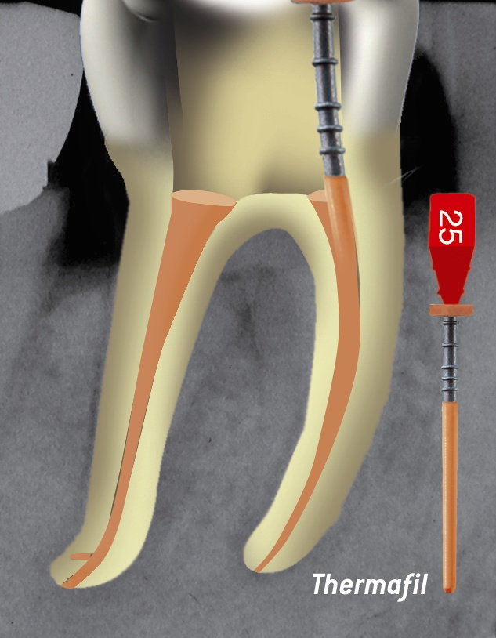
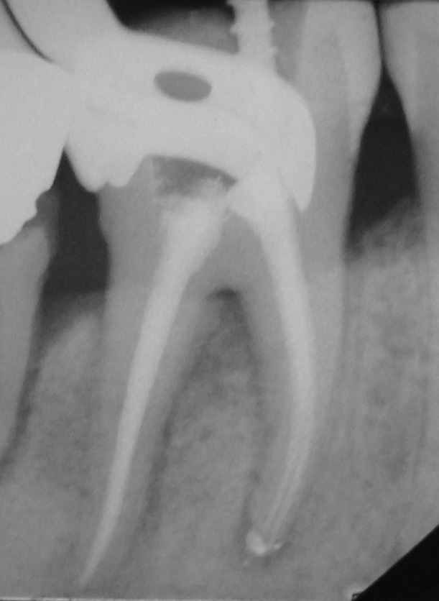

Slide 47
