Slide 1
Respiration under various
(physiological) condition

Slide 2
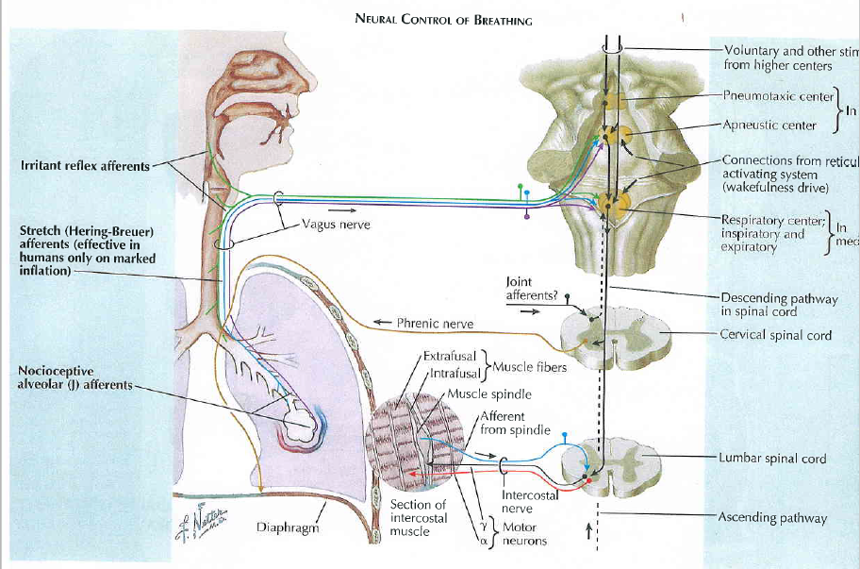
The Netter Collection of Medical Illustration, vol.3,
Respiratory Physiology, 2011.

Slide 3
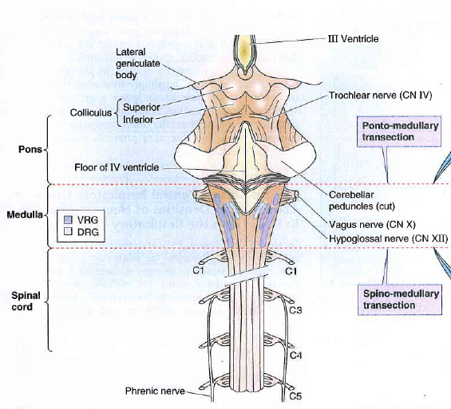
Boron, Boulpaep, Medical Physiology, 2003.

Slide 4
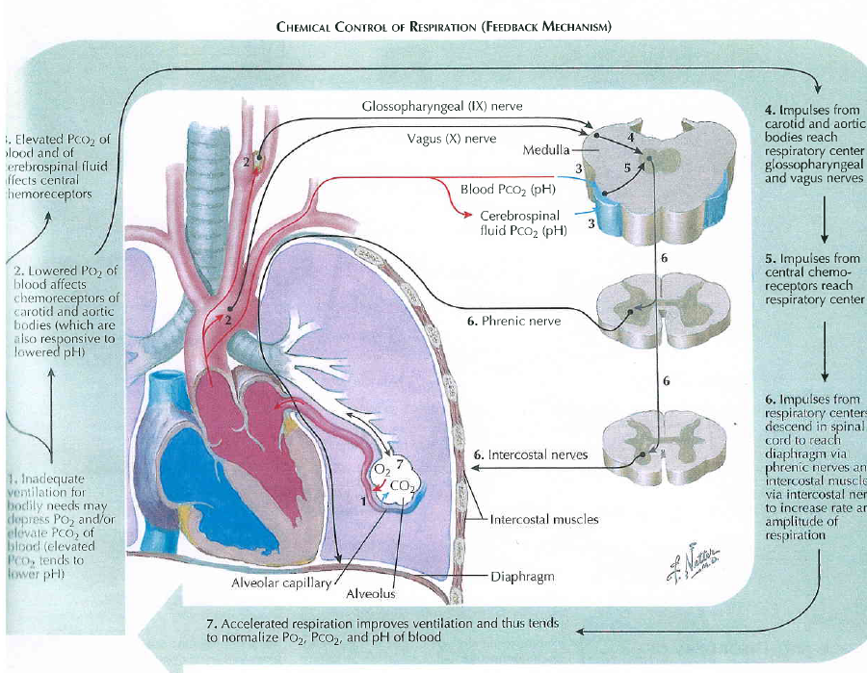
The Netter Collection of Medical Illustration, vol.3,
Respiratory Physiology, 2011.

Slide 5
Modulation of respiratory output
Major parameters for feedback control – classical gases:pO2, pCO2, pH
In additin to these, the respiratory system receives input from two other major sources:
1. variety of stretch and chemical/irritant receptors that monitor the size of airways and the presence of noxious agents receptors in respiratory system
2. Higher CNS centers that modulate respiratory activity for the sake of nonrespiratory activities
Irritants receptors on mucose of respiratory system – rapidly adapting
Stimulus: agens - chemical substances (histamin, serotonin, prostaglandins, ammonia, cigarette smoke).
Respons: increase mucus secretion, constriction of larynx and brochus
C-fibre receptors (juxtacapillary=J receptors)– free nerve ending of n.vagus (unmyelinated axon) in intersticium of bronchus and alveolus;
Stimulus: Mechanical irritans (pulmonary hypertension, pulmonary oedema)+chemical
Response: hypopnoe, rapid shallow breathing, bronchoconstriction, cough
Stretch receptors slowly adapting (mechanoreceptors in tracheobronchial tree that detect the changes in lung volume by sensing the stretch receptors of the airway wall), inform to brain about the lung volume to optimize respiratory; its irritants triggered decrese activity of respiratory centre – Hering-Breuer´s reflexes. (protecting the lungs from overinflation/deflation)

Slide 6
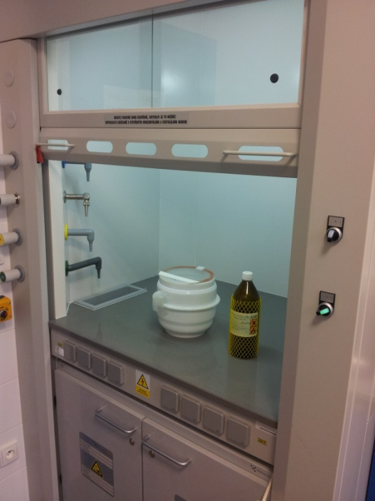
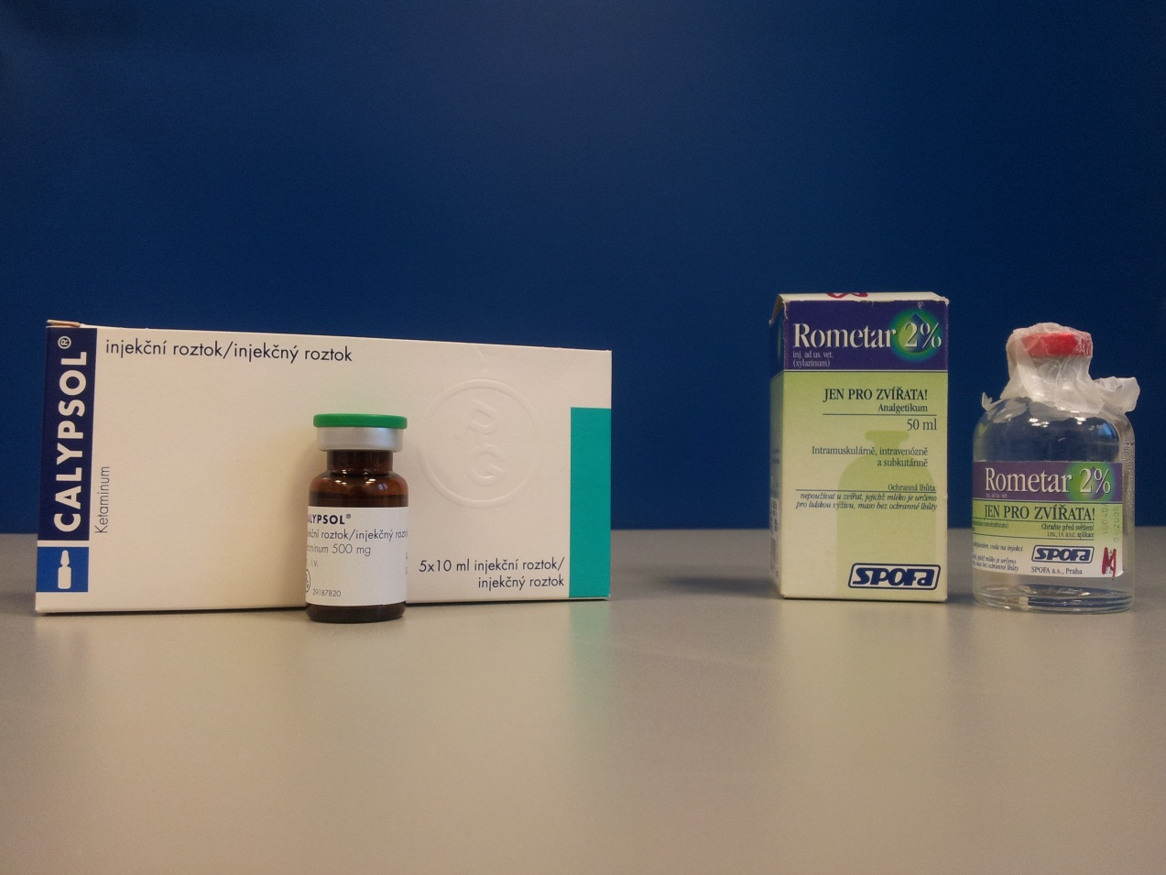
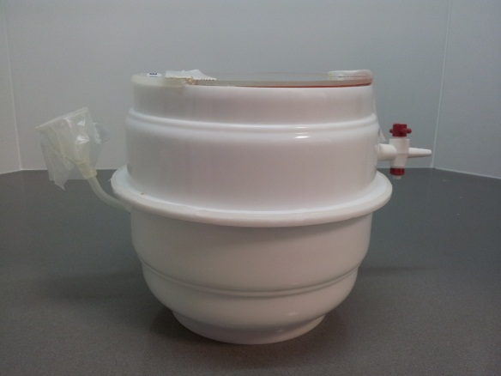
6

Slide 7
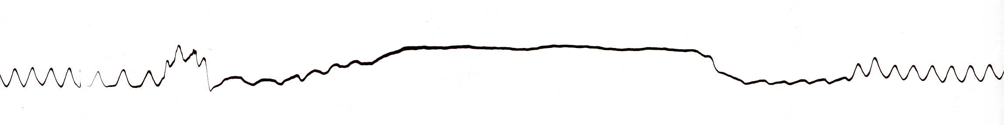
HERING-BREUER REFLEX
Reflex STOP BREATHING
Artefakts
Artefakts
7

Slide 8
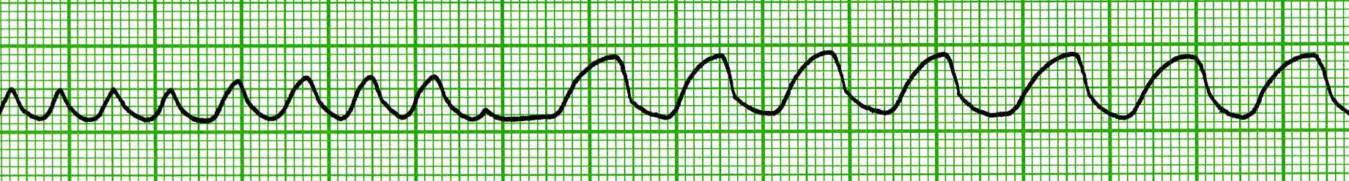
VAGOTOMY
inspirium
exspirium
One-side VAGOTOMY
Both-side VAGOTOMY
8

Slide 9
Periodic breathing
(period of apnea followed again by a few breaths)
CHEYNE-STOKES
BIOT‘S
„gasping“
KUSSMAUL

Slide 10
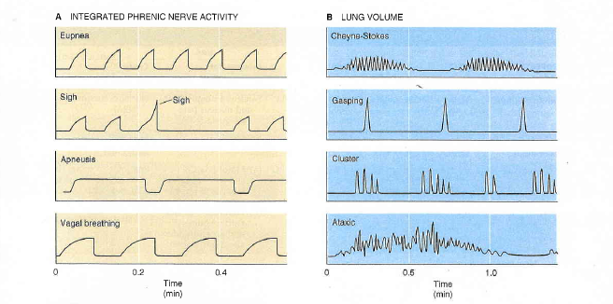
Boron, Boulpaep, Medical Physiology, 2003.

Slide 11
The respiratory pattern can become abnormal for a variety of reasons. Several of these abnormal patterns have recognizable characteristics:
Apnea – cessation of respiration
Eupnea – normal breathing
Tachypnea – an increase in respiratory rate
Apneusis (inspiratory) – prolonged inspirations separated by brief expirations
Ataxic breathing – highly irregular inspirations,often separated by long periods of apnea. Ussualy seen with medullary lesions.
Biot breathing – first describe in patients with meningitis by Biot (in 1876) - with breaths of nearly equal volume separated by periods of apnea

Slide 12
Cheyne – Stokes respiration –a benign respiratory pattern. Cycles of a gradual increase in tidal volume, followed by gradual decrease of tidal volume, and than a period of apnea. Seen a bilateral cortical disease or congestive heart failure, or in healthy people during sleep at high altitude
Cluster breathing - groups of breaths, often of differing amplitude, separated by long periods of apnea
Gasping – maximal, brief inspiratory efforts separated by long periods of expiration. Seen in severe anoxia, as well as a terminal, agonal breathing pattern in patients with brainstem lesions

Slide 13
Hyperventilation – an increase of ventilation that decreases arterial pCO₂. Seen in pregnancy, panic attacks, metabolic acidosis.
Kussmaul breathing refers as extremely deep, rapid breathing seen with metabolic acidosis, such as in diabetic ketoacidosis
Sighs – larger than normal breaths than occur automatically at regular intervals in normal subjects
Vagal breathing- slow, deep inspirations caused by interruption of vagus nerve input to the brain stem
Yawn – an exaggerated sigh

Slide 14
Hypoxia, hypoxemia
11-16 kPa
Hypoxia is a general name for a lack of oxygen in the body or individual tissues.
Hypoxemia is lack of oxygen in arterial blood.
Complete lack of oxygen is known as anoxia.
The most common types of hypoxia:
Hypoxic - physiological: stay at higher altitudes, pathological: hypoventilation during lung or neuromuscular diseases
Transport (anemic) - reduced transport capacity of blood for oxygen (anemia, blood loss, CO poisoning)
Ischemic (stagnation) - restricted blood flow to tissue (heart failure, shock states, obstruction of an artery)
Histotoxic - cells are unable to utilize oxygen (cyanide poisoning - damage to the respiratory chain)

Slide 15
Hypercapnia
5.3-6.65 kPa
Hypercapnia - increase of concentration of carbon dioxide in the blood or in tissues that is caused by retention of CO₂ in the body
possible causes: total alveolar hypoventilation (decreased respiration or extension of dead space)
mild hypercapnia (5 -7 kPa) causes stimulation of the respiratory center (therapeutic use: pneumoxid = mixture of oxygen + 2-5% CO₂)
hypercapnia around 10 kPa - CO₂ narcosis - respiratory depression (preceded by headache, confusion, disorientation, a feeling of breathlessness)
hypercapnia over 12 kPa - significant respiratory depression - coma and death.

Slide 16
Cough reflex - defense mechanism
A cough reflex plays important role in ridding the tracheobronchioal tree of inhaled foreign substances
Mechanosensitive and irritants receptors in the larynx can trigger either coughing or apnea
The tickling sensation that is relieved by a cough is analogous to the cutaneous itch, and its probabaly mediated by
C-fiber receptors. Thus, a cough is a respiratory scratch.
When lower airway receptors trigger a cough, it begins with a small inspiration that increases the coughing force.
Than laryngeal receptors trigger the cough, inspiration is absent, minimizing the chances that offending foreign body
will be forced lower into the lungs. A forced expiratory effort against a closed glottis raises intrathoracic
and intraabdominal pressures to very high levels. The glottis than opens suddenly. And the pressure inside the larynx
falls almost instantaneously to near-atmospheric levels

Slide 17
Sneeze
Sensors in the nose detect irritants and can evoke a sneeze.
Notice: the same receptors are probably also responsible for apnea in response to water applied to the face or nose,
which is part of the diving reflex that evolved in diving mammals such as the seal prevent aspiration during submersion.
A sneeze differs from a cough in that is almost always preceded by a deep inspiration.
Like as cough, a sneeze involves an initial buildup of intrathoracic pressure behind a closed glottis. Unlike a cough,
sneeze involves pharyngeal constriction during the builup phase, and an explosive forced expiration vie the nose, as
well as the mouth.
The effect is to dislodge foreign bodies from the nasal mucosa.

Slide 18
Sleep
Or even closing ones eyes, has powerful effects on the breathing pattern and CO2 responsiveness.
During non-rapid eye movements sleep – there is an increase in the regularity of eupneic breathing;
Also, the sensitivity of the respiratoey system to CO2 decreasees compared with wakefulness, and
The outflow to the muscles of the pharynx decreases.
During rapid eye movements sleep – there is further decrease in the sensitivity of the respiratory system to CO2,
but now the pattern of breathing becomes markedly irregular, sometimes with no discernible rhythm.
The results is that CO2 levels often increase during NREM sleep, and usually even more so during REM sleep
Sleep apnea
The collection of disorders in which ventilation ceases during deeper stages of sleep, particularly during REM sleep,
is known as sleep apnea.
The symptoms are loud snoring, morning headache, fatique, daytime sleepiness
Some cases due to a lack of central drive – central sleep apnea. However most cases
are due to collapse of the airway with sleep - obstructive sleep apnea, usually in obese people

Slide 19
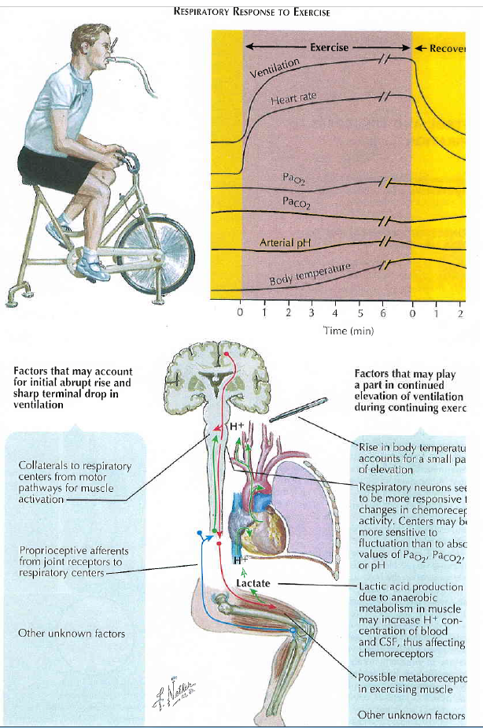
The Netter Collection of Medical Illustration, vol.3,
Respiratory Physiology, 2011.

