Slide 1
Numerals in Anatomical terms

Slide 2
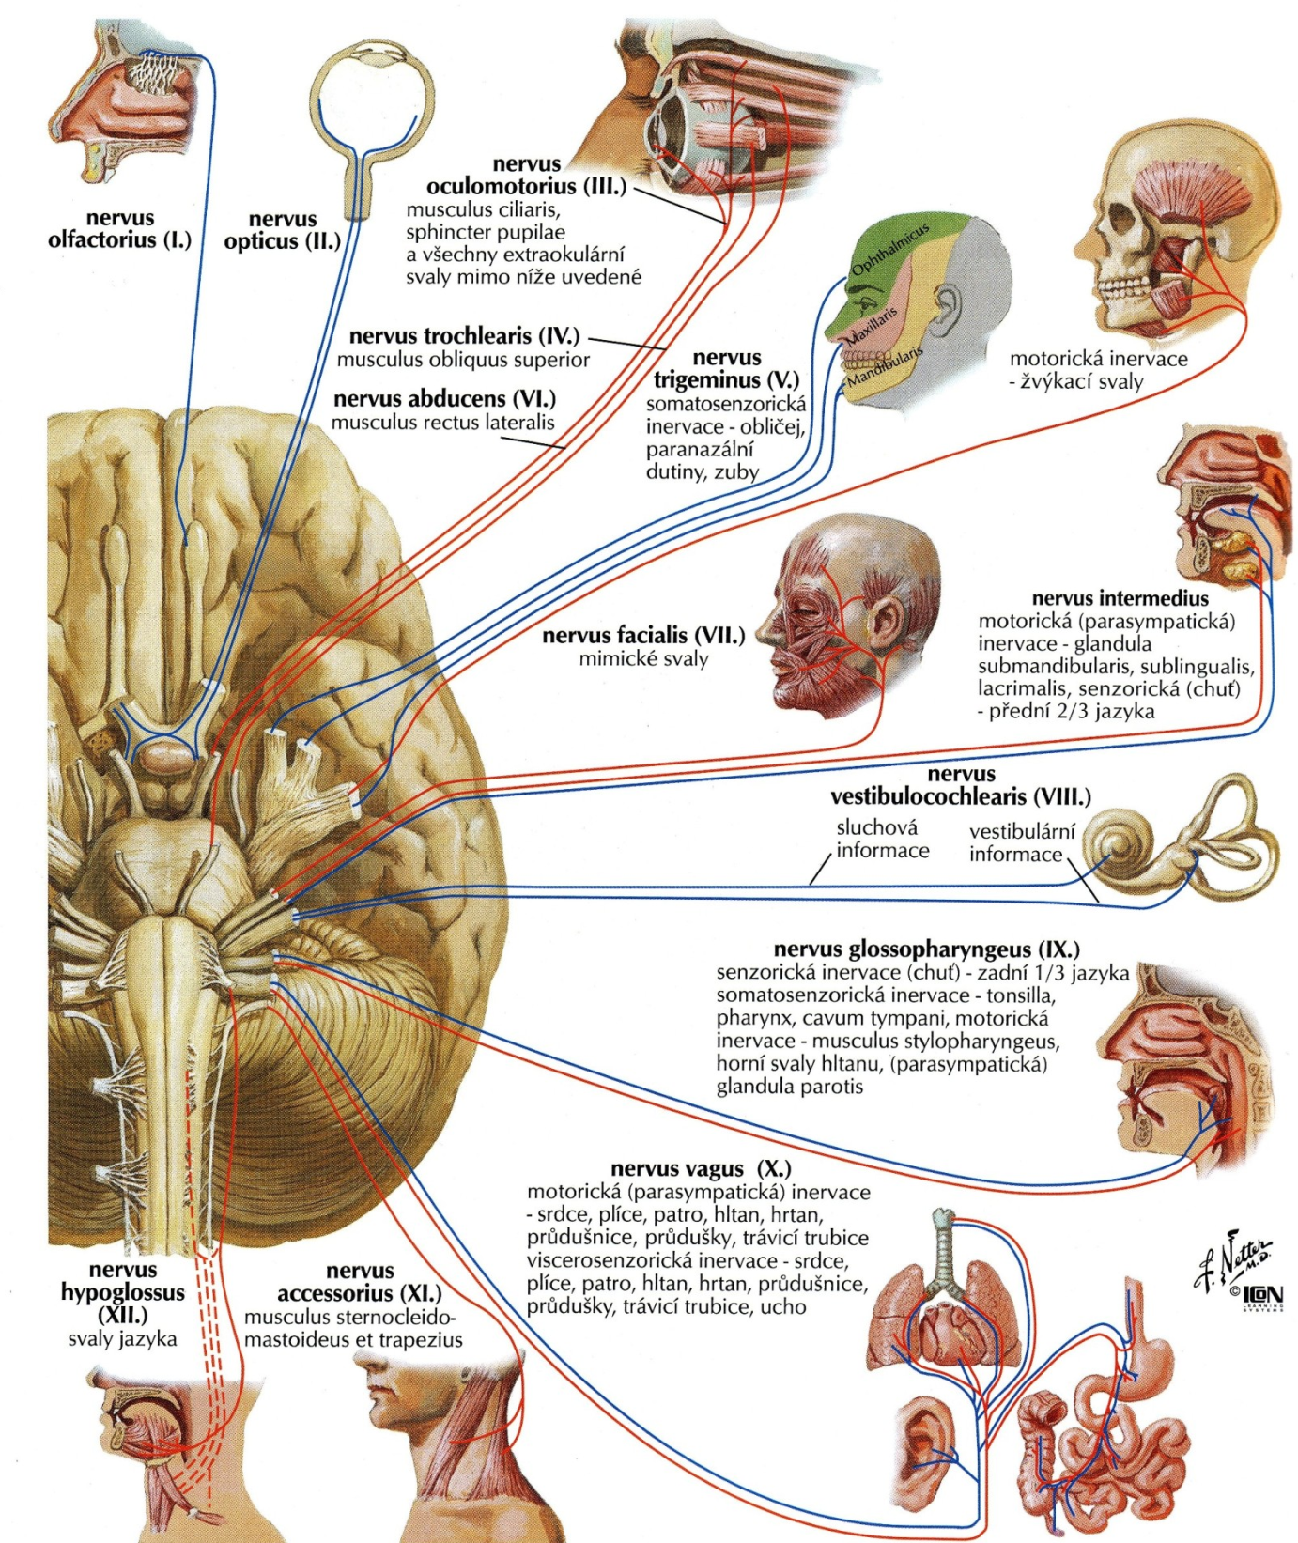
Give ordinal numerals
to the cranial nerves:

Slide 3
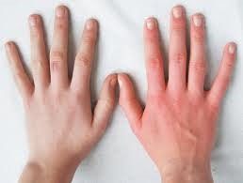
Fill in missing terms to name fingers; connect them with the clinical term vulnus scissum:
Digitus primus seu _________________________
Digitus _________________________ seu index
Digitus tertius seu _________________________
Digitus quartus seu _________________________
Digitus _________________________ seu minimus

Slide 4
Write down diagnoses for anomalies of vertebrae:
Anomalia ________________

Slide 5
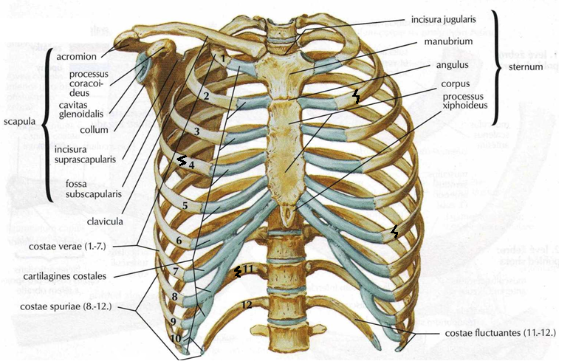
Write down diagnoses for fractures of ribs:
Fractura _____________________________

Slide 6
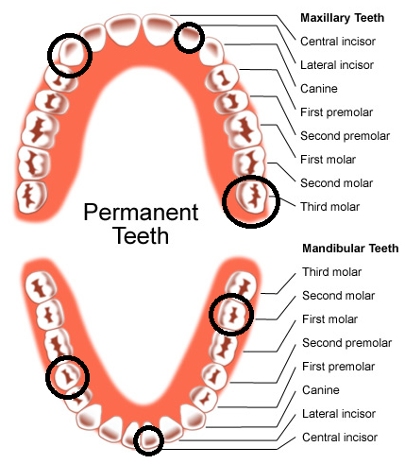
Write down diagnoses for extraction of teeth. Specify their exact position in the oral cavity with the use of adjectives right/left and upper/lower:
Extractio _______________________________________

Slide 7
Numerals in clinical terms

Slide 8
Ordinal numerals
Insufficientia renalis chronica gr. IV.
Decubitus regionis ossis sacri et calcanei l. sin. gr. II.
St. p. amputationem pollicis et digiti III. manus l. dx. traumaticam
Gangraena digiti IV. et V. pedis l. sin.
St. p. fracturam vertebrae Th12 compressivam
St. p. fracturam costae l. sin. IV., V., VI. et VII. ante dies XII

Slide 9
Multiple numerals
St. p. hysterectomiam abdominalem simplicem anno 2012/05
Pelvis renis l. dx. et ureter l. dx duplex
Tumor lobi superioris pulmonis l. sin. triplex
Metastases hepatis multiplices susp.

Slide 10
Numeral adverbs
Funiculus umbilicalis circum collum fetus 1x/2x/3x in grav. hebd. 40+4

