Slide 1
Compound words in medical terminology


Slide 2
BASIC RULES OF COMPOUNDING
DERIVATED WORDS BASIC ELEMENTS
Prefix
Root
Suffix
en- | -cephal- | -(on)
 | cephal- | -icus
en- | -cephal- | -itis
peri- -en- | -cephal- | -itis
peri- en- | -cephal- | -it- -icus

Slide 3
BASIC RULES OF COMPOUNDING
COMPOUND WORDS BASIC ELEMENTS
Prefix
Root
Connect-
ing vowel
Root
Suffix
en- | -cephal- | -o- | -spin- | -alis
Cheil-o-gnath-o-palat-o-schis-is
ROOTS /Nouns, Verbal forms, Numerals
 | cerebr- | -o- | -spin- | -alis
en- | -cephal- | -o- | -graph- | -ia
 | cerebr- | -o- | cardi- | -acus
 | lact- | -i- | fer
 | prim- | -i- | -gravid- | (-a)

Slide 4
BASIC RULES OF COMPOUNDING
CONNECTING WOVELS (ELEMENTS)
Prefix(es)
At least 2
Roots
Connect-
ing vowels
At least 2
Roots
Suffix(es)
en- | -cephal- | -o- | -graph- | -ia
 | falc- | -i- | -formis
 | bili- | -i- | -fer
 | secund- | -i- | -gravid- | (-a)
endo- | brachy- |  | -oesophag- | (-us)
 | cephal- |  | -alg- | -ia

Slide 5
FORM LATIN COMPOUND ADJECTIVES, FOLLOW THE EXAMPLE
articulatio + (carpus+metacarpus) > articulatio carpometacarpalis
articulatio + (costa + vertebra)
articulatio + (metacarpus + phalanx)
articulatio + (sternum + costa)
ganglion + (cervix + thorax)
ganglion + (cranium + spina)
ganglion + (encephalon + spina)
ligamentum + (carpus + metacarpus)
ligamentum + (costa + clavicula)
ligamentum + (hepar + duodenum)
musculus + ( brachium + radius)
muculus + (cranium + spina)
musculus + (urethra + vagina)

Slide 6

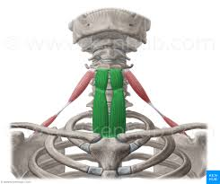
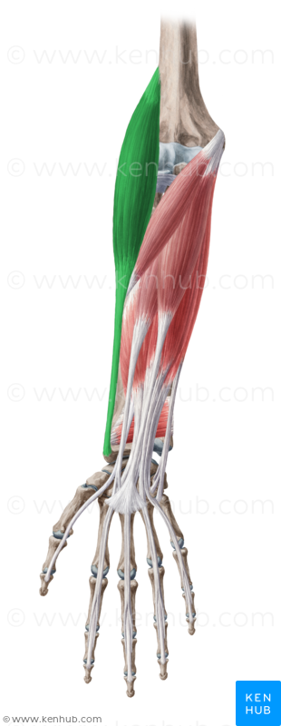
NAME MUSCLES ON PICTURES FORMING COMPOUND WORDS
This muscle arises from crista iliaca and inserts into
the upper six ribs and into the back of the transverse
Process of the seventh cervical vertebra, it is
Musculus _________________________ dorsi
This muscle arises from posterior surface of manubrium and 1st rib. and inserts into oblique line of thyroid cartilage, it is
Musculus _________________________
This muscle arises from crista supracondylaris
lateralis (humeri) and inserts at processus styloideus
radii, it is Musculus _________________________
Notes:
Musculus iliocostalis
Musculus sternothyroideus
Musculus brachioradialis

Slide 7
NAME STRUCTURES ACCORDING TO DEFINITIONS,
TERMS SHOULD BE COMPOUND ADJECTIVES
The structure is the connection between the sacrum and coccyx; it is frequently a true joint, but often occurs as a synchondrosis, it is: Articulatio _____________________________
Suture lateral to the nasal bone that connects the nasal portion of the frontal bone and the frontal process of the maxilla, is:
Sutura _____________________________
Epicanthus, is the skin fold of the upper eyelid covering the inner angle of the eye (i. e. on the side close to the nose), another Latin name for it is: Plica_____________________________
The pleural recess between the lateral wall of thorax (i. e. ribs) and the descending is sides of diaphragm and, is called:
Recessus ___________________________
Notes:
Articulatio saccrococcygea
Sutura frontomaxillaris
Plica palpebronasalis
Recessus costoodiaphragmaticus

Slide 8
NAME STRUCTURES ACCORDING TO DEFINITIONS,
TERMS SHOULD BE COMPOUND ADJECTIVES
Recessus _____________________________ is the deep recess of the peritoneal cavity extending upward between the liver in front and the kidney behind.
The anterior portion of the superficial fibers of the medial collateral ligament of the ankle joint, attached superiorly to the anterior surface of the medial malleolus of the tibia and inferiorly to the navicular bone is: Pars ____________________________ ligamenti collateralis
Right or left opening between the atrium and ventricle is: Ostium____________________________
One of facial lymph nodes situated near the junction of the superior labial and facial arteries, which drains the external nose and upper lip into the submandibular node is called: Nodus lymphaticus ____________________________
Notes:
Recessus hepatorenalis
Pars tibionavicularis ligamenti collateralis
Ostium atrioventriculare
Nodus lymphaticus nasolabialis

Slide 9
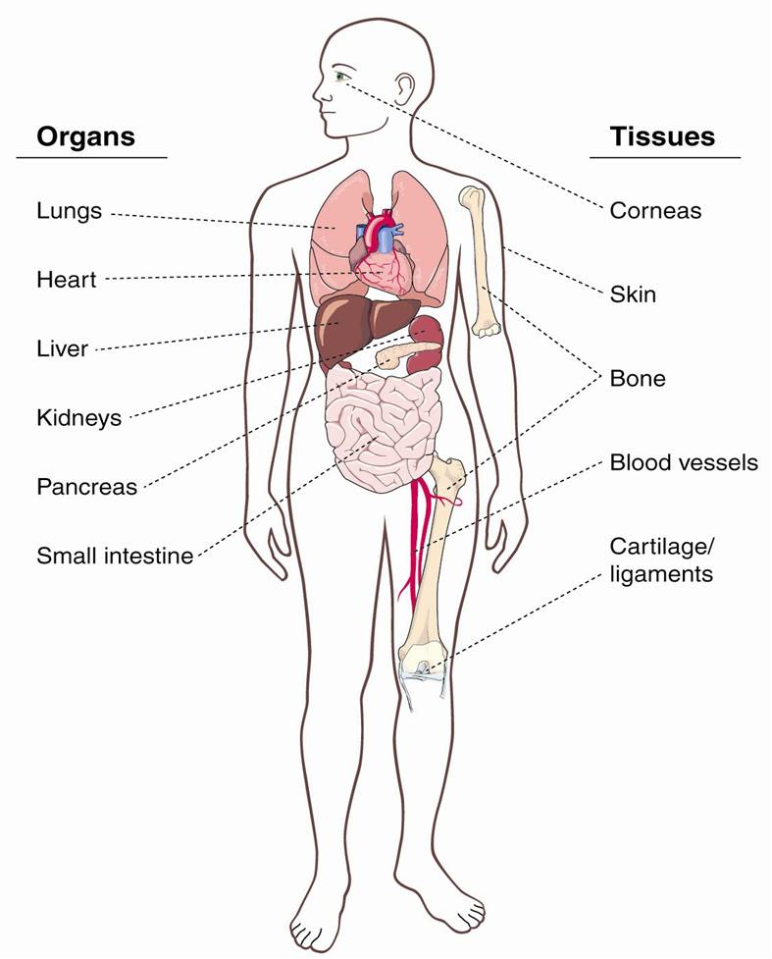
NAME GREEK ELEMENTS OF SELECTED BODY PARTS,
DERIVE TERMS FOR INFLAMMATIONS
Pneum-(on)
Ophthalm-
Eye
Cardi-
Derm-(at)-
Hepat-
Ost-(e)-
Nephr-
Pancreat-
Angi-
Enter-
Chondr-

Slide 10
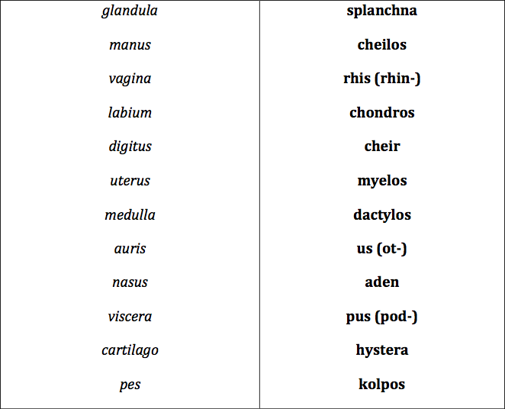
MATCH GREEK ELEMENTS WITH LATIN EQUIVALENTS

Slide 11
GIVE LATIN EQUIVALENTS (FULL FORM) TO GREEK ELEMENTS
Mys………………….
Osteon……………..
Arthron……………
Spondylos………..
Gony………………..
Stoma………………
Soma……………….
Kefale………………
MUSCULUS, I, M.
OS, OSSIS, n.
ARTICULATIO, ONIS, F.
VERTEBRA, AE, F.
GENU, US, N.
OS, ORIS, N.
CORPUS, ORIS, N.
CAPUT, ITIS, N.

Slide 12
FORM COMPOUND TERMS WITH GREEK ELEMENT
-ECTOMIA : excision, surgical removal of part or of all organ….
e. g. appendectomia – removal of vermiform appendix
Removal of the FINGER -
Dactyl-ec-tomia
Removal of the STOMACH -
Gastr-ec-tomia
Removal of the LIVER -
Hepat-ec-tomia
Removal of the LARYNX -
Laryng-ec-tomia
Removal of the LOBE -
Lob-ec-tomia
Removal of the BREAST -
Mast-ec-tomia
Removal of the PANCREAS -
Pancreat-ec-tomia
Removal of the PROSTATE -
Prostat-ec-tomia
Removal of the WOMB-
Hyster-ec-tomia

Slide 13
EXPLAIN MEANING OF THE COMPOUND WORDS
-METRIA : measurement….
e. g. pupillometria – measurement of the diameter of the eye pupil
Crani-o-metria
Measurement of the SKULL
Pelvi-metria
Measurement of the PELVIS
Cephal-o-metria
Measurement of the HEAD
Odont-o-metria
Measurement of TEETH
Oste-o-metria
Measurement of BONES
Cyst-o-metria
Measurement of the BLADDER
to evaluate its function

Slide 14
FORM COMPOUND TERMS WITH GREEK ELEMENT
-SCOPIA : visual examination of the interior of a hollow body organ, broadly also examine, inspect
e. g. endoscopia : examination of the inside of the body
Inspect FETUS-
Fet-o-scopia
Inspect PHARYNX -
Pharyng-o-scopia
Inspect ANUS -
An-o-scopia
Inspect ABDOMINAL CAVITY -
Lapar-o-scopia
Inspect LARGE INTESTINE -
Col-o(no)-scopia
Inspect THORACIC CAVITY -
Thorac-o-scopia
Inspect VAGINA -
Colp-o-scopia
Inspect EYE -
Ophthalm-o-scopia

Slide 15
EXPLAIN MEANING OF THE COMPOUND WORDS
-GRAPHIA : recorging, image, X-ray….
e. g. hysterographia – graphic recording of the strenght of uterine contractions
Mamm-o-graphia
A breast examination with imaging technology
Angi-o-graphia
A vessels examination with some type of viewing/recording device
Radi-o-graphia
Internal organs examination by taking X-ray photographs
Electr-o-cardi-o-graphia
The process of recording electrical impulses of the heart

Slide 16
FORM COMPOUND TERMS WITH GREEK ELEMENT
-TOMIA : cutting, incision, section…
e. g. herniotomia – a cutting for the repair of hernia
Incision of the ARTERY-
Arteri-o-tomia
Incision of the BRONCHUS -
Bronch-o-tomia
Incision of the SKULL -
Crani-o-tomia
Incision of the LOBE -
Lob-o-tomia
Incision of the MUSCLE -
My-o-tomia
Incision of the PERICARDIUM -
Pericardi-o-tomia
Incision of the PERINEUM (PUBIC REGION) -
Episi-o-tomia
Incision of the VEIN -
Phleb-o-tomia
Incision of the TYMPANUM -
Tympan-o-tomia

Slide 17
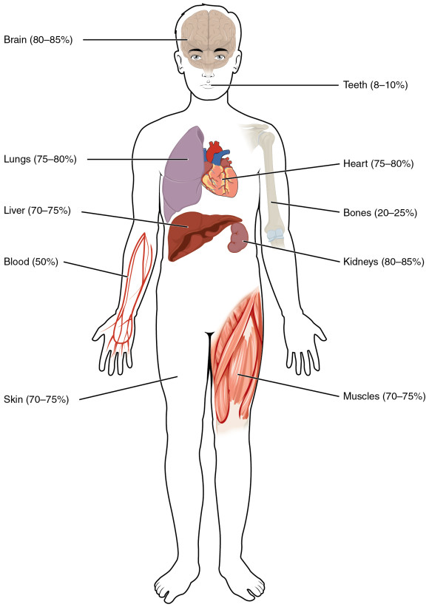
DECIDE WHETHER THE COMPOUND WORD CONTAINS GREEK
ELEMENT CORRESPONDING WITH THE LABELLED BODY PART
Encephalopathia
Somatologia
Thoracographia
Phlebotomia
Cholecystitis
Otoscopia
Adenocarcinoma
Nephrostomia
Podarthritis
Myeloneuritis

Slide 18
NAME GREEK ELEMENTS WHICH CORRESPOND WITH LATIN WORDS
VAS
VENA
COR
REN
VESICA
LINGUA
MAMMA
CUTIS
ANGEION
FLEPS
KARDIA
NEFROS
KYSTIS
GLOTTA
MASTOS
DERMA
Notes:
Angiospasmus
Angioplastica
Phlebographia
Phlebothrombosis
Cardiothoracicus
Cadriopneumographia
Nephrectomia
Nephroureterectomia
Cystostomia
Cystotomia
Glossectomia
Glossopalatinus
Dermatomyositis
dermatoplastica

Slide 19
Plastic surgery to repair a blood vessel (e.g. narrowed artery) is…
An X-ray examination of a vein using radio-opaque dye so the vein will show up on the film is…
(Adjective) One that refers to the heart and the chest region is…
An abbreviation C-PG stands for examination of the heart function and breathing, in Latin it is called…
Surgical operation to make a permanent opening into the pelvis of kidney from the surface is…
Surgical operation to make an opening between the bladder and the abdominal wall is…
Surgical removal of the tongue is...
Plastic surgery to reduce the size of breasts is…
Replacement of the damaged skin by skin taken from a donor is…

Slide 20

FILL IN THE MISSING TERMS
Gall leaving the gallbladder enters the hepatic duct, its descending part that enters the duodenum is common hepatic duct, and the Greek word dochos (receptacle) is used in naming it. Thus inflammation of the common hepatic duct is called …………………., surgical operation to make cut in the common bile duct to remove the stones is………………… .
The combining form MYEL- refers to either bone marrow or the spinal cord, thus the tumor originating in the bone marrow should be called …………………. . Inflammation of the grey matter of the spinal cord, also known as infantile paralysis, or simply polio (from Greek polios grey) is ………………… .

Slide 21
What are the parts of dissection protocol? Try to figure out the meaning of compounds!
I. Melanoblastoma dorsi reg. subscapularis l. dx.
Metastases multiplices cerebri lat. utr., cerebelli lat utr., et ad pulmones.
Oedema cerebri.
Decubitus reg. sacralis superficialis parvus. Hypertrophia lienis.
Arteriosclerosis universalis. Bronchopneumonia hypostatica microfocalis l.dx.
Thromboembolia ramorum arteriae pulmonalis l. dx. multifocalis. Dilatatio ventriculi cordis dextri acuta.
Defectus dentium partialis reg. mandibulae l. sin. Atrophia fusca myocardii et hepatis.
Adenoma lobi sinistri glandulae thyroideae. Stp. HYE et adnexectomiam bilateralem. Striae cutis reg. abdominis. Degeneratio cuspidum valvae mitralis. Cystes serosae corticis renum. Urocystitis catarrhalis.

