Slide 1
AUTONOMIC NERVOUS SYSTEM

Slide 2
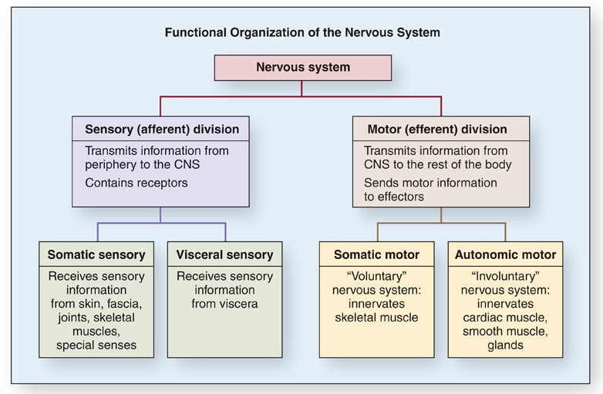

Slide 3
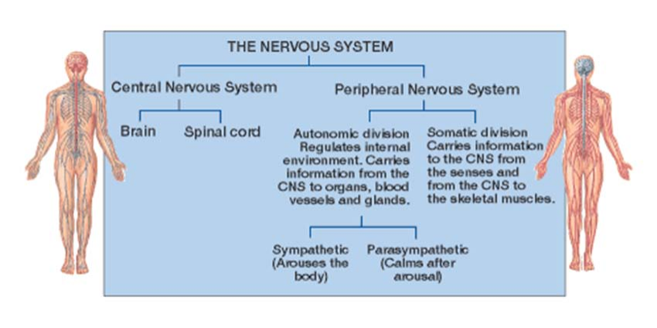

Slide 4
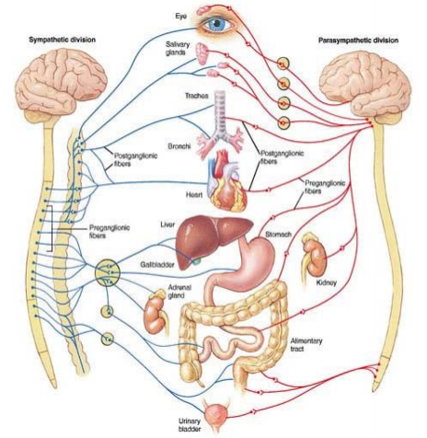
AUTONOMIC NERVOUS SYSTEM
Functions:
Contraction and relaxation of
smooth muscles
Function of all exocrine glands
Heart rate
Some metabolic processes

Slide 5
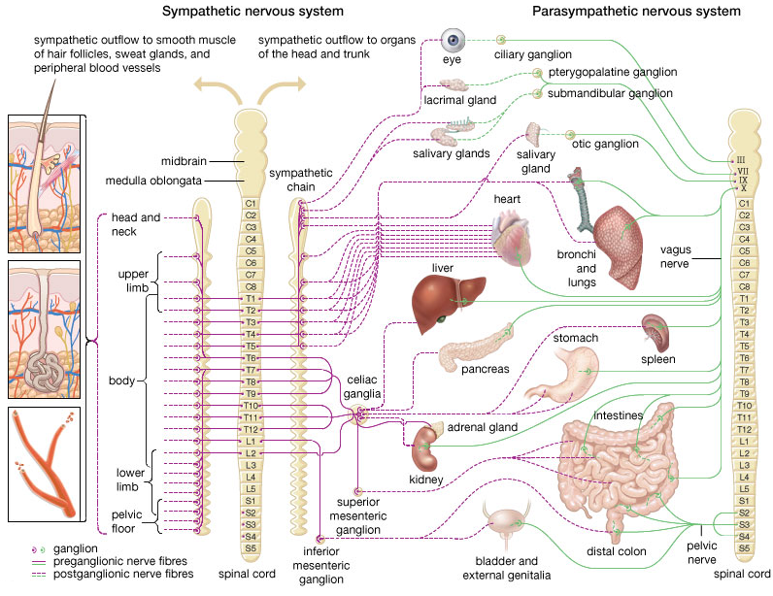

Slide 6
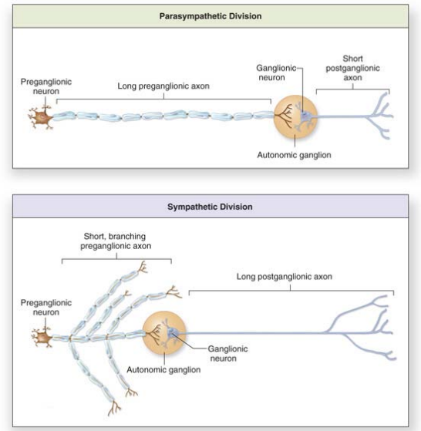

Slide 7
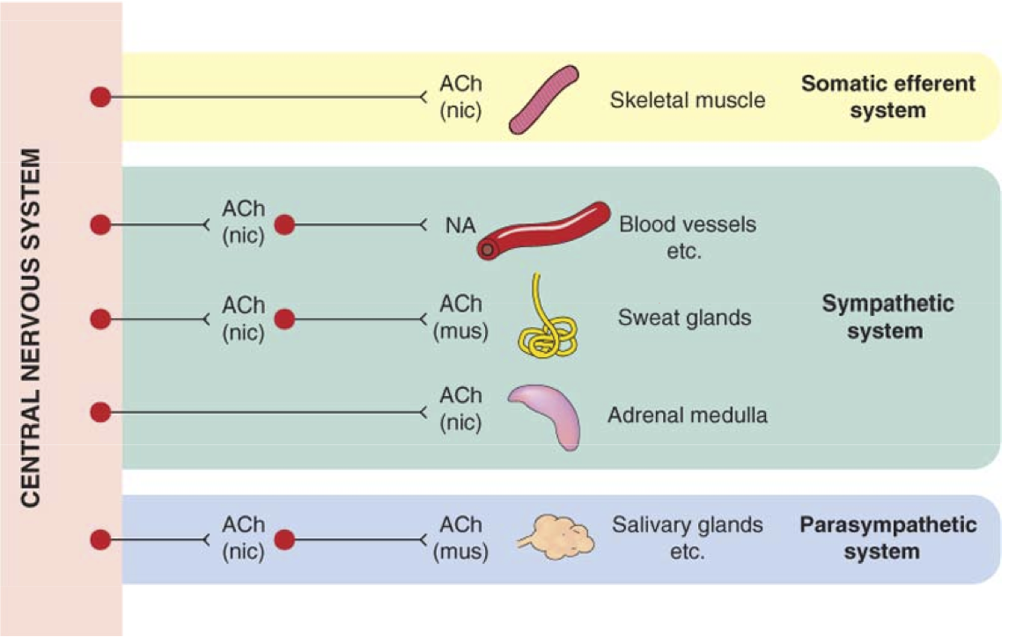

Slide 8
AUTONOMIC NERVOUS SYSTEM
sympathetic NS
ncl. intermediolateralis in
T1 – L2 segments of spinal cord
= thoracolumbar system
paravertebral ganglia
(tr. sympathicus) and
prevertebral ganglia
neurotransmitters
pregangl. – acetylcholine
postgangl. – norepinephrin
(ex. sweat glands and
piloerector muscle)
parasympathetic NS
parasympathetic nuclei
of CN III, VII, IX, X
segments S2 – S4
= craniosacral system
ganglia near the target
organ
neurotransmitter
acetylcholine

Slide 9
Sympathetic system
Catabolic reaction (activities that are mobilized during emergency and stress situations, “fight, fright and flight” responses)
Parasympathetic system
Anabolic reactions (activities associated with
conservation and restoration of body resources,
“rest and digest” responses)
anatomy
Notes:
9
The sympathetic system stimulates those activities that are mobilized by the organism during stress situations.
Increased activity of the sympathetic and following release of adrenergic neurotransmitters prepares the organism for FFF.

Slide 11
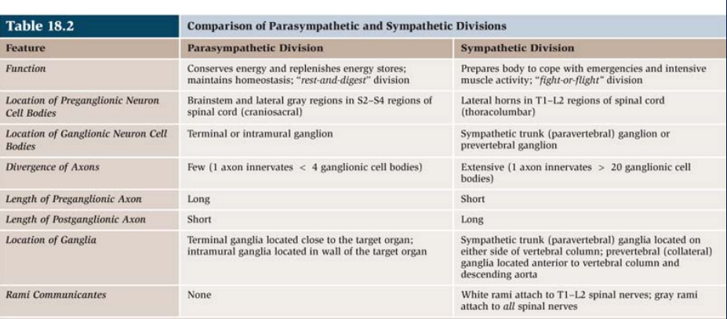

Slide 12
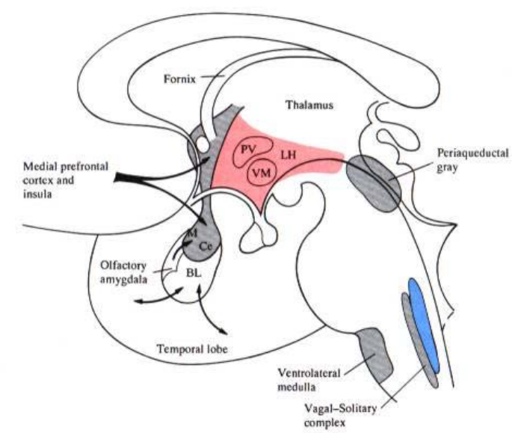

Slide 13
Modulation of ANS
from brain cortex
tr. corticoreticularis → tr. reticulospinalis → preganglionic neurons
from hypothalamus
tr. hypothalamotegmentalis
tr. mammillotegmentalis
from hypothalamus and limbic forebrain
FLD → dorsolateral tegmentum
CC – from amygdalar complex
→ hypothalamus
→ PAG – coordination of somatic and autonomic response to
behavior and defensive reaction → preganglionic neurons of S and PS divisions

Slide 14
Descendent modulatory pathways
fasciculus longitudinalis dorsalis (FLD)
fasciculus telencephalicus medialis (medial forebrain
bundle MFB)
tr. mammillotegmentalis

Slide 15
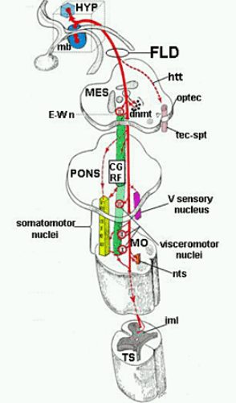
Fasciculus longitudinalis dorsalis

Slide 16
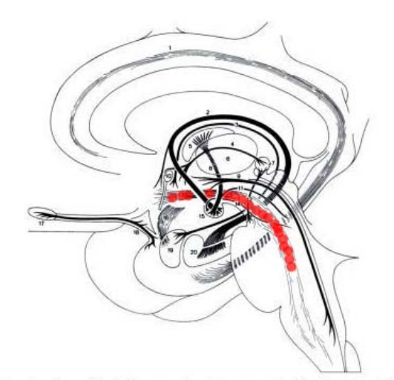
Fasciculus telencephalicus medialis

Slide 17
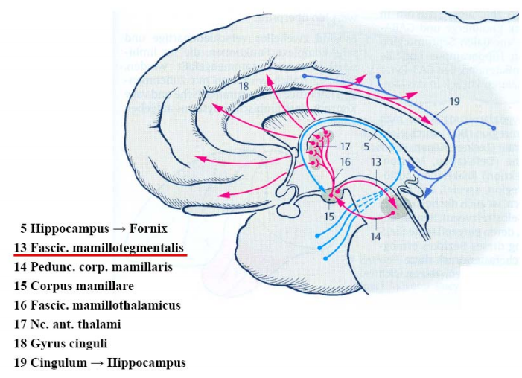
Tractus mammillotegmentalis

Slide 18
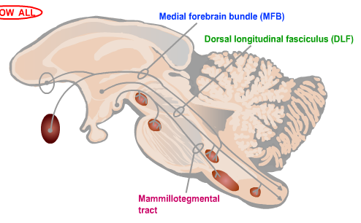

Slide 19
Hypothalamus
Nuclei of the anterior part
ncl. paraventricularis
stimulation of parasympathetic system
Stimulation of the anterior part of hypothalamus
miosis
decrease in heart rate and blood pressure
dilation of cutaneous arteries
increase in peristalsis and secretion in the GIT

Slide 20
Hypothalamus
Nuclei of the posterior part
ncl. mammillaris and hypothalamicus post.
stimulation of sympathetic system
Stimulation of the posterior part of hypothalamus
mydriasis
increase in heart rate and blood pressure
constriction of cutaneous arteries
decrease in peristalsis and secretion in the GIT
erection of hairs

Slide 21
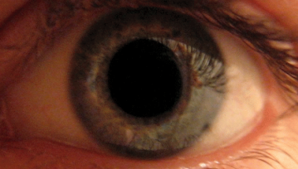
PUPILARY LIGHT REFLEX
a reflex that controls the diameter
of the pupil, in response to the
intensity of light (luminance) that
falls on the retina of the eye
mydriasis: dilation of the pupil
miosis: constriction of the pupil

Slide 22
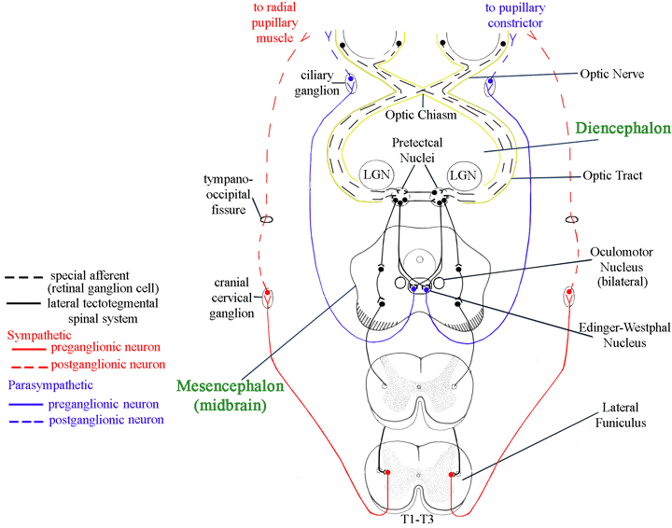

Slide 23
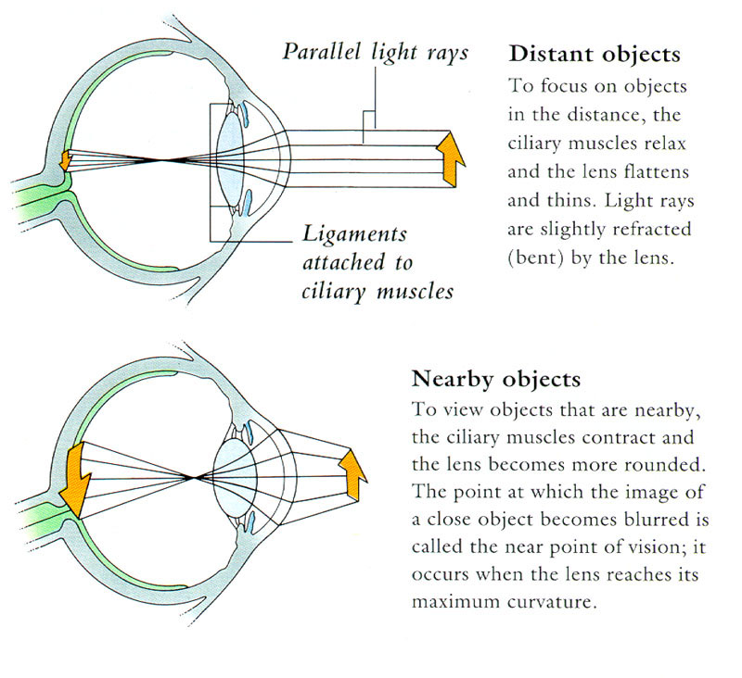
ACCOMMODATION

Slide 25
Illustrations were copied from:
Neuroscience Online, the Open-Access Neuroscience
Electronic Textbook
Department of Neurobiology and Anatomy
University of Texas Medical School at Houston

