Slide 1

Nerve tissue
Neurons
Glial cells
CNS: oligodendrocytes, astrocytes, ependymal cells, microglia
PNS: satellite cells, Schwann´s cells
Synapse
Myelin sheath

Slide 2
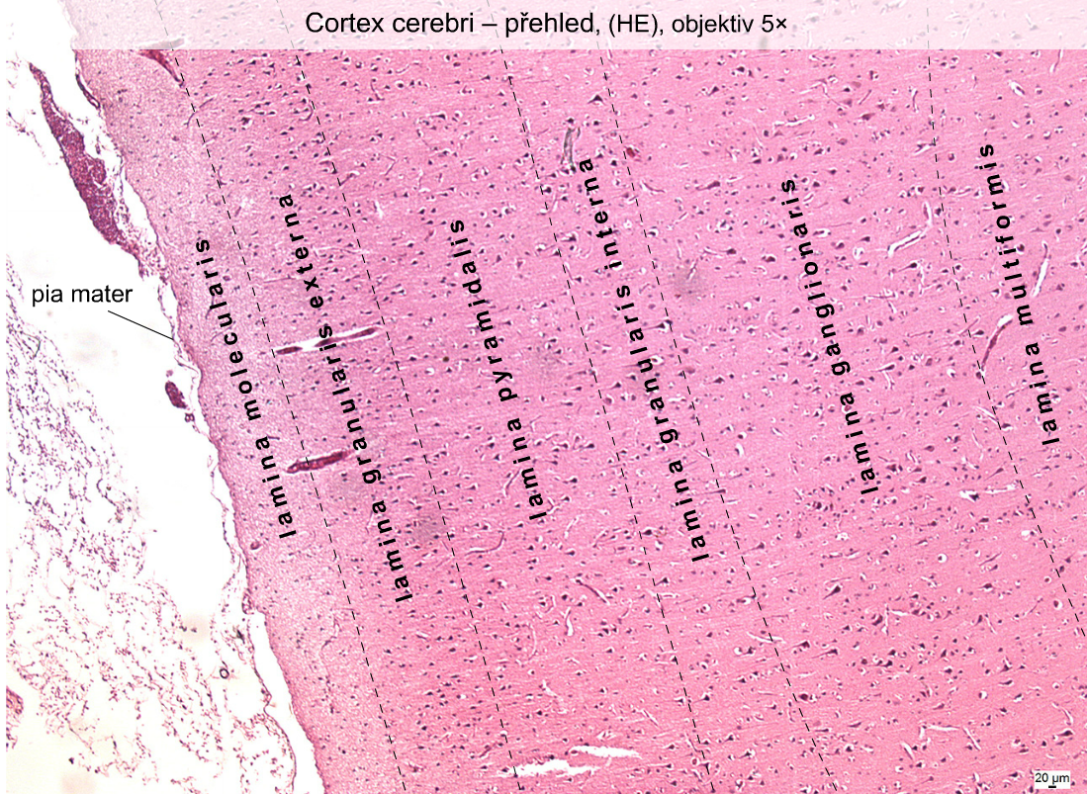

Slide 3
Cortex cerebri – Pyramidal cells – multipolar neurons

Slide 4
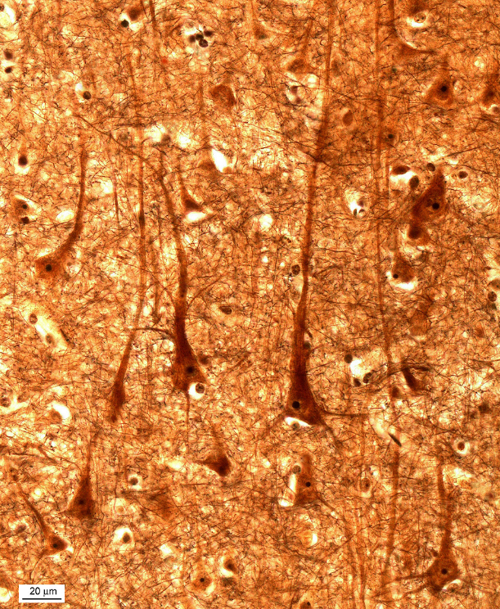
Cortex cerebri – Pyramidal cells – multipolar neurons

Slide 5
Cerebellum

Slide 6
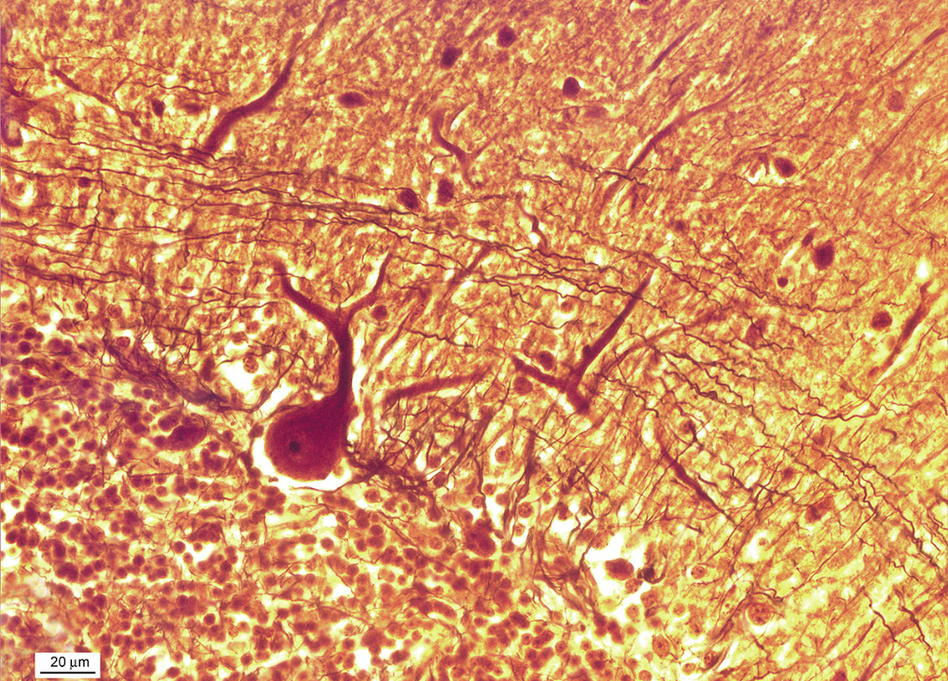
Cerebellum – Purkinje cell

Slide 7
Cerebellum - Nissl bodies
Notes:
Nisslova substance – Purkyňovy buňky mozečku

Slide 8
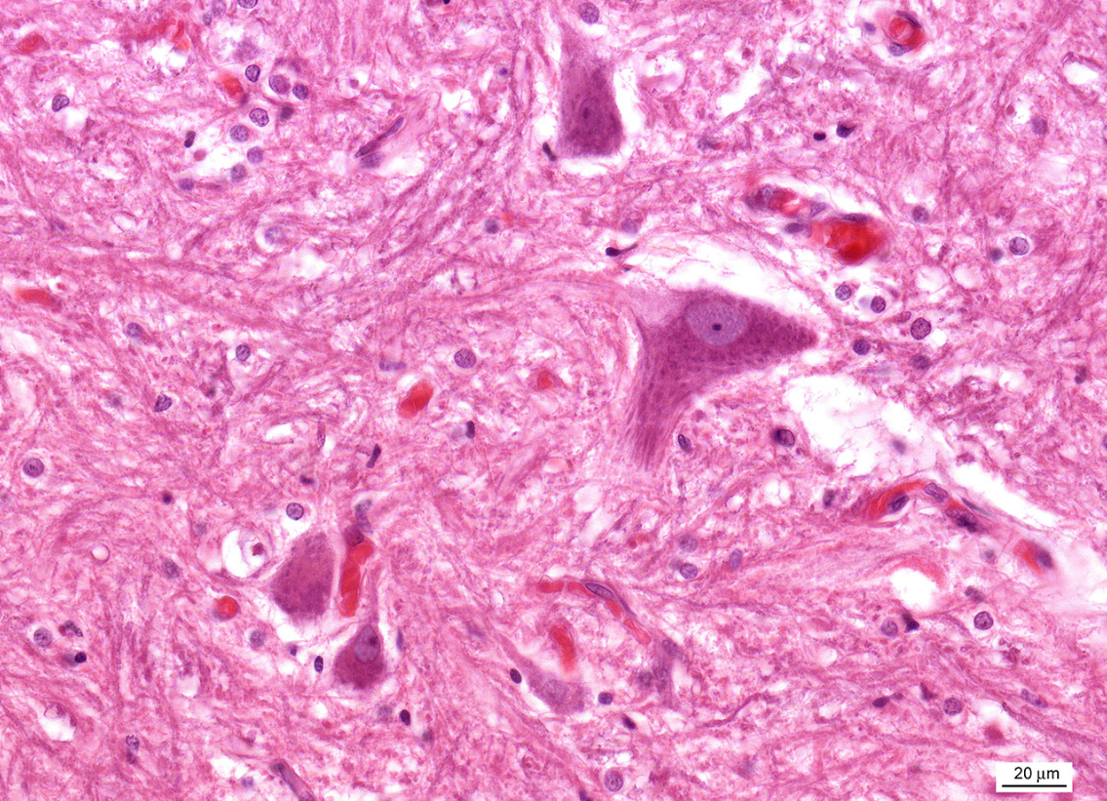
Axon hillock
Nissl bodies
Notes:
Kořenové buňky předního míšního rohu psa

Slide 9
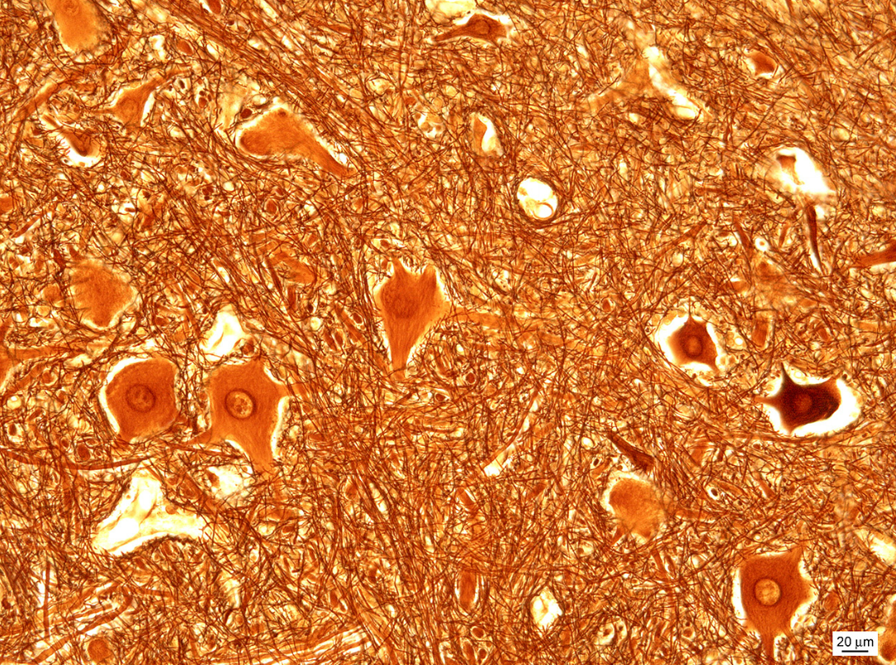
Medulla spinalis
Somatomotoric multipolar neurons

Slide 10
Somatomotoric multipolar neurons
Myelinated axons

Slide 11
Medulla spinalis – ependymal cells

Slide 12
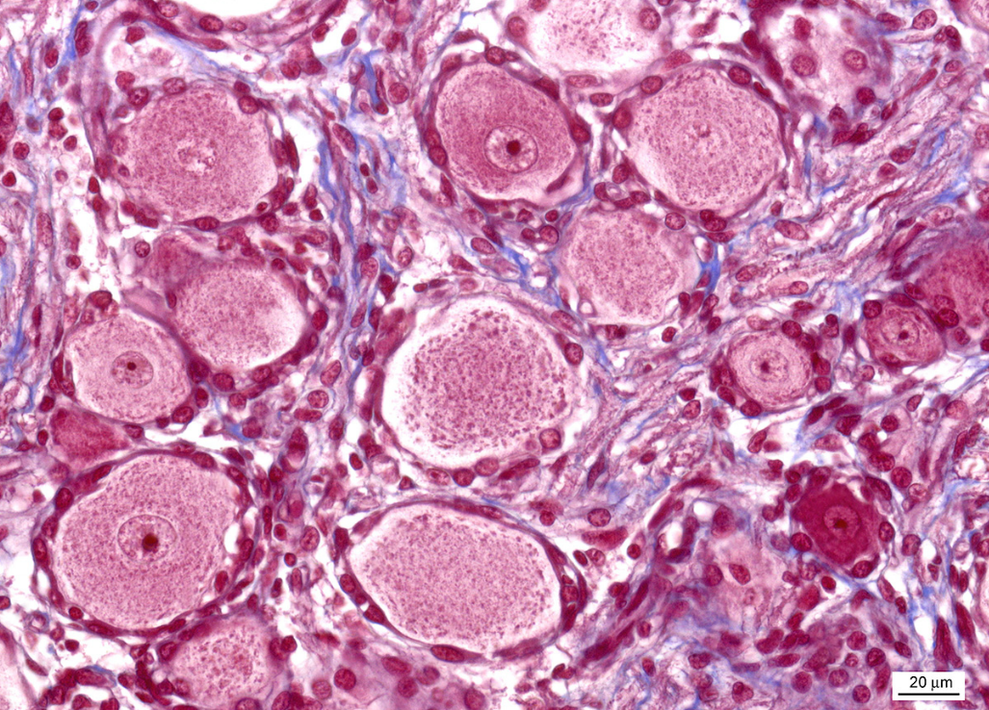
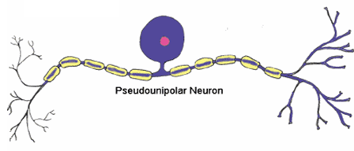
Ganglion spinale
Pseudounipolar neurons
Satellite cells

Slide 13
Vegetative ganglion – ganglion cells (multipolar neurons), satellite cells

Slide 14
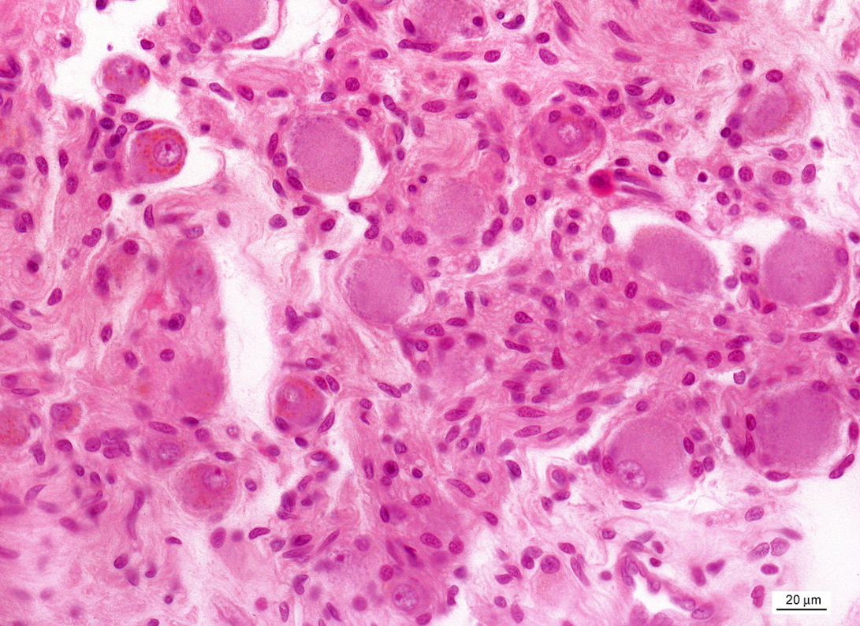
Ganglion cells with lipofuscin

Slide 15
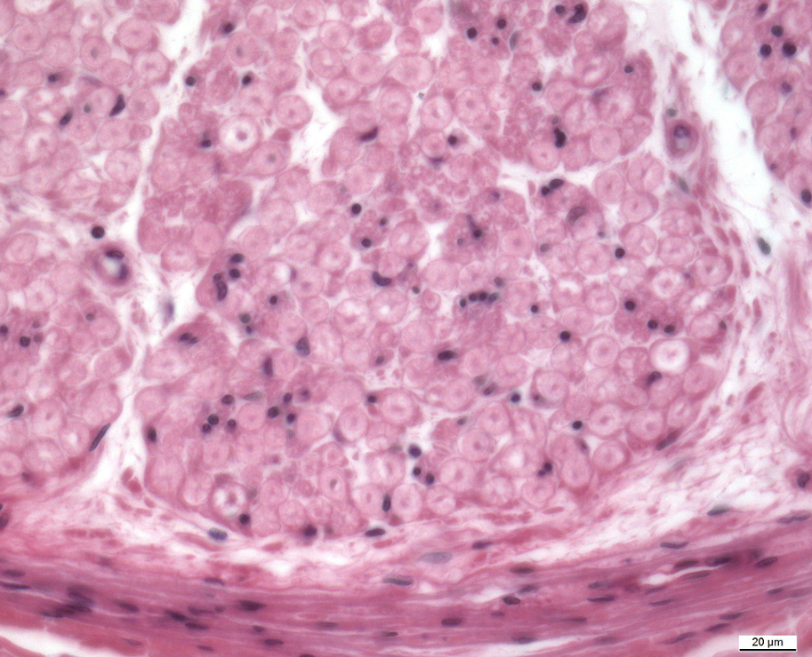
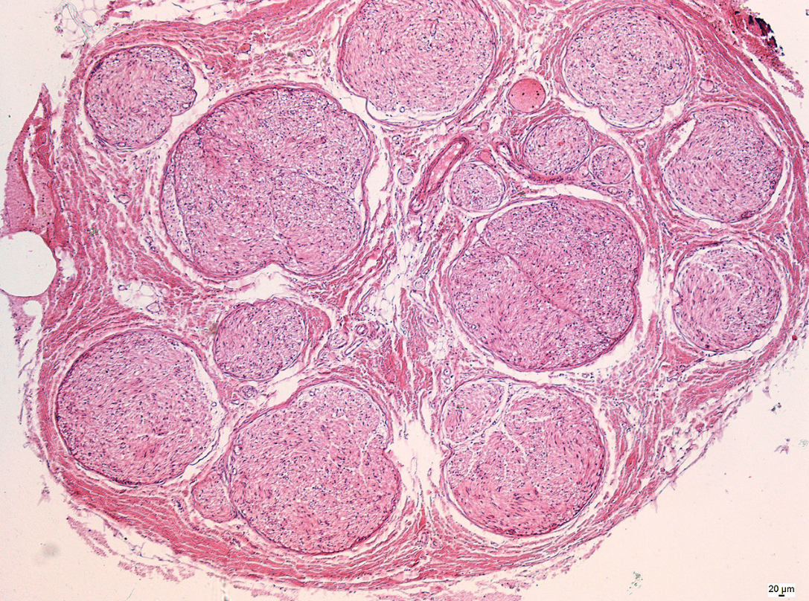
Peripheral nerve
Endoneurium
Perineurium
Epineurium

Slide 16
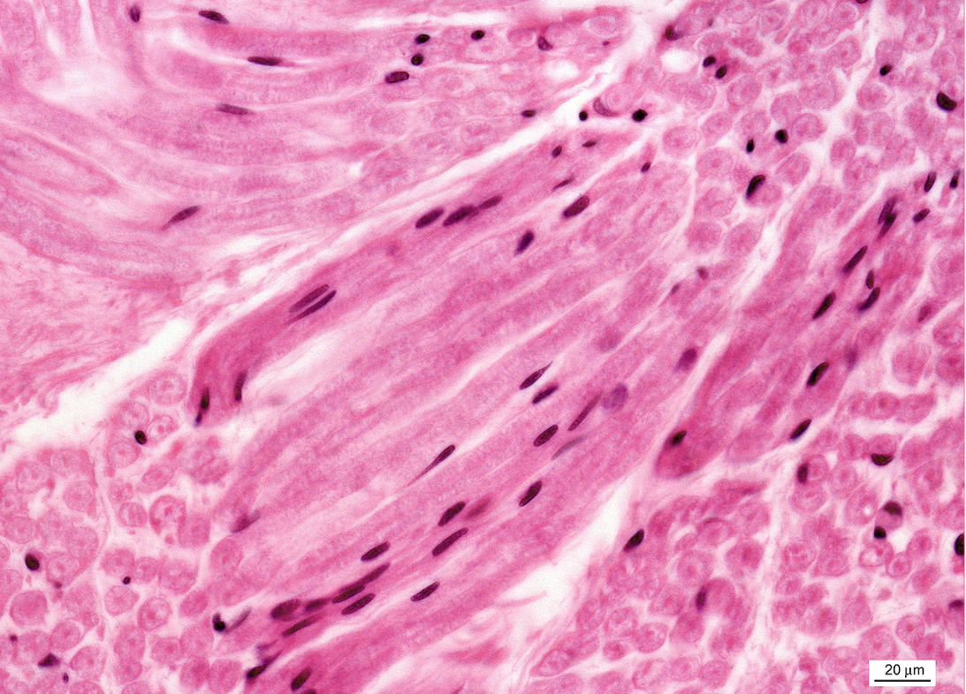
Peripheral nerve

Slide 17
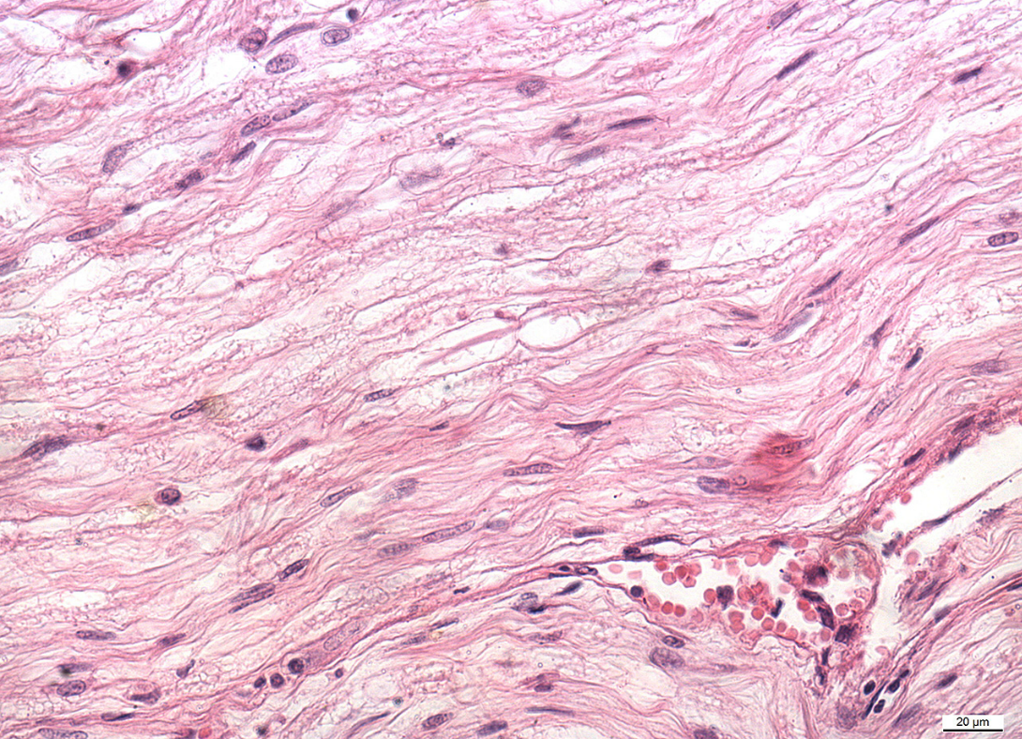
Peripheral nerve – longitudinal section
Node of Ranvier

Slide 18
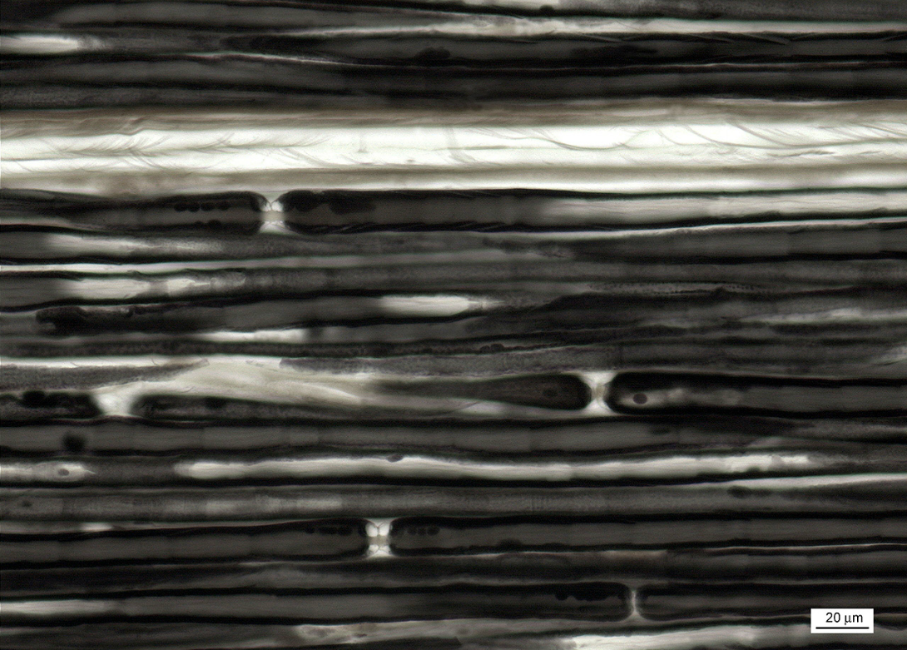
Myelin sheaths with nodes of Ranvier – peripheral nerve (OsO₄)

Slide 19
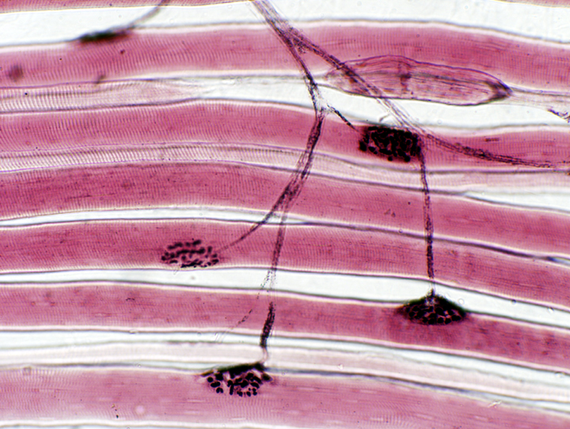
Motor end-plates in motor unit
Axon terminals
Muscle fibers
Motor
end-plate

Slide 20
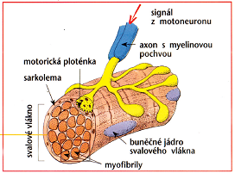
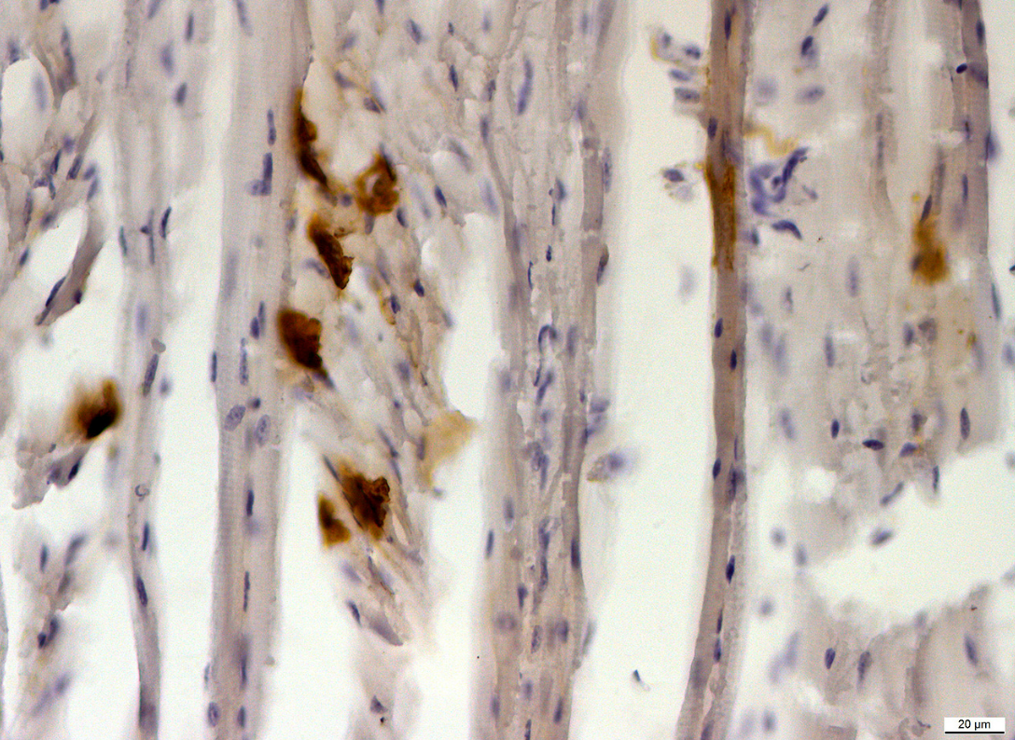
Motor end-plates (localization of acetylcholinesterase)

Slide 21
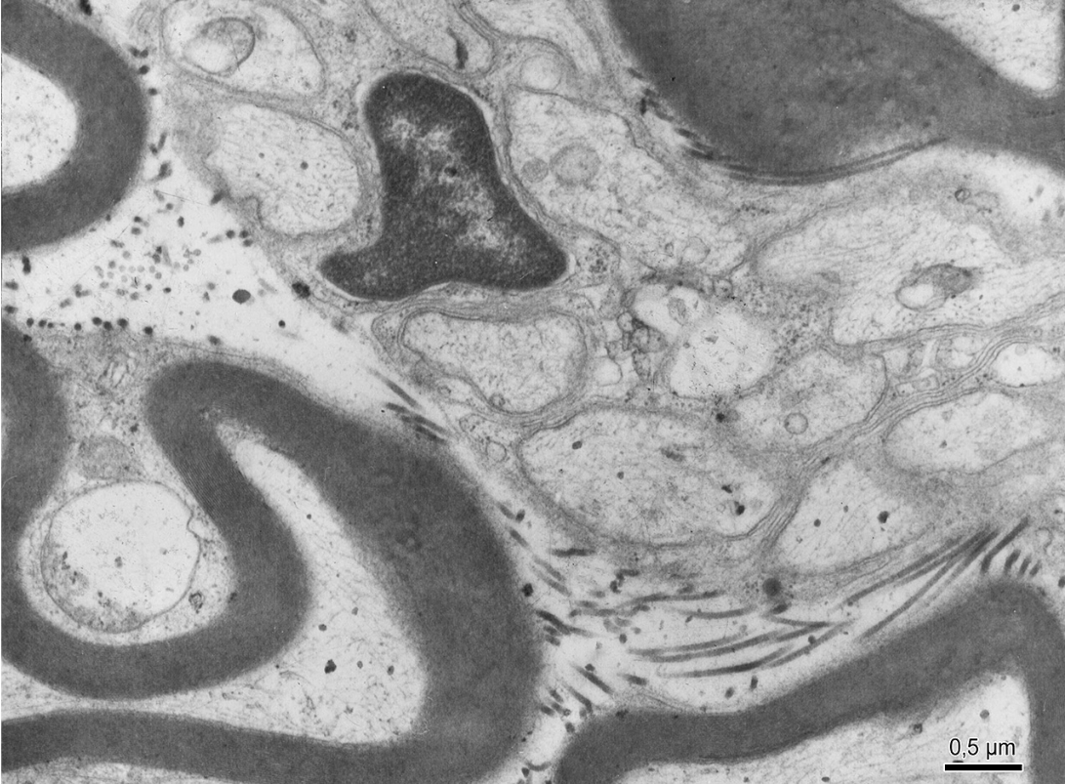
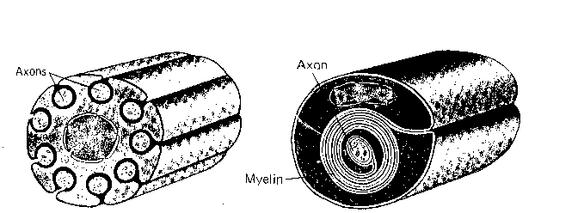
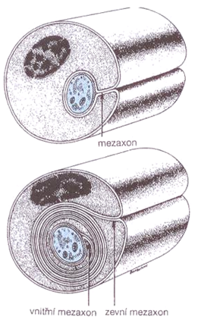
Axons with Schwann sheath
Nucleus of Schwann cell
Myelin sheath

Slide 22
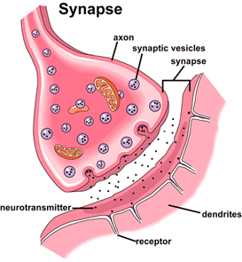
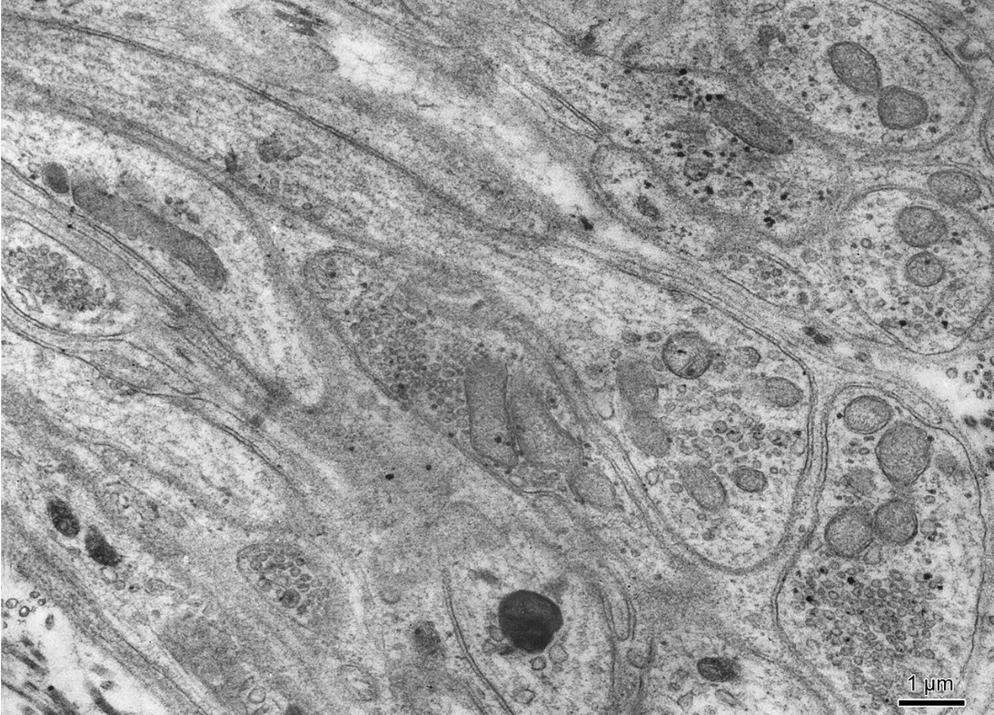
Presynaptic ending

Slide 23
NERVE TISSUE
Slides:
Pyramidal cell (75, 76. Cortex cerebri)
Purkinje cell (77. Cerebellum)
Nissl substance (78. Cerebellum)
Somatomotoric multipolar neuron (79. Medulla spinalis)
Pseudounipolar neuron (81. Ganglion spinale)
Axon with myelin and Schwann sheath (84, 86. Peripheral nerve)
Myelin sheath (87. Peripheral nerve)
Motor end plate (acetylcholinesterase detection)
Atlas EM:
Nucleus (3) and cytoplasm of neuron (55)
Axons with sheaths (56, 58)
Presynaptic endings (57)

