Slide 1
Revision

Slide 2
Declensions
How many declensions are in Latin?
How do you decide on the declension of the noun?
What are the example words for the nouns of Ist declension?
  vena, systole, diabetes
What are the example words for the nouns of IInd declension?
  nervus, septum, nephros, colon
What are the example words for the nouns of IIIrd declension?
  dolor, corpus, pelvis, rete, dosis (febris)
What are the example words for the nouns of IVth declension?
  ductus, genu
What are the example words for the nouns of Vth declension?
  facies

Slide 3
Adjectives
Latin adjective have to match the noun in...?
  gender, case, number
  thus the endings do NOT have to look similarly
    diabetes mellitus, gen.: diabetae melliti
    rete venosum, gen.: retis venosi
    vulnus lacerum, gen.: vulneris laceri
    manus dextra, gen.: manus dextrae
    etc...

Slide 4
Typical mistakes
mors in tabulam
solutio ad injectione intravenosa
operatio propter cancri testis
stratum cornea unguarum
vulnus mors faciei
vulna scissa in regio abdominis
oedema cum thrombosim venarum
cervices dentum caninorum
sub ossia
function laeta
musculi sphinctes
species ad gargarismam
medulla ossium ruberum

Slide 5
Confusing words
Tell the difference between the words and make up illustrative phrases:
  fractura, ae, f. X fractus, fracta, fractum
    fractura costae verae aperta
    costa vera fracta
  ruptura, ae, f. X ruptus, rupta, ruptum
    ruptura tendinis
    tendo rupta
  periculum, i, n, X periculosus, a, um
    periculum mortis in tabula
    morbus periculosus
  thorax, thoracis, m. X thoracicus, a, um
    vulnus punctum thoracis
    vertebra thoracica

Slide 6
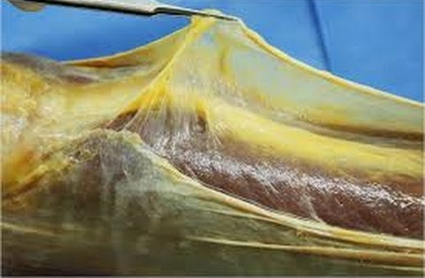
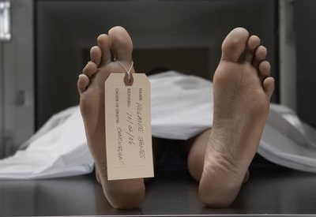
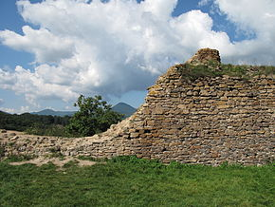
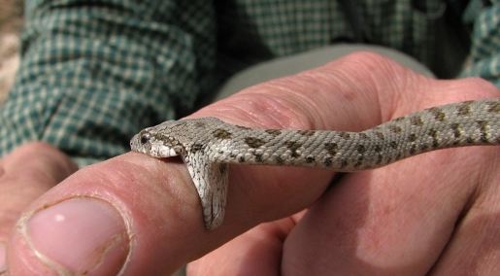

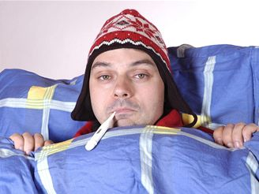

Confusing words II
Match the nouns with the pictures
morsus
paries
pars
mors
facies
morbus
fascia

Slide 7
Confusing words II
Match the nouns with the pictures
fascia, ae, f.
mors, tis, f.
paries, etis, m.
morsus, us, m.
facies, ei, f.
pars, tis, f.
morbus, i, m.
Notes:
ať studenti teď zkusí vytvořit nějaké fráze

Slide 8
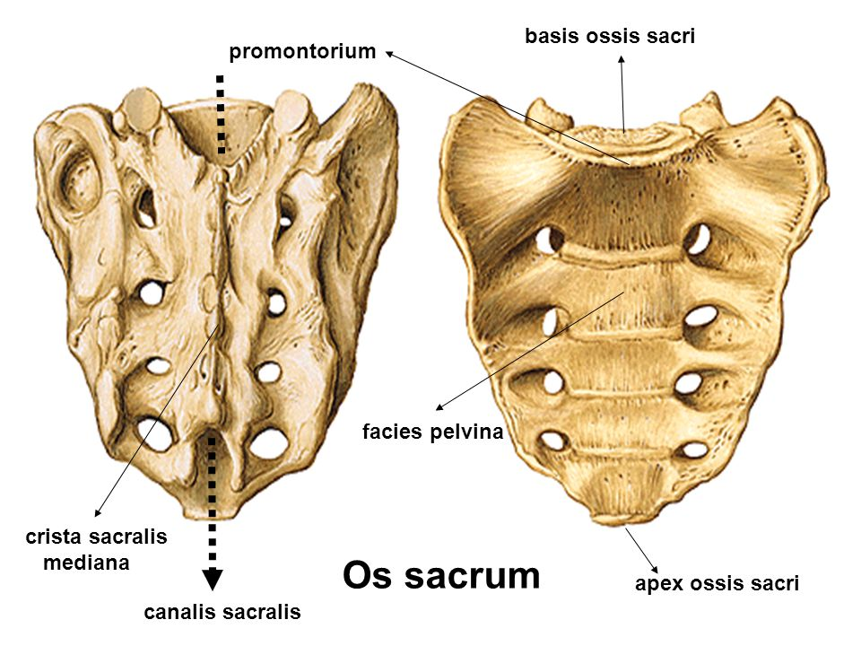
Translate
rupture of the wide fascia
  ruptura fasciae latae
death after an animal bite
  mors post morsum animalis
parts of a gall bladder
  partes vesicae felleae
pelvic surface of sacral bone
  facies pelvina ossis sacri
infectious diseases
  morbi contagiosi
perforation of the wall of the stomach
  perforatio parietis gastris

Slide 9
Form phrases from words in boxes and translate them into English
medicamenta infectiosum
morbum
contra
medicamenta contra morbum infectiosum
medicaments against infectious disease
acutus
pulmonis
dolor
dextri
dolor acutus pulmonis dextri
acute pain of right lung
symptomata
hepatitidis
acutae
symptomata hepatitidis acutae
symptoms of acute inflammation of the liver
collapsus
periculum
digestorii
systematis
periculum collapsus systematis digestorii
danger of a collapse of the digestive system

Slide 10
What are the correct LATIN terms?
paries perforatus
wallum perforatum
neonatus malignus
cancer testiculi
traumata bruisa
vulni sub tempibus
inflammatio cerebri
tea urologica
tumor malignus
cancer testis
vulnera contusa
vulnera sub temporibus
encephalitis
species urologicae

