Slide 1
Respiratory system

Slide 2
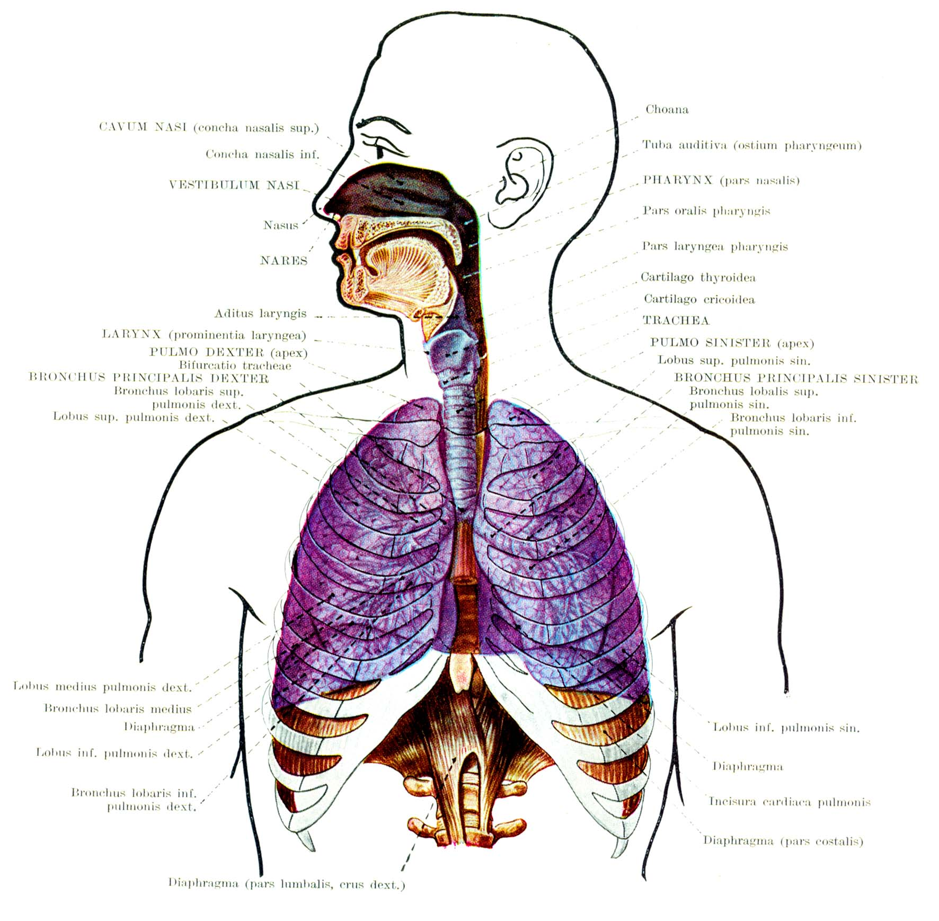

Slide 3
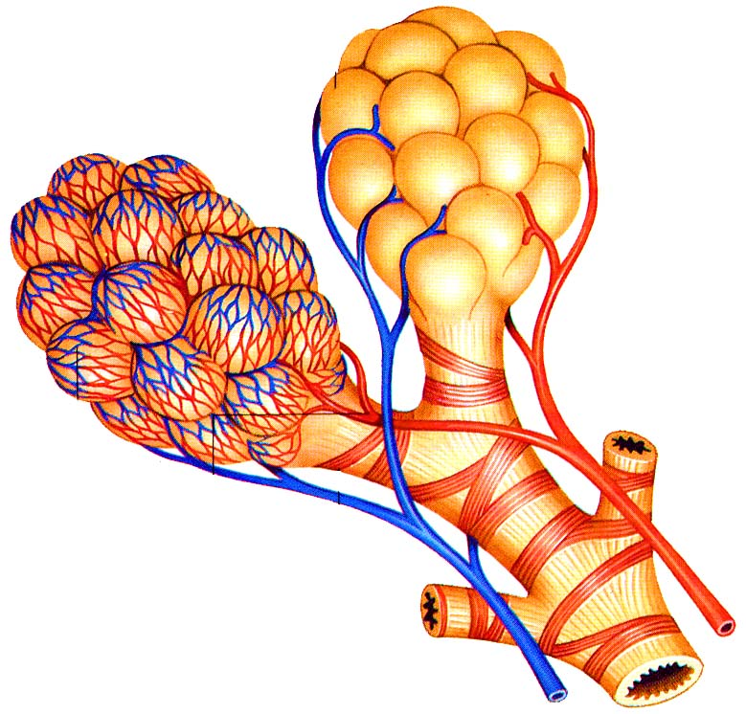

Slide 4
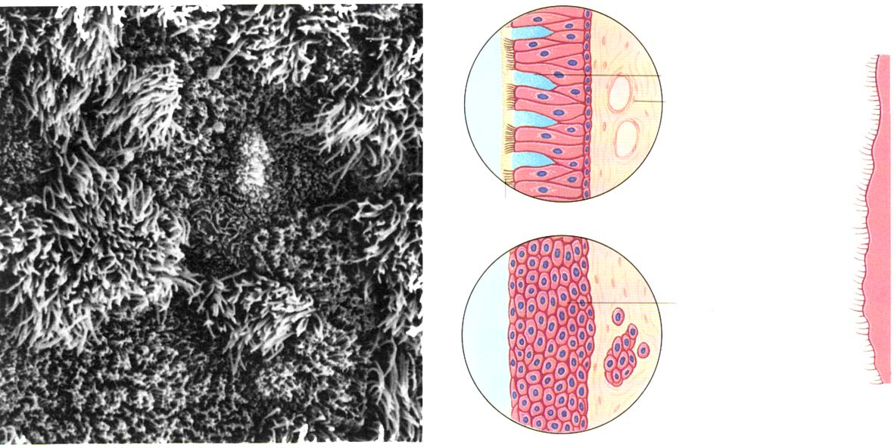

Slide 5
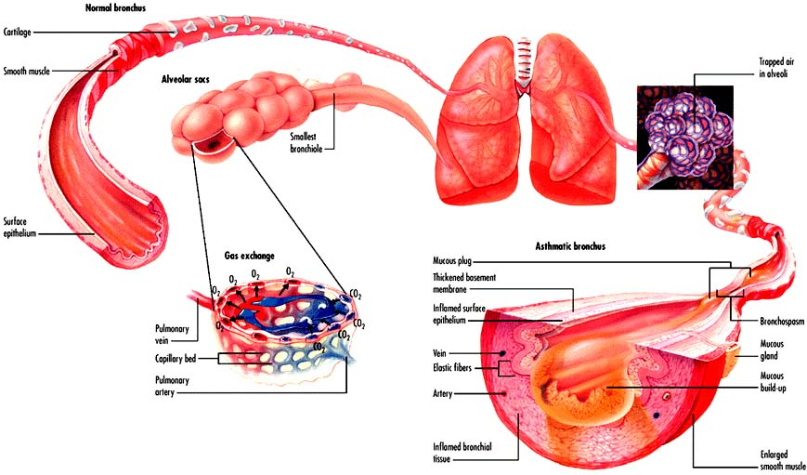

Slide 6
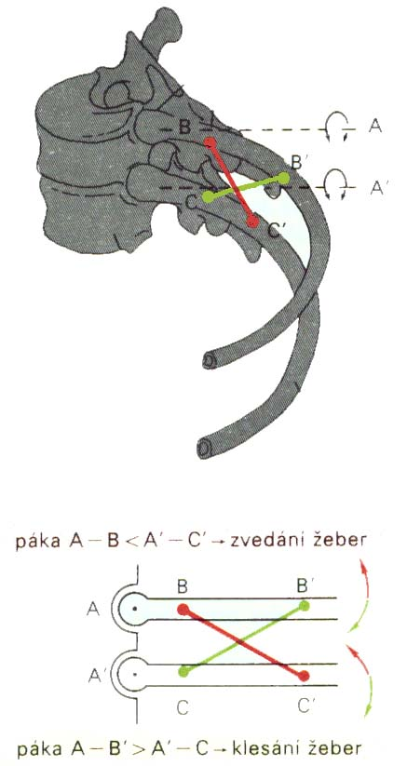
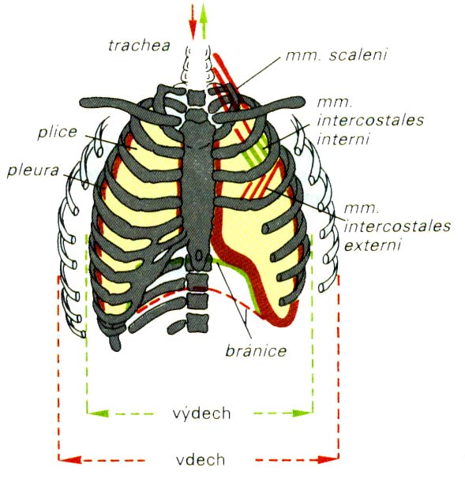
Bucket-handle and water-pump handle effects

Slide 7
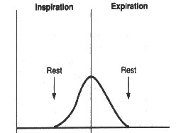
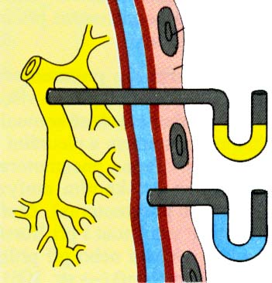
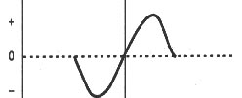
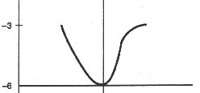
PLEURA
pulmonalis
parietalis

Slide 8
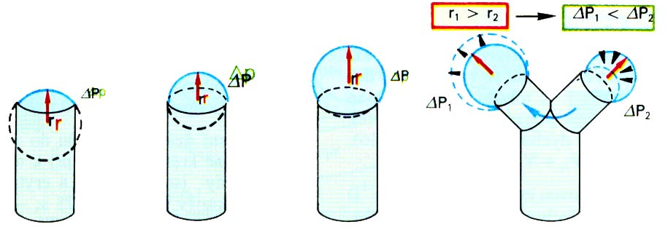
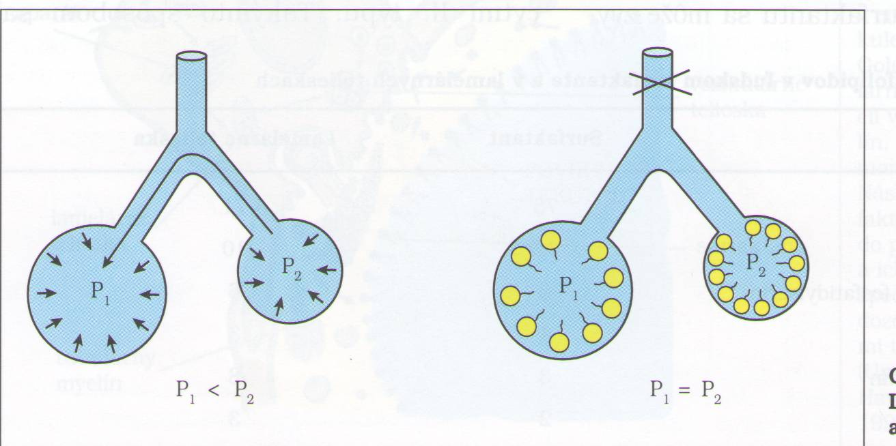
Hollow spherical organ

Slide 9
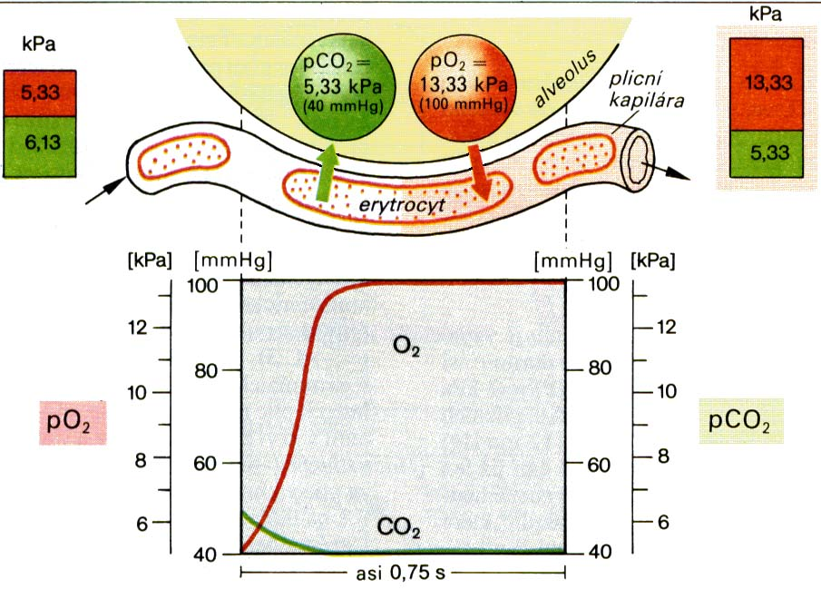
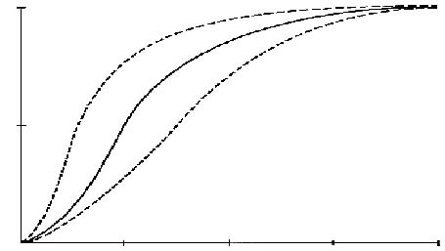
TRANSPORT O₂
↓ temperature
↑ pH
pCO₂
↓ DPG
100%
↑ temperature
↓ pH
↑ pCO₂
↑ DPG
50%
pO₂
25
50
75
100

Slide 10
Regulation of breathing

Slide 11
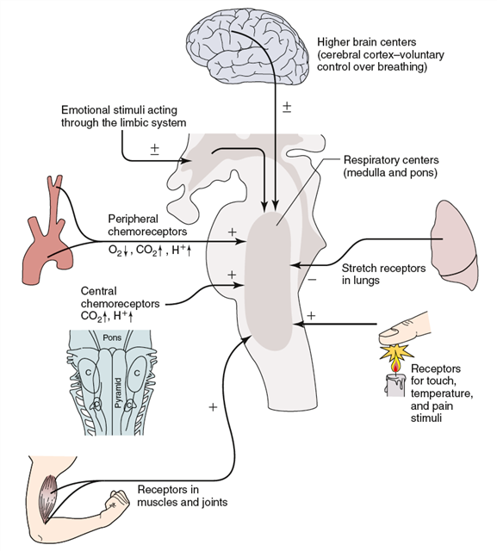
Control of ventilation
https://sleep.sharepoint.com/siteimages/Chapter%203.png

Slide 12
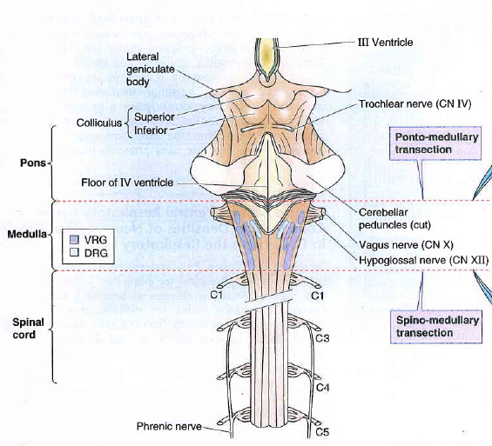

Slide 13
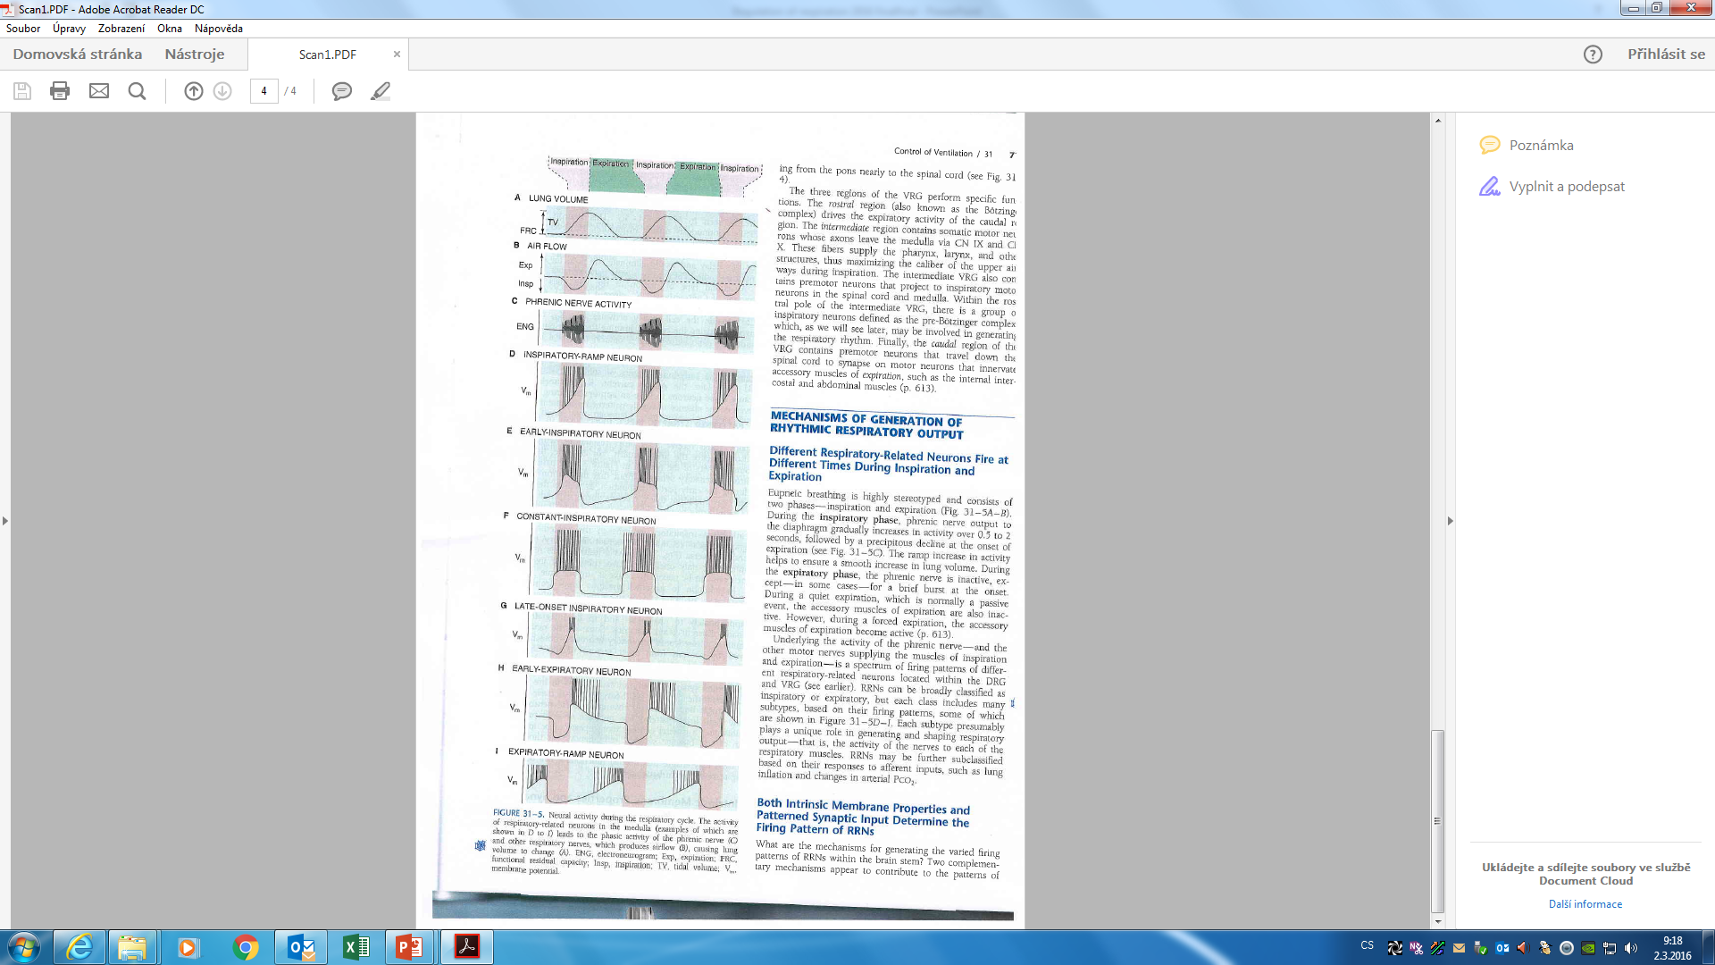

Slide 14
Breathing is an automatic process that takes place unconsciously. Automaticity of breathing comes from regular (rhythmic) activity of groups of neurons anatomically localized in the medulla and its vicinity.

Slide 15
They can be divided into three main groups:
  dorsal respiratory group – placed bilaterally on the dorsal side of the medulla oblongata, only inspiratory neurons, sending axons to motoneurons of inspiratory muscles (diaphragm, external intercostal muscles; their activation=inspiration, their relaxation=expiration; participates on inspiration at rest and forced inspiration
  ventral respiratory group - located on the ventrolateral part of the medulla oblongata, the upper part: neurons whose axons of motor neurons activate the main and auxiliary inspiratory muscles; the lower part: expiratory neurons which innervate expiratory muscles (internal intercostal muscles). Neurons in this group operate only during forced inspiration and forced expiration.
  Pontine respiratory group - pneumotaxic center - dorsally placed on top of the pont, contributes to the frequency and depth of breathing; affects the activity of respiratory neurons in the medulla oblongata.

Slide 16
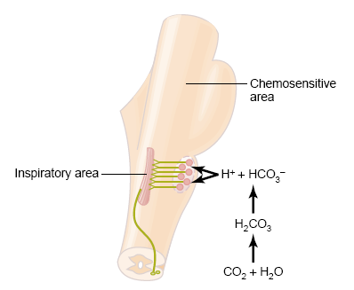
Chemical factors affecting the respiratory center:
Central chemoreceptors
on the front side of the medulla
sensitive only to increase of arterial pCO₂ (by increasing H⁺ )
^{Notice:}
central chemoreceptor are stimulated by other types of acidosis (lactate acidosis, ketoacidosis)

Slide 17
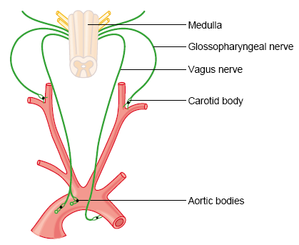
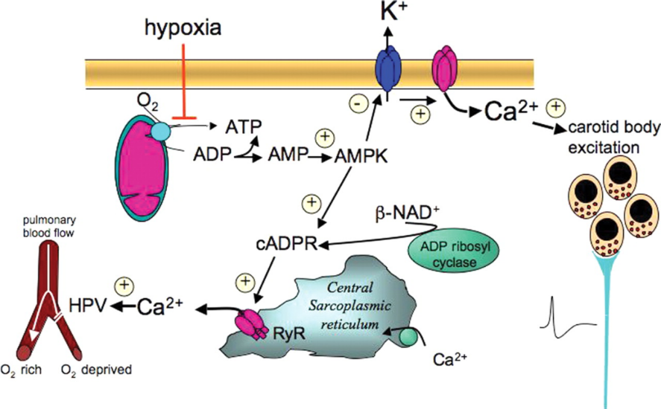
Peripheral chemoreceptors
– located in the aortic and carotid bodies
-primarily sensitive to decrease in arterial pO₂, particularly to decrease of O₂ under 10-13 kPa in the arterial blood.
They convey their sensory information to the medulla via the vagus nerve and glossopharyngeal nerve.
Mechanism of action: Decreased ATP production in mitochondria leads to depolarization of receptors membrane and to excitation of chemoreceptor
http://www.medicine.mcgill.ca/physio/resp-web/sect8.htm,

Slide 18
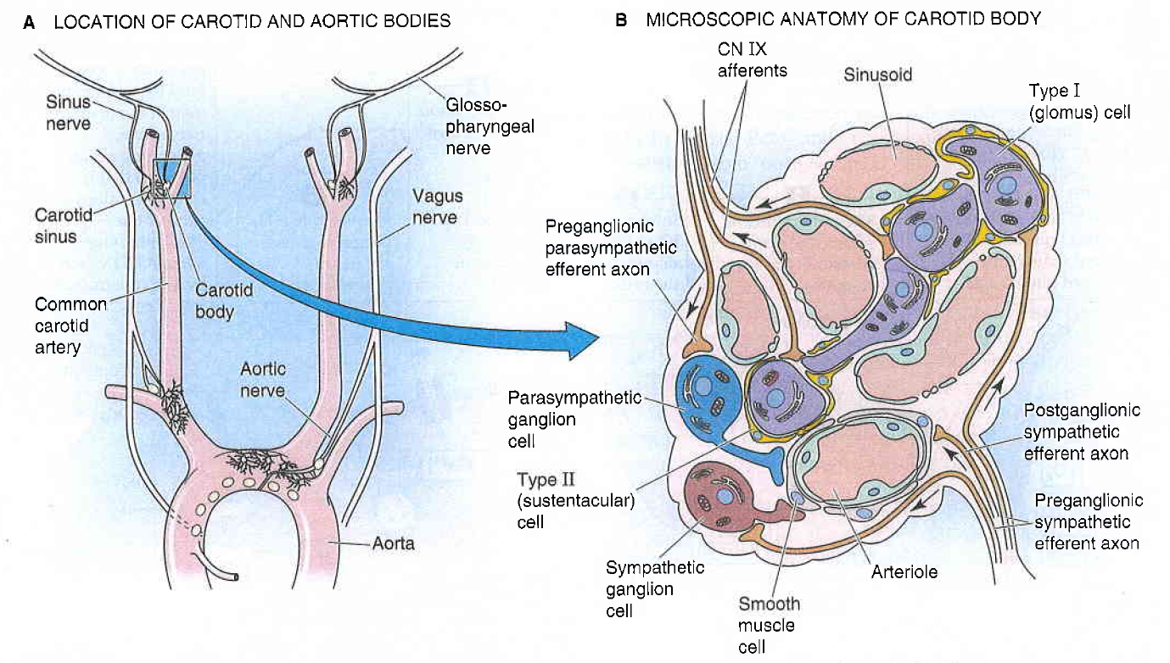

Slide 19
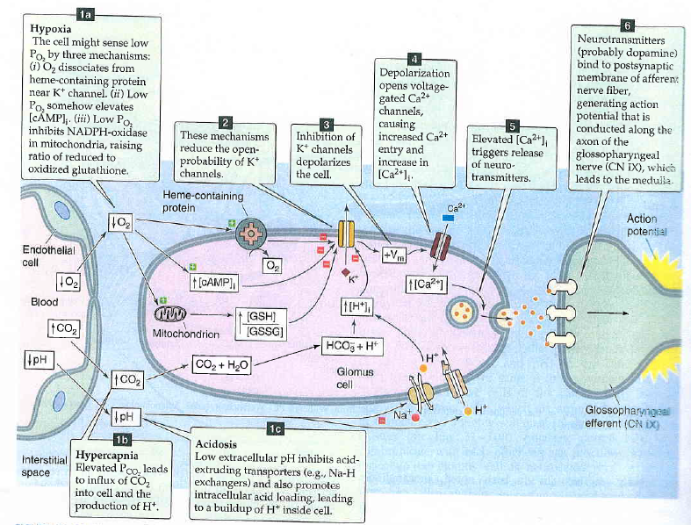

Slide 20
Modulation of respiratory output
Major parameters for feedback control – classical gases:pO2, pCO2, pH
In additin to these, the respiratory system receives input from two other major sources:
1. variety of stretch and chemical/irritant receptors that monitor the size of airways and the presence of noxious agentsreceptors in respiratory system
2. Higher CNS centers that modulate respiratory activity for the sake of nonrespiratory activities
Irritants receptors on mucose of respiratory system – rapidly adapting
Stimulus: agens - chemical substances (histamin, serotonin, prostaglandins, ammonia, cigarette smoke).
Respons: increase mucus secretion, constriction of larynx and brochus
C-fibre receptors (juxtacapillary=J receptors)– free nerve ending of n.vagus (unmyelinated axon) in intersticium of bronchus and alveolus;
Stimulus: Mechanical irritans (pulmonary hypertension, pulmonary oedema)+chemical
Response: hypopnoe, rapid shallow breathing, bronchoconstriction, cough
Stretch receptors slowly adapting (mechanoreceptors in tracheobronchial tree that detect the changes in lung volume by sensing the stretch receptors of the airway wall), inform to brain about the lung volume to optimize respiratory; its irritants triggered decrese activity of respiratory centre – Hering-Breuer´s reflexes. (protecting the lungs from overinflation/deflation)

Slide 21
Baroreceptors – suppresses activity of respiratory centre
Irritants of proprioreceptors of muscles, tendons during active and pasive movements of limbs
Influenced activity of respiratory neurons (increase minute ventilation during work load)
Limbic system, hypothalamus – strong pain, emotion
Tractus corticospinalis =cortex – activated RC during work load
temperature

Slide 22
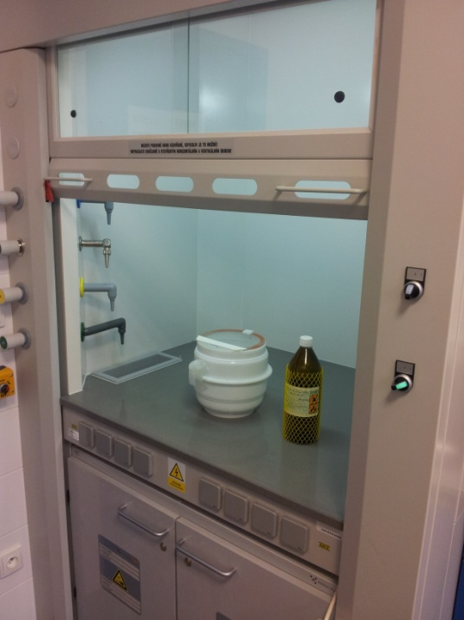
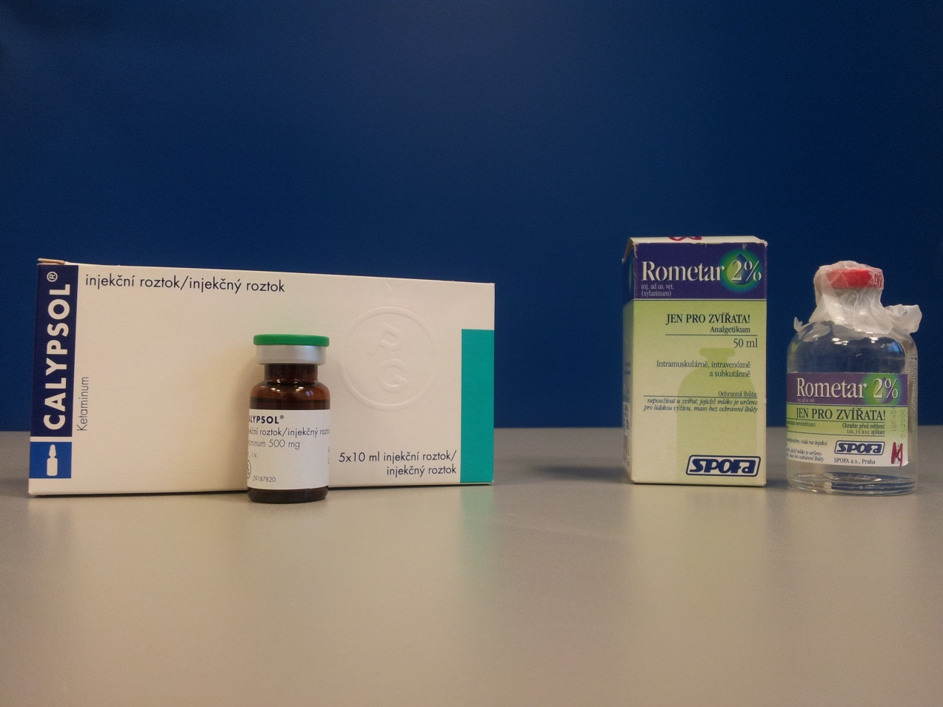
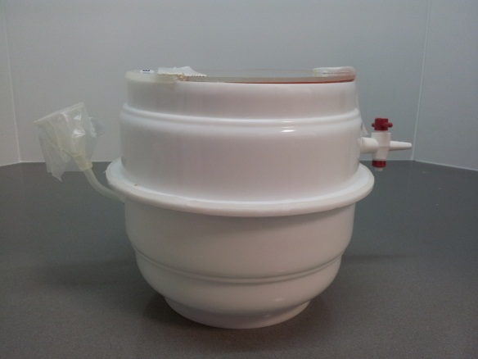
22

Slide 23
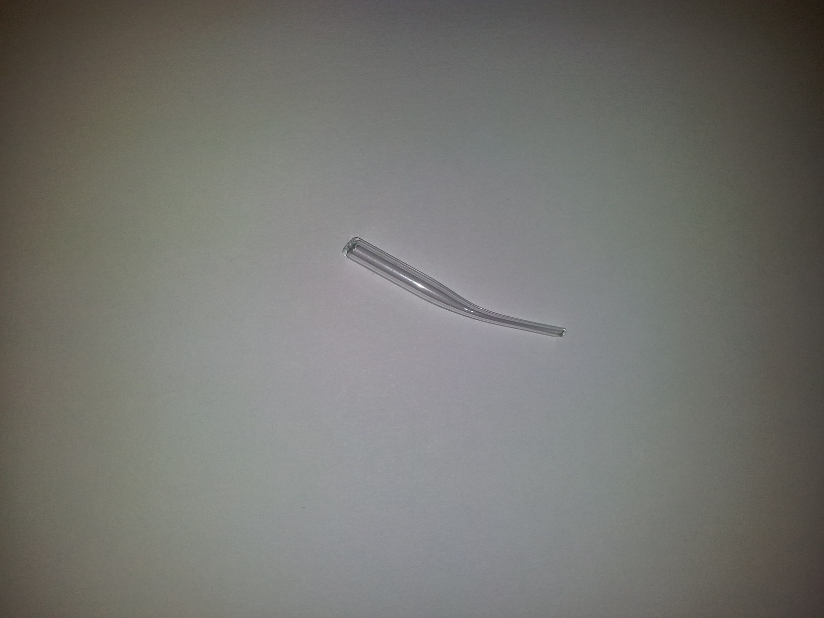
ENDOTRACHEAL CANNULA
TRACHEA
A. CAROTIS
N. VAGUS
23
Upraveno dle: Poopesko Peter a kol. (1990)

Slide 24
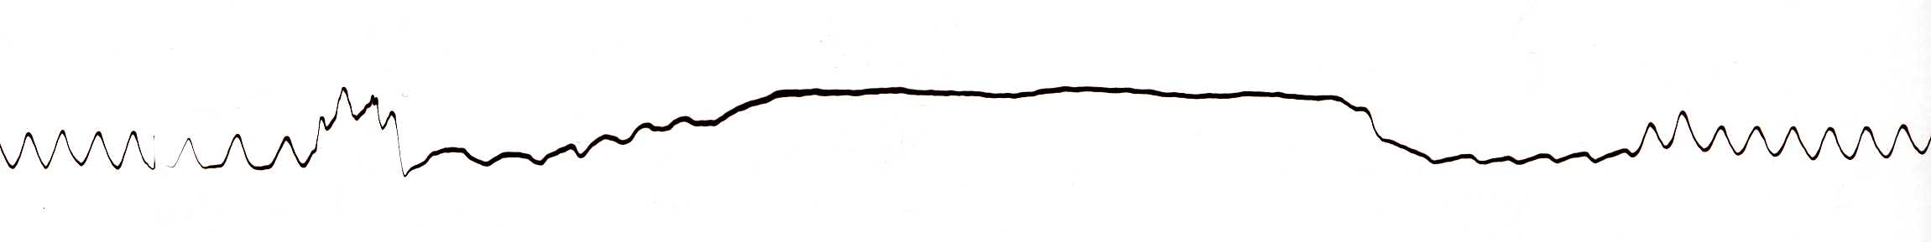
HERING-BREUER REFLEX
Reflex STOP BREATHING
Artefakts
Artefakts
24

Slide 25
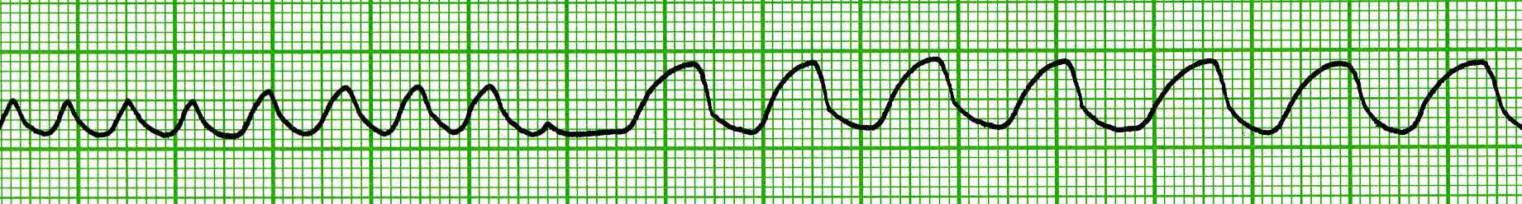
VAGOTOMY
inspirium
exspirium
One-side VAGOTOMY
Both-side VAGOTOMY
25

Slide 26
Periodic breathing
It is not regular, rhythmic, but respiration occurs in periods ("a moment to breathe, take a moment to not breathe„)
CHEYNE-STOKES
BIOT‘S
„gasping“
KUSSMAUL

Slide 27
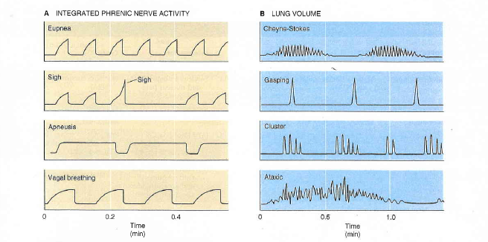

Slide 28
Hypoxia, hypoxemia
Hypoxia is a general name for a lack of oxygen in the body or individual tissues.
Hypoxemia is lack of oxygen in arterial blood.
Complete lack of oxygen is known as anoxia.
The most common types of hypoxia:
Hypoxic - physiological: stay at higher altitudes, pathological: hypoventilation during lung or neuromuscular diseases
Transport (anemic) - reduced transport capacity of blood for oxygen (anemia, blood loss, CO poisoning)
Ischemic (stagnation) - restricted blood flow to tissue (heart failure, shock states, obstruction of an artery)
Histotoxic - cells are unable to utilize oxygen (cyanide poisoning - damage to the respiratory chain)

Slide 29
OXYGEN FALL
mmHg
dry atmospheric air 159
humid atmospheric air 149
ideal alveolar gass 105
end-expiration air 105
arterial blood 77
cytoplasma – mitochondria 3-10
mixed venous blood 40
venous blood 20

Slide 30
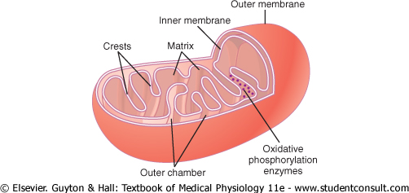
pO₂ = 1 mmHg

Slide 31
Hypercapnia
Hypercapnia - increase of concentration of carbon dioxide in the blood or in tissues that is caused by retention of CO₂ in the body
possible causes: total alveolar hypoventilation (decreased respiration or extension of dead space)
mild hypercapnia (5 -7 kPa) causes stimulation of the respiratory center (therapeutic use: pneumoxid = mixture of oxygen + 2-5% CO₂)
hypercapnia around 10 kPa - CO₂ narcosis - respiratory depression (preceded by headache, confusion, disorientation, a feeling of breathlessness)
hypercapnia over 12 kPa - significant respiratory depression - coma and death.

Slide 32
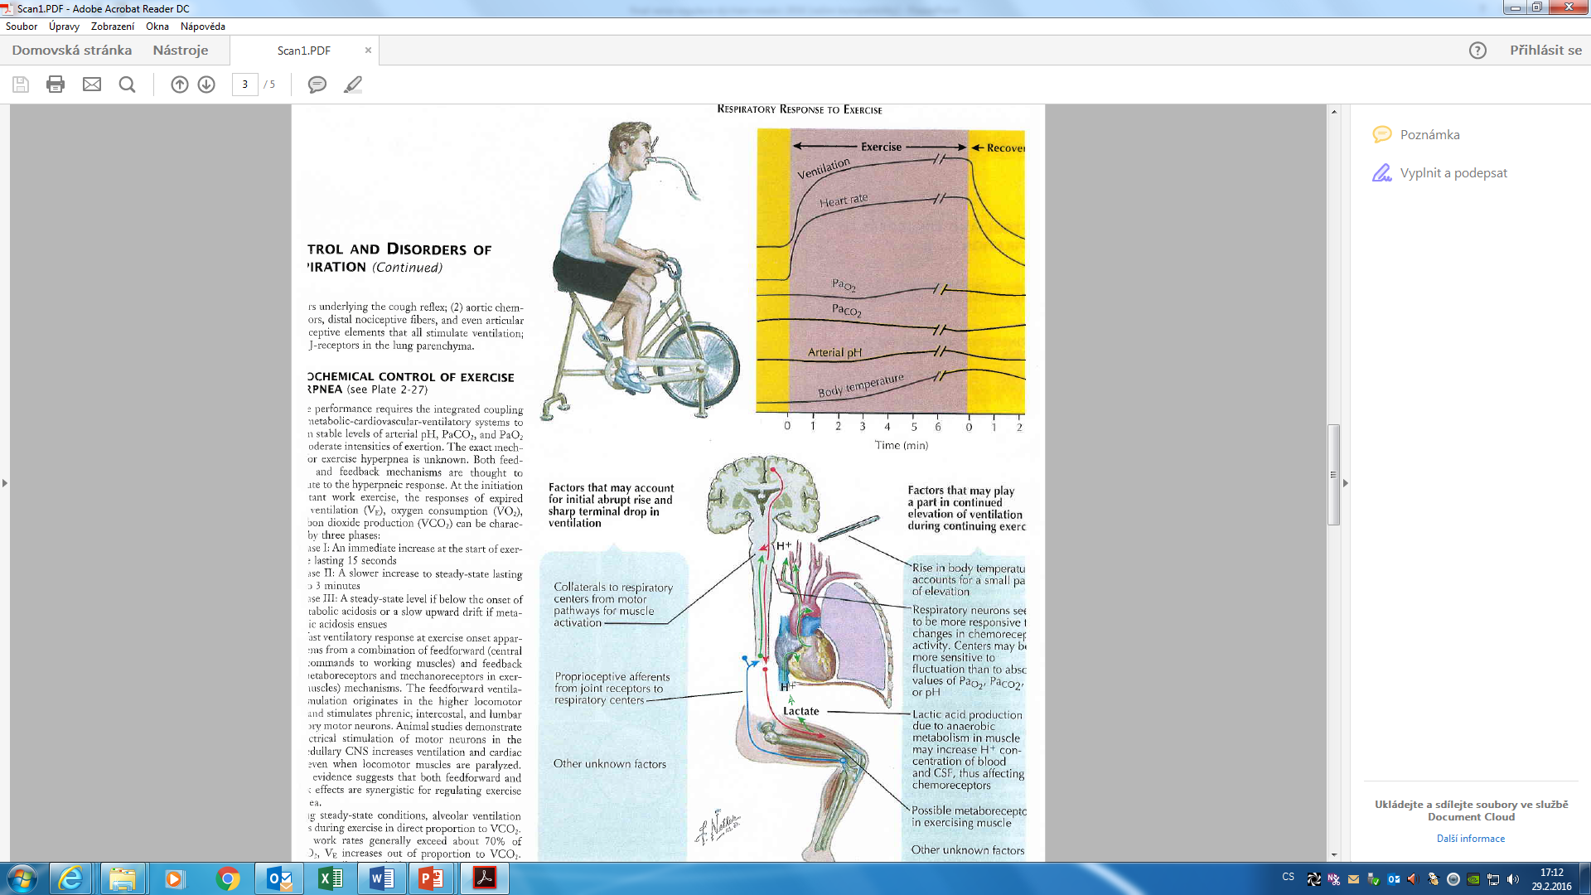

Slide 33
THANK YOU FOR YOUR ATTENTION

