Slide 1
Hana TAKAHASHI 1st year
Masaryk University Faculty of medecine

Slide 2
1.GENERAL TERMS

Slide 3
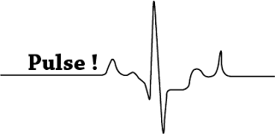
TYPES OF PULSE
pulsus, us, m. (L.) = sphygmo- (G.) = pulse e.g. sphygmometria
pulsatio, onis, f. = pulsation, spreading of the pulse wave along the arteries
pulsans, ntis = pulsating

Slide 4
2. Terms denoting a normal pulse

Slide 5
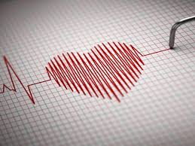
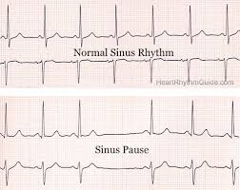
p.regularis = regular pulse
p. aequalis = even, steady pulse
p. plenus = full pulse, occurring when the arteries are filled with blood properly
By PYRO-ENERGEN

Slide 6
3. Terms denoting abnormal/pathological pulses

Slide 7
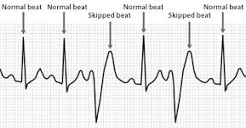
p. inaequalis = uneven pulse
p. irregularis = irregular pulse
p. intermittens = discontinuous pulse,
often owing to the long
pause following the
premature beat, extra long pauses occurring between pulse beat
Irregular pulse

Slide 8
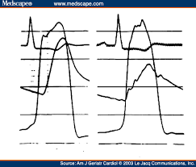
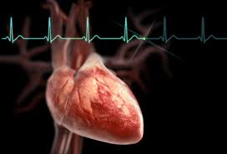
p. intercurrens
= irregular pulse associated
with heart extrasystoles
e.g. diziness due to blood circulatory failure
p. celer/frequens
= accelerated pulse,
tachycardia
e.g. artificial/ventricular fibrillation
p. tardus
= slow, rare pulse
e.g. SSS (Sick Sinus Syndrome) , A-V block
Intercurrent pulse
Slow pulse

Slide 9
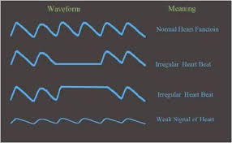
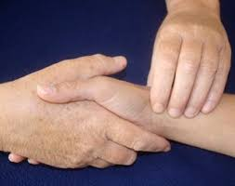
p. fortis/magnus = abnormally strong pulse
e.g. Corrigan pulse of Aortic insufficiency
p. mollis/parvus = shallow, weak pulse
p. durus = hard pulse
e.g. high blood pressure, arteriosclerosis

Slide 10
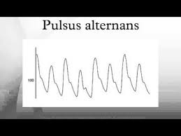
p. alternans = alternating pulse (strong pulse alternated with weak pulse)
e.g. CCM(congestive cardiomyopathy)
p. contractus/oppressus = oppressed, constrained pulse
p. insensibilis = impalpable pulse
From you tube

Slide 11
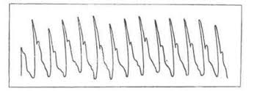
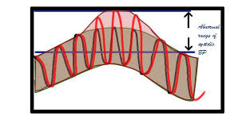
p. filiformis
= thready, wiry pulse
e.g. blood amount decreases, anaemia
p. vibrans
= quavery pulse, hardly palpable
p. paradoxus
= pulse getting weaker when inspiring, stronger when expiring
e.g. status asthmaticus
p.Filiformis by veterinatrua.ru
p.Paradoxus by CLINIPEDIA

Slide 12
p. undosus = wavy, uncertain pulse
p. di/tri/croticus = pulse with two/three waves in a pulse curve
p.Dicroticus by Pulse&JVP

Slide 13
Question ☺
How do you say ‘pulse’ in Greek?
Sphygmo
How do you say even and uneven pulse in Greek?
p. Aequalis
p.inaequalis
What Is the name of this pulse when the arteries are filled with blood properly?
p.plenus

Slide 14
How do you say ‘accelerated pulse’ in GREEK?
p.celer/frequens
How do you say abnormally strong and weak pulse?
p.fortis/magnus
p.mollis/parvus

Slide 15
How can you diagnose this pulse?
If the pulse is getting weaker when inspiring, stronger when expiring, how can you diagnose?
p.Filiformis
p.paradoxus

Slide 16
Thank you for your attention ☺

