Slide 1
NiTi ?

Slide 2
Biological Objectives
Of the Root Canal Treatment
Eliminate pulp and debris
Eliminate bacteria and endotoxins
From the root canal system

Slide 3
The Keys to Success
Shaping (apical taper or enlargement)
IRRIGATION
3D OBTURATION
(Lateral and apical seal)

Slide 4
IRRIGATION Protocole
- SODIUM HYPOCHLORITE (0,5% to 5.25%)
with
- LUBRICATING / CHELATING GEL (Glyde™)
And
- LIQUID EDTA (to eliminate smear layer)
Other solutions and irrigation devices are advocated to allow better desinfecting efficiency:
(Chlorhexidine, heat, ultrasonics, sonics…..)

Slide 5
Evaluation of Glyde File Prep in Combination with Sodium Hypochlorite as a Root Canal Irrigant
Grandini S. et al. J Endodon 2002 ; 28 : 300-303
_______________________________________________________
« Combined use of 2.5% Sodium Hypochlorite and Glyde File Prep allowed to obtain cleaner canal walls (less debris, less smear layer and a greater number of open dentinal tubules) than irrigation with saline or hypochlorite alone»

Slide 6
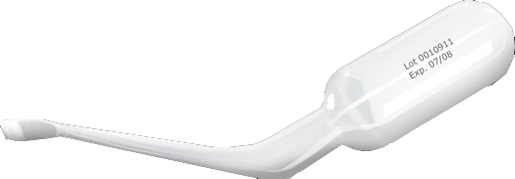
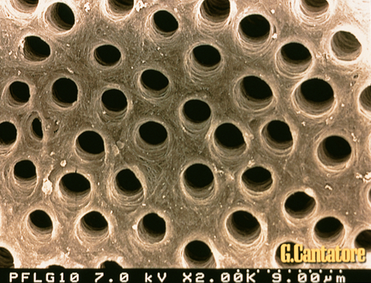
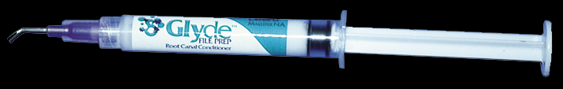
GLYDE File Prep™
Available in single dose compules
(avoids cross contamination)
EDTA
CARBAMIDE
PEROXIDE
HYDROSOLUBLE
GEL (GLYDE)

Slide 7
Drawbacks of Conventional Hand Stainless Steel Preparation Techniques
MISHAPS (ledges, canal blockade, zipping of foramen)
DEBRIS EXTRUSION WITH FILING MOTION
TIME CONSUMING
LESS PREDICTABLE SHAPES IN CURVED
CANALS

Slide 8
Advantages of
Rotary NiTi Techniques
LESS CANAL TRANSPORTATION
LESS DEBRIS EXTRUSION (LESS Post Op PAIN)
FASTER THAN HAND PREPARATION
MORE PREDICTABLE RESULTS

Slide 9
Characteristics of Rotary Nickel Titanium Instruments
Constant Taper
(All instruments)
Variable Taper
(ProTaper)
Cutting blades
Or
Non cutting blades
(Radial Land)
Cutting blades

Slide 10
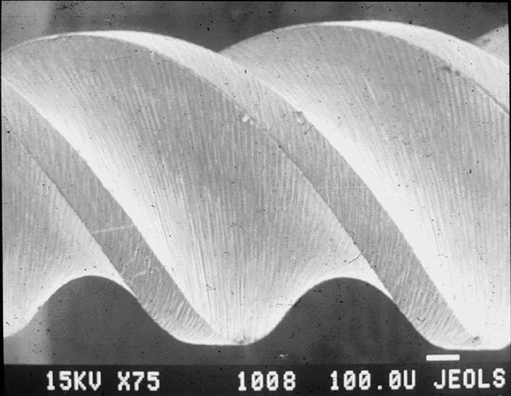
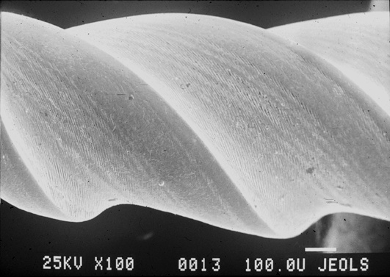
NON CUTTING BLADE
(with Radial Land)
ProFile, GT System, K3
CUTTING ACTIVE
BLADE
(Hero 642, HeroShaper,
Mtwo, Alpha File, RaCe)

Slide 11
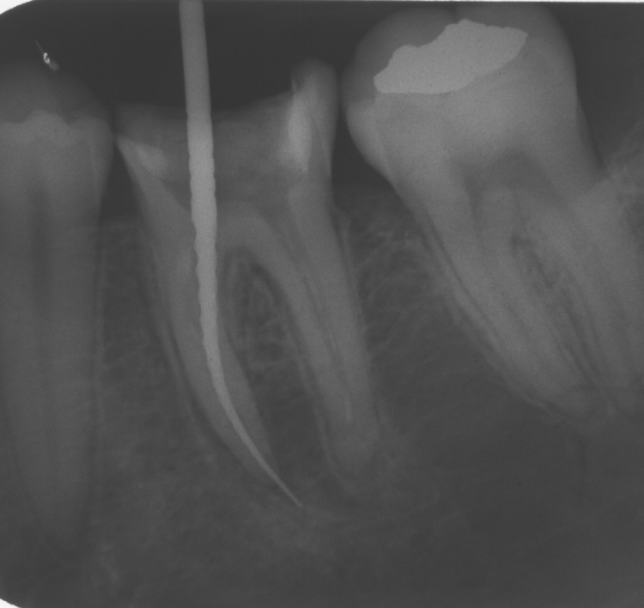
Rotary Instrument with
a Constant taper
and Cutting Blades
have a tendency to screw-in

Slide 12
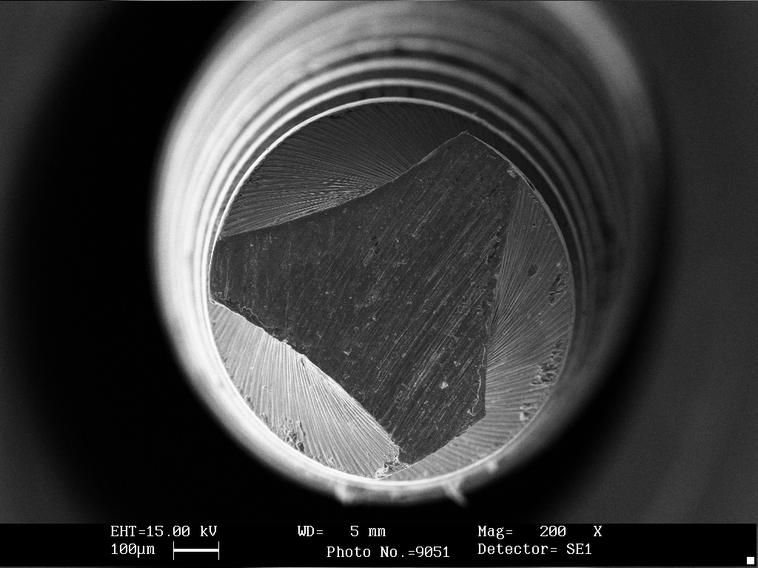
Rotary Instruments with a Constant taper and a Radial Land
Requires more pressure to cut and are subjected to more stress
(surface contact is
increased)
Berutti et al.J Endodon
2003;29:15-19

Slide 13
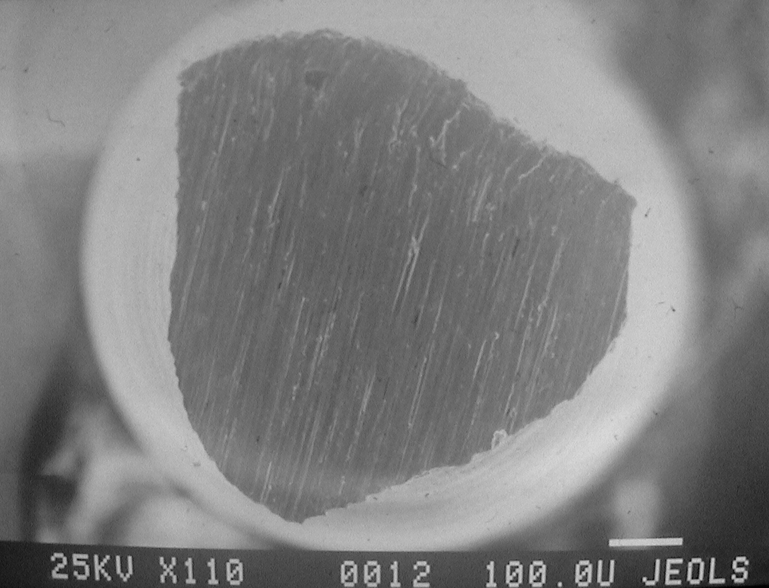
Rotary Instrument with a large cross-section
(central mass)
and a constant taper
are too stiff in taper higher than 4% to shape curvatures without risks of mishaps

