Slide 1
Drug delivery approaches, routes of administration, prolonged release preparations. Ondřej Zendulka

Slide 2
Drug dosage forms (DDF)
final form in which is the drug administered to patients
consists of active drugs and vehicles
enables the drug to be administered by the selected route
helps to administered accurate dose of the drug

Slide 3
DDF
protection of active substance (AS) against environmental influences (light, humidity)
protection of AS in human body (↓ pH in stomach)
adjustment of organoleptic properties (smell, taste)
influence of the PK properties:
release adjustment
targeted distribution of AS

Slide 4
Pharmacological differences between administration routes
Pharmacodynamic
change in the character of the drug‘s effect
Pharmacokinetic
local vs. systemic effect => local vs systemic administration
the change of the latence of the effect onset/duration. or toxicity

Slide 5
Administration/effect of drug
Local
drug absorption is limited
effect aimed on target tissue/organ
low risk of AE
effect depends upon final concentration
Systemic
drug is absorbed to systemic circulation
possible influence on whole body
higher risk of AE
effect depends on dose, bioavailability and DDF

Slide 6
Klasifikace aplikačních způsobů
enteral
local
type of effect
systemic
orally, rectally
on skin, mucosas, vaginal, intraocular,
intraarticular, intrathecal…
parenteral
parenteral
transdermal, intranasal, i.v., i.m., s.c., i.a., inhalations, i.o….
enteral
orally, rectally

Slide 7
Classification of administration routes
with regerd to the disrupotion of natural protective barriers
Non-invasive
vaginal, (intrauterine?)
sublingval
epicutaneous
oral
intranasal
inhalational
rectal
Invasive
intravenous
intraartrerial
intraoseal
intramuscular
subcutaneous
intradermal
implants

Slide 8
Systemic drug administration
Administration
inhalational
intramuscular
transdermal
intravascular
intrathecal
intraosseal
intraarticular
enteral
CSF
bone
joint
muscle
skin
intestine
brain
Systemic circulation
liver
lungs
bile
placent
foetus
milk and sweat glands
kidney
exhaled air
Excretion
milk, sweat
urine
faeces
upraveno dle Rang &Dále‘s Pharmacology 2011

Slide 9
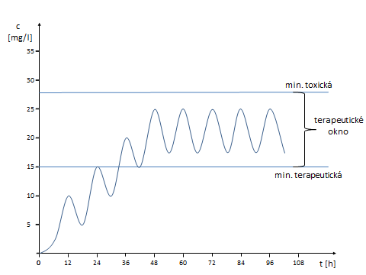
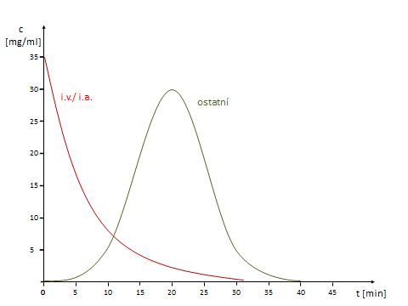
Types of administration with regard to the drug‘s profile of plasma levels
Single (bolus) drug administration
all DDF and routes of administrations
drugs are not cumulated in the body or in case of vaccination
Repeated drug administration
for the chronic therapy
following dose is administered before the previous is fully eliminated = drug cummulation

Slide 10
Typy aplikací léčiv vzhledem k plazmatickému profilu léčiva
35
c
[mg/ml]
30
i.v./ i.a.
other
25
Jednorázové (bolusové) podání léčiva
jakákoliv léková forma a cesta aplikace
nedochází ke kumulaci léčiva, často u akutních stavů nebo vakcinace
20
15
10
Opakované
pro chronickou terapii
následující dávka léčiva podána před plnou eliminací dávky předchozí = kumulace
5
0
0
5
10
15
20
25
30
35
40
45
t [min]

Slide 11
Typy aplikací léčiv vzhledem k plazmatickému profilu léčiva
c
[mg/l]
35
35
c
[mg/ml]
30
30
min. toxic
i.v./ i.a.
ostatní
25
25
Jednorázové (bolusové) podání léčiva
jakákoliv léková forma a cesta aplikace
nedochází ke kumulaci léčiva, často u akutních stavů nebo vakcinace
therapeutic
window
20
20
15
15
min. therapeutic
10
10
Opakované
pro chronickou terapii
následující dávka léčiva podána před plnou eliminací dávky předchozí = kumulace
5
5
0
t [h]
0
12
24
36
48
60
72
84
96
108
0
0
5
10
15
20
25
30
35
40
45
t [min]

Slide 12
Typy aplikací léčiv vzhledem k plazmatickému profilu léčiva
c
[mg/ml]
35
30
min. toxic
Kontinuální
léčivo podáváno/uvolňováno z lékové formy konstantní rychlostí
ustálení plazmatických koncentrací
i.v. infuze, pumpy, náplasti, implantáty, depotní injekce, vag. kroužky a intrauterinní tělíska
25
therapeutic window
20
15
min. therapeutic
10
5
0
t [h]
0
2
4
6
8
10
12
14
16
18

Slide 13
Administration routes for local effect
intraurethral, intravesical, intracavernal
dental, gingival, oral
endotracheopulmonal
intraaural
intraamniotic
intracoronar
conjunctival, intrathecal, intraocular, intraarticular

Slide 14
Conjunctival administration
usually eye drops and ointments
local effect
risk of systemic AE
specific quality requirements - sterility

Slide 15
Intrathecal/intracerebral/intracerebroventricular administration
to the subarachnoideal space/ brain/ brain vetricles

Slide 16
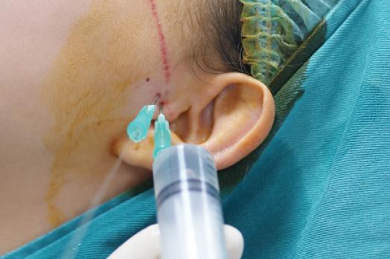
Intraarticular administration
analgesics/antiphlogistics
hyaluronic acid
for local effect
intravitreal implants in macular degeneration
Intraocular administration

Slide 17
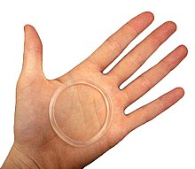
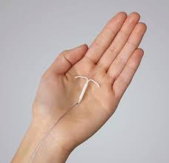
Vaginal, endocervical, intrauterinal
1. local effect
minimum of AE
specific adjuvants ↓ pH
antibiotics, antimycotics, antiparasitics
2. systemic effect
vaginal rings intrauterine devices
controlled drug release
contraceptives
The Liletta hormonal IUD (credit: Medicines360 )

Slide 18
Epicutaneous/transdermal administration
Local effect
ointments, creams, solutions, patches
minimal AE
dermatology
Systemic effect
transdermal administration
mainly patches
continuous release
local+systemic AE
high compliance
easy discontinuation

Slide 19
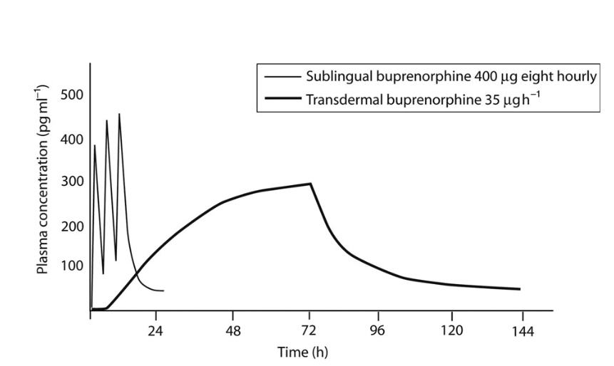
Margetts, Contin Educ Anaesth Crit Care Pain, 2007, 7, 171-176

Slide 20
Intranasal administration
drops, sprays, ointments
local effect - antiseptics, ATB
- antihistamines, decongestants
- antiphlogistics
systemic effect - analgesics, antivirotics
- hormones (ADH, gonadotropin, insulin)

Slide 21
Inhalation
gases, aerosols
systemic effect – general anesthetics
local effect – antiasthmatics
fast onset of effect
minimal presystemic elimination
administration from spray cans or other instruments (turbohaler, dischaler, nebuliser)

Slide 22
Rectal administration
suppositories, capsules, tablets, foams, tampones
alternative for peroral administration in case of nausea/vomitting or unconciousness
variable drug absorption

Slide 23
Sublingual administration
fast onset of effect
oinly for small and lipiphilic molecules
sprays, tablets, dispergable films
analgesics – fentanyl, buprenorfin
hypnotics – zolpidem
vazodilators – nitroglycerine
antiemetics – ondansetrone
homeopatics, alergens, cannabis….

Slide 24
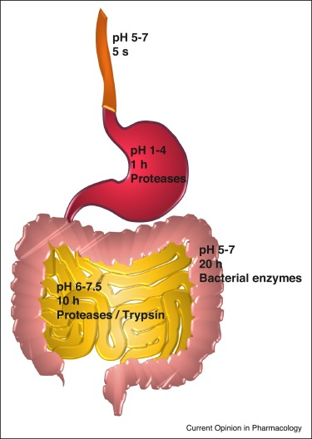
Oral administration
Salvador et al. 2017
1. for local effect
minimal AE
risk of interaction with coadministered drugs
antacids, laxatives, antibiotics
2. for systemic effect
drug absorbed from different parts of GIT
can be influenced by DDF
„slow“ effect onset
the effect depends on patients „compliance“

Slide 25
Perorální lékové formy s řízením uvolňováním
systems of controlled release: matrix
reservoirs
particles
nanoparticles
controlled release: continuous
pulsatile

Slide 26
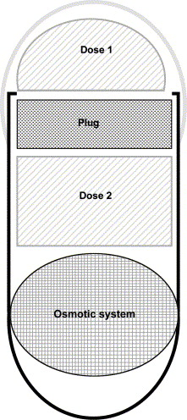
Lobenberg et al, Eur J Pharmaceut Biopharmaceut , 60 2005

Slide 27
Injections
intravenous, intraarterial
injection/infusion
100% bioavailability, „immediate“ effect
true solutions + emulsions
intramuscular
max. volume 5 ml
to m. glu. maximus
absorption: solution> emulsion> suspension
subcutaneous
to 2 ml
variable absorption with regard to adipose tissue

Slide 28
Injections
intradermal
minimal volume
diagnostic purposes
intraosseal
alternative to i.v.
injection/infusion
Eg. Atropine onset of the effect
i.v. 30-90 s; s.c. 15-30 min; i.m. 30-45 min

Slide 29
Implants
degradable/nondegradable
usually s.c. or intraocular
systemic/local effect
continuous/pulsatile release = continuous/repeated drug administration
increased patient‘s compliance
complicated discontinuation

Slide 30
Factors influencing the drug delivery approach
drug physicochemical properties
therapeutic indication + disease severity
benefit:risk ratio
co-morbidities, co-medications

Slide 31
Innovations in drug administration
new posssibilities of administration routes are probably depleted => modification of DDF
the goals are:
1. increase of drug safety/decrease of drug toxicity
2. increase the efficacy of administered dose
3. increase the patient‘s compliance
Notes:
for more see Current Opinion in Pharmacology, vol 36, 2017

