Slide 1
URINARY SYSTEM

Slide 2
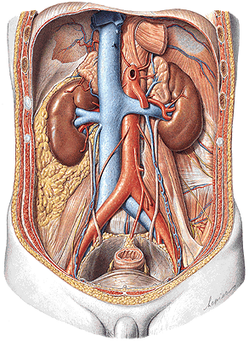
FUNCTIONS
PARTS
Removal of waste product
from the body
Regulation of electrolyte
balance
Regulation of acid-base
homeostasis (blood pH)
Controling blood
volume and maintaining
blood pressure
Kidney (ren)
Efferent urinary tract: renal calices
renal pelvis
ureter
urinary bladder urethra

Slide 3
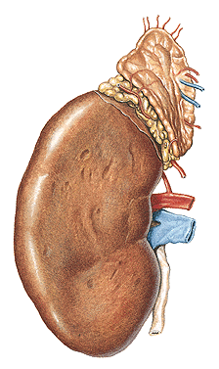
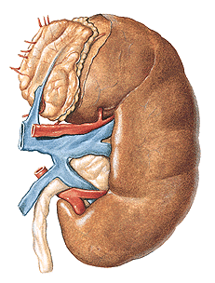
REN, NEPHROS - facies anterior et posterior
- margo lateralis et medialis - hilum renale
- sinus renalis
- extremitas superior et inferior
L
R

Slide 4
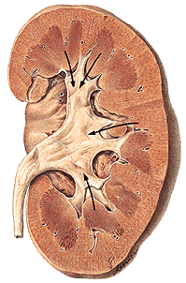
Capsula fibrosa
Sinus renalis
Cortex renalis
Medulla renalis
– 6-20 pyramides renales
Columnae renales
Papilla renalis
Ductus papillares
Foramina papillaria
Area cribrosa
Lobus renalis

Slide 5
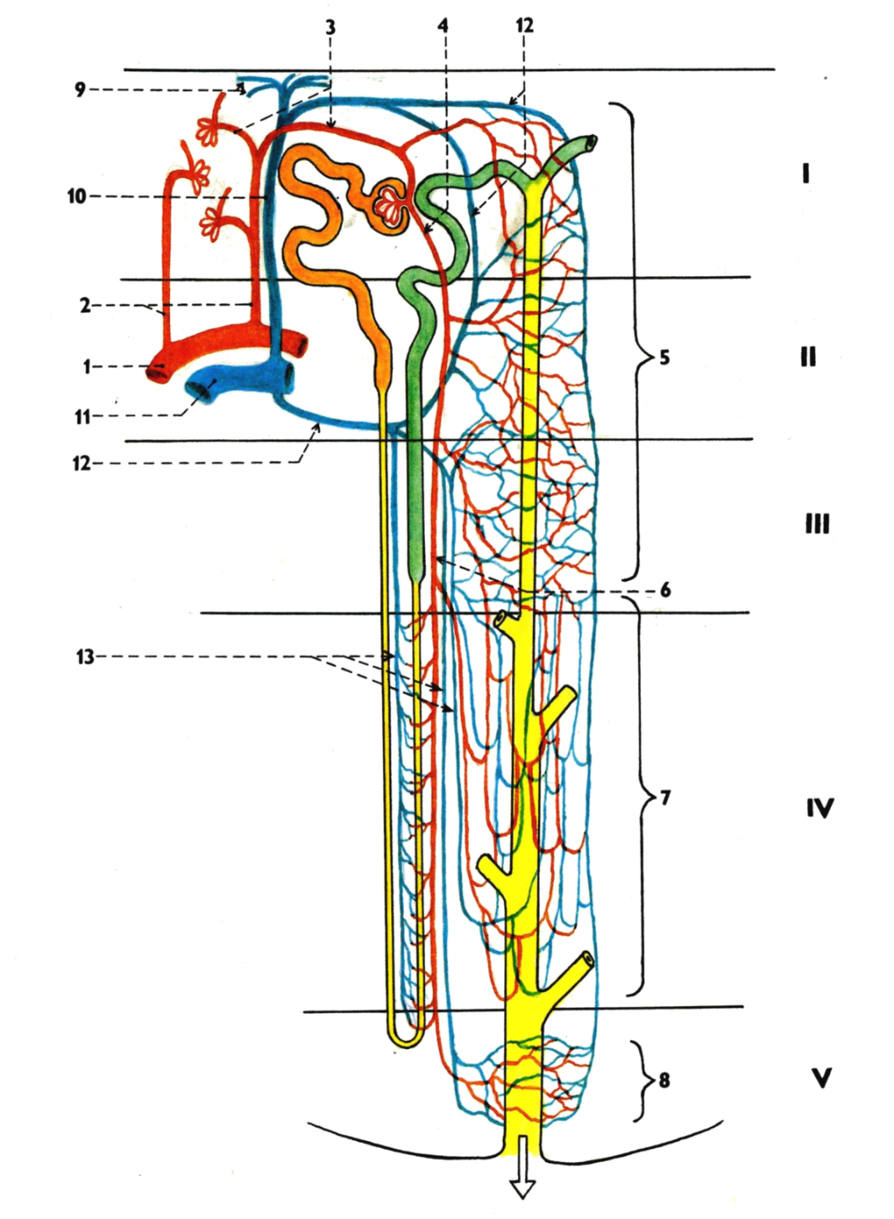
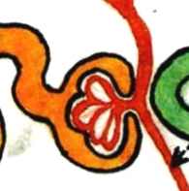
NEPHRON
Corpusculum renale (Malpighi)
- Glomerulus
- Capsula glomeruli (Bowman)
Tubulus proximalis
Henle’s loop
Tubulus distalis
Tubulus colligens
Ductus papillaris
Foramen papillare
200 µm

Slide 6
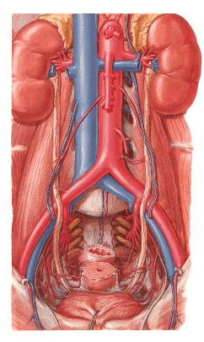
renalis
- r. anterior – 4 rr. praepelvici
- r. posterior – r. retropelvicus

Slide 7
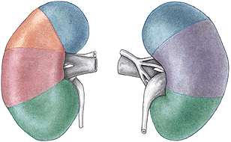
Segmenta renalia – s. superius
- s. anterius superius
- s. anterius inferius
- s. inferius
- s. posterius

Slide 8
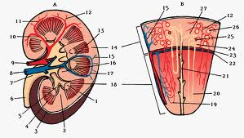
- aa. lobares – aa. interlobares – aa. arcuatae

Slide 9
Aa. interlobares:
1. A. arcuata
2. A. interlobularis
3. Vas afferens
4. Vas efferens
5. Peritubular capillary plexus
6. Arteriola recta
7. Capillary plexus in the medulla
8. Capillary plexus around
papillary duct
9. Venulae stellatae
10.V. interlobularis
11.V. arcuata
12.Vein from the peritubular plexus
13.Venulae rectae

Slide 10
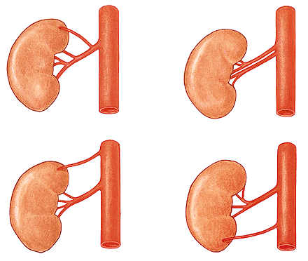
Aa. renales accessoriae

Slide 11
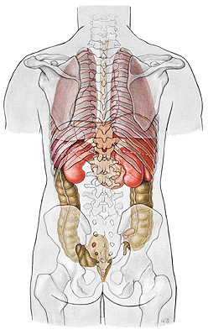
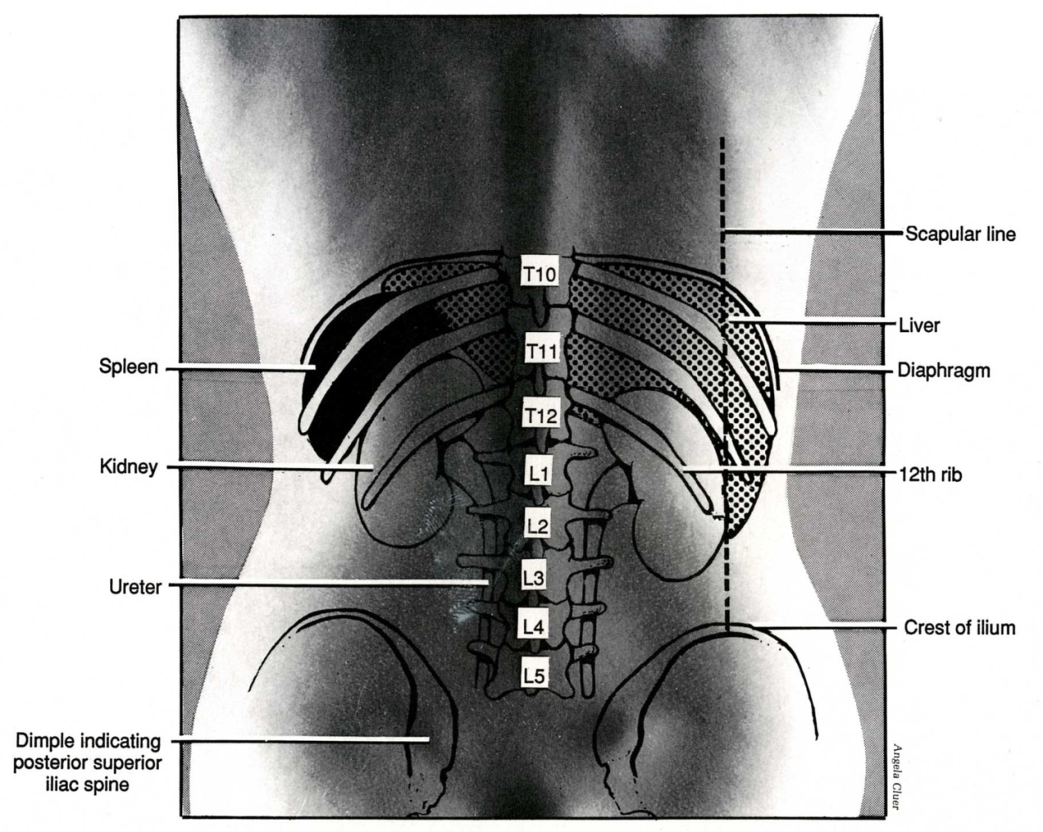

Slide 12
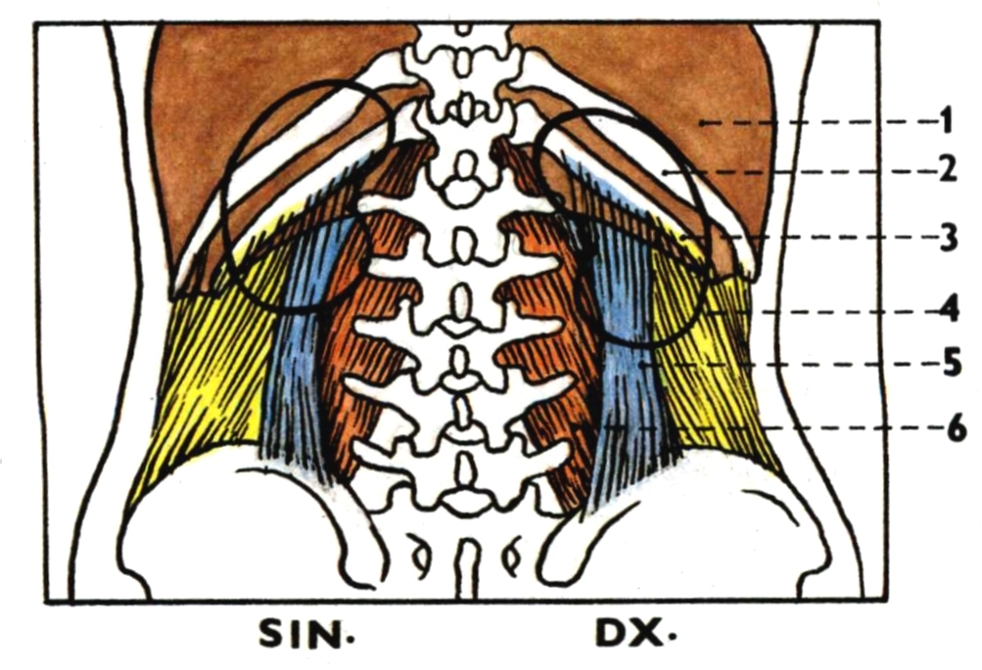
Diaphragma 4. M. transversus abdominis
11th rib 5. M. quadratus lumborum
12th rib 6. M. psoas major

Slide 13
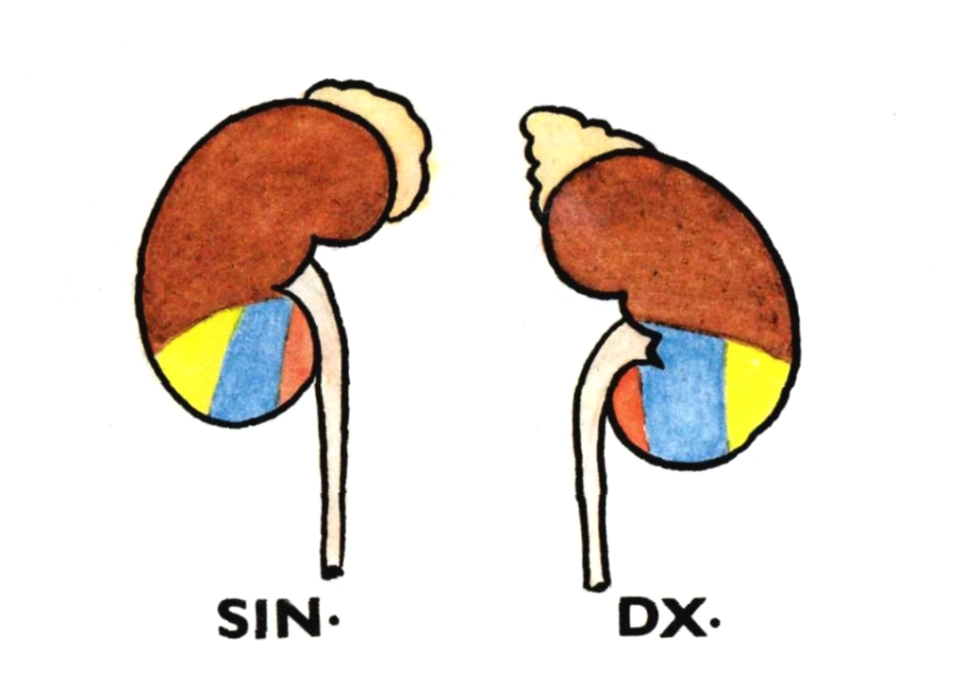

Slide 14
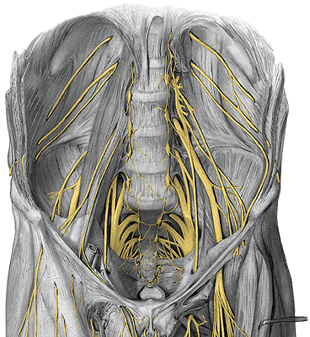
N. subcostalis
N. iliohypogastricus
N. ilioinguinalis

Slide 15
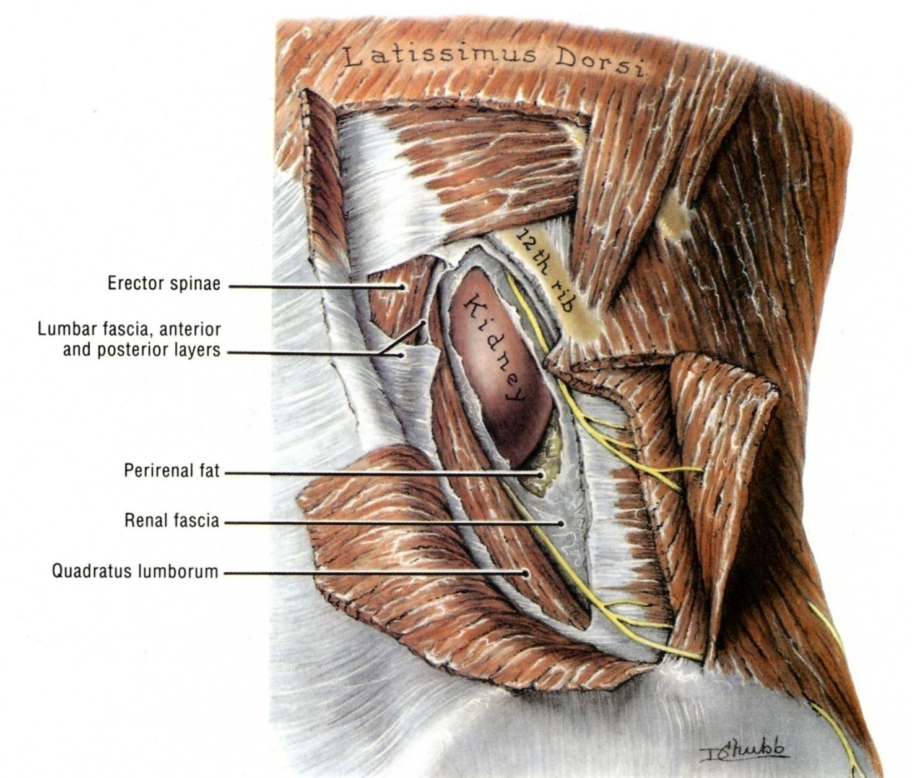

Slide 16
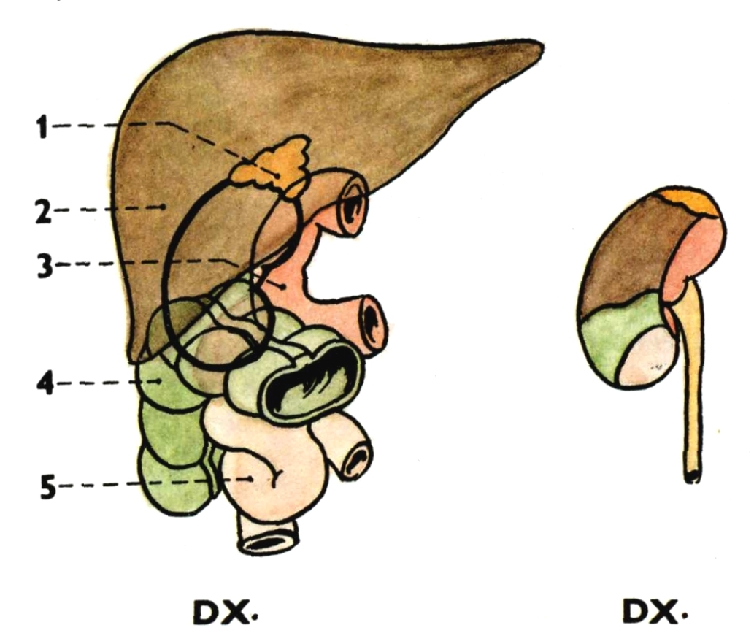
Gl. suprarenalis dx.
Liver
Duodenum
Flexura coli dx.
Jejunum

Slide 17
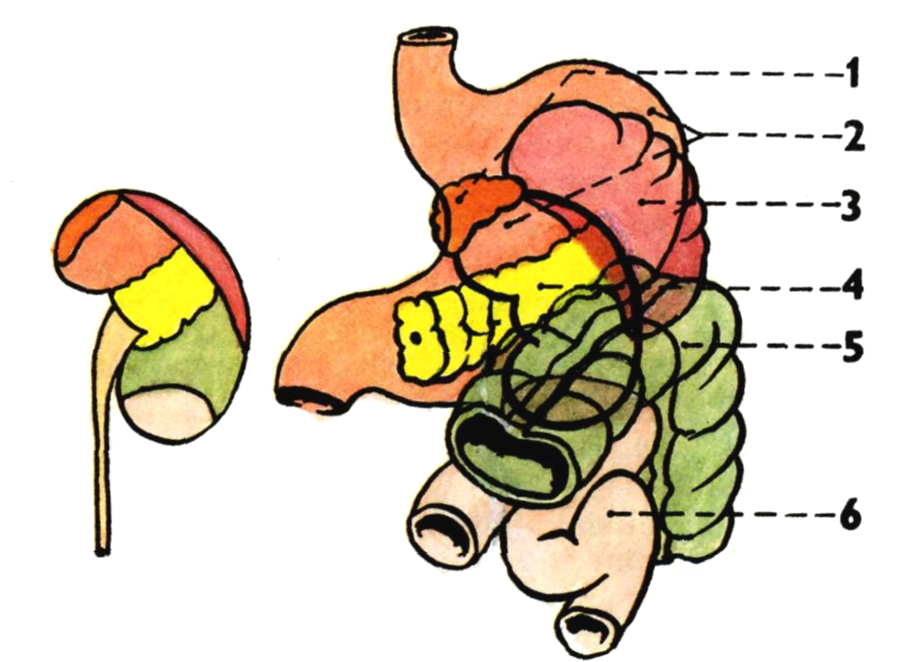
Gl. suprarenalis sin.
Stomach
Spleen
Pancreas
Flexura coli sin.
Jejunum
SIN.

Slide 18
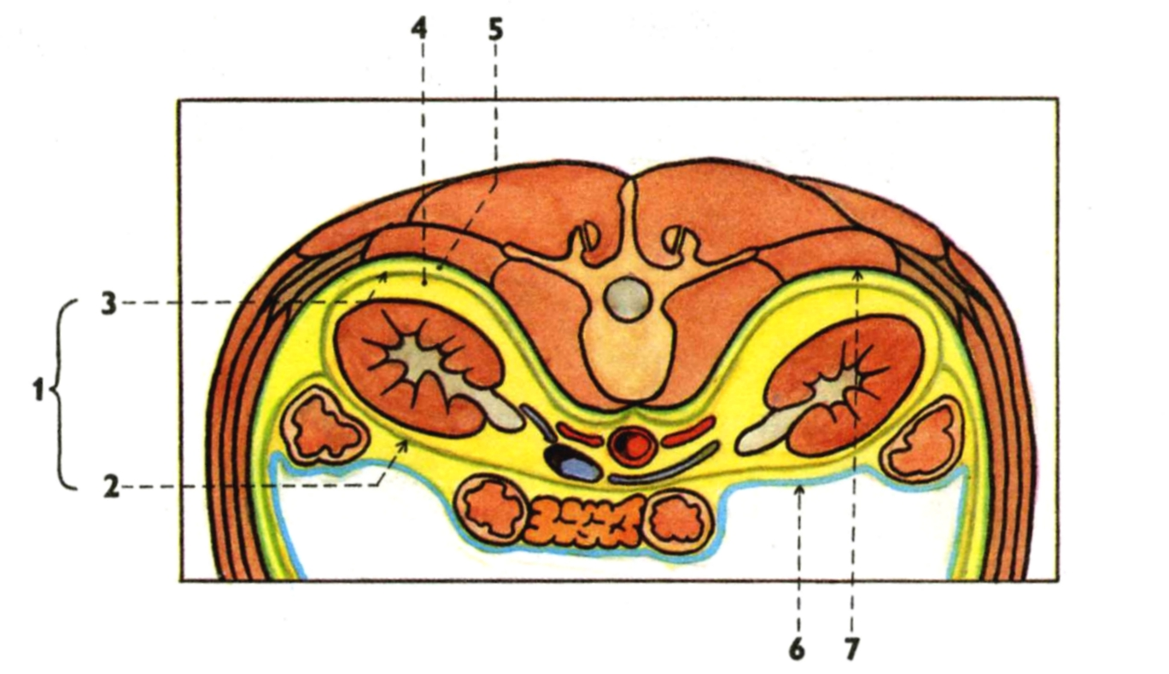
Fascia renalis 5. Corpus adiposum pararenale
Lamina praerenalis 6. Peritoneum
Lamina retrorenalis 7. Fascia transversalis
Capsula adiposa
REN MIGRANS

Slide 19
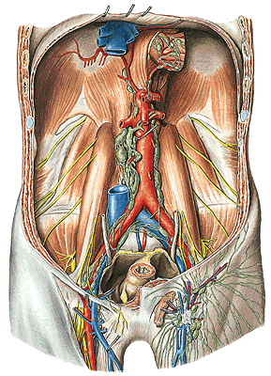
Nll. lumbales
(paraaortici)
tr. lumbalis dx. et sin.
Notes:
Lymphatic vessels, Vasa lymphatica, lymph nodes, Nodi lymphatici, of the pelvic wall in the female; the pelvis has been sectioned in the median plane; the uterus has been pulled sinistroventrally; most of the peritoneum has been removed; lateral view (right). The lymph nodes shown here are often much smaller but always present. Via the lymphatic vessels in the round ligament (Lig. teres uteri) tumor cells may spread from the uterus to the superficial inguinal lymph nodes.

Slide 20
renculi marking
ren arcuatus
ren duplex
ren sigmoideus
ren fungiformis
agenesia renis

Slide 21
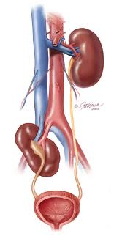
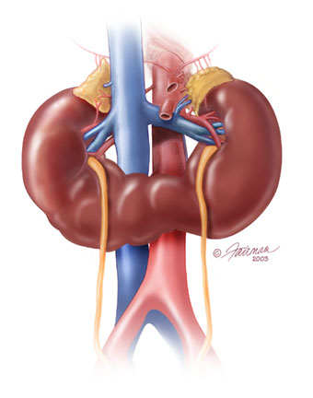
Ectopic kidney x ren migrans
Horseshoe kidney

Slide 22
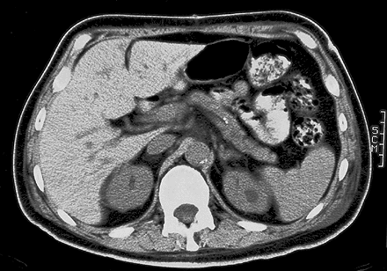
Cross-sectional image through the L1 obtained with CT

Slide 23
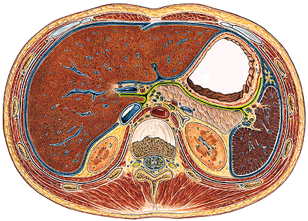
Transverse section through the intervertebral disc between T12 and L1

Slide 24
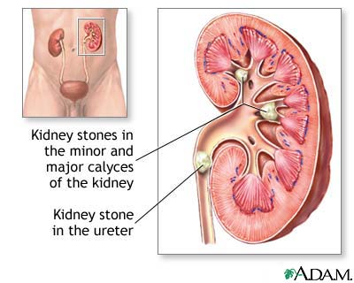
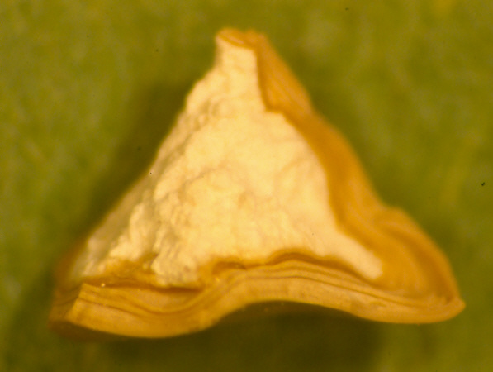
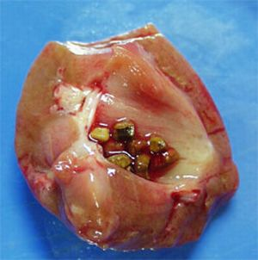
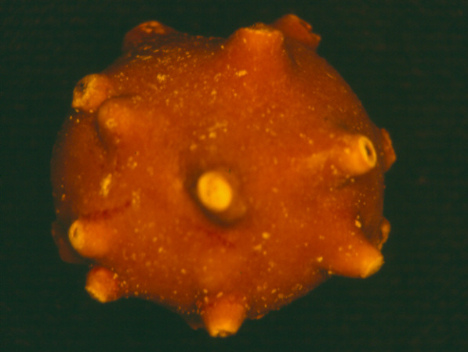
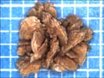
Nephrolithiasis
Calcium oxalate crystals – 80%
Uric acid – 5 - 10%

Slide 25
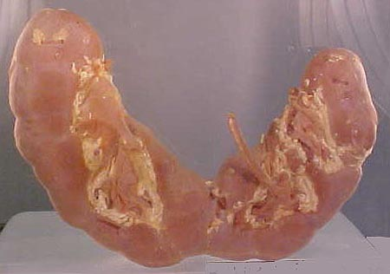
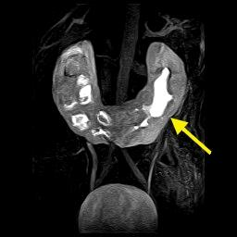
Horseshoe kidney

Slide 26
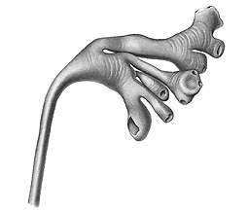
CALICES RENALES – minores et majores
PELVIS RENALIS (PYELUM)

Slide 27
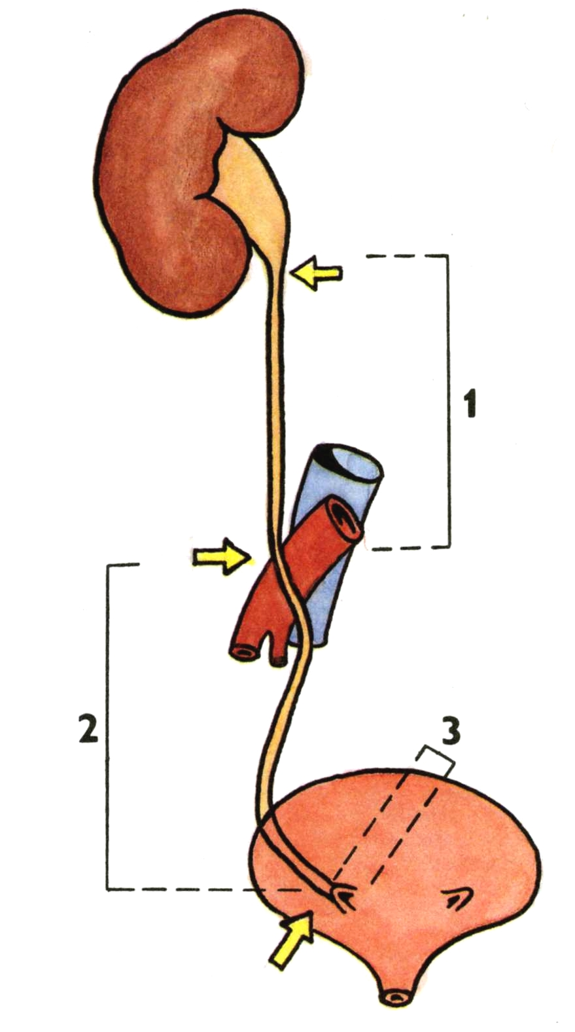
URETER
pars abdominalis
pars pelvina
pars intramuralis
ostium ureteris

Slide 28
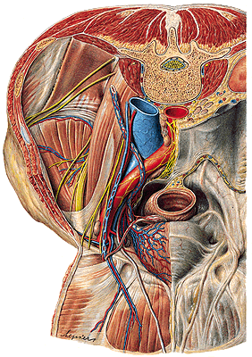
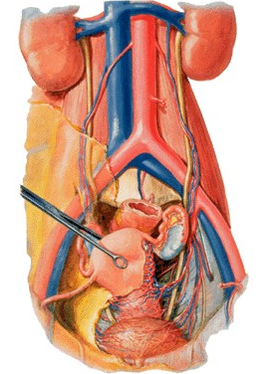

Slide 29
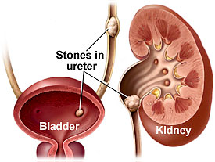
3 physiological constrictions
Point of LANZ
(appendix
vermiformis)

Slide 30
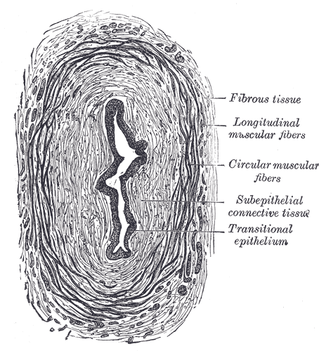
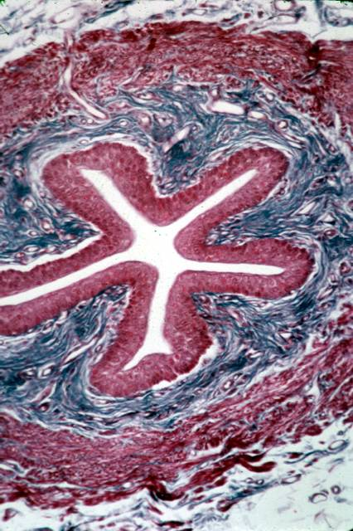
Adventitia
Plicae longitudinales

Slide 31
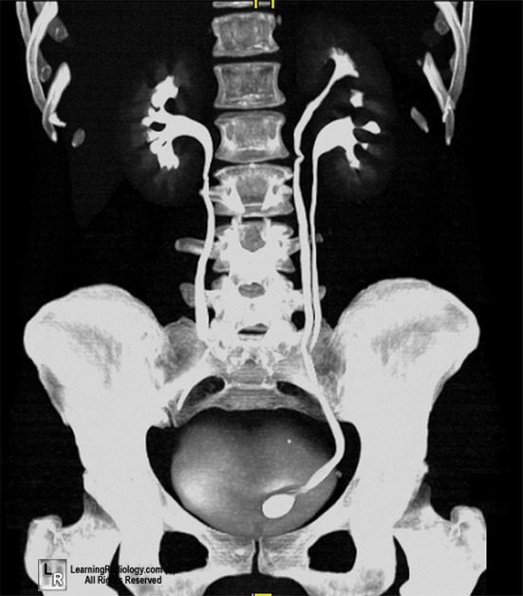
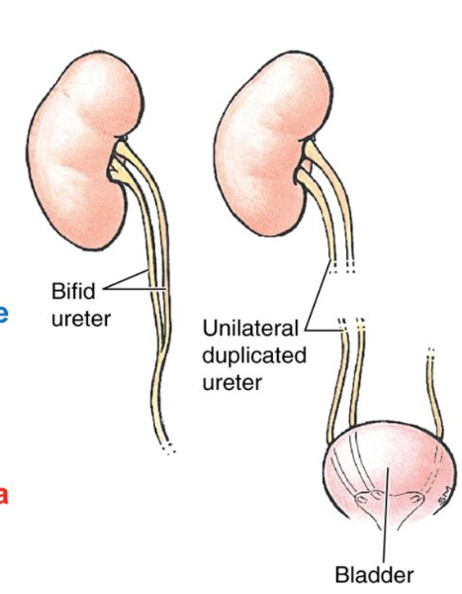
Duplicated ureter

Slide 32
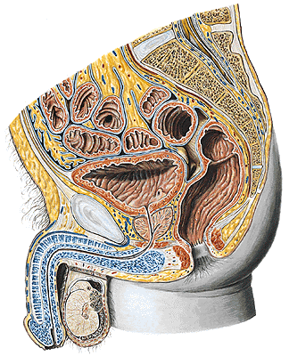
VESICA URINARIA
fundus vesicae
corpus vesicae
apex vesicae
- lig. umbilicale medianum
cervix vesicae

Slide 33
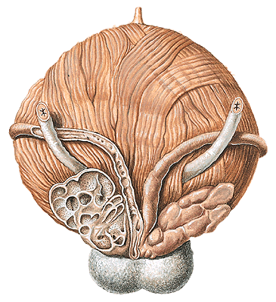
Male - dorsal aspect of urinary bladder
Ductus deferens
Female – anterosuperior aspect
A. uterina

Slide 34
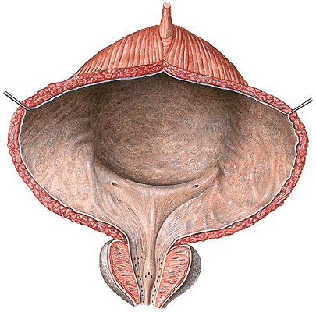
Trigonum vesicae – ostia ureterum
– ostium urethrae internum
– plica interureterica
– fossa retrotrigonalis
– uvula vesicae
– m. detrusor
– m. sphincter vesicae
– m. sphincter urethrae

Slide 35
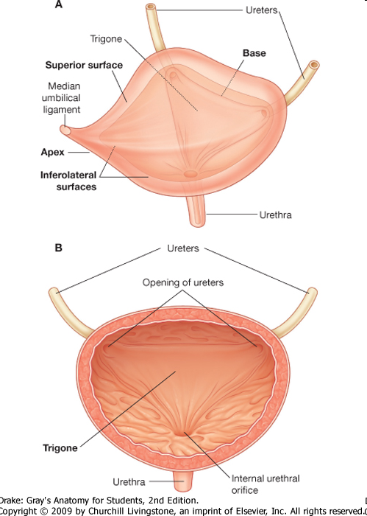
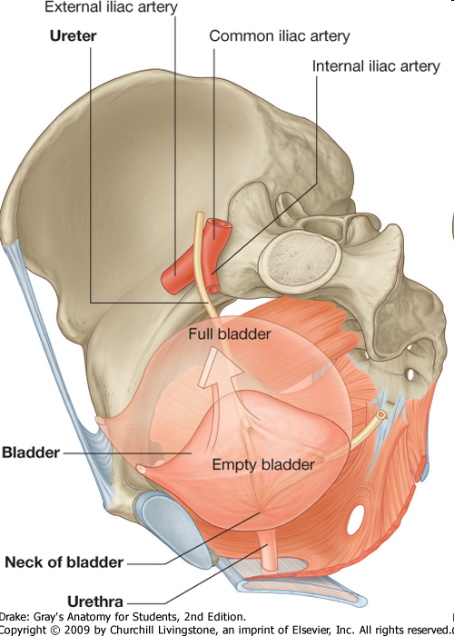

Slide 36
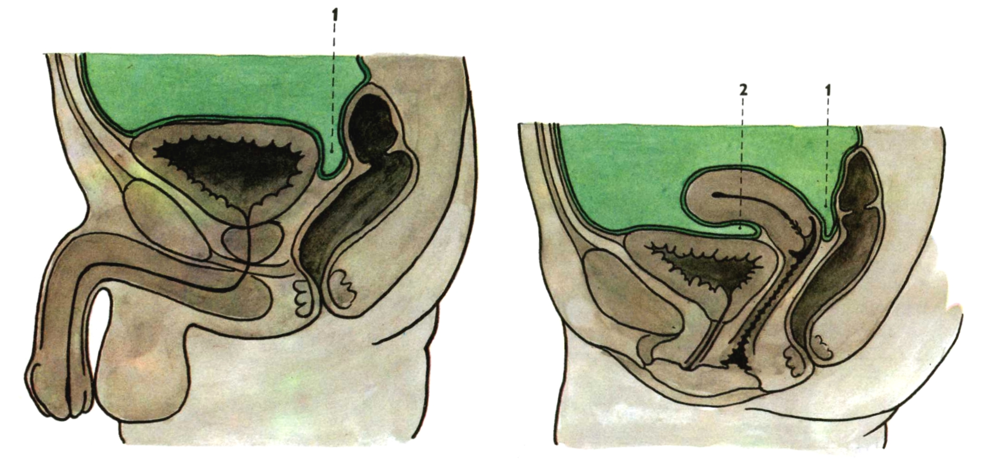
Median section through
the male pelvis
1. Excavatio rectovesicalis
Median section through
the female pelvis
Excavatio rectouterina
Excavatio vesicouterina
Paracystium

Slide 37
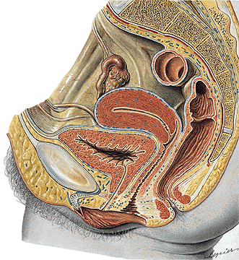
URETHRA FEMININA
Ostium urethrae internum
M. sphincter urethrae
Ostium urethrae externum

Slide 38
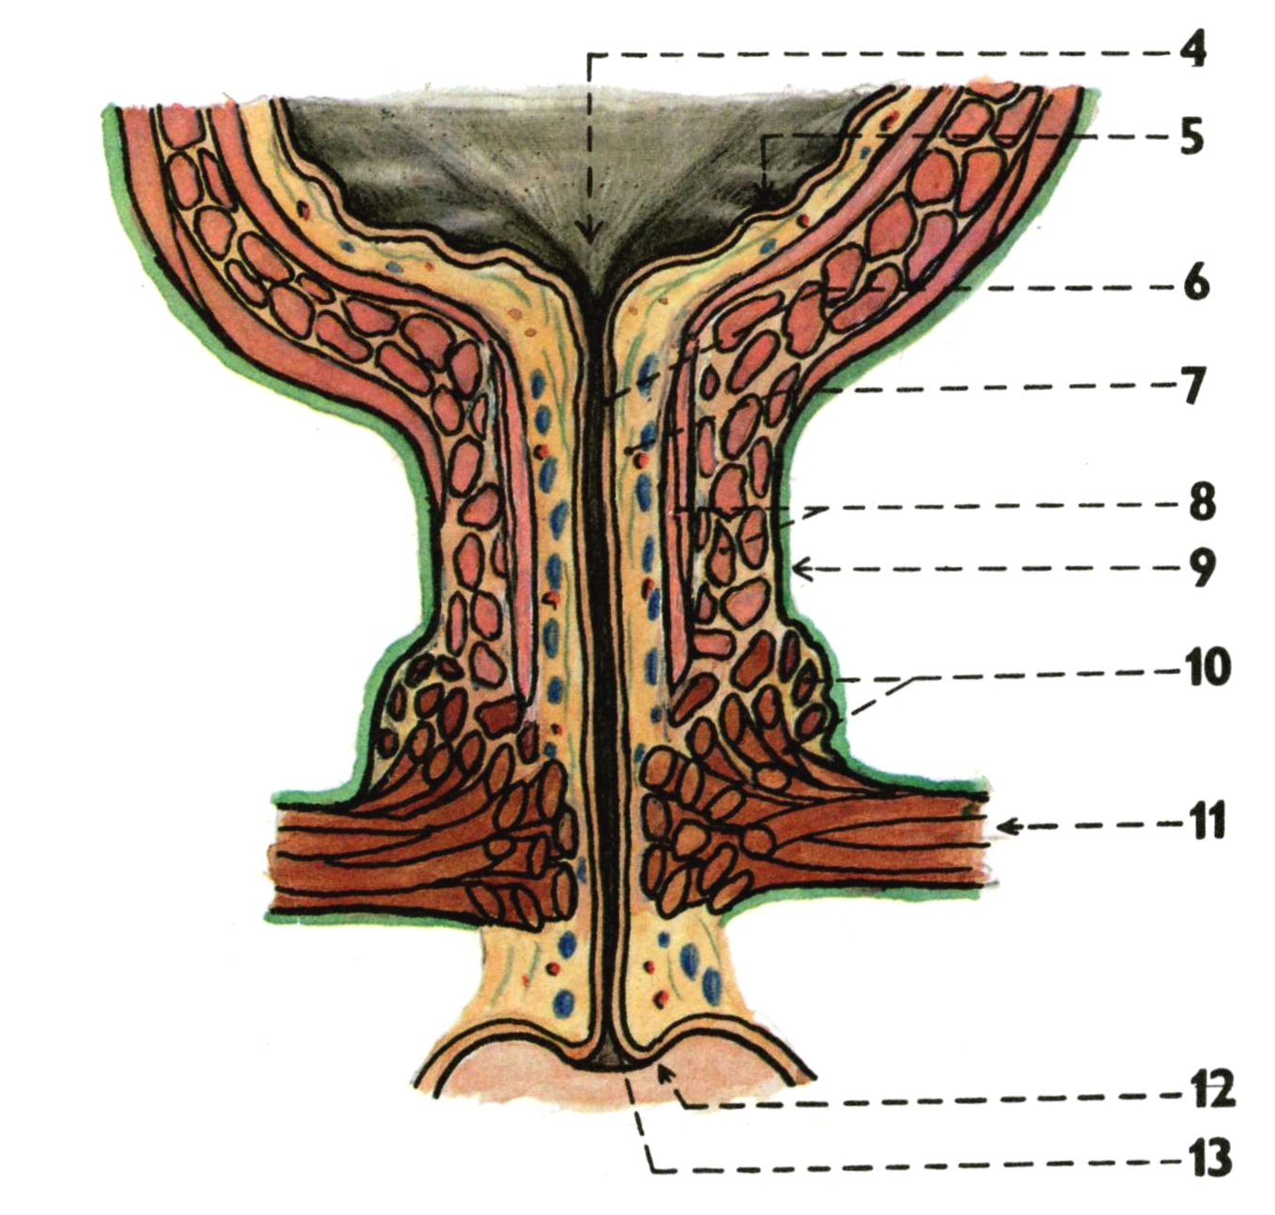
URETHRA FEMININA
Crista urethralis
Lacunae urethrales
Glandulae urethrales
Ductus paraurethrales

Slide 39
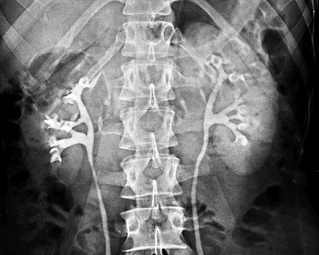
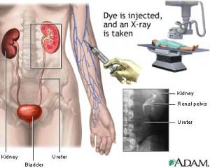
Intravenous urography
IVU

Slide 40
Retrograde pyelography

Slide 42
Cystography

Slide 43
Vesicoureteral reflux (VUR) – voiding cystourethrogram (VCU)

Slide 44
Retrocaval ureter

Slide 45
Ureter duplex

Slide 46
MALE GENITAL ORGANS (ORGANA GENITALIA MASCULINA)

Slide 47
Organa genitalia interna:
Testis
Epididymis
Ductus deferens
Urethra masculina
Vesicula seminalis
Prostata
Organa genitalia externa:
Penis
Scrotum

Slide 48
Development: Wolffian ducts
Müllerian ducts

Slide 49
TESTIS
Facies medialis
Facies lateralis
Extremitas superior
Extremitas inferior
Margo anterior
Margo posterior
Lamina visceralis tunicae vaginalis
(Epiorchium)

Slide 50
Tunica albuginea
Mediastinum testis
Septula testis
Lobuli testis
Hilum testis
Tubuli seminiferi contorti
Spermatozoa
Interstitial cells of Leydig
Tubuli seminiferi recti
Rete testis
Ductuli efferentes testis

Slide 51
A. testicularis
Plexus pampiniformis
- vv. testiculares
Nll. lumbales

Slide 52
EPIDIDYMIS
Caput epididymidis
Corpus epididymidis
Cauda epididymidis
Sinus epididymidis
Lig. epididymidis sup. et inf.
Lig. scrotale
(Gubernaculum testis)
Lobuli epididymidis
Ductus epididymidis

Slide 53
DESCENSUS TESTIUM
Gubernaculum testis → Lig. scrotale
Processus vaginalis → Tunica vaginalis
Lig. vaginale
Retentio testis (cryptorchidism). Ectopia testis.

Slide 54
DUCTUS DEFERENS (VAS DEFERENS)
Pars epididymica
Pars funicularis
Pars inguinalis
Pars pelvina
Ampulla ductus deferentis - diverticula ampullae
Ductus ejaculatorius – colliculus seminalis

Slide 55
FUNICULUS SPERMATICUS: A. testicularis
Plexus testicularis
Plexus pampiniformis
Ductus deferens
A. ductus deferentis
Plexus deferentialis

Slide 56
COVERINGS OF THE TESTIS, EPIDIDYMIS AND SPERMATIC
CORD
Epiorchium (Lamina visceralis tunicae vaginalis)
Periorchium (Lamina parietalis tunicae vaginalis)
Cavum serosum scroti

Slide 57
Fascia spermatica interna (Fascia transversalis)
Fascia cremasterica - M. cremaster
(M. obliquus abdominis internus, M. transversus abdominis)
Fascia spermatica externa (Fascia abdominis superficialis)

Slide 58
CANALIS INGUINALIS
Posterior wall:
Fascia transversalis:
Falx inguinalis
Trigonum inguinale
(Hesselbachi)
Lig. interfoveolare
Anulus inguinalis prof.
Tractus iliopubicus
Anulus femoralis

Slide 59
CANALIS INGUINALIS
Inferior wall:
Lig. inguinale

Slide 60
CANALIS INGUINALIS
Anterior wall:
Aponeurosis m. obliqui
externi abdominis
Anulus inguinalis spf.
- crus mediale
- crus laterale
- fibrae intercrurales
- lig. inguinale reflexum

Slide 61
CANALIS INGUINALIS
Superior wall:
M. obliquus internus abdominis
M. transversus abdominis
- M. cremaster

Slide 62
Plica umbilicalis mediana
- lig. umbilicale medianum
Plica umbilicalis medialis
- lig. umbilicale mediale (laterale)
(pars occlusa a. umbilicalis)
Plica umbilicalis lateralis
- vasa epigastrica inf.
Fossa supravesicalis
Fossa inguinalis medialis
(trig. Inguinale)
Fossa inguinalis lateralis
(anulus inguinalis prof.)

Slide 64
Fossa supravesicalis
- hernia supravesicalis (c)
Fossa inguinalis medialis
- hernia inguinalis directa (b)
Fossa inguinalis lateralis
- hernia inguinalis indirecta (a)

Slide 65
VESICULA SEMINALIS
Ductus excretorius
Ductus ejaculatorius
PROSTATA
Basis
Apex
Facies anterior
Facies posterior
Facies inferolaterales
Lobus medius
Lobus dexter et sinister
Isthmus

Slide 66
Seminal vesiculography

Slide 67
Crista urethralis
Colliculus seminalis
Utriculus prostaticus
Ductus ejaculatorii
Sinus prostatici

Slide 68
Capsula propria
Plexus venosus prostaticus
Fascia periprostatica
Lig. puboprostaticum
Lig. sacrogenitale
Septum rectovesicale
(Denonvilliersʼ fascia)

Slide 70
GLANDULAE BULBOURETHRALES
Ductus gl. bulbourethralis
URETHRA MASCULINA
Ostium urethrae internum
Ostium urethrae externum
Pars intramuralis – M. sphincter vesicae
Pars prostatica
Pars membranacea – M. sphincter urethrae
Pars spongiosa – Ampulla urethrae
Corpus spongiosum penis
Fossa navicularis
Valvula fossae navicularis
Glandulae urethrales
Lacunae urethrales

Slide 71
Curvatura subpubica
Curvatura praepubica
Urethra mobilis (anterior)
Urethra fixa (posterior)

Slide 72
EXTERNAL GENITAL ORGANS
PENIS: Radix
Corpus
Glans
Praeputium
SCROTUM

Slide 73
PENIS
Glans penis Glandulae praeputiales
Collum glandis Smegma praeputii
Corona glandis Frenulum praeputii
Dorsum penis Corpus cavernosum
Facies urethralis Corpus spongiosum
Raphe penis Tunica albuginea
Praeputium Trabeculae
Ostium praeputii Cavernae
A. penis prof. → aa. helicinae

Slide 74
Corpus cavernosum
- crura penis - crista phalica
A. profunda penis
Corpus spongiosum
- bulbus penis
- glans penis

Slide 75
COVERINGS OF PENIS:
Fascia penis profunda
(Aa., Nn. dorsales penis, V. dorsalis penis profunda)
Fascia penis superficialis
(Vv. dorsales penis spf.)
Lig. fundiforme penis
Lig suspensorium penis

Slide 76
SCROTUM
Raphe scroti
Pubes
Tunica dartos scroti
Septum scroti
Cavitas scroti

Slide 77
ANATOMICAL BASIS OF ERECTION
Parasympathetic stimulation
– relaxation of smooth muscle in cavernae and
aa. helicinae, compression of venous plexuses by
bulbospongious and ischiocavernous muscles → erection
Sympathetic stimulation
- contraction of smooth muscle of aa. helicinae, relaxation of
bulbospongious and ischiocavernous muscles, drainage
of blood into v. dorsalis penis prof. → detumescence
EJACULATION OF THE SEMEN
1. Emission of sperms and genital glands secretion
- sympathetic stimulation
2. Expulsion of the semen from the spongy urethra
(ejaculation) – parasympathetic stimulation

Slide 78
Drainage of the male pelvis

Slide 79
PELVIC FLOOR

Slide 80
DIAPHRAGMA PELVIS
M. levator ani – pars iliaca (M. iliococcygeus)
- pars pubica (M. pubococcygeus)
(- M. puborectalis)
M. coccygeus
Hiatus urogenitalis

Slide 81
Arcus tendineus m. levatoris ani

Slide 82
Fascia obturatoria
Canalis pudendalis
(Alcock)
Fascia sup. diaphragmatis
pelvis
Fascia inf. diaphragmatis
pelvis
Fossa ischioanalis/
- rectalis

Slide 83
PERINEUM

Slide 84
Fossa ischioanalis/-rectalis
M. sphincter ani externus
Lig. anococcygeum
N. pudendus – nn. rectales inf.
A. pudenda int. – aa. rect. inf.
V. pudenda int. – vv. rect. inf.

Slide 85
Fascia perinei (superficialis)
Spatium superficiale perinei

Slide 86
M. ischiocavernosus
M. bulbospongiosus

Slide 87
Membrana perinei
Saccus profundus perinei/diaphragma urogenitale
Recessus pubicus
fossae ischioanalis/
- rectalis

Slide 88
M. transversus perinei spf.
Membrana perinei/Fascia inf. diaphragmatis urogenitalis
V. dorsalis penis prof.

Slide 89
SACCUS PROF. PERINEI
M. transversus perinei profundus – Centrum perineale
M. sphincter urethrae
Lig. transversum perinei
Glandulae bulbourethrales

Slide 90
FEMALE SACCUS PROF. PERINEI
(M. transversus perinei profundus)
Lig. transversum perinei
M. sphincter urethrae externus
(M. sphincter urethrovaginalis)
M. compressor urethrae
M. transversus perinei superficialis
Centrum perineale

Slide 91
M. ischiocavernosus
M. bulbospongiosus (M. constrictor cunni)
M. sphincter ani externus
Lig. anococcygeum

Slide 92
A. et v. pudenda interna, n. pudendus – canalis pudendalis -
aa., vv. et nn. rectales inf.

Slide 93
dorsalis penis (clitoridis)
N. dorsalis penis (clitoridis)
V. dorsalis penis (clitoridis) profunda
A.,v. et n. perinealis
Gl. bulbourethralis

Slide 94
Fascia sup.
diaphragmatis
pelvis
Arcus tendineus
fasciae pelvis
Fascia inf.
diaphragmatis
pelvis

Slide 95
Illustrations were copied from:
Atlas der Anatomie des Menschen/Sobotta.
Putz,R., und Pabst,R. 20. Auflage. München:
Urban & Schwarzenberg, 1993)
Netter: Interactive Atlas of Human Anatomy.
Windows Version 2.0
Čihák R: Anatomie 2 (Splanchnologia). Avicenum,
zdravotnické nakladatelství, Praha, 1988.

